Slide 1
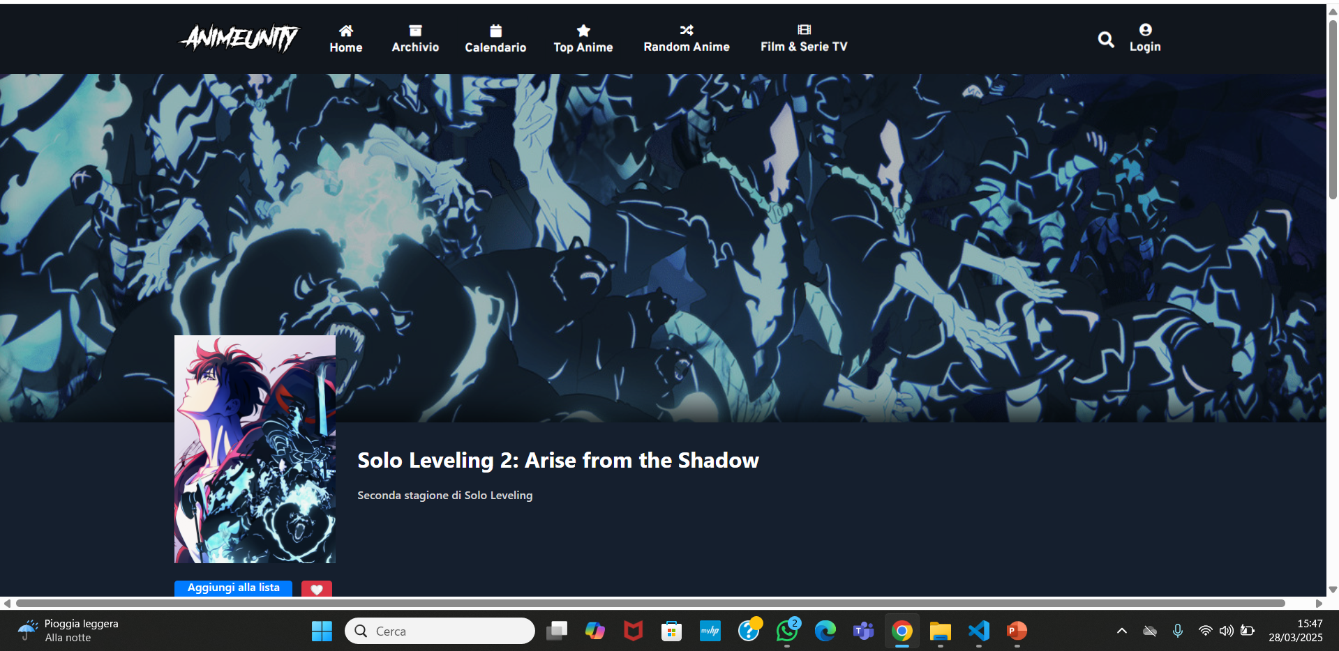

Slide 2
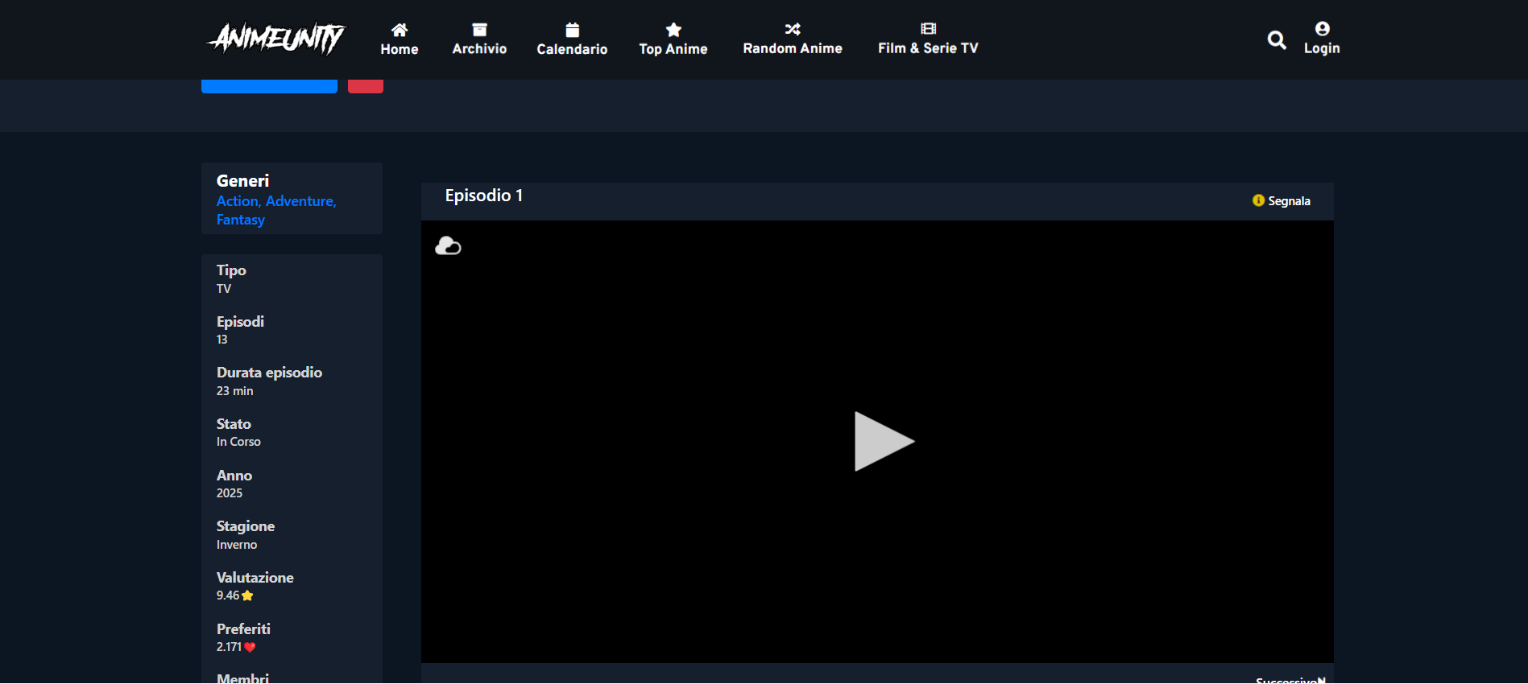

Slide 3
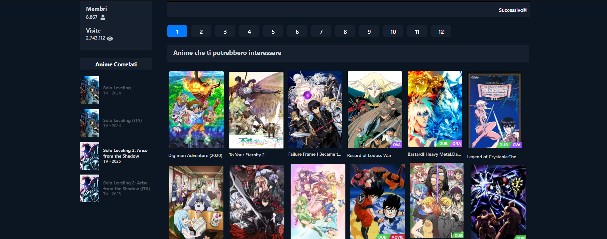

Slide 4
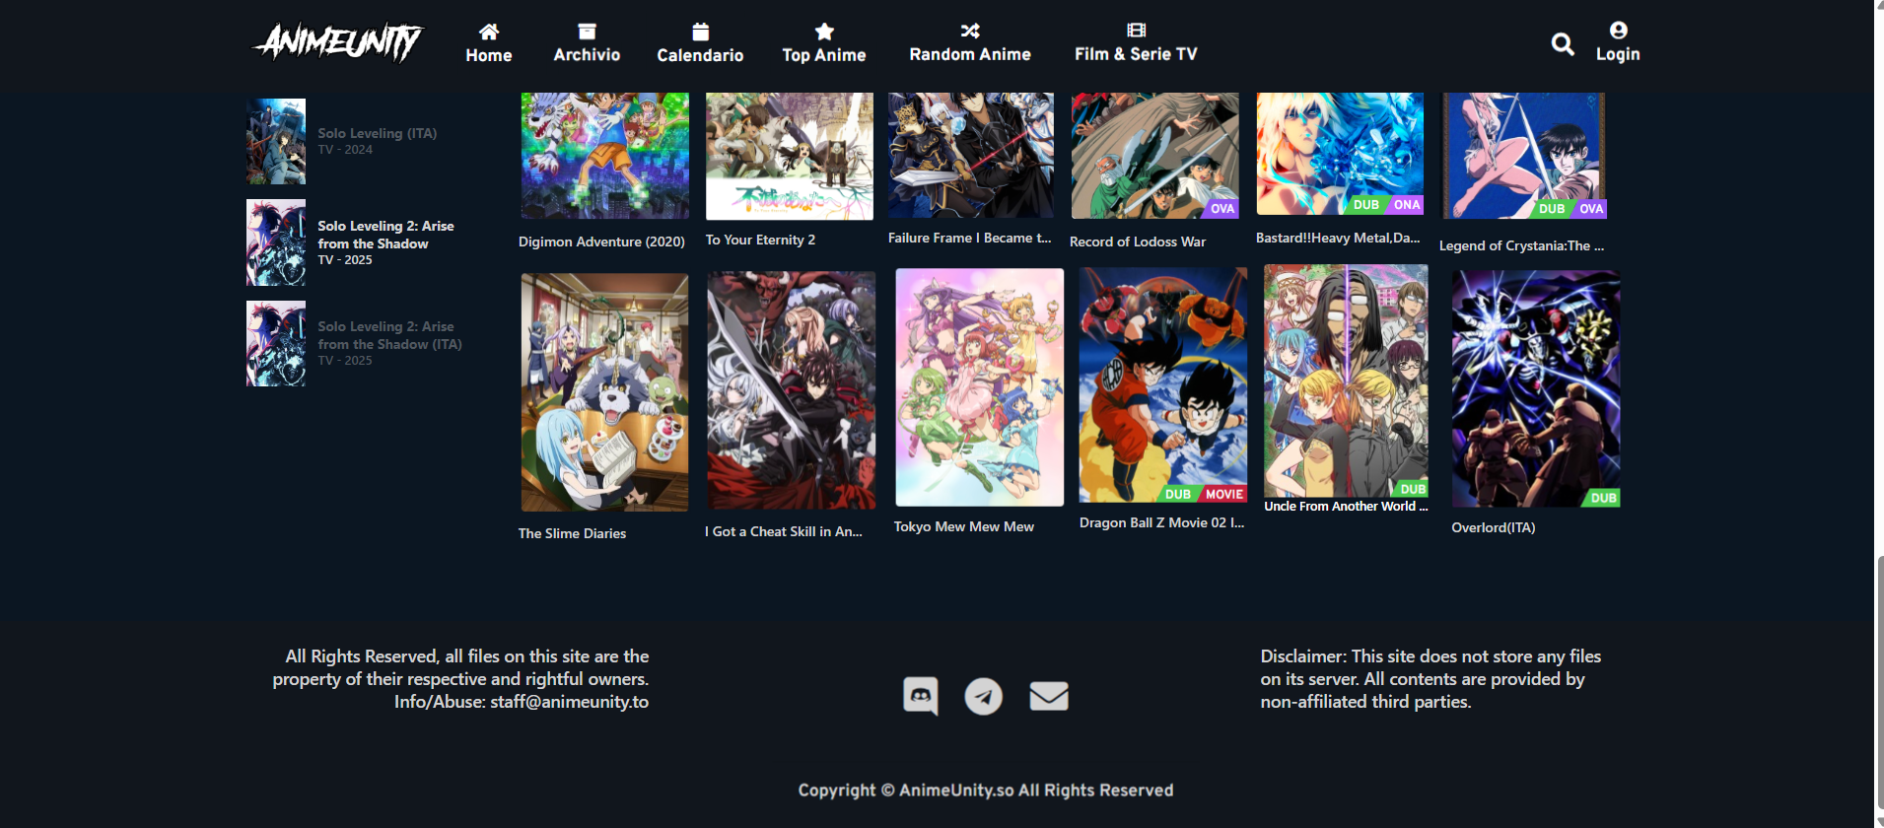

Slide 5
https://www.animeunity.so/anime/5801-solo-leveling-2-arise-from-the-shadow

