Slide 1
HarbourWasteControl – Delivery 2
Project for Internet of Things 2021 - Sapienza

Slide 2
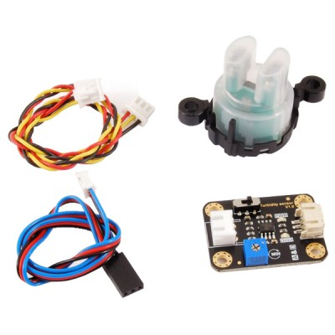
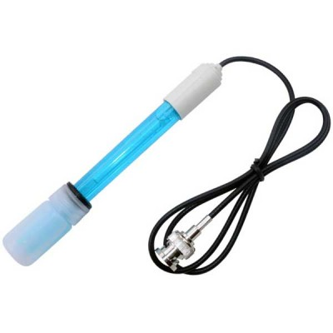
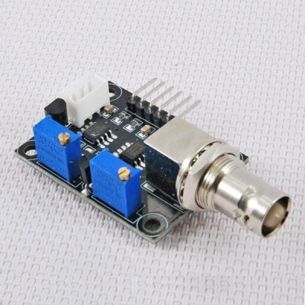
Before starting – Foundamental assumption
We are perfectly aware that the physical quantities involved in this project, namely pH – temperature – Total Suspended Solids, are not enough to point out water pollution phenomenon inside a real harbour, since a complete analysis require a deeper study performed in a lab
but
According to the Legislative decree 152/06, which regulates analysis of superficial waters, these parameters belong to the fundamentals one to be analyzed immediately at the sampling time and before the evaluation of water samples in laboratory (regardless of context, type of environmental water).
Therefore, data provided by the sensor nodes spread all over the harbour, are the starting point for a more complex analysis and can reduce the workload of authorised personnel during sampling activity because they may not care about these parameters.
Turbidity sensor - SKU SEN0189
Module for pH & Temperature sensor – 8300-YB427
pH sensor probe – 2846-PHSENSOR

Slide 3
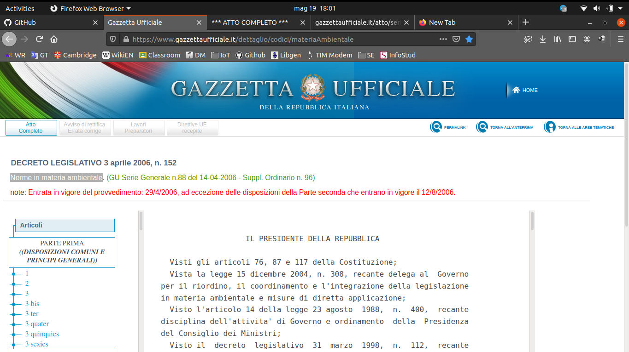
Before starting – Foundamental assumption CONTD.
According to the Legislative decree 152/06, which regulates analysis of superficial waters, these parameters belong to the fundamentals one to be analyzed immediately at the sampling time and before the evaluation of water samples in laboratory (regardless of context, type of environmental water).
Therefore, data provided by the sensor nodes spread all over the harbour, are the starting point for a more complex analysis and can reduce the workload of authorised personnel during sampling activity because they may not care about these parameters.

Slide 4

Before starting – Foundamental assumption contd.
Give their importance they belong to “Parametri I gruppo”.

Slide 5

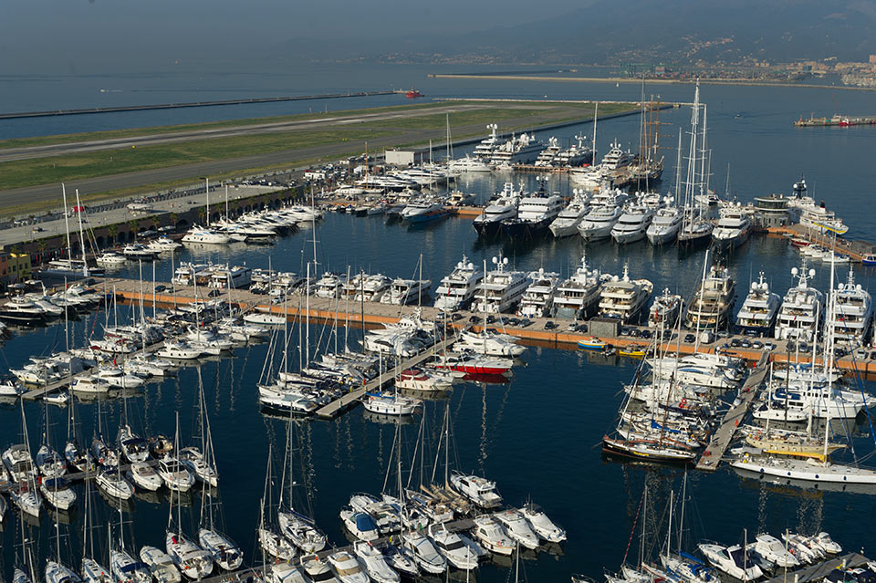
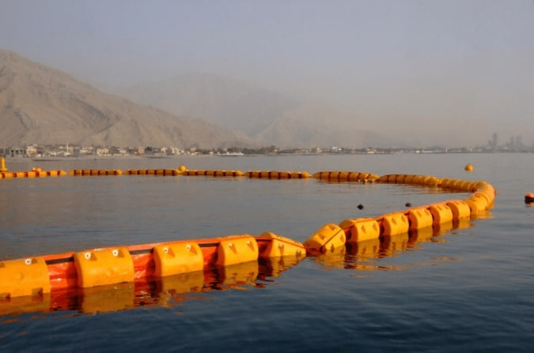
Another important change
https://www.mondobarcamarket.it/wp-content/uploads/2020/05/Marina-di-Ragusa-foto-2-1024x757.jpg
www.marinagenova.it/portals/0/posti-barca-genova-affitto-vendita/posti-barca-affitto-genova.jpg?ver=2016-03-16-180941-383
https://www.resinextrad.com/en/wp-content/uploads/2019/12/barrier-resinex-.jpg

Slide 6
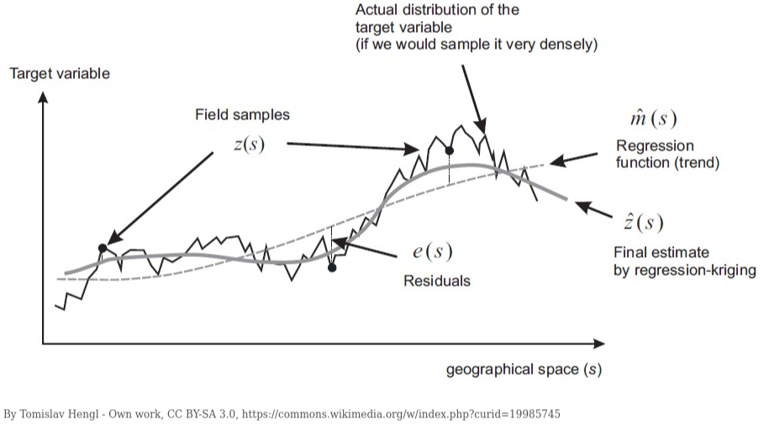
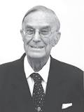
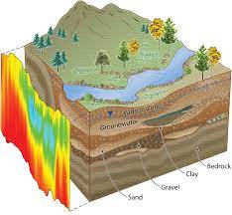
Kriging – Working principles
Danie Krige

Slide 7
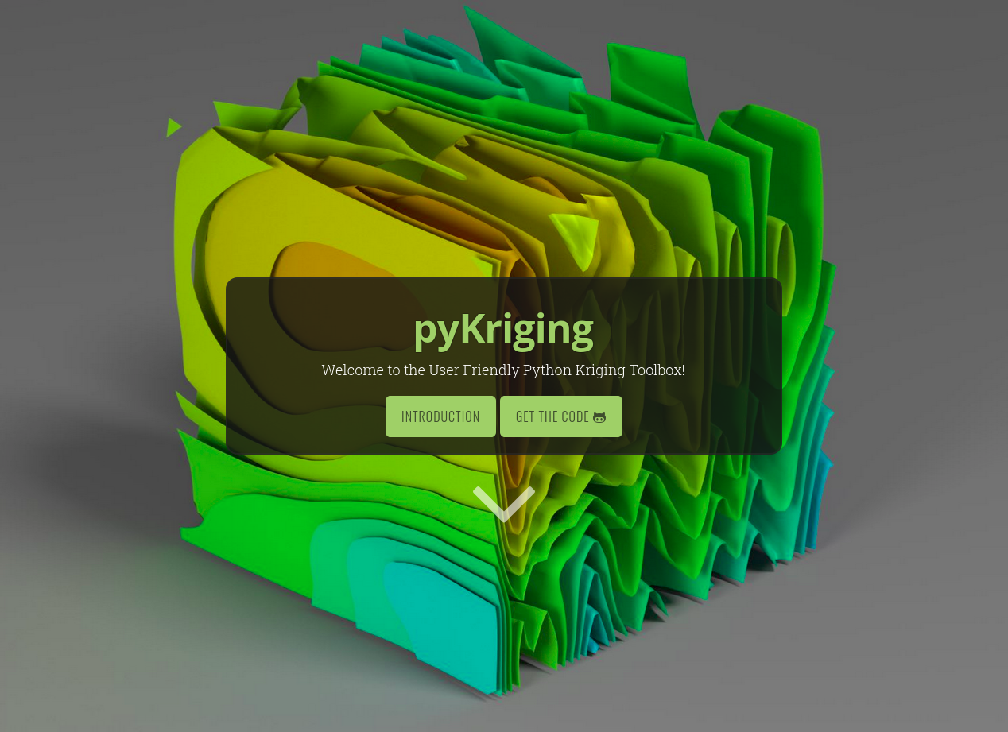


PyKriging – Python toolbox for Kriging
Paulson Chris
Ragkousis Giorgos
http://www.pykriging.com/

Slide 8
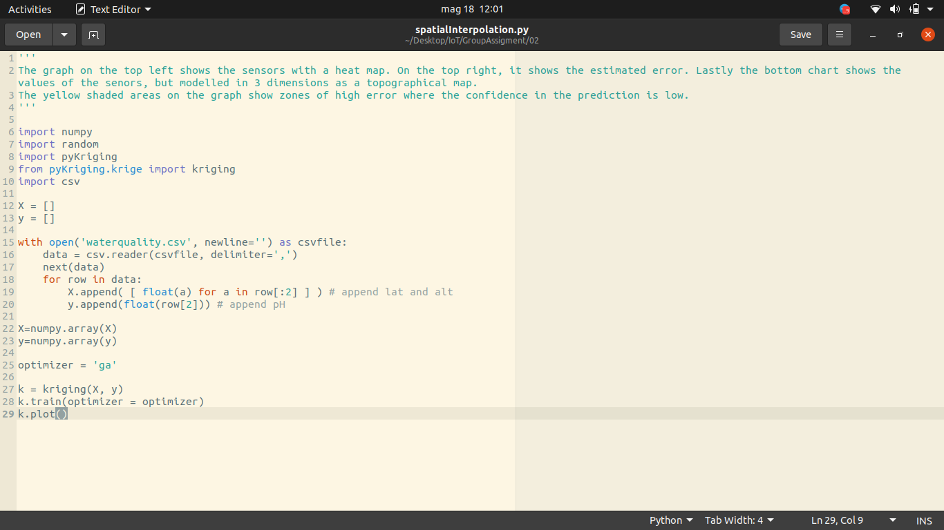
Spatial interpolation - Python script
Library declaration
Numpy array
Kriging object
Plot the data using graphs

Slide 9
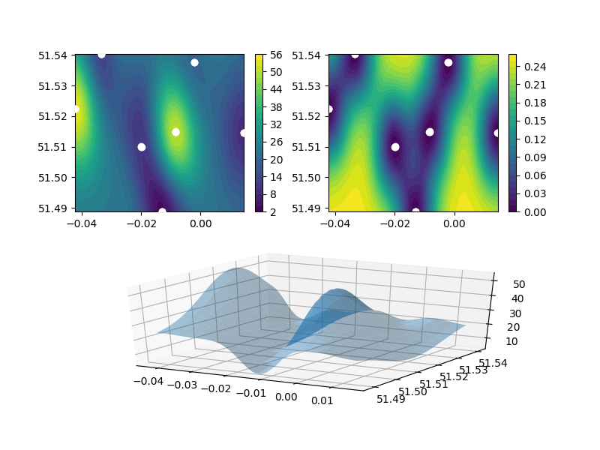
Graphs from Kriging prediction method
Sensors with a heat map
Estimated error
3D topographical map

Slide 10
Technical development and Evaluation
1) Finalise the machine learning algorithm (Kriging method) in Technology
2) Complete Security section in the Evaluation
3)Improvement of the power consumption analysis in the Evaluation

Slide 11

Finalise the Kriging prediction method
Physical quantities
Temperature
TSS
pH
Data storage
CSV file
Data Base Management System

Slide 12
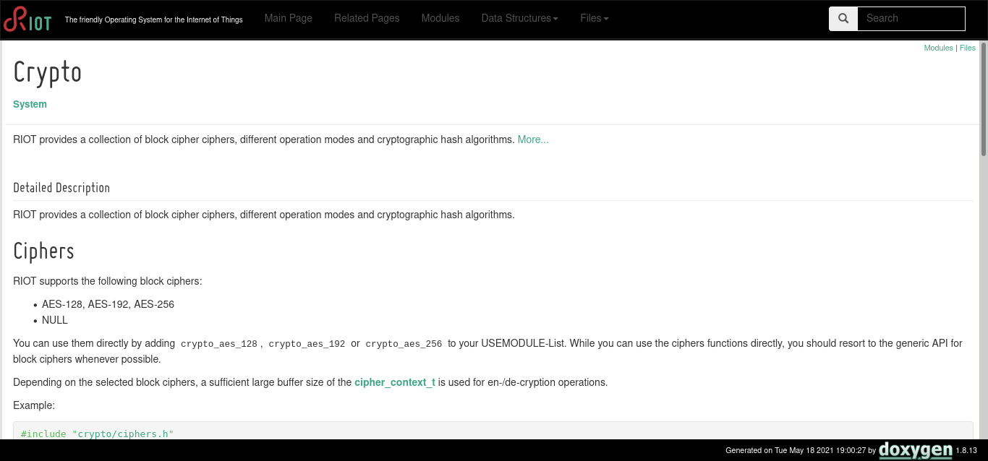

Complete Security section – Evaluation
AES-128
Encryption
LoRa client
LoRa gateway
Intended allowed people

Slide 13


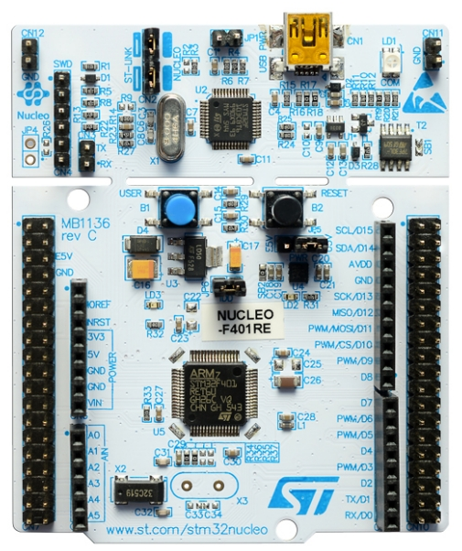
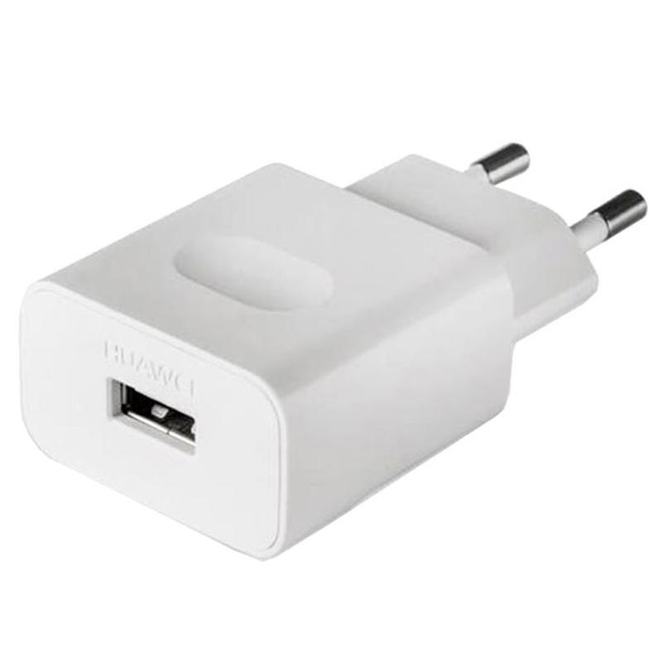
Improvement of the power consumption analysis
Trigger of events
Power consumption monitoring
www.quicktimeonline.com/fluke-177-esfp-digital-multimeter
https://www.st.com/en/evaluation-tools/nucleo-f401re.html

