Slide 1

A*: Analysis and Comparison
Politecnico di Torino
Salvatore Licata
Alessandro Zamparutti
Lorenzo Ferro

Slide 2



Contents
Project timeline
Basic structures
Sequential A*
Parallel A*
Experimental results
Possible enhancements

Slide 3
Project Timeline
Basic structures
All the structures needed by the algorithms, including map reading and graph creation
Sequential A*
Standard sequential version of the A star algorithm
Parallel A*
Decentralized version of the parallel A star algorithm
Testing
Enhancement
Enhancements and fixes of the parallel A star algorithm to improve performances
Testing phase with different map dimensions and difficulties

Slide 4

Basic Structures

Slide 5
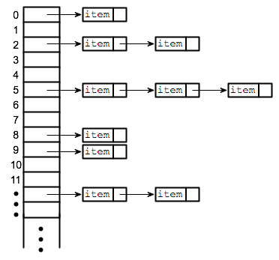

Hash Table
The hash function is implemented with multiplicative modular method with golden ratio:
$$golden ratio = (√5−1)/2$$
$$P = 8191$$
$$hash(key, module)=( key∗golden ratio \% P ) \% module$$
Able to re-allocate itself when it reaches the 75% of the maximum capacity.

Slide 6
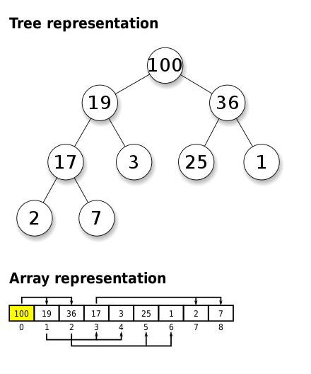
Heap
Implemented as an array of nodes with an additional hash table for faster addressing and as a support for changing priorities.
Heap methods:
heap_insert()
heap_extract()
heap_find()
heap_peek()
heap_update()

Slide 7
Queue and Stack
Queue
FIFO queue implemented with head and tail pointers
tail
head
dequeue
enqueue
Stack
LIFO data structure with insertion and extraction from the head
top
push
pop

Slide 8
Message Queue
Structure that contains an array of queues, each with an associated id. The id of the queue is passed as parameter to the receive and send methods.
msg
receive(msg,0)
queues
0
msg
msg
1
2
msg
send(msg,2)
msg
3

Slide 9
Graph file format
Standard map file format:
Astar input file format:
milan.map
milan.txt
out of bounds
X coordinate
type octile
height 1024
width 1024
map
…..@@@@@.....@@.....@
……@@@@.......@@@@
…….……………….@@@
…….…………….@@@@
…….…………….@@@@
……..@@@@@@@@@
795821 0
0 0 0
1 0 1
2 0 2
…
0 1024 14
0 1 39
1 1025 87
…
node ID
Y coordinate
Source node ID
Edge weight
Destination node ID
passable terrain

Slide 10
Graph struct
struct graph_t {
vertex_t *head;
hash_table *nodes_map;
…
}
struct 2D_data {
int x;
int y;
}
struct vertex_t {
int id;
int true_cost;
int heuristic_cost;
void *data;
edge_t *head;
…
}
struct edge_t {
int weight;
vertex_t *dest;
edge_t *next;
}

Slide 11
Sequential A Star

Slide 12
A* Algorithm
A* is a best-first search algorithm, based on the use of a heuristic function, which estimates the cost from a point to a destination node.
OPEN set
Contains node that have been discovered but not expanded yet
CLOSED set
Contains nodes that have been expanded

Slide 13
A* Heuristic Function
It is an estimation of the cost from one node to a closest goal node
It provides optimality if it is admissible (no overestimation)
It is problem-specific, so it depends on the domain of application

Slide 14
Parallel A Star

Slide 15
Hash Distributed Parallel A*
Each thread has its own OPEN and CLOSED set
Eliminates the concurrency overhead associated with a shared, centralized OPEN set
Load balancing is necessary
Requires a complex terminate detection

Slide 16
Parallel A* Algorithm
Pseudo-code:
1 Initialize OPENp for each thread p; 2 Initialize incumbent.cost = ∞; 3 Add s0 to OPEN_{ComputeRecipient(s0)}; 4 In parallel, on each thread p, execute 5-31; 5 while TerminateDetection() do
6 Check and process messages
7 …
21 Extract and process node from OPEN set
22 …
32 if incumbent.cost = ∞ then 33 Return failure (no path exists); 34 else 35 Return solution path from s0 to n;
Initialization phase
Check solution

Slide 17

Parallel A* Algorithm
Check and process messages:
message queue of thread p
6 while BUFFERp ≠ 0 do 7 Get and remove from BUFFERp a triplet (n’, g1, n); 8 if n’ $∈$ CLOSEDp then
9 if g1 < g(n’) then 10 Remove n0 from CLOSEDp and add it to OPENp; 11 else 12 continue; 13 else 14 if n’ $∉$ OPENp then 15 Add n’ to OPENp; 16 else if g1 g(n’) then 17 continue; 18 Set g(n’) = g1; 19 Set f(n’) = g(n’) + h(n’); 20 Set parent(n’) = n;

Slide 18

Parallel A* Algorithm
Extract and process node from OPEN set:
21 if OPENp = 0 or smallest f(n) value of n $∈$ OPENp ≥ incumbent.cost then 22 continue; 23 Get and remove from OPENp a node n with a smallest f(n); 24 Add n to CLOSEDp; 25 if n is a goal node then 26 if path cost from s0 to n < incumbent.cost then 27 incumbent = path from s0 to n; 28 incumbent.cost = path cost from s0 to n; 29 for every successor n’ of n do 30 Set g1 = g(n) + c(n, n’); 31 Add (n’, g1, n) to BUFFER_{ComputeRecipient(n)};
send a message to a thread

Slide 19
Parallel A* Terminate Detection
Pseudo-code:
1 lock mutex 2 while termination_flags[this_thread] and BUFFER(this_thread) = 0
and not program_terminated do 3 if counter ≥ n_threads - 1 and all BUFFER empty then 4 program_terminated = 1 5 signal all condition variables 6 else 7 counter++ 8 wait on condition variable of this_thread 9 counter-- 10 unlock mutex 11 if program_terminated then 12 return true 13 else 14 return false
last thread wakes all the others

Slide 20
Parallel A* Compute Recipient
The compute recipient function can map the node id into a thread identifier, and it is used to decide the thread which will expand the node of the processed edge
Basic Module
$$node id \% number of threads$$
𝑛𝑜𝑑𝑒 𝑖𝑑 % 𝑛𝑢𝑚𝑏𝑒𝑟 𝑜𝑓 𝑡ℎ𝑟𝑒𝑎𝑑𝑠
Multiplicative hash
$$\text{h}\text{(}\text{node} \text{id}\text{) = ((}\text{a}\text{ ∗ }\text{node} \text{id}\text{ + }\text{b}\text{) \% }\text{p}\text{) \% }\text{number} \text{of} \text{threads}$$
"h(node id) = ((a ∗ node id + b) % p) % number of threads"

Slide 21
Experimental Results

Slide 22
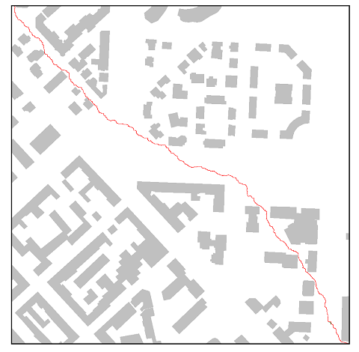
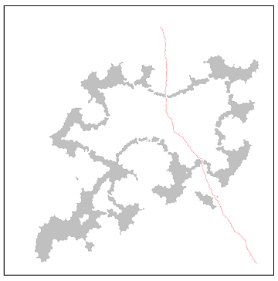
Tested Maps
Grid milan (1024x1024)
Large map (2048x2048)

Slide 23
Grid Milan

Slide 24
Grid Milan

Slide 25
Large Map

Slide 26
Large Map

Slide 27
Large Map

Slide 28
Large Map

Slide 29
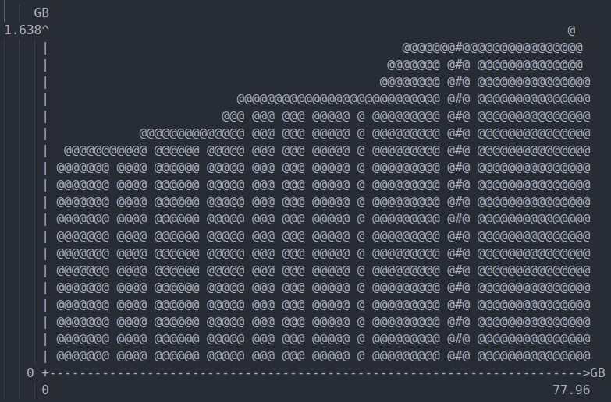
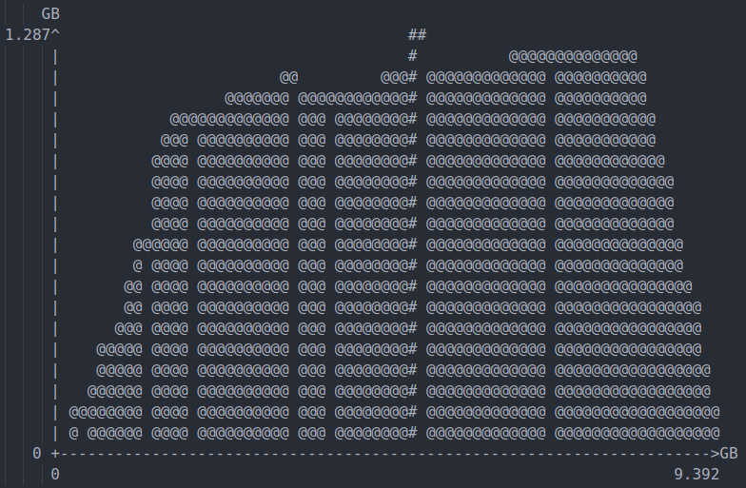
Memory occupation on Large Map
Memory occupation parallel A*
Memory occupation sequential A*

Slide 30
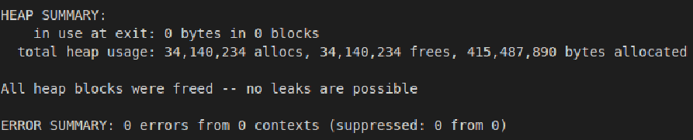
Memory leak
Valgrind output of memory leak of parallel A* with Milan grid

Slide 31
Possible Enhancement
Parallel graph reading
Multiplicative Hash balancing
Abstract Zobrist Hashing

Slide 32

Thanks
Salvatore Licata
Alessandro Zamparutti
Lorenzo Ferro

