Slide 1

Furniture E-Commerce Store Based On Augmented Reality
By : Syamantak Dhavle, Mohammed Qais,Mohd Saif Tabarkullah
Group Number - 28
Project Guide : Prof. Bhavna Arora
Atharva College Of Engineering

Slide 2
The Problem
Problem Definition
When customers buy furniture online, It's not very easy to determine whether it will go well with their overall home decor or the rest of their furniture.
People end up buying furniture with incorrect measurements, inaccurate colours or different designs from the ones that they see in their product images.
This creates a problem for customers as returns in such online stores is also a hassle and generally a bad idea, since it is not easy to ship furniture due to the high prices involved in shipping.

Slide 3
Introduction
E-Commerce in India
The modern home decor and furniture lessens your stress after spending with a hectic schedule at the office. As vast changes have occurred in the furniture world, many innovative startups are accommodating to the huge demand.
The online marketplace of India is expected to grow to $14.5 billion (Rs 88,921 crore), and online furniture share of retail is likely to go up by 2021.
In the beginning, except a few organized players like Home Stop, and HomeTown; none other brands in the furniture retail space have controlled to create a large chain of stores. But, a group of online furniture marketers has come out in the last few years, providing new business models for a company which is certain to grow as India’s middle-class broadens and spending hikes.
Now, platforms like Pepperfry, Urban Ladder, and FabFurnish have become the most successful eCommerce portals of India as they drive the latest market and assisting people to furnish their homes.

Slide 4
Background
“Looking at the current scenario, it seems like Home Decor and Furnishing is rising to the NEXT BIG THING in the Indian eCommerce space.” -Rahul Agarwal, Co-Founder & CEO, Mebelkart.
E-commerce is a gigantic industry when we look at the market size which is close to $20 billion and half of this is expected to be in the furniture category.
After introducing options like partial payment and COD due to customer's apprehensive approach towards buying furniture online, trust started building in for the customers.
Items such as bed, sofa etc. are large items which constitute 25% of the total furnishing items and Indian customers are still hesitant towards online shopping for such large items as there is no touch and feel factor involved.
Introduction of LiDAR Sensor in iphone 12 : LiDAR stands for Light Detection And Ranging. ... That means a LiDAR sensor can use infrared and ultraviolet light to map out the environment around it. It can get a sense of both the physical dimensions and motion (if any) of objects in its vicinity. This sensor is expected to be included in many of the upcoming android as well as ios phones.

Slide 5
Review of Literature
‘ARKit and ARCore in serve to augmented reality’
Provides a basic understanding about the open-source libraries to be used in building this project, their main features and functionalities for a better implementation in the real world.
‘Web-based AR (Web AR) implementation can provide a pervasive Mobile AR experience to users thanks to the many successful deployments of the Web as a lightweight and cross-platform service provisioning platform.’ -Displaying product models through webAR, which is lightweight and does not require much bandwidth or storage.
‘Using Unity 3D to facilitate mobile augmented reality game development. -An approach on the combined use of unity and mobile app development & the general advantage of unity than third party game engines.
‘Creating open source repository of 3D models of laboratory equipments using Blender’ -Facilitates the identification of key design goals and presents a methodology to create a repository of 3D models.

Slide 6
Solution
Use of Blender, Cinema4D to create the most realistic rendition of the furniture products present in the e-commerce store.
Importing the objects created to Android studio and creating an app which includes an e-commerce store with AR functionality.
This app will provide users with a more accurate representation of the said products and will reduce the rate of returns, thereby saving shipping costs.
Provides the user with a substitute to a certain degree for the touch and feel aspect while buying furniture, which also increases their trust in the store.

Slide 7
Feasibility
Mobile Application
Technologies
LiDAR Sensor
Android/Ios Smartphones with ARCore platforms are fairly common, most of the phones are compatible to run AR apps.
Featuring an intelligent Code Editor equipped with IntelliJ IDEA interface, Android Studio makes code writing and analysis faster, easier and more accurate.
ArCore SDK provide native APIs for all of the essential AR features like motion tracking, environmental understanding, and light estimation.
iPhone 12 series’ LiDAR sensor increases AR accuracy and more upcoming phones are expected to follow Apple and implement this sensor in their phones, which will increase the use of AR in the forseeable future.

Slide 8
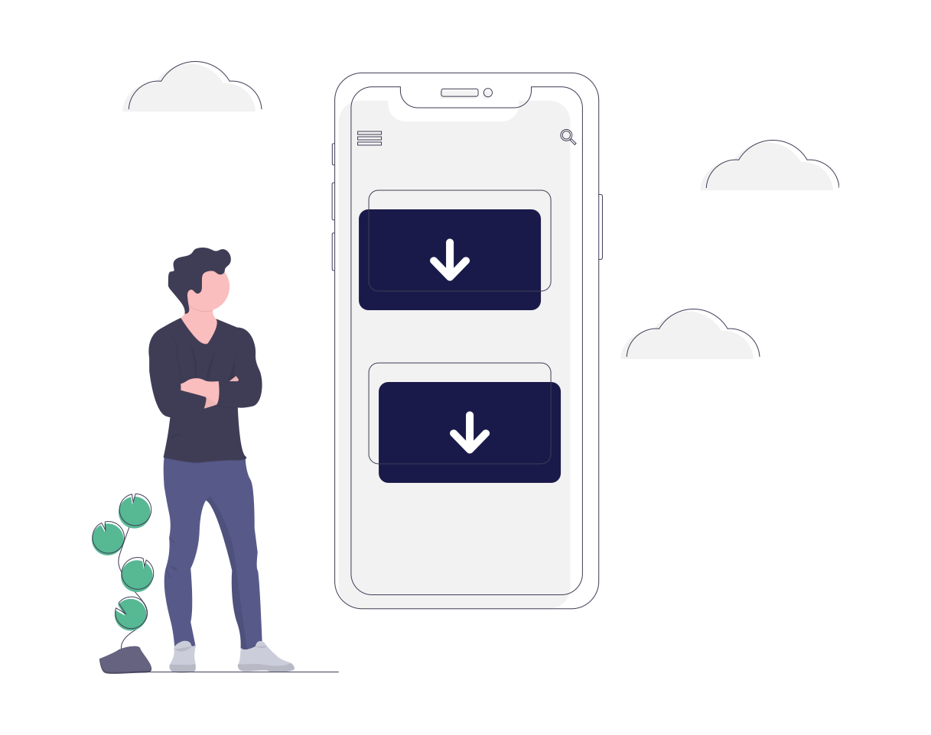



System Overview
User Downloads the store app to their AR Compatible Device
User browses the store for their required products
User checks colour/size/design compatibility of the product with their particular houses through their cameras on AR enabled smartphones.
User places their order and the product is delivered.

Slide 9
Reviewing existing papers based on technologies to be used and assessing them for shortcomings and possible restrictions
Getting the project approval from the mentor, making any refinements in finishing and preparing the final presentation and synopsis.
Finalization of Topic along with reviewing papers.
Nov 1-9
Nov 10-20
Nov 21-Dec 1
Dec 2-20
Dec 20-Jan 10
Research based on technologies and softwares which can be used for an efficient implementation
Use of all research and data collected for creating a working prototype of the project and start of work simultaneously on separate platforms to be assembled in a later stage.

Slide 10
References
Augmented Reality Web Applications with Mobile Agents in the Internet of Things-IEEE 2014 | Authors:Teemu Leppänen; Arto Heikkinen; Antti Karhu; Erkki Harjula; Jukka Riekki; Timo Koskela
Research on the technology of LIDAR data processing: IEEE 2018 | Authors:Dekui Lv; Xiaxin Ying; Yanjun Cui; Jianyu Song; Kuidong Qian; Maolin Li
Using the unity® game engine as a platform for advanced real time cinema image processing: IEEE 2018 | Author:Timothée de Goussencourt; Pascal Bertolino
ARKit and ARCore in serve to augmented reality-IEEE 2020 | Authors: Zainab Oufqir; Abdellatif El Abderrahmani; Khalid Satori
Getting started with AR development in Unity : https://docs.unity3d.com/Manual/AROverview.html
ARCore overview: https://developers.google.com/ar/discover
Top 6 e-commerce furniture sites in india : https://www.business-standard.com/article/companies/the-top-6-online-furniture-ecommerce-sites-in-india-115110401480_1.html
Blender 2.90 Reference Manual: https://docs.blender.org/manual/en/latest/

