Slide 1
AegisCare
Securing CI/ CD
A Comparative Analysis of Code and Packages, Simulated Attacks & LLM-Driven Fixes
Notes:
kjshhfkwhfes

Slide 2
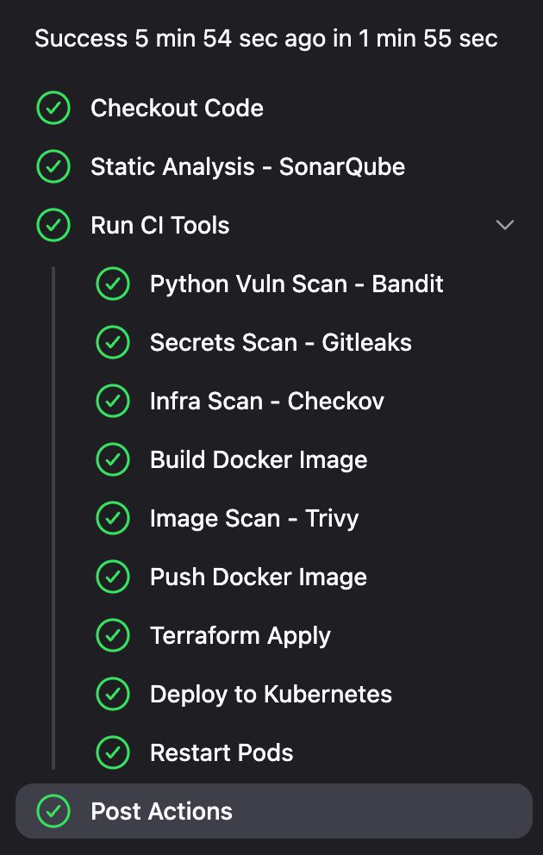
🧩 Platform Overview
CI/CD Pipeline for Microservices with a security-first mindset.
Backend: FastAPI + PostgreSQL
CI/CD: Jenkins, Docker, Terraform, Kubernetes
Security Tools:
✅ SonarQube – Static code analysis
✅ Bandit – Python-specific vulnerability detection
⚠️ Gitleaks – Secret scanning (limited effectiveness)
✅ Checkov – IaC misconfiguration detection
✅ Trivy – Image & package CVE scanning
Monitoring: Prometheus + Grafana
LLM Agent (GPT-4.1 Mini): Used for fix recommendations

Slide 3
Simulated Attacks 🔥
Attack Type | Script | Simulated Impact
JWT Forgery | jwt_forgery.py | Bypassed auth with alg=none tokens
SQL Injection | sql_injection.py | Dumped full user DB with a single crafted input
SSRF | ssrf_attack.py | Internal network exposed
Stress/DoS | stress.py | Triggered CPU spikes, OOM kills
Gitleaks Bypass | Hardcoded PATs, secrets in code | Gitleaks missed 2/5 secrets

Slide 4
📊 Baseline Metrics (Before Fixes)
Category | Value | Impact
Secrets Exposed | 5(PATs,DB URL,JWT key) | GitHub alert but did not block everything
SQLi points | 2 endpoints(portfolio) | DB read without auth
System Crash under load | ~30 req/s stress | CPU 90%+, pods crashed
Bandit & Sonar Issues | 12+ | Secrets, insecure random, raw SQL
Local CPU spike | +35% CPU burst | Scaling triggered 2 more pods

Slide 5
🔍 Tool Performance Analysis
Tool | Strength | Weakness
SonarQube | Deep code analysis | Needs custom config for secrets
Bandit | Python-specific issues | Misses dynamic attack paths
Checkov | Infra misconfig detection | Limited custom rules
Trivy | Fast + accurate | CVEs Base image scan only
Gitleaks | Fast scan for tokens | Missed real secrets in auth.py & dockerfile

Slide 6
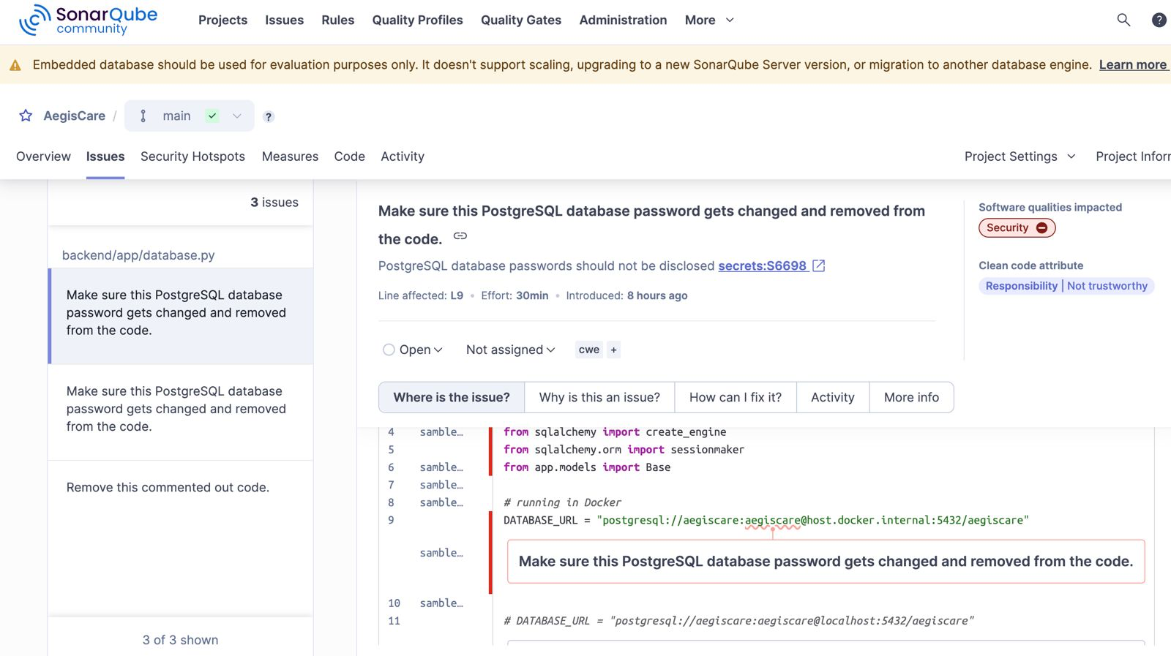
SQL password leaks

Slide 7
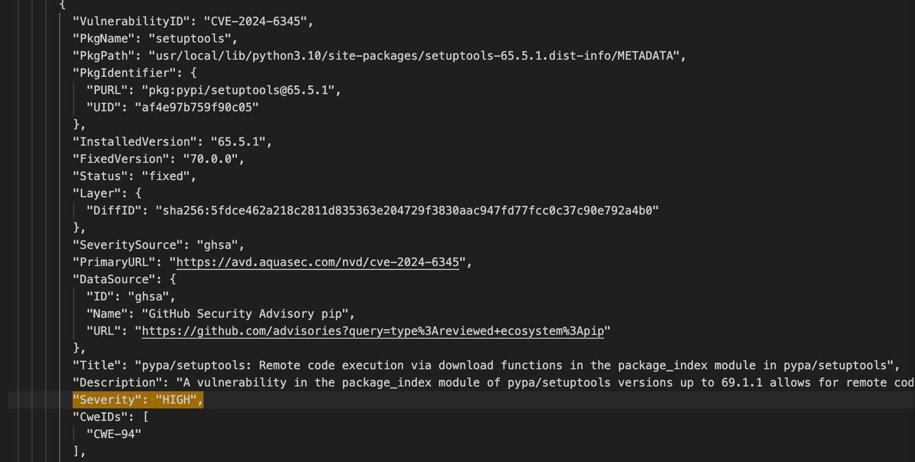
Trivy Scan

Slide 8
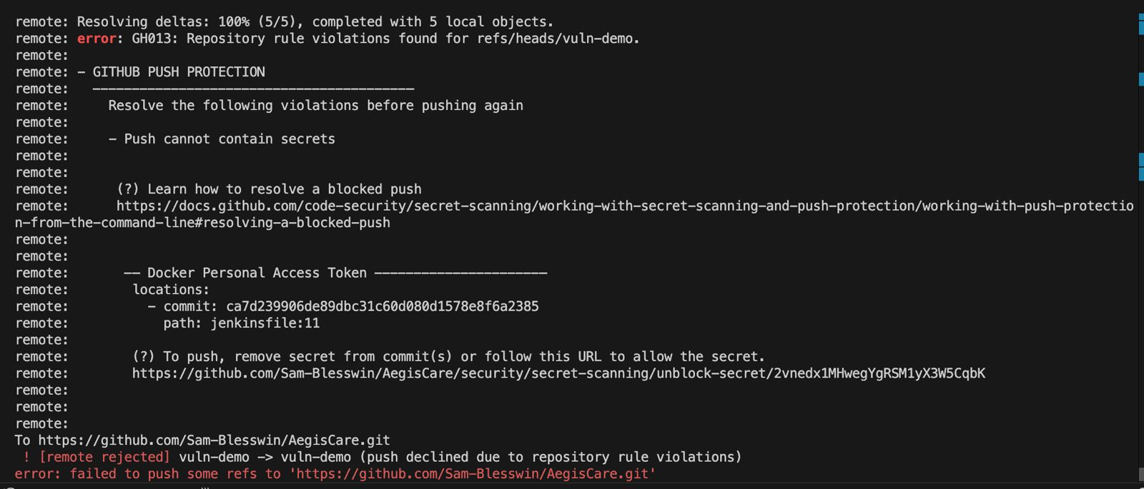
GITHUB Push Protection

Slide 9
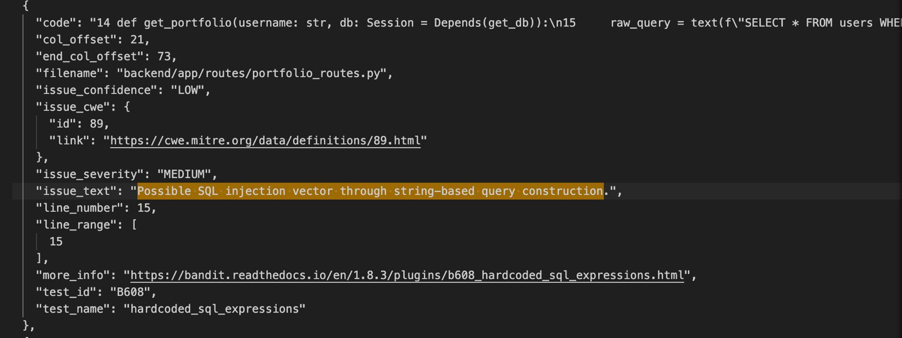
Bandit issues

Slide 10
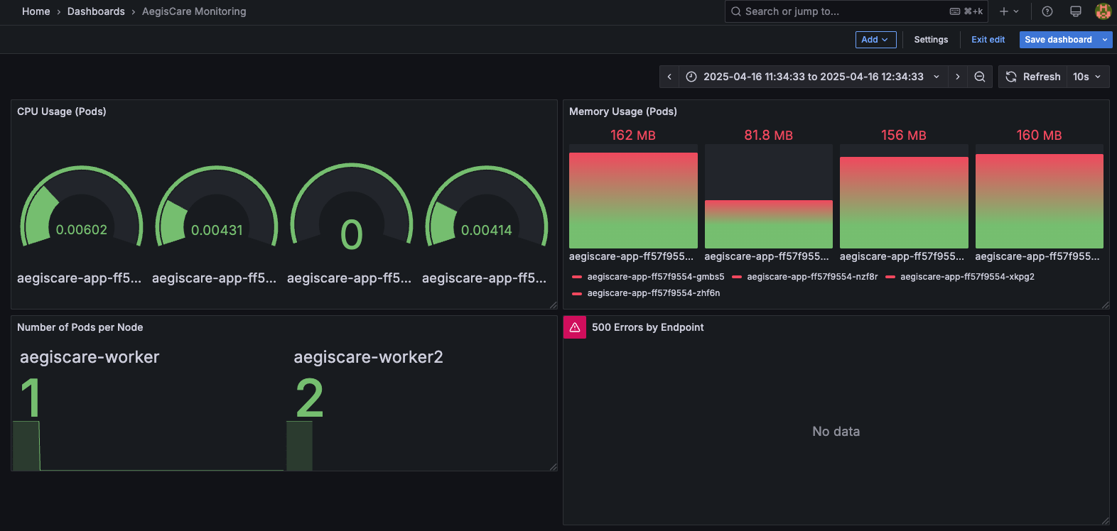
Grafana dashboard

Slide 11
🧠 LLM-Based Fix Analysis
LLM fixes Build Report Only
Detection : Found insecure SQL, hardcoded JWT and misconfigured Docker file.
Suggested Fix: Converted to env-based secrets, used ORM queries instead of direct SQL
2. LLM fixes Build and Runtime report Detection: Identified timeout gaps in requests.get, missing resource limits Suggested Fix : Added timeout and enforced CPU/mem limits
3. LLM fixes OWASP Docs and Prompts Detection: Predicted JWT alg spoof, SSRF, CORS misconfigs
Suggested Fix : CORS restriction, JWT lib config update, token validation middleware

Slide 12
💥 Impact of Poor Practices
Bad Practice | Impacts | LLM Suggested Fix
Hardcoded secrets | Data breaches, GitHub Secrets leaks | Move to .env or Kubernetes Secrets
Raw SQL queries | Remote Code Execution, injection attacks | Use SQLAlchemy ORM with parameterized queries ( :param )
No resource limits | No autoscaling, Business loss, system overload | Add resources.requests and limits in deployment.yaml for horizontal pods scaling
Missing auth on /routes | Anyone can fetch other user data | Add JWT validation middleware on route
No rate limiting | Slows the server from processing other valid requests | Add FastAPI middleware or proxy- level (e.g., NGINX) rate limiting

Slide 13
📈 Final Comparison Metrics
Metric | Before Fix | After Fix
Secrets in Code | 5 | 0
CVEs in Image | 7+ | 2 (base image)
Pod Crashes under Load | 3+ | 0
SQL Injection | Present | Blocked
Gitleaks Coverage | 0 (Not detected) | Fixed
Sonar Issues | 12 | 2
JWT bypass | 4 | 0

Slide 14
Future Work: AI DevSecOps Agent
🌐 Real-Time Context via MCP:
Pull OWASP and CVE docs, latest release docs of tools used, best practices
Always updated with evolving threats
🛠️ AI Code Review and Fix:
Suggests precise code changes
Highlights all impacted locations
One-click apply/discard workflow
🔁 Goal: Full automation across CI/CD with security built-in

