Slide 1
Face Parsing
第 1 組:
黃鼎峰、劉杰、朱育民

Slide 2
Content
Baseline Method
Novelty
Experiment Results

Slide 3
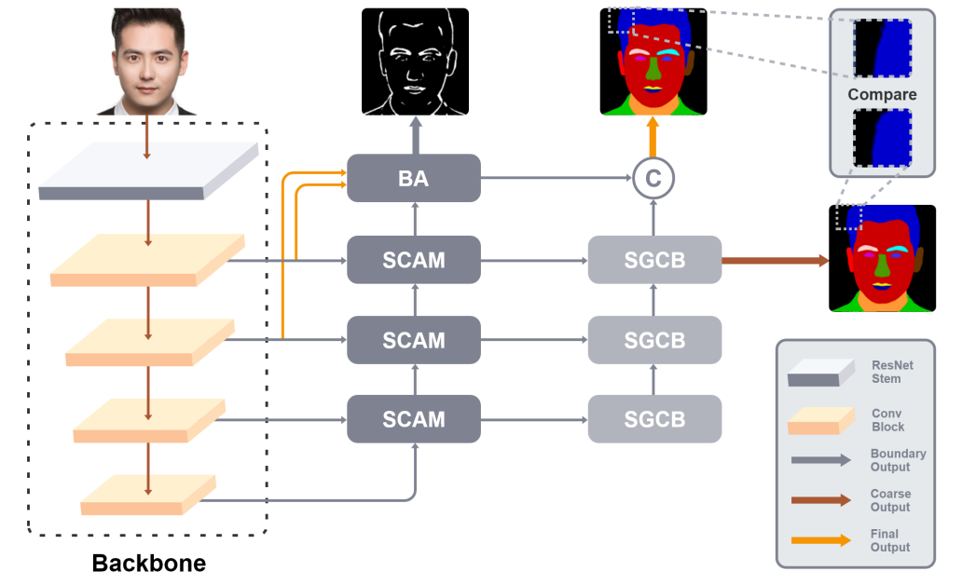
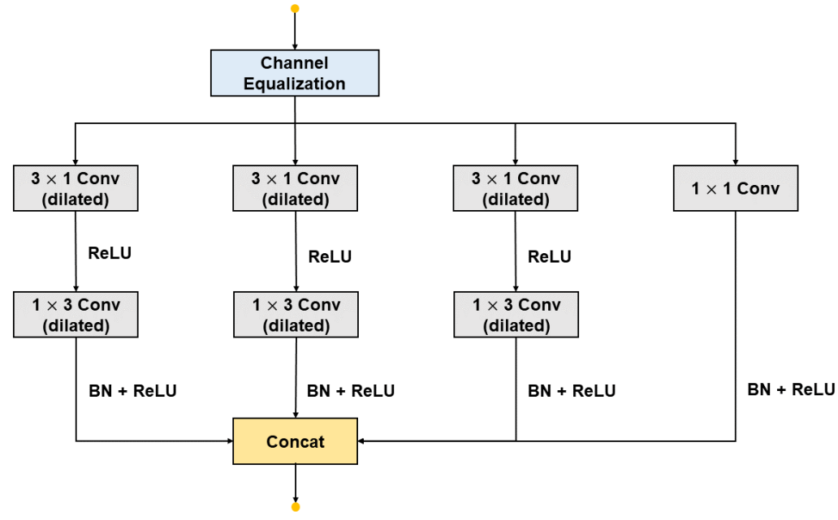
Baseline - EHANet[1]
SGCB

Slide 4
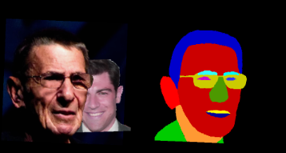
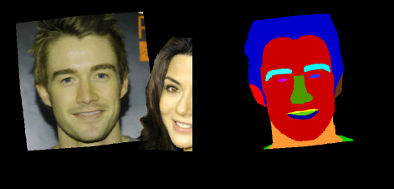
Novelty – Handle Multiple face issue
Domain gap between Source training data and Target unseen data
Main Image
Main Mask
Main Affine
Data Augmentation
Copy Paste
Aug. Image
Aug. Mask
Sec. Image
Sec. Mask
Sec. Affine
Notes:
Main affine 的縮放以及位移都是比較小的，讓他維持主體的效果 Sec affine 的 Copy paste main image 的前景並不會被遮到

Slide 5
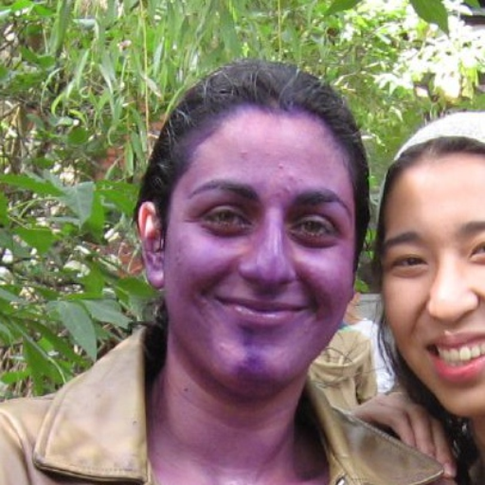
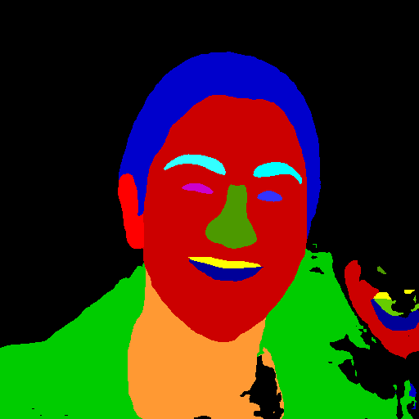
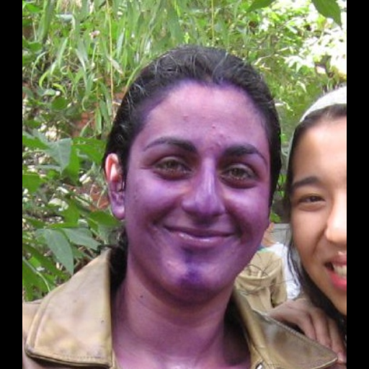
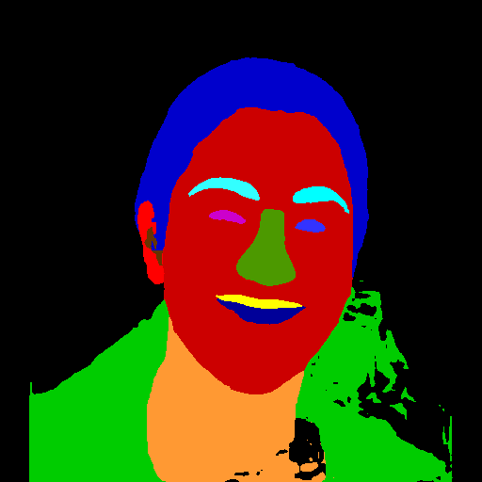
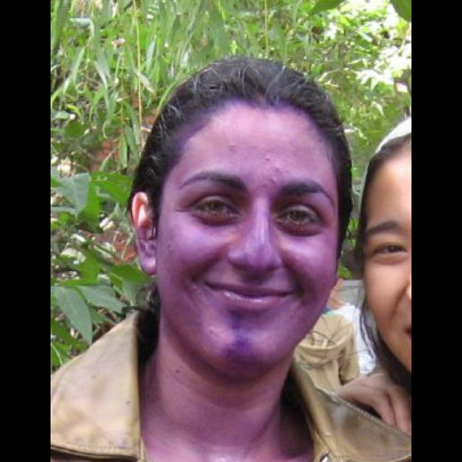
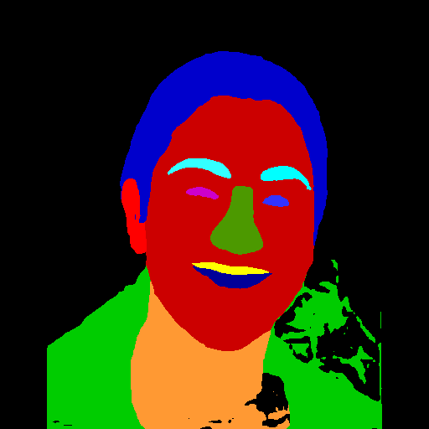
Novelty – Handle Multiple face issue
Trimming borders enhances model focus on the central main face
Crop Size | EHANet w/o FaceSynthetics Data | EHANet w/ FaceSynthetics Data
(512, 512) | 0.4360 | 0.4706
(512, 450) | 0.4390 | 0.4714
(512, 400) | 0.4397 | 0.4702
Notes:
另外一個針對多張人臉的策略是我們去對圖像做寬度的裁剪，我們假設其他人臉大多出現在主體的左右兩側，像是右邊這張圖所呈現的效果，同樣我們去做 ablation study 發現在 512、450的組合下是最好的。

Slide 6
Experiment Results
Model | Cut-Paste Augmentation | Crop-Image (Unseen Data) | Testing Data F1 score | Unseen Data F1 score
DML-CSR |  |  | 0.8762 | 0.4076
DML-CSR | ✓ |  | 0.8788 | 0.4158
DML-CSR | ✓ | ✓ | 0.8788 | 0.4218

Slide 7
Experiment Results
Model | Cut-Paste Augmentation | FaceSynthetics Data (Part 1) | Crop-Image (Unseen Data) | Testing Data F1 score | Unseen Data F1 score
EHANet |  |  |  | 0.880 | 0.4223
EHANet | ✓ |  |  | 0.8863 | 0.4360
EHANet | ✓ |  | ✓ | 0.8863 | 0.4390
EHANet | ✓ | ✓ |  | 0.8804 | 0.4706
EHANet | ✓ | ✓ | ✓ | 0.8804 | 0.4714

Slide 8
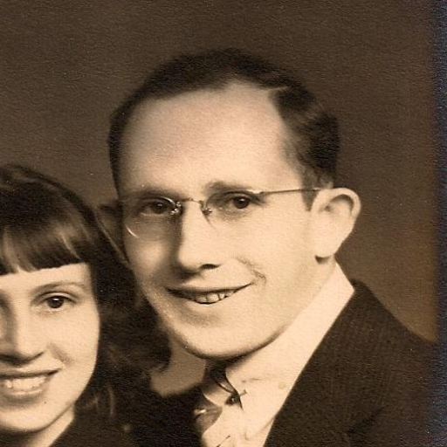
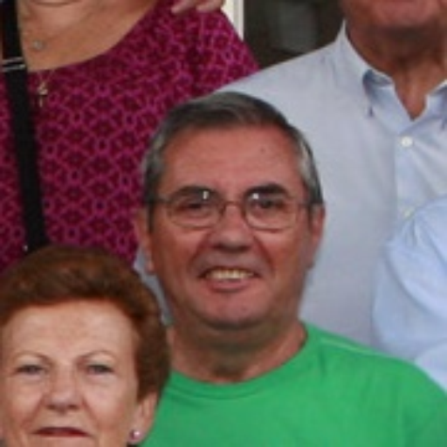
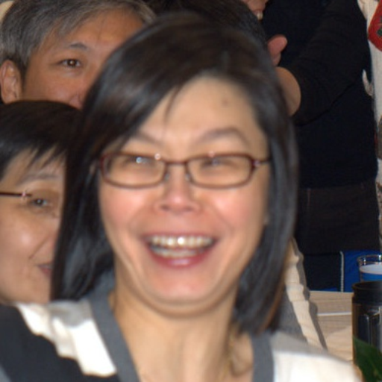
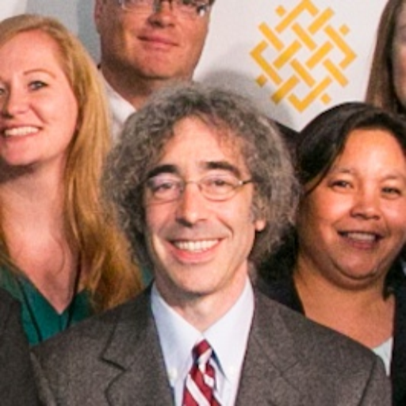
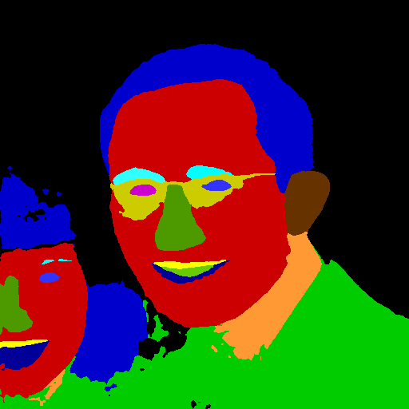
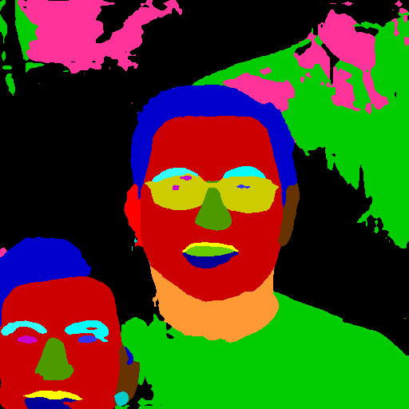
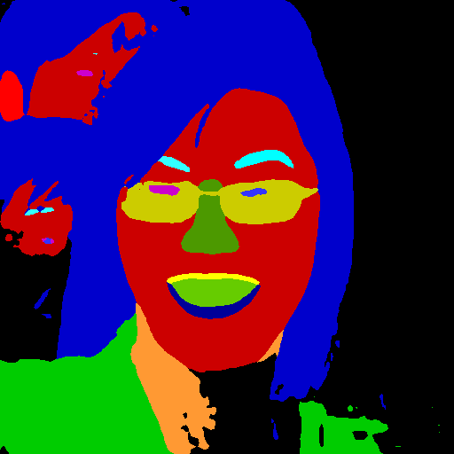
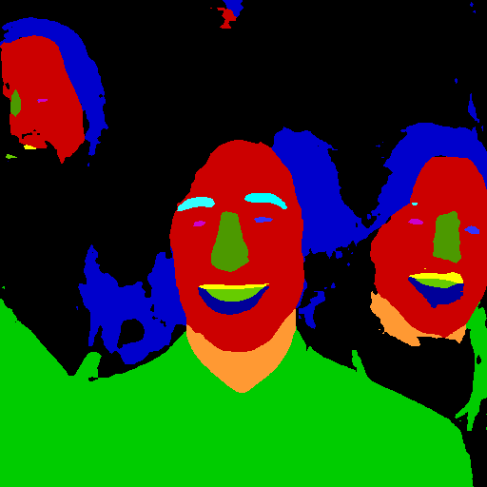
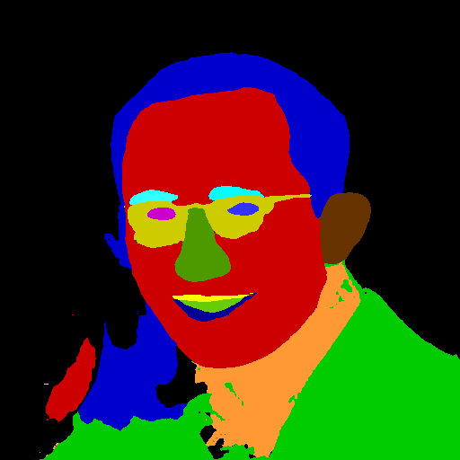
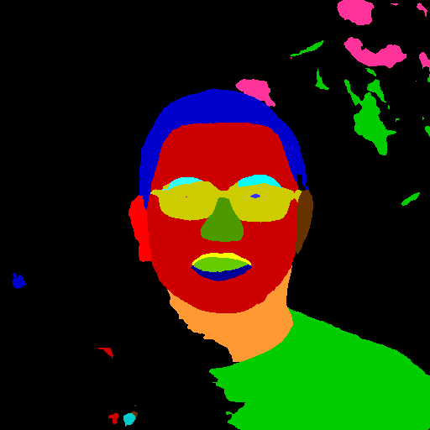
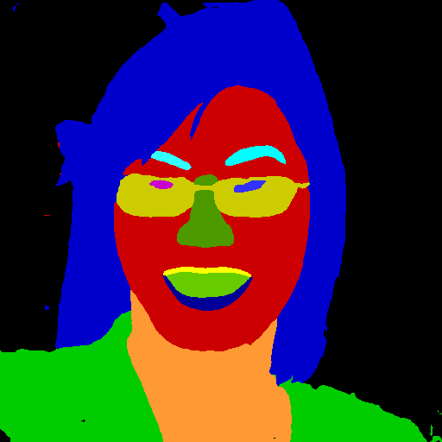
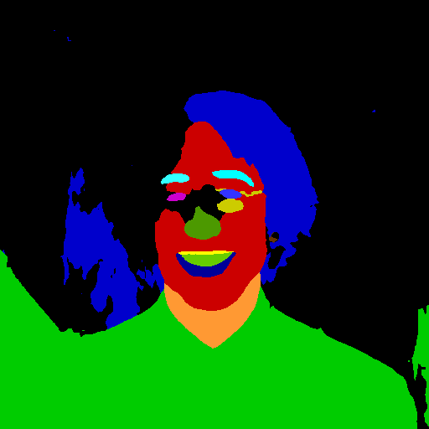
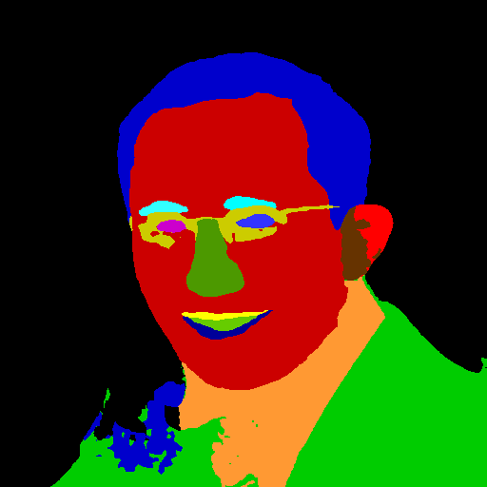
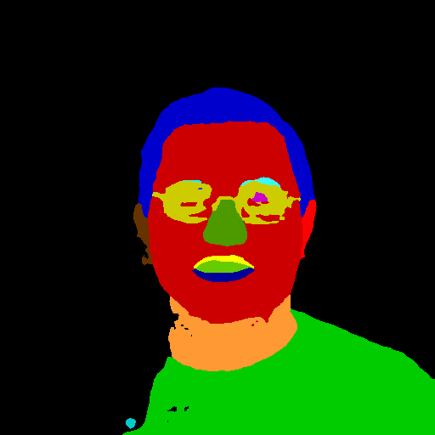
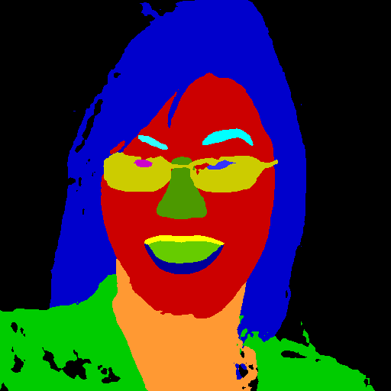
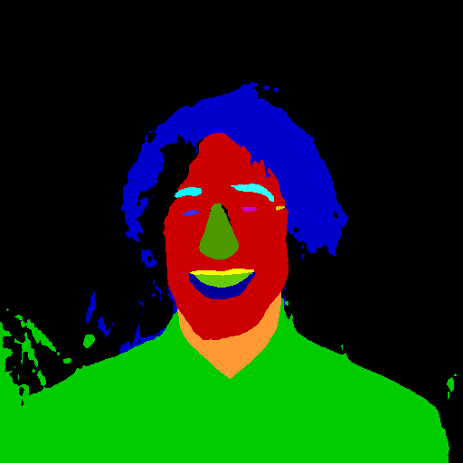
Experiment Results
EHANet
EHANet with
Cut-Paste Augmentation
EHANet with
Cut-Paste Augmentation
+
FaceSynthetics Data

Slide 9
Experiment Setting
Optimizer: SGD
Learning Rate: 0.001
Learning Rate Schedule: Linear
Weight Decay: 0.00001
Momentum: 0.9
Epochs: 200
Batch Size: 16
Model Backbone: Pretrained ResNet 50

Slide 10
Augmentation Strategy
1. RandomHorizontallyFlip (Probability 50%)
2. AdjustBrightness(bf=0.1)
3. AdjustContrast(cf=0.1)
4. AdjustHue(hu=0.1)
5. AdjustSaturation(saturation=0.1)
6. RandomRotate(degree=10)
7. RandomZoomOut(scale_range=(0.8, 1.2))
8. RandomGrayScale (Probability 8%)
9. RandomTranslate(offset=(0.2, 0.2))
10. RandomCombineImage (Probability 40%, Our Novelty CopyPaste Method)

Slide 11
Thanks

