Slide 1

AI Car Valuation System
An AI-powered full-stack web application for predicting the resale value of used cars.
🔧 Tech Stack: Next.js (Frontend & Backend), Tailwind CSS, Machine Learning (Python-based)
🌐 Live Project: https://aicarvaluation.vercel.app/

Slide 2
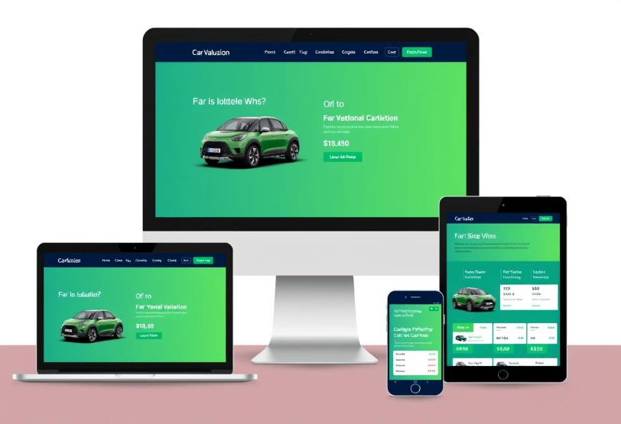

Introduction / Project Overview
This project is a modern web application that helps users determine the resale value of their cars using artificial intelligence.
It is built entirely using Next.js, which powers both the frontend UI and the backend API logic. The application is lightweight, fully responsive, and accessible on both desktop and mobile.
💡 Objective:
To simplify the process of car valuation and make it more accurate by using AI/ML, eliminating the guesswork usually involved in estimating a used car's price.

Slide 3

Problem Statement
🚗 Real-world Problem:
Car resale pricing is often inconsistent, biased, or inaccurate.
Buyers may undervalue, while sellers may overestimate car worth.
Manual estimations from dealers lack transparency.
🎯 Challenge:
There is a clear need for a data-driven, unbiased, and easy-to-use system that gives reliable car price predictions instantly.

Slide 4
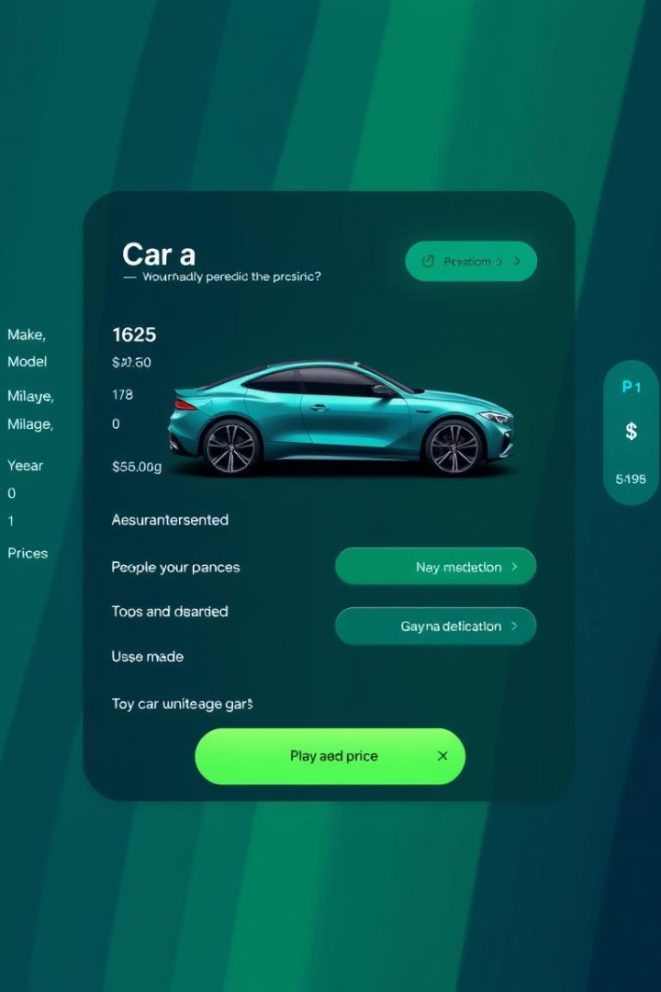




Proposed Solution
Input Car Details
Car brand and model
Manufacturing year
Fuel type and transmission
Mileage driven
Process Data
The app sends this data to a backend API
AI Analysis
Uses a trained ML model to estimate the price
Display Results
The result is displayed to the user in real-time on a clean and minimal UI
⚙️ Solution: An AI-powered car valuation platform that predicts the price of a used car based on user-provided inputs.
🌐 Available 24/7 online with a fast and responsive interface.

Slide 5
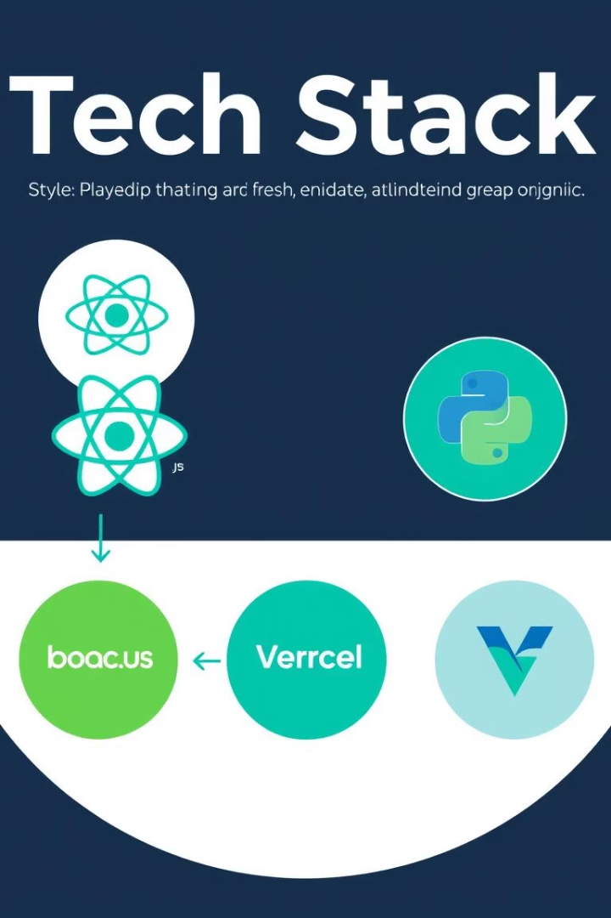



Tech Stack
Frontend
Backend
Deployment
Next.js (React-based with App Router)
Next.js API Routes for serverless backend logic
Vercel for full-stack deployment with automatic serverless scaling and instant CI/CD
Tailwind CSS for responsive styling
ML Model trained in Python (e.g., Scikit-learn)
Client-side form handling and routing
Integration via direct logic or API request to prediction model

Slide 6
Application Architecture
User Input
User enters car details in the form.
API Submission
The form submits data to a backend API route in Next.js.
ML Processing
The API sends the data to an ML model for processing.
Value Prediction
The ML model returns the predicted resale value.
Result Display
The result is instantly displayed on the frontend.
🧩 All layers (frontend + backend) are managed in a single Next.js codebase for simplicity and efficiency.

Slide 7











Future Scope / Enhancements
User Authentication
Expanded Dataset
Add user authentication & history tracking
Expand training dataset for more accurate predictions
2
Premium Features
Global Support
Integrate payment system for premium insights
Support multiple currencies & countries
Reports
Price Trends
Offer PDF download of valuation reports
Visualize predicted price trends over time
🌱 The app is designed to scale as new features and users are added.

Slide 8

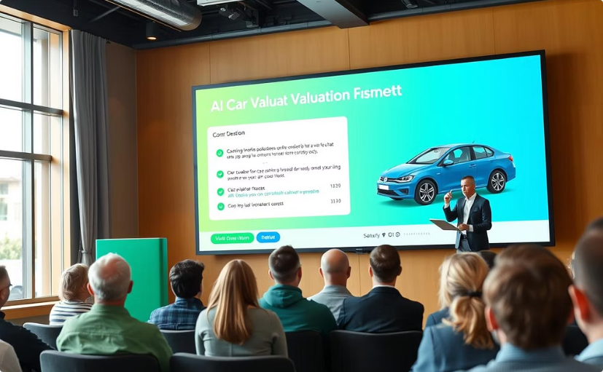
Live Demo + Q/A
Try It Live
Q&A Session
https://aicarvaluation.vercel.app/
Open to questions and feedback.
🙏 Thank You!

