Slide 1

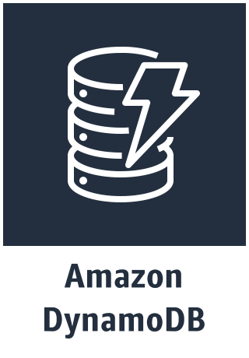


fork-example-checkout-pipeline app
Amazon SNS topic
Amazon SQS queue
Orders Table

