Slide 1

Amazon SNS Fork
Your event processing pipeline
Event storage & backup pipeline
all
events
filtered events
Event search & analytics pipeline
Amazon SNS
topic
Event replay pipeline
events to replay

Slide 2





Amazon SNS Fork / Event Storage & Backup Pipeline
sns-fork-storage-backup app
fan out filtered events
Amazon SNS
topic
Amazon SQS
queue
AWS Lambda function
Amazon S3 backup bucket

Slide 3


Amazon SNS Fork / Event Search & Analytics Pipeline
sns-fork-search-analytics app
fan out filtered events
Amazon SNS
topic
Amazon SQS
queue
AWS Lambda function
Kibana dashboard
store dead-letter events
Amazon S3
dead-letter bucket

Slide 4

Amazon SNS Fork / Event Replay Pipeline
Your regular event processing pipeline
reprocess events…
fan out filtered events
Amazon SQS processing queue
sns-fork-message-replay app
Amazon SNS
topic
enqueue events to replay
Amazon SQS
replay queue
AWS Lambda replay function
enable/disable replay
Your operators

Slide 5



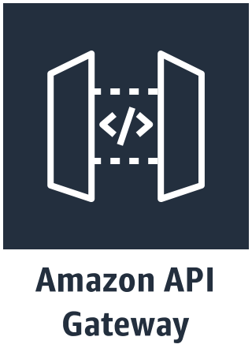

AWS Cloud
Checkout event processing pipeline
Amazon SQS
queue “Orders”
AWS Lambda
function “Process”
Amazon DynamoDB
table “Orders”
E-Commerce Users
Event storage & backup pipeline
all
orders
Event search & analytics pipeline
filtered orders (amount >= $100)
Internet
AWS Lambda
function “Checkout”
Amazon SNS
topic “Orders”
Event replay pipeline
orders to replay

