Slide 1
Compound Helicopter – Individual Assignment 2
Name:
Roll Number:

Slide 2
Section 1: Additional Assumptions & Data

Slide 3
1.1 Individual Assumptions/Data
In custom helicopter, it is assumed that conditions on both rotors are identical Modelling this is done as follows: The weight and power is divided in half, while the resultant power and thrust and torque is mutliplied by two. Essentially two half helecopters glued together working independently Additionally, since antisymmetric moments are generated, the net moment moment normal to the tip path plane cancels out almost perfectly The trims are chosen to cancel out the other two moment directions

Slide 4
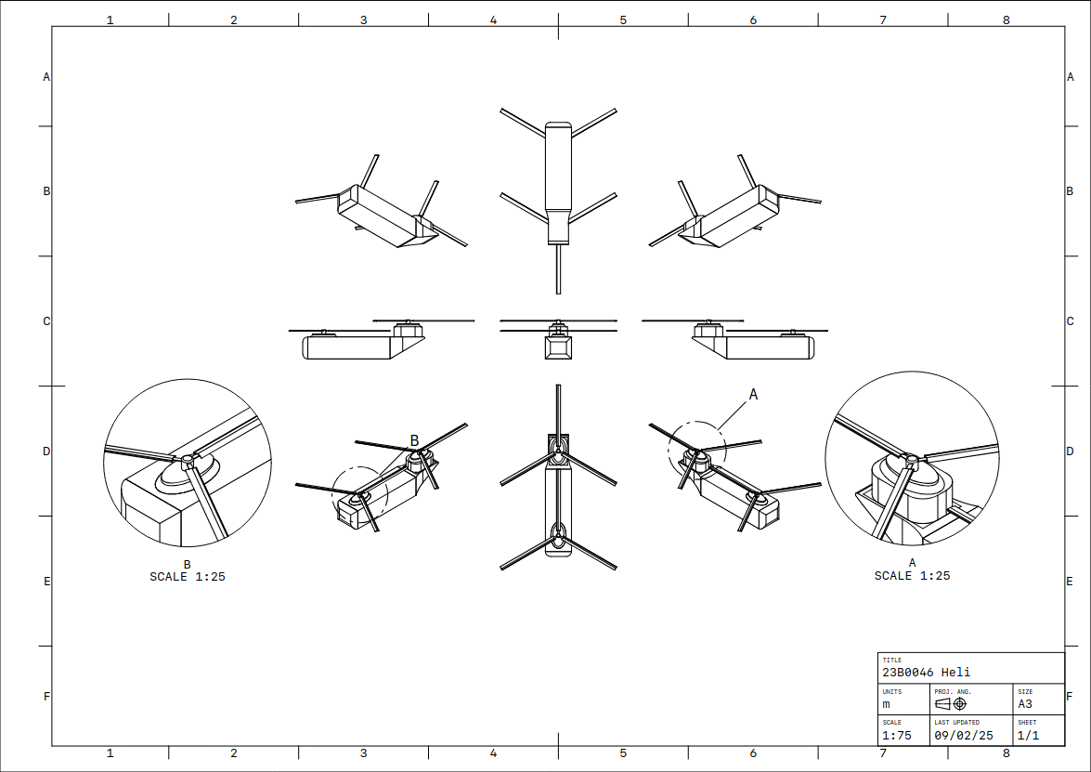
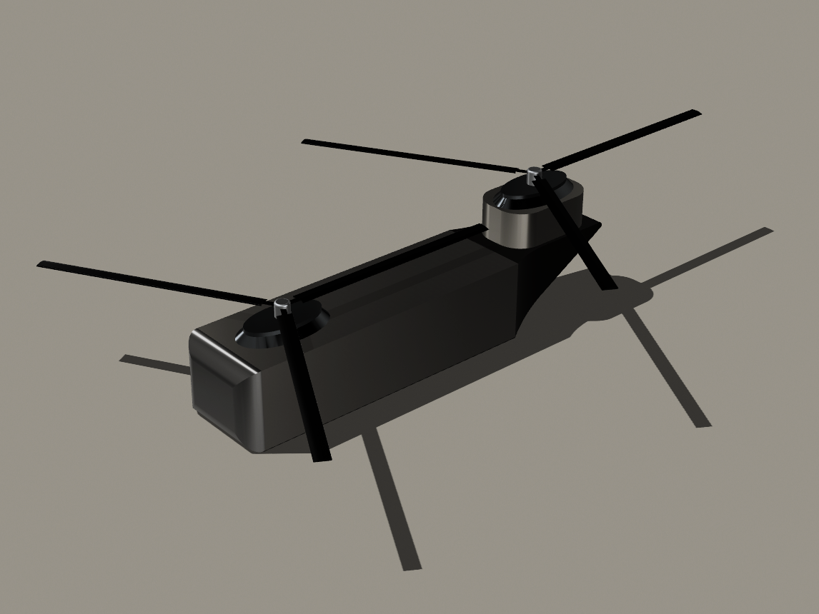
1.2: Rough schematic sketch of own compound helicopter
Note: Helicopter Design (Individual)

Slide 5
Section 2: Updated Helicopter Design

Slide 6
2.1: Design Parameters of your updated Design
 | Rotor 1 | Rotor 2 | Rotor …
Rotor Description (role) | Main Rotor 1 | Main Rotor 2
Airfoil | 2412 | 2412
Rotor Radius (m) | 16m | 16m
Rotor Speed (m) | Variable | Variable
Number of Blades | 3 | 3
Chord Length Variation | 0.9- 0.8 | 0.9-0.8
Twist Variation | 2deg per meter | 2deg per meter
Root Cutout | 0.4m | 0.4m

Slide 7
Section 3: Trim Settings

Slide 8
3.1 Trim settings and resultant forces and moment for 200km/h level flight at 2000 AMSL
θ_{0 (All are in degrees)} | -4.573698366180704 | F_{x In Newtons} | 0
θ_{1s} | 10.461857920418048 | F_{Y} | -27.99360724761209
θ_{1c} | 0.6439573809240575 | F_{Z} | 0
θ_{0,t} | -1.0 | M_{X in Newton-M} | -1.1786887538864856
α_{TPP} | 11.592860908427829 | M_{Y} | 30106.748140726868 (Note, this is equal to zero due to symmetry)
Any Other inputs |  | M_{Z} | -4.169519571674788
 |  | β₀ | 0.38065974027793115

Slide 9
Section 4: Forward Flight Mission Test

Slide 10
Findings for your compound helicopter design at 2000 m AMSL
4.1 Maximum Speed based on blade stall | 110 m/s
4.2 Maximum Speed based on power requirement | 130 m/s
4.3 Maximum Range | 639.6 km in 2.0 hours
4.4 Maximum Endurance | 2.3 hours

Slide 11
Section 5 : Bonus Task : Flight Simulator Development

Slide 12
5.1 Placement of components and C.G. w.r.t. Helicopter nose
Component | X | Y | Z
Assumed C.G | 12 | 1 | 0
Rotor 1 | 20 | 1 | 0
Rotor 2 | 1 | 1 | 0
Rotor…
Wing/Stabilizer - 1 | NA | NA | NA
Wing/Stabilizer - 2 | NA | NA | NA
Actuator – 1 | NA | NA | NA
Actuator – 2 | NA | NA | NA

Slide 13
5.2 Algorithm of the simulator augmented for forward flight

Slide 14
5.3: Video Clip of Flight Simulator

Slide 15
5.4: Observations from Simulations
Comments / Observations
…

Slide 16
Acknowledgement
< Mandatory to acknowledge people you discussed with or took help for any part of the assignment>

Slide 17
References
< List all references (books, paper, websites, etc.) used while doing the assignment>

