Slide 1
Compound Helicopter - Assignment 1
NAME:
ROLL NUMBER:

Slide 2
Team Member Contribution
Sr.No | Roll Number | Name | Contribution Level (0 - 5) | Specifics of contribution
1 | 23b0046 | Samanth Martis | 5 | Making the performance estimator tool and Mission planner
2 | 23b0079 | Ayush Kumar | 5 | Performance estimator tool
3 | 23b0011 | Ambika Soni | 5 | Mission planner
4 | 23b0065 | Konda Venkata Srivatchav | 5 | Performance estimator tool
5

Slide 3
Section 1:
Assumptions & Data

Slide 4
1.1 Physics Assumptions/Data
Flow is assumed to be incompressible inviscid and steady while M(tip)<0.3, density is constant. Ignored blade wake interaction and compressibility ;Prandtl tip-loss factor used Neglected swirl losses. The blade elements are considered to be independent sections. Viscous effects are neglected in the Blade element momentum theory
1.2 Environmental Assumptions/Data
Value of gravitational constant assumed to be constant(9.81) at all altitudes Assumed pressure and temperature as per the ISA model and assumed wind velocity to be zero ISA model was used to calculate the pressure , temperature at different altitudes. Assumed that the pressure , temperature conditions do not change while climbing with a constant velocity.

Slide 5
1.3 Vehicle Assumptions/Data
2D airfoil data for lift(Cl) and drag(Cd) coefficients are taken from standard tables and websites. The total drag of the aircraft is modeled using a parabolic drag polar equation The vertical drag (airflow coming from the top of the fuselage/ rotor exit flow) on the fuselage and tail surfaces were assumed to be absent in this assignment Only Horizontal drag is taken into account No drag due to the Tail airflow (the air which the tail pushes back on to the helicopter tail) The modelling of the drag of the fuselage is done by thinking the helicopter is made Two cylinders connected axially with two different radius and also a rectangular slab at the back.

Slide 6
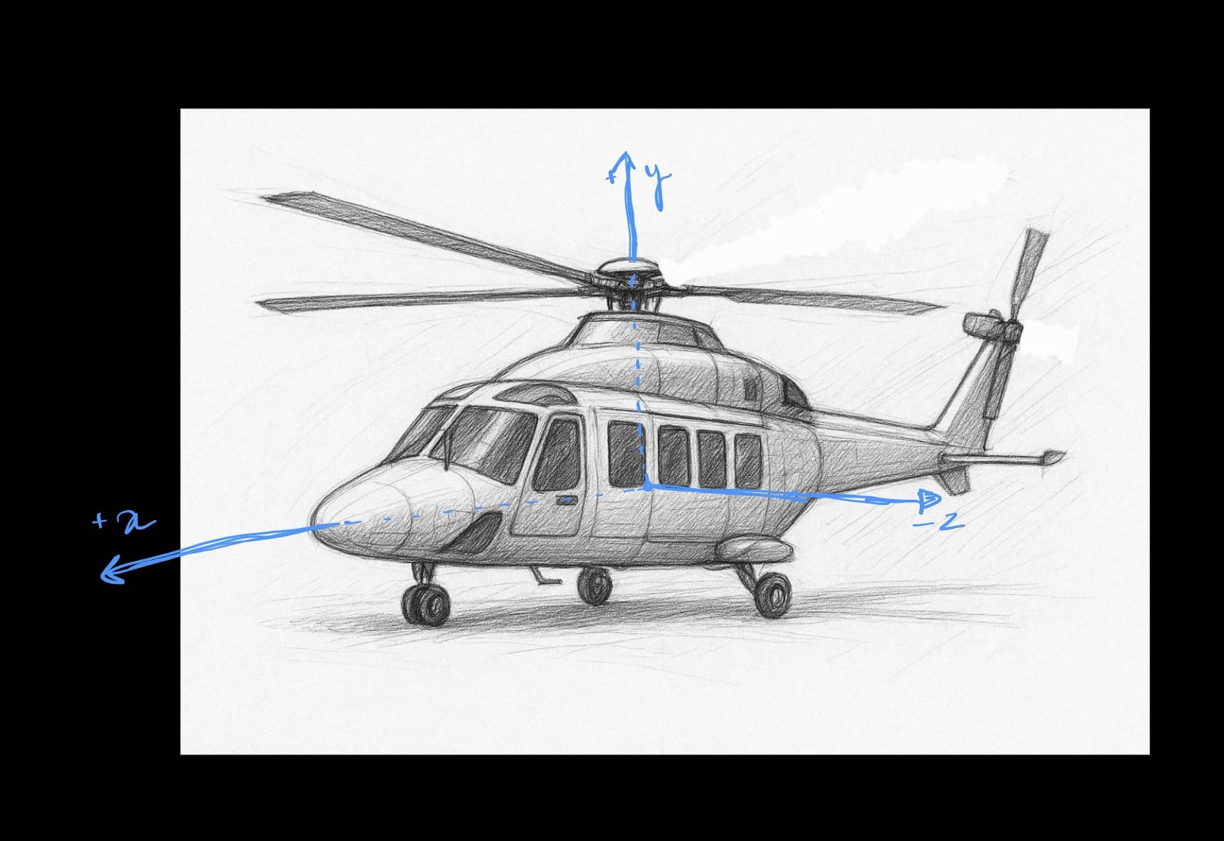

Slide 7
1.4 Flight Condition Assumptions/Data
Steady and unaccelerated flight. Constant speed during climb and constant altitude during hover. Radial flow components are neglected (purely axial plus tangential flow assumed) Mutual interference between blades neglected. There is no tilt in the rotor shaft. All the angles (β0, β1s, β1c, θ0, θ1s, θ1c) are all assumed to be small. β1c >> β1s The rotor torque is normal to the TPP (Tip Path Plane). The distance of the tail rotor from the axis of main rotor is assumed to be long enough such that Thrust of Tail is minimum. Thrust of the tail is small enough to justify a first order approximation in the β1s angle.

Slide 8
Section 2:
Algorithm/Logic Flow Diagrams

Slide 9
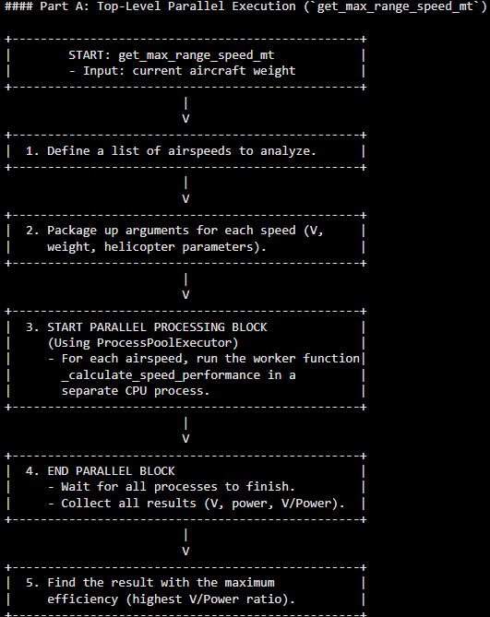
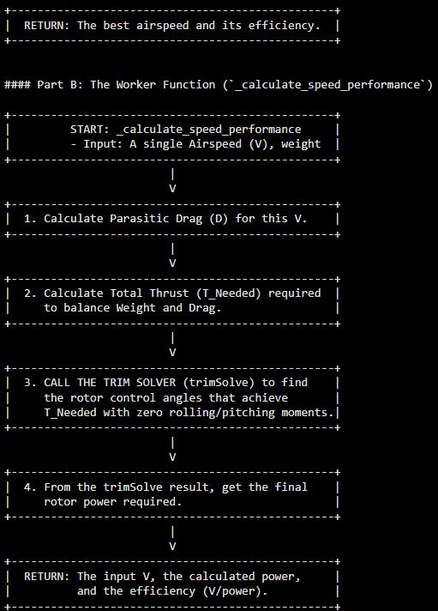
2.1: Working/Algorithm/Logic Flow Diagram of the Performance Estimator Tool

Slide 10
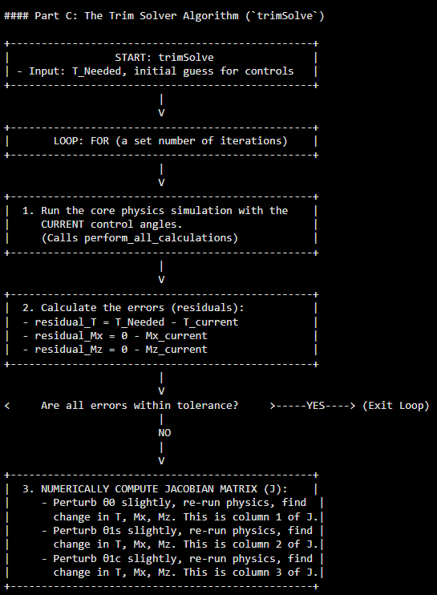
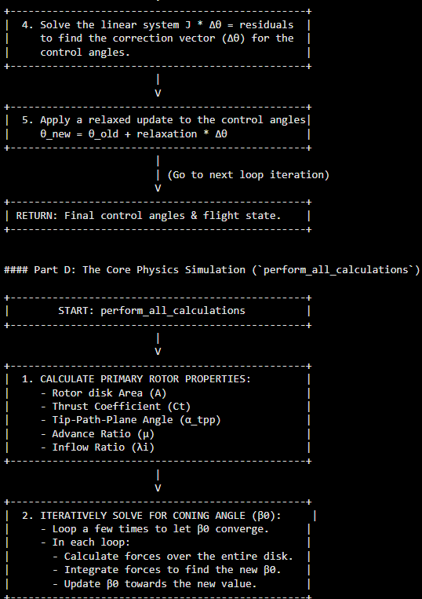

Slide 11
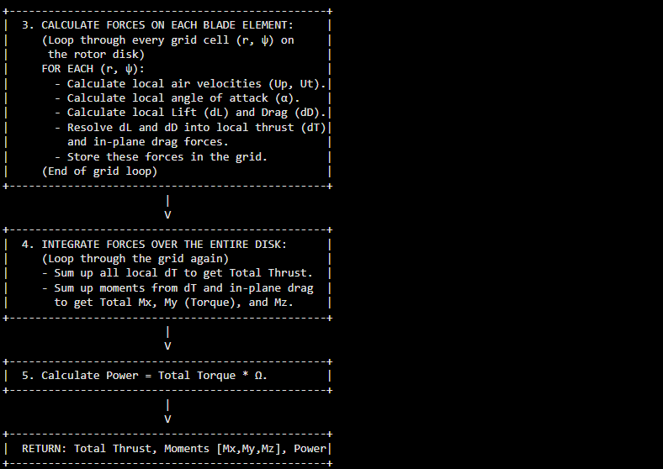

Slide 12
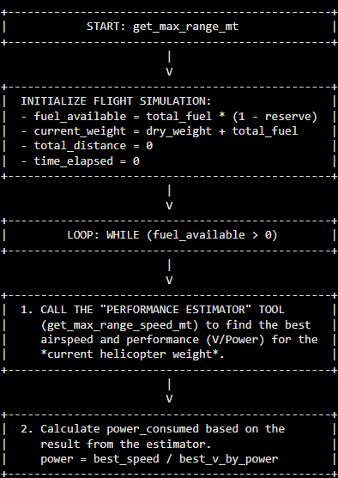
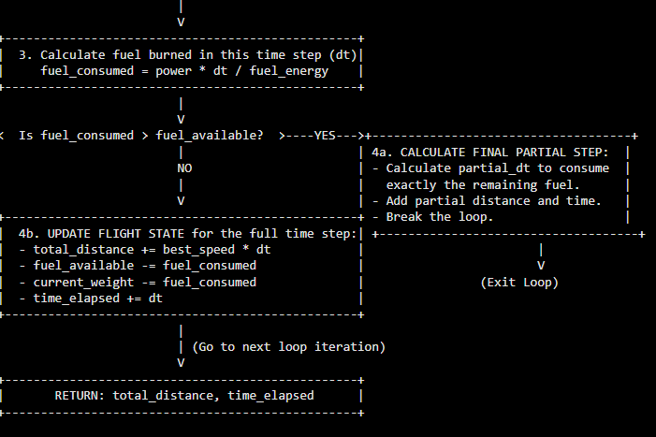
2.2: Working/Algorithm/Logic Flow Diagram of the Mission Planner

Slide 13
Section 3:
Pilot Input Tests and Observations

Slide 14
3.1: Plot of F_{x}, F_{Y}, F_{Z}, M_{X}, M_{Y}, M_{Z} with changes in pilot inputs

Slide 15
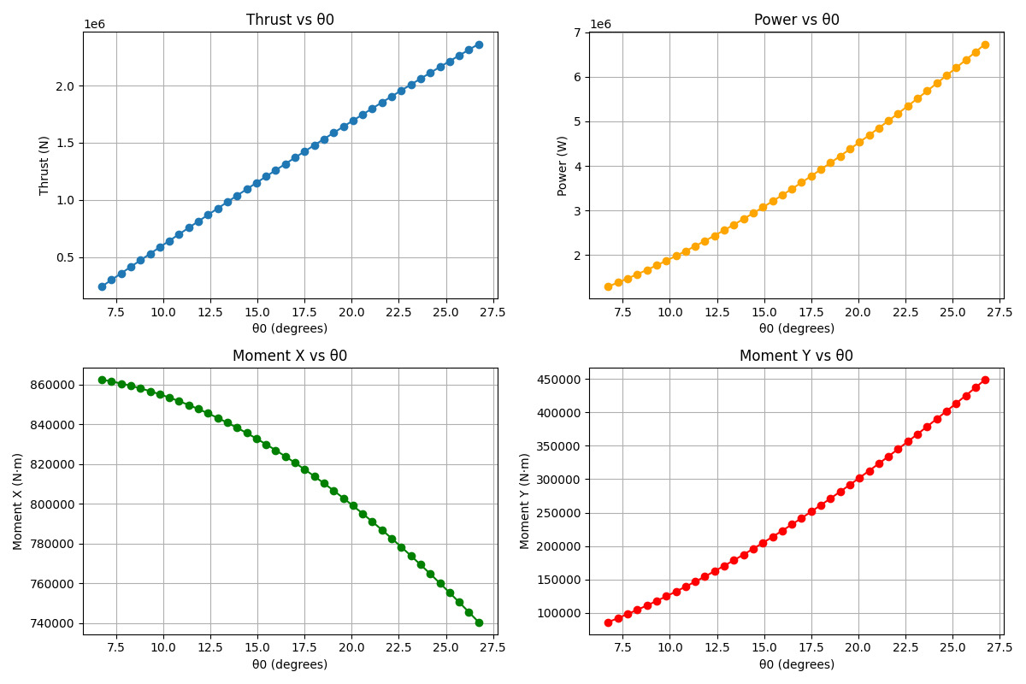

Slide 16
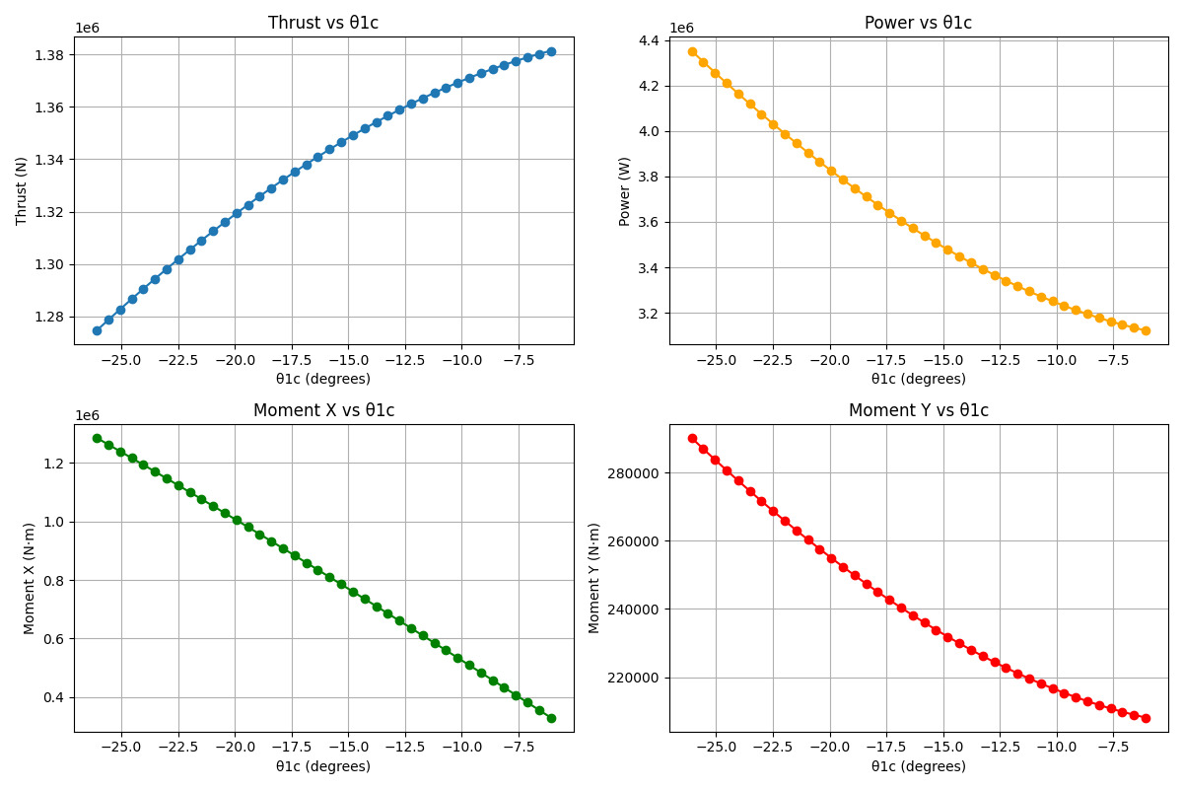

Slide 17
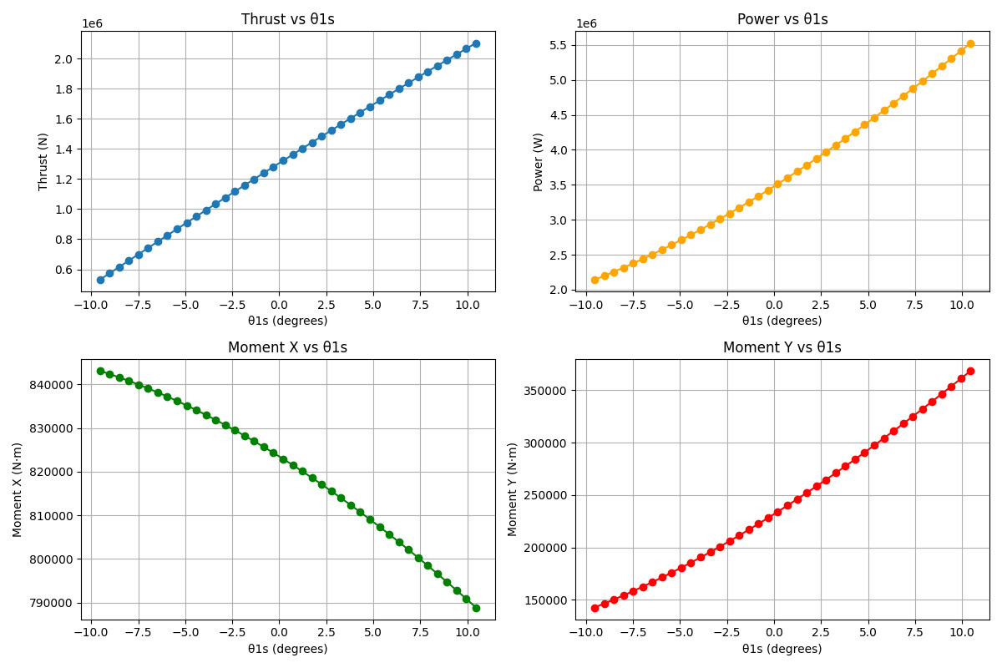

Slide 18
3.2: Observation and reasoning for behaviour of F_{x}, F_{Y}, F_{Z}, M_{X}, M_{Y}, M_{Z .}
Variation in Theta0
As observed from the graphs, with an increase in theta0: Thrust is increasing Power is increasing Mx decreasing My is increasing | Thrust is increasing because, the pitch is increasing and Hence the angle of attack is increasing Power is increasing because with increased Cl, the drag will also increase quadratically. (trend approximation) My is increasing because now the torque by the main rotor is more than the trim settings, torque as increased due to the increase in drag.
Variation in Theta1c
As observed from the graphs, with an increase in theata1c: Thrust is increasing through very less there is a significant decrease in power required Mx and My are decreasing. | thrust in increasing because for certain region on the rotor blade sweep area, more lift will be generated though not really significant.
Variation in Theta1s
As observed from the graphs, with an increase in theta1s: thrust is increasing more significantly than in the case of increase in theta1s there is an increase in power Mx is decreasing My is increasing | Thrust is increasing because for a certain region on the rotor balde sweep area, more lift will be generated.

Slide 19
Section 4:
Trim Settings

Slide 20
4.1:Trim settings and resultant forces and moments
θ₀ | 11.5 degree | F_{x} | -1744 N
θ_{1s} | -6.51 degree | F_{Y} | 0 N (assumed)
θ_{1c} | 3.68 degree | F_{Z} | 37, 278 N
θ_{0,t} | - | M_{X} | -191. 7 N-m
α_{TPP} | 2.68 degree | M_{Y} | 48,125 N-m
Any Other inputs | Omega= 47.12 rad/s | M_{Z} | 158.9
 |  | β₀ | 5.57 degree

Slide 21
Section 5:
Mission Planner Test

Slide 22
Findings for compound helicopter in trim conditions ( at 2000m AMSL)
5.1 Maximum speed based on blade stall | 120 m/s
5.2 Maximum speed based on power requirement | 110m/s
5.3 Maximum Range | 742 Km
5.4 Maximum Endurance | 2.9 hours

Slide 23
Acknowledgement
We acknowledge Dhwanil Sir for giving us this project, through which we implemented theory learned in class into real application.

Slide 24
References
http://airfoiltools.com/airfoil/naca4digit
Aeronautics, Aerodynamics and Flight Mechanics by Barnes & McCormick
https://en.wikipedia.org/wiki/Blade_element_momentum_theory
https://www.youtube.com/watch?v=b7JzgybKvys
https://colab.research.google.com/drive/1j7yyqqiu0aPtEGgfdpLXn6CjISlaJ0pc?usp=sharing#scrollTo=3KjusZ-jUWc7
https://ntrs.nasa.gov/archive/nasa/casi.ntrs.nasa.gov/19930081433.pdf

