Slide 1
Two-factor and time-series metabolomic data analysis
Metabolomics 2011 Cairns | Australia
Jianguo (Jeff) Xia
University of Alberta, Canada
Notes:
Metabolomics 2011 Cairns | Australia

Slide 2
Metabolomics @ Univ. of Alberta
To establish infrastructure and to facilitate the application of metabolomics
  Creating comprehensive, public accessible metabolomic databases
    The Human Metabolome Database (HMDB)
    Drugbank, SMPDB
    MarkerDB, etc
  Developing robust analytical protocols
    NMR, GC-MS, LC-MS, DI-MS
    The Metabolomics Innovation Center (TMIC)
  Developing bioinformatics tools for metabolomics data analysis

Slide 3
Bioinformatics Tools
MetaboAnalyst
  General-purpose metabolomic data analysis pipeline
    Raw data processing, normalization, statistical analysis …
  http://www.metaboanalyst.ca
MSEA - metabolite set enrichment analysis
  Identification of enriched groups of metabolites that are biologically meaningful
    Associated with pathways, diseases, genetic traits ….
  http://www.msea.ca
MetPA - metabolic pathway analysis
  Identification of metabolic pathways that are most likely to be affected by or involved in the experimental conditions
    Pathway enrichment analysis, topology analysis, visualization
  http://metpa.metabolomics.ca
Note, both enrichment analysis and pathway analysis can also be accessed from MetaboAnalyst

Slide 4
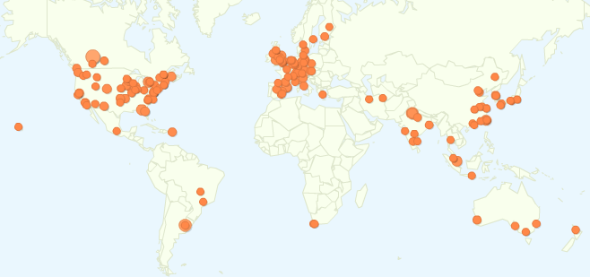
Widely Used
> 25,000 visits world wide
~ 100 jobs /day

Slide 5
GC/LC-MS
raw spectra
MS / NMR
peak lists
MS / NMR
spectra bins
Metabolite
concentrations
Peak detection
Retention time correction
Baseline filtering
Peak alignment
Resources & utilities
Peak searching
Pathway mapping
Name conversion
Lipidomics
Metabolite set libraries
Data integrity check
Missing value imputation
Data normalization
Row-wise normalization
Column-wise normalization
Pathway analysis
Enrichment analysis
Topology analysis
Interactive visualization
Statistical analysis
Univariate analysis
Dimension reduction
Feature selection
Cluster analysis
Classification
Time-series /two factor
Clustering
Two-way ANOVA
ASCA
Temporal Comparison
Enrichment analysis
Over representation analysis
Single sample profiling
Quantitative enrichment
analysis
Downloads
Processed data
PDF report
Images

Slide 6
Motivation
Metabolomics is very suitable for longitudinal studies
  Relatively cheaper
  Convenient sample collection (urine, saliva, blood, etc.)
Metabolome directly interacts with environment. It is subjected to the effects of various factors
  Age, sex, life style …..
We need bioinformatics tools for time-series and multi-factor metabolomic data analysis

Slide 7
Project Overview
Objective
  To develop a user-friendly web-based tool for analyzing time-series / multifactor metabolomic data
Target users
  Experimental biologists looking for practical solutions to analyzing their data
Target experimental design
  Time and group
  General two-factor design

Slide 8
Literature Survey
Common tasks
  Identification of metabolites with similar patterns of change
  Identification of metabolites with different patterns of change
  Identification of global patterns of change
Commonly used approaches
  Clustering approaches
  Linear model (i.e. LIMMA)
  ANOVA-based approaches (i.e. ASCA)
  Bayesian approaches (i.e. BATS)
  Other approaches ….
Smilde, A.K., et al. “Dynamic metabolomic data analysis: a tutorial review” Metabolomics (2010) 6:3–17

Slide 9
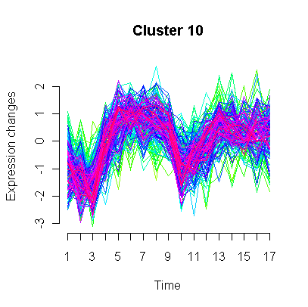
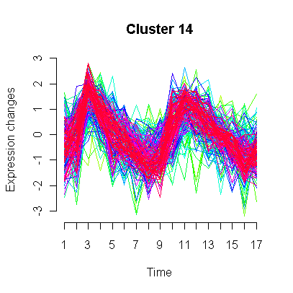
Clustering Technique
Goal: to identify metabolites with similar or correlated expression profiles
Methods: hierarchical clustering, Kmeans, SOM, etc
Generated using Mfuzz package (L., Kumar and M., Futschik, 2007)

Slide 10
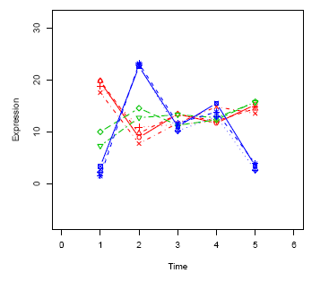
Temporal Profile Analysis
Goal: to identify temporal profiles that are significantly different among different experimental conditions
Methods (TimeCourse):
  Comparing time-course mean profiles of each metabolite
  Taking consideration of both within and between time points variance

Slide 11
ANOVA-based techniques (ASCA)
Goal: to identify major trends associated with each experimental factor
Method: two stages
    Calculating main effects & interaction
    PCA on each partition

Slide 12
Which Methods?
Selection criteria (for web-based applications)
  Underlying theory are generally understood (by biologists)
  Algorithms well established
    Not proprietary, preferably open-source (i.e. R code)
    Not computationally prohibitive
  Relatively straightforward to present

Slide 13
Selected Methods
Univariate method
  Two-way within/between-subject ANOVA
Clustering + visual exploration
  Interactive 3D PCA
  Two-way heatmap hierarchical clustering
Multivariate methods
  ANOVA – simultaneous component analysis (ASCA)
    Model selection
    Model validation
    Feature selection
  Multivariate empirical Bayes time-series analysis (MEBA)

Slide 14
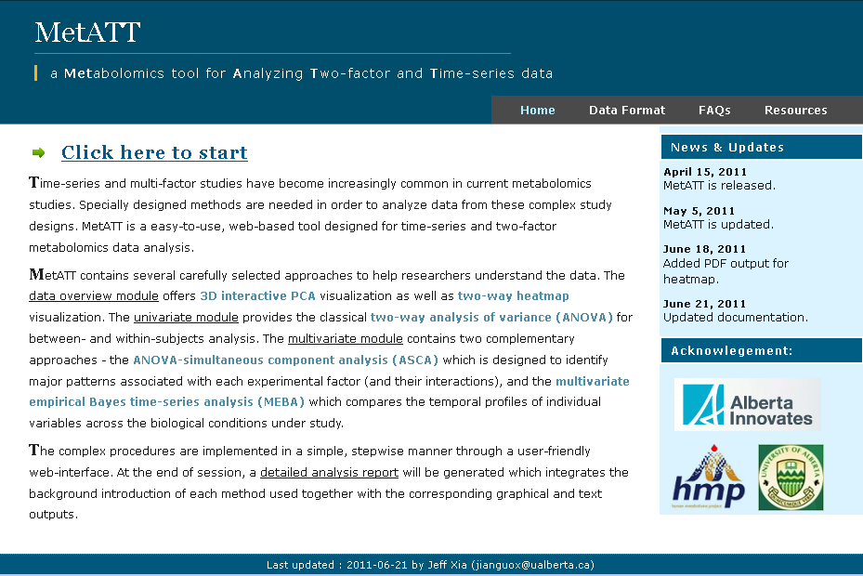
http://metatt.metabolomics.ca
You can also access from within MetaboAnalyst

Slide 15
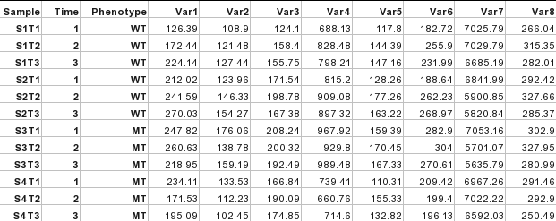
Input Format
Time-series replicates
Experimental conditions

Slide 16
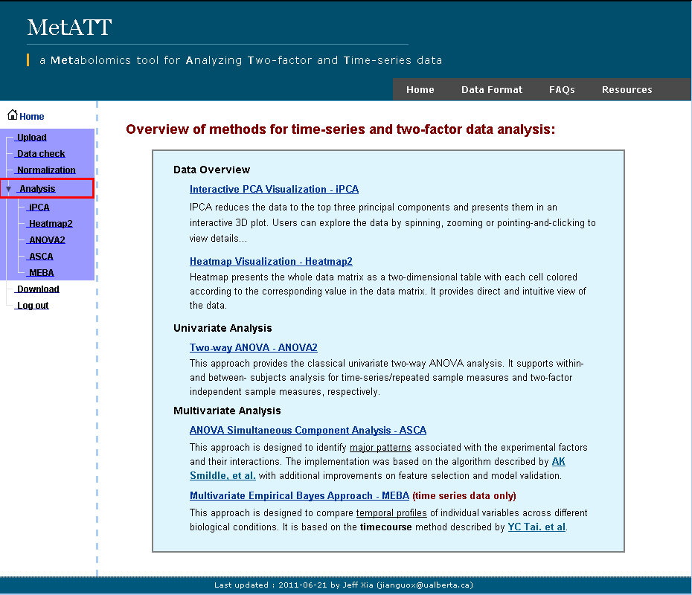

Slide 17
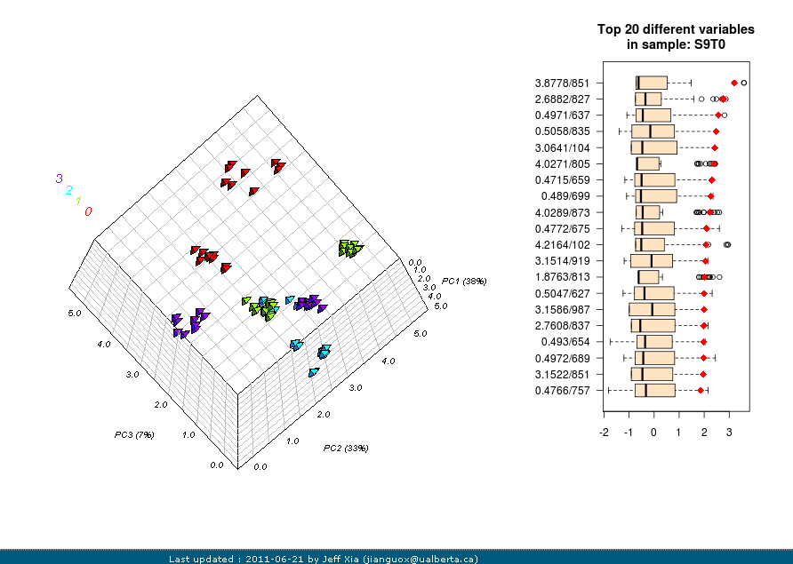
Interactive 3D PCA visualization

Slide 18
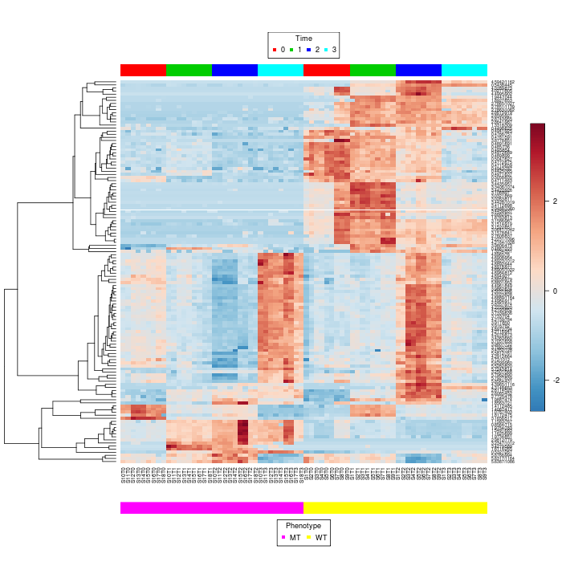
Two-way clustered heatmap

Slide 19
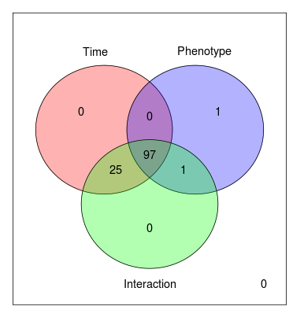
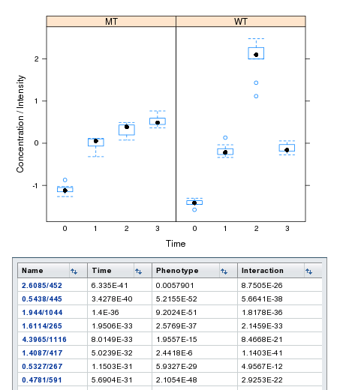
Two-way ANOVA

Slide 20
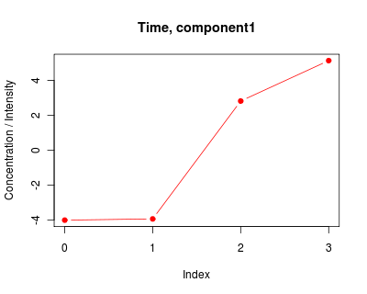
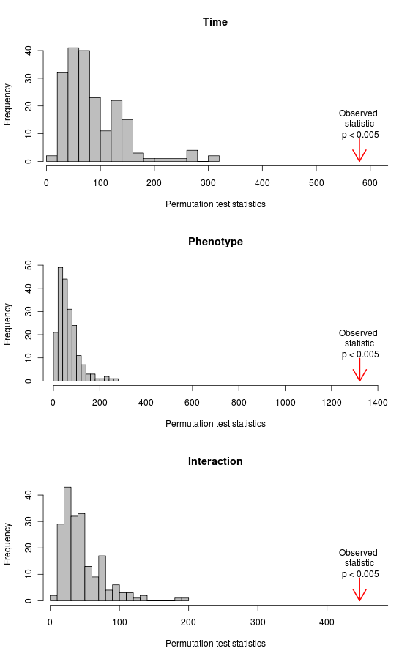
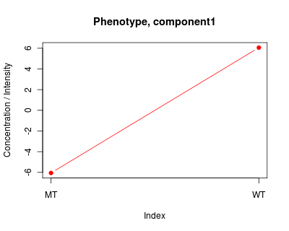
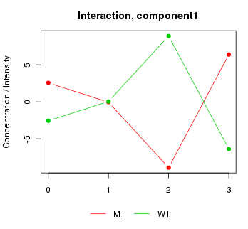
ASCA – identification of major trends
Smilde, A.K., et al. and Vis, D.J., et al.

Slide 21
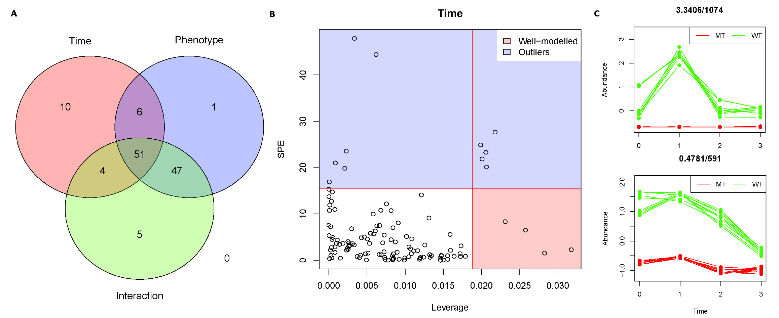
ASCA – variable selection
To identify significant variables that behave according to the detected patterns.
  Leverage
    Derived from loadings
  Squared prediction error (SPE)
    Derived from residuals
Nueda, et al., 2007

Slide 22
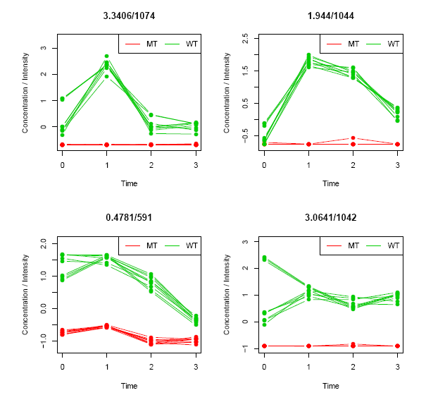
Temporal Profile Analysis
To detect variables with distinctive temporal profiles
The variables are ranked by MB-statistics
Tai, Y.C. and Speed, T.P.

Slide 23
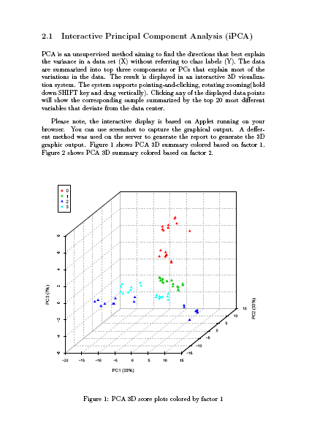
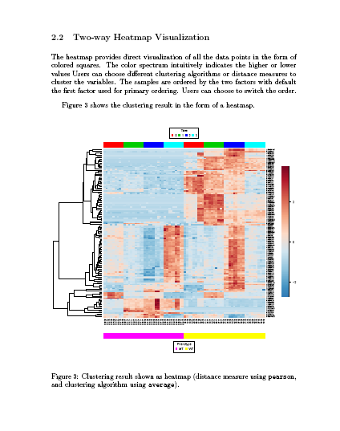
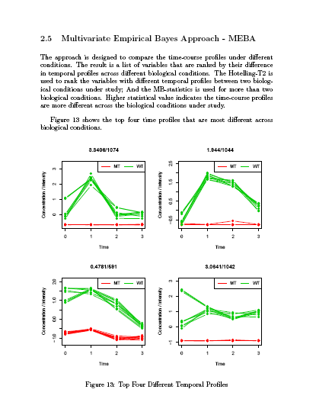
Analysis Report (PDF)

Slide 24
Tips
Data should be centered (zero-means) and properly normalized before analysis
When there appear to be a strong interaction effect, the result need to interpreted in the context of each other; otherwise, it is advisable to analyzed the data with regard to each factor independently for ease of interpretation
Multi (> 2) factor data analysis can be decomposed into two-factor data analysis

Slide 25
Summary
MetATT offers three commonly used approaches
  Identification of compounds with similar patterns - PCA, heatmap
  Identification of compounds with different temporal profile analysis - MEBA, ANOVA
  Identification of global major (and secondary) patterns - ASCA
Time-series and multi-factor omics data analysis is still at its early stages.
  No well-defined procedures
Future efforts
  Evaluate other approaches
    PARAFAC, Tucker, N-PLS, etc
  Challenges
    Too complex to be presented on a web-based program
    Lack of widely-accepted outputs & associated interpretations

Slide 26
References
Smilde, A.K., et al. (2005) ANOVA-simultaneous component analysis (ASCA): a new tool for analyzing designed metabolomics data, Bioinformatics, 21, 3043-3048.
Tai, Y.C. and Speed, T.P. (2006) A multivariate empirical Bayes statistic for replicated microarray time course data, Annals of Statistics, 34, 2387-2412.
Vis, D.J., et al. (2007) Statistical validation of megavariate effects in ASCA, BMC Bioinformatics, 8, 322.
Nueda, M.J., et al. (2007) Discovering gene expression patterns in time course microarray experiments by ANOVA-SCA, Bioinformatics, 23, 1792-1800.
Glaab, E., et al. (2010) vrmlgen: An R Package for 3D Data Visualization on the Web, Journal of Statistical Software, 36, 2347-2348.

Slide 27






Acknowledgements
Dr. David Wishart
Dr. Rupa Mandal
Dr. Igor Sinelnikov
Dr. David Broadhurst

