Slide 1
Canadian Bioinformatics Workshops
www.bioinformatics.ca

Slide 2
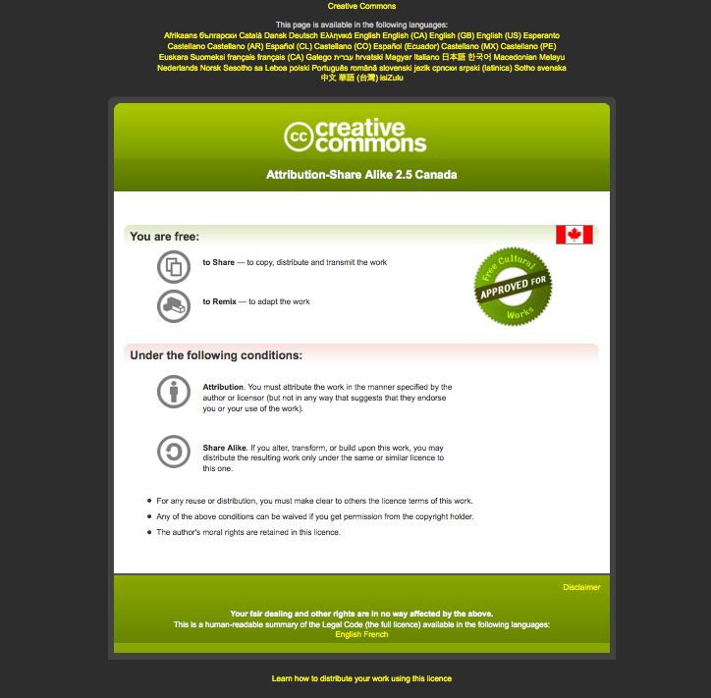
Module #: Title of Module

Slide 3

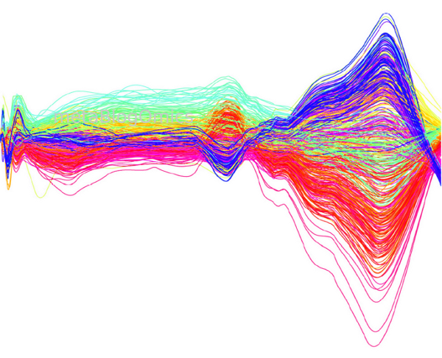

Module 5
Processing Raw LC-MS spectra using R and XCMS
An image to represent your workshop or module

Slide 4
Learning Objectives
Learn the basic steps in untargeted metabolomics
Learn about XCMS and various input data formats
Learn how to process raw LC-MS spectra using XCMS for MetaboAnalyst

Slide 5
Untargeted Metabolomics Overview
Raw Spectra (NetCDF, mzXML)
Data Processing
(XCMS)
Statistical Analysis
(MetaboAnalyst)
Module 5 Lab
Module 7 Lab
Peak Identification
(HMDB, METLIN)
Pathway Analysis
(SMPDB, KEGG)
Integrated Assignments Lab

Slide 6
R & Bioconductor
R is a statistical programming environment
Open source, cross platform
Bioconductor project - open source software packages written in R for high-throughput “omics” data analysis
  Genomics, microarray, RNA-seq, proteomics, metabolomics
Limitations
  Requires substantial effort to learn statistics and programming skills before one can do a meaningful data analysis
  Mainly command driven

Slide 7
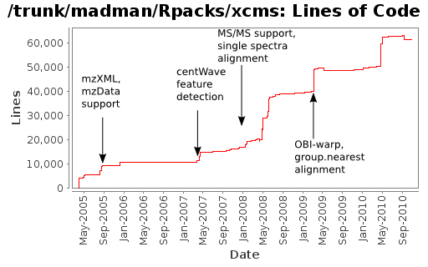
XCMS
Bioconductor package for processing LC/GC-MS spectra
Widely used for untargeted metabolomic studies
http://metablogomics.blogspot.ca/

Slide 8
Why XCMS (1)
Free, open source, powerful and flexible
High-throughput (batch processing)
Cutting-edge algorithms
  peak detection
  peak deconvolution
  peak alignment

Slide 9
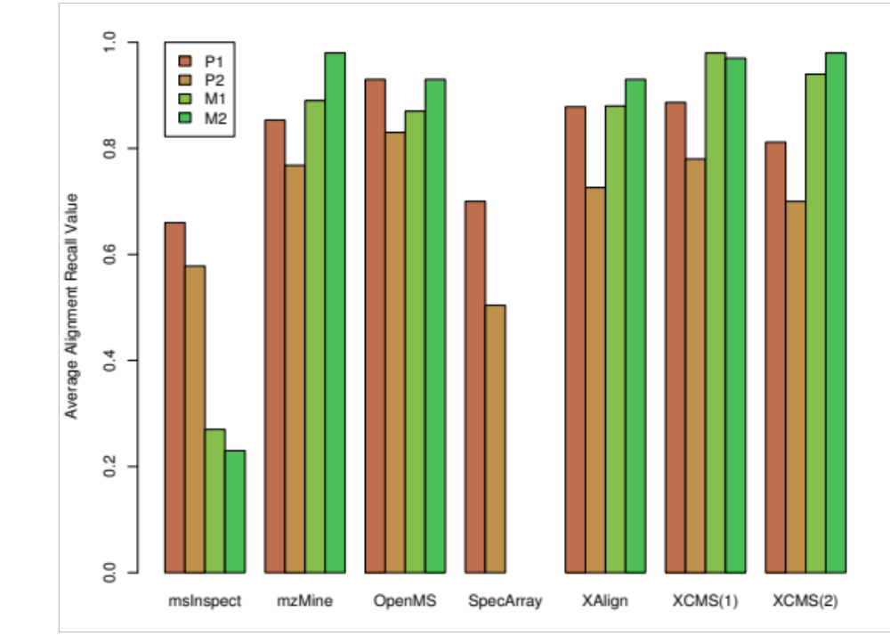
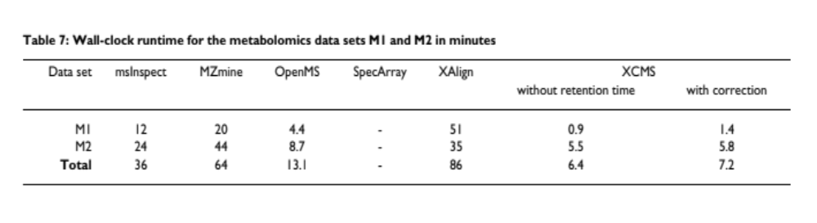
Why XCMS (2)
Highest average precision and recall
Superfast
BMC Bioinformatics. 2008; 9: 375.

Slide 10
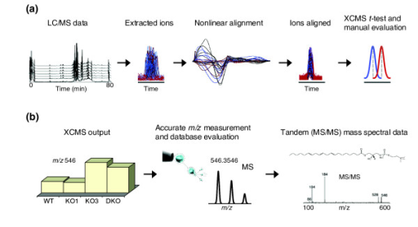
LC-MS and XCMS

Slide 11
Some Notes
# start of comments
> start of R command
# R command format
> output.data <- function(input.data)
> ?function # getting help

Slide 12
Prerequisites
Latest R installed
XCMS package installed
Test data “faahKO” installed
# use biocLite to install a Biocondcutor package
> source("http://bioconductor.org/biocLite.R")
# Install the xcms package
> biocLite("xcms")
# Install dataset package used in this session
> biocLite("faahKO")
# Install multtest package for diffreport function
> biocLite("multtest")

Slide 13
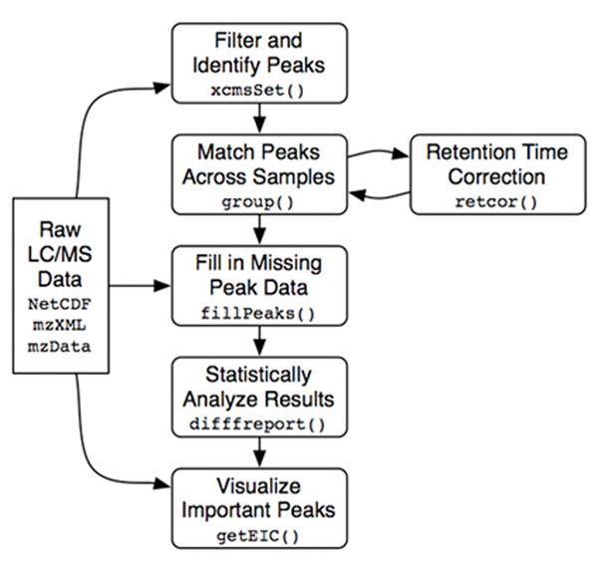
Basic XCMS Flowchart
Step 1
Step 2
Step 3
Step 4
Step 5.2
MetaboAnalyst
Step 5.1
Step 6

Slide 14
R commands overview
> library(xcms)
> cdfpath <- system.file("cdf", package = "faahKO")
> cdffiles <- list.files(cdfpath, recursive = TRUE, full=T) # input files (step 1)
> xset <- xcmsSet(cdffiles) # peak picking (step 2)
> xsg <- group(xset) # peak alignment (step 3.1)
> xsg <- retcor(xsg) # retention time correction (step 3.2)
> xsg <- group(xsg) # re-align (step 3.3)
> xsg <- fillPeaks(xsg) # filling in missing peak data (step 4)
> dat <- groupval(xsg, "medret", "into") # get peak intensity matrix (step 5)
> dat <- rbind(group = as.character(phenoData(xsg)$class), dat) # add group label
> write.csv(dat, file=‘MyPeakTable.csv’) # save the data to CSV file
>

Slide 15
Prepare Input (step 1)
Supported formats: NetCDF, mzXML, mzData
Software for most instruments can export to NetCDF (often referred to as CDF or AIA)
# put all .cdf files inside a folder named ‘myspectra’, save the
# folder under your current working directory
> cdffiles <- list.files(‘./myspectra’, recursive = TRUE, full=T)
# cdffiles now contain absolute path to all raw spectra
> cdffiles

Slide 16
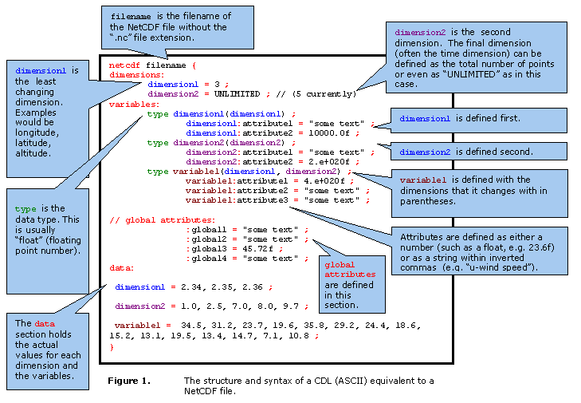
Prepare input (step 1)

Slide 17
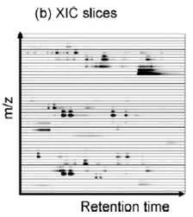
Peaking Detection (step 2)
Time

Slide 18
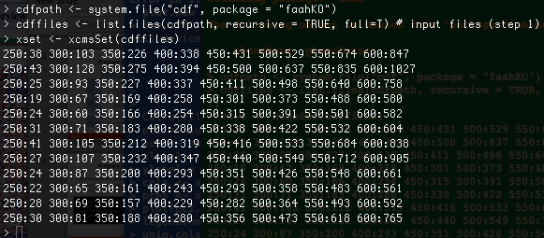
Peaking Detection (step 2)
Some important parameters
  xcmsSet(..., scanrange=c(lower, upper) ) # to scan part of the spectra
  xcmsSet(…, fwhm = seconds)
  # specify full width at half maximum (default 30s) based on the type of chromatography
  xcmsSet(…, method = ‘centWave’)
  # use wavelet algorithm for peak detection, suitable for high resolution spectra

Slide 19
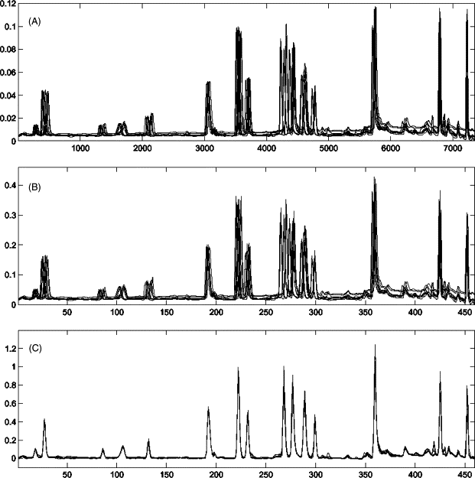
Peak Alignment & Retention Time Correction (step 3)

Slide 20
Peak Alignment & Retention Time Correction with XCMS
Matching peaks across samples
Using the peak groups to correct drift
Re-do the alignment
Can be performed iteratively until no further change
> xsg <- group(xset) # peak alignment
> xsg <- retcor(xsg) # retention time correction
# xsg <- retcor(xsg, plottype = ‘mdevden’) # also plot the result
> xsg <- group(xsg, bw=10) # re-align with tighter range

Slide 21
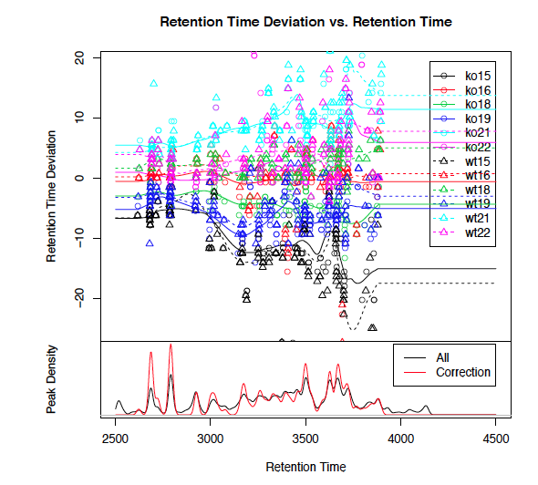
Retention Time Deviation Profile

Slide 22
Filling in Missing Peaks (step 4)
A significant number of potential peaks can be missed during peak detection
Missing values are problematic for robust statistical analysis
We now have a better idea about where to expect real peaks and their boundaries
Re-scan the raw spectra and integrate peaks in the regions of the missing peaks

Slide 23
Filling in missing peaks (step 4)
> xsg <- fillPeaks(xsg) # filling in missing peak data
Some warnings may show up when the expected peak (as indicated by many other files) are beyond the "end" of the file. There is no raw data available for fillPeaks(). These warnings can be ignored.

Slide 24
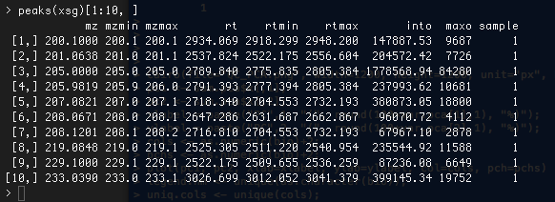
Results of Peak Detection
Long list of peaks with
  mz, mzmin, mzmax
  rt, rtmin, rtmax
  peak intensities/areas (raw data)

Slide 25
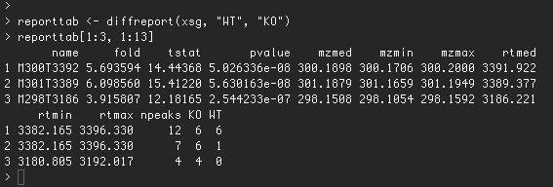
Statistical Analysis with XCMS (step 5.1)
XCMS ‘diffreport’ computes Welch's two-sample t-statistic for each analyte and ranks them by p-value.
It returns a summary report
Multivariate analysis and visualization can be performed using MetaboAnalyst

Slide 26
Statistical Analysis with MetaboAnalyst (step 5.2)
The general format required by MetaboAnalyst and most other statistical tools is a data matrix:
  Features (peaks) in rows;
  Samples in columns;
  Group labels;
> dat <- groupval(xsg, "medret", "into") # get peak intensity matrix
# add group labels (KO, WT)
> dat <- rbind(group = as.character(phenoData(xsg)$class), dat)
> write.csv(dat, file=“MyPeakTable.csv”) # save the data to CSV file
Notes:
Conflict resolution:
medret: use the peak closest to the median retention time
maxint: use the peak with the highest intensity
Intensity calculation:
into: integrated area of original (raw) peak
intf: integrated area of filtered peak
maxo: maximum intensity of original (raw) peak
maxf: maximum intensity of filtered peak

Slide 27
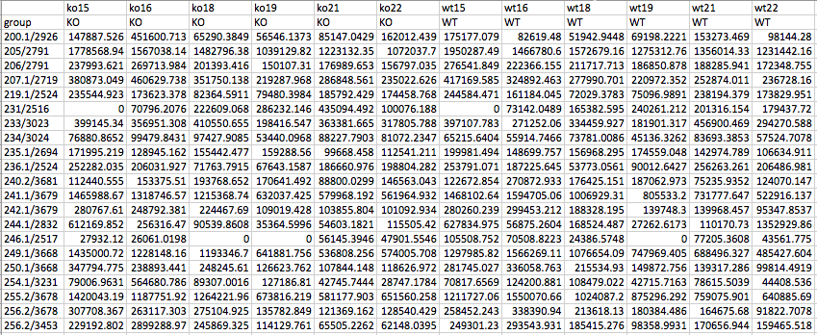
Peak Intensity Table
Peaks are identified by “m/z / retention time”
Can be directly uploaded to MetaboAnalyst

Slide 28
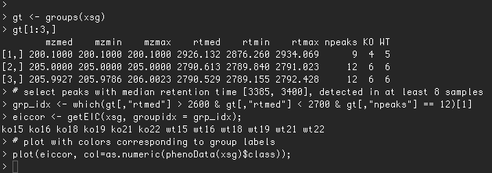
Visualizing Peaks (step 6)
When significant peaks are identified, it is critical to visualize these peaks to assess quality
This is done using the Extracted ion chromatogram (EIC)

Slide 29
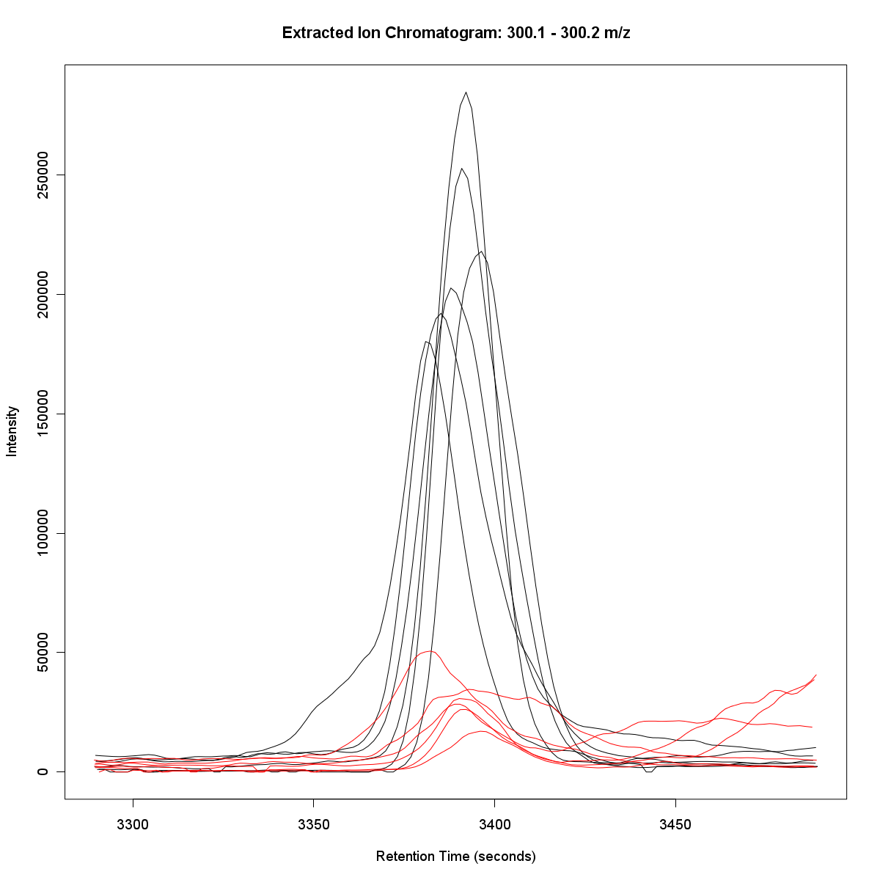
Visualizing Important Peaks (step 6)

Slide 30
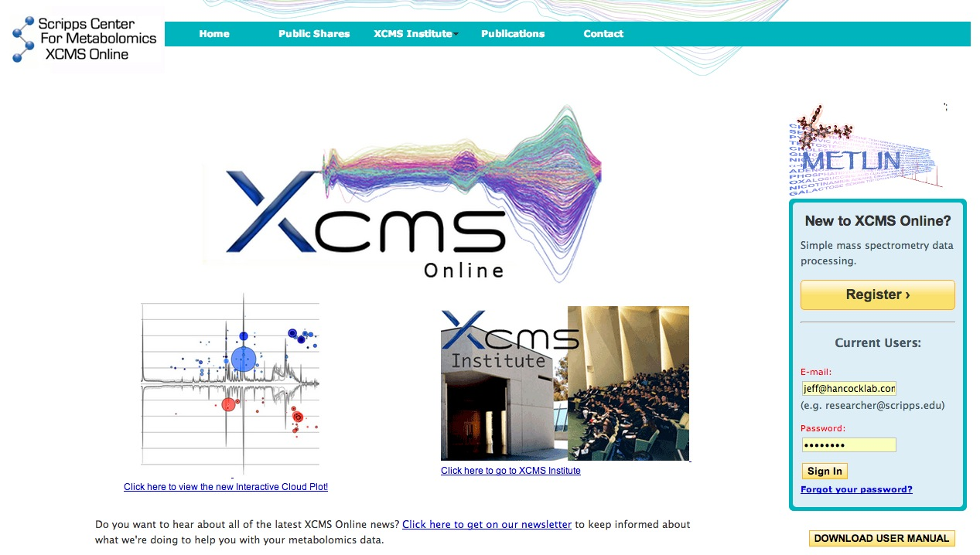
XCMS Online

Slide 31
File Format
File formats that can be directly uploaded to XCMS Online are:
  mzXML
  mzData
  .cdf NetCDF (AIA/ANDI)
  .d folders (Agilent; Bruker)
  .wiff files (AB SCIEX)

Slide 32
The Main Steps
Log in (need to register first)
Create a new job
Upload your data
Specify parameters
Submit the job
Wait for email notification
Reformat your data for MetaboAnalyst

Slide 33
Summary
We have only shown the most basic functions of XCMS. For more advanced tutorials and troubleshooting see:
  Tutorial:
    http://bioconductor.org/packages/release/bioc/vignettes/xcms/inst/doc/xcmsPreprocess.pdf
  Discussion Forum
    http://www.metabolomics-forum.com/viewforum.php?f=8

