Slide 1
Design and Control of WEDM Pulsed Power Supply for Fabrication of Silicon Wafers
Akshay Khadse
(153079011)

Slide 2
Introduction
Extracting silicon wafers: 20% of total energy consumption throughout process^{[1]}
Traditional silicon cutting
Wire loose slurry
Diamond saw cutting
Wire diameter = o(100 um)
Micro-fractures depth = 20 um
Wafer thickness = 180 um^{[2]}
Material lost = 50% approx.^{[3]}
Contamination of wafers due to slurry^{[4]}

Slide 3
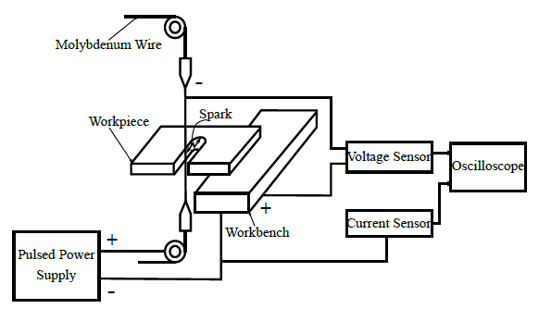
Wire Electric Discharge Machining
Diagrammatic representation of WEDM

Slide 4
WEDM for Si-wafer manufacturing
Advantages
Non contact micro-drilling process
Cuts free form contours
Thinner wires can be used
Reduced kerf width^{[5]}
Net material saving of 200 - 300%^{[5]}
Disadvantages
Electrical characterisation of metal-semiconductor-dielectric sparks
VI characteristics of silicon are different from that of steel^{[6]}
Discrete setting ranges - Applicable only to steel^{[7]}

Slide 5
Scope
Design of pulsed power supply for WEDM
Linear and nonlinear modelling
Design and implementation of controller
Fabricating hardware for pulsed power supply
Verification under switched R load

Slide 6
Literature Survey
WEDM
Mechanical
Electrical
Process Modelling
Fuzzy Control Systems
Wire Breakage Avoidance
Wire lag and wire vibration
RC Relaxation circuit
Switching circuit
LCC Resonant Converter
Parallel converters

Slide 7
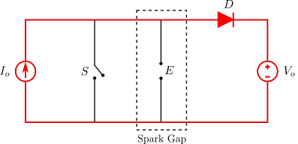
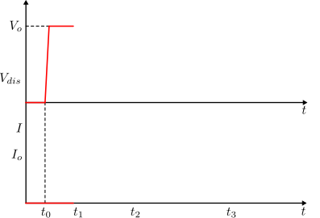
Working: Pre-breakdown Stage
Source
Voltage
Pre-breakdown

Slide 8
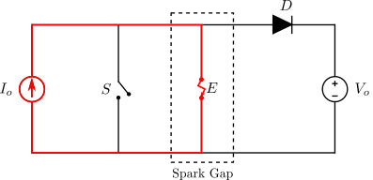
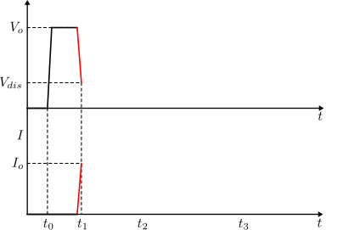
Working: Breakdown Stage
Source
Voltage
Breakdown
Spark
Voltage
Spark
Current

Slide 9
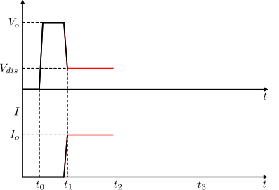
Working: Sparking Stage
Source
Voltage
Spark
Voltage
Sparking/Discharge
Spark
Current

Slide 10
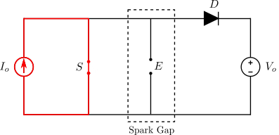
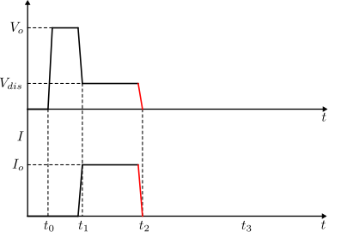
Working: Implosion
Source
Voltage
Spark
Voltage
Implosion
Spark
Current

Slide 11
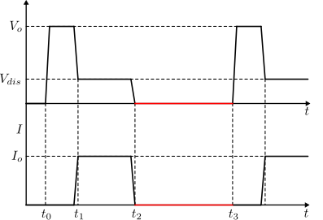
Working: Dead Time
Source
Voltage
Spark
Voltage
0.1D
0.9D
Spark
Current
*Not to the scale

Slide 12
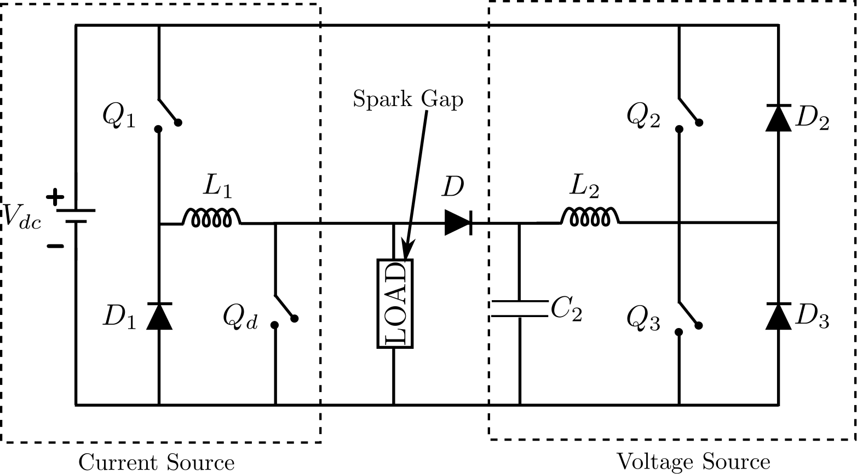
Converter Topology
Pulsed power supply using power electronic switches^{[8]}

Slide 13
Modelling & Control
4 switches – 16 switching states
Increased complexity in modelling
3 distinct components:
Single Quadrant DC-DC Converter
2 Quadrant DC-DC Converter
Ignition Control Switch
Current from single quadrant converter acts as a disturbance to 2 quadrant converter
Separate modelling of current and voltage sources

Slide 14
Linear Time Average Modelling
1
State Variable Description for ON State of Q
State Variable Description for OFF State of Q
2
Time Averaging using duty ratio
3
Introducing Small Perturbations
Separating AC and DC Components
4
Transforming to s-Domain
Solving for Transfer Function
Time average modelling steps ^{[9]}

Slide 15
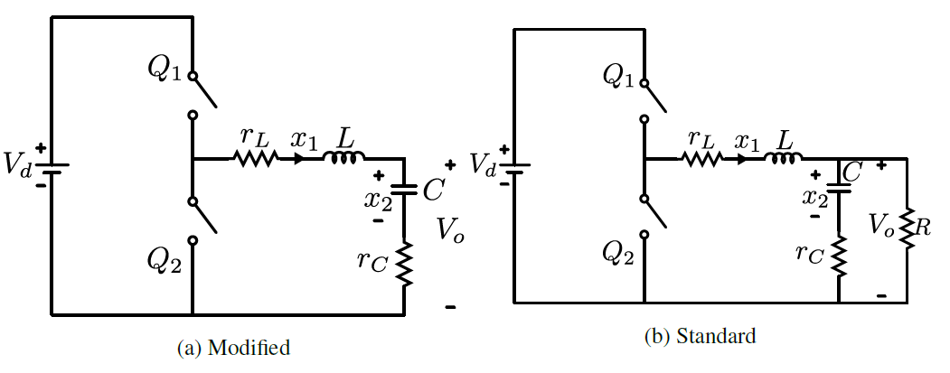
Voltage Source

Slide 16
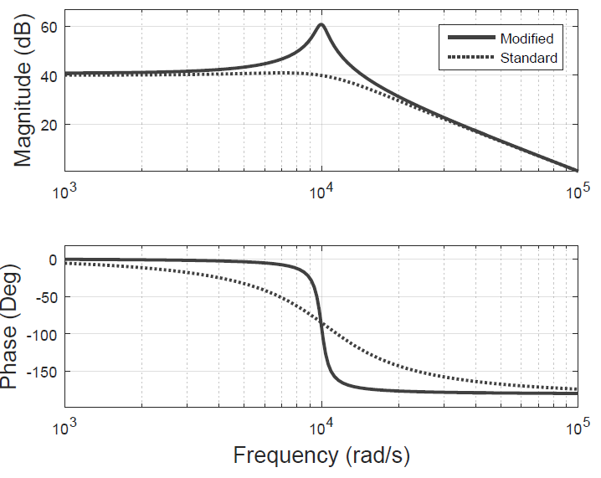
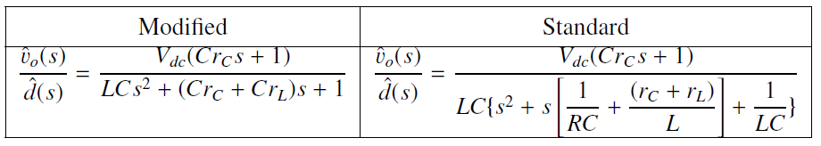
Voltage Source

Slide 17
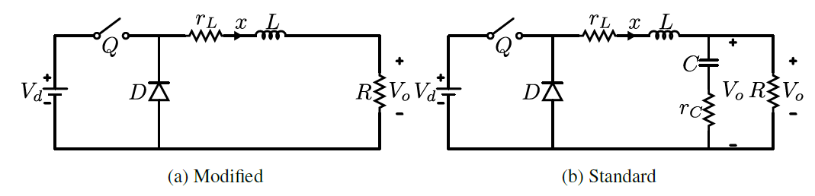
Current Source

Slide 18
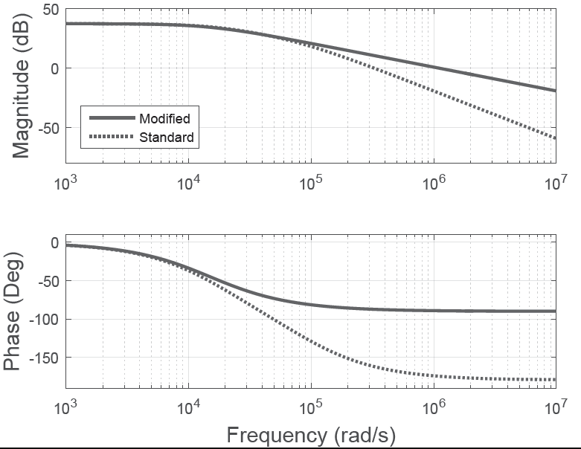
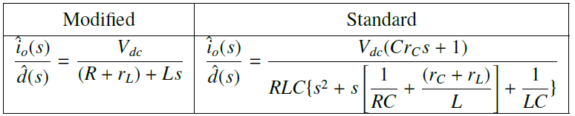
Current Source

Slide 19
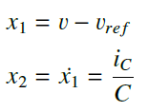
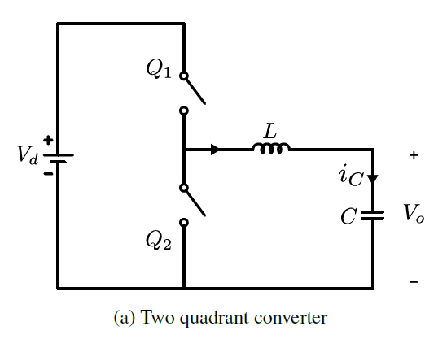
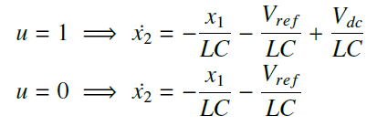
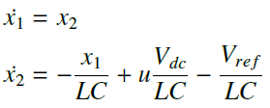
Nonlinear Model

Slide 20

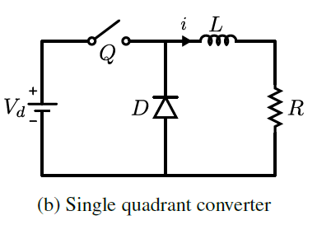
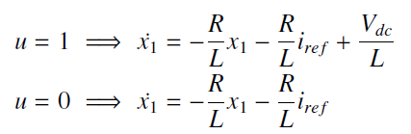

Nonlinear Model

Slide 21
Compensator Design
Gain crossover freq. below switching frequency
Phase margin between 45º to 60º
High gain at low frequencies
Lead Compensator
Lead Compensator
Lag Compensator

Slide 22
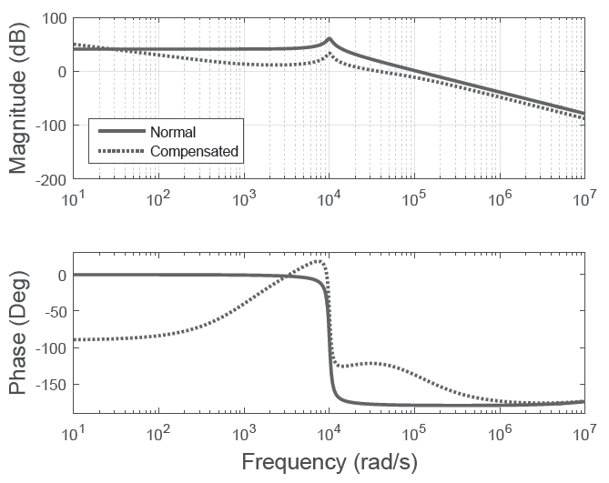
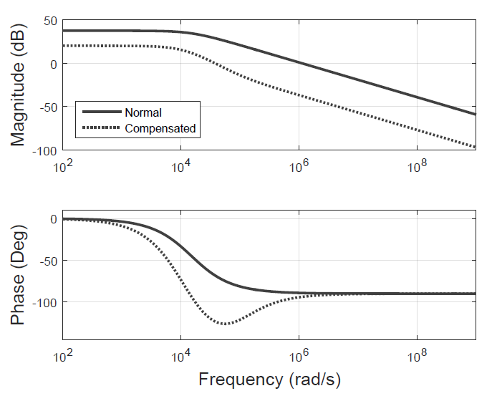
Compensator Design
Voltage Source Bode Plot
Current Source Bode plot

Slide 23
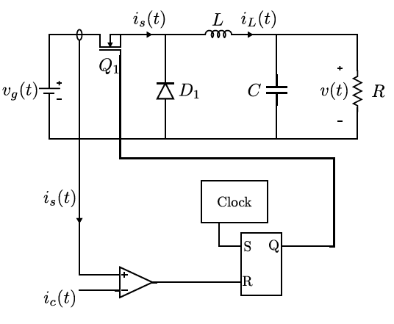
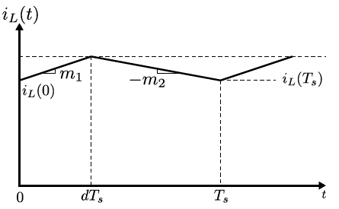
Current Mode Control
Inductor Current in
current mode control

Slide 24
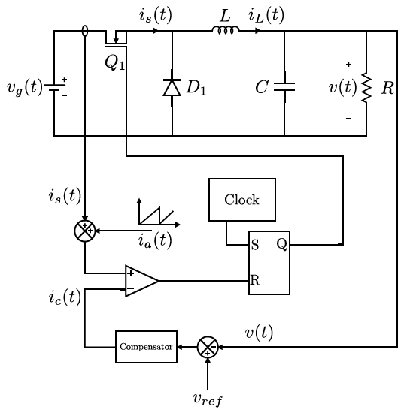
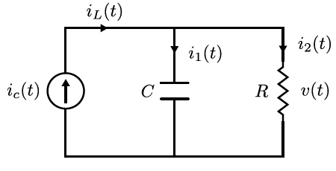

Current Mode Control
Equivalent circuit of voltage source
with current mode control

Slide 25
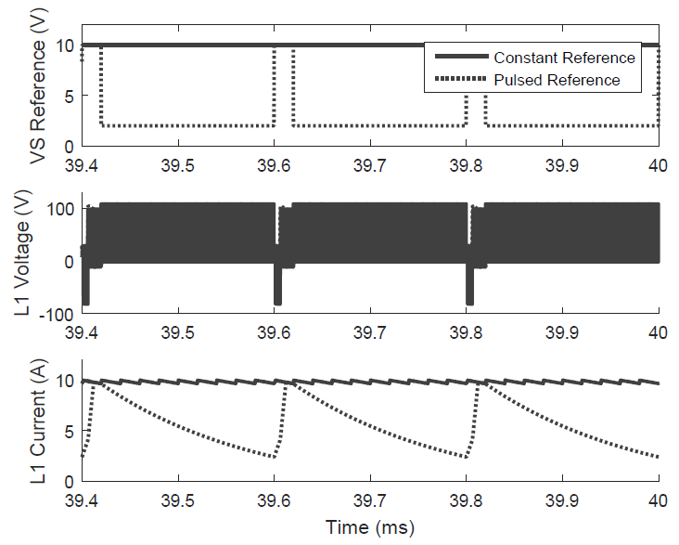
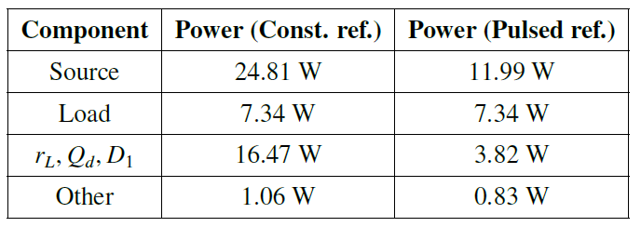
Pulsed Reference Scheme

Slide 26
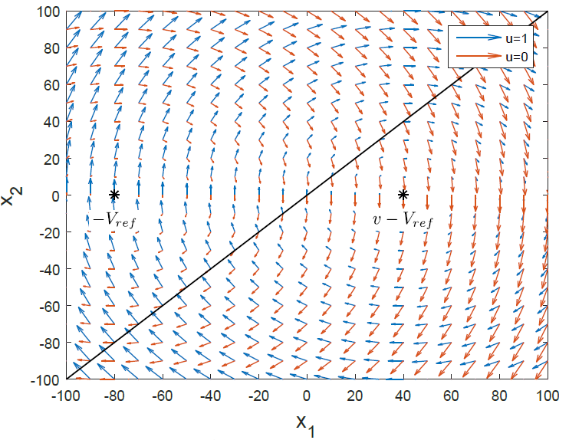


Sliding Mode Control
Phase Portrait of voltage source
[10]

Slide 27
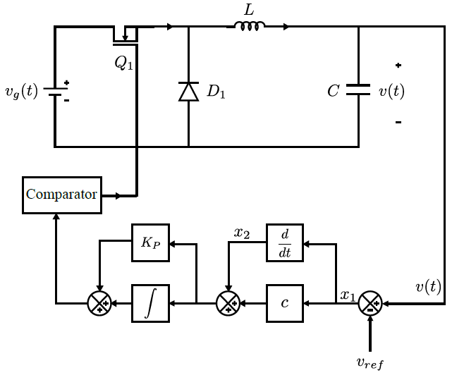
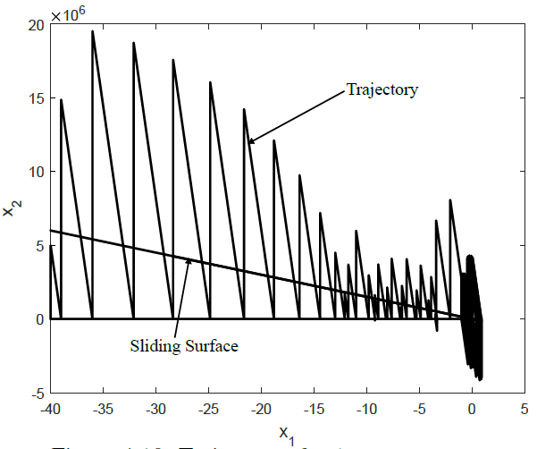
Sliding Mode Control
Voltage source trajectory

Slide 28
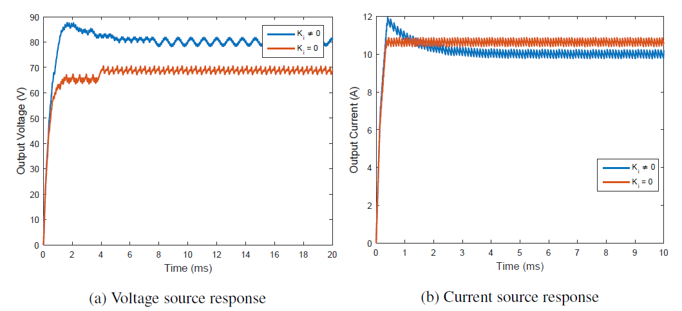
Sliding Mode Control

Slide 29
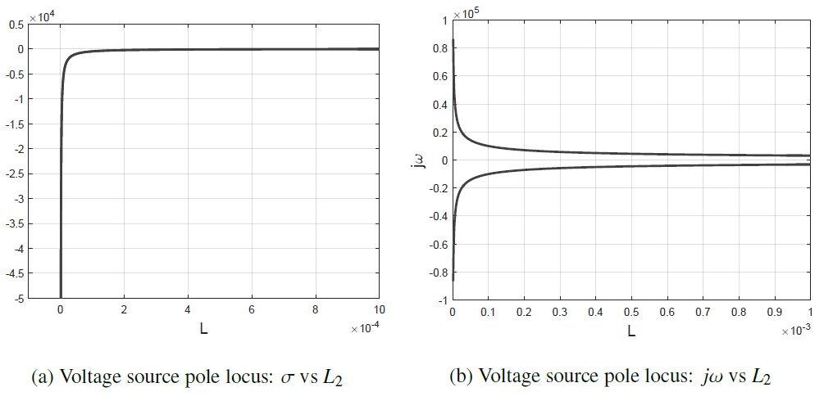
Selection of L and C

Slide 30
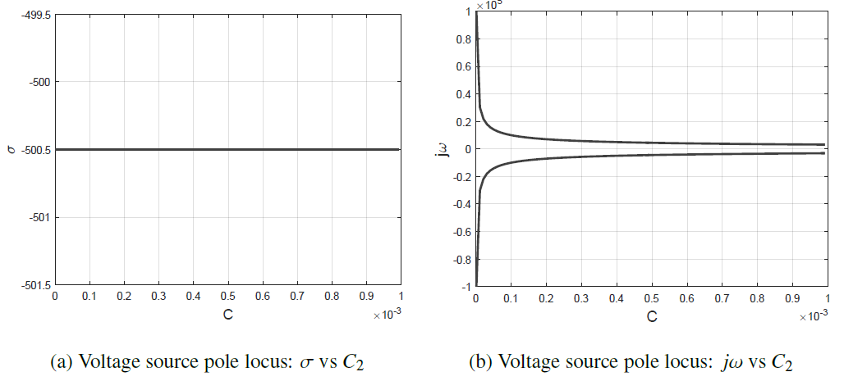
Selection of L and C

Slide 31
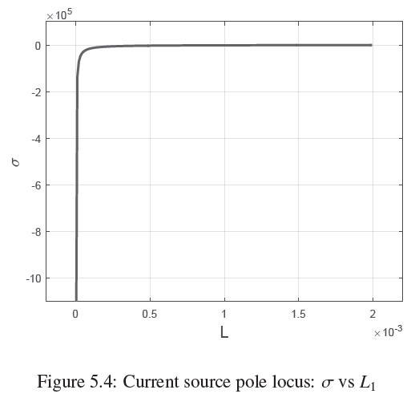
Selection of L and C

Slide 32
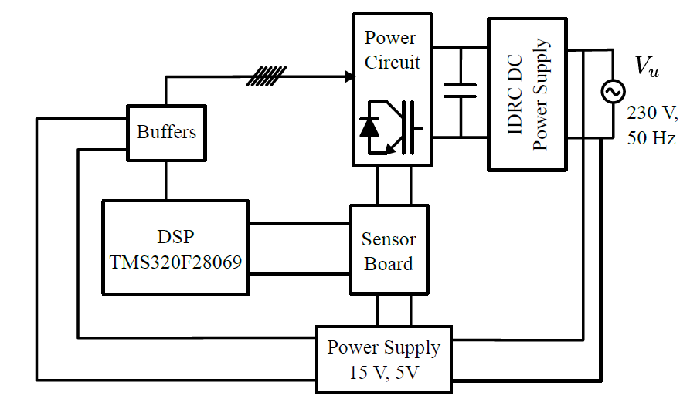
Hardware Setup
Block diagram of hardware setup

Slide 33
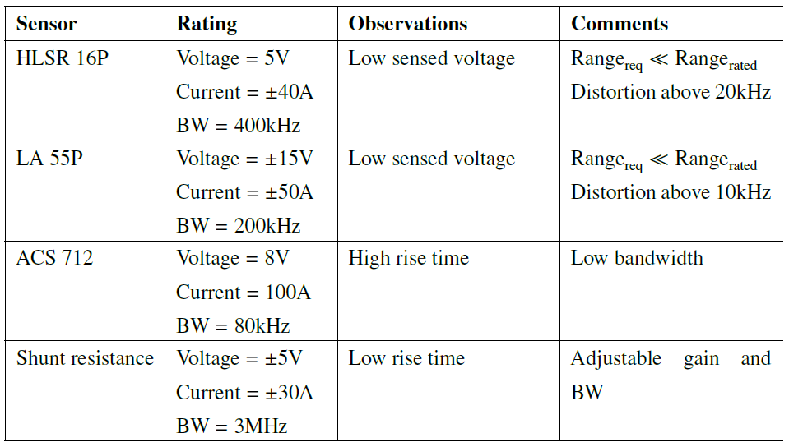
Current Sensor
Current sensor testing

Slide 34
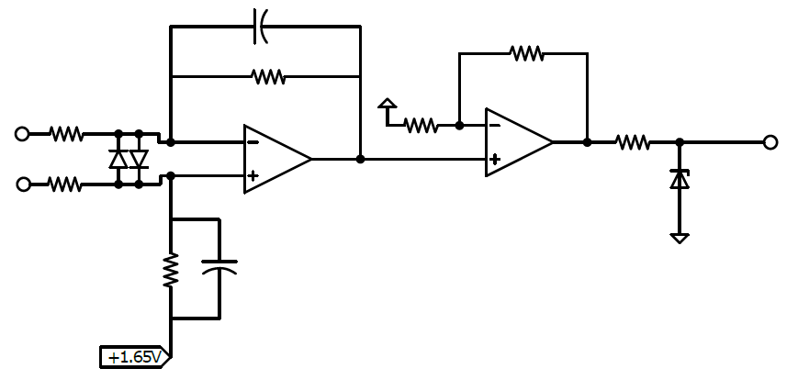
Voltage Sensor
C₁
R₆
R₃
R₅
R₁
R₇
R₂
R₄
C₂

Slide 35
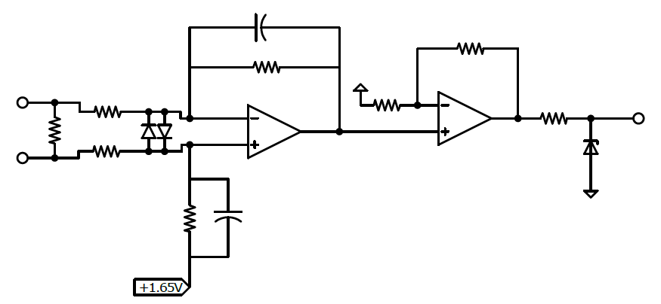
Current Sensor
C₁
R₆
R₃
R₅
R₁
R₇
R_{s}
R₂
R₄
C₂

Slide 36
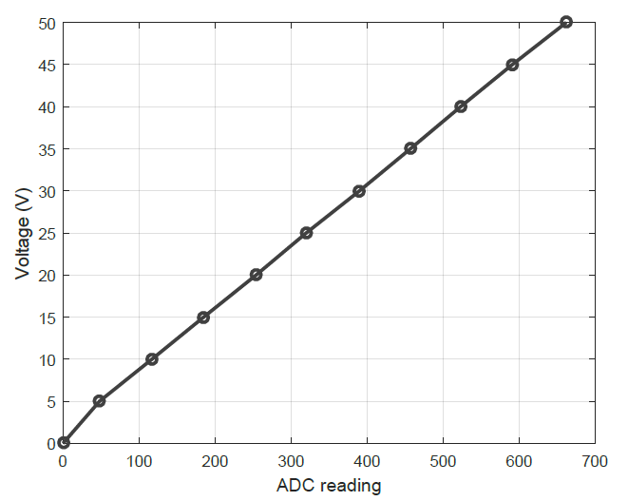
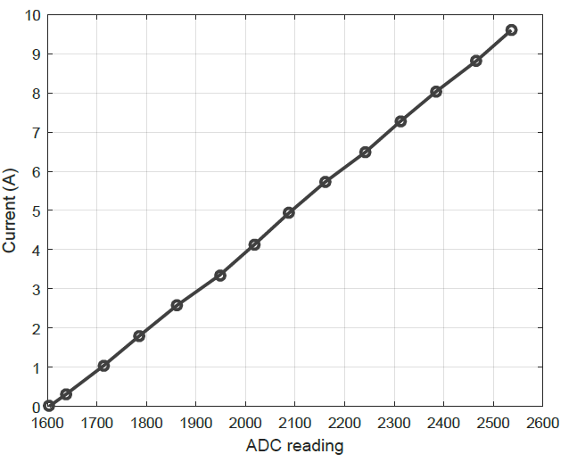
Sensor Calibration
Voltage Sensor Calibration
Current Sensor Calibration

Slide 37
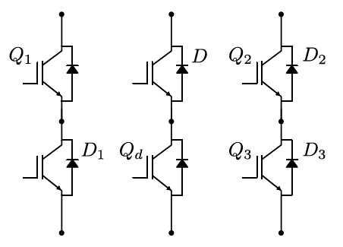
IGBT Modules
Module 1
Module 2
Module 3
Buck
Converter
Ignition
Control
2 Quadrant
Converter
Semikron IGBT Modules
Converter Topology

Slide 38
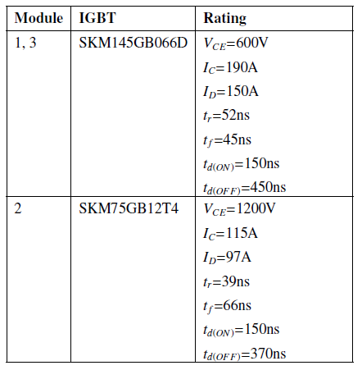
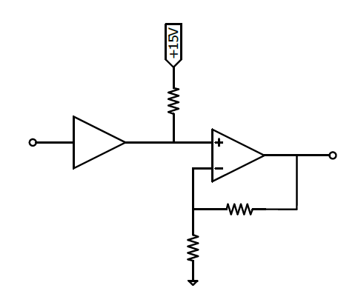
DSP Interfacing
R₁
R₂
R₃
IGBT Module Ratings

Slide 39
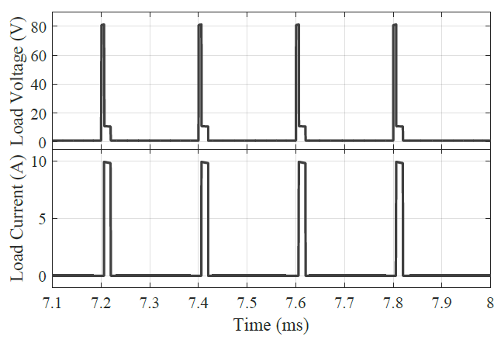
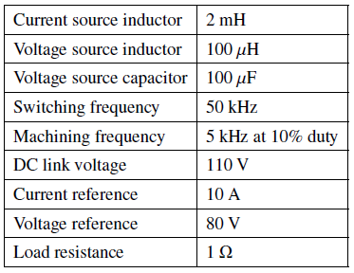
Simulation Results: PI Controller

Slide 40
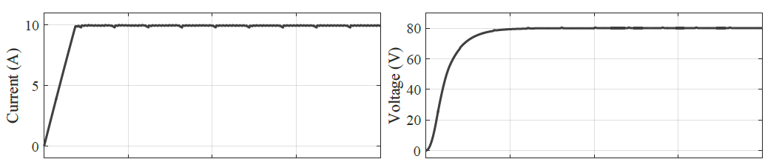
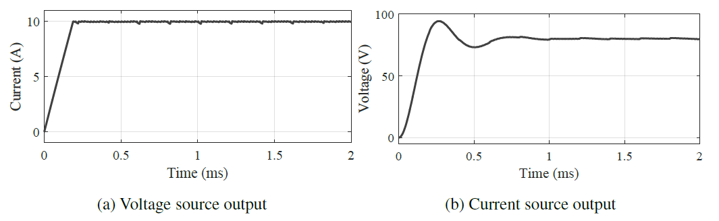

PI
Control
Current Mode
Control
Compensator
Control

Slide 41



Experimental Setup

Slide 42

Results: Fixed R_{L}
Operation with fixed resistance

Slide 43


Results: Switched R_{L}

Slide 44



Results: Switched R_{L}

Slide 45
Conclusions
Initial power supply setup developed
Pulsed reference scheme verified in simulations
PI controllers implemented in hardware
Sliding mode control for individual converters verified in simulation
Current and voltage sensing board developed
Possible causes of unexpected current source determined

Slide 46
Future Work
Sensor Improvement via precision measurement resistances
Resizing inductors and capacitors for spark-gap load
Hardware implementation of pulsed reference scheme
Repeating experiments at higher voltage levels

Slide 47
References
C. Del Canizo, G. Del Coso, and W. Sinke, “Crystalline silicon solar module technology: Towards the 1 euro per watt-peak goal,” Progress in photovoltaics: research and applications, vol. 17, no. 3, pp. 199-209, 2009.
B. Sopori, S. Devayajanam, S. Shet, D. Guhabiswas, P. Basnyat, H. Moutinho, L. Gedvilas, K. Jones, J. Binns, and J. Appel, “Characterizing damage on Si wafer surfaces cut by slurry and diamond wire sawing,” in 39th Photovoltaic Specialists Conference (PVSC). IEEE, 2013, pp. 0945-0950.
G. G. Dongre, C. Vesvikar, R. K. Singh, and S. S. Joshi, “Efficient dicing of silicon ingots for photovoltaic applications,” in 35th IEEE Photovoltaic Specialists Conference, June 2010, pp. 3629-3634.
H. J. Moeller, “Chapter two-wafering of silicon,” Semiconductors and Semimetals, vol. 92, pp. 63-109, 2015.
G. Dongre, S. Zaware, U. Dabade, and S. S. Joshi, “Multi-objective optimization for silicon wafer slicing using wire-edm process,” Materials Science in Semiconductor Processing, vol. 39, pp. 793-806, 2015.

Slide 48
References
M. Kane, Annual progress seminar report, Indian Institute of Technology Bombay, August 2017.
G. Levy and F. Maggi, “WED machinability comparison of different steel grades,” CIRP Annals-Manufacturing Technology, vol. 39, no. 1, pp. 183-185, 1990.
D. Tastekin, H. Krotz, C. Gerlach, and J. Roth-Stielow, “A novel electrical power supply for electrothermal and electrochemical removal machining methods,” in Energy Conversion Congress and Exposition, 2009. ECCE 2009. IEEE, 2009, pp. 2682-2688.
N. Mohan, T. M. Undeland, and W. P. Robbins, Power Electronics: Converters, Applications, and Design, 3rd ed. John Wiley & Sons, Inc., 2002.
P. Mattavelli, L. Rossetto, G. Spiazzi, and P. Tenti, “General-purpose sliding-mode controller for dc/dc converter applications,” in Power Electronics Specialists Conference, 1993. PESC’93 Record., 24th Annual IEEE. IEEE, 1993, pp. 609–615

