Slide 1
Cyclase 15 Tree
Sam Williams

Slide 2
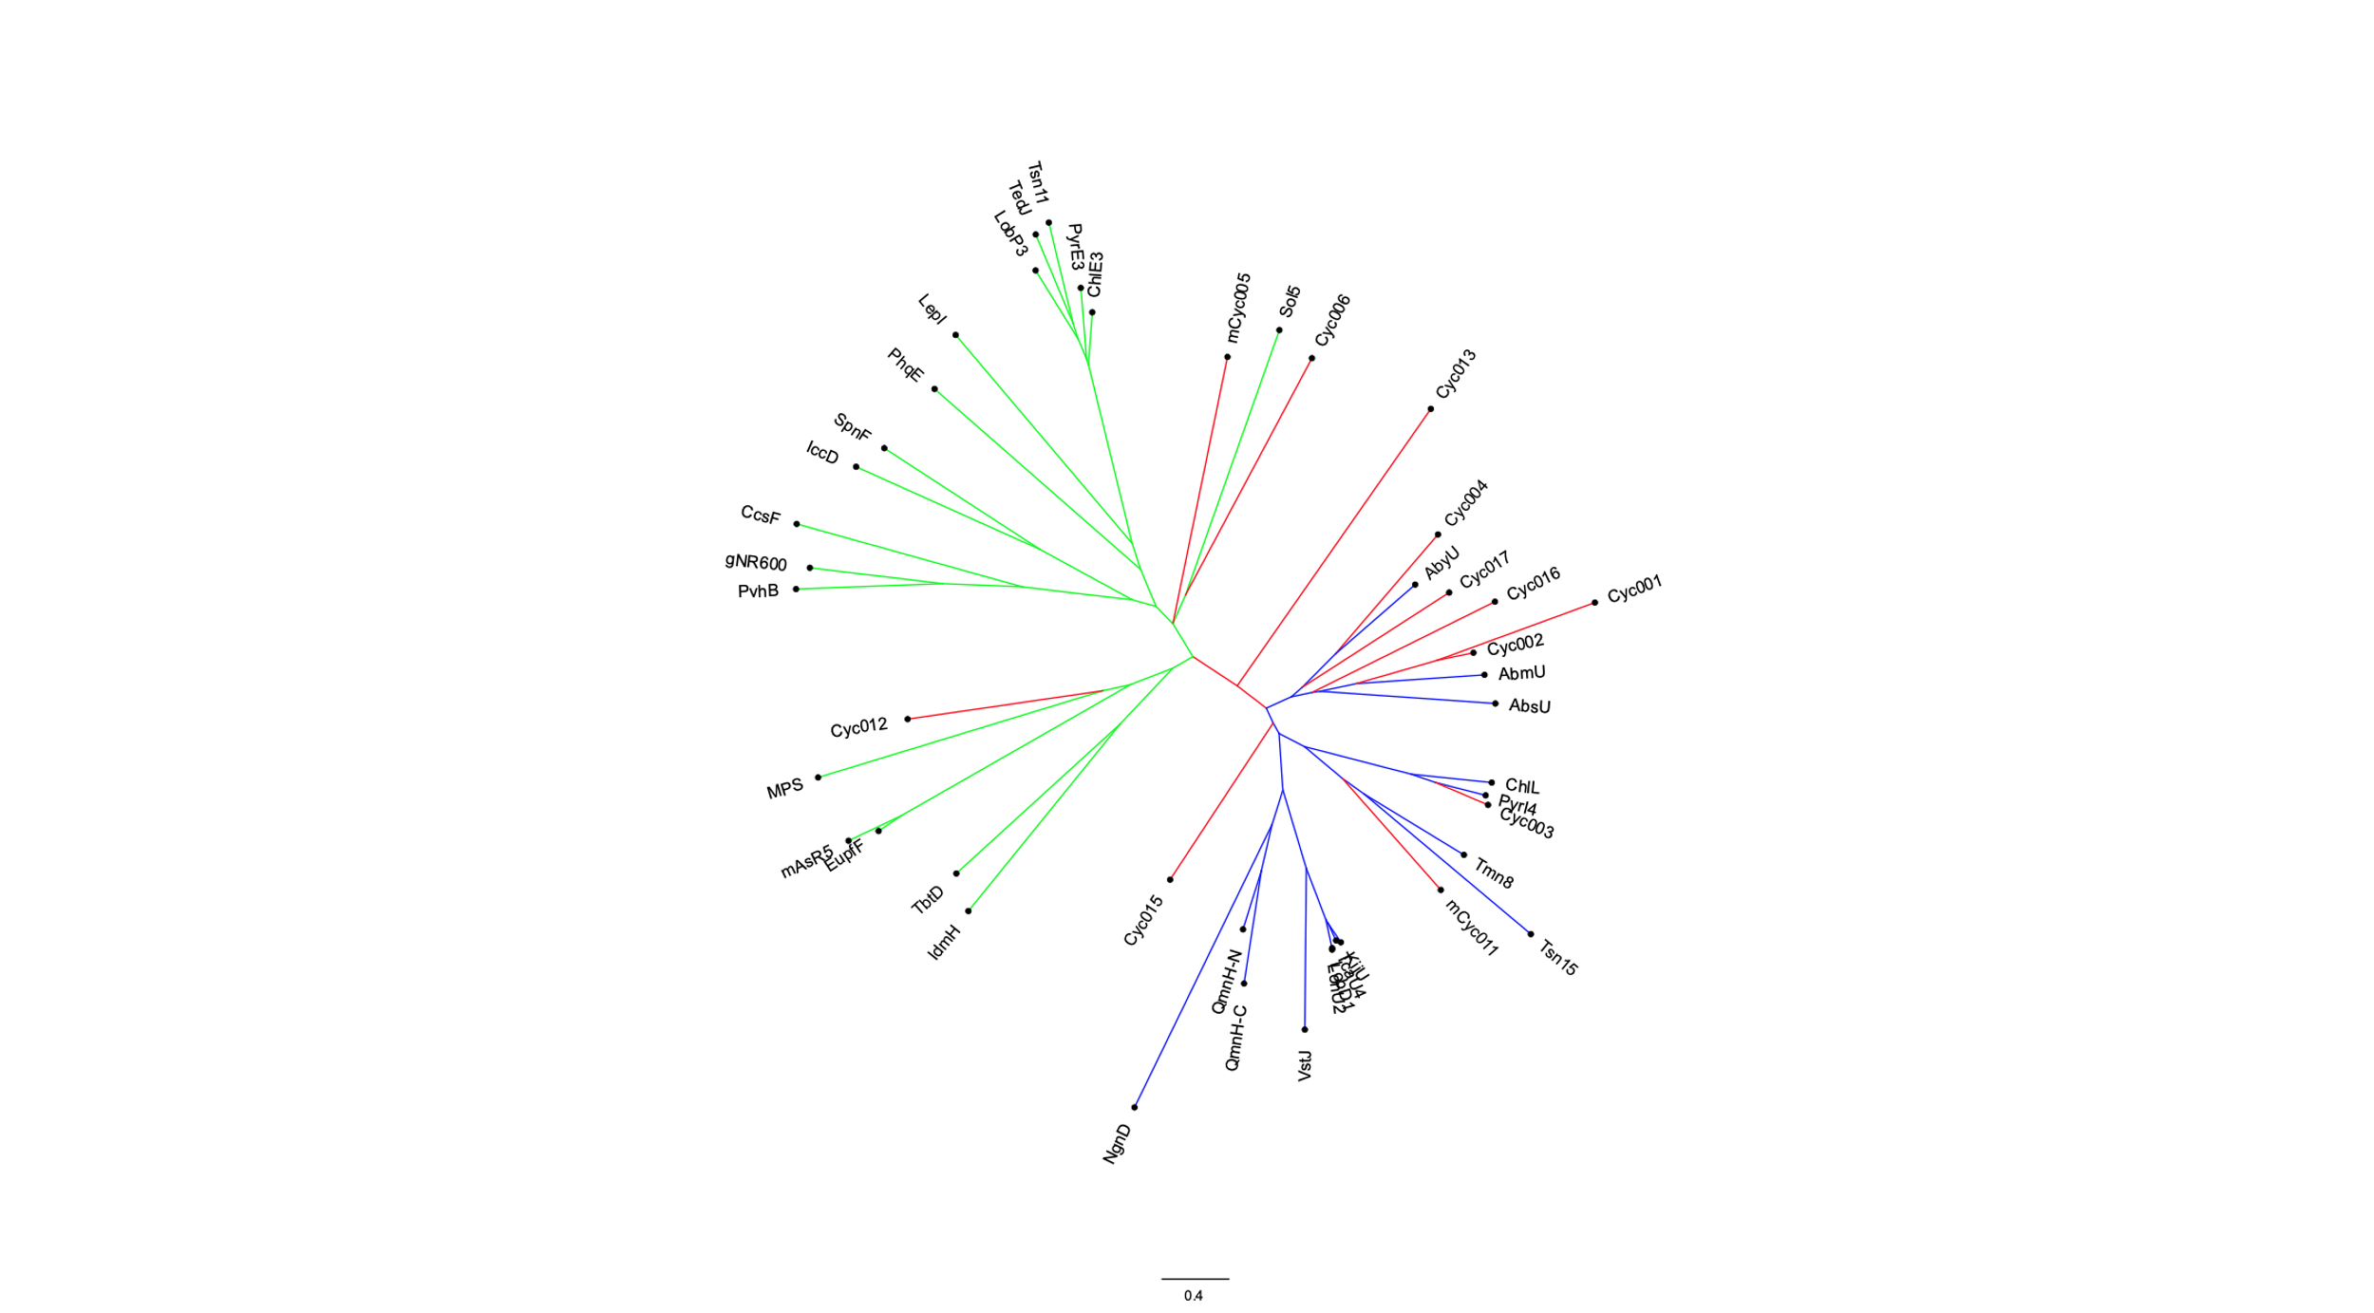
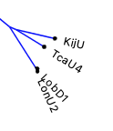
Non-spirotetronate cyclase
Spirotetronate cyclase
Putative cyclase

Slide 3
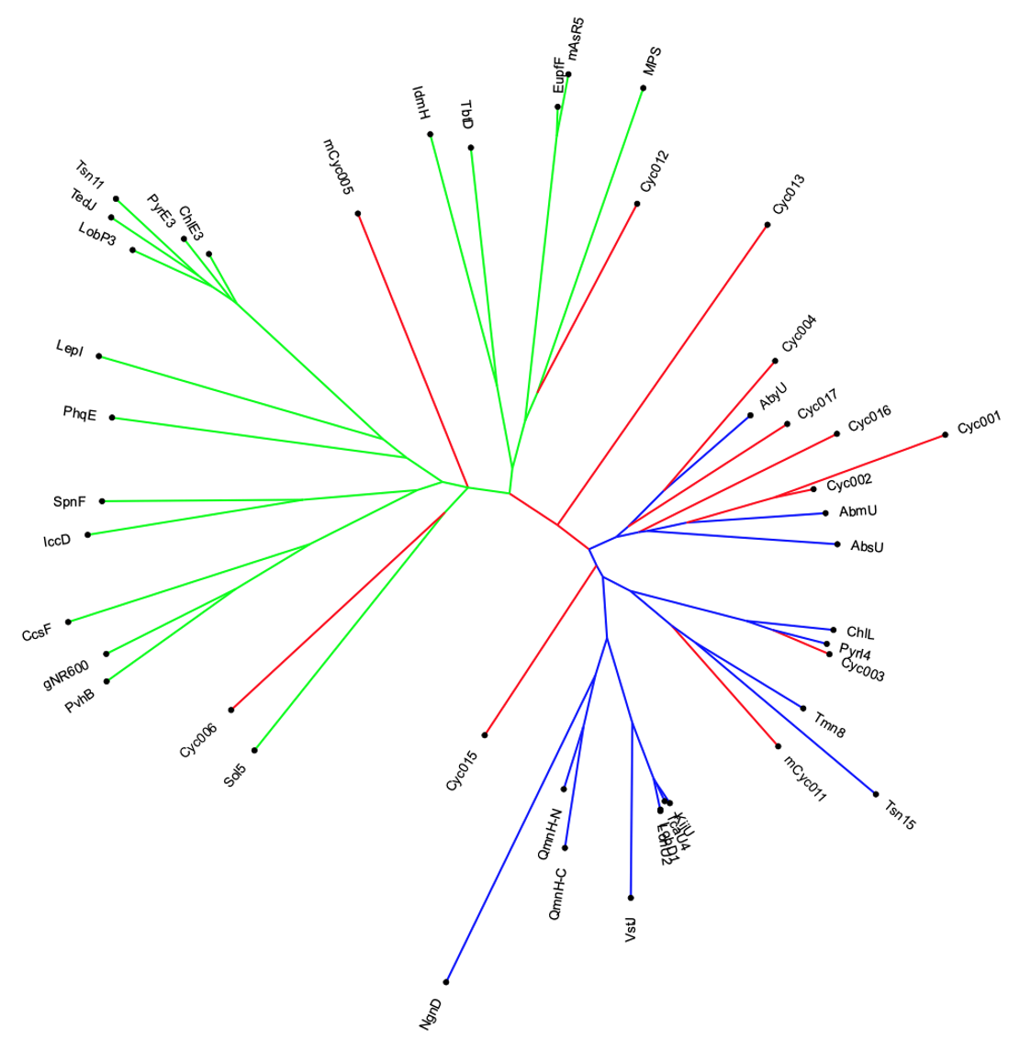
Non-spirotetronate cyclase
Spirotetronate cyclase
Putative cyclase

Slide 4
Non-spirotetronate cyclase
Spirotetronate cyclase
Putative cyclase

Slide 5
Non-spirotetronate clade
Non-spirotetronate cyclase
Spirotetronate clade
Spirotetronate cyclase
Putative cyclase

Slide 6
Non-spirotetronate clade
Spirotetronate clade
Non-spirotetronate cyclase
Spirotetronate cyclase
Putative cyclase

Slide 7
Non-spirotetronate clade
Spirotetronate clade
Non-spirotetronate cyclase
Spirotetronate cyclase
Putative cyclase

Slide 8
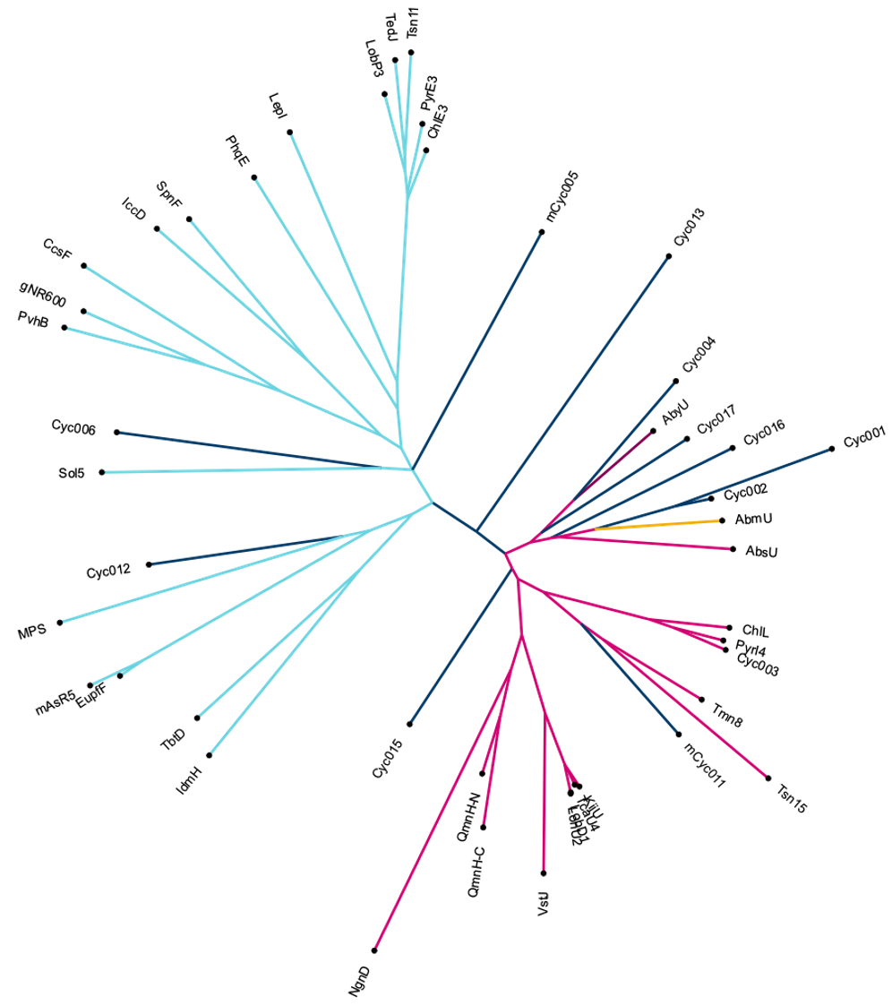

Non-spirotetronate clade
Spirotetronate clade
Non-spirotetronate cyclase
Spirotetronate cyclase
Putative cyclase

Slide 9
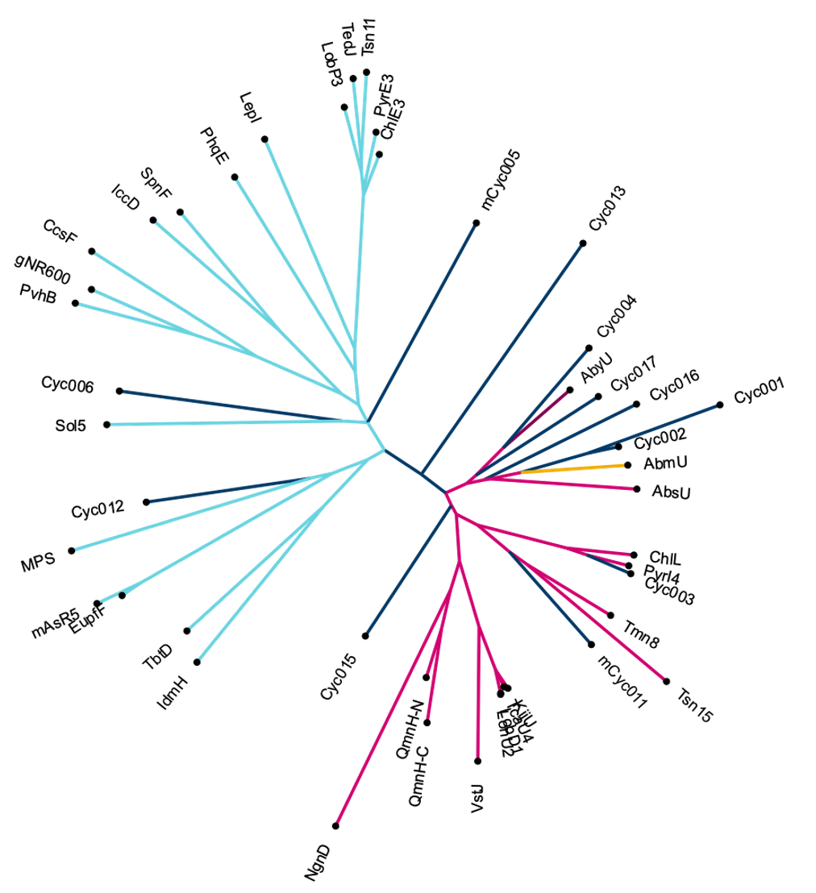
Non-spirotetronate clade
Spirotetronate clade
Non-spirotetronate cyclase
Spirotetronate cyclase
Putative cyclase
AbyU
AbmU

Slide 10
Non-spirotetronate clade
Spirotetronate clade
AbyU
AbmU
Putative cyclase
Non-spirotetronate cyclase
Spirotetronate cyclase

Slide 11
Non-spirotetronate
clade
Spirotetronate clade
Non-spirotetronate cyclase
Spirotetronate cyclase
Putative cyclase

Slide 12
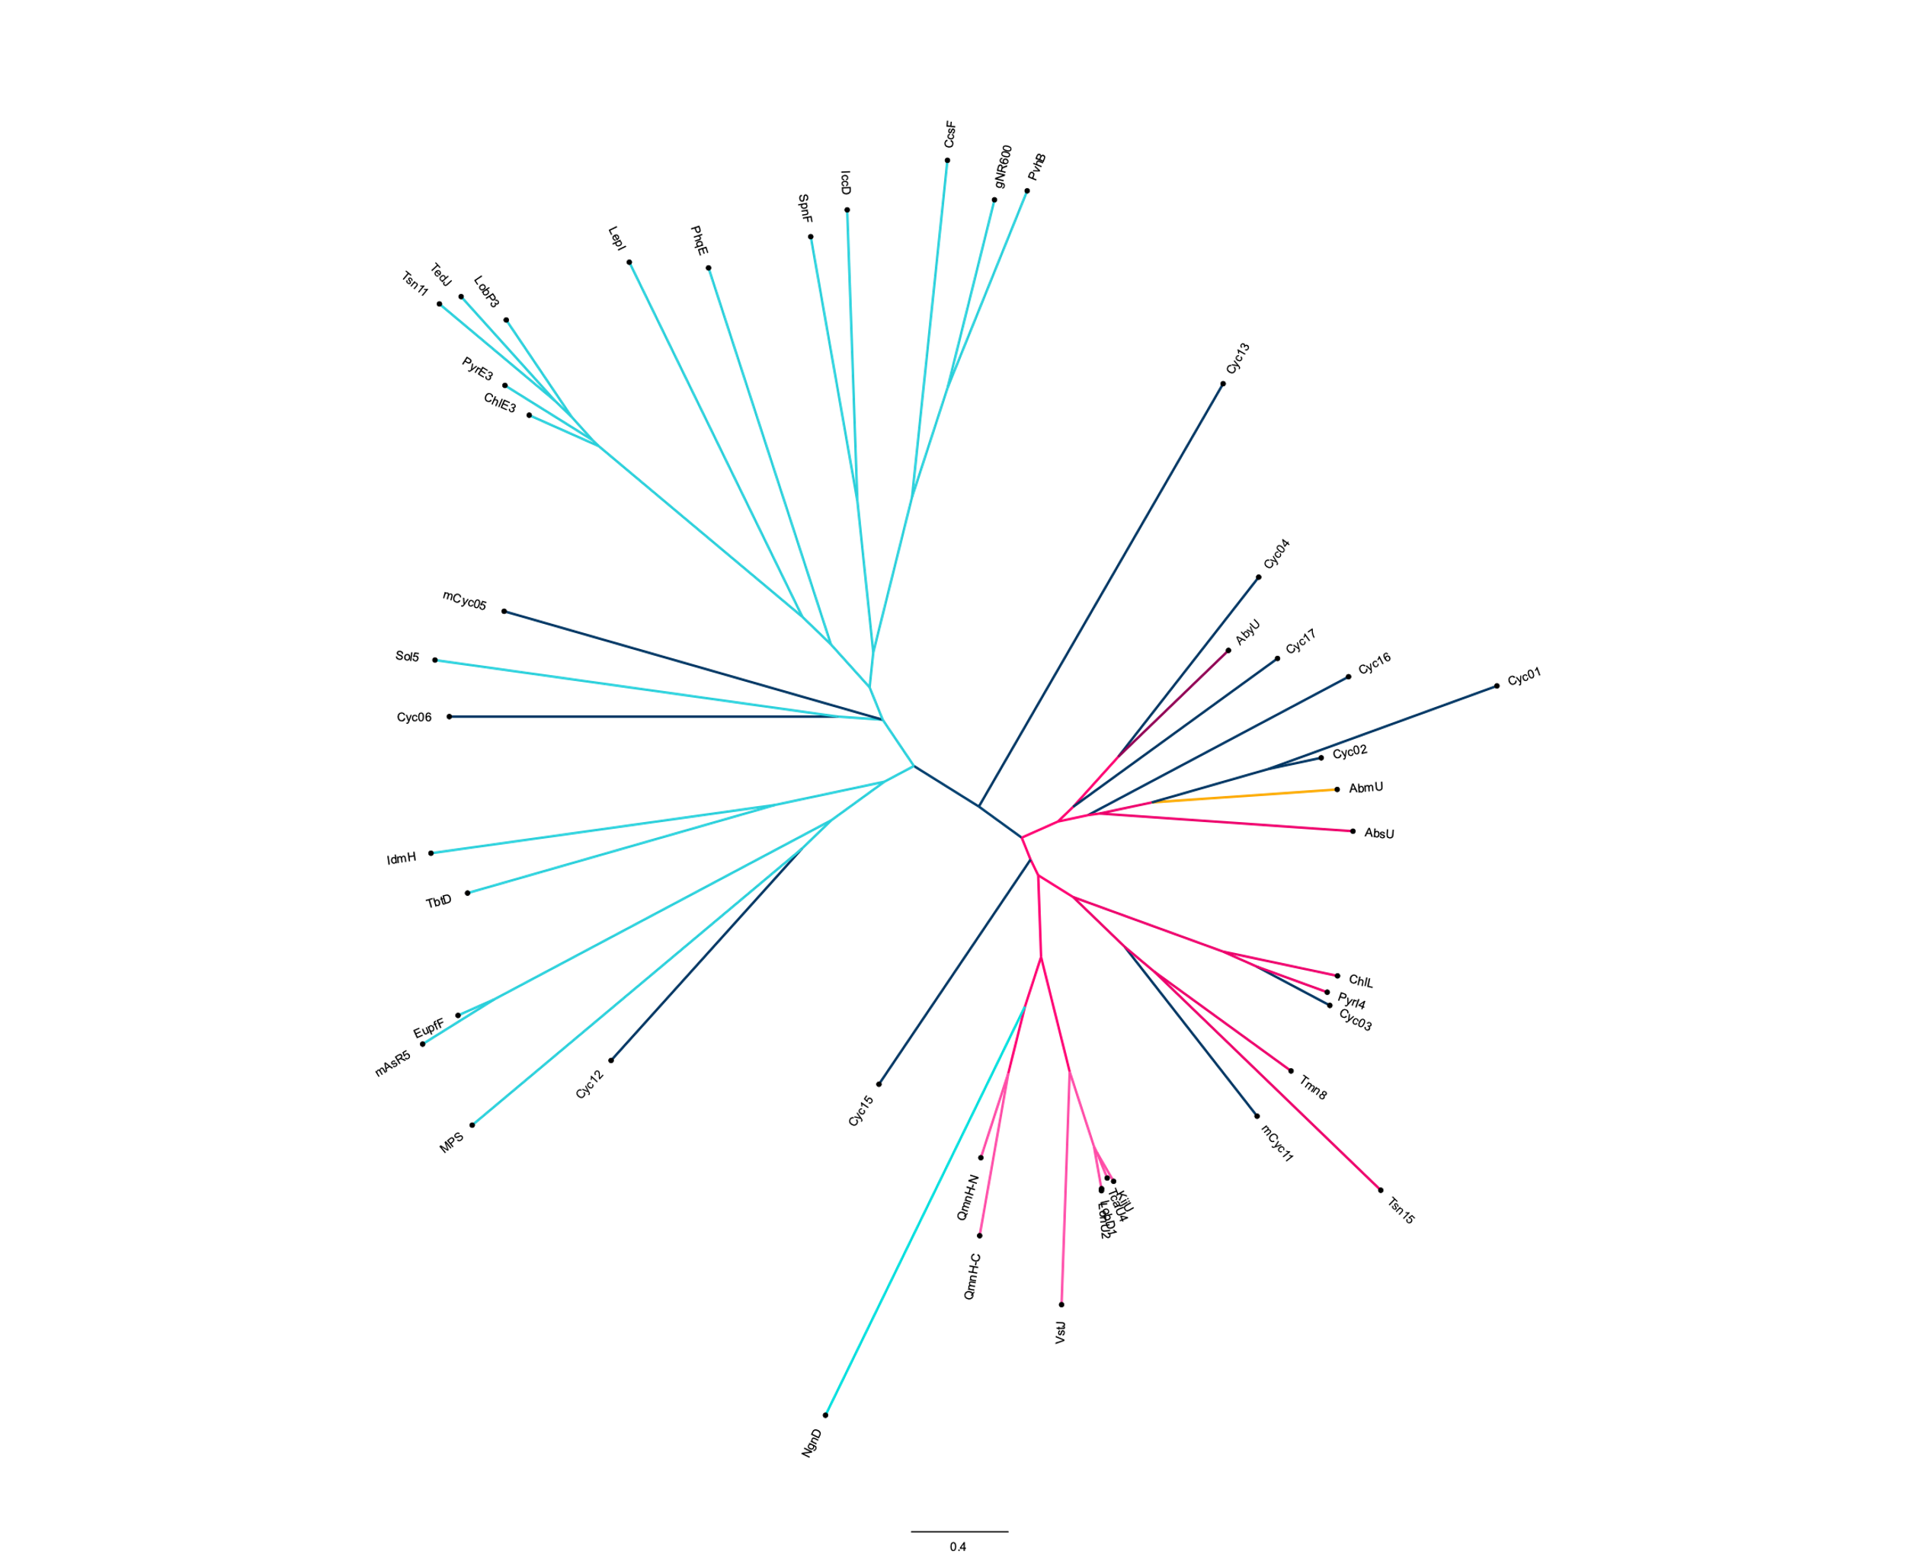
Non-spirotetronate clade
Spirotetronate clade*
AbyU
AbmU
Putative cyclase
Non-spirotetronate cyclase
Spirotetronate cyclase

Slide 13
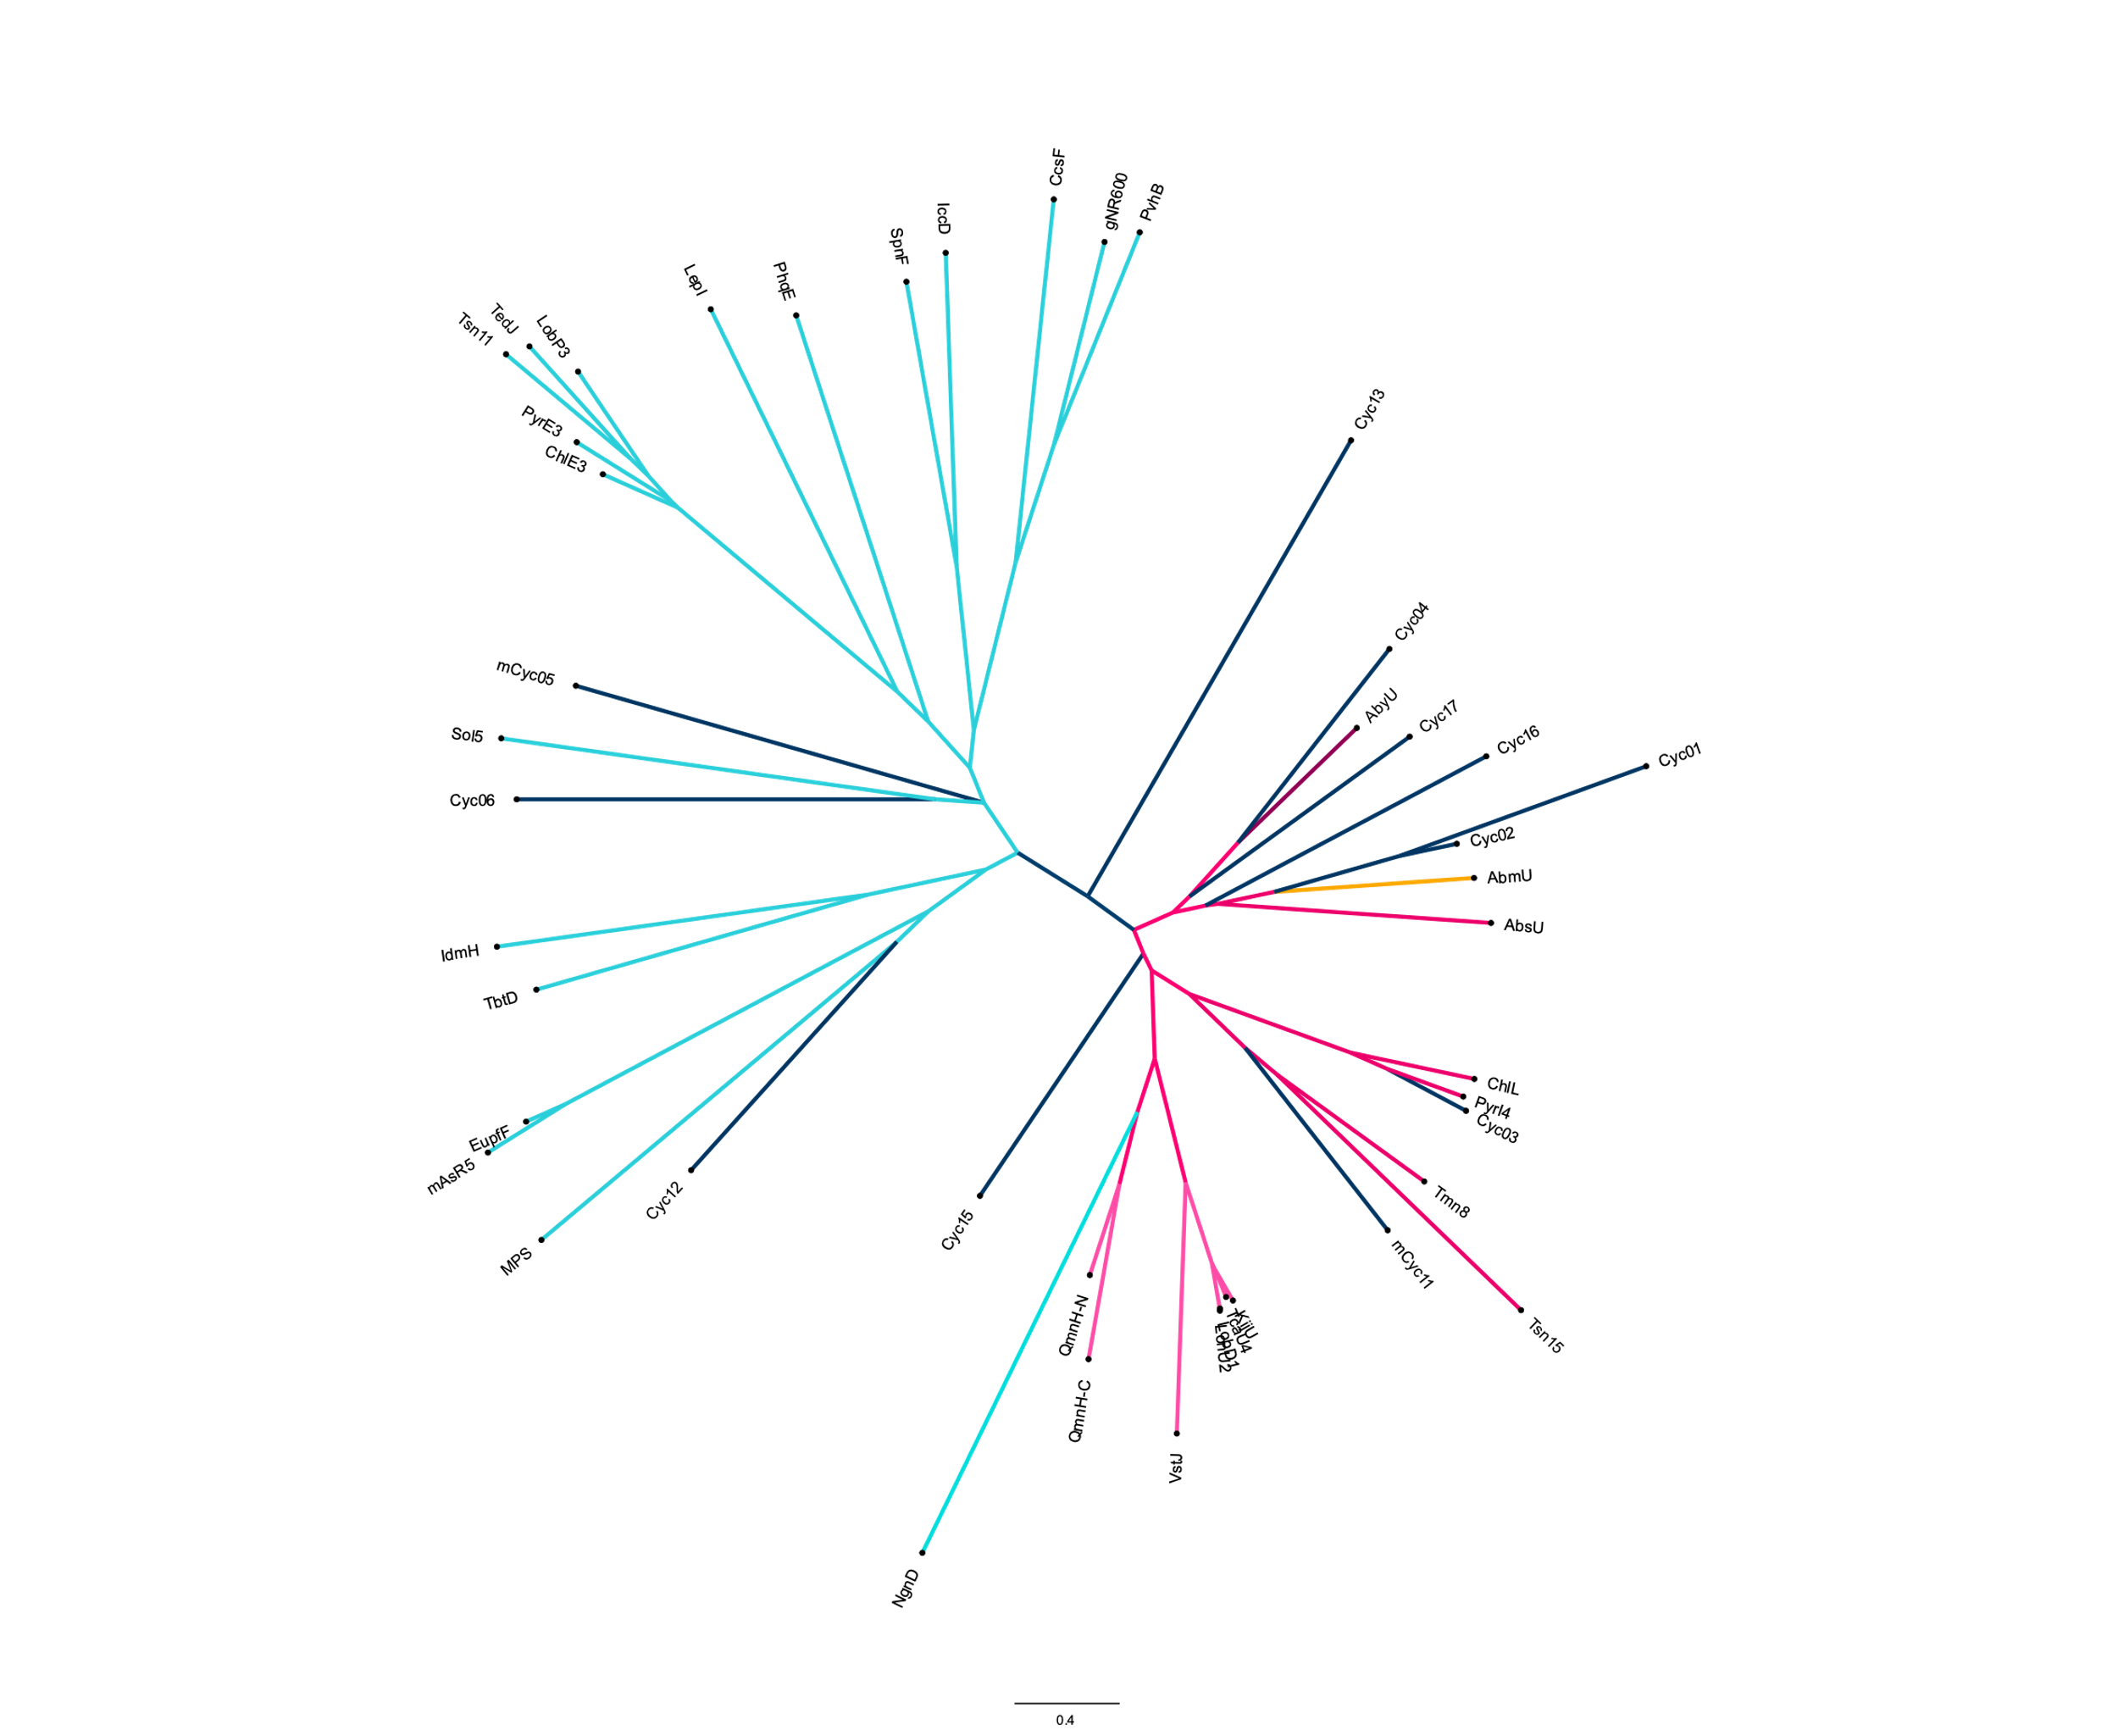
Non-spirotetronate clade
Spirotetronate clade*
AbyU
AbmU
Putative cyclase
Non-spirotetronate cyclase
Spirotetronate cyclase

