Slide 1

Research, design and development of a robotic waiter
Individual project: ENGD3000

Slide 2
Contents:
Introduction
Aims and Objectives
Background
Requirement specification
Design propositions
Final design choice
Advantages and disadvantages of design choice
Conclusion
References

Slide 3
Introduction:

Slide 4
Aims and objectives:

Slide 5
Background:

Slide 6
Requirement specification:

Slide 7
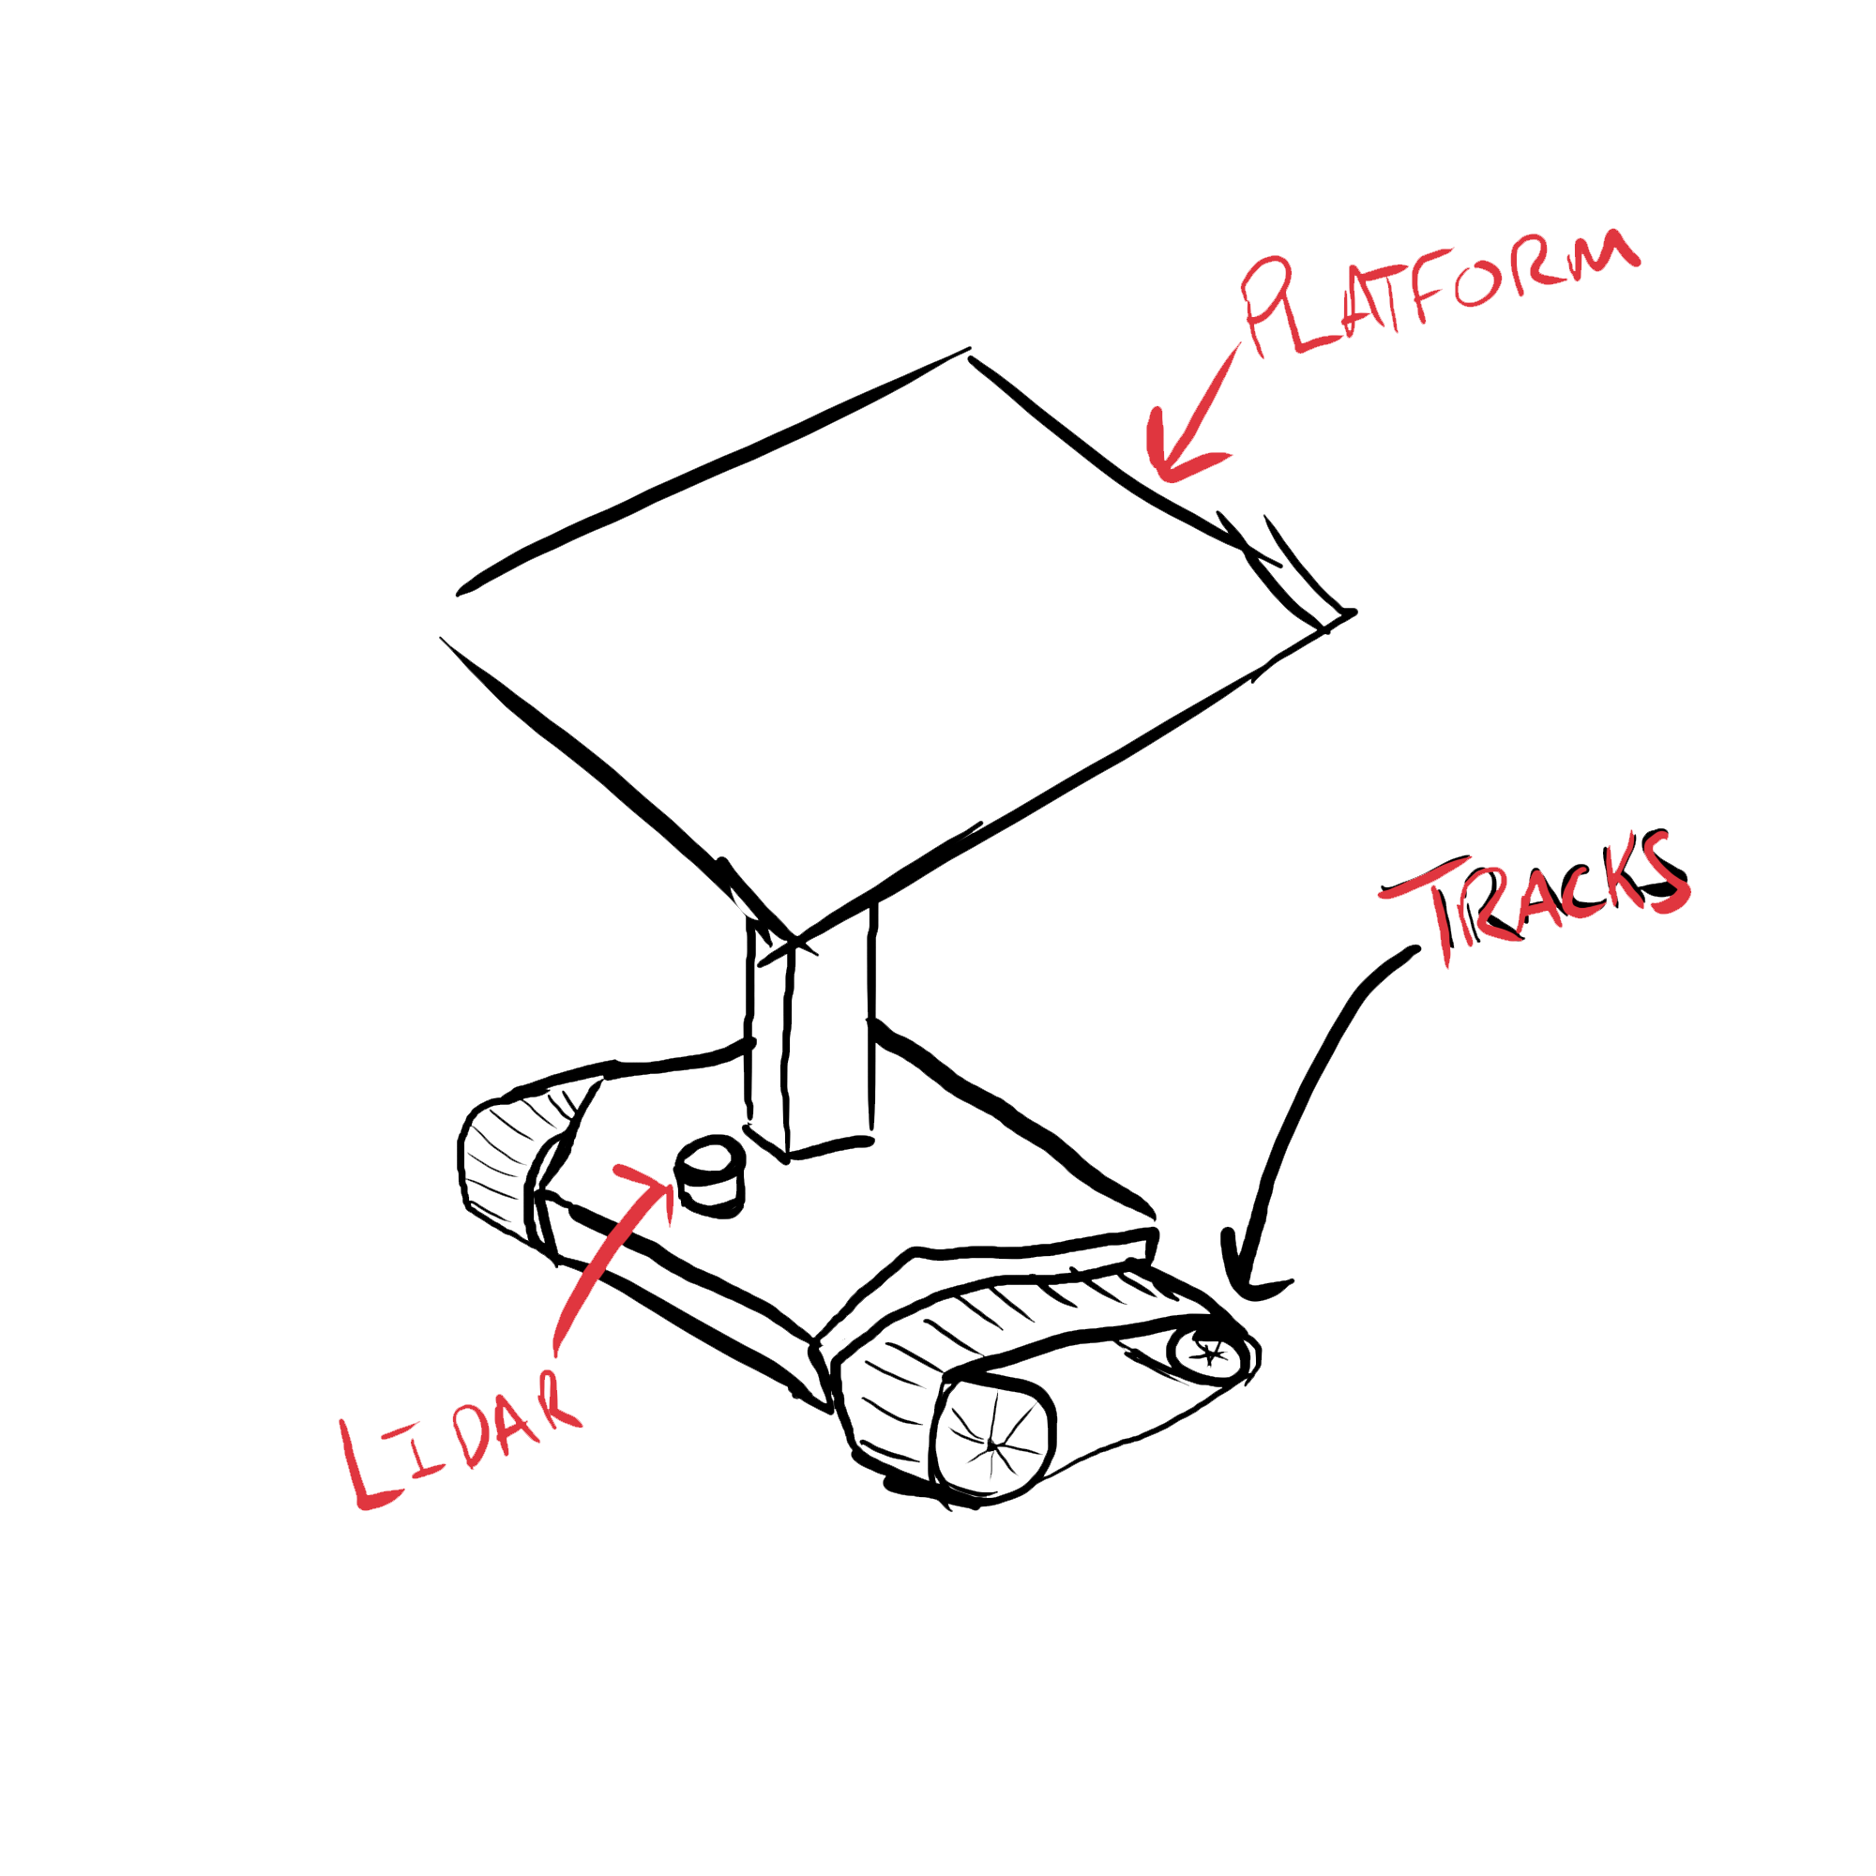
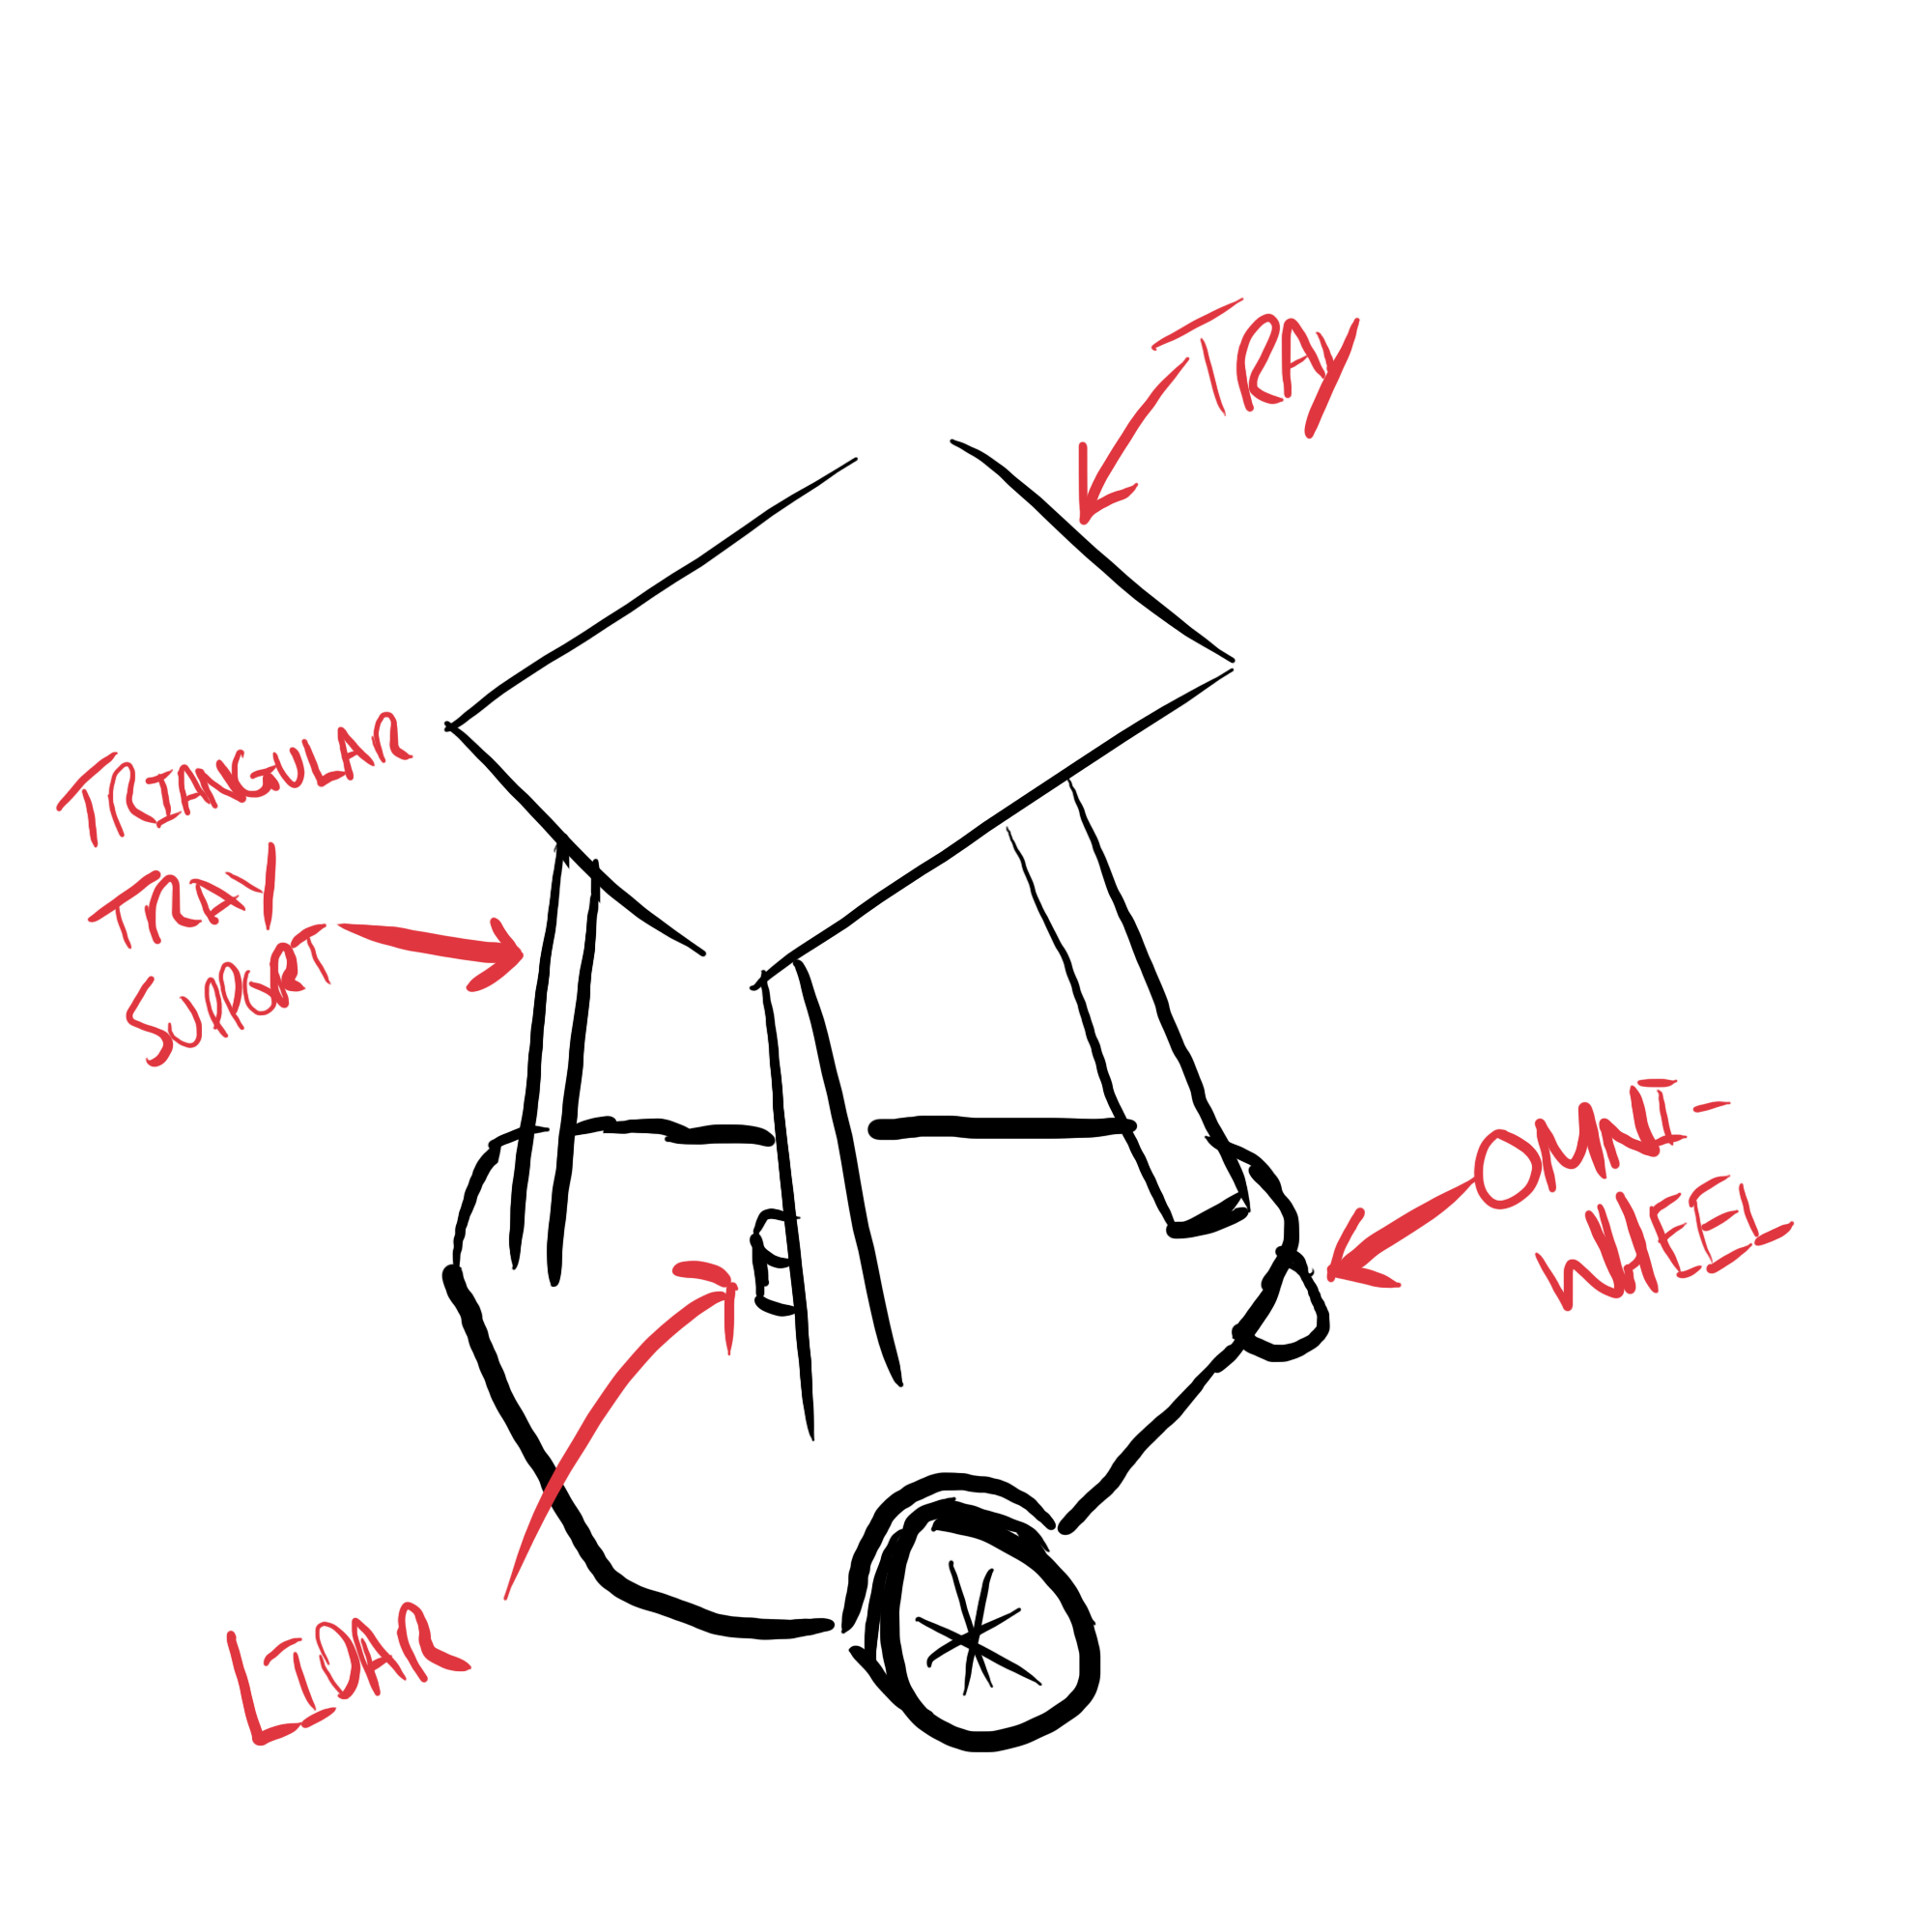
Design propositions:

Slide 8
Final design choice:

Slide 9
Advantages and disadvantages of design choice:

Slide 10
Conclusion:

Slide 11
References:

