Slide 1

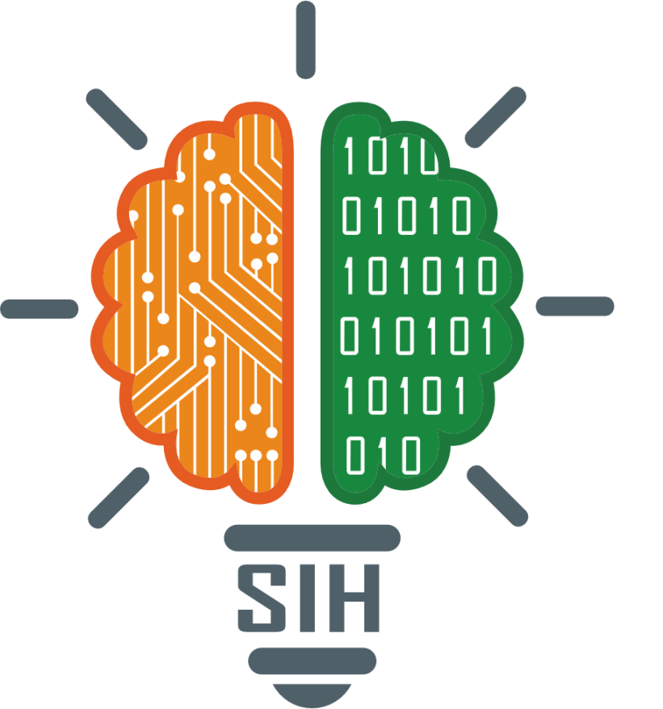
SMART INDIA HACKATHON 2026
TITLE PAGE
Problem Statement ID : SIH26047
Problem Statement Title :
AI-Powered Patient Case-Taking Software for Indian Hospital OPDs
Theme : MedTech / BioTech / HealthTech
PS Category : Software
Organization : Ministry of Ayush, Govt. of India
Team ID : [Insert Team ID]
Team Name (Registered on portal) : FULCRUM

Slide 2
































IDEA TITLE
FULCRUM
Proposed Solution : Our solution, "AyushKiosk" is an AI-powered, voice-first patient case-taking kiosk for hospital OPD waiting rooms. It covers 22 scheduled Indian languages using a LiveKit WebRTC audio pipeline and Sarvam / IndicWhisper speech models. Paper prescriptions and lab reports are digitized with open-source Chandra OCR (90+ languages). Clinical structuring is powered by Med-Gemma 1.5 fine-tuned on AYUSH clinical data with LoRA, running locally on our hospital servers for complete privacy. It generates an 8-stage clinical history, formats Dashavidha Pariksha lifestyle data, and pushes verified FHIR R4 records to hospital HIS and the patient web portal.
FEATURES MAKES IT UNIQUE
o DeepMind Med-Gemma on AYUSH Data : Specialized medical foundation model fine-tuned on 15,160 AyurGenixAI cases and Charaka Samhita. Self-hosted on-premise for complete privacy.
o Chandra Open-Source OCR (90+ Languages) : Layout-aware recognition parses handwritten prescriptions, lab tables, and auto-builds an interactive chronological medical timeline.
o 22-Language LiveKit Voice Pipeline : Sub-100ms real-time audio streaming across all 22 scheduled Indian languages plus English, noise-hardened for busy OPDs.
o Physician Verification Gate : Doctors retain 100% review control with an Accept / Amend / Reject interface before any record commits to the hospital HIS.
o Dual HIS & Patient Web Portal Sync : Exports standardized NRCeS OPConsultRecord to Bahmni HIS and provides a secure login/password patient portal to store records.
Med-Gemma 1.5 + LoRA (AYUSH) :
Specialized DeepMind medical model fine-tuned on AyurGenixAI (15K cases) and Charaka Samhita. Self-hosted for total privacy.
Chandra OCR (90+ Languages) :
Open-source layout engine parses handwritten prescriptions, lab tables, and auto-dates them into a chronological timeline.
LiveKit Voice (22+ Languages) :
Sub-100ms real-time WebRTC audio streaming across 22 scheduled Indian languages with native Hinglish code-switching.
ABDM & Consent Handling :
ABHA card login, Aadhaar OTP registration, or Guest mode. Ephemeral RAM processing with zero disk writes for DPDP compliance.
FHIR R4 & Patient Portal :
Outputs NRCeS OPConsultRecord to Bahmni HIS, patient web dashboard (login/password), and ABDM health locker.
Patient Data Privacy :
Self-hosted Med-Gemma on our own servers. Zero third-party cloud API calls. Full DPDP Act 2023 compliance.
8-Stage Clinical Depth :
Standard medical sequence: CC -> HPI -> PMH -> Meds -> Family -> ROS -> Ayush. SOCRATES probing for pain.
HOW IT ADDRESSES THE PROBLEM
Universal Accessibility :
Voice-first UI, audio-guided (blind), high-contrast, 20mm+ tiles, & ISL sign-language video avatar (stretch goal).
AYUSH Integration & Safety :
Captures Ahara-Vihara for Vaidya's Dashavidha Pariksha. Doctor verification gate retains 100% diagnostic control.

Slide 3


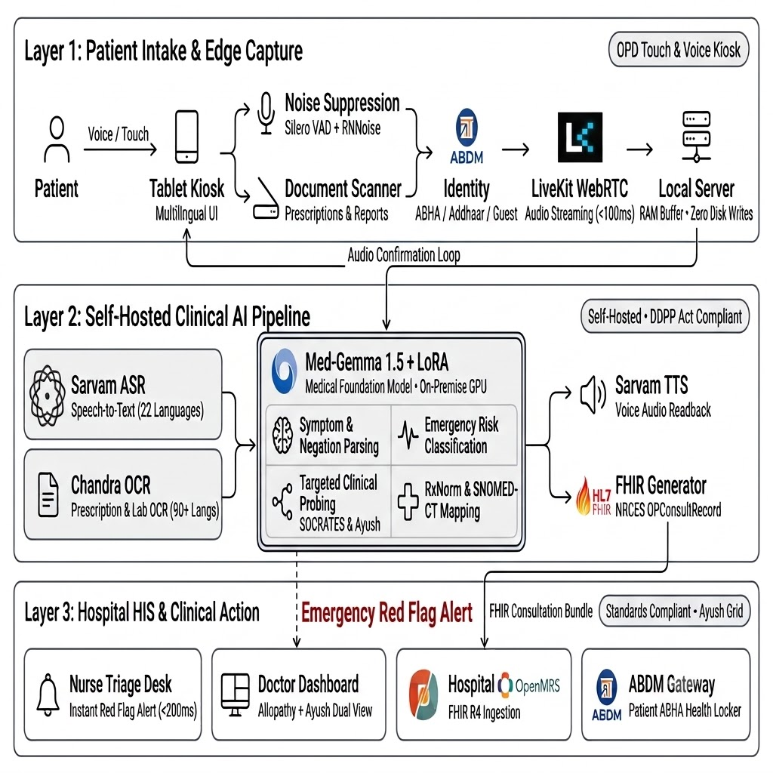


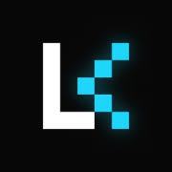




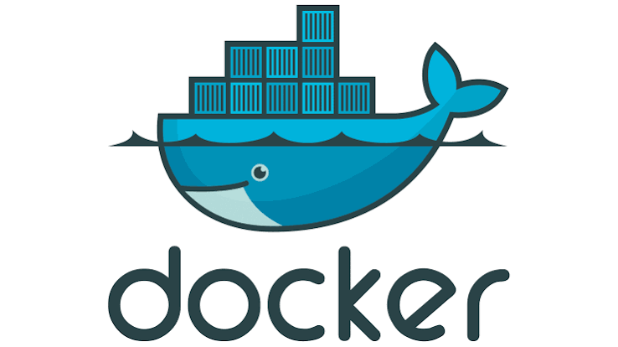

TECHNICAL APPROACH
FULCRUM
Frontend Kiosk UI
• React.js UI: 20mm+ picture tiles (WCAG 2.2 AAA)
• Multilingual Intake: Voice prompts in 22 languages
Backend & LiveKit Transport
• LiveKit + Node.js: <100ms WebRTC voice stream
• FHIR R4 Adapter: Direct push to Bahmni & ABDM
Backend & Streaming Stack
• Node.js & Express: WebRTC audio sessions & nurse alerts
• LiveKit WebRTC: Sub-100ms ultra-low latency audio stream
Chandra OCR (Document Vision)
• Layout-Aware AI: Parses multi-column lab report tables
• Doctor Prescriptions: Reads messy handwriting
(90+ langs)
Document Vision Stack
• Chandra OCR (Datalab): 90+ language layout-aware engine
• Self-Hosted Vision: Reads handwritten Rx & lab tables locally
Med-Gemma 1.5 (Clinical Brain)
• DeepMind Model: Specialized for clinical reasoning
• Indian Domain LoRA: Maps 249K drugs & 15K AYUSH records
Security & Privacy Layer
• 100% On-Premise: Zero data leaves hospital
• DPDP Compliant: RAM buffer, zero disk writes

Slide 4





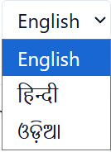


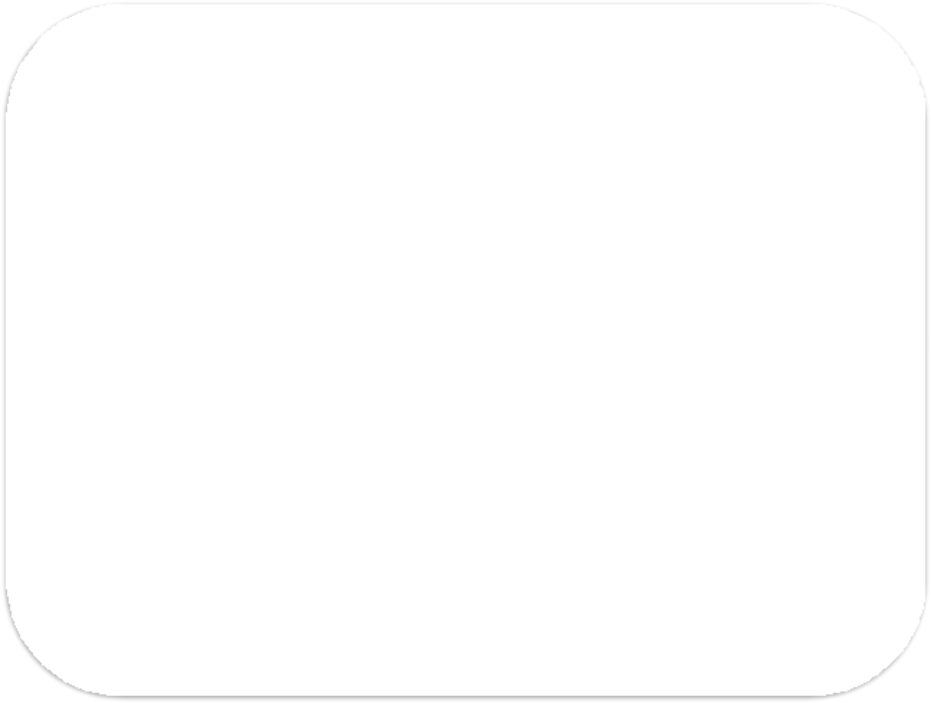


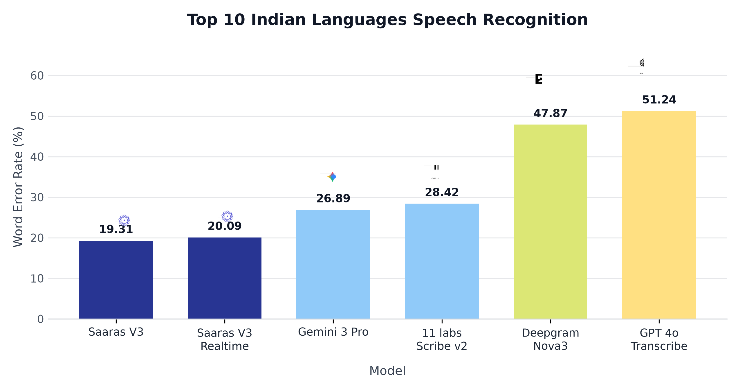
FEASIBILITY AND VIABILITY
FULCRUM
Feasibility:
Potential Challenges and Strategies to overcome them :
1. 22-Language Voice Intake : LiveKit WebRTC and Sarvam / IndicWhisper deliver sub-100ms streaming speech input in all 22 official Indian languages + English.
1. Noisy Hospital OPD Environment
Challenge: Indian OPDs run at 65 to 82 dBA sustained noise with sudden peaks up to 98 dBA.
Strategy: LiveKit WebRTC audio pipeline with RNNoise neural suppression, Silero VAD, and Push-to-Talk fallback.
2. Patient Health Data Privacy
Challenge: Hospital medical data is strictly confidential. DPDP Act penalties reach up to 250 Crore.
Strategy: 100% self-hosted stack (Med-Gemma, Chandra, Sarvam). Ephemeral RAM processing with zero disk writes.
2. Chandra 90+ Language OCR : Open-source layout extraction covering 90+ languages and all 22 Indian scripts on-premise without commercial API costs.
3. Med-Gemma LoRA on AYUSH : Specialized DeepMind model for clinical reasoning, fine-tuned on 15,160 AyurGenixAI cases and Charaka Samhita on local GPU.
4. OPD Noise Resilience : RNNoise WASM and Silero VAD (0.80 threshold) filter ambient hospital noise (65 to 89 dBA) with Push-to-Talk fallback.
3. Disabled, Illiterate & Elderly Patients
Challenge: Vision, hearing, or literacy impairments prevent form entry.
Strategy: Audio-guided mode for blind, ISL sign-language video avatar for deaf (stretch goal), and 20mm+ pictograms.
5. Zero-Cloud Marginal Cost : 100% open-source stack means no per-query cloud bills. One orderly manages 5 kiosks handling 50 patients/day each.

Slide 5










IMPACT AND BENEFITS
FULCRUM
IMPACT
BENEFITS
Clinical & Safety Benefits
Doctor verification gate (Accept/Amend/Reject): AI never diagnoses.
Chronological document timeline auto-built from past prescriptions.
Abnormal lab values (HbA1c, BP, Hb) and drug conflicts flagged.
Dual-panel summary: Allopathic left and AYUSH right.
60% Reduction in Doctor Case-Taking Time :
Physicians receive structured, pre-verified clinical summaries before consultation begins, cutting intake time from 15+ minutes down to 6 minutes.
100% Inclusion for Disabled & Elderly :
Audio-guided mode for visually impaired, ISL sign-language avatar for deaf (stretch goal), and voice-first interaction for illiterate patients.
Economic & Hospital Benefits
1 orderly per 5 kiosks replaces manual nurse data entry.
100% open-source stack eliminates recurring commercial cloud API fees.
Patient web portal (login/password) reduces repeat visit overhead.
Bridging Allopathy and AYUSH :
First kiosk to capture Ahara-Vihara lifestyle data for Vaidya's Dashavidha Pariksha, supporting integrated hospital workflows.
Hospital throughput increases from 4 to 8+ patients per doctor-hour.
Scales from a 10-tablet clinic pilot up to 100+ kiosks in 5,000 OPD/day hospitals.
Sub-200ms Emergency Red Flag Triage :
Specialized triage classification detects acute emergencies (chest pain, stroke, shock) and alerts the triage nurse desk via WebSocket.
Privacy & Sovereignty Benefits
Med-Gemma on local hospital GPU ensures zero data leaves premises.
Chandra OCR, LiveKit, and Sarvam models run 100% on-premise.
Fully compliant with Digital Personal Data Protection (DPDP) Act 2023.
Accelerating Ayush Grid & ABDM Adoption :
Generates standardized FHIR R4 records, synchronizing public hospital kiosks with national digital health infrastructure.

Slide 6
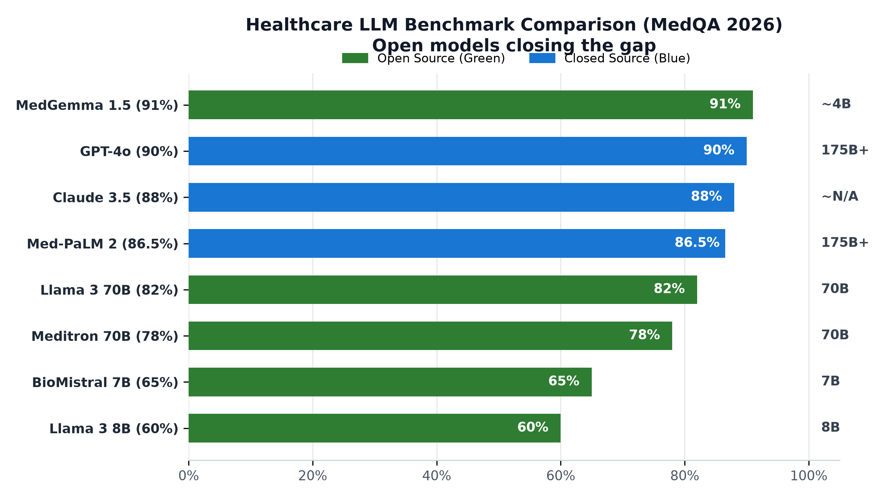
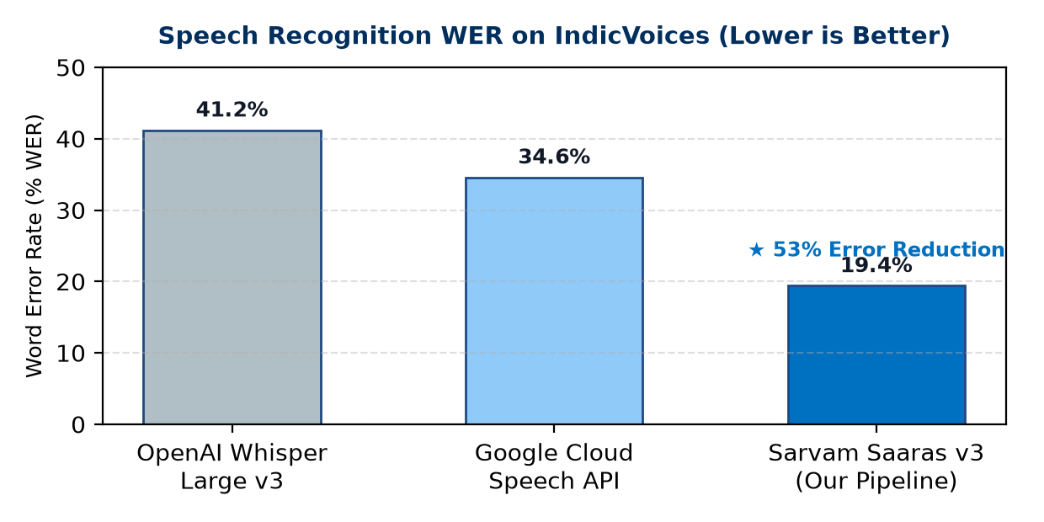
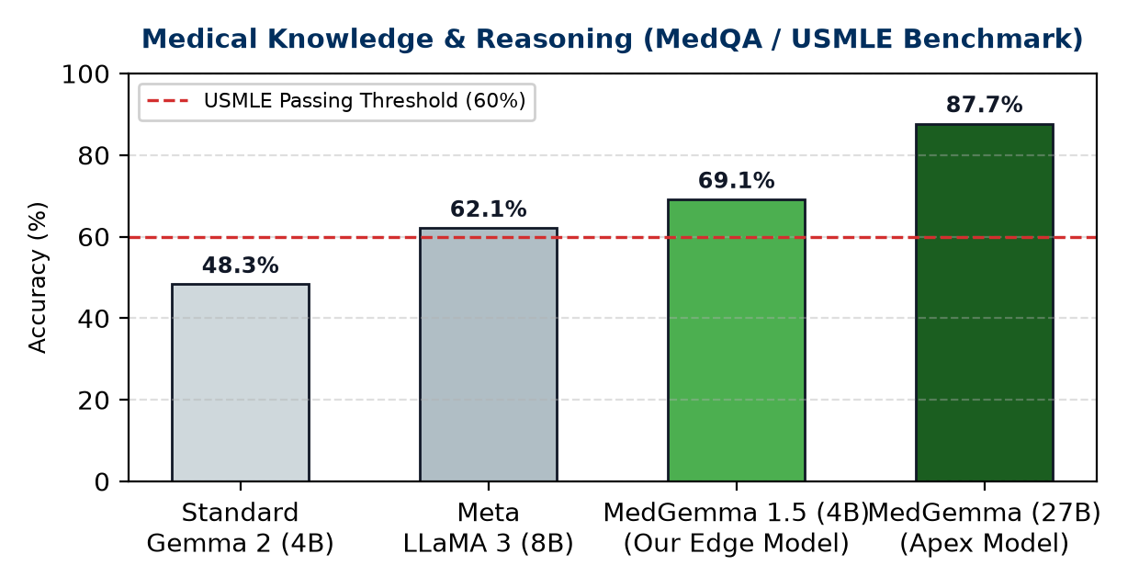
RESEARCH AND REFERENCES
FULCRUM
Med-Gemma 1.5 (Google DeepMind) :
https://ai.google.dev/gemma/docs/medgemma (LoRA on AYUSH Data)
AyurGenixAI & Charaka Samhita Datasets :
15,160 Ayurveda clinical records across 447 disease profiles
Chandra OCR (Open-Source Datalab) :
https://github.com/VikParuchuri/chandra (90+ Languages, 22 Indian Scripts)
LiveKit WebRTC Voice Pipeline (Open Source) :
https://github.com/livekit/livekit (Sub-100ms 22-Language Streaming)
Sarvam AI Saaras v3 & AI4Bharat IndicWhisper :
22 Scheduled Indian Languages + English Speech Recognition
ABDM Sandbox & NRCeS FHIR R4 :
https://sandbox.abdm.gov.in | https://nrces.in/ndhm/fhir/r4
MediTOD (IIT Delhi SOCRATES Dialogue) :
22,500+ turns of structured clinical conversation
Feature / Dimension | AyushKiosk (Fulcrum) | Practo | Eka Care | Generic Kiosk (BDIC)
Clinical Intake | Adaptive 8-Stage (SOCRATES) | None (Appt only) | Basic text forms | Token / slip only
Multilingual Voice | 22 Indian Langs (<100ms) | None | English/Hindi typing | None
Prescription OCR | Chandra 90+ Langs (Rx & Tables) | None | Basic photo upload | None
AYUSH Pariksha | Dashavidha + Ahara-Vihara | None | None | None
Physician Safety Gate | Accept / Amend / Reject Gate | N/A | Doctor types scratch | N/A
Patient Portal & ABDM | Web Portal (Login) + FHIR R4 | Proprietary cloud | ABHA link only | Paper ticket only
Data Privacy | 100% On-Premise (Zero Disk) | Commercial cloud | Commercial cloud | Local printer

