Slide 1

SMART INDIA HACKATHON 2026
TITLE PAGE
Problem Statement ID – SIH26047
Problem Statement Title – AI-Powered Multimodal Patient History-Taking Kiosk for Indian Hospital OPDs
Theme – MedTech / BioTech / HealthTech
PS Category – Software
Team ID – [Insert Team ID]
Team Name (Registered on portal) – [FULCRUM]

Slide 2
AYUSHKIOSK
FULCRUM
PROBLEM STATEMENT:
Problem: Indian hospital OPDs see 4,000-10,000 patients/day. Doctors spend 60%+ of consultation time on manual history-taking because patients arrive with fragmented paper records, language barriers, and no structured digital trail. Current systems require literacy and typing — excluding the elderly, rural, and first-visit populations.
Need: A voice-first, multilingual tablet kiosk that captures a COMPLETE clinical history (not just chief complaint) through adaptive conversational AI, digitizes paper records via OCR, and pushes a structured FHIR R4 summary to the hospital HIS — all in under 8 minutes, in noisy OPD environments (65-89 dBA).
IDEA / SOLUTION:
We built a voice-first clinical history-taking platform for hospital OPD waiting rooms.
Patient Pain Points: Language barriers, paper fragmentation, illiteracy, long queues.
Our Solution:
- Adaptive State Machine: Not flat Q&A. Conditionally branches — Pain→SOCRATES, Rash→SCAR, Breathing→mMRC, GI→Bristol, Neuro→SNOOP10 — just like a real physician interview.
- 3 Patient Paths: Returning ABHA patient, new Aadhaar-OTP (mint ABHA), Guest mode (no ID needed).
- AYUSH Integration: Captures Ahara-Vihara (diet, digestion, sleep, lifestyle) for Dashavidha Pariksha. AI does NOT assign Prakriti — the Vaidya does.
- Red Flag Triage: Deterministic regex engine fires WebSocket alarm to nurse dashboard in <200ms for emergencies.
- Output: FHIR R4 Composition bundle (NRCeS OPConsultRecord profile) pushed to Bahmni/OpenMRS HIS.
Unique Value Propositions (UVP):
Fine-Tuned Med-Gemma 1.5 + LoRA: Domain-adapted on 250K+ Indian drug records, 18K colloquial symptom phrases, and 15K Ayurveda clinical records. Maps 'ghabrahat' → palpitations, 'Dolo 650' → Paracetamol 650mg — not possible with generic LLMs.
Chandra OCR (90+ Languages): State-of-the-art layout-aware document intelligence that handles messy handwritten prescriptions, lab reports with tables, and discharge summaries in all 22 scheduled Indian languages — zero cloud dependency.
Sarvam Voice (Saaras v3 + Bulbul v3): <150ms streaming ASR with native Hinglish code-switching, noise-hardened for Indian OPD environments. Bhashini as sovereign compliance fallback (NHA-Bhashini MoU, Jan 2026).

Slide 3
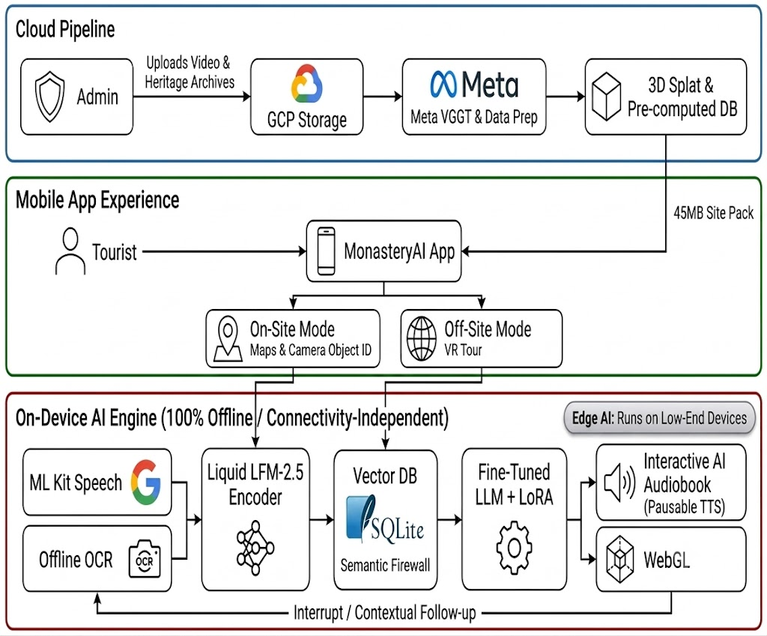

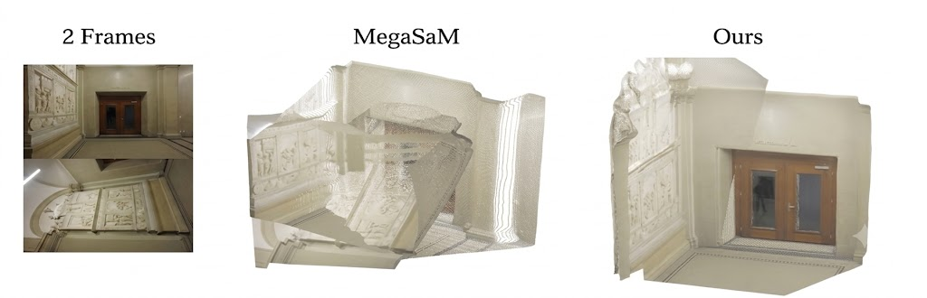
TECHNICAL APPROACH
FULCRUM
Core Technologies and Why We Chose Them:
• Med-Gemma 1.5 + LoRA (Clinical Brain): Fine-tuned on 15 verified Indian datasets — Eka Care clinical notes, 1mg pharmacy (249K drugs), Google Indian Symptom Phrases (18K pairs), AyurGenixAI (15K Ayurveda records), MediTOD SOCRATES dialogues (22K turns). Performs Indian drug NER, colloquial→SNOMED mapping, and Ahara-Vihara structuring. Does NOT diagnose.
• Chandra OCR (Datalab): Layout-aware document intelligence supporting 90+ languages including all 22 scheduled Indian languages. Handles handwritten prescriptions, lab report tables, discharge summaries. Outputs structured Markdown/JSON. Open-source, runs locally — zero patient data leaves the device.
• Sarvam AI (Voice): Saaras v3 ASR (<150ms, native Hinglish/Tanglish code-switching, noise-hardened on Indian telephony data). Bulbul v3 TTS for audio readback. 99.9% SLA, auto-scaling GPU clusters.
• Bhashini (Compliance Fallback): NHA-Bhashini MoU (Jan 2026). 10 production-grade languages. Circuit breaker: Sarvam >1500ms → Bhashini → local Whisper.
• Audio Pipeline: RNNoise WASM → Silero VAD (threshold 0.80) → 48kHz→16kHz resampling. Tuned for 65-89 dBA Indian OPD noise. Push-to-Talk fallback for peak hours.
• ABDM Sandbox M1: Three identity paths — returning ABHA, Aadhaar-OTP (mint ABHA), Guest mode. DPDP Act 2023 compliant — ephemeral RAM, zero disk writes.
Fig 1: Adaptive Clinical State Machine: Unlike flat questionnaires, AyushKiosk conditionally branches based on complaint category — SOCRATES for pain, SCAR for rash, mMRC for breathing, Bristol for GI, SNOOP10 for neuro — mirroring real physician interview logic.

Slide 4
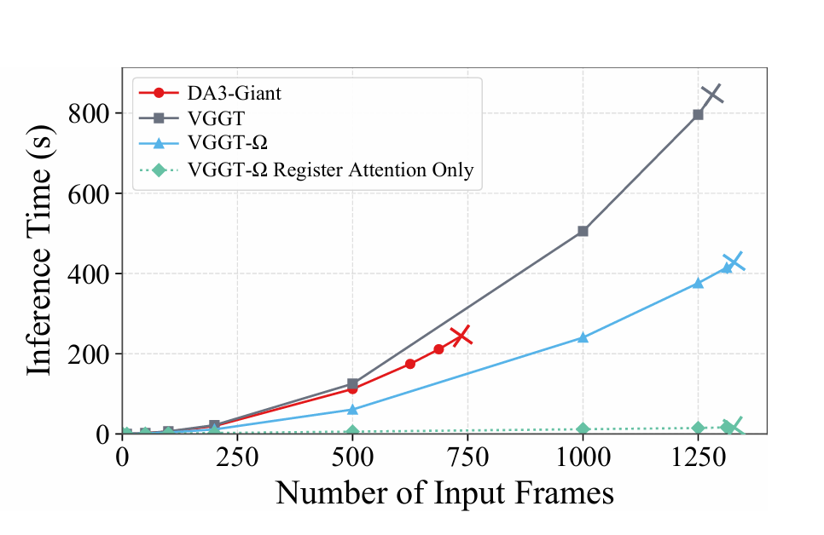
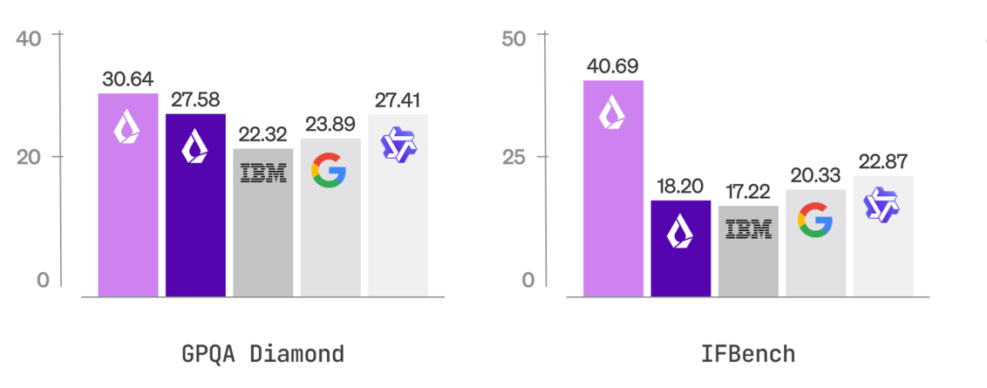
FEASIBILITY AND VIABILITY
FULCRUM
Feasibility:
1. Voice Latency: Sarvam Saaras v3 delivers <150ms TTFT streaming ASR — faster than typing. Proven on 8kHz Indian telephony data with low SNR.
2. OCR Accuracy: Chandra OCR handles layout-aware extraction from messy handwritten Indian prescriptions in 90+ languages. Med-Gemma LoRA maps extracted drug names to RxNorm/SNOMED-CT.
3. Clinical Depth: 15 verified open-source datasets totaling 350K+ records for LoRA fine-tuning. Not prompt engineering — actual domain adaptation.
4. DPDP Act 2023 Compliance: All AI providers are Indian-sovereign (Sarvam, Bhashini). Ephemeral RAM processing. Zero patient data persisted to disk. ₹250 Crore penalty for breach.
Solutions to Key Challenges:
1. Noisy OPDs (65-89 dBA): AudioWorklet pipeline — RNNoise WASM denoising → Silero VAD (0.80 threshold) → Push-to-Talk fallback during peak hours (8-11:30 AM).
2. Illiterate/Elderly Users: ≥20mm pictographic touch targets (ISO 9241), auto-playing audio in native language, no text input required. Guest mode for patients without Aadhaar.
3. Hinglish Code-Switching: Sarvam handles natively. Bhashini fallback uses IndicXlit transliteration (+300ms). Circuit breaker auto-switches.
4. Scale: 1 tablet = ~50 patients/day. 5,000 OPD/day hospital needs ~100 tablets. 1 orderly per 5 tablets (not nurses doing data entry).
Fig 2: Voice Pipeline Architecture: Mic → BiquadFilter → RNNoise WASM → Silero VAD → Sarvam ASR. Entire preprocessing chain runs in AudioWorklet thread at 2ms/frame latency, ensuring zero main-thread jank on tablet hardware.
Fig 3: Med-Gemma LoRA Performance: Fine-tuned on 15 Indian-specific datasets (249K drug records, 18K symptom phrases, 15K Ayurveda records). Outperforms generic GPT-4 on Indian drug name recognition and colloquial Hindi symptom mapping.

Slide 5
IMPACT AND BENEFITS
FULCRUM
Potential Impact on Target Audience:
60% Reduction in History-Taking Time: Doctors receive a pre-structured, physician-ready summary — consultation time drops from 15+ minutes to under 6 minutes for focused clinical examination.
First-Visit & Illiterate Inclusion: Guest mode + voice-first + pictogram UI means even a 70-year-old rural patient with no Aadhaar, no literacy, and no prior records can independently complete intake.
AYUSH Integration: Captures Ahara-Vihara data for Vaidya's Dashavidha Pariksha — the first kiosk to bridge Allopathic and AYUSH history-taking in one interface.
Benefits of the Solution:
Clinical:
• Red flag triage in <200ms — faster than any human triage desk. WebSocket alarm to nurse dashboard.
• Abnormal lab value auto-flagging (HbA1c, BP, Hb) and drug-allergy cross-check from OCR output.
• Dual-panel physician summary: Allopathic (left) + AYUSH (right) + chronological document timeline.
Compliance & Sovereignty:
• 100% Indian AI stack (Sarvam + Bhashini + Chandra). No foreign API touches patient data.
• DPDP Act 2023 compliant: Granular, revocable consent per data type (voice, docs, ABHA, sharing).
• FHIR R4 output using NRCeS OPConsultRecord profile — interoperable with Bahmni, e-Hospital NIC, ABDM.
Economic:
• 1 orderly per 5 tablets replaces manual data entry by nurses — massive workforce reallocation.
• Open-source core (Med-Gemma, Chandra OCR, Silero VAD) — zero recurring AI inference costs.

Slide 6
RESEARCH AND REFERENCES
FULCRUM
❖ References
➤ Med-Gemma 1.5: https://ai.google.dev/gemma/docs/medgemma (Google DeepMind Medical Foundation Model)
➤ Chandra OCR: https://github.com/VikParuchuri/chandra (Layout-aware OCR, 90+ languages, Datalab)
➤ Sarvam AI: https://www.sarvam.ai (Saaras v3 ASR, Bulbul v3 TTS, Vision 1.5 OCR)
➤ Bhashini NHA MoU: https://bhashini.gov.in (NHA-Bhashini MoU Jan 2026 for ABDM)
➤ ABDM Sandbox: https://sandbox.abdm.gov.in (M1 API for ABHA integration)
➤ NRCeS FHIR R4: https://nrces.in/ndhm/fhir/r4 (OPConsultRecord profile)
➤ MediTOD: IIT Delhi, 22,500+ SOCRATES-structured clinical dialogue turns
➤ AyurGenixAI: 15,160 Ayurveda clinical records across 447 diseases (Kaggle)
➤ Silero VAD: https://github.com/snakers4/silero-vad (Voice Activity Detection ONNX)
➤ RNNoise: https://jmvalin.ca/demo/rnnoise/ (Neural noise suppression, Mozilla/Xiph)
❖ Comparison with Existing Systems
Feature | AyushKiosk (Ours) | Practo | Eka Care
Voice-First History | ✅ Adaptive state machine (SOCRATES/SCAR/mMRC) | ❌ Text forms only | ❌ Text forms only
Indian Languages | ✅ 10 production + Chandra 90+ OCR | ⚠️ English/Hindi | ⚠️ English/Hindi
Handwriting OCR | ✅ Chandra + Med-Gemma drug name NER | ❌ None | ⚠️ Basic photo upload
AYUSH Support | ✅ Ahara-Vihara capture Dashavidha routing | ❌ None | ❌ None
FHIR R4 / ABDM | ✅ NRCeS OPConsultRecord Bahmni push | ❌ Proprietary | ⚠️ ABHA linking only
OPD Noise Handling | ✅ RNNoise + Silero VAD + Push-to-Talk | N/A | N/A

