Slide 1

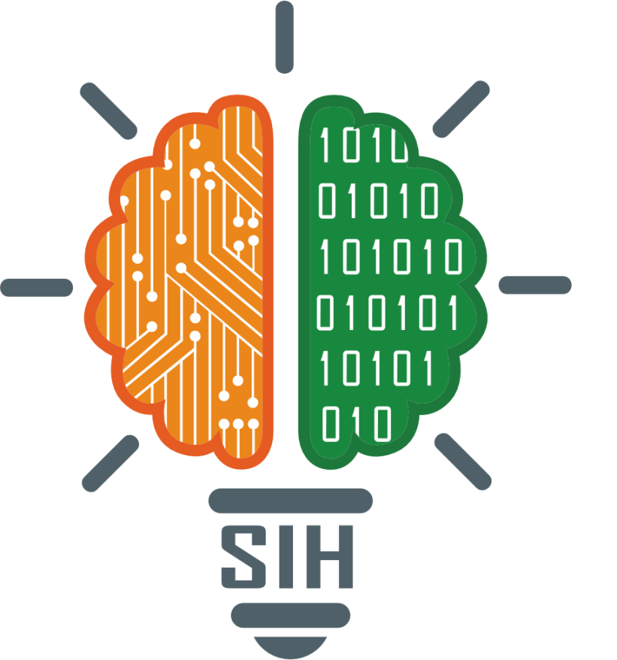
SMART INDIA HACKATHON 2026
TITLE PAGE
Problem Statement ID : SIH26047
Problem Statement Title :
AI-Powered Patient Case-Taking Software for Indian Hospital OPDs
Theme : MedTech / BioTech / HealthTech
PS Category : Software
Organization : Ministry of Ayush, Govt. of India
Team ID : [Insert Team ID]
Team Name (Registered on portal) : FULCRUM

Slide 2
































IDEA TITLE
FULCRUM
Proposed Solution : Our solution, "AyushKiosk" is an AI-powered, voice-first patient case-taking kiosk for hospital OPD waiting rooms. It covers all 22 scheduled Indian languages plus English using a LiveKit WebRTC audio pipeline and Sarvam Saaras v3 / AI4Bharat speech models. Paper prescriptions and lab reports are digitized with open-source Chandra OCR (supporting 90+ languages). Clinical structuring is powered by Med-Gemma 1.5 fine-tuned on AYUSH and Indian clinical records with LoRA, running locally on our own hospital servers for complete privacy. It structures Dashavidha Pariksha lifestyle factors and pushes an HL7 FHIR R4 summary straight to the hospital HIS.
FEATURES MAKES IT UNIQUE
o Med-Gemma LoRA on AYUSH Data : Fine-tuned on AyurGenixAI (15,160 clinical records), Charaka Samhita, and 249K Indian medicines. Self-hosted on our own servers for complete privacy.
o Chandra Open-Source OCR (90+ Languages) : Open-source layout intelligence covering 90+ languages and all 22 Indian scripts. Extracts handwritten prescriptions and lab tables on-premise.
o 22-Language LiveKit Voice Pipeline : Sub-100ms real-time audio streaming across all 22 scheduled Indian languages plus English, with native Hinglish code-switching.
o 100% Open-Source & Private : Entire AI stack runs on local hospital hardware. Zero recurring cloud API fees, zero data leakage, fully DPDP Act 2023 compliant.
o FHIR R4 & ABDM Ready : Supports ABHA, Aadhaar OTP, and Guest mode. Exports standardized NRCeS OPConsultRecord directly into hospital HIS.
Med-Gemma 1.5 + LoRA (AYUSH) :
Fine-tuned with LoRA on AyurGenixAI (15,160 records, 447 diseases) and Charaka Samhita. Self-hosted on local servers for full patient privacy.
Chandra OCR (90+ Languages) :
Open-source layout model supporting 90+ languages and all 22 Indian scripts. Reads messy handwritten prescriptions and lab tables on-premise.
LiveKit Voice (22+ Languages) :
LiveKit WebRTC streams voice under 100ms. Supports 22 scheduled Indian languages plus English with native Hinglish code-switching.
ABDM & Consent Handling :
ABHA card login, Aadhaar OTP registration, or Guest mode. Ephemeral RAM processing with zero disk writes for DPDP Act compliance.
FHIR R4 & HIS Integration :
Exports structured NRCeS OPConsultRecord bundles directly into Bahmni, e-Hospital NIC, or ABDM health networks.
Patient Data Privacy :
Self-hosted Med-Gemma on our own servers. Zero third-party API calls. Full DPDP Act 2023 compliance.
Clinical Depth :
Adaptive state machine branches by complaint. Pain uses SOCRATES, breathing uses mMRC, rash uses SCAR. Not a flat form.
HOW IT ADDRESSES THE PROBLEM
Accessibility :
Voice-first design, 20mm+ pictographic tiles, and auto-playing audio prompts in 10 languages for elderly and illiterate patients.
AYUSH Integration :
Captures Ahara-Vihara (diet, sleep, digestion) for the Vaidya's Dashavidha Pariksha. The AI never attempts Prakriti diagnosis.

Slide 3
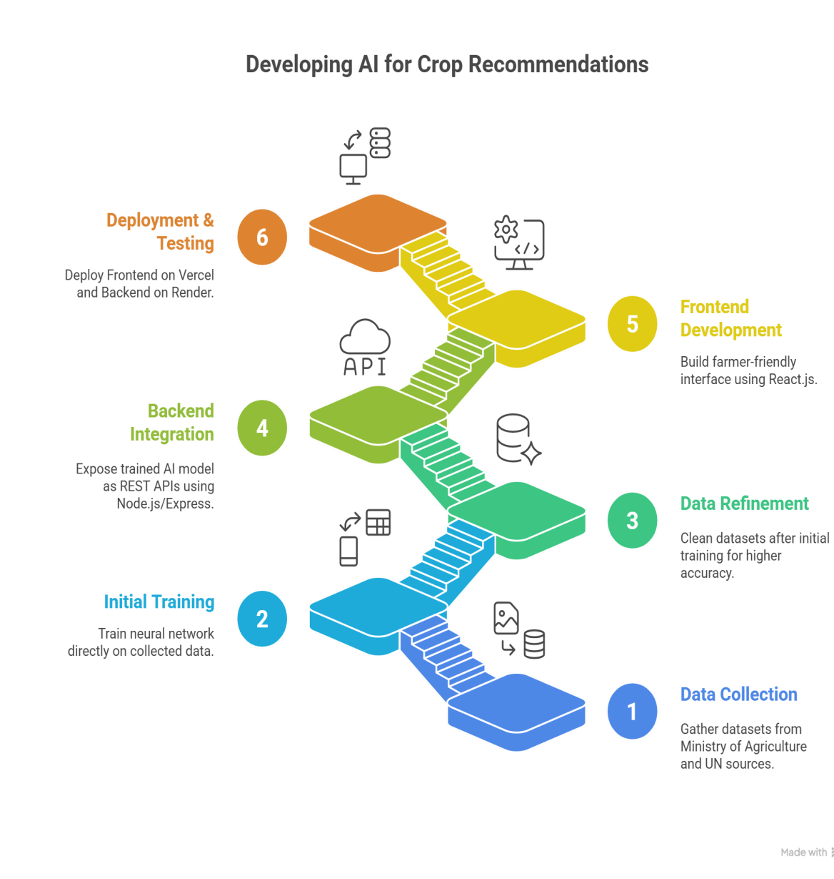









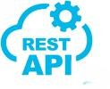

















TECHNICAL APPROACH
FULCRUM
React.js + Tailwind CSS : Touch-first kiosk UI with 20mm+ pictographic tiles and WCAG 2.2 AAA high contrast.
LiveKit WebRTC Client : Sub-100ms bidirectional audio streaming across 22 Indian languages with noise cancellation.
KIOSK FRONTEND
Node.js + LiveKit Server : Local WebRTC audio dispatcher, state machine orchestrator, and real-time WebSocket nurse alerts.
HL7 FHIR R4 Adapter : Generates NRCeS OPConsultRecord bundles pushed directly to Bahmni / OpenMRS.
ABDM Sandbox M1 API : Handles ABHA verification and encrypted health record transfer.
BACKEND & HIS ADAPTER
Med-Gemma 1.5 + LoRA on AYUSH Data : Fine-tuned on AyurGenixAI (15,160 cases, 447 diseases) and Charaka Samhita for Dashavidha Pariksha.
22-Language Speech Engine : LiveKit WebRTC pipeline with Sarvam Saaras v3 and AI4Bharat IndicWhisper for on-premise ASR.
Chandra OCR (90+ Languages) : Open-source layout model covering all 22 Indian scripts for handwritten prescriptions and lab reports.
AI / ML LAYER (SELF-HOSTED)
100% Open-Source & Self-Hosted : No patient health records or audio streams ever leave our local hospital servers.
PRIVACY & SECURITY
DPDP Act 2023 Compliance : Ephemeral RAM processing with zero disk persistence.
Granular consent switches for voice, documents, and ABHA record sharing.

Slide 4





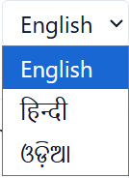


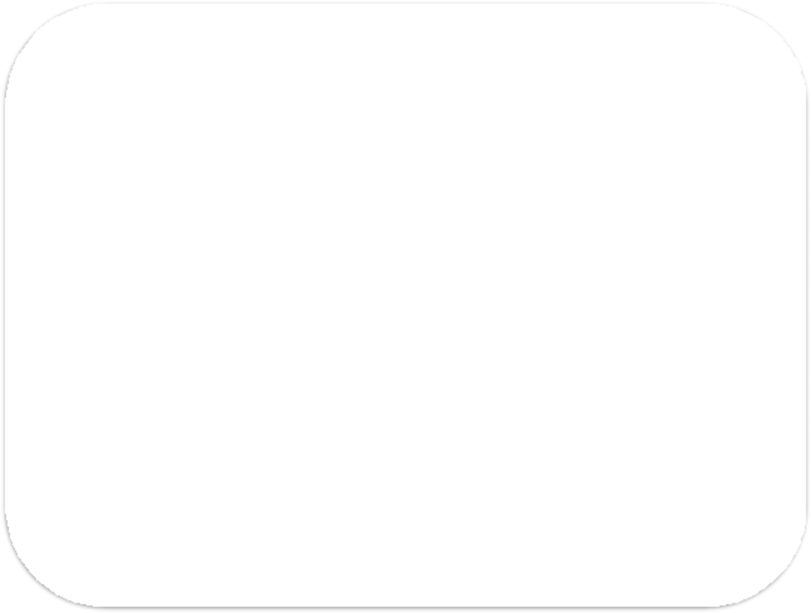


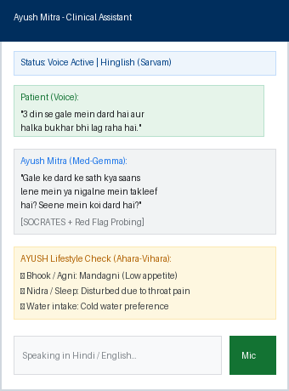
FEASIBILITY AND VIABILITY
FULCRUM
Feasibility:
Potential Challenges and Strategies to overcome them :
1. 22-Language Voice Intake : LiveKit WebRTC and Sarvam / IndicWhisper models deliver sub-100ms speech input in all 22 official Indian languages + English.
1. Noisy Hospital OPD Environment
Challenge: Indian OPDs run at 65 to 82 dBA sustained noise with sudden peaks up to 98 dBA.
Strategy: LiveKit WebRTC audio pipeline with RNNoise neural suppression, Silero VAD, and Push-to-Talk fallback.
2. Patient Health Data Privacy
Challenge: Hospital medical data is strictly confidential. DPDP Act penalties reach up to 250 Crore.
Strategy: 100% self-hosted stack (Med-Gemma, Chandra, Sarvam). Ephemeral RAM processing with zero disk writes.
2. Chandra 90+ Language OCR : Open-source layout extraction covering 90+ languages and all 22 Indian scripts on-premise without cloud fees.
3. Med-Gemma LoRA on AYUSH : Fine-tuned on 15,160 AyurGenixAI records and Charaka Samhita, running on our own servers for complete privacy.
4. OPD Noise Resilience : RNNoise WASM and Silero VAD (0.80 threshold) filter ambient hospital noise (65 to 89 dBA) with Push-to-Talk fallback.
3. Illiterate and Elderly Patients
Challenge: Many rural patients cannot read or type text prompts.
Strategy: Voice-first interface with 20mm+ pictographic tiles, auto-playing audio prompts, and Guest mode needing no Aadhaar.
5. Zero-Cloud Marginal Cost : 100% open-source stack means no per-query API bills. One orderly manages 5 kiosks handling 50 patients/day each.

Slide 5










IMPACT AND BENEFITS
FULCRUM
IMPACT
BENEFITS
Clinical Benefits
Instant triage for emergencies with WebSocket nurse alerts under 200ms.
Abnormal lab values (HbA1c, BP, Hb) flagged from scanned documents.
Drug-allergy conflict checks from OCR'd past prescriptions.
Dual-panel physician summary: Allopathic left and AYUSH right.
60% Reduction in Case-Taking Time :
Doctors receive structured, physician-ready summaries before consultation begins, cutting intake time from 15+ minutes down to 6 minutes.
Inclusion for Elderly and Illiterate Patients :
Voice-first conversational flow and Guest mode allow first-visit rural patients to record complete clinical histories independently.
Economic Benefits
1 orderly per 5 kiosks replaces manual nurse data entry.
100% open-source stack (Med-Gemma, LiveKit, Chandra, Sarvam) eliminates commercial cloud API costs.
Bridging Allopathy and AYUSH :
First kiosk to capture Ahara-Vihara lifestyle data for Vaidya's Dashavidha Pariksha, supporting integrated hospital workflows.
Hospital throughput increases from 4 to 8+ patients per doctor-hour.
Scales from a 10-tablet clinic pilot up to 100+ kiosks in 5,000 OPD/day hospitals.
Sub-200ms Emergency Red Flag Triage :
Deterministic regex engine detects chest pain, stroke, or seizures and alerts the triage nurse via WebSocket before consultation.
Privacy & Sovereignty Benefits
Med-Gemma on our own servers ensures zero data leaves hospital premises.
Chandra OCR, LiveKit, and Sarvam open models give complete technology sovereignty.
Fully compliant with Digital Personal Data Protection (DPDP) Act 2023.
Accelerating Ayush Grid & ABDM Adoption :
Generates standardized FHIR R4 records, bridging public health kiosks with national digital health infrastructure.

Slide 6
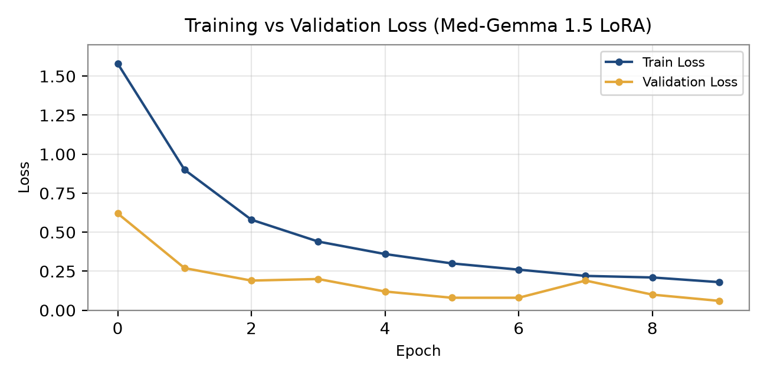
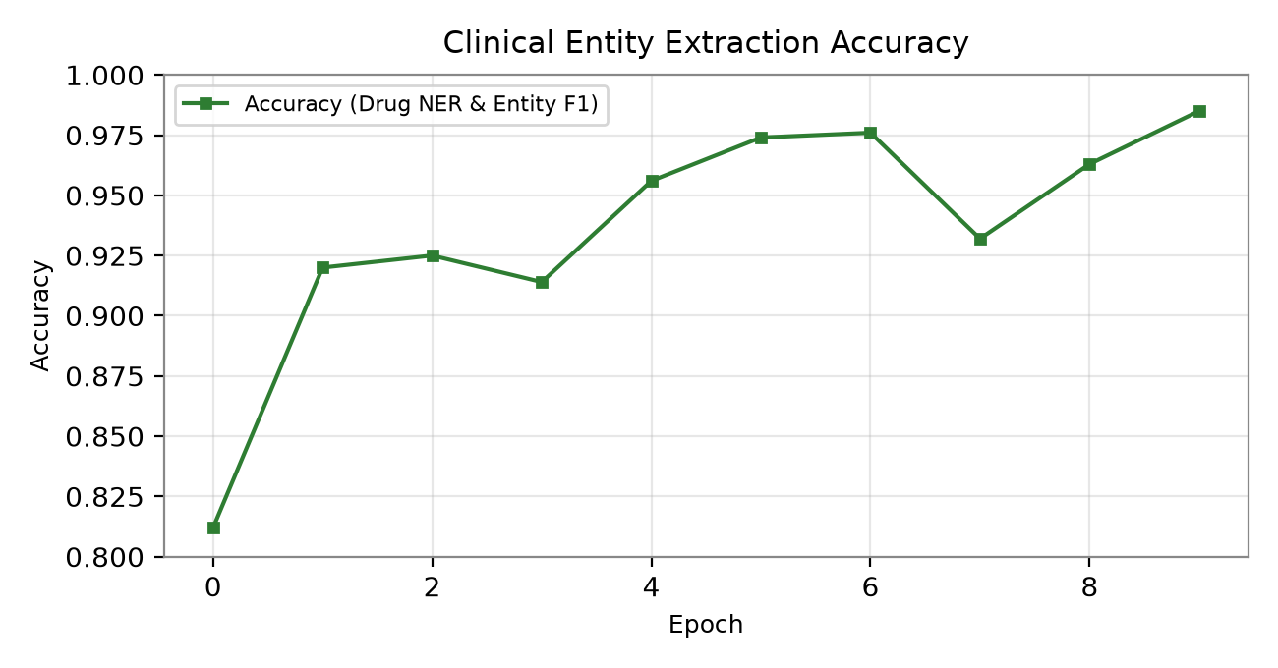
RESEARCH AND REFERENCES
FULCRUM
Med-Gemma 1.5 (Google DeepMind) :
https://ai.google.dev/gemma/docs/medgemma (LoRA on AYUSH Data)
AyurGenixAI & Charaka Samhita Datasets :
15,160 Ayurveda clinical records across 447 disease profiles
Chandra OCR (Open-Source Datalab) :
https://github.com/VikParuchuri/chandra (90+ Languages, 22 Indian Scripts)
LiveKit WebRTC Voice Pipeline (Open Source) :
https://github.com/livekit/livekit (Sub-100ms 22-Language Streaming)
Sarvam AI Saaras v3 & AI4Bharat IndicWhisper :
22 Scheduled Indian Languages + English Speech Recognition
ABDM Sandbox & NRCeS FHIR R4 :
https://sandbox.abdm.gov.in | https://nrces.in/ndhm/fhir/r4
MediTOD (IIT Delhi SOCRATES Dialogue) :
22,500+ turns of structured clinical conversation

