Slide 1

SMART INDIA HACKATHON 2026
TITLE PAGE
Problem Statement ID – SIH26061
Problem Statement Title- Digitize and Showcase Monasteries of Sikkim
Theme- Heritage & Culture
PS Category- Software
Team ID- [Insert Team ID]
Team Name (Registered on portal)- [FULCRUM]

Slide 2
MONASTERYAI
FULCRUM
PROBLEM STATEMENT:
Problem: The Government of Sikkim needs a way to digitize and showcase their monasteries for cultural preservation. However, these Himalayan structures are highly vulnerable to natural disasters (like the 2011 earthquake) and sit in remote regions with zero internet connectivity.
Need: An offline-first mobile app with a 3D visualization system and an on-device AI. It acts as an interactive, offline voice guide you can ask questions, completely bypassing cloud servers to ensure zero latency in internet-dead zones.
IDEA / SOLUTION :
We built an offline 3D rendering platform and Artificial Intelligence guide.
Tourist Pain Points: Weak connectivity and lack of verified cultural context.
Our Solution:
- Data Capture: Monastic Partners & Crowdsourcing (local monks and trained guides capture the video to scale to 100+ sites).
- Languages: Phase 1: English, Hindi, Nepali (via offline Whisper). Phase 2: Community-sourced Bhutia and Lepcha models.
- Phased Rollout: Starting with Rumtek and Pemayangtse, scaling to 100+ sites.
Unique Value Propositions (UVP):
  Eliminates Expensive Gear: Instead of $4,000 LiDAR rigs, we reconstruct true 3D environments using just normal videos taken on a smartphone.
  Interactive AI Audiobook: A pausable, real-time voice guide fine-tuned on historical data. Users can interrupt the guide mid-tour to ask contextual questions.
  Zero Cloud Dependency: The 350-million parameter AI model runs locally on the device, functioning 100% offline in internet-dead Himalayan zones.

Slide 3
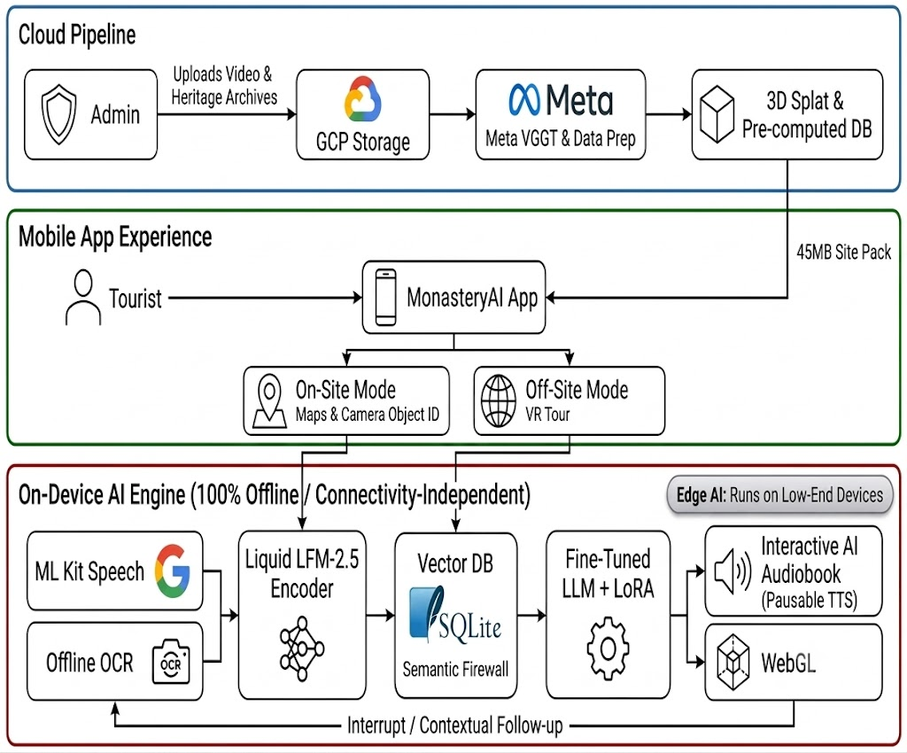

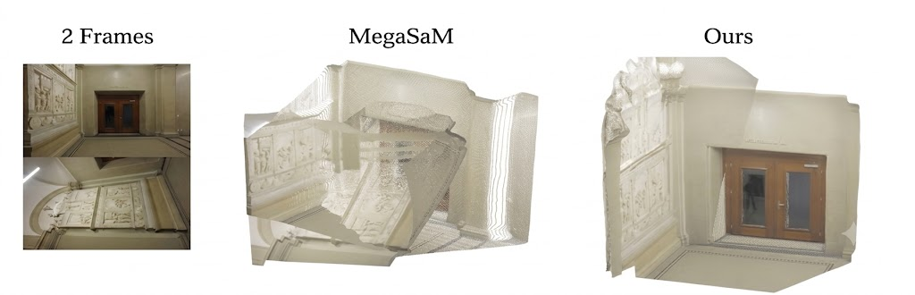
TECHNICAL APPROACH
FULCRUM
Core Technologies and Why We Chose Them:
• React Native (Expo): Cross-platform mobile framework allowing rapid deployment across iOS and Android.
• 3D Gaussian Splatting (gsplat.js): Compresses photorealistic 3D scans down to mobile-friendly sizes.
• Offline AI (LFM-2.5 350M): Runs entirely on-device, preserving battery life and functioning without cellular service. We bridge the 350M model's knowledge gap by strictly routing it through our SQLite-VSS Semantic Firewall and LoRA fine-tuning.
• Whisper.cpp: Real-time, localized offline voice recognition optimized for edge devices.
• Architecture Security: Role-based OAuth (Admin vs Guest) and Background Sync Queues (offline field data syncs automatically when Wi-Fi is restored).
Fig 1: 3D Consistency: Older models like MegaSaM bend the walls and smear textures. Meta VGGT-Ω builds a straight, consistent 3D environment, even if the input photos are tilted or messy

Slide 4
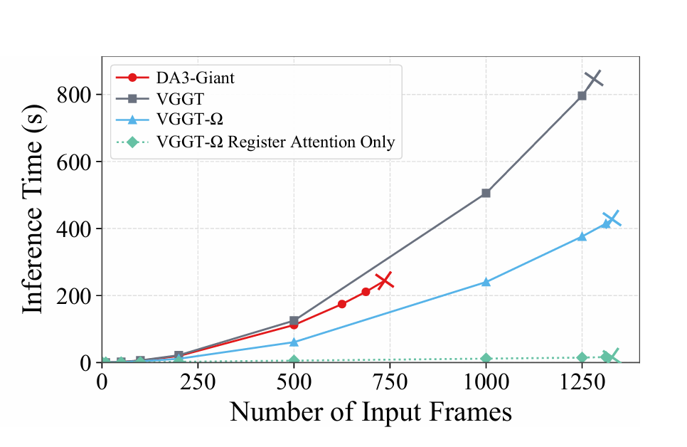
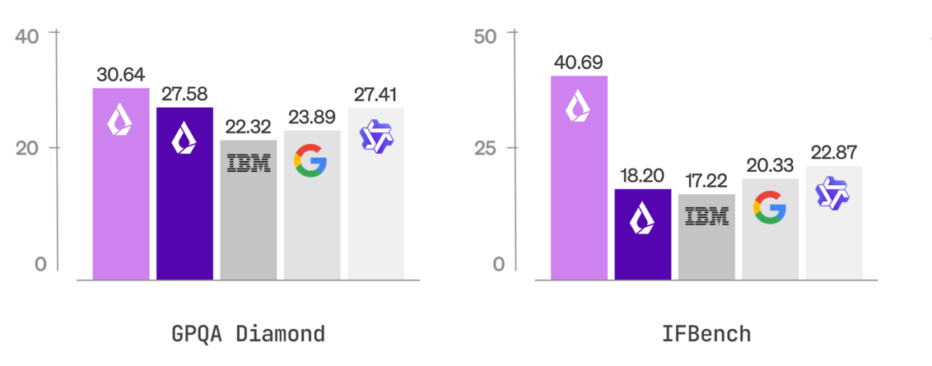
FEASIBILITY AND VIABILITY
FULCRUM
Feasibility:
1. Processing Speed (See Fig. 2): Meta VGGT-Ω drastically accelerates video-to-3D rendering compared to legacy methods.
2. Efficiency (See Fig. 3): LFM-2.5 offers superior reasoning with a fraction of the parameter count, making offline edge-AI viable.
3. Disaster Resilience: Geo-redundant AWS Multi-Region backups ensure the 3D digital heritage survives physical earthquakes.
Solutions:
1. Mobile Optimizations: We use gsplat.js to compress 3D models under 45MB for smooth 60fps rendering on mid-range phones.
2. Cost Management: Open-source models eliminate recurring cloud inference APIs, driving marginal costs to zero.
3. Monk-in-the-Loop Validation: Historians and head monks review RAG embeddings before deployment.
4. Revenue Streams: Automated Razorpay/Stripe integration for VR subscriptions and API token provisioning.
Fig. 2: 3D Generation Efficiency: Meta VGGT-Ω drastically reduces inference time compared to older models. Proves processing hundreds of videos into 3D environments is fast and highly cost-effective. (Source: Meta AI)
Fig. 3: On-Device Intelligence: Liquid LFM-2.5 outperforms massive cloud models (IBM/Google) on graduate-level reasoning (GPQA) and instruction following (IFBench). Proves offline AI maintains state-of-the-art intelligence. (Source: Liquid AI)

Slide 5
IMPACT AND BENEFITS
FULCRUM
Potential impact on target audience:
  Enhanced Cultural Immersion: Tourists experience a 100% deeper connection to history via zero-latency offline audio guides.
  Democratized Preservation: Remote monasteries finally receive digital archiving without relying on expensive, cloud-dependent LiDAR teams.
  Boosted Local Economy: Local guides and tech talent see increased opportunities through data analytics and SaaS API integration.
Benefits of the solution:
Social:
• Fosters global appreciation for fragile Himalayan heritage.
• Connects rural artisans directly to a global digital tourist economy.
• Ethical Data Consent: Explicit approval from Monastic Authorities before digitizing sacred murals.
Economic:
• Zero-cost API scaling allows the state government to deploy the app with minimal server overhead.
• Strategic Partnerships: Collaborating with Sikkim Dept. of Ecclesiastical Affairs and State Tourism.
• Premium global VR subscriptions directly fund the ongoing AWS storage and maintenance costs after government handover.

Slide 6
RESEARCH AND REFERENCES
FULCRUM
❖ References
➤ VGGT-Ω CVPR 2026: https://arxiv.org/abs/2602.04561 (Novel View Synthesis via Gaussian Splatting)
➤ Liquid AI LFM-2.5 Technical Report: https://liquid.ai/research/lfm-2-5
➤ Whisper.cpp GitHub Repository: https://github.com/ggerganov/whisper.cpp
➤ React Native Architecture Details: https://reactnative.dev/architecture
❖ Comparison with Existing Systems
Features | MonasteryAI | Matterport | Google A&C
True Volumetric 3D | ✅ | ✅ | No
Hardware Cost | $0 | ~$4,000 | N/A
Offline Gen. AI | ✅ | No | No
Cloud Hosting Fees | One-time S3 | $100+/mo | Free
Neural TTS & OCR | ✅ | No | Cloud
100% Offline Access | ✅ | No | No

