Slide 1

SMART INDIA HACKATHON 2026
TITLE PAGE
Problem Statement ID – [Insert PS ID]
Problem Statement Title – Digitize and Preserve the Cultural Heritage of Odisha
Theme – Heritage & Culture
PS Category – Software
Team ID – [Insert Team ID]
Team Name (Registered on portal) – [FULCRUM]

Slide 2
IDEA / APPROACH DETAILS
FULCRUM
PROBLEM STATEMENT:
Problem: Odisha is home to one of India's richest cultural heritages — from the UNESCO World Heritage Site Konark Sun Temple to Jagannath Puri, Lingaraja Temple, and Udayagiri-Khandagiri caves. These monuments face deterioration from pollution, climate change, and human interference. Tourists lack immersive multilingual cultural context.
Need: A digitalized platform for cultural preservation and tourism of Odisha Heritage with AR/VR experiences, an AI-powered multilingual tour guide (Sarvam AI), crowdsourced 3D scanning (VGGT-Ω), and gamification to engage visitors.
How it Addresses the Problem:
1. Digitization and Preservation — Ensures long-term preservation of cultural assets that may otherwise deteriorate due to pollution, climate change, or human interference.
2. Inclusivity and Community Involvement — Accessibility features (audio guides, subtitles, voice navigation) ensure inclusivity for differently-abled users.
Innovation and Uniqueness:
1. Digital 3D Scanning & AR Models → Preserve monuments and artifacts virtually via VGGT-Ω.
2. Mobile/Web AR App → Provide immersive tours of heritage sites.
3. Integration of storytelling and history with immersive AR experiences.
4. Promotes inclusivity by bridging the digital divide — Sarvam AI supports 22 Indian languages.
5. Low-bandwidth optimized — downloadable content for areas with poor connectivity.
6. Gamification makes exploration fun and engaging.
7. AR-based maps for navigation and discovery.
Proposed Solution:
1. The platform provides an immersive experience through augmented reality technologies.
2. An AI-powered AR tour guide (Sarvam AI) tells the history behind all monuments in the user's preferred language.
3. Users can have one-to-one communication with the AR guide and ask questions — the guide answers in 22 Indian languages.
4. Virtual Reality modules with animated reconstructions and immersive audio guides for experiencing heritage in its original form.
5. Users can step inside monuments virtually and explore a 360-degree view.
6. AR-based maps help users find travel routes to monuments and nearby attractions.
7. Gamification — cultural treasure hunts, quizzes, and rewards for visiting multiple sites, encouraging exploration.
8. Crowdsourced 3D Scanning — tourists capture smartphone video → VGGT-Ω AI instantly generates 3D models, turning visitors into digital preservationists.

Slide 3
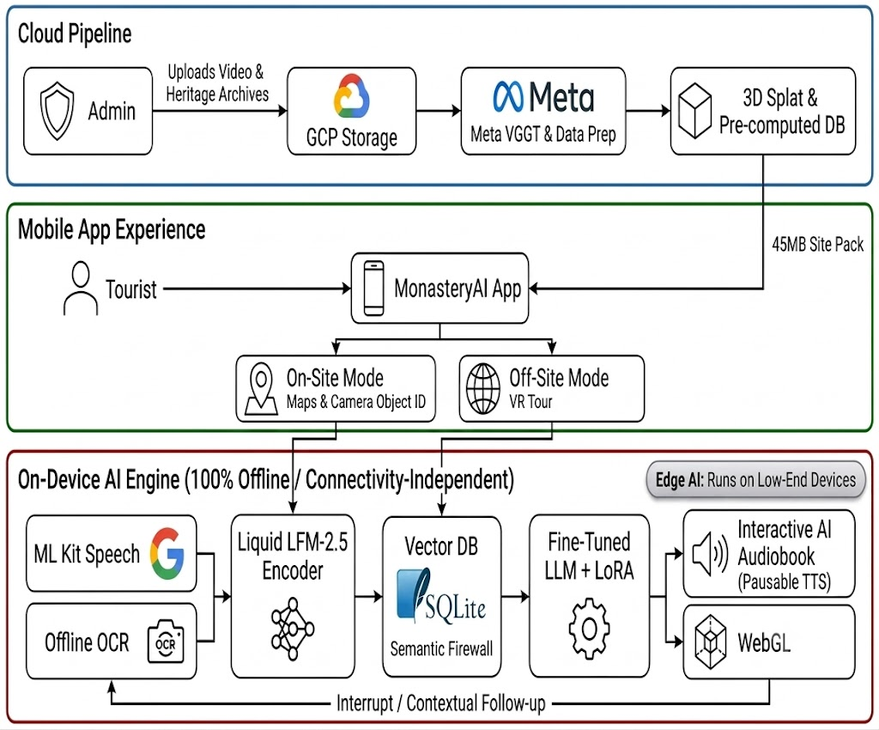

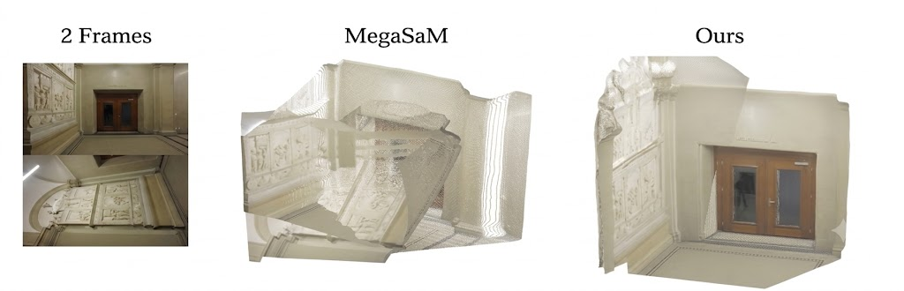
TECHNICAL APPROACH
FULCRUM
Core Technologies:
• Unity (C#): For developing immersive AR/VR experiences on mobile and VR headsets.
• Three.js / gsplat.js: Display animated 3D graphics, Gaussian splats, and 360-degree views in browser.
• React Native (Expo): Cross-platform mobile framework for iOS & Android.
• NextJS + React: Server-side rendering and static site generation for web frontend.
• VGGT-Ω (Meta AI, CVPR 2026): State-of-the-art feed-forward 3D reconstruction. Converts smartphone video → 3D models — no LiDAR needed.
• Sarvam AI Suite: Saaras (ASR, 22 languages), Bulbul (TTS, 11 languages), Translate (22 languages). India's sovereign Indic AI.
• NodeJS backend + MongoDB (NoSQL) for scalable data storage.
• Cloudinary: Media CDN to optimize and deliver images, videos, and 3D assets globally.
Fig 1: 3D Consistency: Older models like MegaSaM bend walls and smear textures. Meta VGGT-Ω builds straight, consistent 3D environments from smartphone videos — enabling crowdsourced heritage preservation.

Slide 4
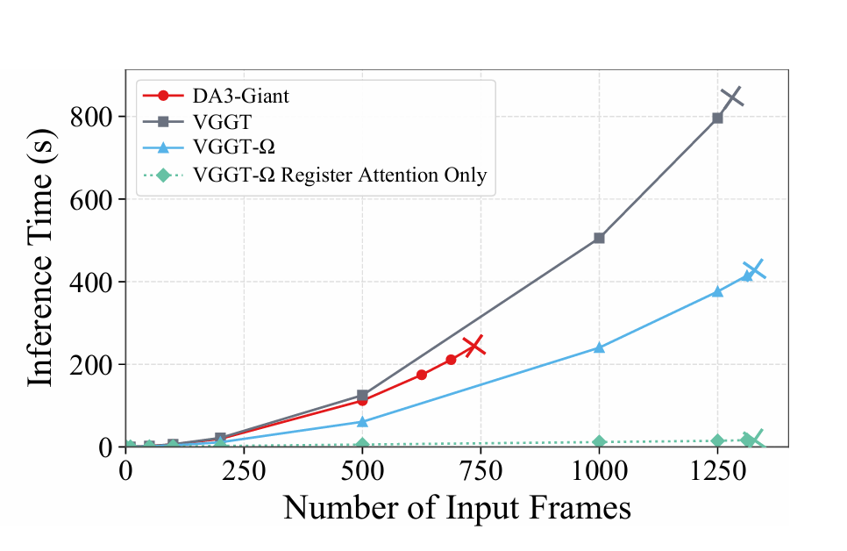
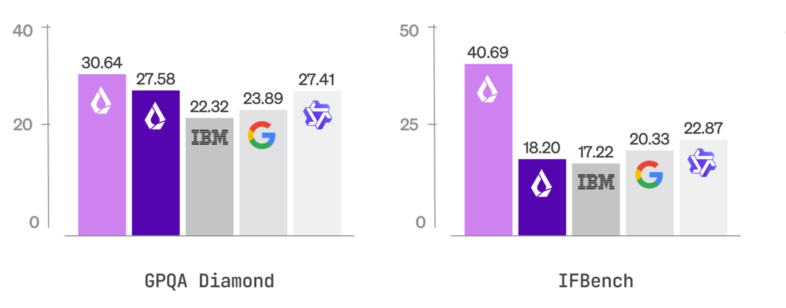
FEASIBILITY AND VIABILITY
FULCRUM
Feasibility:
1. Processing Speed (Fig. 2): Meta VGGT-Ω is 50× faster than optimization-based methods, processing 1000+ frames on a single GPU.
2. Sovereign AI (Fig. 3): Sarvam AI is optimized for Indian languages with code-mixed speech support — outperforming global models.
3. Cloud Infrastructure ensures scalability. Cloudinary CDN + AWS for global delivery of heavy 3D/AR assets.
4. Collaboration with ASI, UNESCO, and Odisha Tourism Board for content approval and outreach.
5. Education: Engages students and researchers with immersive AR/VR storytelling.
Viability & Solutions:
1. Mobile Optimizations: gsplat.js compresses 3D models for smooth 60fps rendering on mid-range phones.
2. Multiple revenue streams: Partnerships, Subscriptions, API licensing for tourism boards.
3. Large potential user base: Millions of domestic and international tourists.
4. Scalable: Can expand from Odisha to all heritage sites across India without re-architecture.
5. Increasing smartphone penetration and interest in immersive experiences make AR adoption practical.
Fig. 2: 3D Generation Efficiency: Meta VGGT-Ω drastically reduces inference time compared to older models. Processing hundreds of videos into 3D environments is fast and cost-effective. (Source: Meta AI)
Fig. 3: Sovereign Indic AI: Sarvam AI's models natively handle 22 Indian languages with code-mixed speech recognition, outperforming global models on Indian benchmarks. Powers our multilingual AR tour guide. (Source: Sarvam AI)

Slide 5
IMPACT AND BENEFITS
FULCRUM
Impact:
• Cultural Awareness → Increases pride and knowledge about Odisha's rich heritage.
• Global Reach → Puts Odisha's heritage on the international digital map.
• Sustainable Heritage Management → Ensures long-term preservation with periodic digital updates.
• Tourism → Target 10% increase in tourist engagement.
• Inclusive Growth → Benefits not just tourists but also schools, rural communities, and researchers.
Benefits:
• Digital Preservation → Preserve the monuments digitally for future generations.
• Enhanced Tourism → Immersive AR and VR attract more visitors and boost revenue.
• Educational Value → Interactive learning of history through AR and VR for students, researchers, and the public.
• Community Engagement → Boost Odisha tourism across the world.
• Economic Growth → An increase in tourism helps in increasing the economic growth of Odisha.
• Bridging Digital Divide → Sarvam AI enables access in 22 Indian languages for all citizens.

Slide 6
RESEARCH AND REFERENCES
FULCRUM
❖ References
➤ VGGT-Ω (CVPR 2026): Feed-forward 3D/4D reconstruction at scale. https://vggt-omega.github.io/
➤ Sarvam AI: Sovereign Indic language AI — ASR, TTS, Translation for 22 Indian languages. https://www.sarvam.ai/
➤ UNESCO (2021): Digital Heritage Preservation Initiatives. https://en.unesco.org/themes/information-preservation/digital-heritage
➤ JOCCH Report (2018): Survey of AR/VR/MR for Cultural Heritage. https://www.researchgate.net/publication/323975580
➤ ScienceDirect: AR for Intangible Heritage (dance, rituals, oral traditions). https://www.sciencedirect.com/science/article/pii/S2577444121000113
➤ React Native Architecture: https://reactnative.dev/architecture
❖ Comparison with Existing Systems
Features | Our Platform | Matterport | Google A&C
Crowdsourced 3D (VGGT-Ω) | ✅ | No | No
Hardware Cost | $0 (smartphone) | ~$4,000 | N/A
Indic Language AI (Sarvam) | ✅ (22 langs) | No | Cloud
Cloud Hosting Fees | Cloudinary CDN | $100+/mo | Free
AR/VR Immersive Tours | ✅ | Partial | No
Code-Mixed Speech Support | ✅ | No | No

