Slide 1


Slide 2
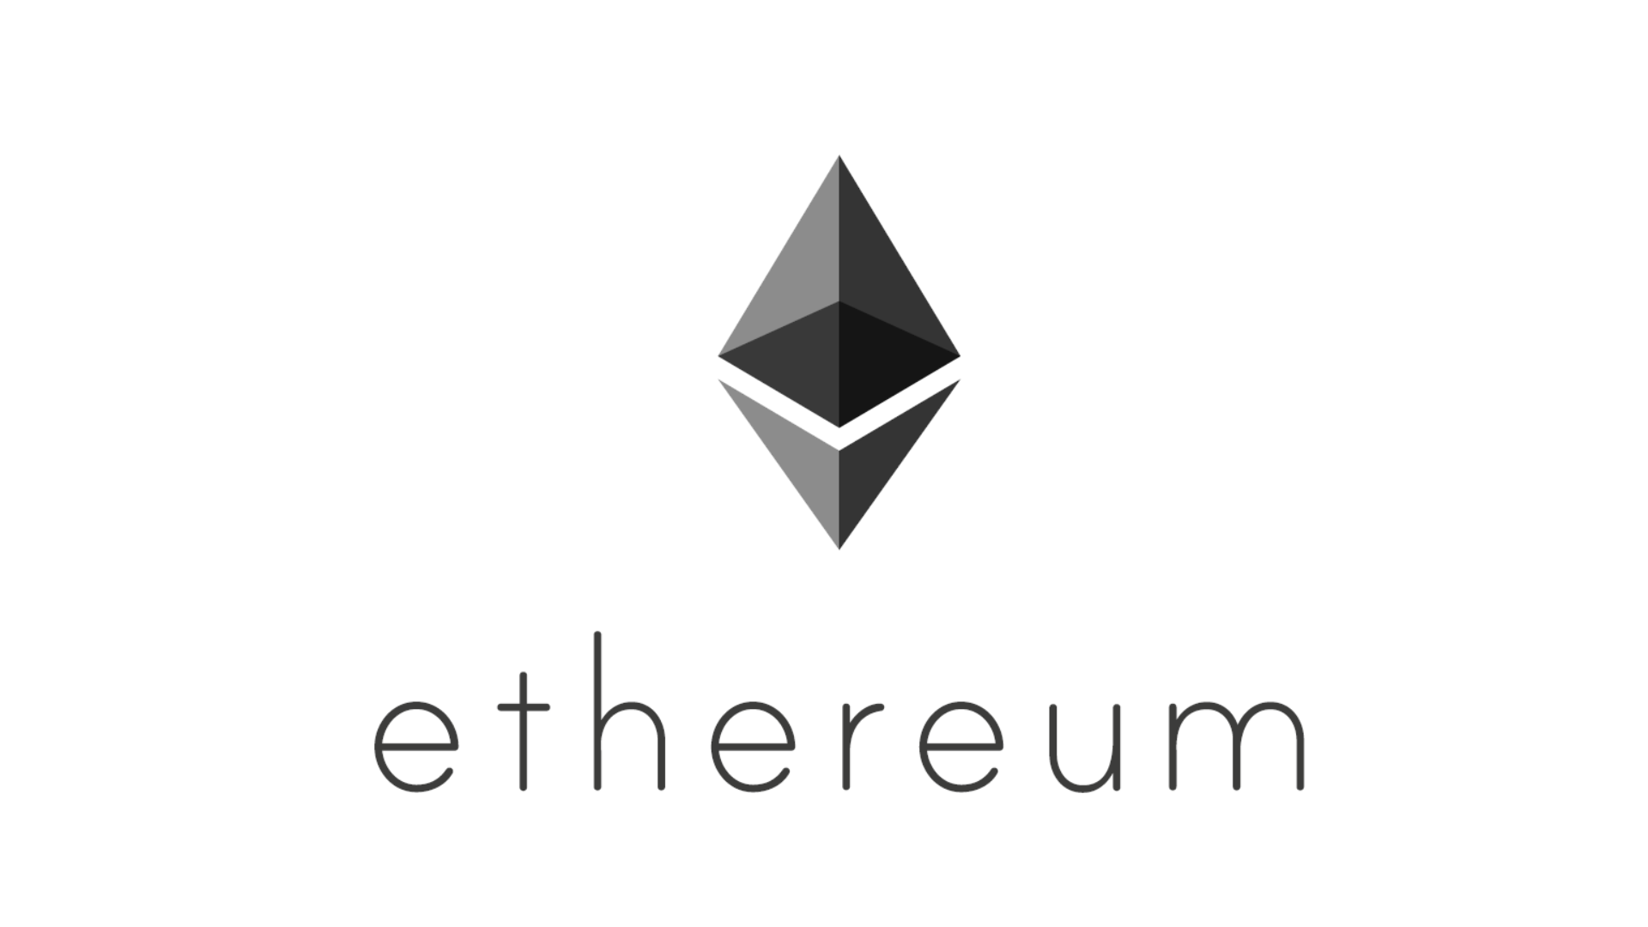
Ethereum crypto-currency
An upgraded version of Bitcoin.

Slide 3

What is Ethereum ?
Ether is a cryptocurrency whose blockchain is generated by the Ethereum platform. Ether can be transferred between accounts and used to compensate participant mining nodes for computations performed.
An open-source, public, blockchain-based distributed computing platform and operating system featuring smart contract (scripting) functionality.
Supports a modified version of Nakamoto consensus via transaction-based state transitions.

Slide 4
Thanks For Watching.

