Slide 1

SUNWAH FINTECH
SUNWAH Fintech Phase 2
M2 Functional Acceptance Walkthrough
An acceptance-ready view of the Phase 2 mobile and web delivery, organised by module and User Story, with every walkthrough step traced to its AC.
Live Cloud
11 Stories
iOS App
Web Admin
Canonical AC
July 2026
SUNWAH FINTECH · M2 Functional Acceptance Walkthrough
01 / 06

Slide 2
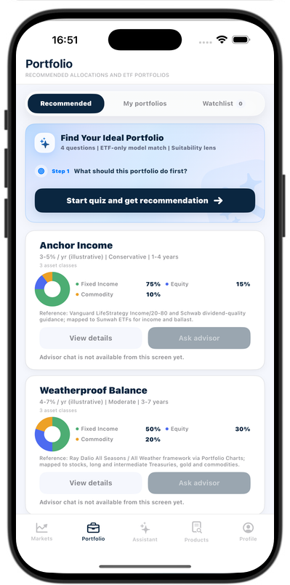
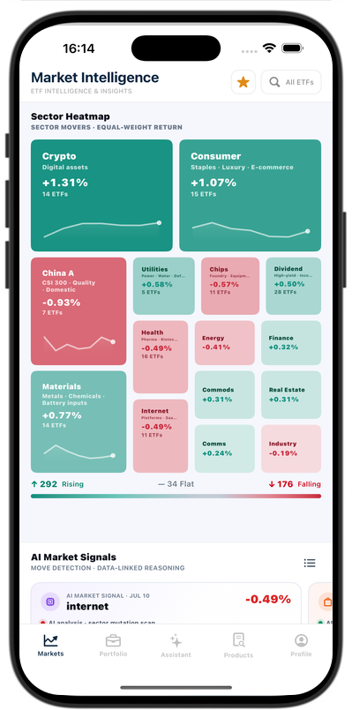
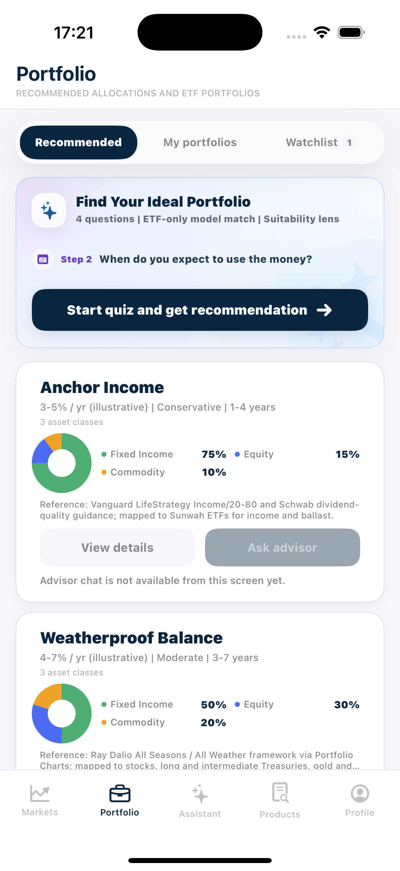
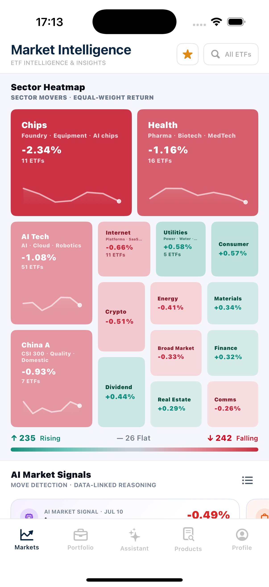
SUNWAH
FINTECH
M2 Acceptance Walkthrough Structure
Four modules, eleven User Stories and one traceable acceptance path
01
Login
02
Market
03
Portfolio
01
02
Admin
Login
Market
04
1 story · Slides 04–06
4 stories · Slides 07–11
03
04
Portfolio
Admin
5 stories · Slides 12–22
1 story · Slides 23–26
11 User Stories planned across iOS research flows and protected web operations.
Canonical product views · iPhone 17 Pro
SUNWAH Fintech · M2 Functional Acceptance · Confidential
02 / 06

Slide 3
SUNWAH
FINTECH
One Structure, Three Complementary Deliverables
Each format uses the same Module → User Story → Walkthrough → AC index
01
Login
02
Market
03
Portfolio
01
02
03
DOCUMENTATION
PRESENTATION
VIDEO
04
Admin
Defines Story scope, ordered walkthrough and the authoritative AC list.
Navigates the acceptance meeting with concise screenshot-to-AC evidence.
Shows the full interaction continuously, one recording per User Story.
The document defines what to prove; the video proves the interaction; this deck lets reviewers locate every walkthrough step and its AC quickly.
SUNWAH Fintech · M2 Functional Acceptance · Confidential
03 / 06

Slide 4
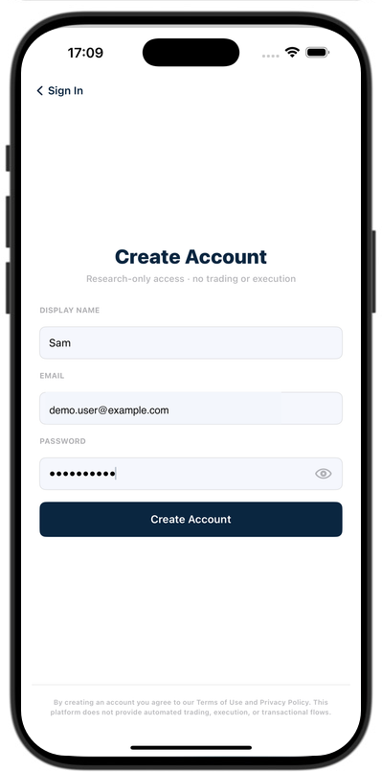
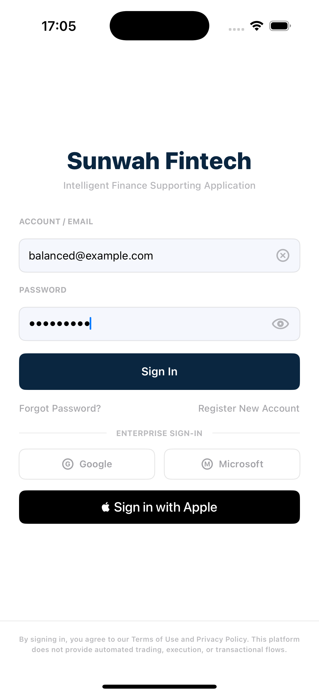
SUNWAH
FINTECH
01 Login / Register
One Story covers two accepted authentication paths and the shared Markets landing
01
Login
02
Market
STORY + EVIDENCE MAP
1.1
US-AUTH-01 · Slides 05–06
03
Portfolio
1.2
Accepted paths · Register / email-password sign in
1.3
Story AC · 15 Must criteria
04
Admin
1.4
Evidence · 4 canonical screenshots
1.5
Frame 01 · Login and scope
1.6
Frame 02 · Create Account
1.7
Frame 03 · Verify Email
1.8
Frame 04 · Markets landing
SUNWAH Fintech · M2 Functional Acceptance · Confidential
04 / 06

Slide 5
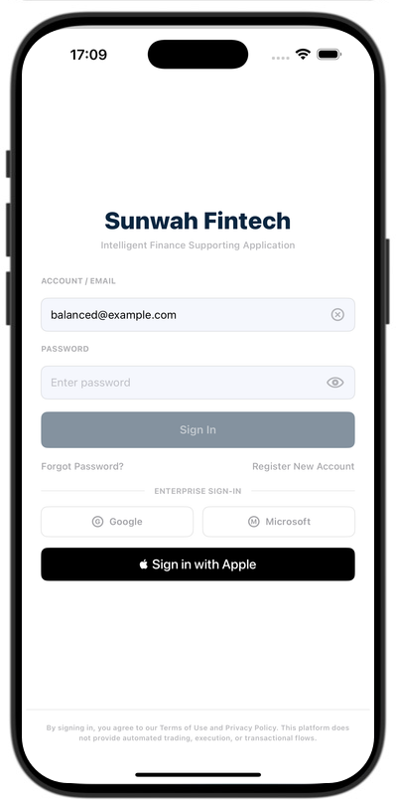
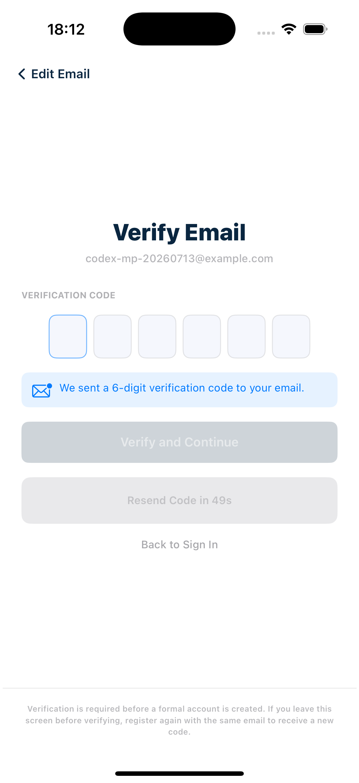
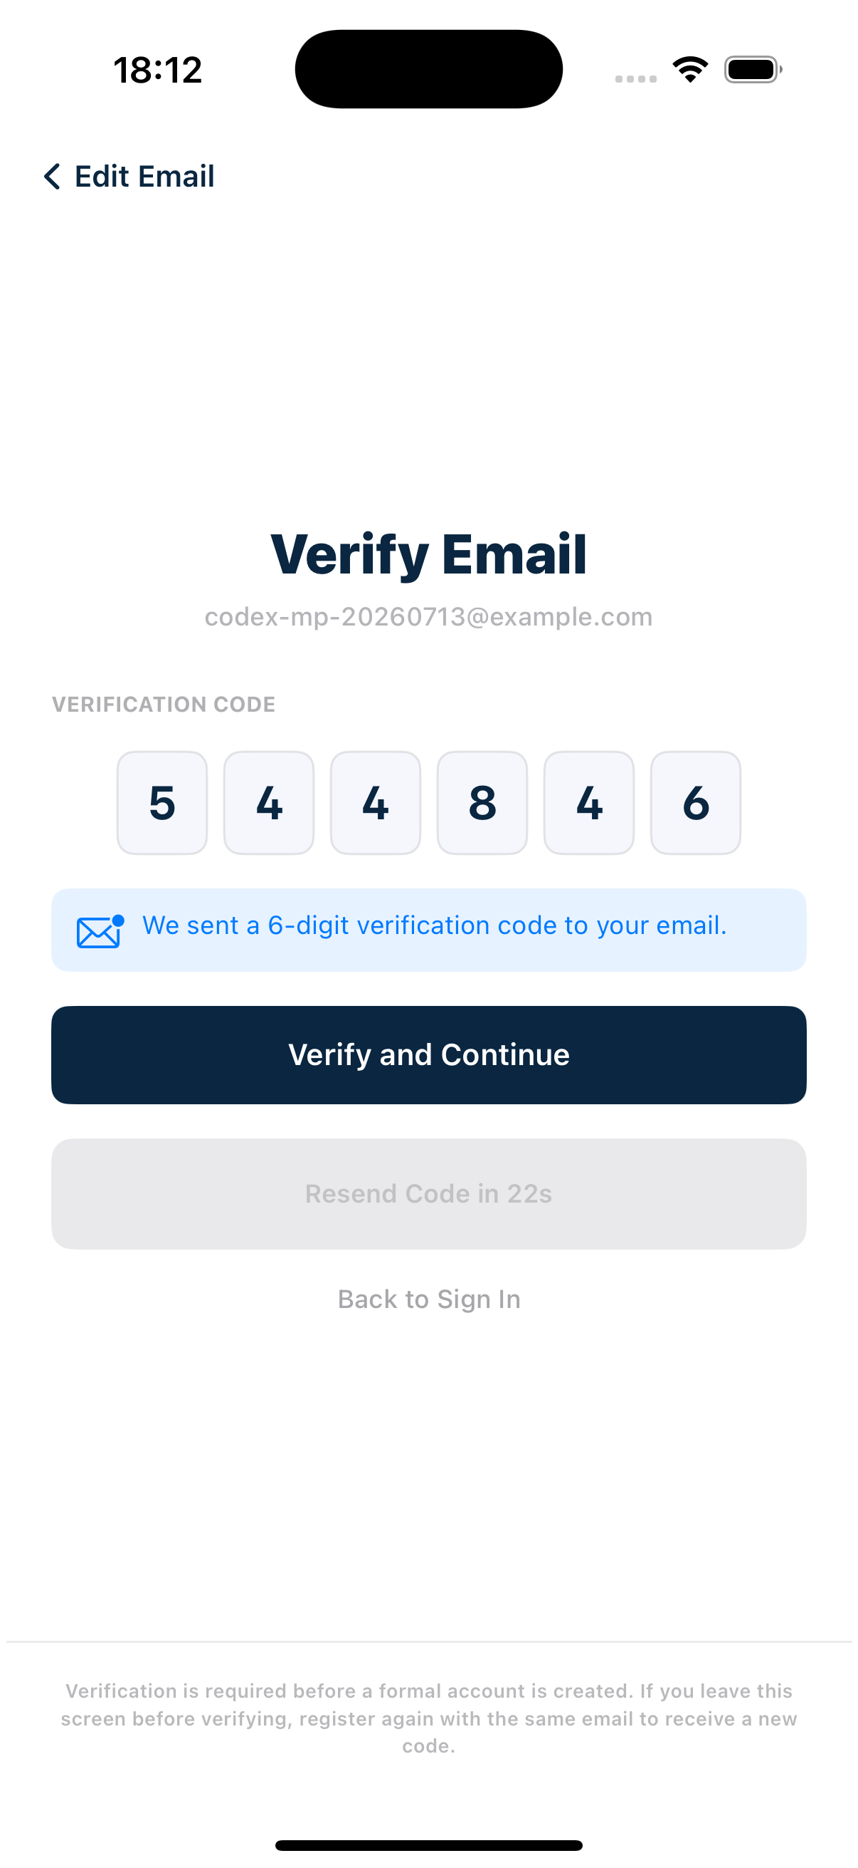
SUNWAH
FINTECH
US-AUTH-01 · Start from Login and prepare registration
Frames 01–02 establish the accepted paths and the registration gate
01
Login
02
Market
WALKTHROUGH
01 · LOGIN Open Login; inspect the required fields, toggle password visibility and show the Sign In button gate. Choose either accepted path.
02 · CREATE ACCOUNT Enter display name, email and password. Show the under-eight-character disabled state, then submit a valid form.
03
Portfolio
04
Admin
AC MAPPING
01 · LOGIN AC01–06 · AC12–13 · AC15 — entry, fields, button state, accepted scope, sign-in and privacy.
02 · CREATE ACCOUNT AC06–08 · AC15 — fields, validation gate, pending registration, Verify Email and privacy.
SUNWAH Fintech · M2 Functional Acceptance · Confidential
05 / 06

Slide 6
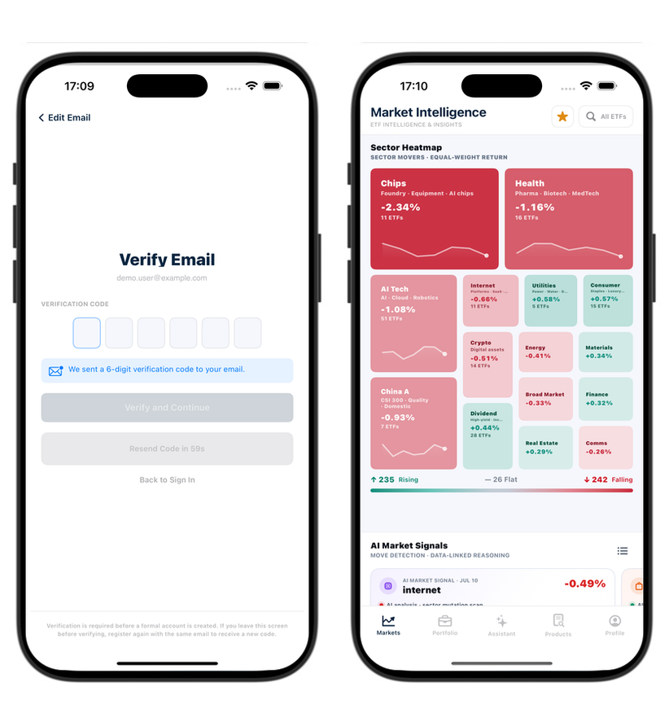
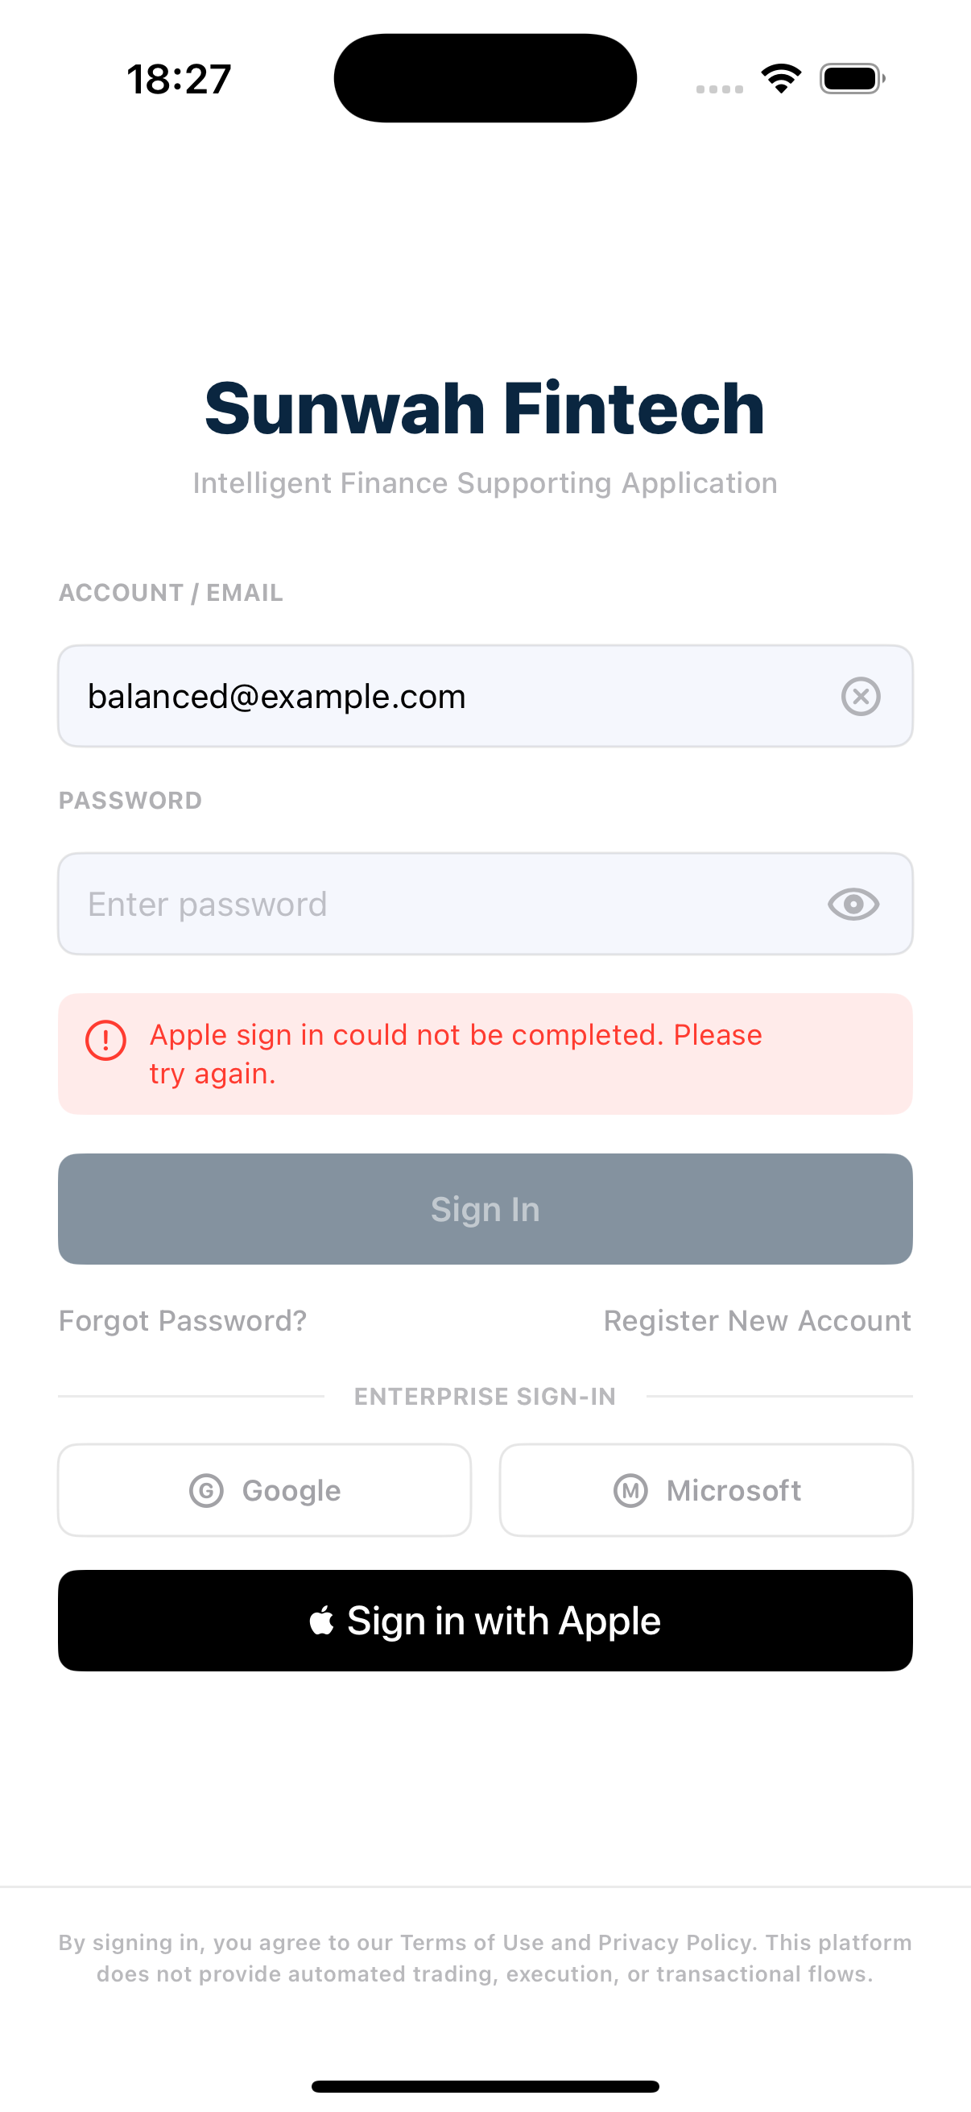
SUNWAH
FINTECH
US-AUTH-01 · Verify the email and enter Markets
Frames 03–04 complete registration and prove the shared authenticated landing
01
Login
02
Market
WALKTHROUGH
03 · VERIFY EMAIL Confirm the six-digit code is sent and Verify Email opens. Show the button gate below six digits and at six digits.
04 · MARKETS Submit the correct code to open Markets; repeat with existing-account sign-in and confirm the same landing.
03
Portfolio
04
Admin
AC MAPPING
03 · VERIFY EMAIL AC08–10 · AC15 — code delivery, six-digit gate, single account, automatic sign-in and privacy.
04 · MARKETS AC10–14 — registration completion, existing-user request state and the shared Markets landing.
SUNWAH Fintech · M2 Functional Acceptance · Confidential
06 / 06

