Slide 1

SUNWAH FINTECH
SUNWAH Fintech M2
Functional Acceptance Walkthrough
Documentation, presentation and video share one Module → User Story → Walkthrough → Acceptance Criteria evidence chain.
Live Cloud
11 Stories
iOS App
Web Admin
AC Traceable
July 2026
SUNWAH FINTECH · M2 Functional Acceptance Walkthrough
01 / 10

Slide 2
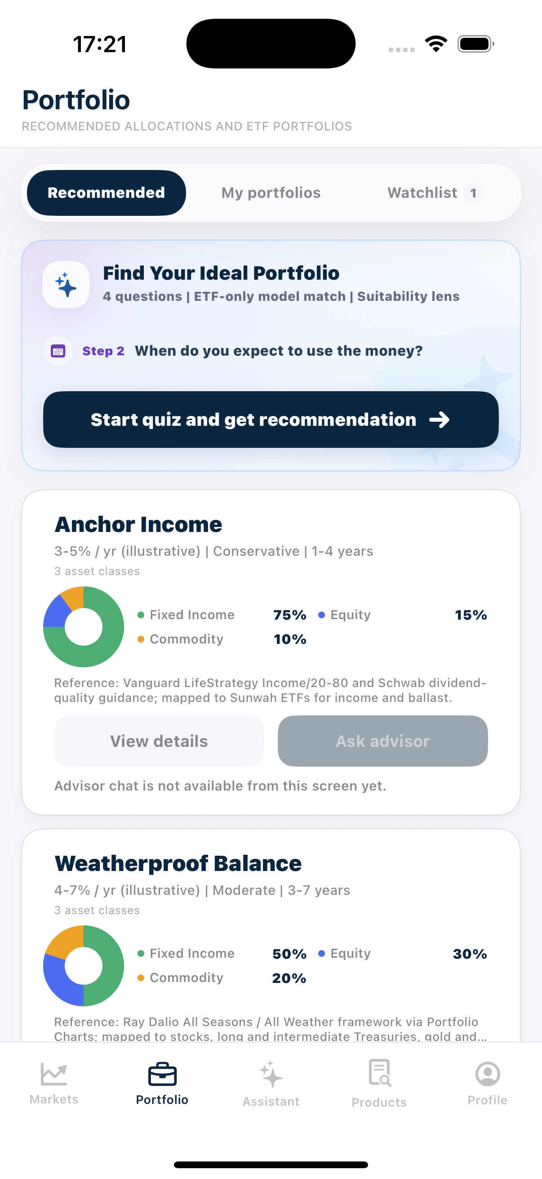
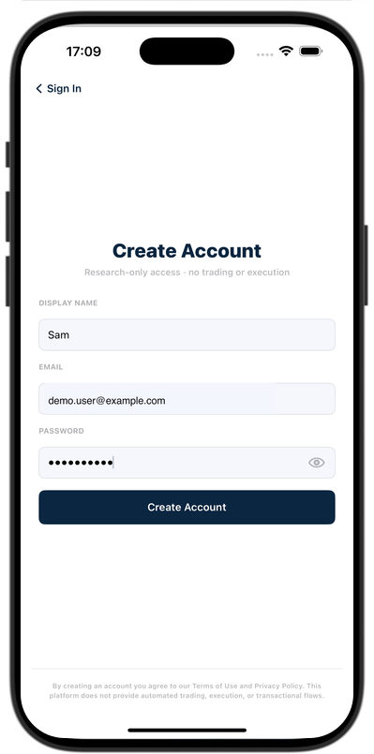
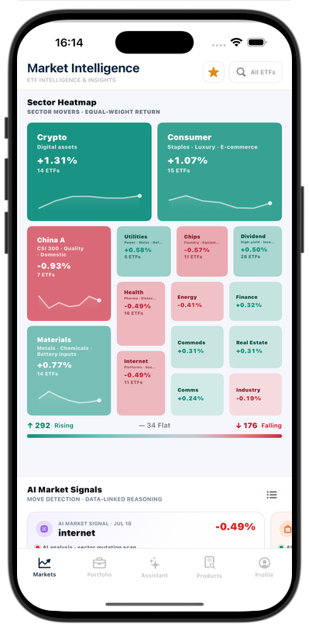
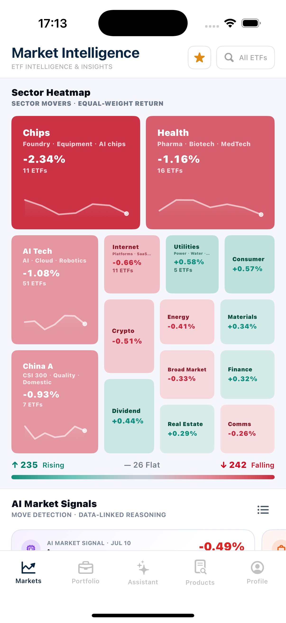
SUNWAH
FINTECH
M2 Acceptance Walkthrough Structure
Four modules · eleven User Stories · one shared acceptance evidence chain
01
Login
02
Market
03
Portfolio
01
02
Admin
Login
Market
04
1 User Story · Slides 04–05
4 User Stories · Slides 06–10
03
04
Portfolio
Admin
5 User Stories · Full build
1 User Story · Full build
This review build completes the front overview, Login module and Market module for layout approval.
Representative Login and Market views
SUNWAH Fintech · M2 Functional Acceptance · Confidential
02 / 10

Slide 3
SUNWAH
FINTECH
One Structure, Three Complementary Deliverables
Each format uses the same Module → User Story → Walkthrough → AC index
01
Login
02
Market
03
Portfolio
01
02
03
DOCUMENTATION
PRESENTATION
VIDEO
04
Admin
Defines scope, ordered walkthrough steps and the authoritative Acceptance Criteria for every User Story.
Guides the acceptance meeting with concise screenshot evidence and step-by-step AC mapping.
Shows the complete interaction continuously, with one recording aligned to each User Story walkthrough.
Document defines what must be proven · Video proves the interaction · PPT lets reviewers locate the evidence and AC quickly
SUNWAH Fintech · M2 Functional Acceptance · Confidential
03 / 10

Slide 4
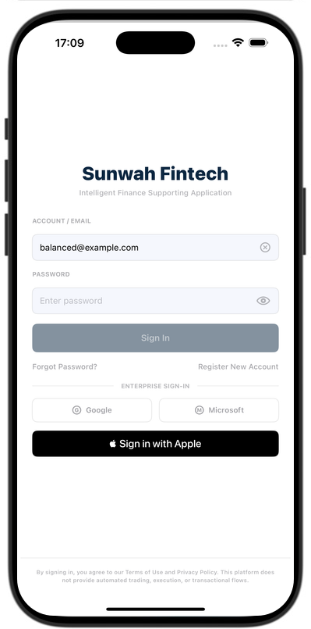
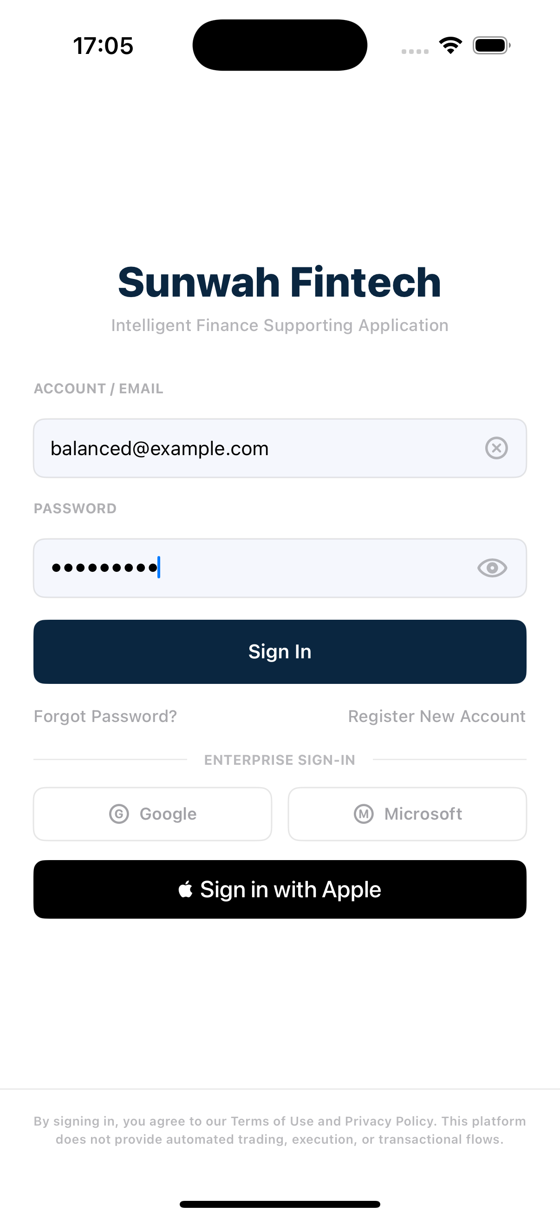
SUNWAH
FINTECH
01 Login / Register
Two accepted authentication paths converge on the same Markets landing
01
Login
MERMAID SOURCE
02
Market
flowchart LR A[Open Login] --> B{Choose path} B -->|New account| C[Create Account] C --> D[Verify Email] B -->|Existing user| E[Email / Password] D --> F[Markets] E --> F
03
Portfolio
04
Admin
SUNWAH Fintech · M2 Functional Acceptance · Confidential
04 / 10

Slide 5
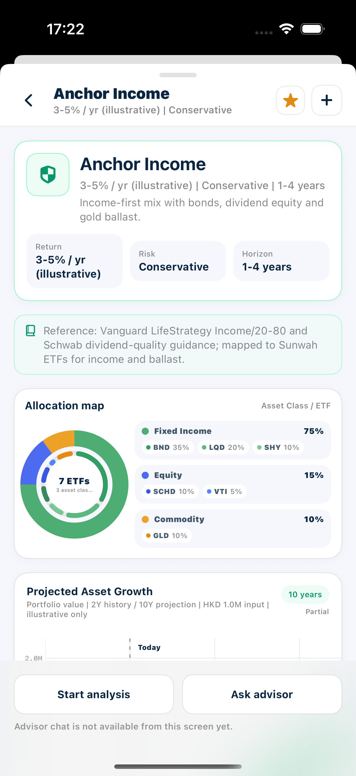
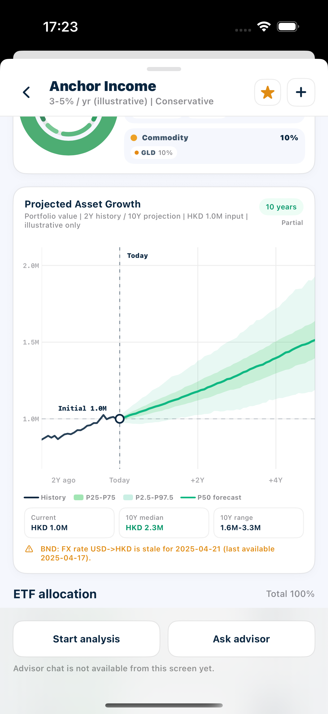
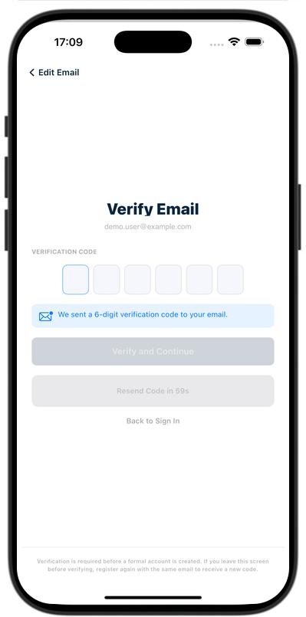
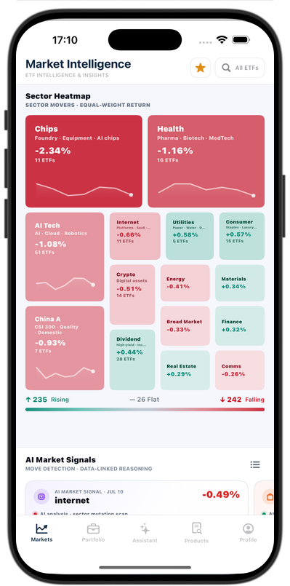
SUNWAH
FINTECH
User Story 1 — Register a new account and sign in
Four walkthrough frames cover both accepted paths and map all 15 Must Acceptance Criteria
01
Login
01 · LOGIN / EXISTING SIGN-IN
WALKTHROUGH
Open Login, inspect the required fields, toggle password visibility, verify the Sign In gate, explain excluded SSO entries, then submit an existing account and show the in-progress state.
AC MAPPING
AUTH-US1-AC01 Login is the first unauthenticated screen.
AUTH-US1-AC02 Account/email and hidden password are required.
AUTH-US1-AC03 The eye toggle preserves the entered password.
AUTH-US1-AC04 Sign In follows the required-field gate.
AUTH-US1-AC05 Displayed SSO entries are outside this scope.
AUTH-US1-AC12 Existing credentials can submit Sign In.
AUTH-US1-AC13 Progress is shown and duplicate submits are blocked.
AUTH-US1-AC15 Evidence protects reusable secrets and personal data.
02 · CREATE ACCOUNT
WALKTHROUGH
Tap Register New Account. Enter display name, email and password; show the disabled state below eight characters, then submit a valid registration form.
AC MAPPING
AUTH-US1-AC06 Registration opens Create Account with three fields.
AUTH-US1-AC07 Required fields and eight-character password gate apply.
AUTH-US1-AC08 Valid submit creates pending registration and sends a code.
02
Market
03
Portfolio
04
Admin
03 · VERIFY EMAIL
WALKTHROUGH
Confirm Verify Email opens after submission. Show the disabled state below six digits, enter a complete code, and tap Verify and Continue.
AC MAPPING
AUTH-US1-AC09 The verification action follows the six-digit gate.
AUTH-US1-AC10 A correct code creates one account and auto-signs in.
04 · MARKETS LANDING
WALKTHROUGH
Confirm successful registration opens Markets. Repeat the accepted existing-account path and verify that both paths reach the same default landing.
AC MAPPING
AUTH-US1-AC11 Newly registered users enter Markets.
AUTH-US1-AC14 Successful authentication enters Markets.
SUNWAH Fintech · M2 Functional Acceptance · Confidential
05 / 10

Slide 6
SUNWAH
FINTECH
02 Market
A complete research flow from market direction to ETF comparison and saving
01
Login
MERMAID SOURCE
02
Market
flowchart LR A[Market Intelligence] --> B[Heatmap + Signals] B --> C[Sector Detail] C --> D[ETF Rankings] D --> E[ETF Detail] E --> F[Compare ETF] E --> G[Watchlist] E --> H[Add to My Portfolio] G --> I[Screener] H --> J[My Portfolio]
03
Portfolio
04
Admin
SUNWAH Fintech · M2 Functional Acceptance · Confidential
06 / 10

Slide 7
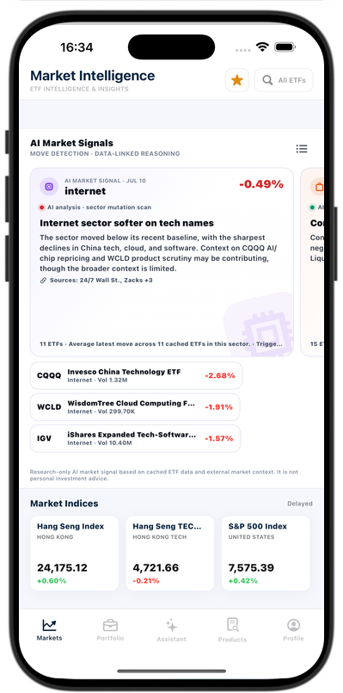
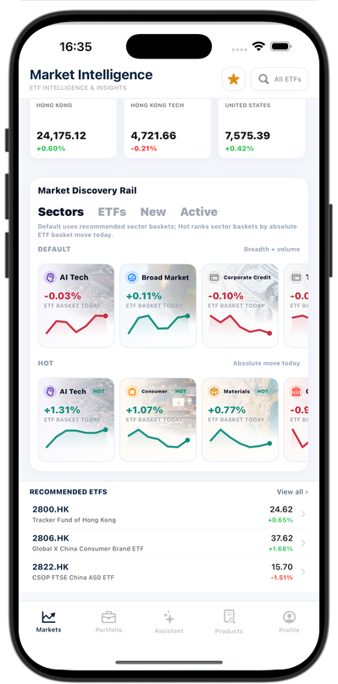
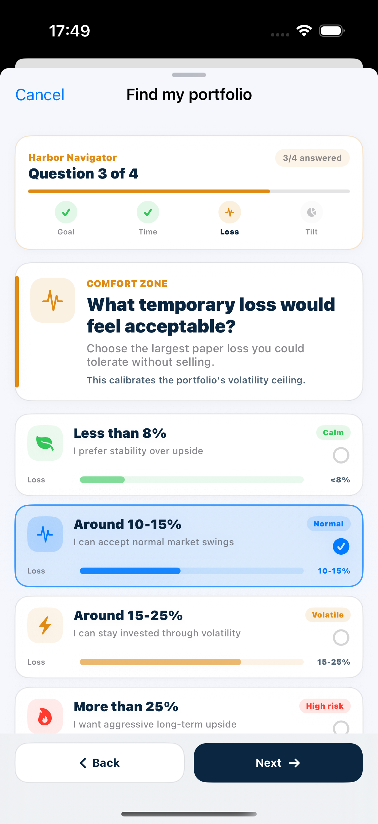
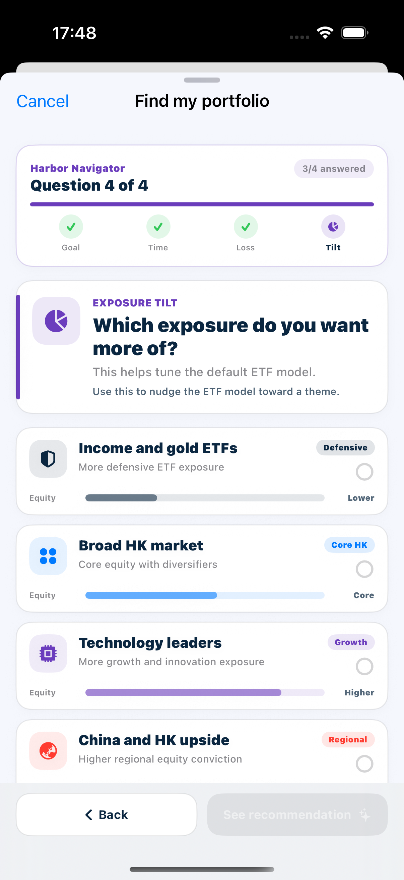
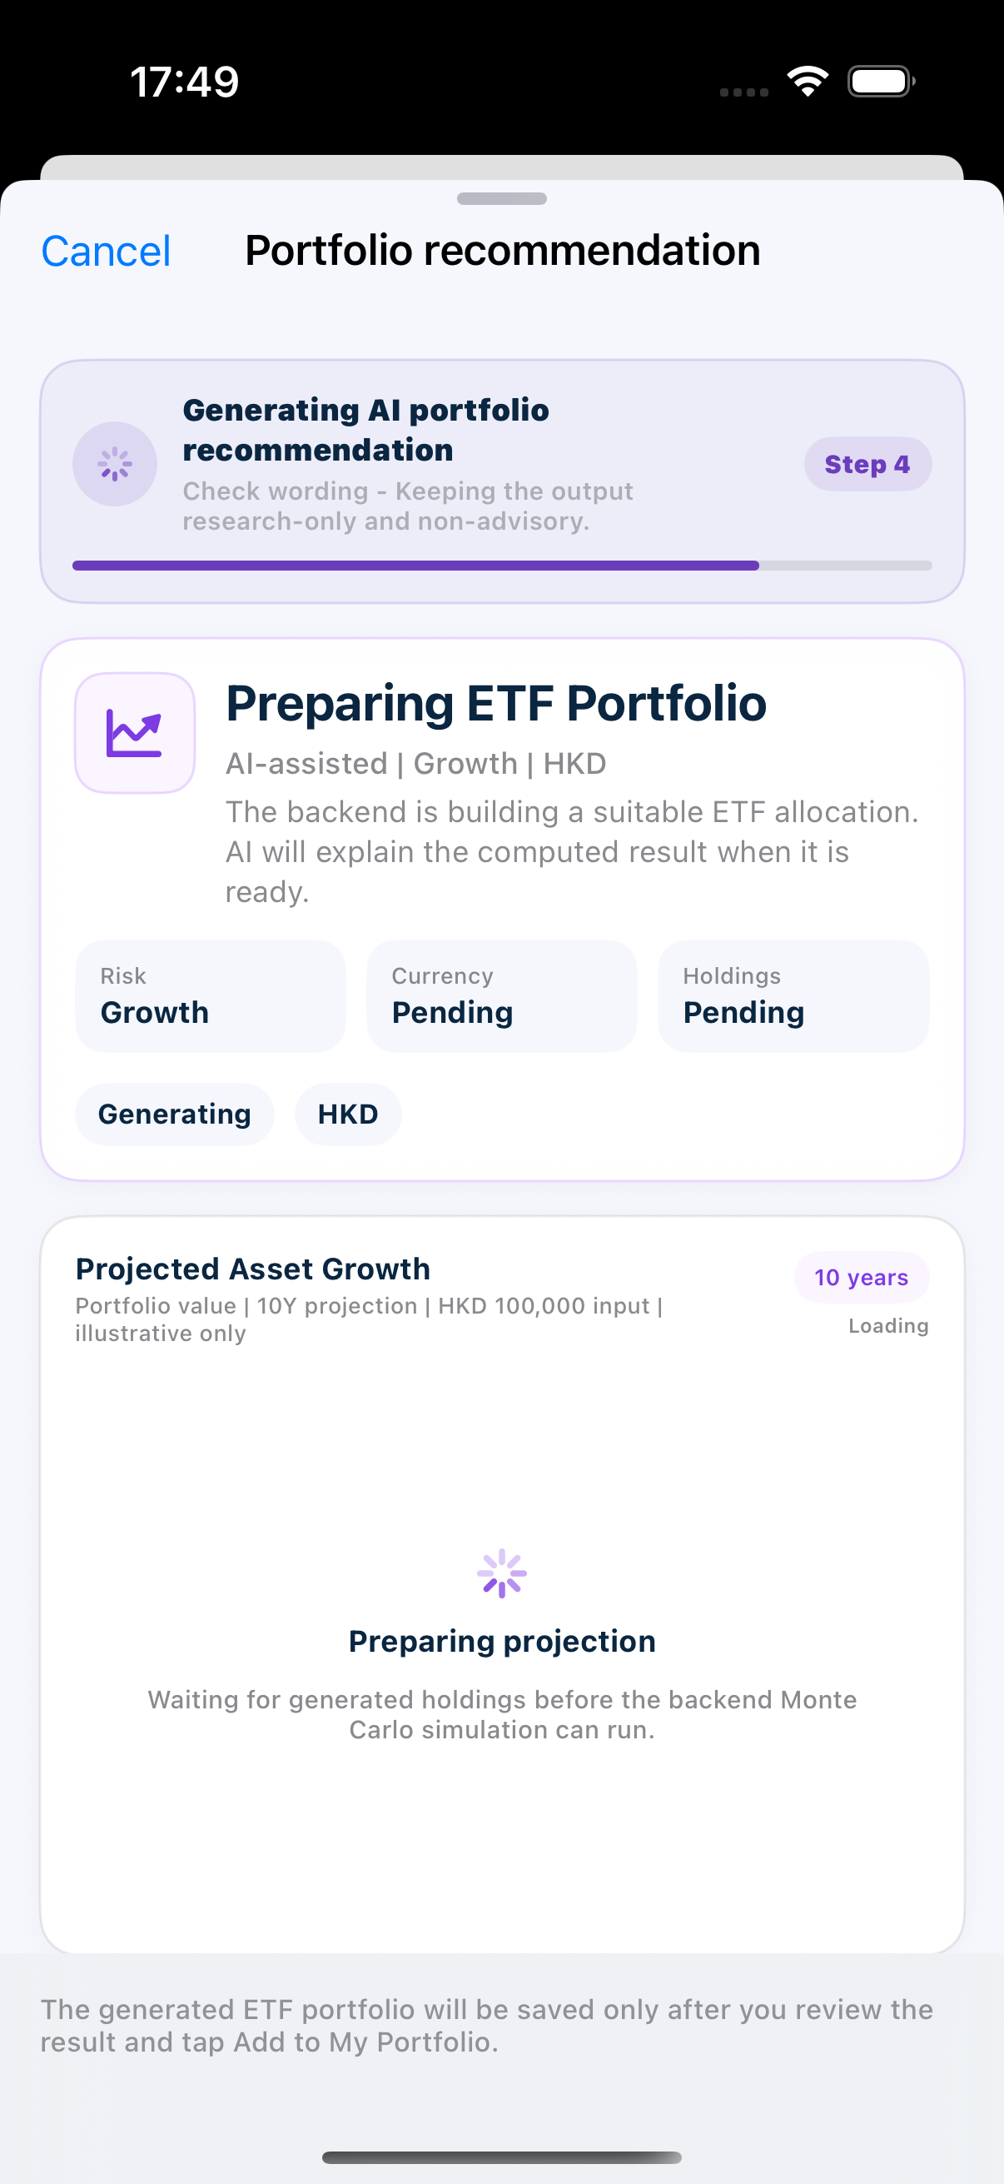
SUNWAH
FINTECH
User Story 1 — Establish research direction
Market Intelligence turns daily breadth, signals and discovery rails into the next sector research target
01
Login
02
Market
03
Portfolio
04
Admin
01 · SECTOR HEATMAP
WALKTHROUGH
Open Market Intelligence, explain its research-only role, then scan sector blocks and the Rising / Flat / Falling breadth summary.
AC MAPPING
MKT-US1-AC01 All research sections load successfully.
MKT-US1-AC02 Heatmap blocks show name, move, count and trend.
MKT-US1-AC03 Breadth summary matches current heatmap data.
MKT-US1-AC10 Research views are not presented as recommendations.
02 · AI SIGNALS + INDICES
WALKTHROUGH
Browse an AI Market Signal with date, movement, analysis, related ETFs and sources, then show major indices with the delayed-data label visible.
AC MAPPING
MKT-US1-AC04 Signal cards expose analysis context and sources.
MKT-US1-AC05 Major indices retain delayed-data boundaries.
03 · DISCOVERY TO SECTOR
WALKTHROUGH
Switch Default / Hot sectors, inspect Recommended ETFs and View all, then open a sector to continue into Sector Detail.
AC MAPPING
MKT-US1-AC06 Discovery supports sector and ETF research scopes.
MKT-US1-AC07 Default / Hot switches update the visible selection.
MKT-US1-AC08 Recommended is curated and rows expose core facts.
MKT-US1-AC09 A selected sector opens matching Sector Detail.
SUNWAH Fintech · M2 Functional Acceptance · Confidential
07 / 10

Slide 8
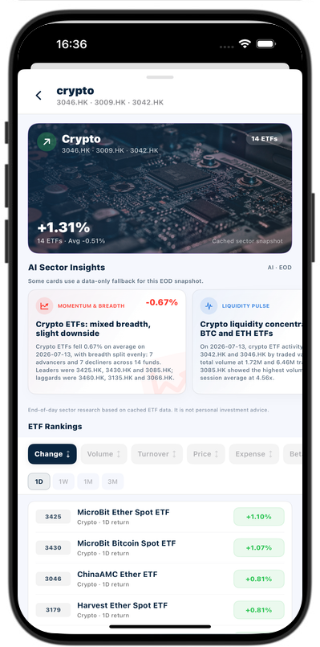
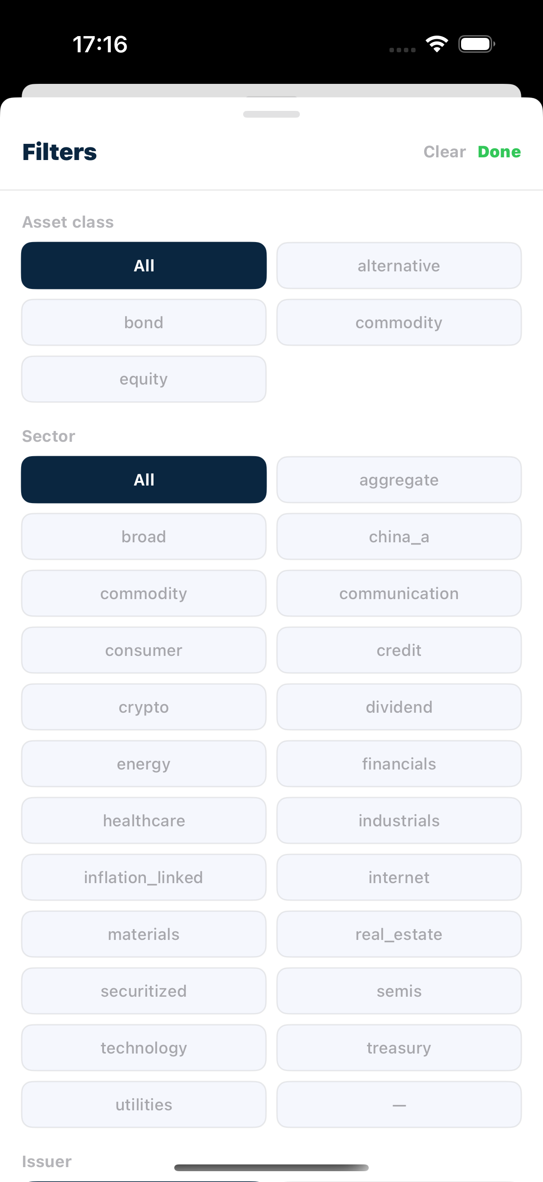
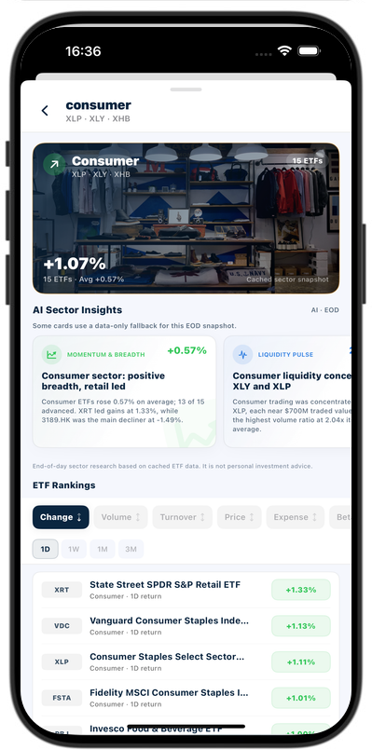
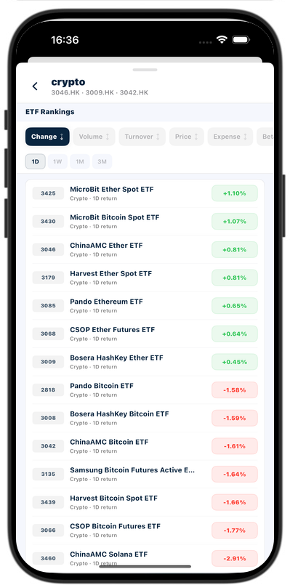
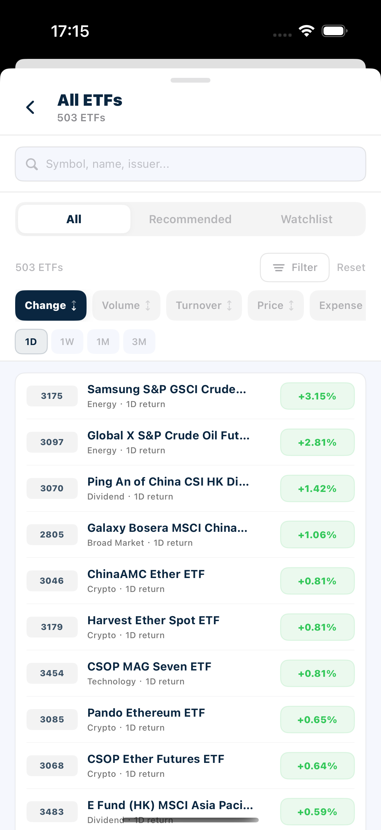
SUNWAH
FINTECH
User Story 2 — Understand sector trends and filter ETFs
Sector context, EOD research observations and sortable rankings produce the next ETF candidate
01
Login
02
Market
03
Portfolio
04
Admin
01 · SECTOR BANNER
WALKTHROUGH
Open a selected sector such as Crypto and confirm the banner identity, representative tickers, ETF count, movement and cached snapshot label.
AC MAPPING
MKT-US2-AC01 Selected sector data replaces the prior sector.
MKT-US2-AC02 Banner shows tickers, ETF count and movement.
MKT-US2-AC03 Snapshot / EOD boundaries remain explicit.
02 · AI SECTOR INSIGHTS
WALKTHROUGH
Read Momentum & Breadth, Liquidity Pulse and Trend & Risk in order; explain the EOD basis and the non-predictive research wording.
AC MAPPING
MKT-US2-AC04 At least three research angles are covered.
MKT-US2-AC05 Insufficient data stays unavailable, not fabricated.
MKT-US2-AC11 Insights avoid predictions and trade advice.
03 · ETF RANKINGS
WALKTHROUGH
Keep the selected sector, switch sorting metrics and return periods, then open one ETF from the resulting sector-only ranking.
AC MAPPING
MKT-US2-AC06 Only current-sector ETFs appear.
MKT-US2-AC07 Implemented ranking metrics are selectable.
MKT-US2-AC08 1D / 1W / 1M / 3M periods update results.
MKT-US2-AC09 Sorting and period preserve sector scope.
MKT-US2-AC10 A ranking row opens the matching ETF Detail.
SUNWAH Fintech · M2 Functional Acceptance · Confidential
08 / 10

Slide 9
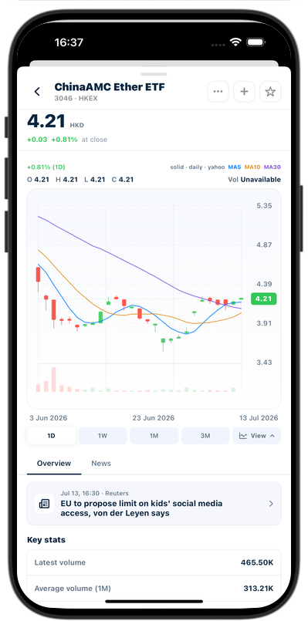
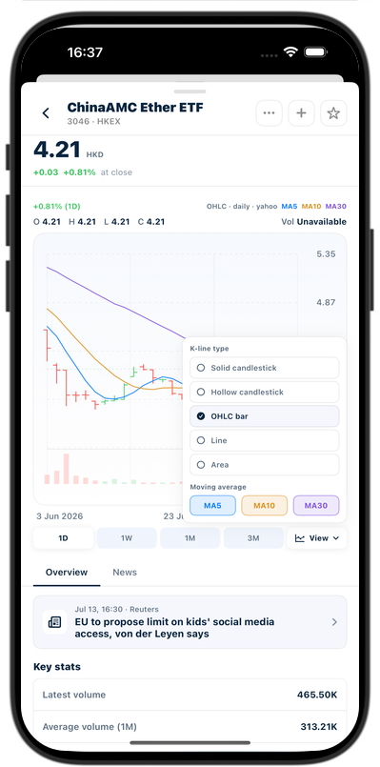
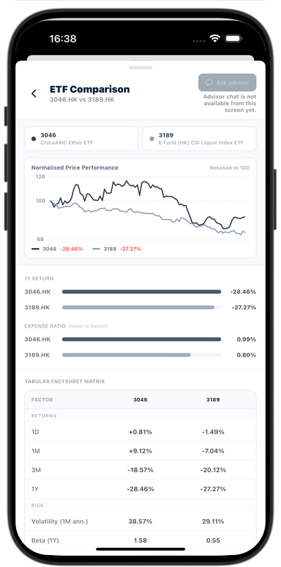
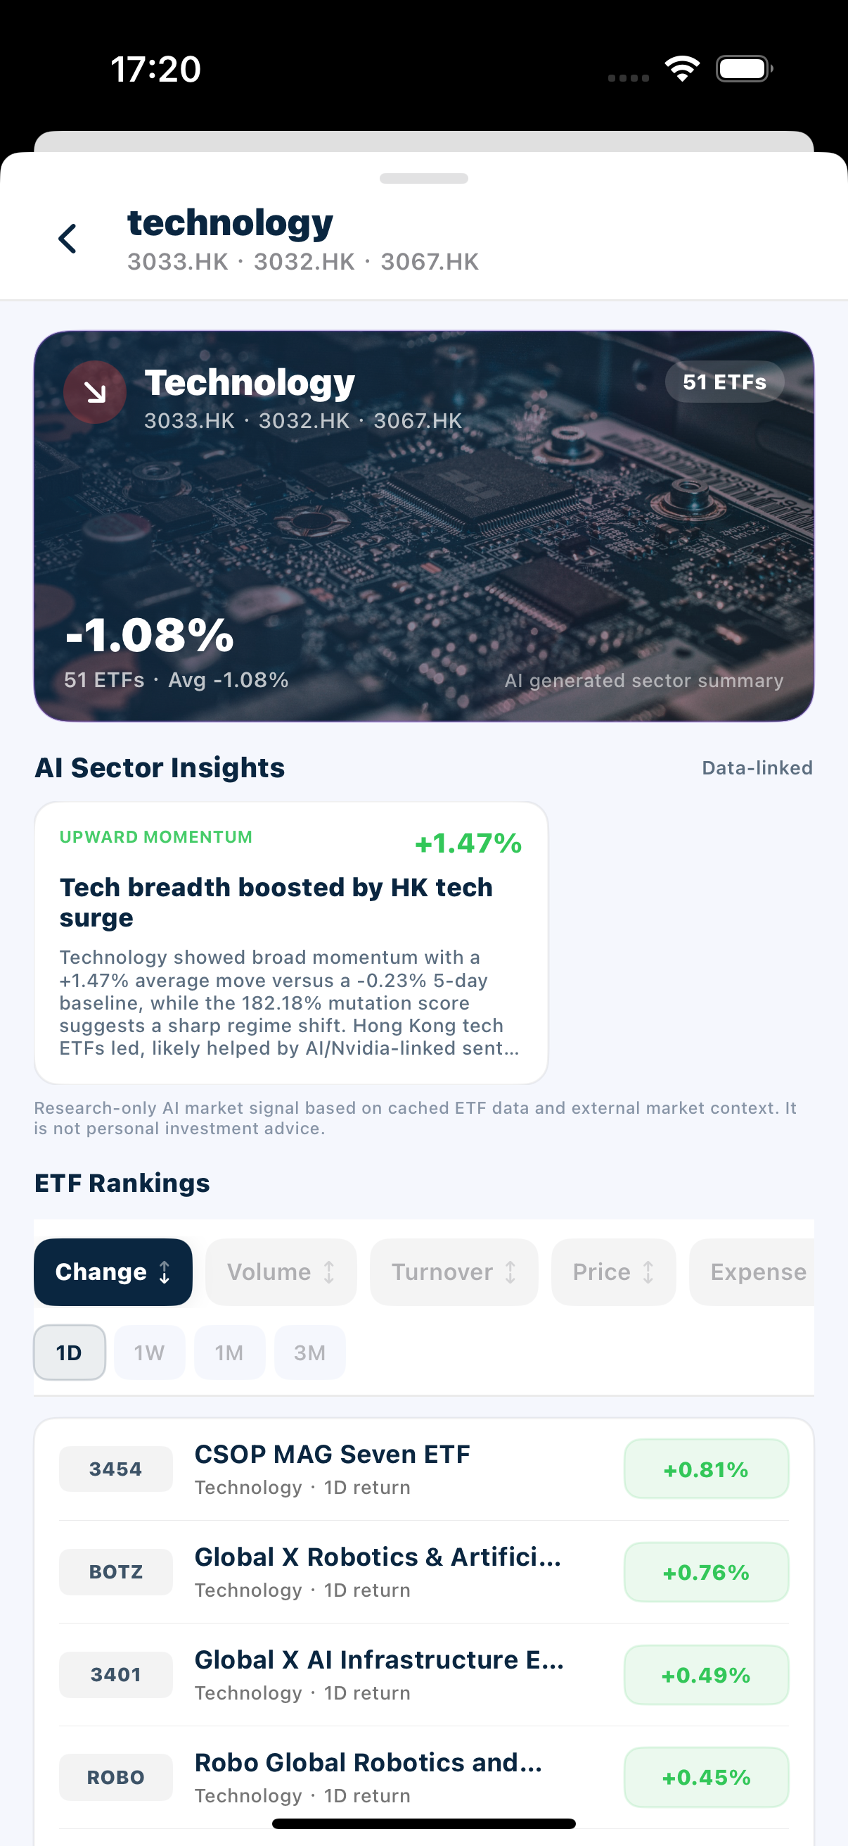
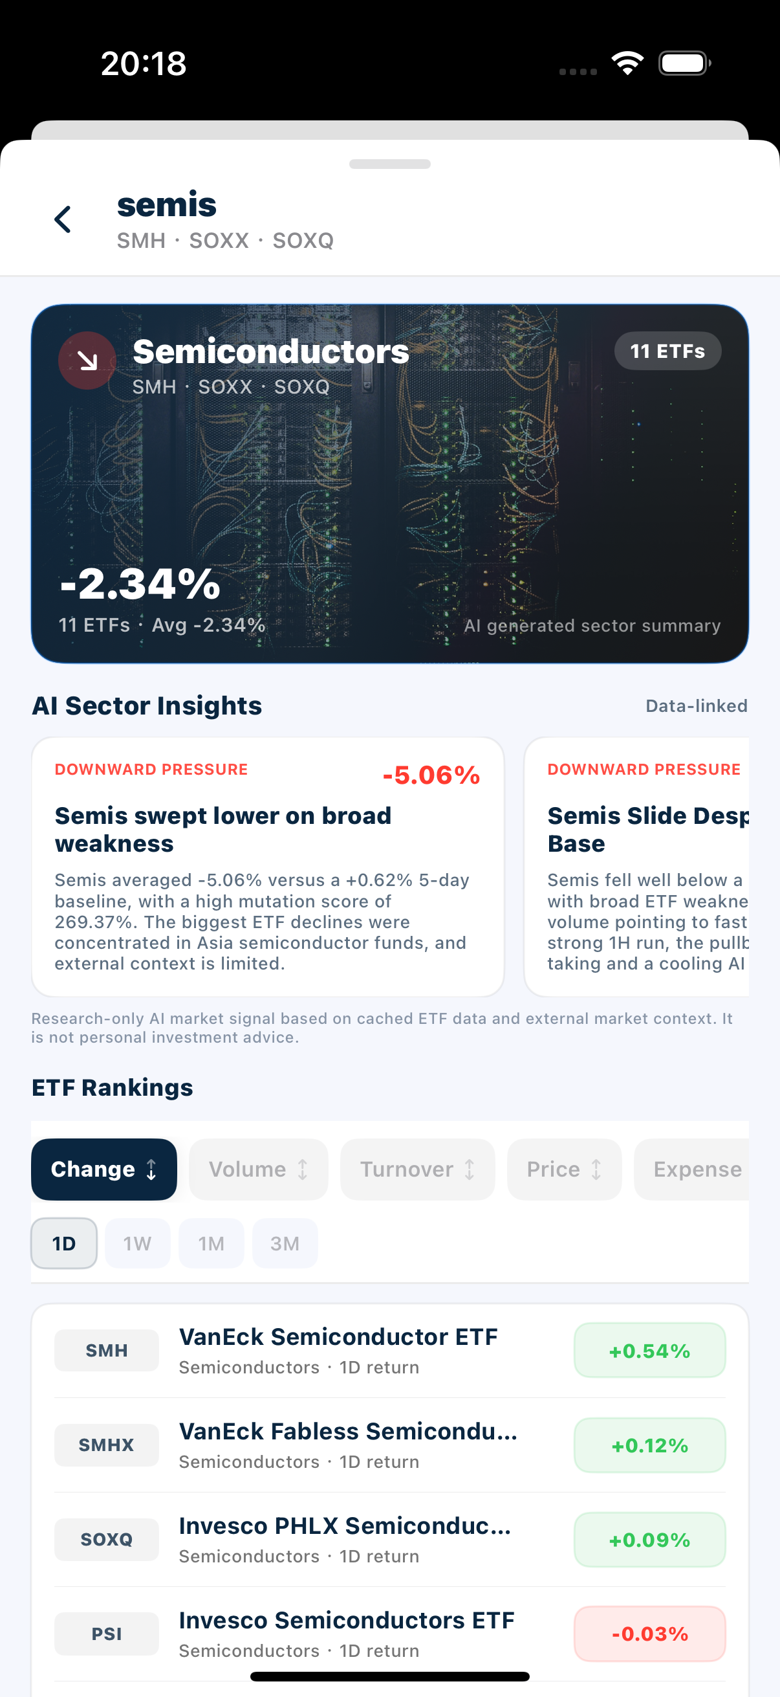
SUNWAH
FINTECH
User Story 3 — Research and compare individual ETFs
ETF identity, interactive chart controls and normalized comparison support instrument-level research
01
Login
02
Market
03
Portfolio
04
Admin
01 · ETF DETAIL + CHART
WALKTHROUGH
Open a candidate ETF, confirm identity and quote context, switch time ranges, then scrub the chart to update OHLC and volume.
AC MAPPING
MKT-US3-AC01 Header facts match the selected ETF.
MKT-US3-AC02 Chart uses only the current ETF series.
MKT-US3-AC03 Available time ranges update the chart.
MKT-US3-AC04 Scrubbing synchronizes OHLC and volume.
02 · VIEW / OVERVIEW / NEWS
WALKTHROUGH
Open View, change chart type and a moving average, then check currently available key stats and ETF-related news metadata.
AC MAPPING
MKT-US3-AC05 Enabled chart types are selectable.
MKT-US3-AC06 MA switches affect only the current overlay.
MKT-US3-AC07 Unavailable key stats remain explicit.
MKT-US3-AC08 News shows headline, source and timestamp.
03 · COMPARE ETF
WALKTHROUGH
Open Compare ETF from More, retain the current ETF as the first object, select a second ETF and review the normalized overlay before returning.
AC MAPPING
MKT-US3-AC09 Current ETF remains the first comparison object.
MKT-US3-AC10 Two series share one normalized comparison option.
MKT-US3-AC11 Exit returns to the original ETF context.
SUNWAH Fintech · M2 Functional Acceptance · Confidential
09 / 10

Slide 10
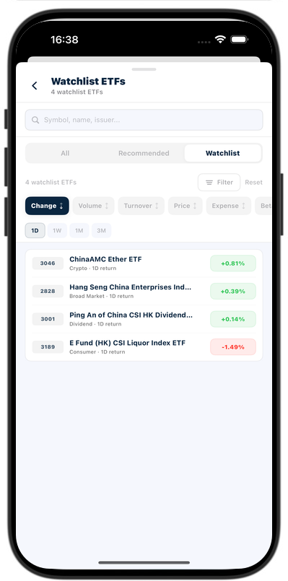
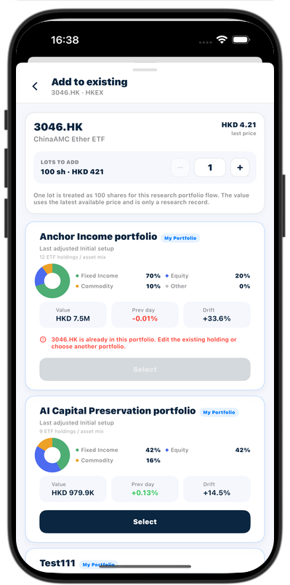
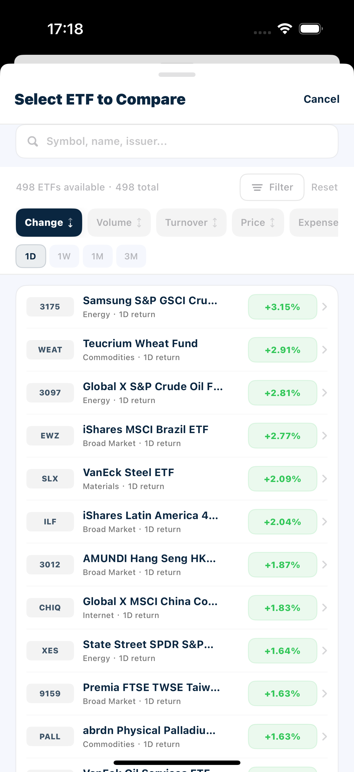
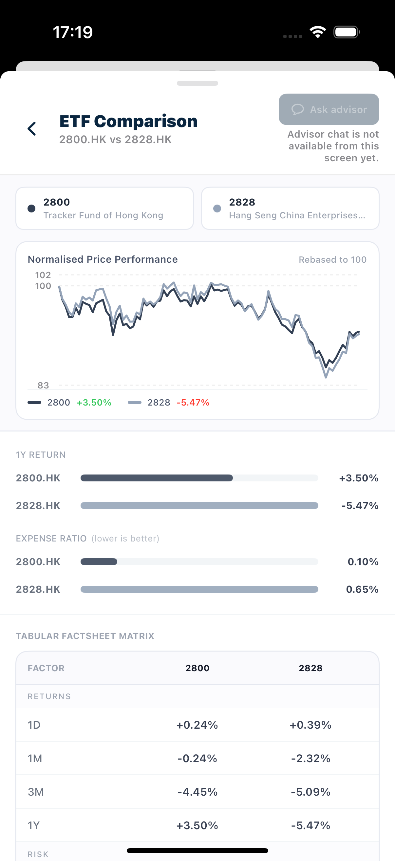
SUNWAH
FINTECH
User Story 4 — Save ETF research results
Watchlist, My Portfolio and the unified Screener preserve research results without implying execution
01
Login
02
Market
03
Portfolio
04
Admin
01 · WATCHLIST
WALKTHROUGH
Star the ETF, verify it appears in Screener > Watchlist, then remove it and confirm the saved range updates immediately.
AC MAPPING
MKT-US4-AC01 Star state matches actual saved status.
MKT-US4-AC02 Watchlist adds and removes the ETF consistently.
MKT-US4-AC03 Watchlist creates no holdings or orders.
02 · ADD TO MY PORTFOLIO
WALKTHROUGH
Open Add to existing, inspect price, lots and value, reject a duplicate portfolio, save to an eligible one, then confirm the new holding.
AC MAPPING
MKT-US4-AC04 Plus opens the current ETF sheet.
MKT-US4-AC05 Price, lots and 1 lot = 100 shares value show.
MKT-US4-AC06 Duplicate portfolios are disabled.
MKT-US4-AC07 An eligible portfolio can be selected and saved.
MKT-US4-AC08 The holding appears only after confirmation.
MKT-US4-AC13 Saving records research; no order is executed.
03 · UNIFIED SCREENER
WALKTHROUGH
Move through Recommended, All and Watchlist, then run search, filter and sort while keeping the current data range unchanged.
AC MAPPING
MKT-US4-AC09 Three scopes share one Screener interaction.
MKT-US4-AC10 Search and supported filters apply.
MKT-US4-AC11 Implemented sort metrics apply.
MKT-US4-AC12 Controls preserve the selected data scope.
SUNWAH Fintech · M2 Functional Acceptance · Confidential
10 / 10

