Slide 1

SUNWAH FINTECH
SUNWAH Fintech M2
Functional Acceptance Walkthrough
Documentation, presentation and video share one Module → User Story → Walkthrough → Acceptance Criteria evidence chain.
Live Cloud
11 Stories
iOS App
Web Admin
AC Traceable
July 2026
SUNWAH FINTECH · M2 Functional Acceptance Walkthrough
01 / 35

Slide 2
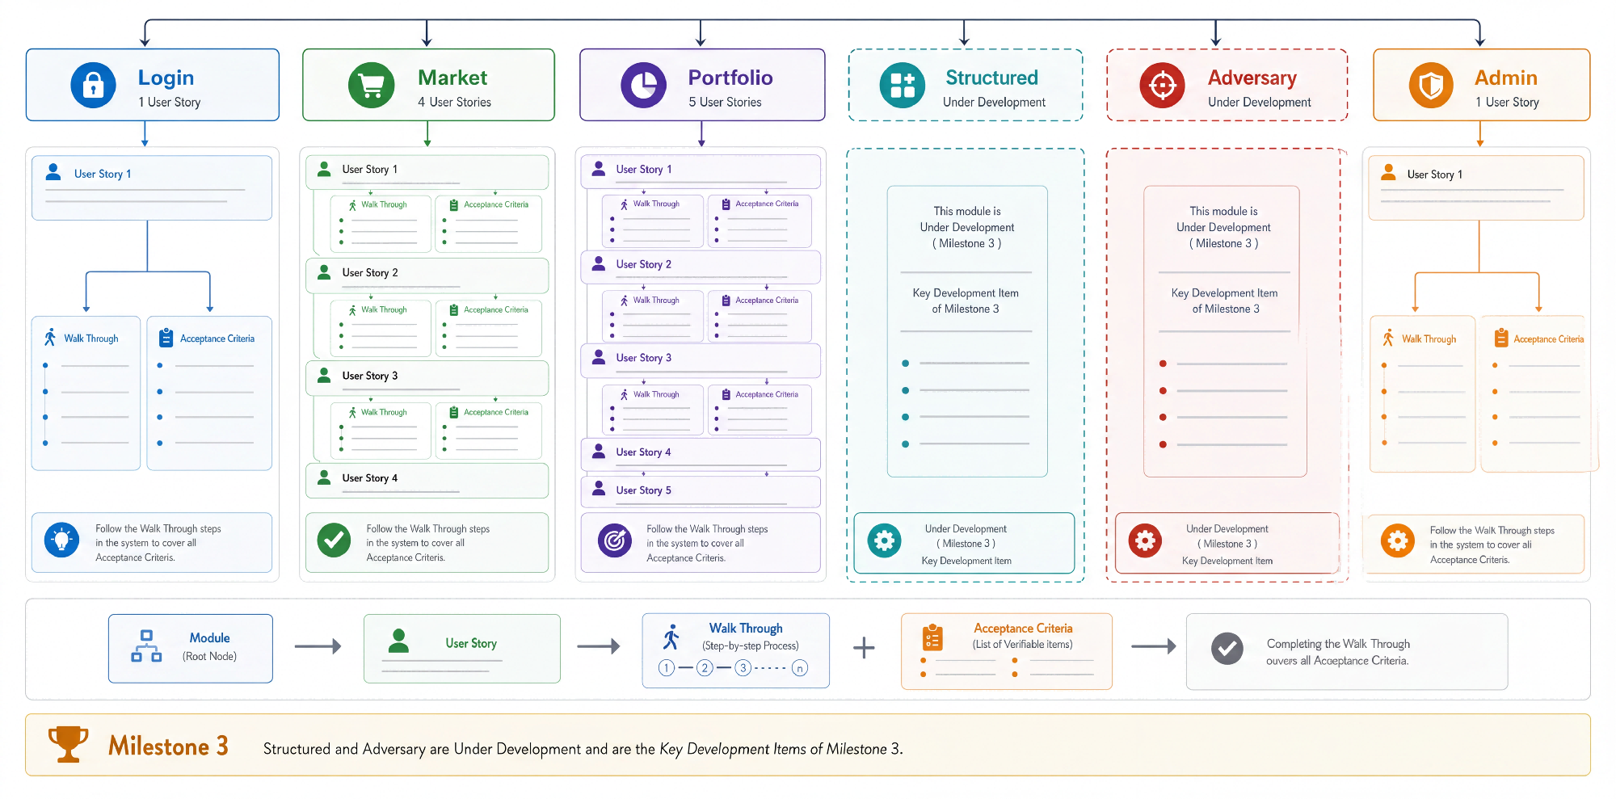
SUNWAH
FINTECH
M2 Acceptance Walkthrough Structure
01
Login
02
Market
03
Portfolio
04
Admin
SUNWAH Fintech · M2 Functional Acceptance · Confidential
02 / 35

Slide 3
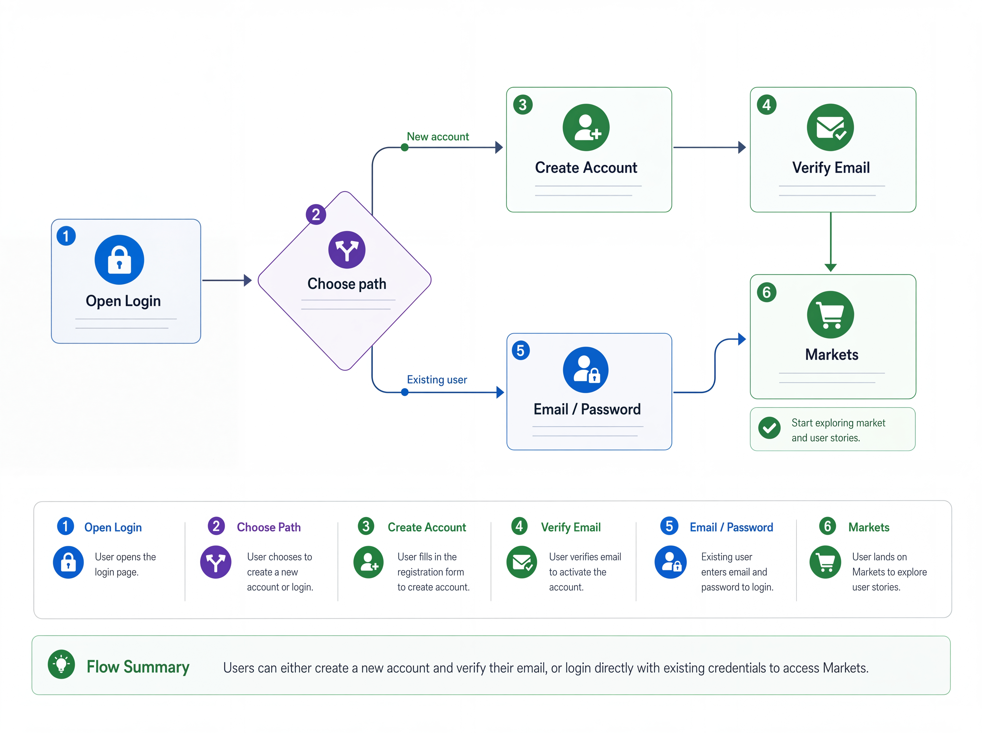
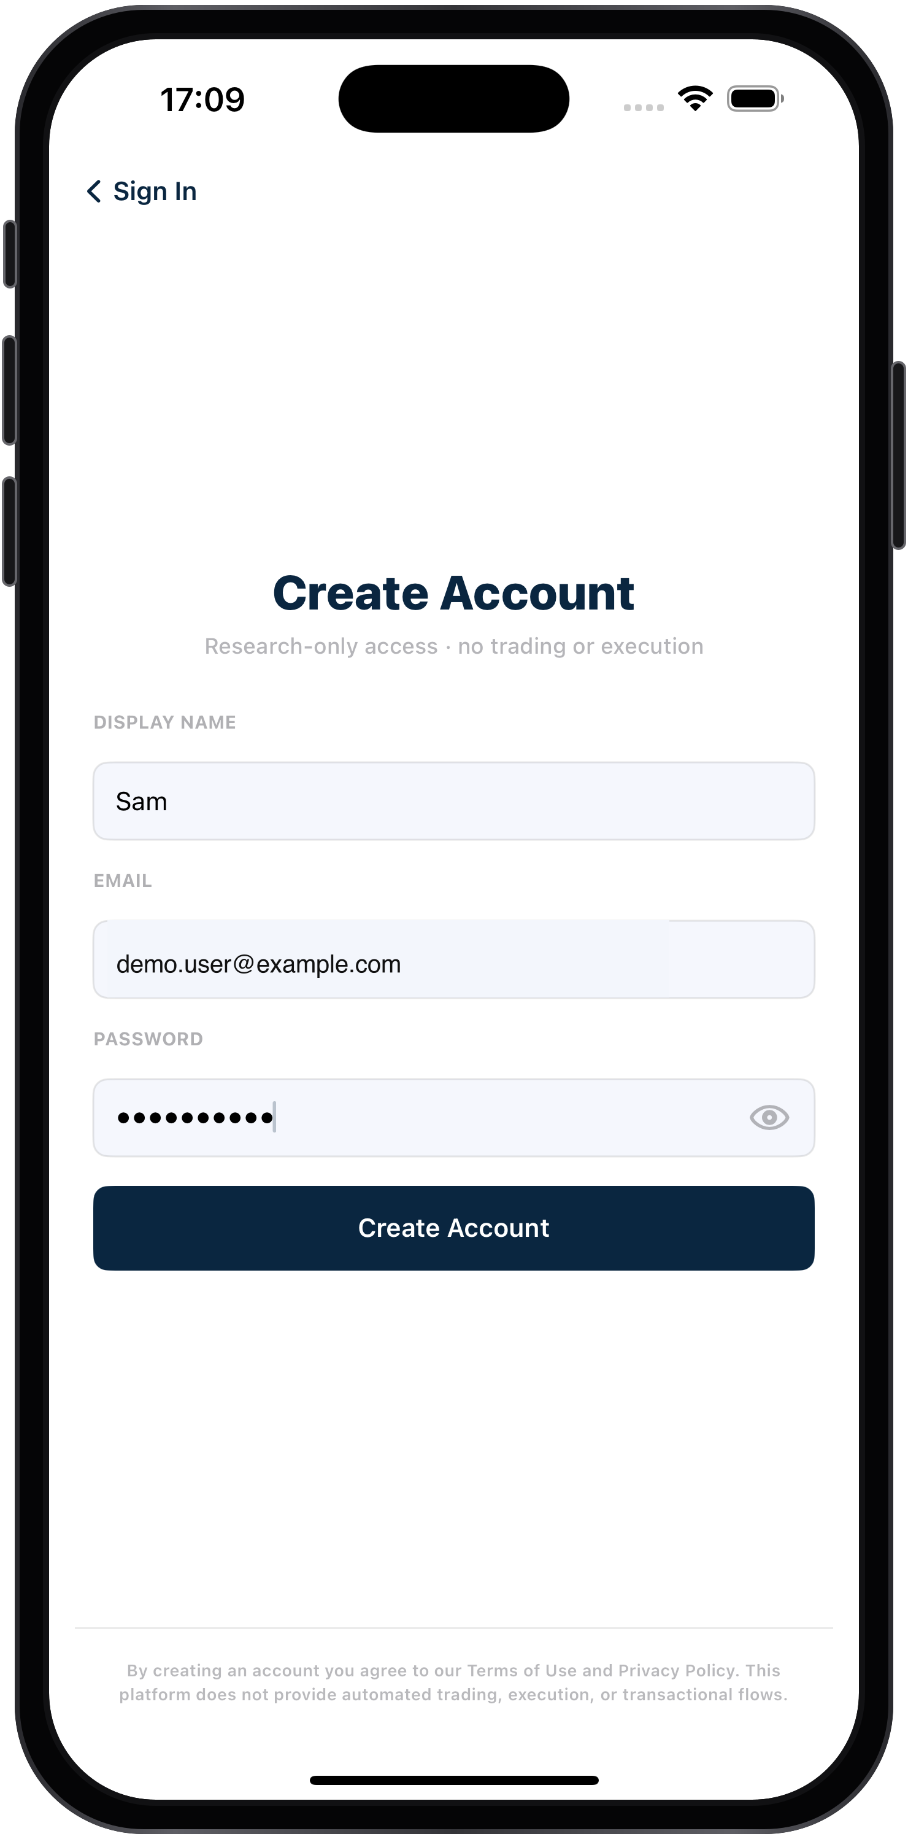
SUNWAH
FINTECH
01 Login / Register
Two accepted authentication paths converge on the same Markets landing
01
Login
02
Market
03
Portfolio
04
Admin
SUNWAH Fintech · M2 Functional Acceptance · Confidential
03 / 35

Slide 4
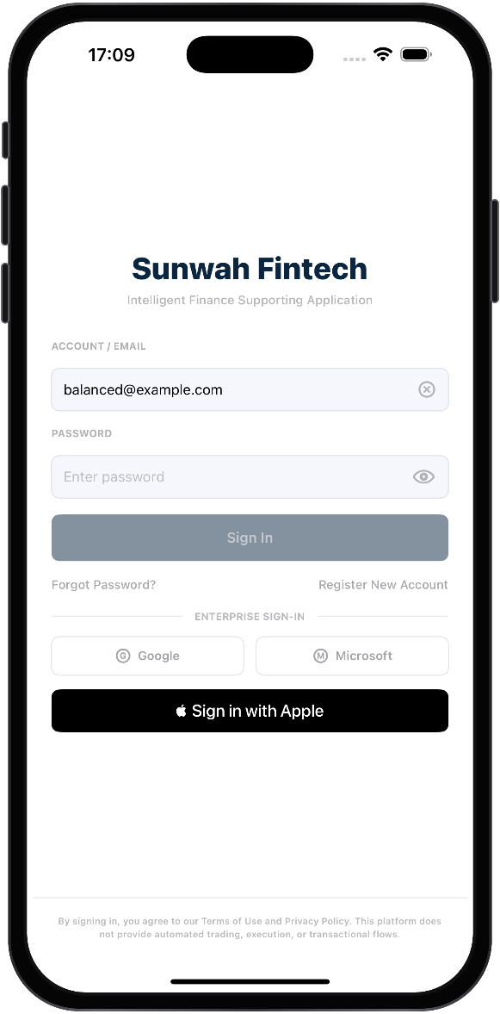

SUNWAH
FINTECH
01 User Story 1 — Start from Login and prepare registration
The first page proves authentication scope, form gates and the hand-off into registration.
01
Login
01
Market
Open the app on Login. Show account/email and password fields, toggle password visibility, demonstrate the required-field gate, explain the excluded SSO entries, then submit an existing account and show the in-progress state.
02
Portfolio
AC Mapping:
03
Login is first and requires account/email plus a hidden password.
Password visibility and the Sign In gate preserve entered data.
Displayed SSO options remain outside the accepted path.
Existing credentials submit once with an in-progress state.
Evidence exposes no reusable secrets or personal data.
04
Admin
02
Tap Register New Account. Enter display name, redacted test email and password; show the disabled state below eight characters, then submit a valid form.
AC Mapping:
Register New Account opens a form for display name, email and password.
Create Account stays disabled until all fields and an eight-character password are valid.
A valid submission creates one pending account, sends a six-digit code and opens Verify Email.
SUNWAH Fintech · M2 Functional Acceptance · Confidential
04 / 35

Slide 5
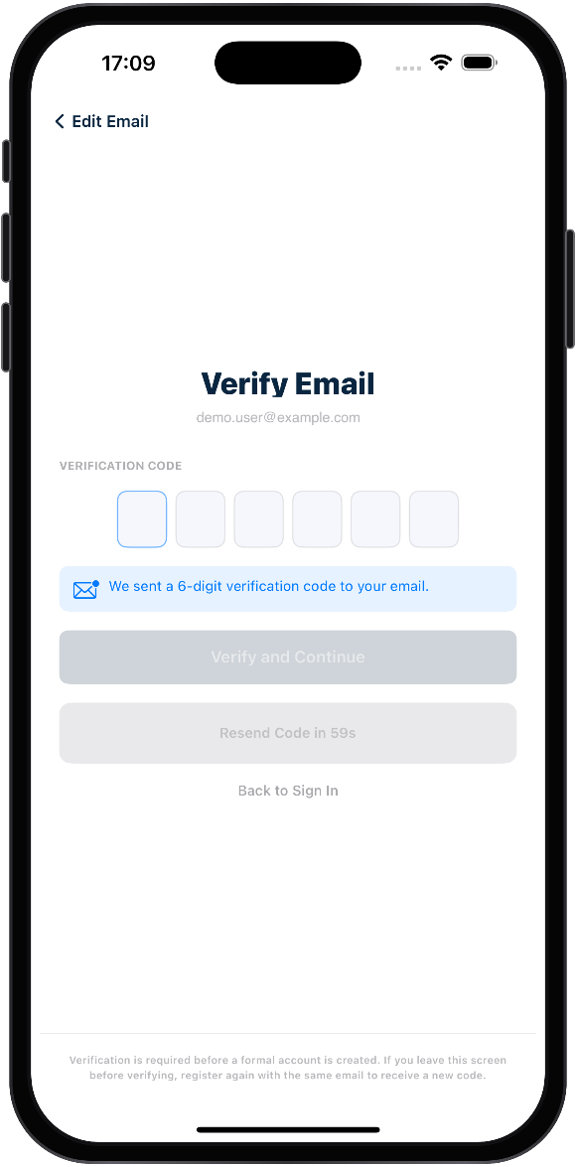
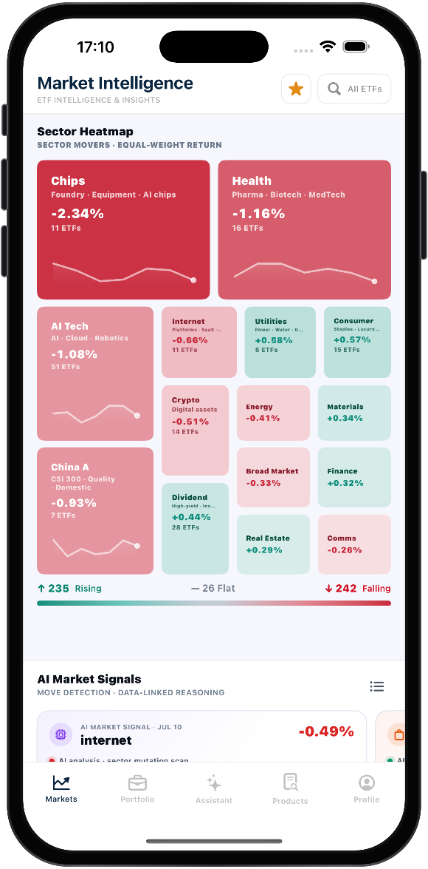
SUNWAH
FINTECH
01 User Story 1 — Verify the email and enter Markets
The second page proves email verification and the shared successful landing.
01
Login
03
02
Market
Confirm Verify Email opens after registration. Show the disabled state below six digits, enter a complete code, then tap Verify and Continue.
03
Portfolio
AC Mapping:
Verify and Continue stays disabled until all six code digits are entered.
A correct code creates one account and signs the user in automatically.
04
Admin
04
Confirm successful registration opens Markets. Repeat the accepted existing-account path and verify that both paths reach the same default landing.
AC Mapping:
Newly registered users will enter the default Markets landing page.
Enter the default Markets landing page after successful user authentication.
SUNWAH Fintech · M2 Functional Acceptance · Confidential
05 / 35

Slide 6
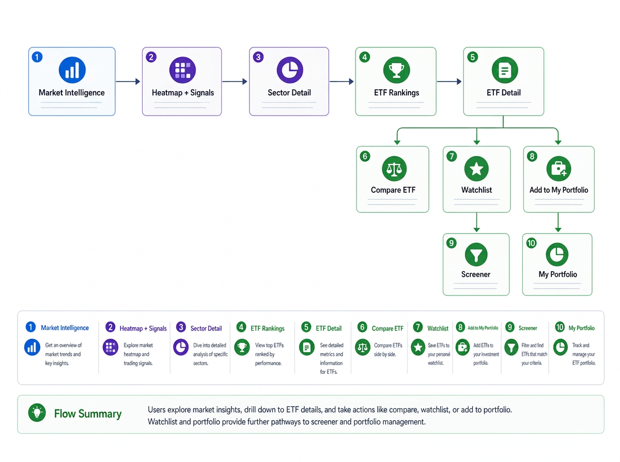

SUNWAH
FINTECH
02 Market
A complete research flow from market direction to ETF comparison and saving
01
Login
02
Market
03
Portfolio
04
Admin
SUNWAH Fintech · M2 Functional Acceptance · Confidential
06 / 35

Slide 7
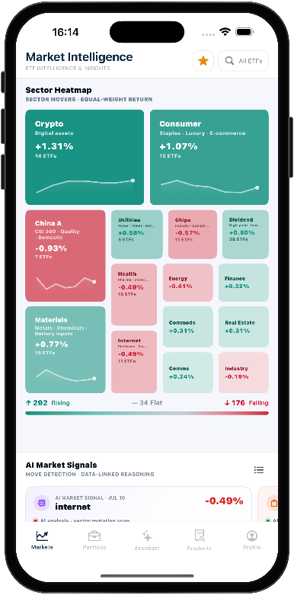
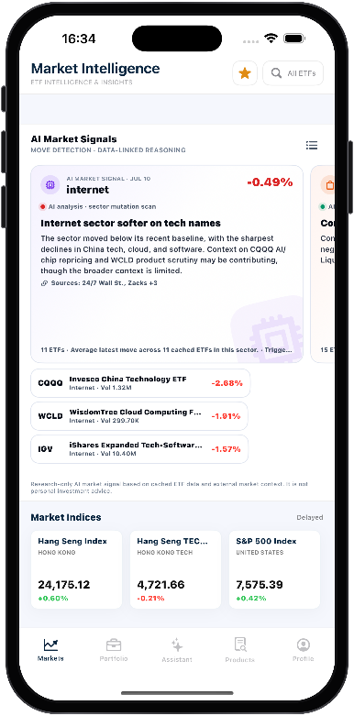
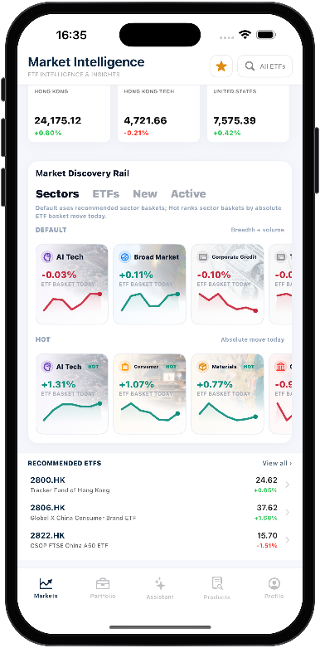
SUNWAH
FINTECH
01 User Story 1 — Establish research direction from Market Intelligence
Daily breadth, signals and discovery rails produce the next sector research target.
01
Login
01
02
03
02
Market
Open Market Intelligence, explain its research-only role, then scan sector blocks and the Rising / Flat / Falling breadth summary.
Open an AI Market Signal with date, movement, analysis, related ETFs and sources; keep the delayed-data label visible on major indices.
Switch Default / Hot sectors, inspect Recommended ETFs and View all, then open a sector to continue into Sector Detail.
03
Portfolio
04
Admin
AC Mapping:
AC Mapping:
AC Mapping:
Market Intelligence loads all research entries with sector context and matching heatmap breadth totals.
Market signals, sector performance and selected ETFs are presented as research, not recommendations.
AI Market Signals shows its date, detected changes, analysis, related ETFs and available sources.
Market Indices shows available index changes and clearly marks delayed-data boundaries.
Discovery supports several research routes, and Default or Hot sectors show the selected scope.
Recommended ETFs is a curated list with key quote data and a View all entry.
Selecting a sector opens the matching Sector Detail page.
SUNWAH Fintech · M2 Functional Acceptance · Confidential
07 / 35

Slide 8
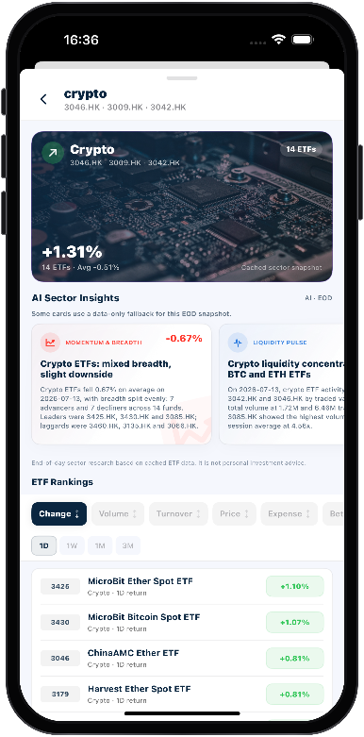
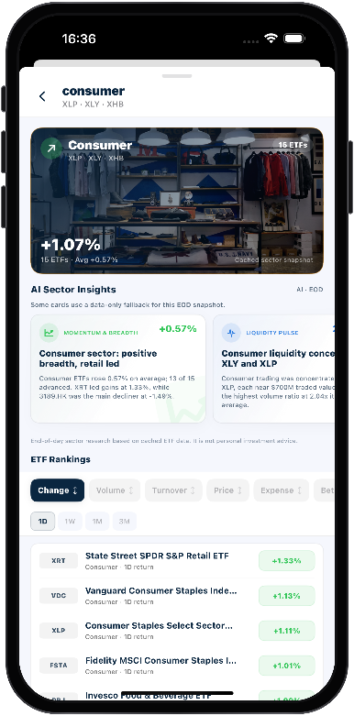
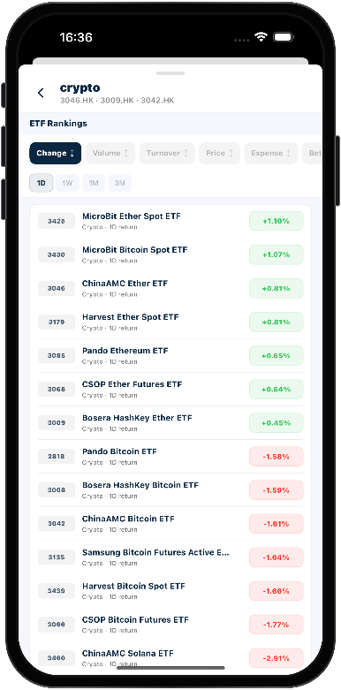
SUNWAH
FINTECH
02 User Story 2 — Understand sector trends and filter ETFs
Sector context, EOD observations and sortable rankings produce an ETF candidate.
01
Login
01
02
03
02
Market
Open a selected sector such as Crypto and confirm the banner identity, representative tickers, ETF count, movement and cached snapshot label.
Read Momentum & Breadth, Liquidity Pulse and Trend & Risk in order; explain the EOD basis and non-predictive research wording.
Keep the selected sector, switch sorting metrics and return periods, then open one ETF from the sector-only ranking.
03
Portfolio
04
Admin
AC Mapping:
AC Mapping:
AC Mapping:
Sector Detail matches the selected sector and shows its tickers, ETF count and movement.
The page clearly identifies its cached EOD snapshot and avoids implying real-time data.
AI Sector Insights covers momentum, liquidity and risk, with an explicit state when data is insufficient.
Insight wording describes research observations rather than real-time predictions or trading advice.
ETF Rankings only displays ETFs within the currently selected sector.
Supported sort metrics and return periods update ranking order without changing the selected sector.
Selecting a ranked ETF opens the matching ETF Detail page.
SUNWAH Fintech · M2 Functional Acceptance · Confidential
08 / 35

Slide 9
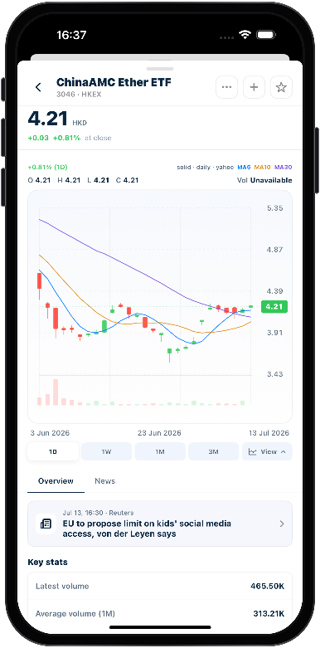
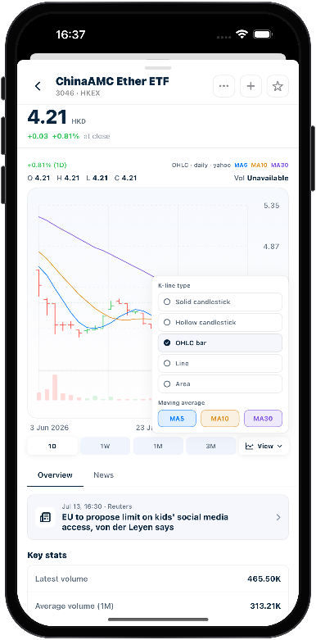
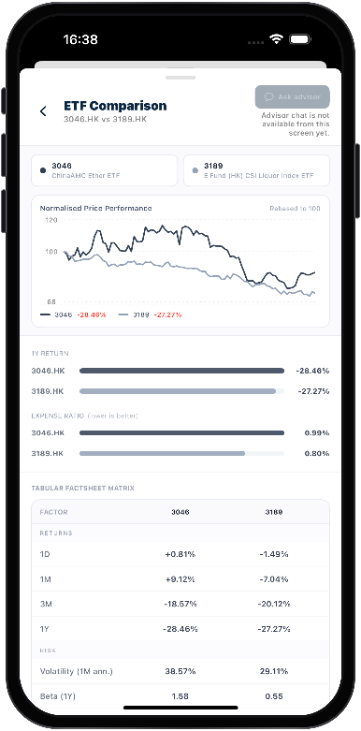
SUNWAH
FINTECH
03 User Story 3 — Research and compare individual ETFs
ETF identity, chart controls and normalized comparison support instrument-level research.
01
Login
01
02
03
02
Market
Open a candidate ETF, confirm identity and quote context, switch at least two time ranges, then scrub the chart to update OHLC and volume.
Change chart type and one moving average, then check available key stats and ETF-related news metadata.
Open Compare ETF from More, retain the current ETF as the first object, select a second ETF and inspect the normalized overlay before returning.
03
Portfolio
04
Admin
AC Mapping:
AC Mapping:
AC Mapping:
ETF Detail and its chart display the selected fund's identity, quote context and price series.
Supported time ranges reload the chart, and scrubbing updates OHLC and volume for the selected point.
View controls change the enabled chart type or moving-average overlays for the current ETF.
Overview and News show available ETF statistics and related articles, with unavailable values identified clearly.
Compare ETF retains the current fund and allows a second fund to be selected.
The comparison chart normalizes both price series under the same chart settings.
Closing Compare ETF returns to the original ETF Detail context.
SUNWAH Fintech · M2 Functional Acceptance · Confidential
09 / 35

Slide 10
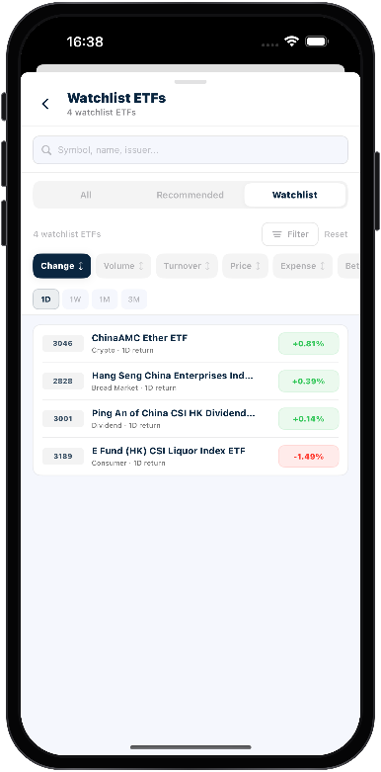
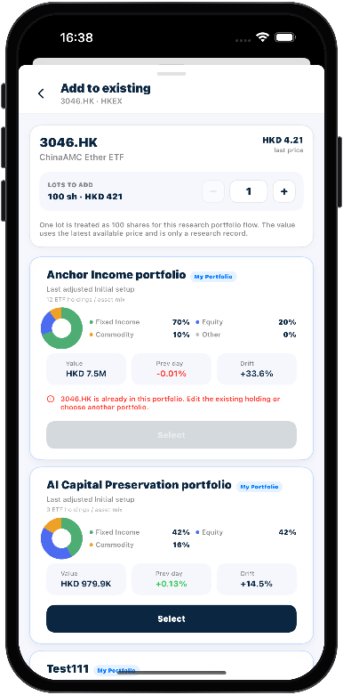
SUNWAH
FINTECH
04 User Story 4 — Save ETF research results
Watchlist, My Portfolio and Screener preserve research without implying execution.
01
Login
01
02
03
02
Market
Star the ETF, verify it appears in Screener > Watchlist, then remove it and confirm the saved range updates.
Inspect price, lots and value, reject a duplicate portfolio, save to an eligible portfolio, then reopen it to confirm the holding.
Move through Recommended, All and Watchlist, then use search, filter and sort while preserving the selected data scope.
03
Portfolio
04
Admin
AC Mapping:
AC Mapping:
AC Mapping:
A successful star action adds the ETF to Watchlist, and removal updates both states consistently.
Watchlist saves research objects without creating portfolio holdings or transactions.
The add sheet shows the current ETF's price, lots and value, while blocking duplicate targets.
An eligible target saves a research holding after reopening without placing a trade.
Recommended, All and Watchlist share the same Screener controls and result layout.
Supported search, filter and sort controls update results using the selected criteria.
Search, filter and sort preserve the active Recommended, All or Watchlist scope.
SUNWAH Fintech · M2 Functional Acceptance · Confidential
10 / 35

Slide 11
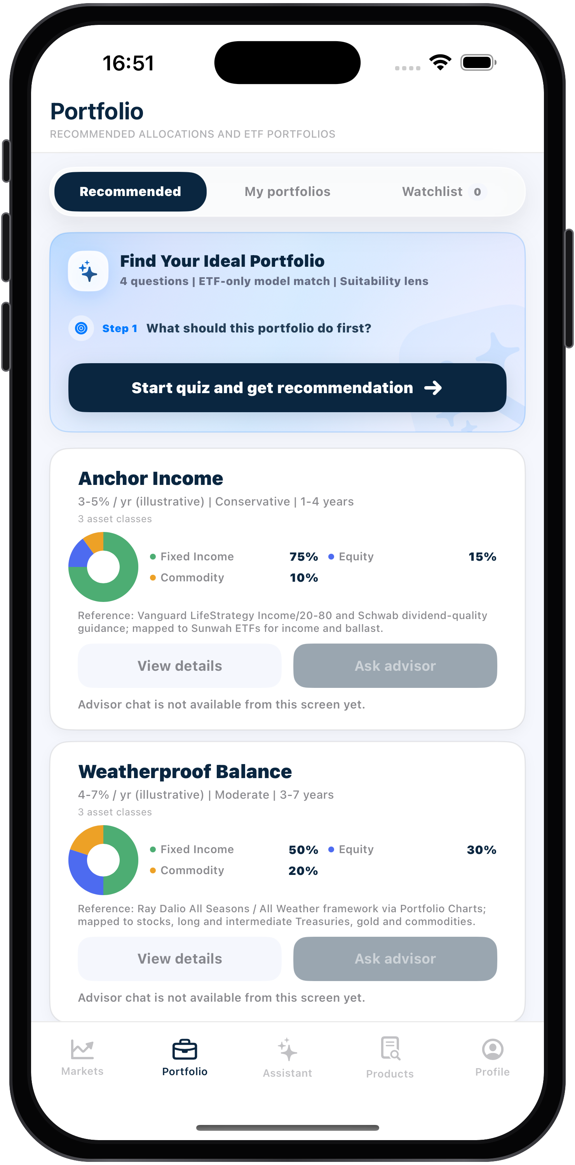
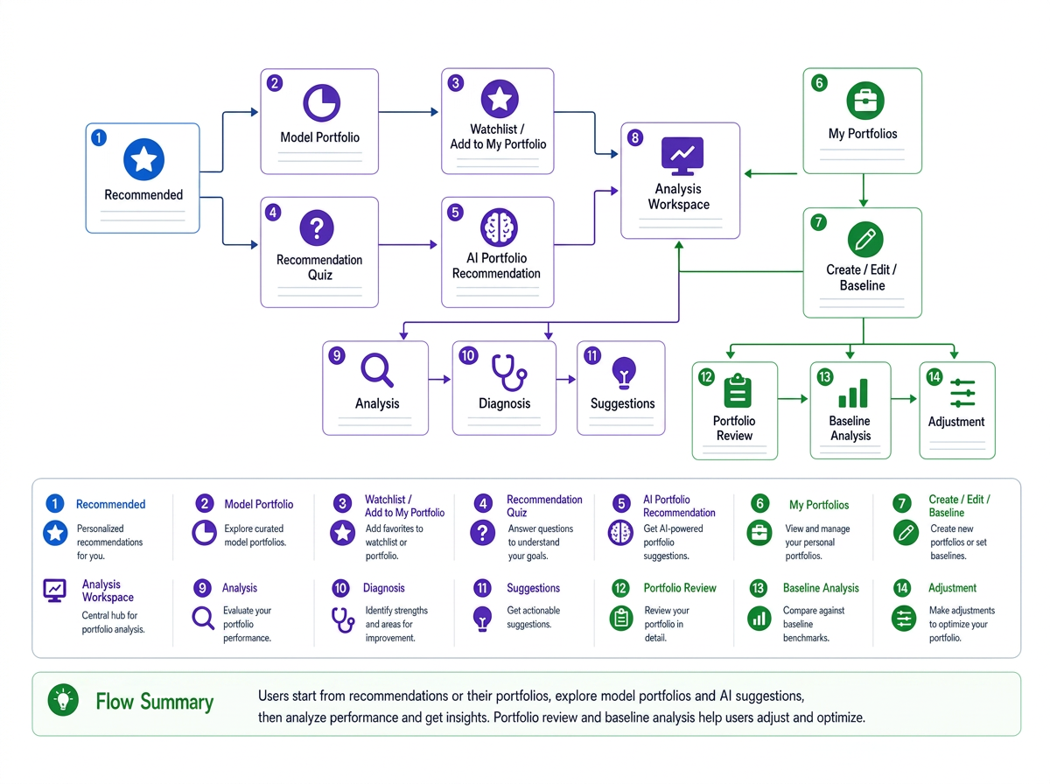
SUNWAH
FINTECH
03 Portfolio
Five research workflows from templates and saved holdings to analysis and baseline review
01
Login
02
Market
03
Portfolio
04
Admin
SUNWAH Fintech · M2 Functional Acceptance · Confidential
11 / 35

Slide 12

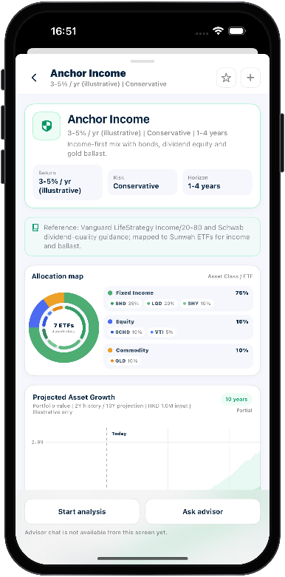
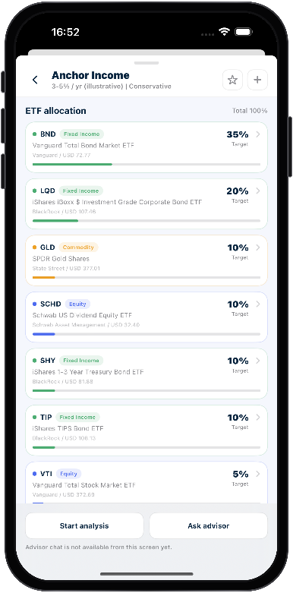
SUNWAH
FINTECH
01 User Story 1 — Discover a Model Portfolio
Catalogue identity, portfolio facts and ETF allocation establish the selected template.
01
Login
01
02
03
02
Market
Open Portfolio > Recommended, inspect loaded Model Portfolio cards and their Reference descriptions, then open one selected item.
Confirm title, return, risk, duration, summary, Reference and allocation groups match the selected catalogue card.
Inspect every ETF row, target weight and available metadata; confirm Total 100% and open one matching ETF detail before returning.
03
Portfolio
04
Admin
AC Mapping:
AC Mapping:
AC Mapping:
Recommended shows backend-loaded cards with portfolio facts, allocation and matching References.
View details opens the selected item after its loading state completes.
Detail facts, Reference and ETF groups match the selected catalogue card and current backend data.
An ETF row opens the matching detail, and returning preserves the Model Portfolio state.
ETF rows show identifiers, weights and available metadata, with Total fixed at 100%.
SUNWAH Fintech · M2 Functional Acceptance · Confidential
12 / 35

Slide 13
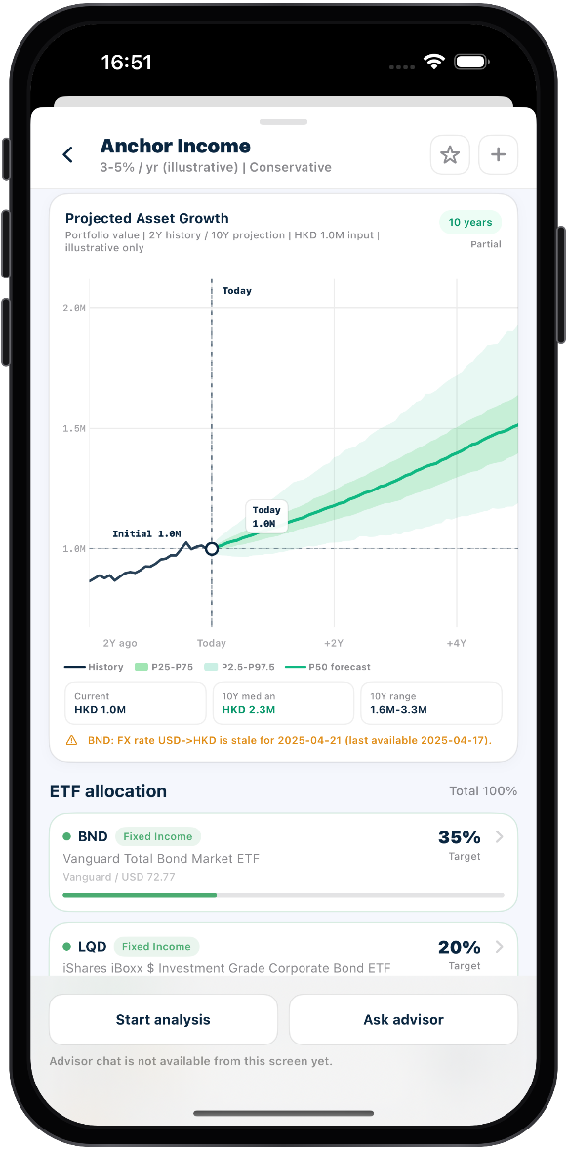
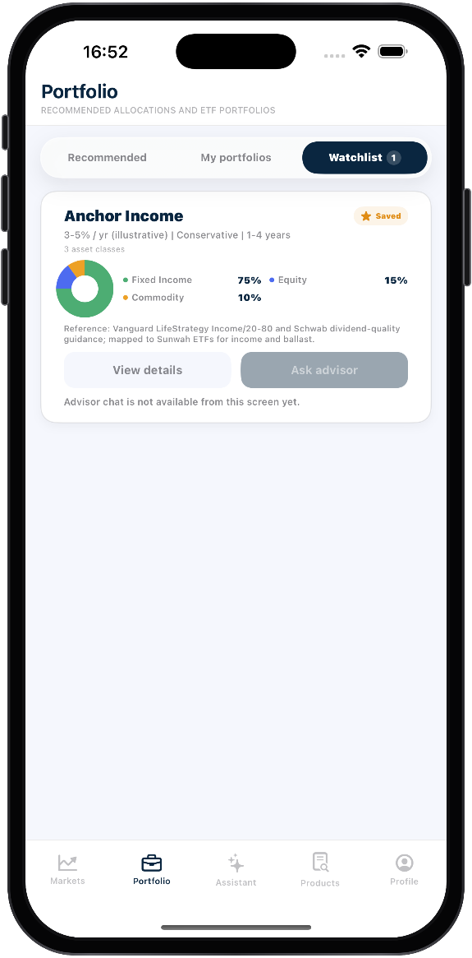
SUNWAH
FINTECH
01 User Story 1 — Evaluate the forecast and save for later
Projection evidence is paired with the persistent Watchlist result.
01
Login
04
Market
Wait for Monte Carlo completion, inspect history and percentile bands, drag and pinch the timeline, select a historical point, generate/hide backtest and keep Partial data coverage visible.
02
Portfolio
AC Mapping:
03
Loading remains until the forecast is ready; chart interaction stays in range and backtesting uses history only.
Backtest preserves the forecast, coverage and research boundaries.
04
Admin
05
Save the selected Model Portfolio, reopen it from Watchlist, remove it and verify the count and final star state remain consistent.
AC Mapping:
A successful save fills the star, updates Watchlist and reopens with matching facts.
Removal keeps the list, count, empty state and final star consistent across views.
SUNWAH Fintech · M2 Functional Acceptance · Confidential
13 / 35

Slide 14
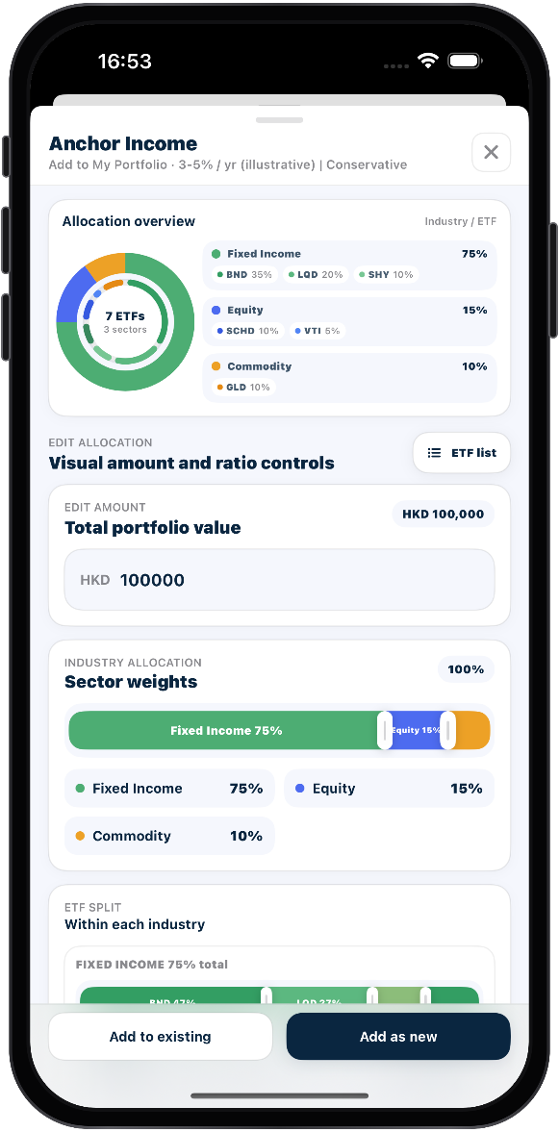
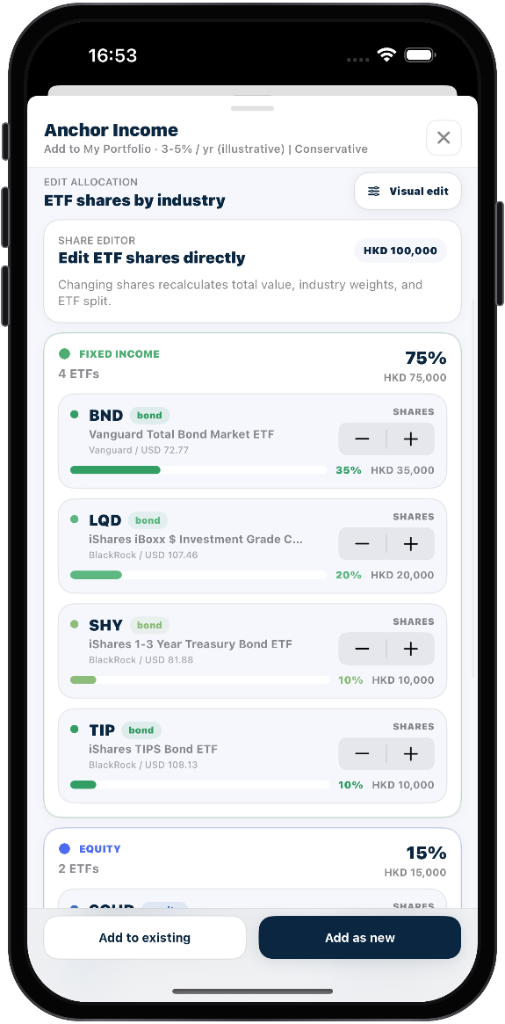
SUNWAH
FINTECH
01 User Story 1 — Edit the configuration before saving
Visual and ETF-list editors preserve one evolving allocation state.
01
Login
06
Market
Open Add to My Portfolio, change modeled total value and allocation boundaries, and keep all weights non-negative with a 100% total.
02
Portfolio
AC Mapping:
03
Add to My Portfolio opens with the selected model, context and default amounts.
Changing total value recalculates ETF amounts and quantities while preserving normalized weights.
Allocation drags update only affected groups, keep values non-negative and preserve a 100% total.
04
Admin
07
Switch to ETF list, edit shares, return to Visual and enter confirmation without losing the latest values, weights or quantities.
AC Mapping:
Visual and List modes convert amounts, weights and shares without losing valid edits.
Confirmation uses the latest edit and shows the target, totals and per-ETF results.
SUNWAH Fintech · M2 Functional Acceptance · Confidential
14 / 35

Slide 15


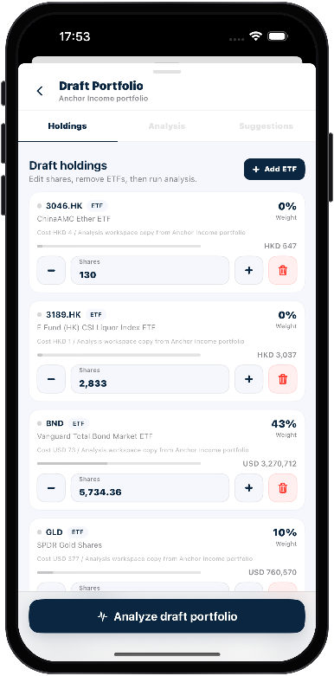
SUNWAH
FINTECH
01 User Story 1 — Persist or analyze the edited Model Portfolio
The final step branches to Add as new, Add to existing, or a read-only analysis draft.
01
Login
08
09
10
02
Market
Choose Add as new, confirm the final edited summary, create one research-only My Portfolio, then reopen it to prove persisted holdings and values.
Choose an existing target, wait for preview, confirm combined and new positions, then reopen the target to verify the merged result.
Start analysis from the Model Portfolio. Confirm the Analysis Workspace receives the edited working copy and does not expose Apply to My Portfolio for this source.
03
Portfolio
04
Admin
AC Mapping:
AC Mapping:
AC Mapping:
Confirm stays disabled while the name is empty or creation is in progress.
One successful creation appears in My portfolios and preserves its holdings after reopening.
Creation is research-only, triggers no trade and cannot be submitted repeatedly.
Target facts and ETF changes appear in preview before Confirm becomes available.
Confirmation merges and persists positions, while navigation preserves the last confirmed editing draft.
Analysis Workspace opens with the selected model's title, holdings, values and normalized weights.
Draft edits affect only the working copy and expose no Apply to My Portfolio action.
Analysis uses the current draft and does not reuse results from another source.
SUNWAH Fintech · M2 Functional Acceptance · Confidential
15 / 35

Slide 16
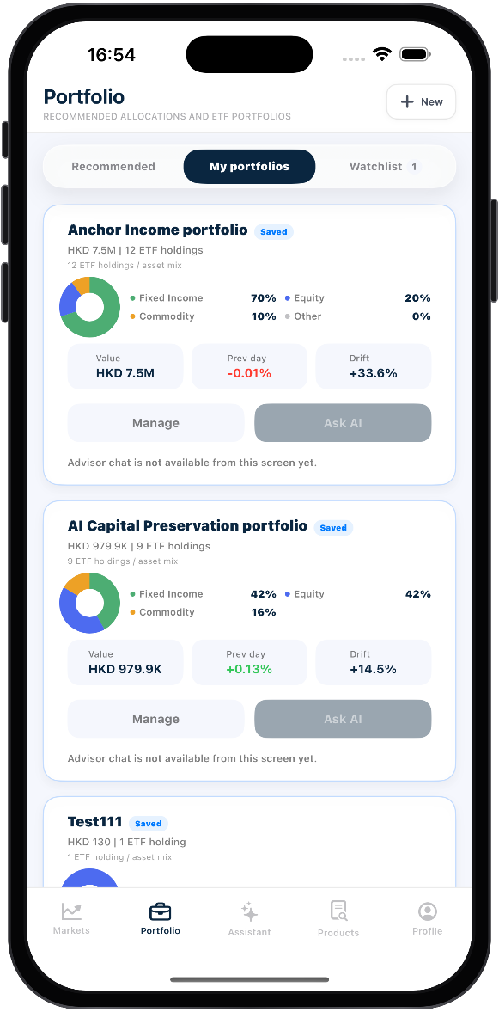
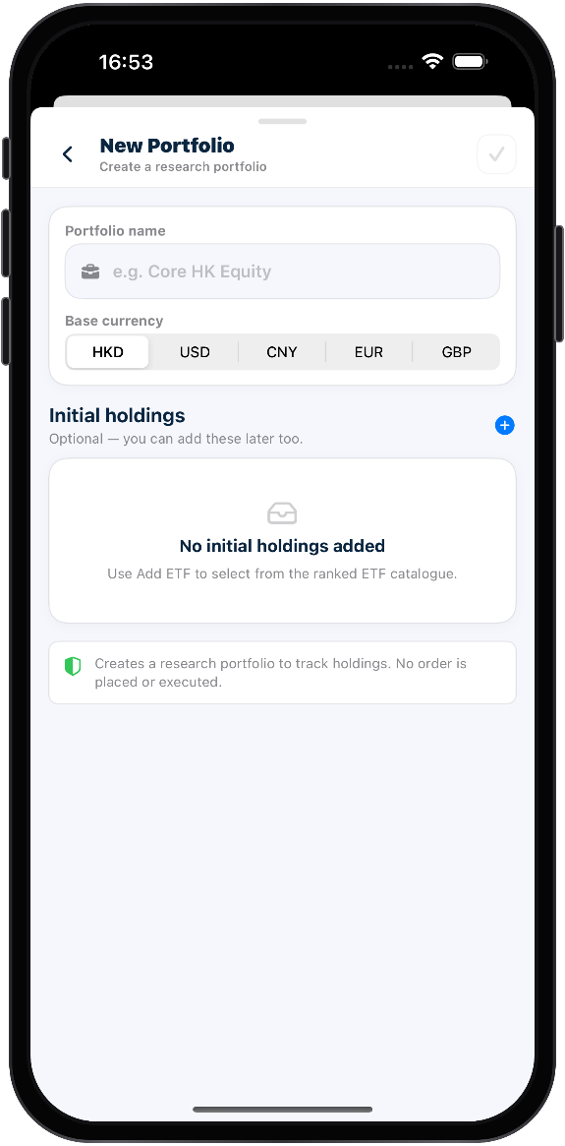
SUNWAH
FINTECH
02 User Story 2 — Create a My Portfolio
The saved-portfolio list leads into a validated research-only creation draft.
01
Login
01
Market
Open My portfolios, wait for the saved list, enter New Portfolio, then reopen the created result and confirm its card and values.
02
Portfolio
AC Mapping:
03
My portfolios shows a loading state before replacing it with the current saved list.
A new portfolio appears with matching facts and reopens with its saved holdings.
Creation is clearly identified as research-only and does not execute a transaction.
04
Admin
02
Enter name and base currency, add searchable ETF holdings, edit quantities in the draft and create only when all validation gates pass.
AC Mapping:
The form supports available currencies and enables creation only with a valid name and holdings.
ETF search, sort and empty results behave consistently and can restore the full list.
Initial holdings support quantity controls and deletion while rejecting invalid values.
SUNWAH Fintech · M2 Functional Acceptance · Confidential
16 / 35

Slide 17
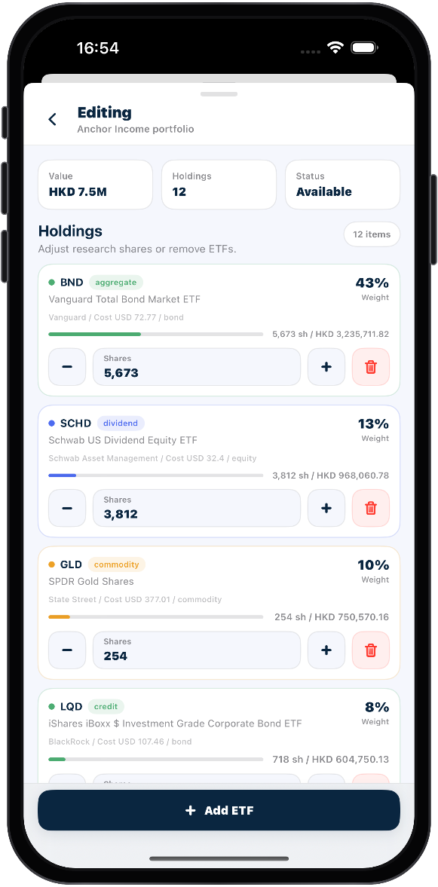
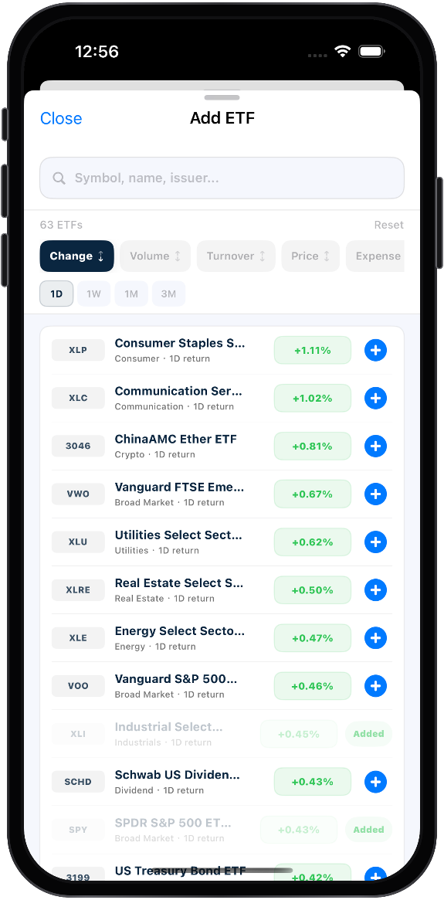
SUNWAH
FINTECH
02 User Story 2 — Inspect and edit saved holdings
Current detail context and the editable holdings screen prove persisted, isolated updates.
01
Login
03
Market
Open the saved My Portfolio, confirm header, grouping, positions, current value, allocation and forecast boundaries, then save a Baseline Snapshot.
02
Portfolio
AC Mapping:
03
Header, holdings and forecast match this saved portfolio rather than another source.
Position rows show current facts and open the matching ETF.
Saving creates one timestamped snapshot whose detail preserves value, quantities and weights.
04
Admin
04
Edit quantities, add one valid ETF, reject duplicates, remove only the intended ticker and reopen the portfolio to prove persistence without changing untouched positions.
AC Mapping:
The editor validates quantities, blocks duplicates and persists one new holding.
Only intended positions change; closing unchanged leaves holdings untouched.
SUNWAH Fintech · M2 Functional Acceptance · Confidential
17 / 35

Slide 18
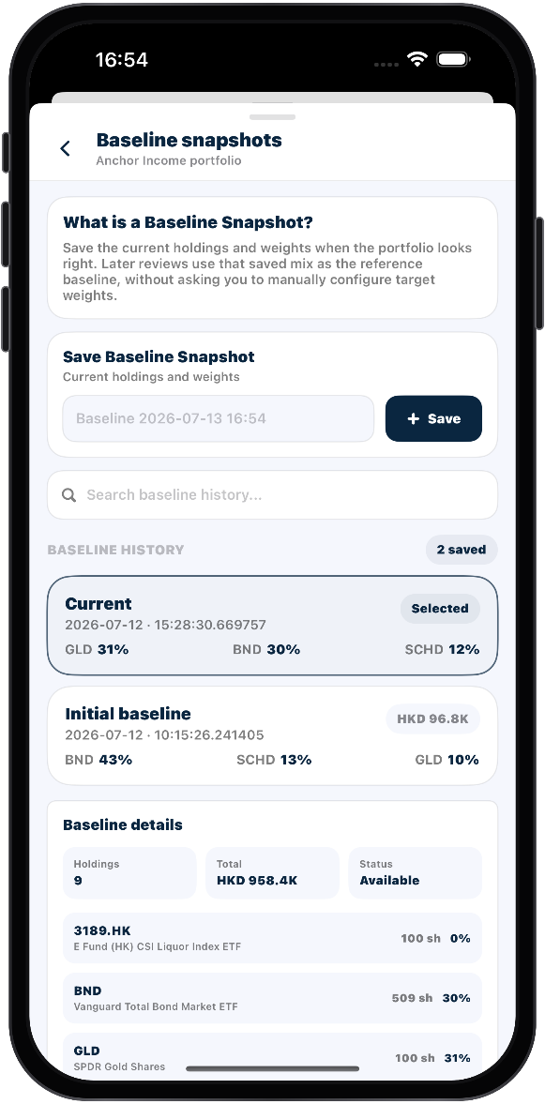

SUNWAH
FINTECH
02 User Story 2 — Maintain baseline history and remove a portfolio
Historical snapshots remain independently searchable, renameable and removable.
01
Login
05
Market
Open Baseline snapshots, create exactly one snapshot, search, rename and remove a temporary entry, then reopen the history to verify retained state.
02
Portfolio
AC Mapping:
03
Each action creates one selectable snapshot, and search filters its saved history.
Rename rejects empty tags, while deletion removes only the selected snapshot.
The retained snapshot preserves its pre-edit holdings and remains correct after reopening.
04
Admin
06
Demonstrate the explicit empty-holdings state, then cancel and confirm destructive portfolio removal while proving other portfolios are unaffected.
AC Mapping:
A portfolio with no holdings still opens with an explicit empty state.
Removal requires an irreversible-action confirmation and deletes only the selected portfolio.
SUNWAH Fintech · M2 Functional Acceptance · Confidential
18 / 35

Slide 19
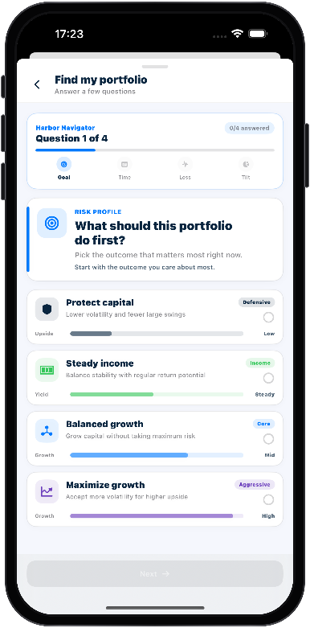
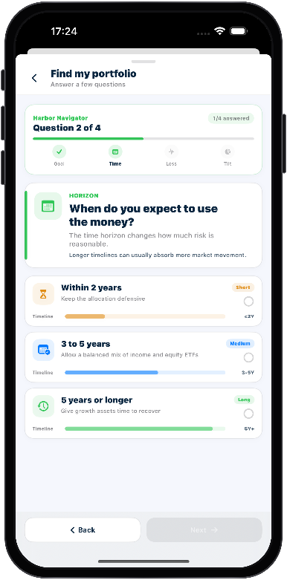
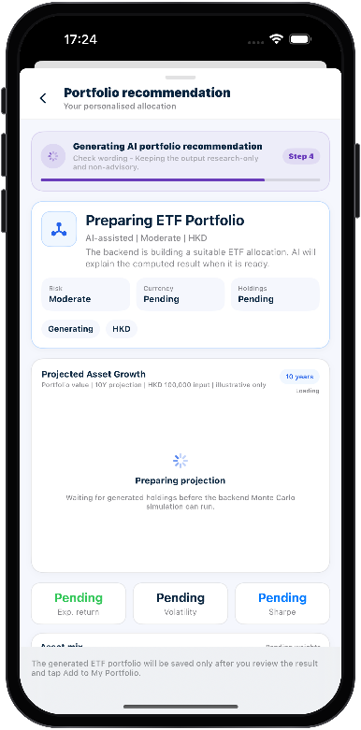
SUNWAH
FINTECH
03 User Story 3 — Complete the recommendation questionnaire
Four validated answers lead into a clean, non-stale generation state.
01
Login
01
02
03
02
Market
Open Find Your Ideal Portfolio. Show the four-step structure, supporting option context and the disabled Next gate before selection.
Select one option, move forward and backward, retain answers, then later adjust one answer and regenerate from the same questionnaire state.
Submit all answers and show four generation stages with pending placeholders; confirm saving stays disabled until the new result is ready.
03
Portfolio
04
Admin
AC Mapping:
AC Mapping:
AC Mapping:
The questionnaire shows four steps, current progress and contextual single-choice options.
Next or See recommendation stays disabled until the current question is answered.
Each question retains one selected answer when moving forward or backward.
Completing all answers produces a result aligned with the selected risk profile.
Return to the questionnaire and keep the current answers.
Submission immediately starts one visible four-stage recommendation flow.
Pending sections are identified clearly, and saving stays disabled until the result is complete.
SUNWAH Fintech · M2 Functional Acceptance · Confidential
19 / 35

Slide 20
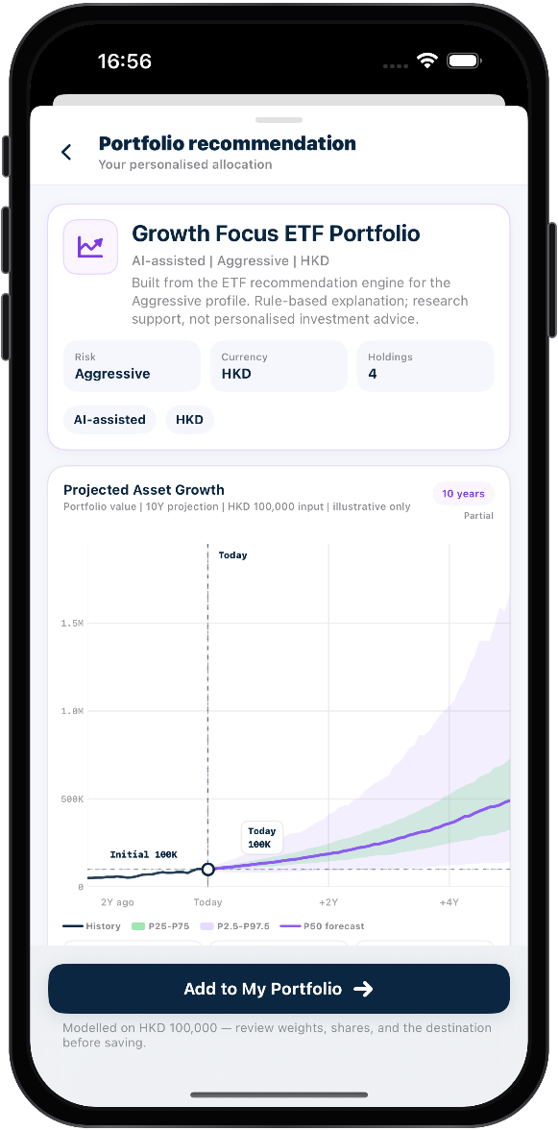
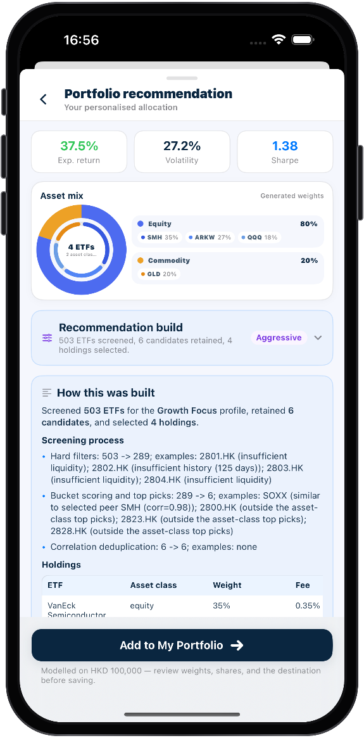
SUNWAH
FINTECH
03 User Story 3 — Review the recommendation result and build
Generated identity, metrics and build context remain consistent with one run.
01
Login
04
Market
Confirm generated title, risk level, currency, positions, projection and AI-assisted research-only boundary.
02
Portfolio
AC Mapping:
03
Result identity, metrics and forecast all reflect the same generated weights and modeled amount.
The recommendation is consistently marked as AI-assisted, research-only and non-executing.
04
Admin
05
Inspect returned metrics, asset mix, screening/optimization summary, as-of date, candidate scope, exclusions and warnings.
AC Mapping:
Recommendation Build shows this run's risk profile, metrics, allocation, scope, date and warnings.
SUNWAH Fintech · M2 Functional Acceptance · Confidential
20 / 35

Slide 21
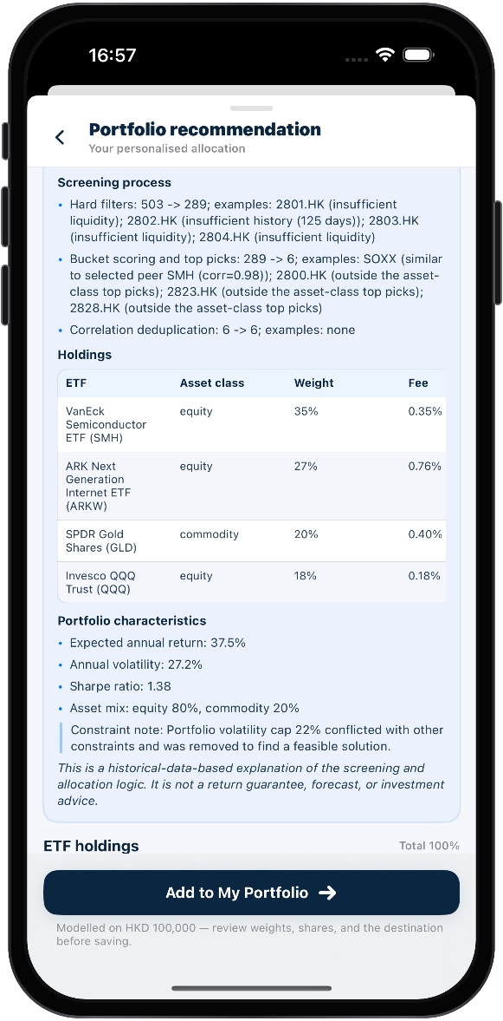
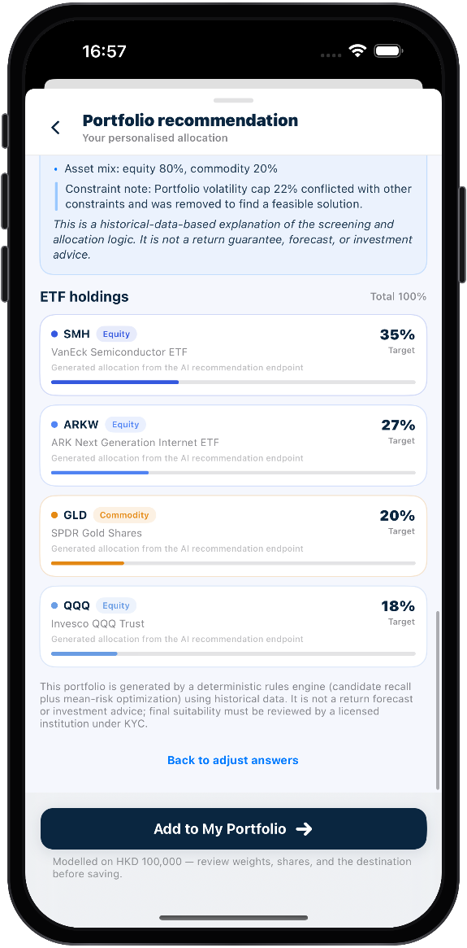
SUNWAH
FINTECH
03 User Story 3 — Inspect explanation, constraints and ETF holdings
The explanation and final holdings remain traceable to the same Recommendation Build.
01
Login
06
Market
Read rendered AI explanation, holdings table, portfolio characteristics and constraints without exposing raw Markdown or overstating the result.
02
Portfolio
AC Mapping:
03
AI description markup renders readable structure without exposing raw Markdown.
Explanation, holdings, characteristics and constraints match the current build.
04
Admin
07
Check ticker, name, asset class, target weight and progress for every generated ETF; confirm weights total 100% within rounding tolerance.
AC Mapping:
Each ETF row shows identity, asset class and target weight, with totals equal to 100% within rounding.
SUNWAH Fintech · M2 Functional Acceptance · Confidential
21 / 35

Slide 22
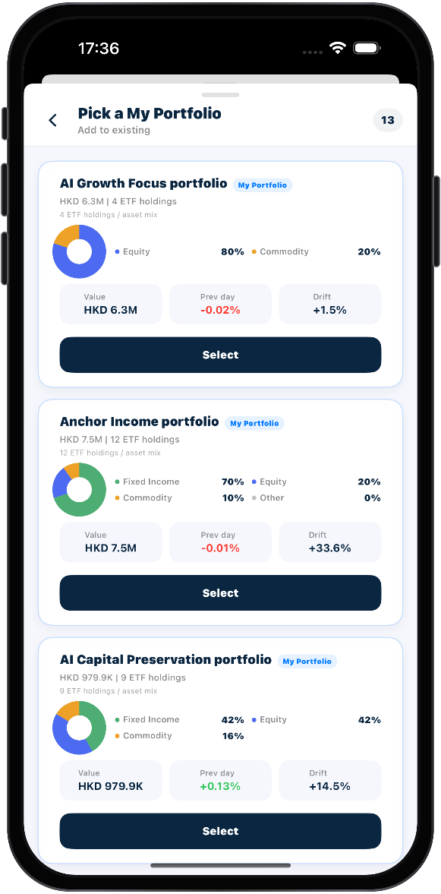
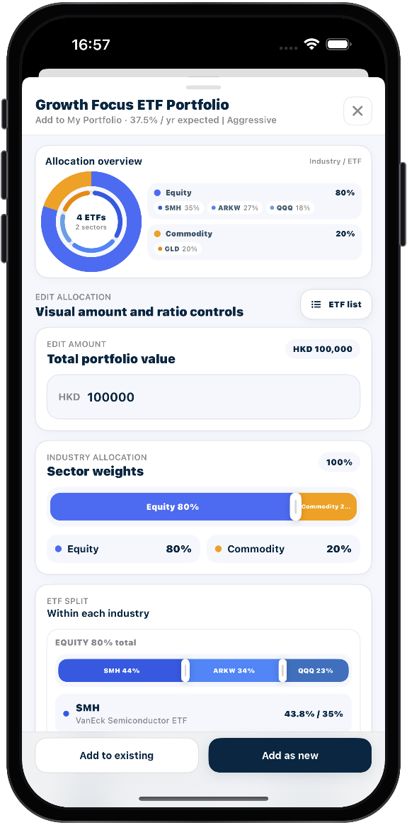
SUNWAH
FINTECH
03 User Story 3 — Save the recommendation
The generated configuration is not persisted until target selection and confirmation complete.
01
Login
08
Market
Open Add to My Portfolio, choose Add as new or an eligible existing target, finish confirmation and reopen the saved target.
02
Portfolio
AC Mapping:
03
The add page uses the current recommendation, modeled amount, currency and latest prices.
Confirmation creates a new target or merges quantities into the selected existing portfolio.
Opening or leaving the add page does not save anything before confirmation.
04
Admin
09
Verify the recommendation uses its modeled amount, currency and latest prices while sharing the same Visual/List editing behavior as User Story 1.
AC Mapping:
Visual and List editing, validation and target choices follow the shared portfolio workflow.
SUNWAH Fintech · M2 Functional Acceptance · Confidential
22 / 35

Slide 23
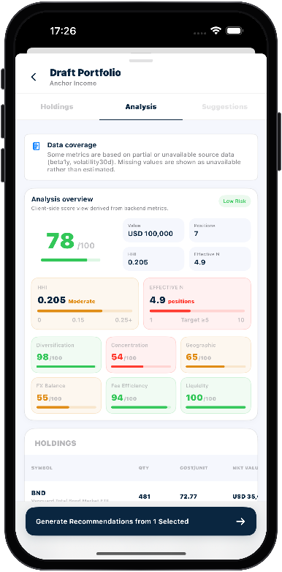
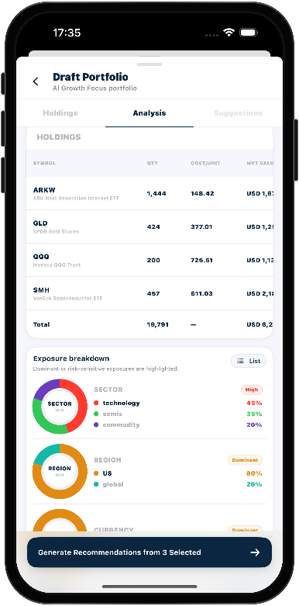
SUNWAH
FINTECH
04 User Story 4 — Run portfolio analysis
An editable working draft becomes a traceable analysis result without changing saved holdings.
01
Login
01
02
03
02
Market
Start analysis from My Portfolio, edit the working copy, add/remove ETFs and run analysis only when the draft is valid; do not alter the saved source yet.
Wait for completion, inspect current-draft value, positions, HHI, Effective N, diagnostics and Data coverage, then prove stale results clear after a draft change.
Scroll the read-only holdings table and switch Sector, Region and Currency between Pie and List without changing the underlying analysis.
03
Portfolio
04
Admin
AC Mapping:
AC Mapping:
AC Mapping:
Workspace loads selected holdings; draft edits stay isolated, block duplicates and clear stale results.
Analyze validates the draft, shows one progress flow and opens Analysis.
The completed overview shows current draft metrics and identifies unavailable indicators explicitly.
Analysis boundaries stay visible, and results belong only to the current draft and run.
The read-only Holdings table shows each position's quantity, cost, value and weight.
Sector, Region and Currency exposures remain consistent between Pie and List views.
SUNWAH Fintech · M2 Functional Acceptance · Confidential
23 / 35

Slide 24
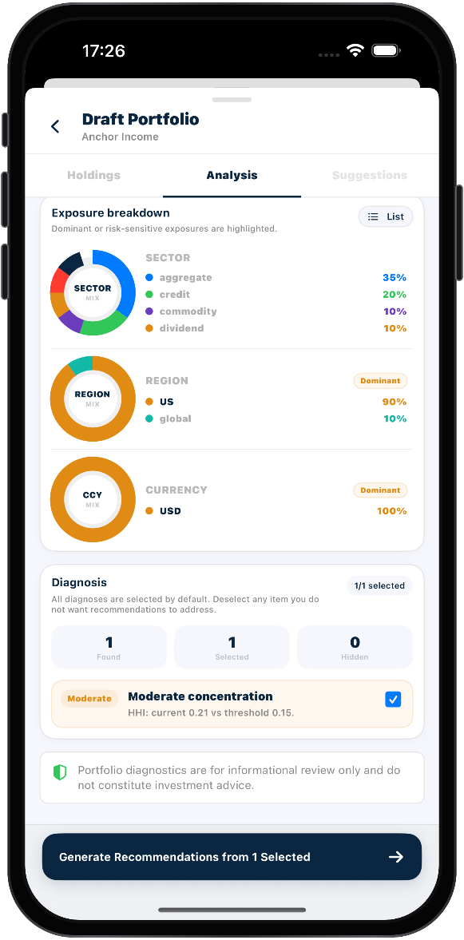
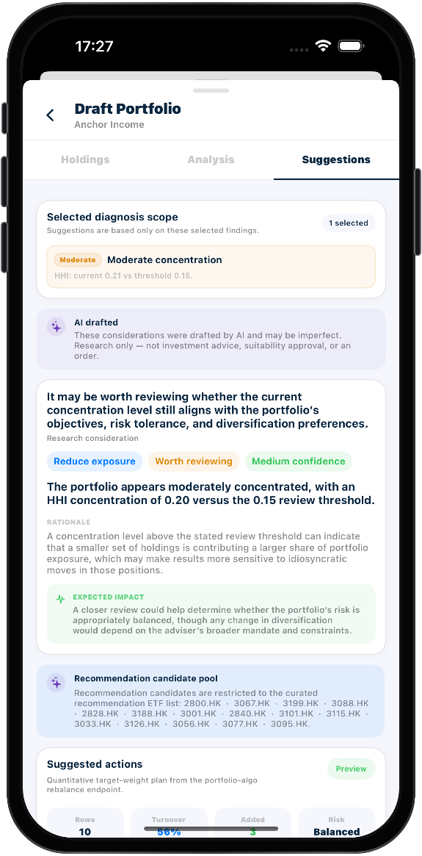
SUNWAH
FINTECH
04 User Story 4 — Select findings and generate recommendations
Only the diagnosis selected at submission enters the AI-assisted recommendation scope.
01
Login
04
Market
Review severity, metric and selection state, change the selected findings, verify counts, and show the disabled generate action when zero items are selected.
02
Portfolio
AC Mapping:
03
Diagnosis items show severity, metrics and selection, with counts matching the returned results.
Generation requires completed analysis and at least one selected diagnosis.
04
Admin
05
Observe the four progress stages, then verify selected diagnosis scope, AI drafted boundary, research consideration content and excluded findings.
AC Mapping:
Suggestions shows four-stage generation and limits AI-drafted results to submitted diagnoses.
Each consideration presents its observation, rationale, expected impact and research boundary.
SUNWAH Fintech · M2 Functional Acceptance · Confidential
24 / 35

Slide 25
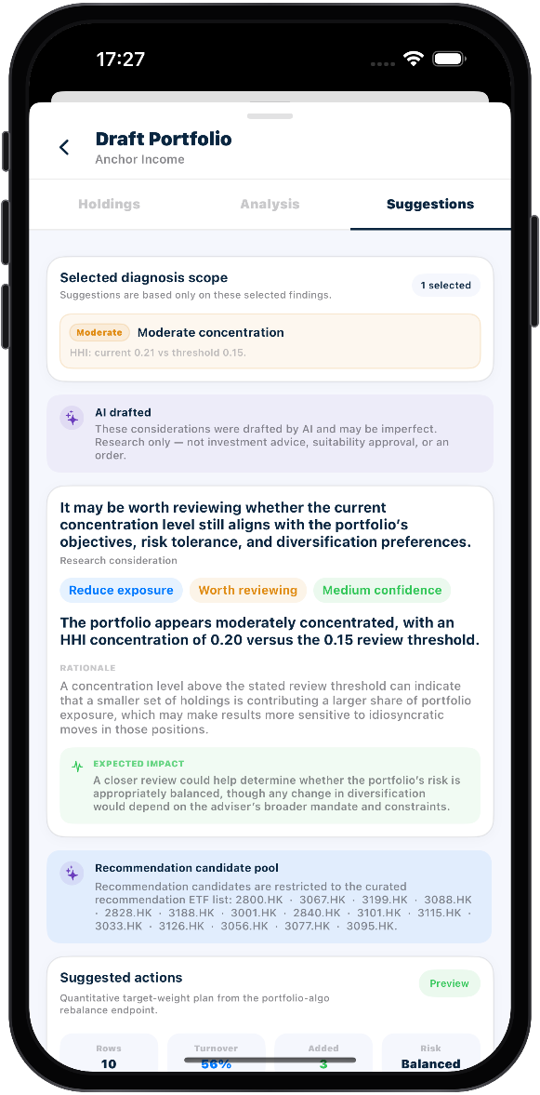
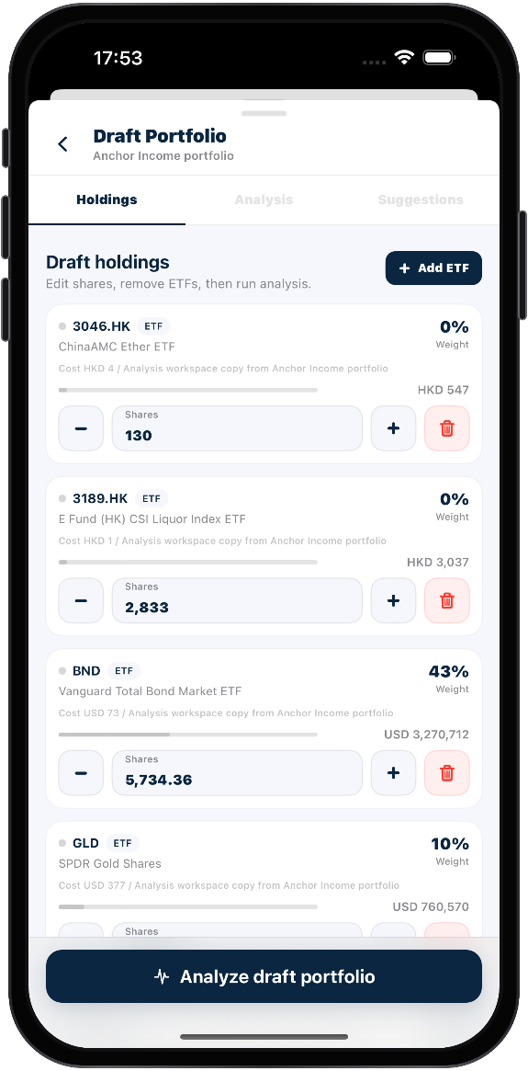
SUNWAH
FINTECH
04 User Story 4 — Review, edit and apply Suggested actions
My Portfolio results can be applied after validation; Model Portfolio results remain read-only.
01
Login
06
Market
Inspect feasibility and candidate scope, scroll every Held/New row, edit non-negative targets, reset, apply once, then reopen the portfolio to prove refreshed holdings and invalidated old analysis.
02
Portfolio
AC Mapping:
03
Preview metrics, rows and candidate scope remain mutually consistent.
Non-negative targets recalculate or reset, and Apply requires a complete feasible scenario.
Apply updates holdings; reopening proves results and clears stale analysis.
Apply cannot repeat and produces only one portfolio update.
04
Admin
07
Run the same workflow from a Model Portfolio and confirm the final rows are read-only with no Reset or Apply to My Portfolio action and no saved-portfolio mutation.
AC Mapping:
A Model Portfolio draft completes the same analysis while preserving its selected diagnosis scope.
Its Suggested actions are read-only and expose neither Reset nor Apply to My Portfolio.
SUNWAH Fintech · M2 Functional Acceptance · Confidential
25 / 35

Slide 26
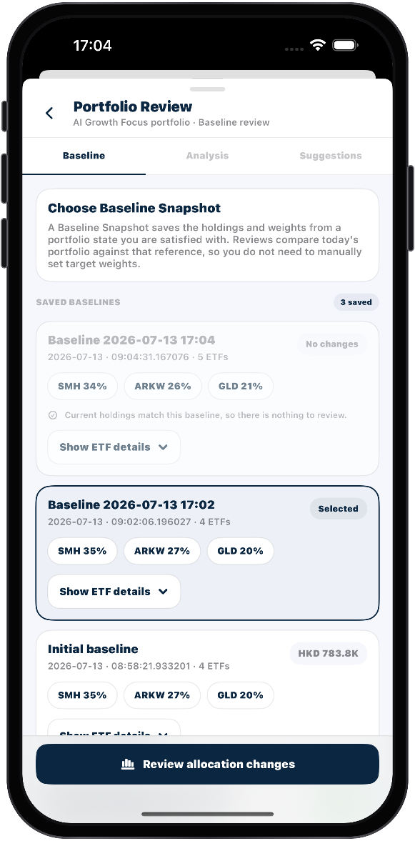
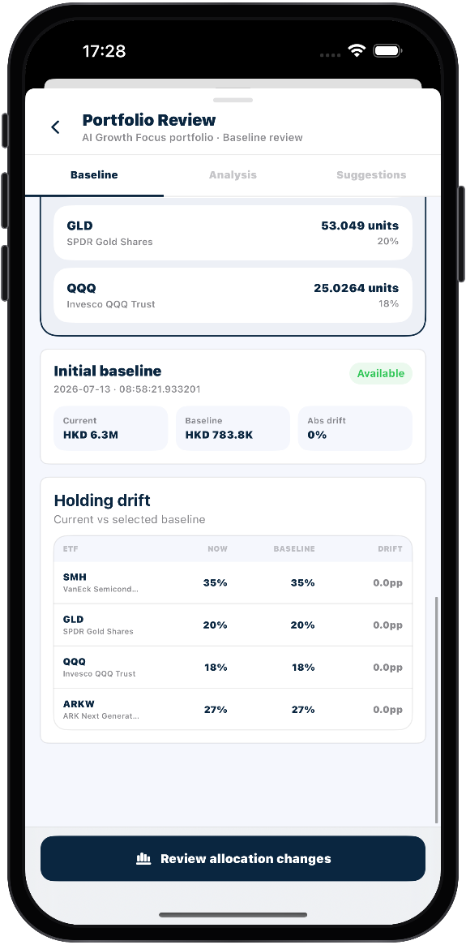
SUNWAH
FINTECH
05 User Story 5 — Select a baseline and inspect drift
Only a changed Baseline Snapshot can drive a review; No changes remains inspectable but not selectable.
01
Login
01
Market
Open Portfolio Review, distinguish No changes from a reviewable snapshot, inspect saved ETF details and select one changed baseline.
02
Portfolio
AC Mapping:
03
Baseline lists only this portfolio's saved reference configurations.
No changes remains unselectable for Analysis but still allows ETF detail inspection.
A changed snapshot can be selected and expanded to show saved quantities and weights.
04
Admin
02
Review current/baseline summary and the drift table, including added/removed ETFs, signed deviations and the enabled Review allocation changes action.
AC Mapping:
The deviation table includes added and removed ETFs with signed, significance-sorted changes.
The summary identifies the baseline, date and total absolute deviation.
SUNWAH Fintech · M2 Functional Acceptance · Confidential
26 / 35

Slide 27
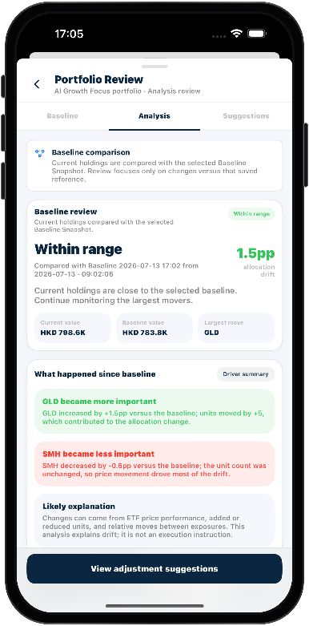


SUNWAH
FINTECH
05 User Story 5 — Explain the baseline deviation
Status, allocation and quantity views describe a deterministic snapshot comparison rather than AI advice.
01
Login
03
04
05
02
Market
Confirm the selected baseline identity, drift status, current/baseline values, largest move and driver summary; keep the comparison explicitly non-AI.
Read Industry allocation changes and ETF movement detail with signed weights and plain-language reasons.
Inspect baseline, current and target quantities plus unit and value differences for material ETF rows.
03
Portfolio
04
Admin
AC Mapping:
AC Mapping:
AC Mapping:
Analysis identifies the baseline, drift status and largest increase or decrease driving the result.
Baseline comparison is deterministic and displays no AI-generated or recommendation labels.
Industry and ETF movement views compare baseline and current weights with signed changes and reasons.
Quantity changes shows baseline, current and target quantities with unit and value differences.
SUNWAH Fintech · M2 Functional Acceptance · Confidential
27 / 35

Slide 28

SUNWAH
FINTECH
05 User Story 5 — Adjust and apply the baseline scenario
A loaded target scenario can be edited, reset and applied once to My Portfolio.
01
Login
06
Market
Wait for the selected baseline preview, inspect scope and target rows, edit non-negative shares, reset and enable Apply only after the scenario is complete.
02
Portfolio
AC Mapping:
03
Suggestions waits for the current preview and identifies the selected baseline and row scope.
Each row compares current, baseline and calculated target holdings.
Non-negative edits recalculate or reset, and Apply waits for a complete target.
04
Admin
07
Apply once, return to refreshed My Portfolio details, reopen the review and confirm the final target quantities and updated comparison persist.
AC Mapping:
A successful Apply refreshes target holdings, and reopening confirms shares and comparison.
Apply cannot be triggered repeatedly while the request is in progress.
SUNWAH Fintech · M2 Functional Acceptance · Confidential
28 / 35

Slide 29


SUNWAH
FINTECH
04 Admin
Operational visibility plus a Web Admin → shared backend → iOS verification loop
01
Login
02
Market
03
Portfolio
04
Admin
SUNWAH Fintech · M2 Functional Acceptance · Confidential
29 / 35

Slide 30


SUNWAH
FINTECH
01 User Story 1 — Monitor the platform and inspect the ETF catalogue
Dashboard metrics lead into searchable, filterable ETF maintenance data.
01
Login
01
02
02
Market
03
Portfolio
04
Admin
Open Dashboard and explain the current users, ETF catalogue, portfolios, structured notes and ETF tier distribution returned by the shared backend.
Search by symbol/name/issuer, apply tier or asset-class filters, and inspect the fields required to maintain an ETF record.
AC Mapping:
AC Mapping:
Dashboard summarizes the current backend's users, ETFs, portfolios, notes and tier distribution.
ETF Catalogue supports symbol, name or issuer search plus available tier and asset-class filters.
ETF records expose the exchange, currency, classification, issuer and expense fields needed for maintenance.
SUNWAH Fintech · M2 Functional Acceptance · Confidential
30 / 35

Slide 31



SUNWAH
FINTECH
01 User Story 1 — Add or deactivate an ETF and verify it on iOS
The acceptance result is the refreshed client state, not the Admin submission toast.
01
Login
03
04
BEFORE ADMIN
AFTER REFRESH
02
Market
03
Portfolio
04
Admin
Use Add by Ticker or Add ETF manually, show duplicate validation and submit only one valid test record; repeat the process for an active/inactive state change.
Return to the simulator after each Admin mutation, refresh or reopen the ETF search/list and prove the client universe changed exactly once.
AC Mapping:
AC Mapping:
Administrators can create one valid ETF through Add by Ticker or manual entry.
Add or deactivate requests cannot repeat in progress or create duplicates and conflicts.
After refresh, a created ETF appears on iOS and a deactivated ETF leaves the active universe.
Client-facing changes require refreshed iOS evidence; an Admin Toast alone is insufficient.
SUNWAH Fintech · M2 Functional Acceptance · Confidential
31 / 35

Slide 32




01 User Story 1 — Maintain and verify Model Portfolios
A published template is edited in Admin and then reloaded from the iOS catalogue.
05
07
Inspect template key, display order, title, risk band, return range, horizon, summary, reference, status and allocation entry points.
AC Mapping:
Model Portfolios maintains template identity, order, facts, status, Reference and ETF allocations.
06
Edit one recognizable field, keep allocations at Total 100%, save as published, then verify draft/hidden visibility boundaries with a dedicated test template.
AC Mapping:
Reopen the selected Model Portfolio on iOS and compare the visible data with the saved Admin configuration.
A template can be saved or published only when its allocation totals 100%.
iOS shows the current published configuration after refresh and excludes draft or hidden templates.
SUNWAH Fintech · M2 Functional Acceptance · Confidential
32 / 35

Slide 33


SUNWAH
FINTECH
01 User Story 1 — Review protected operations data
Users and User Portfolios support visibility and troubleshooting without mutating holdings.
01
Login
08
09
02
Market
03
Portfolio
04
Admin
Use search and role/status filters, inspect verification, account, risk, last-login and created metadata, and keep identifiable data redacted.
Inspect owner, currency, objective, horizon, holdings count and created time; explain that this story is read-only for ordinary user holdings.
AC Mapping:
AC Mapping:
Users supports search and role or status filters with current account metadata.
Videos and screenshots use test data or redact emails, owners and other personal information.
User Portfolios shows owner, currency, objective, horizon, holdings count and creation time.
Operations pages support visibility and troubleshooting without modifying ordinary user holdings.
SUNWAH Fintech · M2 Functional Acceptance · Confidential
33 / 35

Slide 34
SUNWAH FINTECH
Acceptance Review and Q&A
Four modules · eleven User Stories · three complementary deliverables
- Confirm Story-level walkthrough completeness.
- Confirm AC mapping and any evidence that must remain video-only.
- Confirm Admin-to-iOS refresh evidence is complete and traceable to dedicated test data.
4 Modules
11 Stories
248 ACs
35 Slides
0 Capture Gaps
July 2026
SUNWAH FINTECH · M2 Functional Acceptance Walkthrough
35 / 35

