Slide 1
Employee Data Analysis using Excel
STUDENT NAME: SRI SAKTHI S
REGISTER NO: 422200402/unm130122d167
DEPARTMENT: B.COM INFORMATION SYSTEM MANAGEMENT
COLLEGE: AGURCHAND MANMULL JAIN COLLEGE
NM ID:15FF2B39F676940A99B4609EDF2340C8

Slide 2
PROJECT TITLE
Employee Performance Analysis using Excel

Slide 3


AGENDA
Problem Statement
Project Overview
End Users
Our Solution and Proposition
Dataset Description
Modelling Approach
Results and Discussion
Conclusion
3/21/2024 Annual Review

Slide 4

PROBLEM STATEMENT
Measuring employee performance helps calibrate those goals by providing insight into where someone is doing well and could be stretched and areas that are not a strength yet. Based on performance feedback ,self reflection,and business needs, employess should set their own goals.
Notes:
h

Slide 5

PROJECT OVERVIEW
Employee performance analysis is the process of evaluating how employees are performing against company expectations and goals
PURPOSE:
To improve performace or ensure it remains acceptable.
BENEFITS:
Helps businesses make more consistent accurate and informed decisions.
HOW IT WORKS:
Analyzes HR data to measure how employees are performing against KPIs,which are role-specific performance goals.
WHEN TO USE IT :
To check metrics every month or year and make plans for adjustment and improvement.

Slide 6
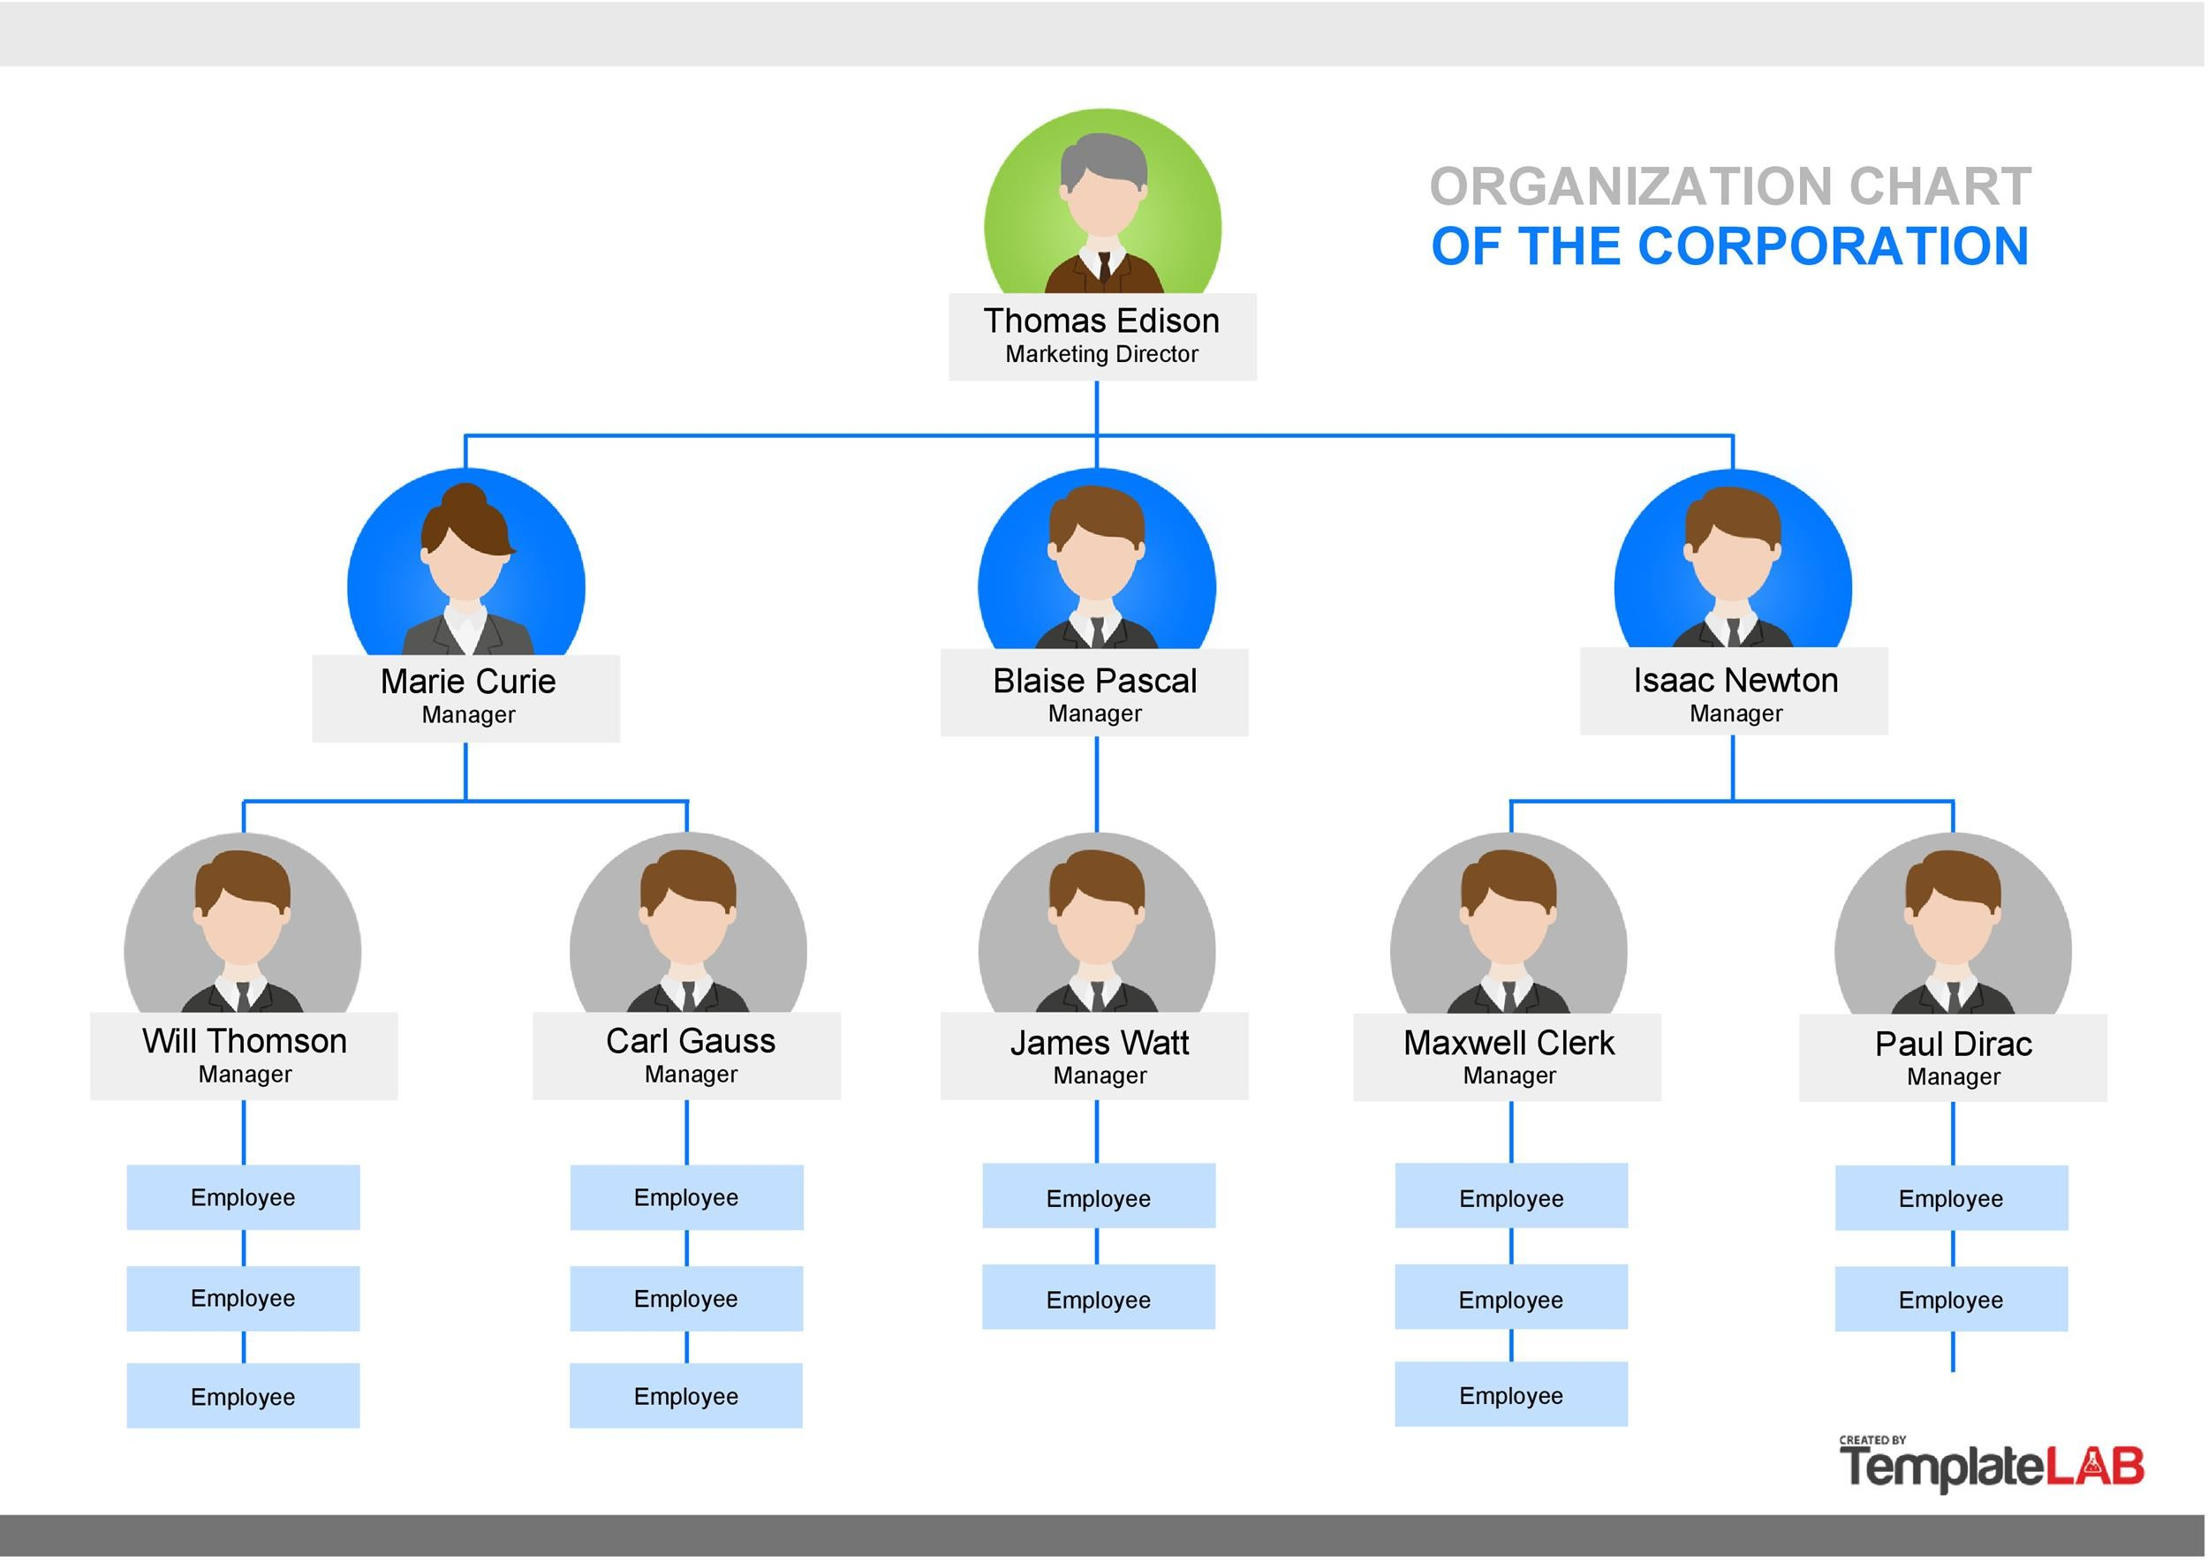

WHO ARE THE END USERS?
Manager
Employees
Employer
Organisation

Slide 7

OUR SOLUTION AND ITS VALUE PROPOSITION
Conditional formatting-missing
Filter-remove
Formula- performance
Pivot-summary
Graph-data visualization

Slide 8
Dataset Description
Download employee data set from –Kaggle
Out of 26 features I choosed 9 features there are;
1.Emp-ID-(Numerical values)
2. First name(Text value)
3.Last name (Text value)
4.Business unit (Text value)
5.Employee status (Active/Future start)
6.Employee type(Full time/contract/part time)
7.Gender code(Male/Female)
8.Current employee rating(Numerical values)
9.Performance level(Very High /High/Medium)

Slide 9

THE "WOW" IN OUR SOLUTION
PERFORMANCE LEVEL:
=IFS(Z8>=5,"VERYHIGH",Z8>=4,"HIGH",Z8>=3,"MED",TRUE,"LOW")
3/21/2024 Annual Review
9

Slide 10
MODELLING
DATA COLLECTON:
First i login my Naan mdhalvan id and went to Edu-net dashboard.
From there I download “Employee data set “.
FEATURES COLLECTION:
Though I’m doing the Eployee performance analysis I collected;
EMP-ID :For employee refernce.
EMPLOYEE FIRST AND LAST NAME: For identifying their performance.
BUSINESS UNIT: To ascertain their working sector.
EMPLOYEE STATUS : To know whether there are active or futre start.
EMPLOYEE TYPE: Is to find whether there are working for full time or partime or contarct.
GENDER CODE : To access their sex.
PERFORMANCE SCORE : It is calculated to judge his skills whether he/she wants to improve or not.
EMPLOYEE CURRENT RATING: This helps us to acknownledge his/her talent using these ratings.
PERFOMANCE LEVEL: This is derivated to know the rank of the employees
10

Slide 11
DATA CLEANING:
Here I done two things, First I figure out missing or blank column ,then I filter those blanks.
STEPS TO IDENTIFY MIISING VALUES:
STEPS TO REMOVE THISE BLANK USING FILTER:
Select the whole row which you figure it out .
select conditional formatting .
Select highlight cells rules and click more rules.
Choose blank from format cells and choose colours and press ok .
Search for sort and filter and select filter.
There will be small arrow on the selected row click that and choose filter by colour.
Then press no fill to remove the blanks.

Slide 12
PERFORMANCE LEVEL:
Performance level is calculated using the data’s in the employees current rating .
I DONE THROUGH THESE STEPS;
Choose the appropriate column
And type IFS formula to calculated all.
Type equal to and select the row and enter >= number…..
Finally type “TRUE”,”LOW” and press entre to get results.

Slide 13
SUMMARY OF PIVOT TABLE:
I PREPARE THE PIVOT TABLE FORM THE FOLLOWING MANNER:
First, I consider “BUSINESS UNIT” as my rows.
Secondly,I drag the “PERFORMANCE LEVEL” in column.
Next,I drop “GENDER CODE” in filter
If we want a specific data use “slicer”
I choose “EMPLOYEE STATUS” using slicer.
VISUALIZATION:
The process of showing data in pictorial form is called visualization.
I done through few steps:
go to insert and select recommended chart.
Select the chart which ever you like and click ok.
Add title by pessing the pessing the plus symbol on the top corner of the chart.
Add trend lines like the previvous step.
Notes:
E

Slide 14
RESULTS
14

Slide 15
conclusion
By comparing performance of employees,there are “AVERAGE” performing employee are higher in the organisation , so you want to motivate the employees for a better outcome.

