Slide 1



Student Database Management System
(SDMS)
MASTERS IN COMPUTER APPLICATION
Submitted By: Submitted To:
Name-Radheshyam Singh Mrs. Palwinder Kaur Mangat
UID- 24MCA20360
Branch- MCA
Section- 6-A
(Assistant Professor)

Slide 2
Student Database Management System
A Comprehensive Solution for Academic Record Management

Slide 3
INDEX
S No. | Title | Page No.
1 | Introduction | 4
2 | Objective | 5
3 | Technology Used | 6
4 | System Requirements | 7
5 | System Architecture | 8
6 | GUI Design | 9--13
7 | Output | 14
8 | Database Design | 15
9 | Modules | 16
10 | Key Features and Functionalities | 17
11 | Advantages and Disadvantages
12 | Testing and Evaluation
13 | Future Enhancements
14 | Conclusion

Slide 4
Introduction
This application allows users to manage student records using SQLite for database storage and Tkinter for the GUI.
Manual record-keeping is outdated, and digital systems are essential.
Key Technologies: Python, Tkinter, SQLite

Slide 5
Objective
To provide an interface for adding, viewing, updating, and deleting student records.
Features:
Add Student
Update Student
Delete Student
View All Students
Search for Student by Name,
Grade, or Course
SQLite Database to store student data
Tkinter GUI for ease of use

Slide 6
System Requirements
Software Requirements:
- Python: Logic implementation
- Tkinter: GUI development
- SQLite: Data storage
- PIL: Image handling
Hardware Requirements:
- 4GB RAM, 50MB Disk Space

Slide 7
System Architecture
Architecture Layers:
- Presentation: Tkinter-based GUI
- Business Logic: Python core operations
- Database: SQLite for data storage

Slide 8
GUI Design
Describe the layout:
Input Fields: ID, Name, Phone, Age, Grade, Course
Buttons: Add, Update, Delete, Search, View
Text Area: Display student records
Mention the color scheme (e.g., dark blue background, vibrant button colors) for a modern look.

Slide 9
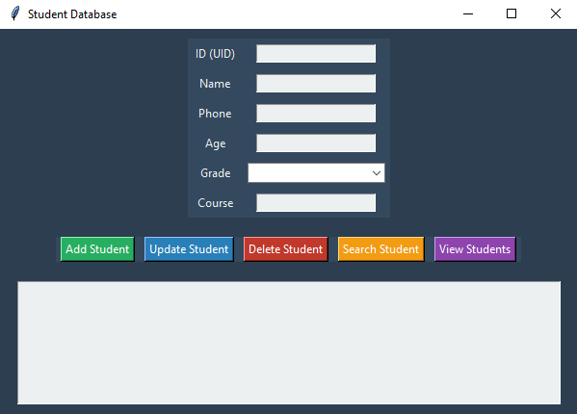
Output 1. Dashboard Page

Slide 10
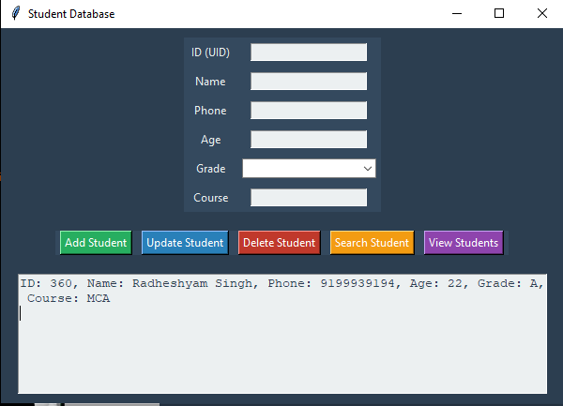
2. View Students

Slide 11
Database Design
Tables:
- Course: Stores course details
- Student: Stores student information
- uid: INTEGER (Primary Key)
A unique identifier for each student. This is set as the primary key, ensuring no two students can have the same uid.
Example:
CREATE TABLE course (...)

Slide 12
Modules
The application is built with various modules that each serve a distinct function.These modules work together to allow users to manage student records, including adding, updating, deleting, and viewing students.The key modules in the system are:Database Connection
Table Creation
Add Student
Update Student
Delete Student
Search Student
View Students
Input Validation

Slide 13
Key Features and Functionalities
- Add New Student:Add new student records to the database, capturing details like UID, Name, Phone, Age, Grade, and Course.
Update Student Information:Allows modification of existing student records by providing a unique Student ID (UID).
Delete Student Records:Enables deletion of a student record based on UID.
Search for Students:Search for student records by name, showing results dynamically.
View All Students:Displays a list of all students stored in the database.
Input Validation:Ensures that all data is entered correctly (e.g., valid numeric input, non-empty fields).

Slide 14
Advantages
- User-Friendly Interface
- Lightweight Database
- Cross-Platform Compatibility
- Scalable Design

Slide 15
Disadvantages
- Database Limitations: Not for large datasets
- Performance: Tkinter may lag
- Security Concerns: Requires robust measures

Slide 16
Testing and Evaluation
- Functional Testing: Verified features
- Usability Testing: Improved based on feedback
- Performance Testing: Measured response under load

Slide 17
Future Enhancements
- Improved user experience
Enhanced functionality
- Multi-User Access: Enhanced security
- Advanced Security: Encryption and secure login
- Scalability and performance improvements
- Integration with additional systems and services

Slide 18
Conclusion
Summarize the key features and functionality.
Highlight how the project meets its goal of creating an easy-to-use student management application.
Thank the audience for their attention and invite questions.

