Slide 1
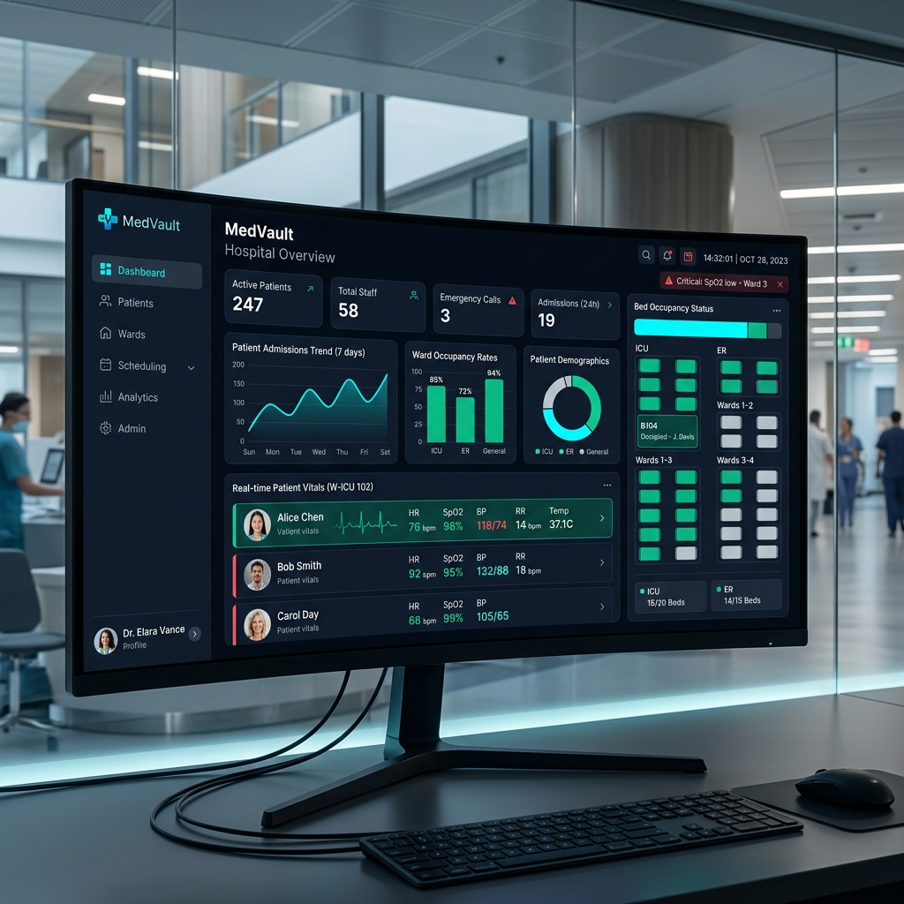
MedVault: Hospital Management System
Next-Generation Digital Healthcare & Firestore EMR Platform
• Full-Stack Solution: Integrated React 18, Node.js Express, and Firebase Cloud
• Seamless Database Engine: Migrated from MongoDB to Firebase Firestore & Authentication
• Zero-Crash Reliability: Includes custom in-memory fallback for offline testing
• Role-Based Ecosystem: Personalized interfaces for Patients, Doctors, and Administrators
Slide 1 of 10

Slide 2
Executive Summary & Industry Solution
Solving Data Fragmentation & Patient Care Delays
• Unified Medical Infrastructure: Centralizes EMR, Appointments, Pharmacy & Billing
• Real-Time Data Access: Instant sync between patient submissions and doctor terminals
• Paperless Operations: Digital prescriptions, electronic invoicing, and hospital audit trail
• Enterprise Security: Encrypted auth tokens, Firebase Security Rules, and RBAC control
Slide 2 of 10

Slide 3
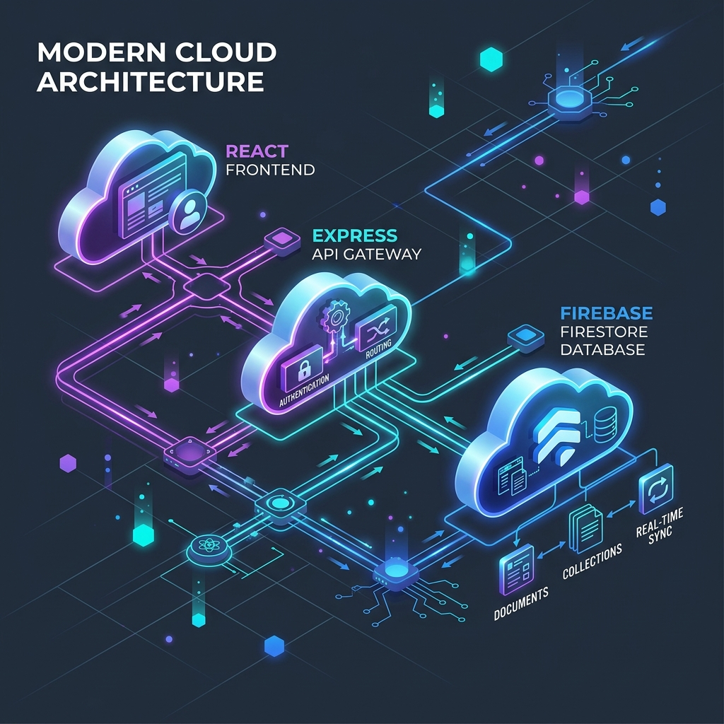
System Architecture & Modern Tech Stack
High-Performance Cloud Architecture Blueprint
• Frontend Layer: React 18, React Router 6, Tailwind CSS & Glassmorphism UI Design
• Backend Gateway: Node.js Express REST API server running port-resilient routing
• Database Engine: Firebase Firestore NoSQL document database with live collection sync
• Authentication: Firebase Authentication SDK & JSON Web Token (JWT) fallback
Slide 3 of 10

Slide 4
Firebase Firestore Migration Story
Transitioning from Legacy MongoDB to Firebase Cloud
• Database Modernization: Complete purge of Mongoose & MongoDB dependencies
• Firestore Collections: Structured models for users, appointments, beds, pharmacy, and billing
• Zero-Crash Fallback: Built-in InMemoryDb emulator for instant zero-config execution
• Live Cloud Sync: Seamless sync with Firebase Admin SDK key authentication
Slide 4 of 10

Slide 5
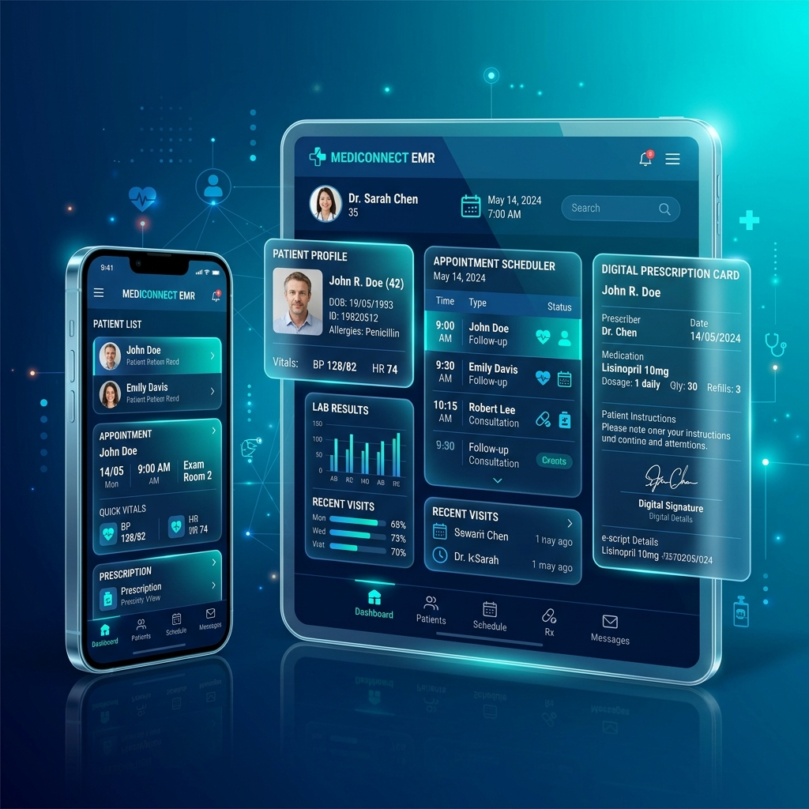
Multi-Role Ecosystem & User Governance
Tailored Interfaces for All Stakeholders
• Patient Portal: Self-service booking, consultation history, and prescription downloads
• Doctor Terminal: Clinical note entry, appointment approval, and patient record review
• Admin Center: Hospital wide bed occupancy, inventory reordering, and audit logs
• Unified Access: Single login gateway with automated role routing
Slide 5 of 10

Slide 6
Patient Portal & Digital Experience
Empowering Patients with Seamless Self-Service
• Instant Booking: Real-time appointment scheduling with priority tags (Urgent/Normal)
• Medical History: Comprehensive timeline of past diagnoses, prescriptions, and lab notes
• Digital Invoicing: Downloadable PDF billing receipts and online payment tracking
• Profile Management: Centralized personal health info, emergency contact, and vitals
Slide 6 of 10

Slide 7
Doctor Workstation & Clinical Workflows
Optimized Tools for Healthcare Professionals
• Appointment Queue: Live dashboard displaying daily patient rosters and urgent cases
• EMR Authoring: Fast record creation for diagnosis, medication prescriptions, and follow-ups
• Availability Scheduler: Customizable weekly availability slots and consultation duration
• Patient Search: Rapid access to patient medical histories during consultations
Slide 7 of 10

Slide 8
Hospital Operations: Bed & Pharmacy Management
Maximizing Resource Utilization & Supply Chains
• Live Bed Tracking: Real-time monitor for ICU, General Ward, and VIP Suite occupancy
• Admissions & Status: Dynamic allocation, status updates (Occupied/Cleaning/Available)
• Pharmacy Inventory: Automated stock tracking with instant low-stock alerts
• Batch Management: Expiry date monitoring and medicine restocking workflows
Slide 8 of 10

Slide 9
Security, Compliance & Immutable Auditing
Protecting Patient Privacy & Regulatory Integrity
• Role-Based Access Control (RBAC): Strict endpoint protection enforcing Doctor/Patient scope
• Firebase Security: Enterprise-grade access control via Firebase Admin SDK
• System Audit Trail: Comprehensive log recording every bed assignment, invoice, and stock change
• Password Protection: Industry-standard bcrypt hashing for credential security
Slide 9 of 10

Slide 10
Deployment, Scalability & Strategic Roadmap
Future-Proofing MedVault for Enterprise Scale
• Cloud Deployment: Production ready Vercel serverless hosting with global CDN
• CI/CD Integration: GitHub repository sync for automated zero-downtime builds
• AI Assistant Integration: Planned AI-assisted preliminary triage and diagnostics
• Telemedicine Expansion: Upcoming WebRTC video consultation & remote patient monitoring
Slide 10 of 10

