Slide 1


MANCHESTER UNITED | DATA SUMMARY
Champions League Group Stage 2021/22

Slide 2
MANCHESTER UNITED | EXPECTED GOALS FOR AND AGAINST
Champions League Group Stage 2021/22
MANCHESTER UNITED | MINUTES PLAYED
Champions League Group Stage 2021/22
Data: Statsomb via Fbref

Slide 3
CHAMPIONS LEAGUE | EXPECTED GOALS FOR AND AGAINST
Champions League Group Stage 2021/22
CHAMPIONS LEAGUE | EXPECTED GOALS VS ACTUAL GOALS
Champions League Group Stage 2021/22
Data: Statsomb via Fbref
Data: Statsomb via Fbref

Slide 4
ATTACKING SEQUENCE INVOLVEMENTS | MANCHESTER UNITED
Champions League Group Stage 2021/22
Involvement In Final 1/3 Passes
Passes That Lead To Shots
Shots On Target
Data: Statsomb via Fbref

Slide 5
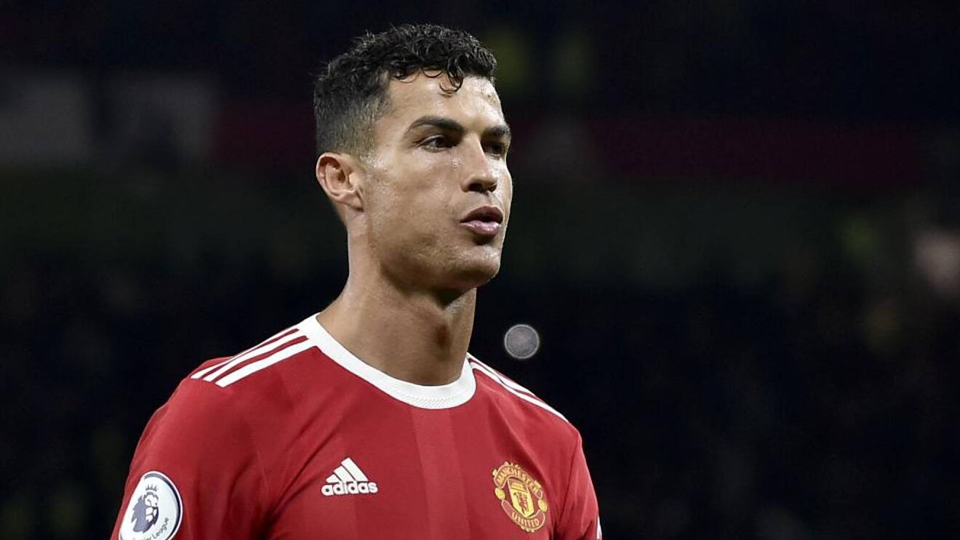
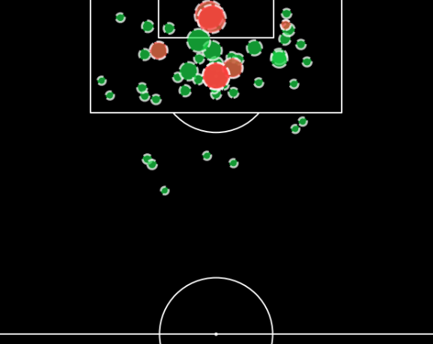
CRISTIANO RONALDO | MANCHESTER UNITED | PLAYER PROFILE
All Competitions 2021/22
Low Chance
High Chance
Goals
Shots
Shots On Target
DIRECTION OF PLAY
DIRECTION OF PLAY
Shot Map Premier League 2021/22
Data: Understat

