Slide 1
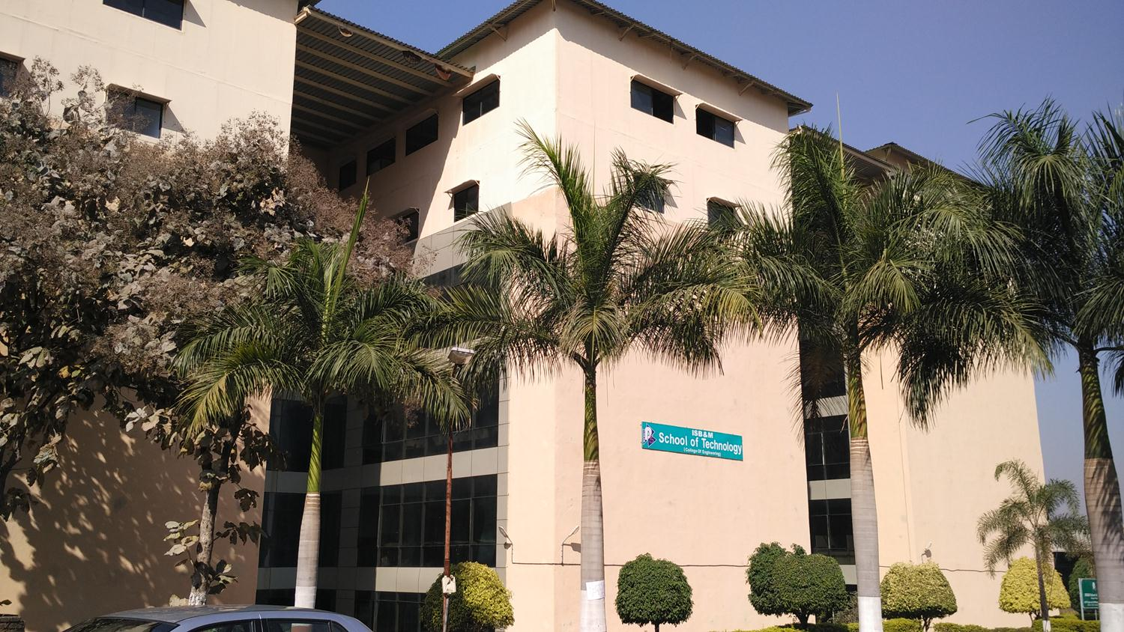
ISB&M School of Technology

Slide 2
FACE-ATTENDANCE
ISB&M School of Technology
Presented By :- Sopan Bhere

Slide 3
AIM
Face recognition is a method of identifying or verifying the identity of an individual using their face.
Face recognition systems can be used to identify people in photos, video, or in real-time.
The attendance system will track employee location, time of clocking/out, and the report recorded.

Slide 4
PRINCIPLE
Support vector machines (SVMs) are powerful yet flexible supervised machine learning algorithms which are used both for classification and regression.
The goal of SVM is to divide the datasets into classes to find a maximum marginal hyperplane (MMH).
Support Vectors − Datapoints that are closest to the hyperplane is called support vectors. Separating line will be defined with the help of these data points.
Hyperplane − As we can see, it is a decision plane or space which is divided between a set of objects having different classes.
Margin − It may be defined as the gap between two lines on the closet data points of different classes. It can be calculated as the perpendicular distance from the line to the support vectors. Large margin is considered as a good margin and small margin is considered as a bad margin.

Slide 5
PROJECT METHODOLOGY
Dataset Creation
With CSV name & Roll no.
Pre-processing-
Face Detection
Pre-Processing – 128-D embedding for ML
Training –
ML - SVM
Load Model, LE & CSV
Pre-process frame from Camera
Classification

Slide 6
CONTINUE..
Dataset Creation Training With ML
Pre-processing With Embeddings Attendance System

Slide 7
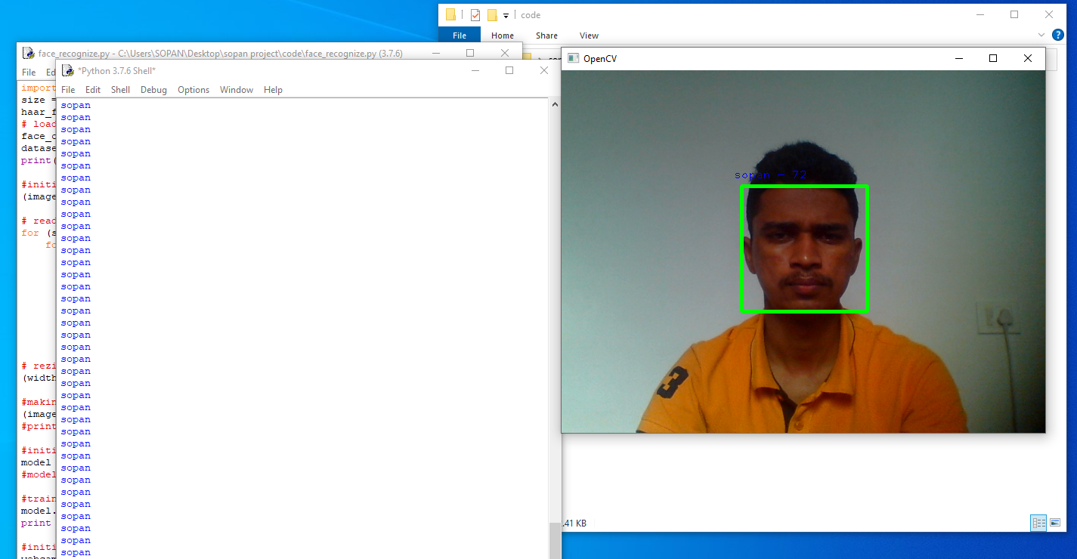
OUTPUT & CONCLUSION

Slide 8
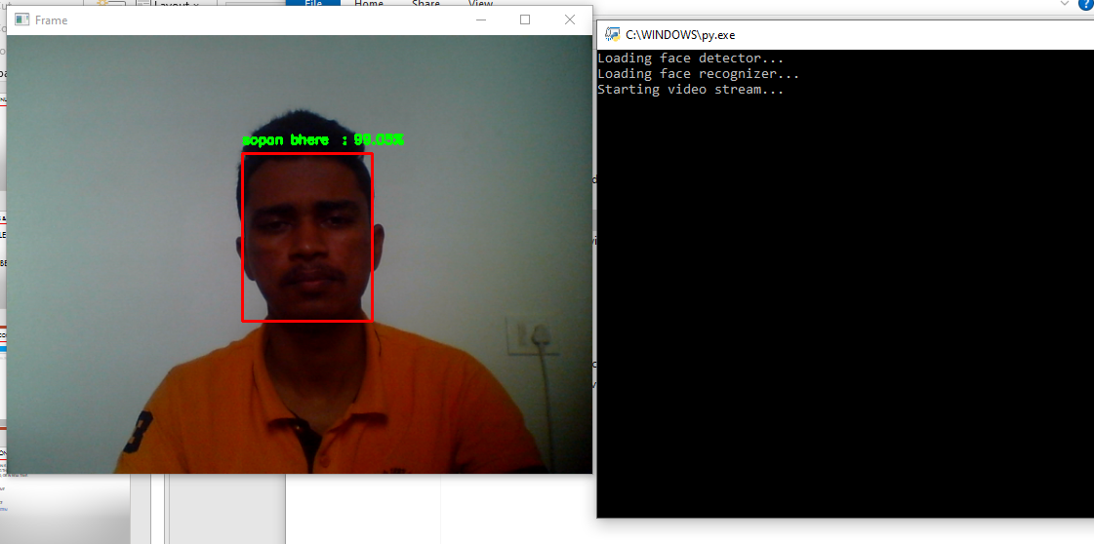
Continue…

Slide 9
APPLICATION
Face recognition is a method of identifying or verifying the identity of an individual using their face.
Face recognition systems can be used to identify people in photos, video, or in real-time.
Preventing crime
Unlock device
Blind assistance
Attendance system
Payments

Slide 10
SKILL
Python language
Opencv-python package
Imutils package
Time package
CSV package
OS package

Slide 11
OPINION
This project was totally new to me.
I have never created like this and the experiences I made were good.
I looked critically at the project, but as time went by my thoughts got clearer and i had a better plans of what the project might look like.

Slide 12
THANK YOU...

