Slide 1
ROLE BASED LEARNING (online Platform)
Final Year Project(BE)
by

Slide 2
Content
Introduction
Literature Review
Problem Statement
Methodology
Applications
Conclusion
Future Scope

Slide 3
INTRODUCTION
Web-based learning, also known as online learning or e-learning, is a modern approach to education that utilizes the internet and web technologies to deliver educational content and facilitate learning experiences. Instead of traditional face-to-face classrooms, learners can access courses and resources through digital platforms, allowing for greater flexibility and accessibility.
We are offering free different learning resources based on your interest or based on role/position
We provide high-quality learning content tailored to each role or position. This could include video tutorials, articles, quizzes, interactive exercises, and downloadable resources.

Slide 4
LITERATURE REVIEW
Index | Paper Name | Literature Survey | Paper Year | Author
01 | Model for web-based e-learning education | Web-based e-learning education research and development now focuses on the inclusion of new technological features and the exploration of software standards. | 2022(IEEE) | Vines, J. M.
02 | Influencing E-Learning | E-learning is gaining more and more impact, especially in the format of blended learning, and this new kind of traditional teaching and learning can be practiced in many ways | 2021(Sage Journals) | Anne Kristine Petersen
03 | Problem Based Learning | Studies that have examined the process of PBL and how its various components impact students’ learning. | 2019(science direct) | Karen Goh

Slide 5
METHODOLOGY
Define Target Audience
Content Creation
Platform Development
User Authentication
Progress Tracking
Interactivity & Engagement
Mobile Compatibility
Collaborations with Experts
Marketing and Outreach
Continuous Improvements
Legal & Privacy Considerations

Slide 6
TOOLS & TECHNOLOGY UTILIZED
FRONT END
HTML, CSS
JS, ReactJS
BACK END
Python
Django
DATA BASE
SQLite
Postgre SQL

Slide 7
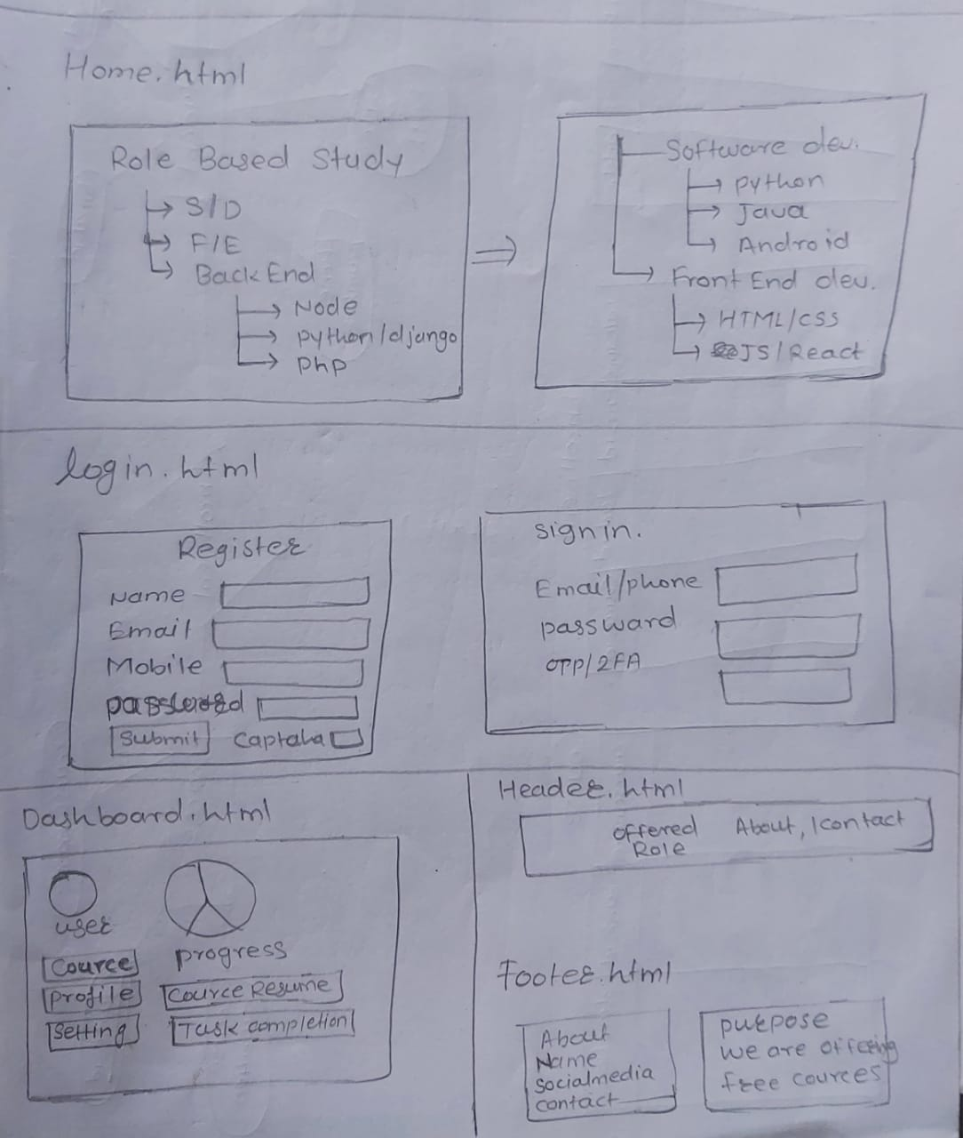
FRONT END DESIGN

Slide 8
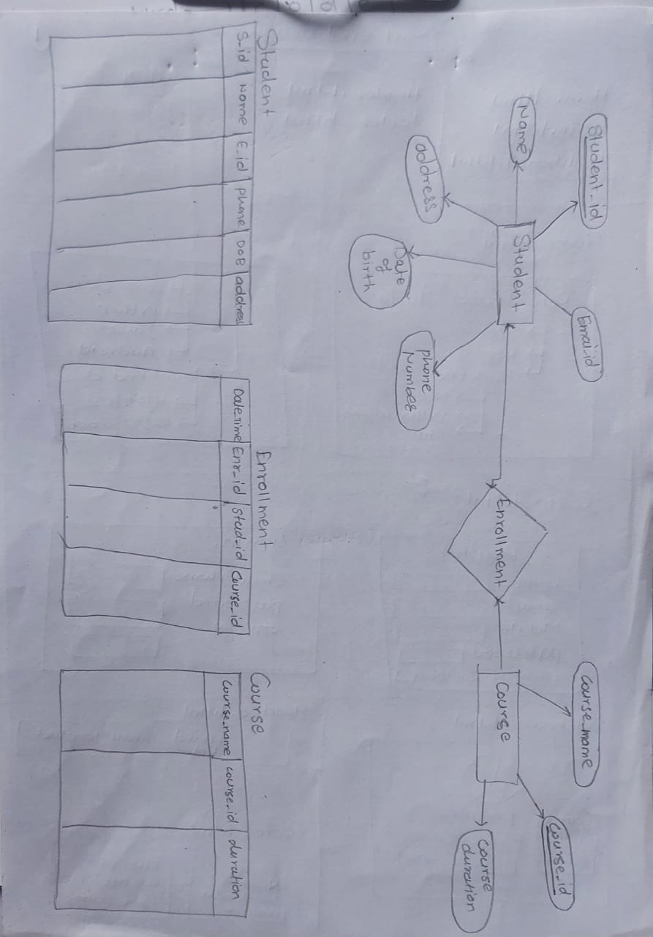
DATA BASE DESIGN

Slide 9
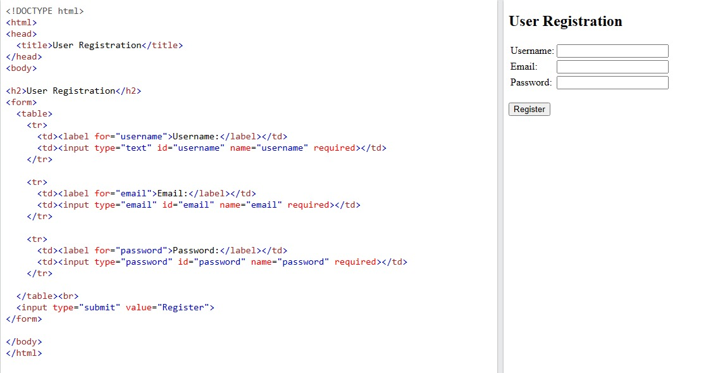

Slide 10
APPLICATIONS
Corporate Training
IT & Technology
Healthcare
Education
Government and Public Sector

Slide 11
CONCLUSION
Relevance: Role-based learning ensures that learners receive content directly related to their job roles, making the learning experience more meaningful and practical.
Efficiency: Tailored content allows learners to focus on what is most relevant to their roles, reducing the time and effort spent on irrelevant topics.
Engagement: By addressing specific challenges and scenarios encountered in their roles, learners are more engaged and motivated to complete the training.
Personalization: Role-based learning offers a personalized learning path for each learner, promoting a sense of ownership and empowerment over their professional development.

Slide 12
FUTURE SCOPE
Advanced Personalization: As technology advances, role-based learning platforms can use AI algorithms and data analytics to offer even more personalized learning experiences based on learners' preferences, progress, and performance.
Microlearning: Role-based microlearning, where content is delivered in small, easily digestible units, can become more prevalent. This approach allows learners to access relevant information on-demand and fits well with busy work schedules.
Virtual and Augmented Reality: The future of role-based learning may involve incorporating virtual and augmented reality to provide immersive training experiences. This can be particularly useful in fields where hands-on practice is critical, like healthcare and technical professions.
Continuous Learning: Role-based learning platforms can support continuous learning by providing regular updates and new content to keep learners up-to-date with industry trends and advancements.

Slide 13


ANY QUESTION FOR US?

