Slide 1
Probe VA: Noam Chomsky’s Universal Grammar & Language Acquisition
By Samuel Pearce

Slide 2
Project Structure
Universal Grammar Summary Paper
Language Acquisition Experiment
Read “Chomsky’s Universal Grammar: An Introduction”
Summarise its contents
Analyse the current state of the field
Teach two participants Toki Pona with different methods
Hold an interview with them both
Summarise the experiment results

Slide 3

Hold on, what is Toki Pona?
A minimalist language
Only ~120 words
Grammar can be summarised in 7 rules
Can be both learned and acquired in a very short period of time

Slide 4
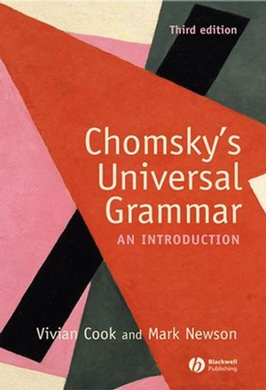
Universal Grammar Paper
I have begun reading it
I’ve skimmed other introductory resources to get an overview of what needs my attention the most
No work done on the paper yet

Slide 5
Language Acquisition Experiment
Participant A (Traditional Learning)
Participant B (Immersion Learning)
Has the Toki Pona official book
Has begun studying
Still at a beginner level, but has spent less time learning
Has been spoken to in person, via text chat and in a virtual environment
Has already picked up conversational basics

Slide 6

Participant B Dialogue Example:
Participant B
Experimenter
“lon”
“mi sona”
“kasi li laso?”
“sina wile ala wile sona e nimi ‘Kule’?”
“kasi li jo e kule seme?”
“lon!”
“Would you like to learn the word ‘kule’ ?”
“Yes.”
“This is Red/Green/Blue/Yellow”
“I understand.”
“What colour are plants?”
“Plants are green?”
“Correct!”

Slide 7

Thanks for your attention
Any Questions?

