Slide 1

Simulation of blood flow in multi-layered arterial model using CFD
1

Slide 2
Contents
Sl.no | Contents | Slide no.
1. | Introduction and background | 3, 4
2. | Problem statement and Objectives | 5
3. | Literature survey | 6-11
4. | Requirement Analysis | 12
5. | Task Identification and Material Research | 13, 14
6. | Flow Chart | 15
7. | Applications and future scope | 16
8. | Proposed system (modelling) | 17,18
9. | Conclusion | 19
2

Slide 3
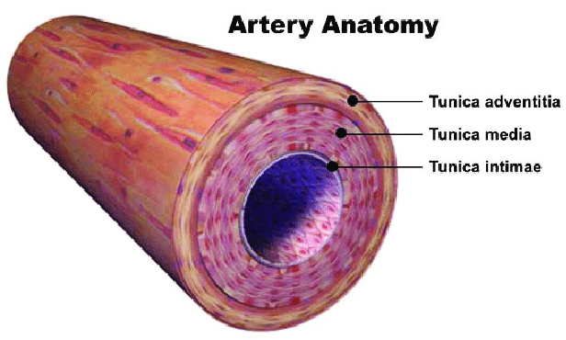
Introduction
Three-Layered Artery Structure:
Tunica Intima: Thin endothelial lining minimizing friction.
Tunica Media: Smooth muscle and elastic fibers enabling dilation/constriction.
Tunica Adventitia: Connective tissue with collagen fibers for structural support.
Functional Benefits: Provides strength, elasticity, and resilience under high-pressure blood flow.
Ensures adaptability to varying hemodynamic forces.
Simulation Approach: Utilizes COMSOL 6.2 for realistic, high-fidelity arterial simulations incorporating all three layers.
3

Slide 4
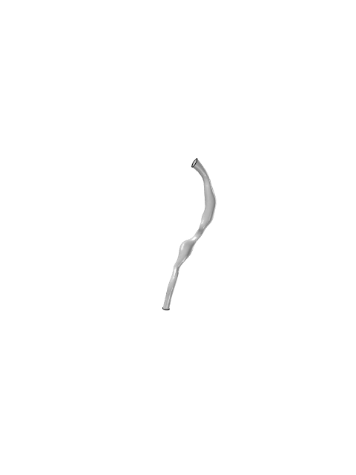
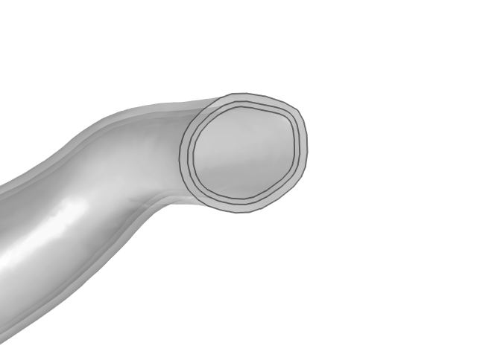
Motivation and Background
Improvement from Single-Layer Model: Addresses oversimplified arterial dynamics
Layer Differentiation: Models intima, media, and adventitia with distinct properties.
Three-Layer Approach: Enhances blood flow simulation and hemodynamic accuracy.
HGO Framework Implementation: Captures nonlinear stiffening and anisotropy.
Fiber Orientation Integration: Simulates directional stiffness for realism.
CFD Simulations: Analyzes velocity, pressure, and wall shear stress effectively.
Single layered artery model
Three Layered artery model
4

Slide 5
Problem Statement
Simulation of blood flow in multi-layered arterial model using CFD.
Objectives
Develop a robust and multilayered 3 Dimensional arterial structure.
Incorporate realistic material properties for the media, adventitia, and intima layers using advanced mathematical models and incorporate hyperelastic behavior.
Capture nonlinear stiffening and anisotropic behavior to resemble a real non uniform artery.
Analyze velocity profiles, pressure gradients, and wall shear stress under physiological conditions.
5

Slide 6
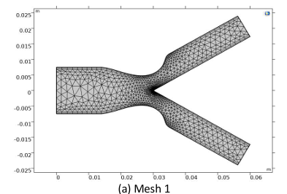
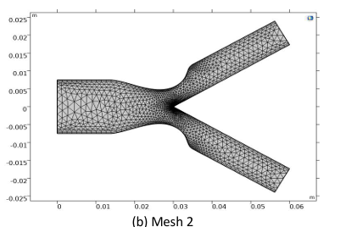
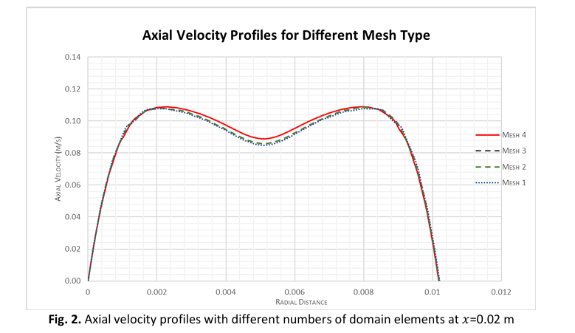
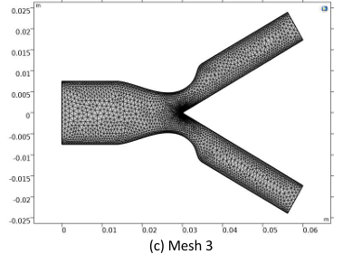
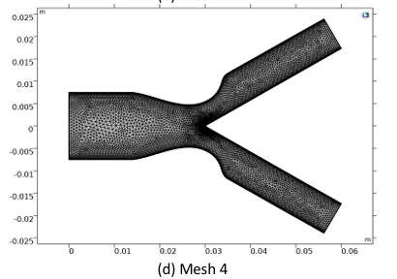
Literature Survey
Numerical Computational of Blood Flow and Mass Transport in Stenosed Bifurcated Artery
Kannigah Thirunanasambantham, Zuhaila Ismail, Lim Yeou Jiann, Amnani Shamjuddin
Journal of Advanced Research in Fluid Mechanics and Thermal Sciences Volume 110, Issue 2 (2023) 79-94
Introduction :
Coronary Artery Disease (CAD): Leading cause of mortality due to atherosclerosis.
Stenosis Impact: Narrows arteries, alters hemodynamics, and increases cardiovascular risks.
Study Approach: Uses COMSOL Multiphysics (FEM) to simulate blood flow in a stenosed bifurcated artery.
Blood Model: Non-Newtonian Carreau fluid to account for shear-thinning properties.
Key Analysis: Examines velocity distribution, mass concentration, and recirculation effects.
Objective: Assess stenosis severity and Reynolds number effects on hemodynamics.
Results :
Velocity Profiles
Velocity increased as Reynolds number increased.
Higher stenosis severity (60%) caused a peak velocity in the narrowed region, leading to disturbed flow patterns.
Recirculation zones were observed downstream of stenosis, leading to turbulence.
Mass Concentration
Higher Reynolds numbers led to greater mass transport.
In severe stenosis (60%), mass concentration was higher, increasing the risk of plaque formation.
Recirculation zones showed higher solute accumulation, indicating atherosclerosis-prone areas.
Wall Shear Stress (WSS)
Shear stress increased significantly at stenosis sites, potentially leading to endothelial damage.
Bifurcation points showed high WSS, confirming their role in plaque development.
Methodology :
Computational Modeling
A 2D stenosed bifurcated artery model was created.
Artery assumed as a rigid wall with no-slip conditions.
Blood modeled as a non-Newtonian Carreau fluid.
Governing Equations
Continuity equation for mass conservation.
Momentum equations for blood flow behavior.
Mass transport equation (Fick’s Law) for solute concentration.
Simulation Setup
Solved using COMSOL Multiphysics 5.2 (FEM).
Simulations for Reynolds numbers: Re = 300, 500
Simulations for stenosis severity: 20%, 40%, 60%.
Mesh refinement to ensure accuracy
6

Slide 7
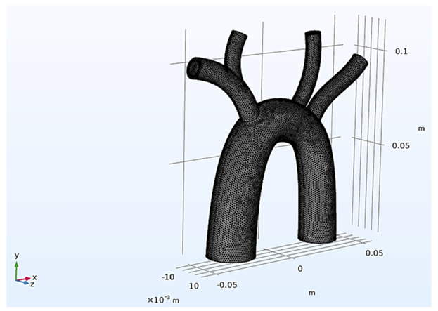
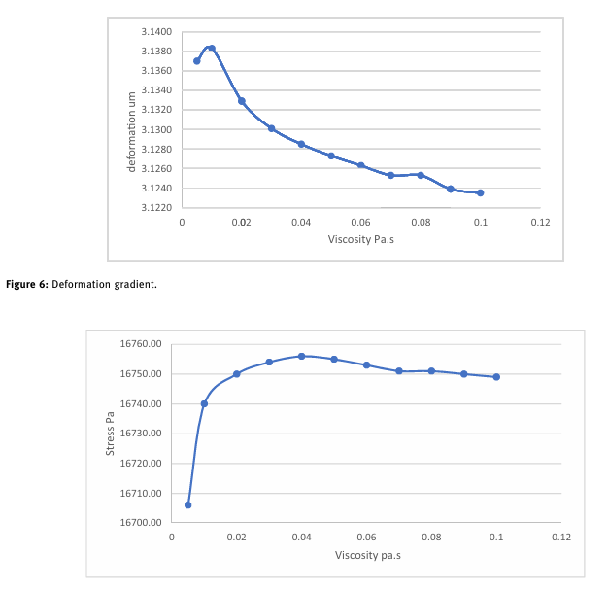
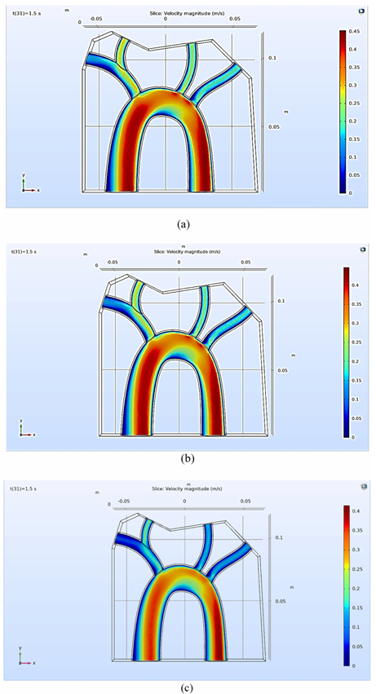
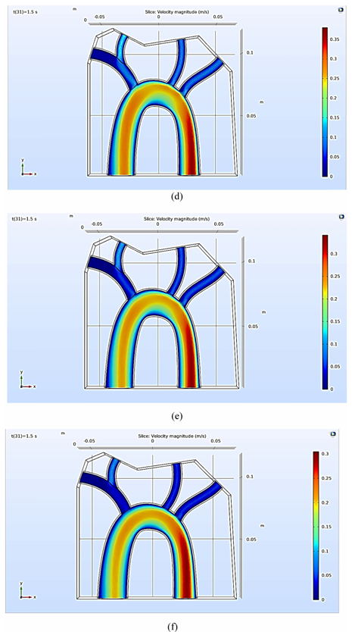
Literature Survey
Multiphysics analysis for fluid–structure interaction of blood biological flow inside three-dimensional artery
Natiq Abbas Fadhil, Karrar A. Hammoodi, Lina Jassim, Hasan A. Al-Asadi, and Laith Jaafer Habeeb
Curved and Layered Structures 2023; 10: 20220187
Introduction
Blood is a liquid with mechanical properties, and arteries have structural mechanics that influence their behavior.
Smoking increases blood viscosity, affecting velocity, pressure, and arterial deformation.
The study focuses on fluid-structure interaction (FSI) in the aorta, analyzing how viscosity changes blood flow characteristics.
Uses COMSOL Multiphysics to solve kinetic equations and analyze blood-artery interactions.
Investigates the impact of viscoelasticity on arterial deformation and stress distribution.
Results :
Higher blood viscosity reduces velocity, increasing arterial stress.
Increased viscosity leads to higher pressure at the carotid artery, restricting blood flow.
Arterial deformation decreases with increasing viscosity, indicating stiffness.
The model confirmed recirculation zones that could contribute to plaque formation.
Methodology :
Computational Modeling
A 3D aorta model was designed using SolidWorks and imported into COMSOL Multiphysics.
The finite element method (FEM) was used to solve equations.
Variable viscosity levels were tested to assess their effect on blood flow and artery behavior.
Governing Equations
Navier-Stokes equations for incompressible, viscous fluid motion.
Continuity equation for mass conservation.
Stress-strain equations for arterial deformation analysis (FSI model).
Simulation Setup
The inlet velocity profile was set to mimic pulsatile blood flow.
Boundary conditions:
Inlet pressure = 126.09 mmHg.
Time step = 0.005 s over 1.5 s simulation period.
Mesh convergence analysis was conducted to ensure accuracy.
6

Slide 8
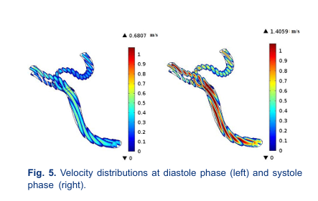
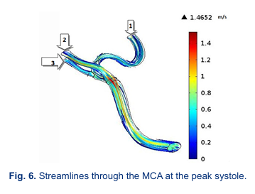
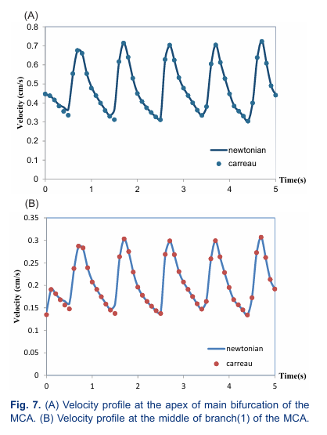
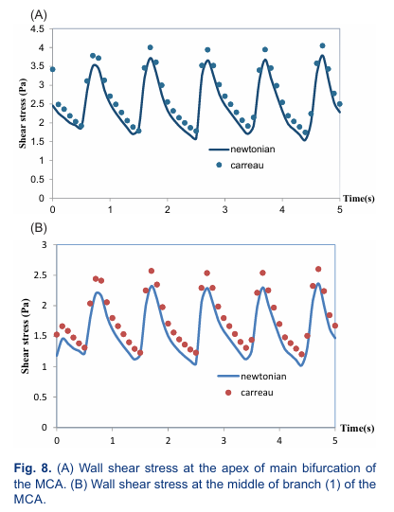
Literature Survey
Numerical investigation of the blood flow through the middle cerebral artery
Seyed Esmail Razavi1, Vahid Farhangmehr2*, Nafiseh Zendeali
BioImpacts, 2018, 8(3), 195-200
Introduction
Stroke is the second leading cause of death globally (WHO report, 2012).
Ischemic stroke, caused by blood clots or stenosis, mainly affects middle cerebral arteries (MCAs).
This study uses Computational Fluid Dynamics (CFD) simulations to analyze blood flow in MCA.
Newtonian vs. Non-Newtonian models were compared for realistic blood flow representation.
Results :
Newtonian and non-Newtonian models showed minimal difference, making the Newtonian assumption valid for MCA.
The most vulnerable region for atherosclerosis was found at the highest curvature of MCA branches.
Velocity peaks occurred at stenotic regions, altering flow dynamics and potentially increasing stroke risk.
Methodology :
Computational Modeling
A 3D MCA model was created using CT angiography data from a 75-year-old man.
Blood was assumed to be laminar, incompressible, and unsteady.
Used COMSOL Multiphysics 5.2 with Galerkin's finite element method (FEM).
Governing Equations
Continuity equation for mass conservation.
Navier-Stokes equations for momentum conservation.
Carreau-Yasuda model was applied for non-Newtonian viscosity effects.
Simulation Setup
Unstructured tetrahedral meshing was used for high accuracy.
Simulated pulsatile blood flow with inlet velocity from Doppler ultrasound tests.
Constant pressure = 1440 Pa at the outlet with no-slip boundary conditions.
8

Slide 9
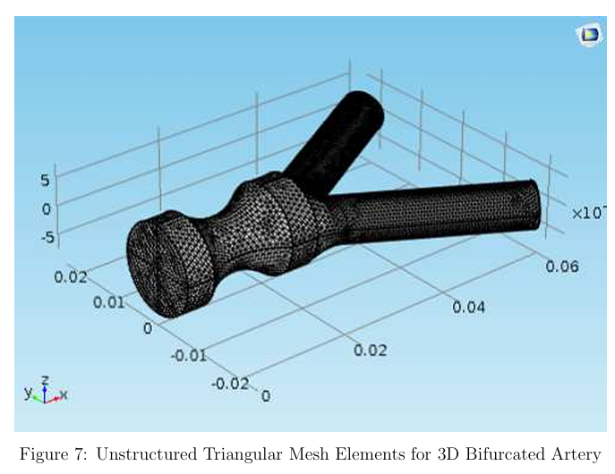
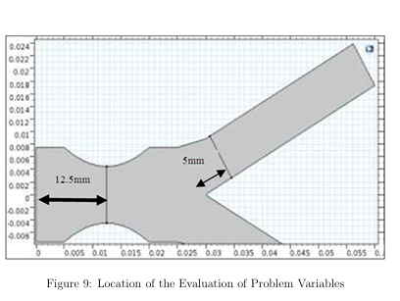
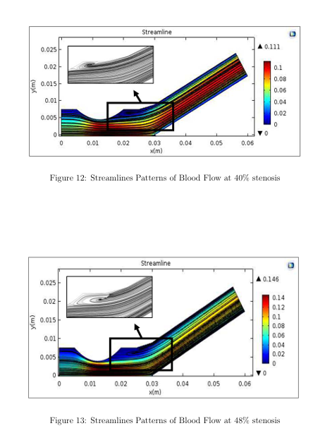
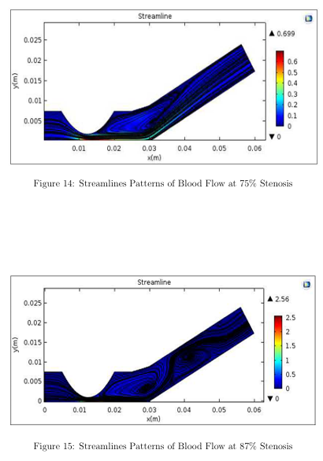
Literature Survey
3D Model of Generalized Power Law Blood Flow in a Stenosed Bifurcated Artery
Azim Azahari, Zuhaila Ismail∗ and Normazni Abdullah
MATEMATIKA, 2018, Volume 34, Number 1, 87–102
Introduction
Atherosclerosis leads to stenosis, reducing blood flow and increasing cardiovascular risk.
Bifurcated arteries are particularly prone to plaque formation due to complex flow patterns.
This study simulates 3D blood flow in a stenosed bifurcated artery using the Generalized Power Law model.
The goal is to analyze velocity, recirculation zones, and shear stress variations.
Results :
Higher stenosis severity increased velocity fluctuations, affecting downstream blood supply.
Recirculation zones formed near bifurcation points, which may lead to atherosclerosis.
Low wall shear stress (WSS) regions correlated with plaque-prone areas.
Methodology :
Computational Modeling
A 3D bifurcated artery model was created based on a previous 2D study by Chakravarty & Mandal.
Blood flow was modeled as steady, incompressible, and non-Newtonian (Power Law model).
Governing Equations
Navier-Stokes equations for fluid motion.
Power Law model for non-Newtonian blood viscosity effects.
Simulation Setup
COMSOL Multiphysics 5.2 was used for finite element modeling (FEM).
Unstructured triangular meshing was applied for high resolution.
Inlet velocity = parabolic profile, ensuring fully developed flow conditions.
9

Slide 10
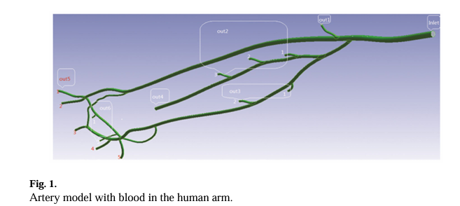
Literature Survey
SIMULATION ANALYSIS OF BLOOD FLOW IN ARTERIES OF THE HUMAN ARM
Wu Quanyu, Liu Xiaojie, Pan Lingjiao, Tao Weige, and Qian Chunqi
Biomed Eng (Singapore). 2017 August ; 29(4)
Introduction
Arm arteries play a crucial role in blood circulation, with ulnar and radial arteries being key blood suppliers.
The radial artery is historically important in traditional Chinese medicine.
This study uses Ansys Fluent to simulate blood flow in arm arteries, analyzing velocity, pressure, and shear stress.
Results :
Ulnar artery dominates blood supply over the radial artery.
High velocity in bifurcations, with peak velocity of 5.8 m/s in the radial collateral artery.
High shear stress in bifurcations, suggesting increased atherosclerosis risk.
Methodology :
Computational Modeling
3D model of human arm arteries created from MRI data.
Blood modeled using the Carreau fluid model to capture non-Newtonian behavior.
Governing Equations
Navier-Stokes equations for fluid flow.
Bird-Carreau model for non-Newtonian viscosity.
Simulation Setup
Inlet velocity = time-varying periodic function (heartbeat model, 75 bpm).
Mesh refinement with tetrahedral elements for accuracy.
Simulation performed using Ansys Fluent with PISO scheme.
10

Slide 11
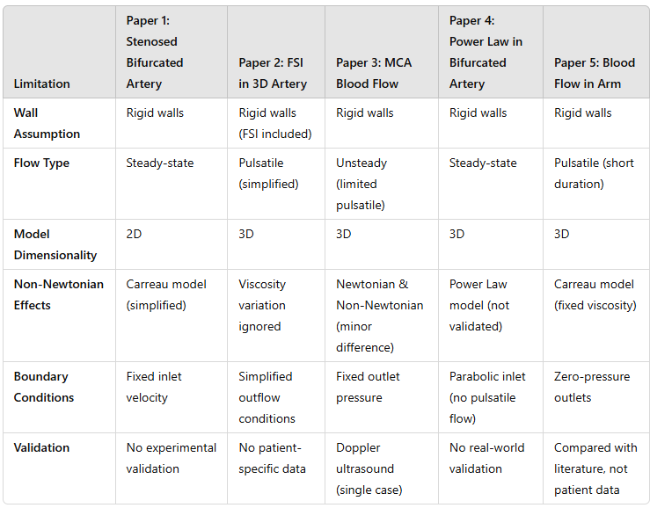
Limitations
11

Slide 12
Requirement Analysis
Functional Requirements:
Accurately model arterial wall properties: Hyper-elasticity, Non linear arterial stiffening, conditions where anisotropy is not the main focus
Simulate realistic blood flow dynamics and wall deformations.
Incorporate three distinct layers: media, adventitia, intima.
Non-Functional Requirements:
Ensure simulation accuracy and reproducibility.
Maintain computational efficiency.
Provide scalability for future extensions.
12

Slide 13
Materials Research
Feature | Mooney-Rivlin | Ogden | HGO (Holzapfel-Gasser-Ogden)
Computational Cost | LOW | HIGH | HIGH
Anisotropic (Fiber Direction)? | NO | NO | YES
Highly Nonlinear Materials? | LIMITED | BEST | BEST
Realistic for Arteries? | OK for ELASTIN | GOOD | BEST
Best Use Case | Elastomers, simple arteries | Soft tissues, Complex arteries | Fiber-reinforced arteries
15

Slide 14
Task Identification
1.Modelling:
Determine optimal model for capturing nonlinear stiffening and fiber reinforcement.
2. Research on mathematical models:
Compare mathematical models (Mooney-Rivlin, Ogden, HGO) for arterial simulations.
3. 3D Geometry Creation:
Design and model a non-uniform, multilayered and realistic arterial geometry.
4. Material Assignment:
Define and assign material properties for the three layers:
Media, adventitia, and intima.
Model | Anisotropy | Nonlinear Stiffening | Best Used For
Mooney-Rivlin | No | Moderate | General soft tissue simulations, preliminary studies
Ogden | No | High | Large deformations, nonlinear artery response
Holzapfel-Gasser-Ogden (HGO) | Yes | Very High | Accurate artery simulations with fiber reinforcement
13

Slide 15
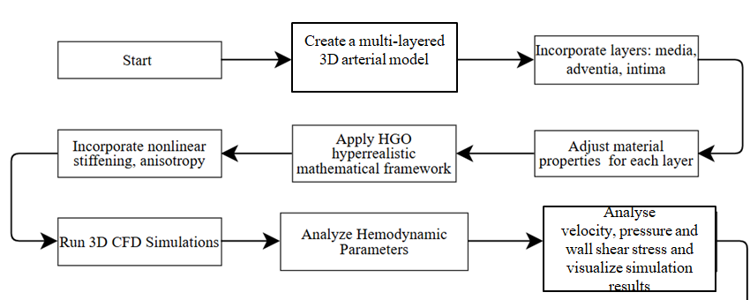
Flow Chart
Generate Dataset
15

Slide 16
Application and Future Scope
Applicability of the problem solution in social context
1.Enhanced Diagnostics: Improves early detection and management of cardiovascular diseases through precise simulation of blood flow dynamics.
2.Personalized Medicine: Supports tailored treatment plans by modeling patient-specific arterial behavior.
3.Non-Invasive Research: Reduces reliance on invasive procedures and expensive clinical trials.
4.Educational Impact: Serves as an advanced tool for training healthcare professionals and engineers.
5.Cost-Effective Healthcare: Streamlines device development and testing, lowering overall healthcare costs.
16

Slide 17
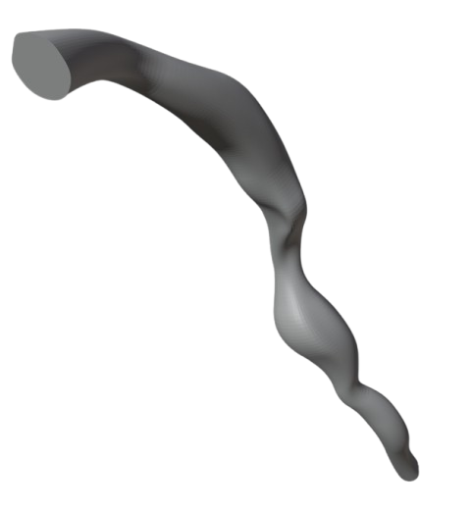
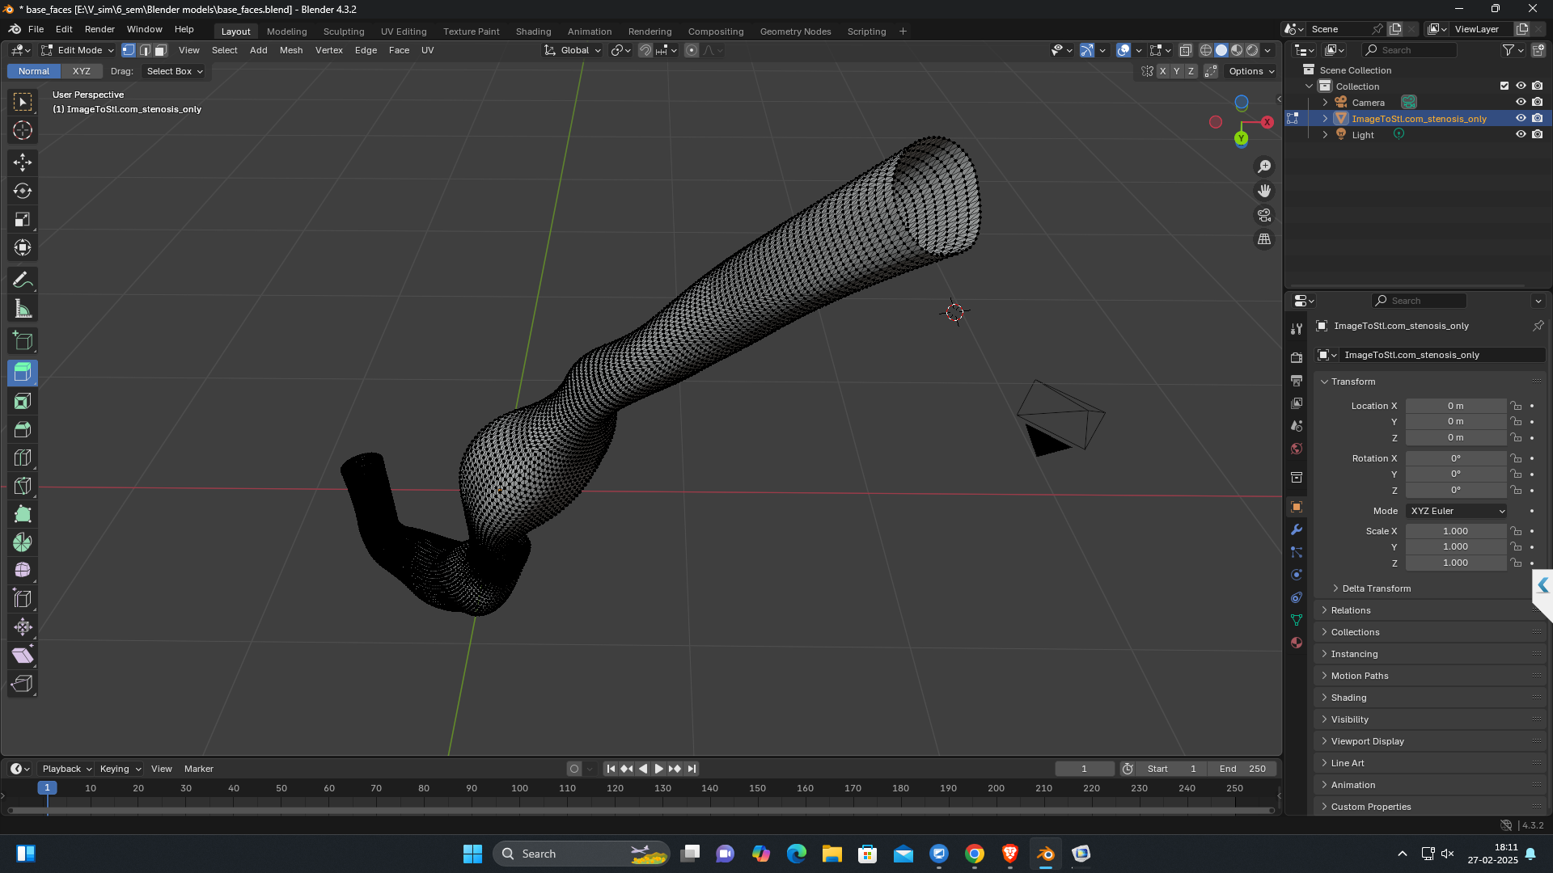
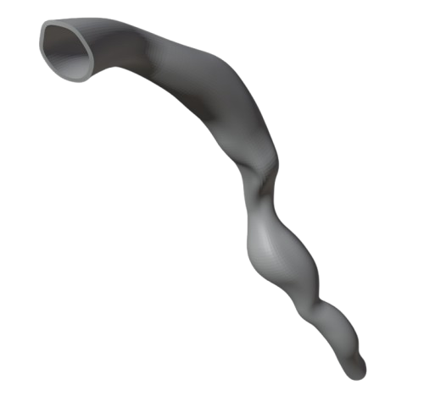
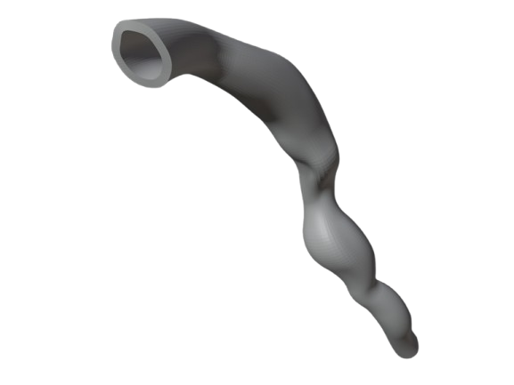
Proposed System
Intima
Media
Adventia
17

Slide 18
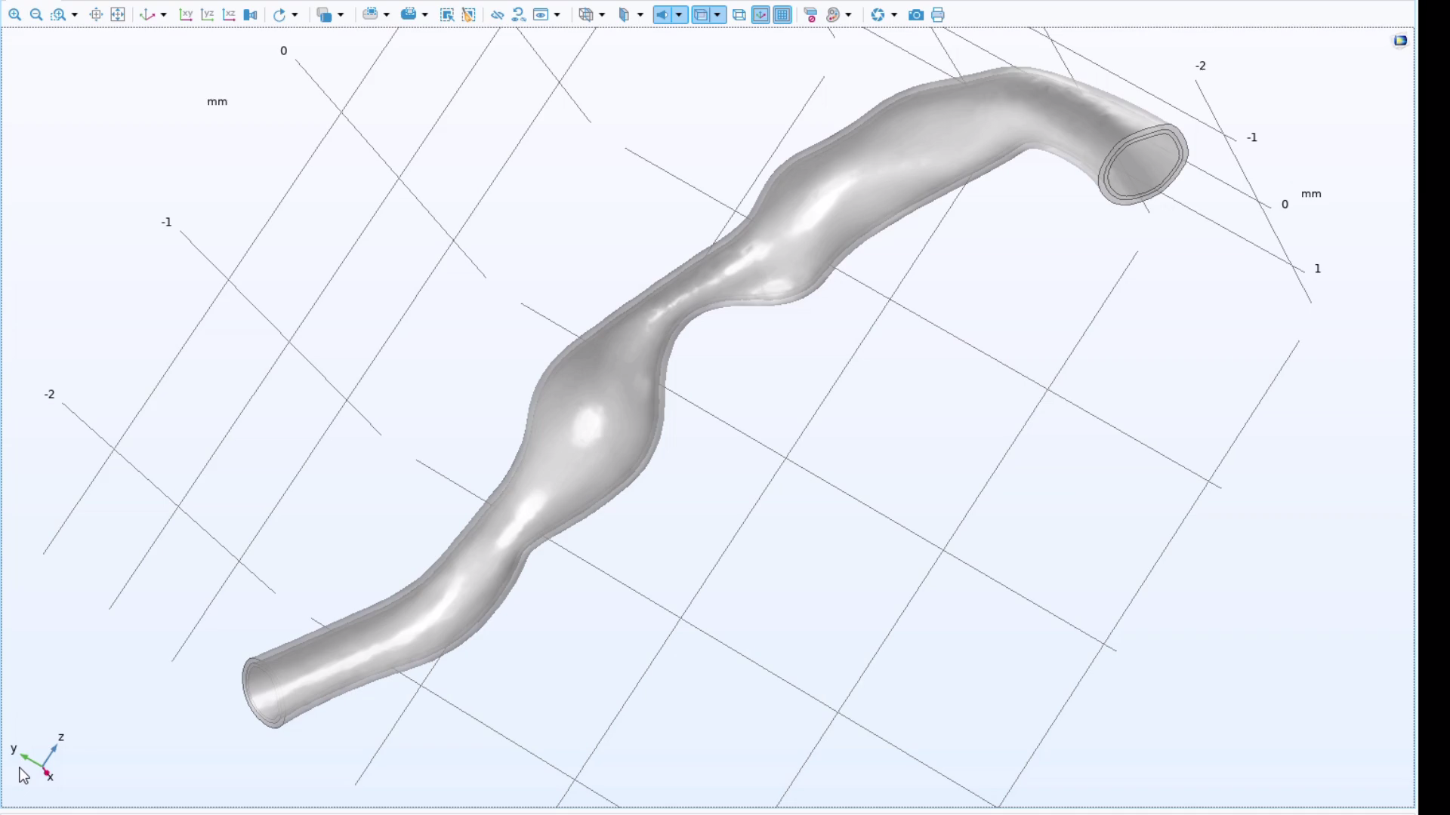
Proposed System
18

Slide 19
Conclusion
Enhanced CFD Model: Captures nonlinear stiffening and anisotropic arterial behavior.
Multilayer Structure: Intima, media, and adventitia improve hemodynamic accuracy.
HGO-Based Transition: More realistic physiological representation for diagnostics and therapy.
19

Slide 20
THANK YOU
20

