Slide 1
Cleaning and Quality Assessment Pipelines

Slide 2
Questions
How to clean well:
Gradient artifacts?
BCG artifacts?
Other physiological artifacts (Blinks, muscles, head movement)?
For free?
How to check the cleaning quality?
In time domain?
In frequency domain?

Slide 3
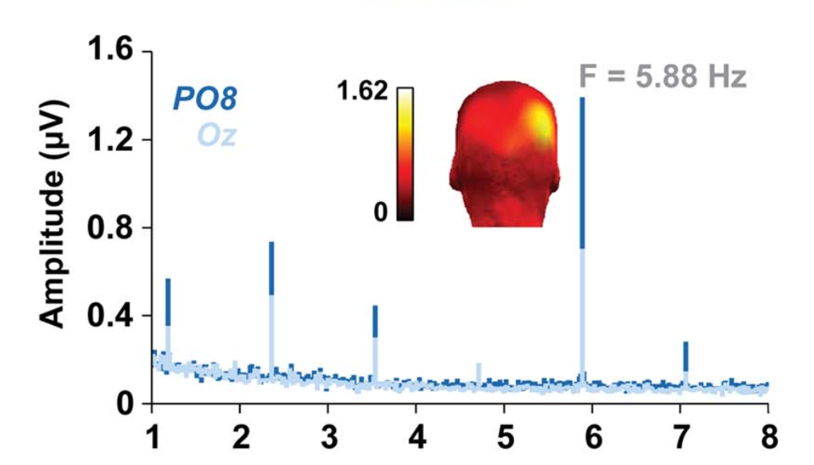
Proposed solutions
Python automated pipeline to clean EEG-fMRI data
Average Artifact Subtraction (AAS) → Gradient artifacts removal
SSP vector projection → BCG artifacts removal
ASR, PREP → Other physiological artifacts removal
Python automated pipeline to evaluate EEG data quality:
Time domain metrics
Frequency domain metrics
(Hz)

Slide 4
frequency_analysis.py
Amplitude spectrum
Zscore
SNR
time_analysis.py
average_rms
max_gradient
zero_crossing_rate
hjorth_mobility
hjorth_complexity
kurtosis
skewness
variance
signal_range
signal_IQR
epoch_snr
signal_metrics.py
raw = mne.io.read_raw_fif(filename,preload=True)
metrics = signal_metrics.SignalMetrics(raw)
metrics.calculate_metrics()
main.py

Slide 5
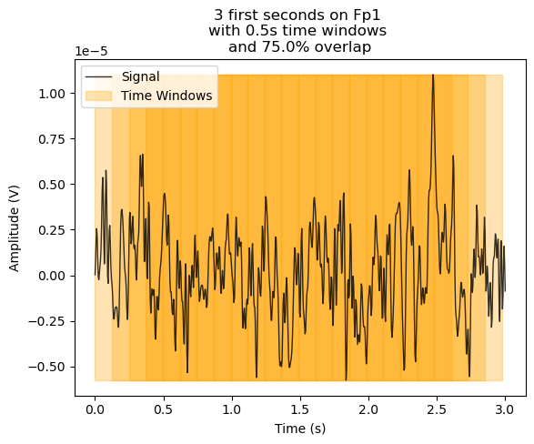
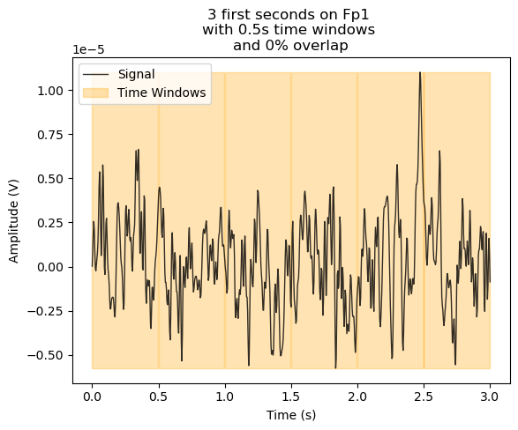
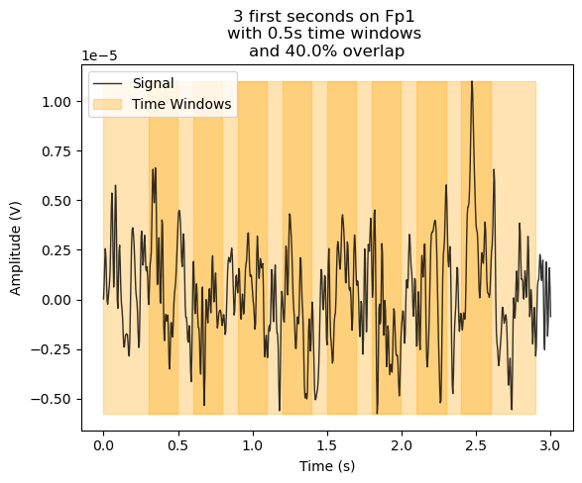
raw data
(channels x time)
signal_metrics.py
Signal metrics
mean_rms
(windows x channels x time)
variance
(window x channels x time)
…
Epoched data
(epoch x channels x time)

Slide 6
Cleaning Methods to Compare
BrainVision software
EEGLAB
CBIN_cleaner (AAS (Gradient removal) + SSP)
CBIN_cleaner + ASR (need portion of data outside of scanner)
A. CBIN_cleaner + ASR + Prep Pipeline (find bad channels)
5. B. and optimal reference)

Slide 7

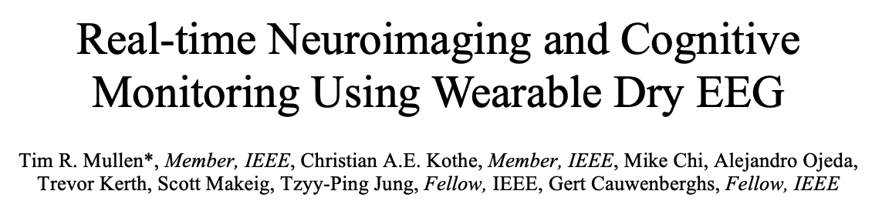
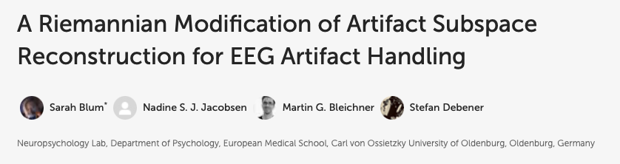
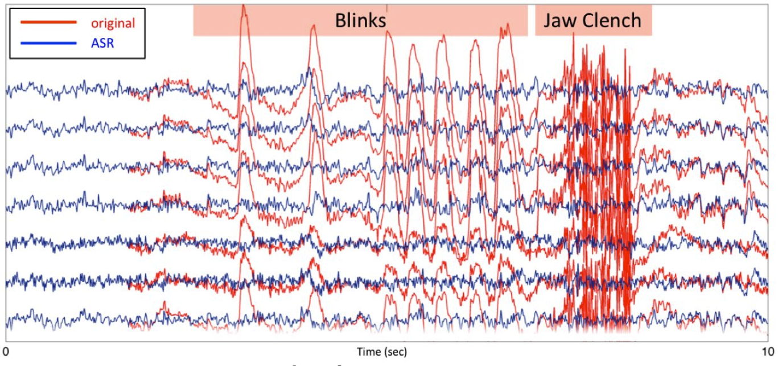
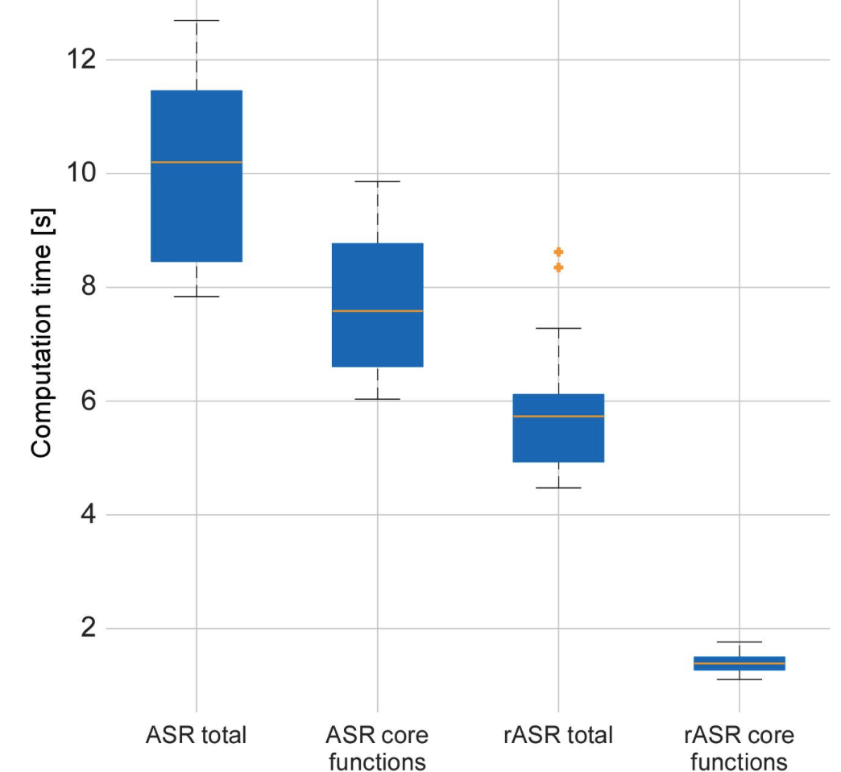
Artifact Subspace Reconstruction (ASR and Riemann ASR)
EEE Trans Biomed Eng. 2015 Nov; 62(11): 2553-67.
doi: 10.1109/TBME.2015.2481482.

Slide 8
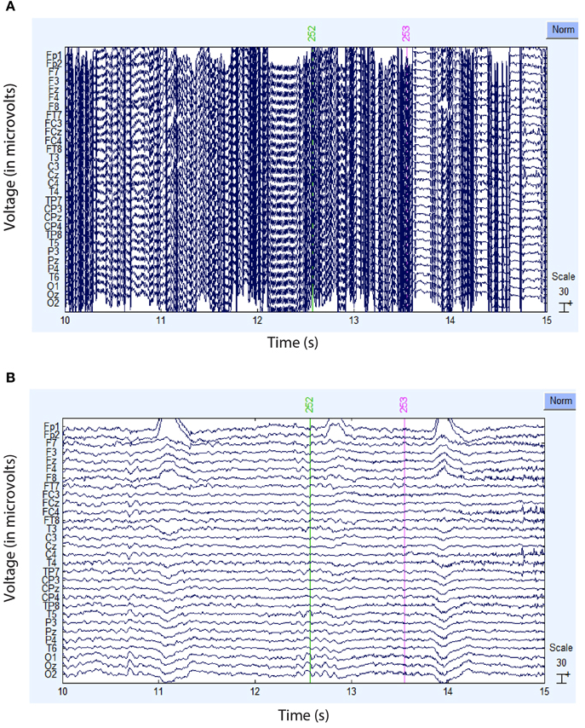

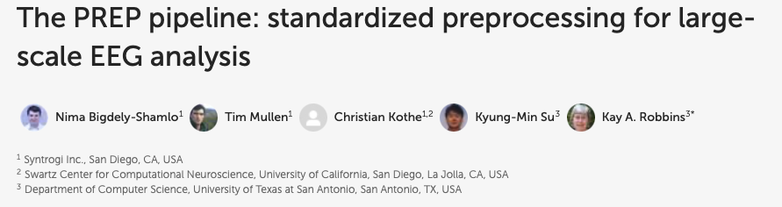
Prep pipeline

Slide 9
Short term goals: Evaluation of Cleaning Pipelines (min 38h)
Integrating ASR and Prep in CBIN-cleaner (16h)
Integration (4h)
Debugging and Testing (12h)
Apply the different methods on all raw data (n data x 4)
”Loop” development, debugging and testing (4h)
Run pipelines (???)
Computing metrics for each output (each methods: n data x 4)
”Loop” development, debugging and testing (2h)
Run pipeline (???)
Write and plot detailed report for each methods. (16h)

Slide 10
Long term goals
Finish GUI
Write documentation and tutorials
Publish python packages
Publish documentation on MNE
Write article on methodology?

