Slide 1

KIT-KALAIGNARKARUNANIDHI INSTITUTE OF TECHNOLOGY COIMBATORE -641 402
Approved by AICTE Affiliated to Anna University, Chennai Accredited With‘A’ Grade by NAAC & By NBA
DEPARTMENT OF ELECTRICAL AND ELECTRONICS ENGINEERING
Sign Language To Speech Conversion
B19EEE504 – IOT TERM PROJECT
Batch Member:
Mahendran R – (711522BEE027) Sam Prakash A – (711522BEE051) Selva Ganesh J – (711522BEE304) Muneeswaran M–(711521BEE501)
Under the Guidance of
Mr. K Pradheep
AP/ EEE
THIRD REVIEW- 25/11/2024

Slide 2
Abstract
This project presents a system that converts sign language into audible speech using flex sensors to detect finger movements and gestures. By translating these hand movements into visual output, it aims to bridge the communication gap for India’s speech-impaired population. This innovative solution enhances interaction ease and accessibility for those with speech impairments, and can potentially transform everyday communication.

Slide 3
Objective
Create a system that converts sign language gestures into audible speech using flex sensors to detect finger movements and bending.
Reduce barriers between sign language users and those who do not know sign language, improving accessibility and interaction in various social and professional contexts.
Provide a user-friendly solution that makes communication more accessible for individuals with speech impairments in everyday situations.
Facilitate easier and more effective communication for the speech-impaired population by translating sign language into spoken words.

Slide 4
Existing System
The Sign Language Recognition System using Machine Learning (ML). This technology employs machine learning algorithms and sensors, such as cameras or accelerometers, to recognize and interpret sign language gestures. The system processes the captured data to identify specific signs and translates them into text or speech. Examples of such systems, SignAloud it is a wearable device with sensors that translates American Sign Language (ASL) into spoken words. It uses motion sensors to detect and interpret sign language gestures

Slide 5
Proposed System
The proposed system is a wearable device that translates sign language into spoken words using flex sensors. These sensors detect hand movements and send the information to an Arduino UNO, which figures out the gesture. The DF Mini Player then plays the matching voice output through a speaker. This device helps speech-impaired individuals communicate more easily by converting their signs into speech in real time. The system is designed to be user-friendly and efficient, making it a practical tool for improving communication for those with speech impairments.

Slide 6
Components:-
Arduino UNO
Flex Sensor
DF Mini Player
LCD Display

Slide 7
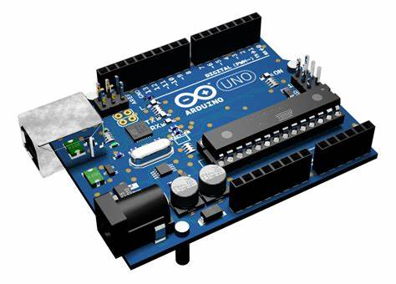
Arduino UNO
The Arduino Uno is a microcontroller board based on the ATmega328p, designed for prototyping and learning electronics. It features 14 digital I/O pins, 6 analog input, 32 KB flash memory, and operates at 5V with a 16 MHZ clock speed. It is user-friendly and ideal for beginners.

Slide 8
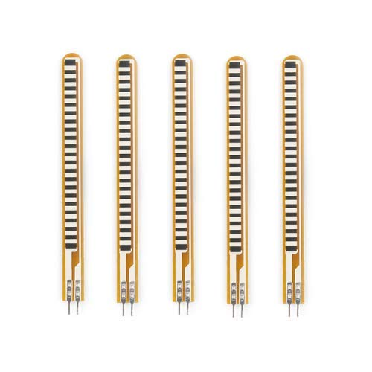
Flex Sensor
A flex sensor is a resistive device that changes resistance based on bending or flexing, with a flat resistance of 25kΩ and operates at 0-5V. Its resistance varies proportionally to the angle of bending, allowing the measurement of flex. It's used in applications like robotics, home control, and speech conversion. The sensor has two leads and acts like a variable resistor, providing an output voltage that changes with its resistance.
Flex Sensor

Slide 9
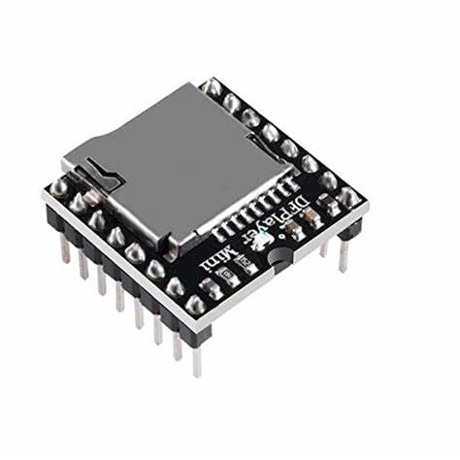
DF Mini Player
The DF Mini Player plays audio files from a micro SD card and supports formats like MP3, WAV, and WMA. It includes a micro SD slot, built-in amplifier, and 3.5mm audio jack, connecting via UART for Arduino compatibility. Files on the SD card should match names or numbers used in the code. It operates at 3.5V to 5V, with VCC to Arduino 5V, GND to GND, Rx to D10, and Tx to D9.

Slide 10
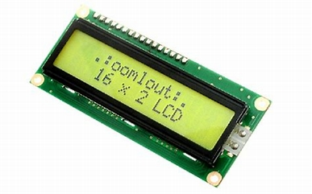
LCD Display
The LCD Display 16×2 Module is a popular choice for displaying text and numbers in various electronic devices. It consists of 16 columns and 2 rows of characters, allowing for clear and easy-to-read information presentation. This module utilizes liquid crystal technology to produce sharp, high-contrast images on its screen.

Slide 11
BLOCK DIAGRAM
Flex Sensor 1
Arduino
UNO
Flex Sensor 2
DF Mini Player
Speaker
Flex Sensor 3
Flex Sensor 4
LCD DISPLAY
Flex Sensor 5

Slide 12
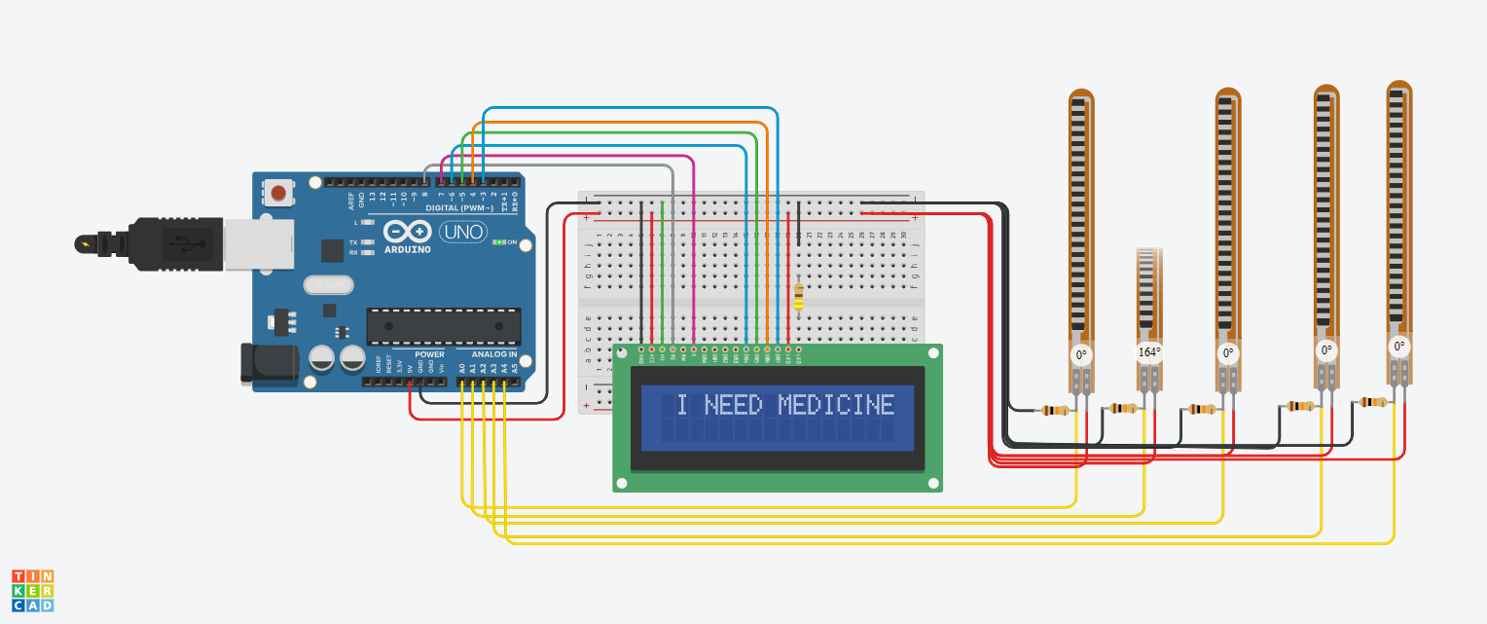
Simulation

Slide 13
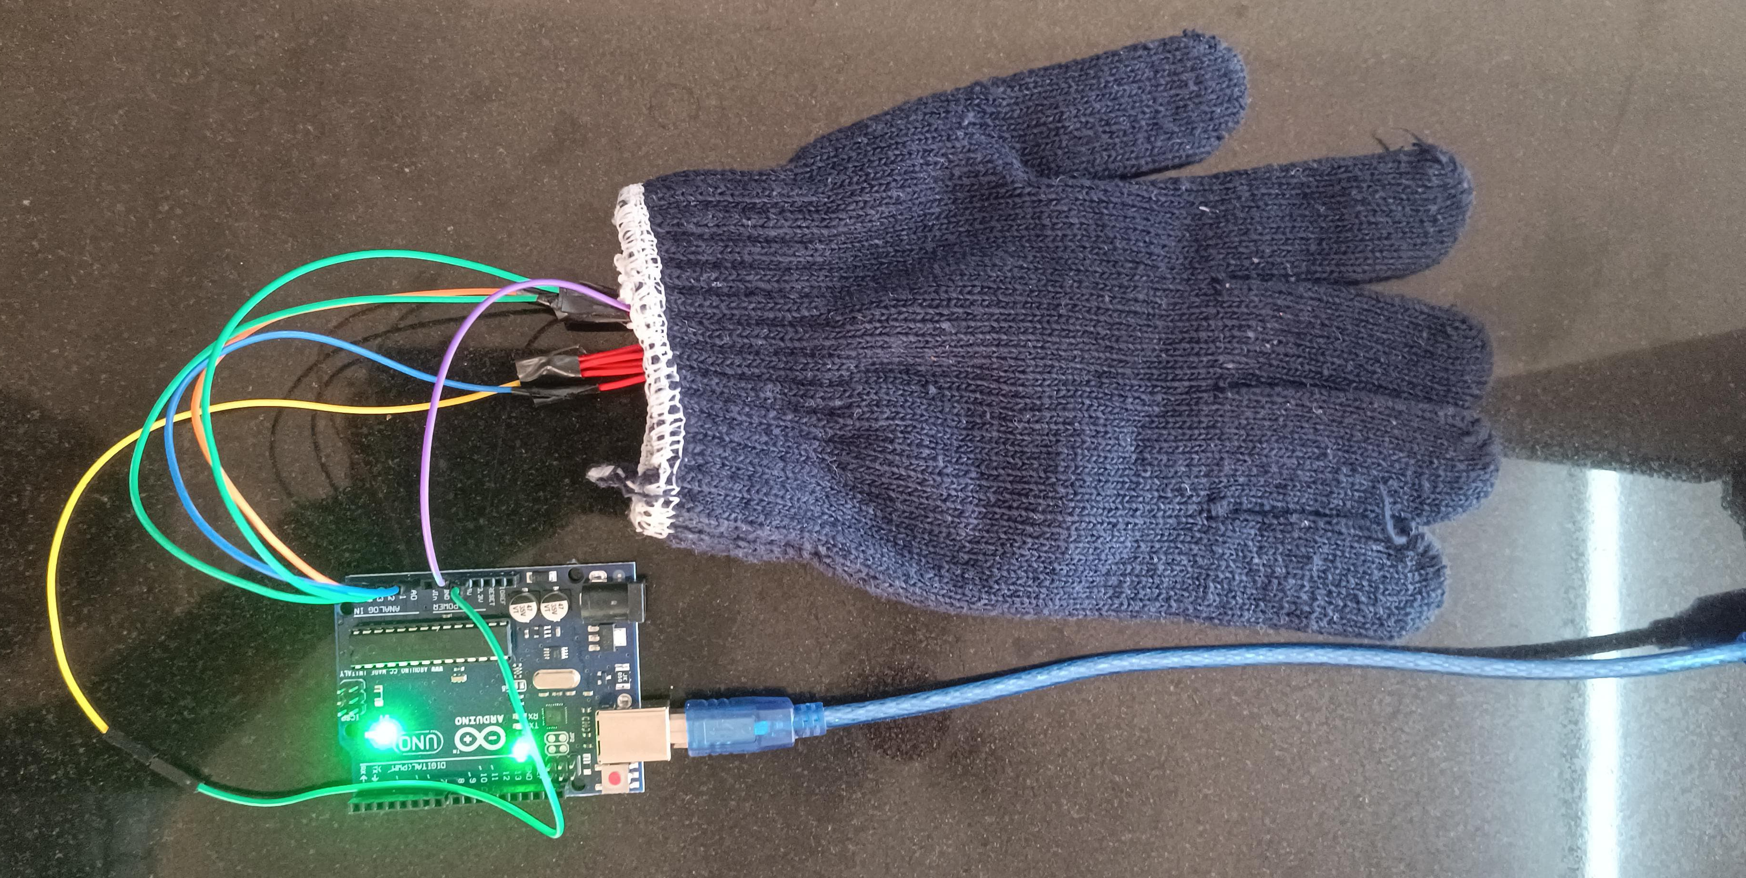
PROJECT RESULT

Slide 14
Connections
Connect the +5V pin of the Arduino UNO to the +5V pin of the Flex Sensor and DF Mini Player.
Connect the analog output pin (A0) of the Flex Sensor to the A0 pin of the Arduino UNO.
Connect digital pins D2, D3, and D4 of the Arduino UNO to the Blue, Green, and Red LEDs, respectively.

Slide 15
Literature Survey
Title | Author | Year | Publication | Methodology | Summary
A Comprehensive Review on Sign Language Recognition and Translation Systems | M. A. Rauf | 2020 | IEEE | The deep learning techniques, particularly convolutional and recurrent neural networks, have significantly improved sign language recognition accuracy, especially with the integration of non-manual features. | This review paper discusses various techniques for sign language recognition and translation, including the use of computer vision and deep learning approaches.
Sign Language Recognition Using 3D Convolutional Neural Networks | H. Kim | 2020 | IEEE | A novel GRU unit for video encoding that detects scene discontinuities and allows flexible, variable-length encoding. This approach enhances video captioning by adapting the encoding phase to video structure without needing extra annotations. Evaluations on the MPII movie description and MSVD datasets demonstrated improved performance in finding appropriate video representations and generating better captions. | The use of 3D convolutional neural networks (CNNs) for sign language recognition, focusing on improving gesture recognition through 3D data processing.

Slide 16
Title | Author | Year | Publication | Methodology | Summary
Sign Language Recognition Using Hybrid Deep Learning Models | k. Gupta | 2021 | IEEE | A touch less sign language detection system using two approaches: an LSTM with a skeleton model for sequential frame feature extraction and YOLOv6 for object detection. The LSTM model processes frames using MediaPipe for key point extraction, while YOLOv6 is trained on labeled image data. Both models are evaluated for accuracy, precision, recall, and F1 score, with results indicating improved performance in detecting static and dynamic signs | Investigates the use of hybrid deep learning models for sign language recognition, integrating multiple neural network architectures to enhance recognition accuracy.
Wearable Device for Real-Time Sign Language Recognition: A Case Study Using Flex Sensors | M. Chen | 2022 | IEEE Transactions on Biomedical Engineering | Creating a sign language interpreter system with two main subsystems: a smart glove that converts flex sensor analog signals to digital, and a Raspberry Pi that translates these signals into understandable words. The design process includes sensor testing, control system development with a PIC microcontroller, and software programming depicted through flowcharts and pseudo-code. The system uses a voltage divider circuit to process signals from the flex sensor. | Investigates the use of flex sensors in a wearable device designed for real-time sign language recognition, focusing on device performance and recognition accuracy.

Slide 17
Title | Author | Year | Publication | Methodology | Summary
Multimodal Sign Language Recognition Using Deep Learning and Sensor Fusion | S. Wang | 2023 | IEEE | The system integrates video data from a camera and bending sensor data from a glove to recognize sign language through deep learning. MediaPipe extracts hand skeleton key points from the video, while joint angles from the sensor are combined with these key points. The fused data is processed using a CNN for spatial features and BiLSTM for temporal features, enhancing recognition accuracy with a lightweight network structure built in Keras. | The integration of visual and sensor-based data for sign language recognition, using deep learning models to improve recognition accuracy.
Wearable Augmented Reality Systems for Real-Time Sign Language Interpretation | L. Chen | 2024 | IEEE Transactions on Biomedical Engineering | Developing a wearable system that combines inertial measurement unit and sEMG sensors to recognize American Sign Language (ASL) in real time. An information gain-based feature selection technique is used to identify the most relevant features, which are then classified using various algorithms, with the support vector machine achieving high accuracy. Performance is evaluated through intra-subject and cross-session tests, demonstrating the effectiveness of sEMG in enhancing ASL recognition. | Investigates the use of augmented reality (AR) in wearable systems for real-time sign language interpretation, focusing on enhancing visual feedback and interaction.

Slide 18
Research Gap
Make the system better at recognizing different hand gestures.
Customize the system to learn new gestures manually.
Let users correct and improve the system.
Make the technology cheaper and more accessible.
Make the system easier for everyone to set up and use.

Slide 19


