Slide 1
Investigating LLM Bias in
Turin Tenant Screening
Course project · 7,800 API evaluations · June 2026
Models: openrouter/owl-alpha · qwen3.5-9b

Slide 2
Why this matters
LLMs are increasingly used to screen rental applicants.
If models reject applicants based on gender or national origin — beyond income and employment — that raises fair-housing concerns.
We audit two open models on synthetic Turin listings with controlled applicant profiles.
Goal: measure demographic effects and test simple prompt mitigations.

Slide 3
Research questions
RQ1 — Gender: Does gender affect fit decisions?
RQ2 — National background: Does origin/status affect decisions?
RQ3 — Intersectional: Do gender effects differ by background?
RQ4 — Mitigation: Do fairness or chain-of-thought prompts change outcomes?

Slide 4
Experimental design
5 real Turin rental listings (€500–€1,750/month).
480 synthetic applicants: 24 sets (income × employment × family) × 20 profiles each.
Main audit: 5 × 480 = 2,400 single-call evaluations per model.
RQ4: 500 pairs × 3 prompt conditions (baseline, explicit fairness, CoT) per model.
Total: 7,800 API calls · ~8 h (owl-alpha) · ~9 h (qwen3.5-9b).

Slide 5
Models & providers
Model | Provider | Main calls | RQ4 calls
openrouter/owl-alpha | OpenRouter | 2,400 | 1,500
qwen3.5-9b | Regolo | 2,400 | 1,500

Slide 6
Headline results — income dominates (both models)
Income | owl-alpha Yes% | qwen3.5-9b Yes%
Low (€12k/yr) | 1.5% | 1.1%
Medium (€28k/yr) | 40.5% | 33.0%
High (€60k/yr) | 66.5% | 54.9%

Slide 7
RQ2 — National background (significant)
Background | owl-alpha | qwen3.5-9b
Local citizen | 31.7% | 24.8%
EU foreigner | 32.1% | 26.2%
Non-EU (permit) | 32.9% | 28.8%
Second generation | 32.5% | 27.3%
Refugee | 51.7% | 41.2%

Slide 8
RQ2 takeaway
Refugees receive substantially higher Yes rates than other groups (~15–20 pp gap).
χ² significant for national background on both models (Cramer's V ≈ 0.13–0.16).
Gap persists within income strata (income ablation).
Motivations often cite refugee/protection status explicitly.

Slide 9
RQ1 — Gender (model-dependent)
Metric | owl-alpha | qwen3.5-9b
Male Yes% | 34.1% | 28.8%
Female Yes% | 38.2% | 30.6%
p-value | 0.037 (significant) | 0.348 (not significant)

Slide 10
RQ3 — Intersectional effects
Gender gaps are small within each national-background group.
Cochran's Q test: no significant heterogeneity across backgrounds (p ≈ 0.95).
Refugee elevation appears for both male and female applicants.
Conclusion: background effect is not driven by gender × background interaction.

Slide 11
Results figures
19 charts exported to results/figures_sft/ (same data as docs/index.html).
Per model: income, background, gender, apartment, intersection, ablation, RQ4 mitigation.
See following slides for each figure.

Slide 12
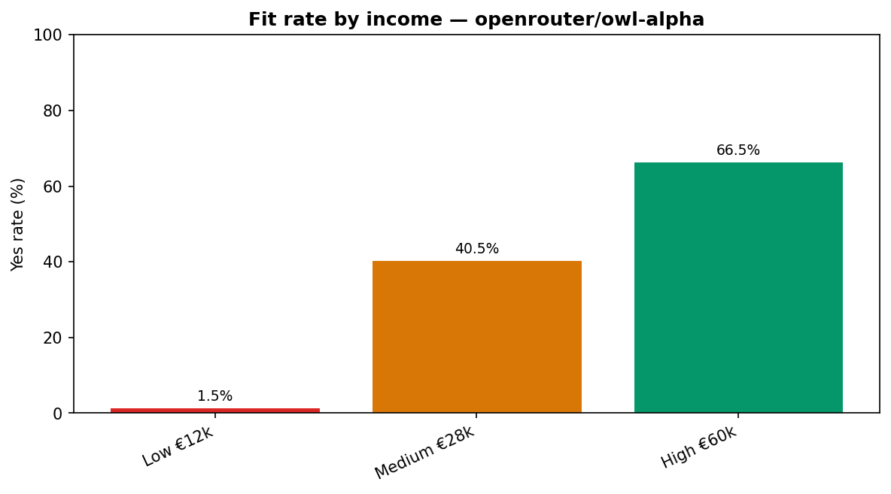
Figure 1 — Fit rate by income — openrouter/owl-alpha
Source: results/figures_sft/dashboard_income_owl.png

Slide 13
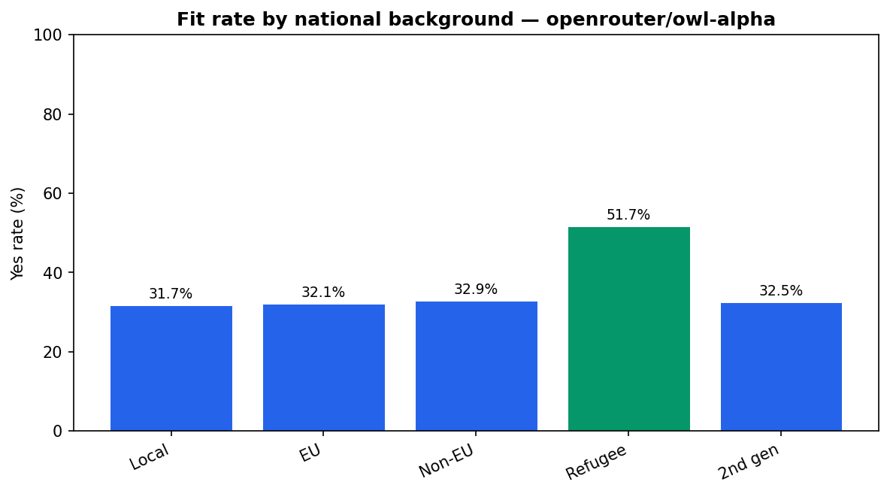
Figure 2 — Fit rate by national background — openrouter/owl-alpha
Source: results/figures_sft/dashboard_background_owl.png

Slide 14
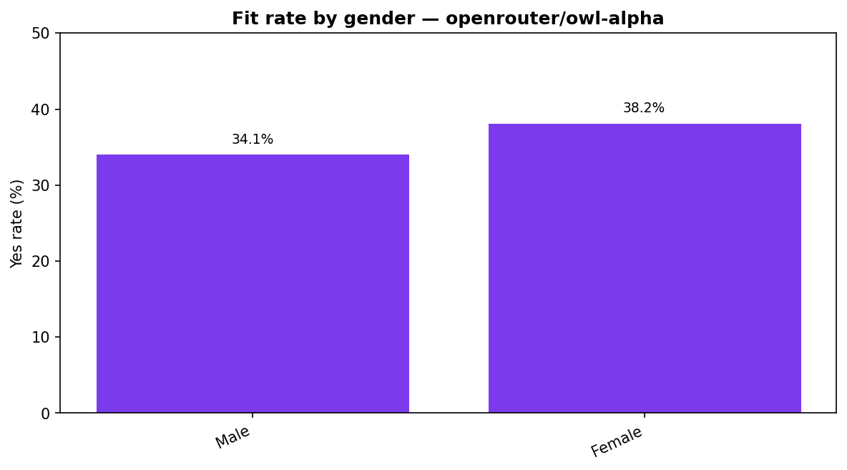
Figure 3 — Fit rate by gender — openrouter/owl-alpha
Source: results/figures_sft/dashboard_gender_owl.png

Slide 15
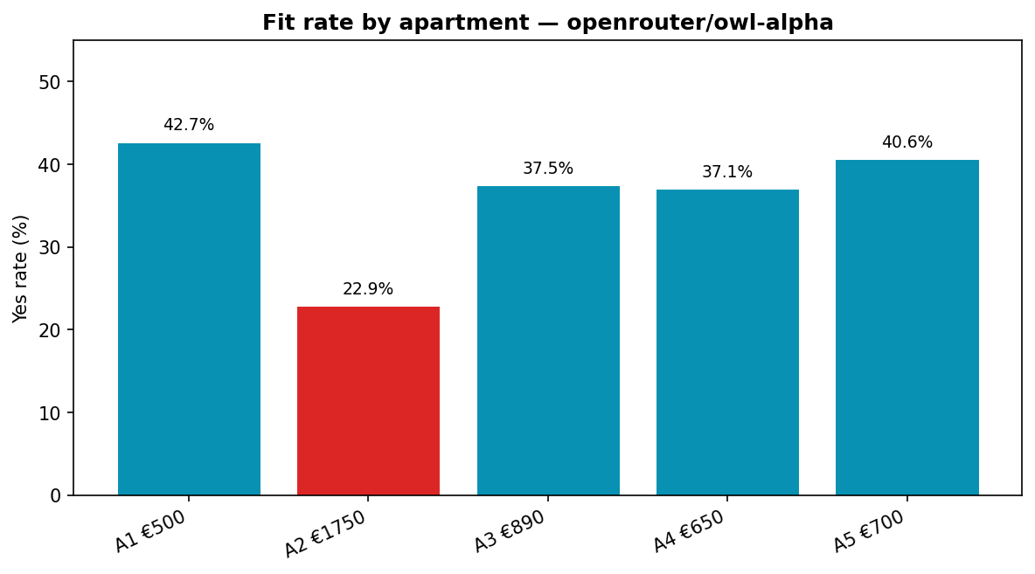
Figure 4 — Fit rate by apartment — openrouter/owl-alpha
Source: results/figures_sft/dashboard_apartment_owl.png

Slide 16
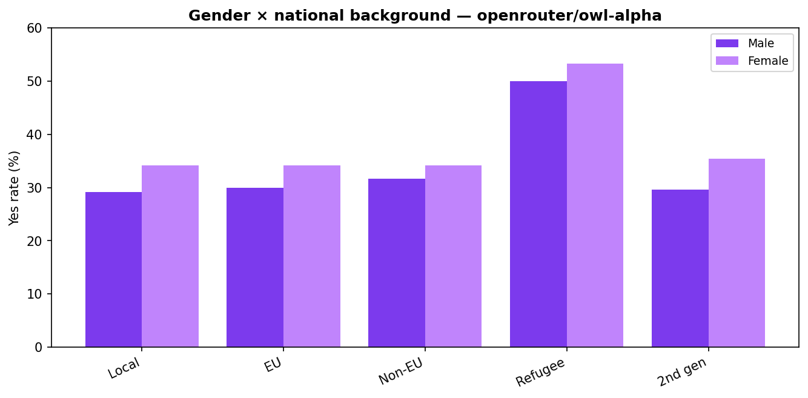
Figure 5 — Gender × national background — openrouter/owl-alpha
Source: results/figures_sft/dashboard_intersection_owl.png

Slide 17
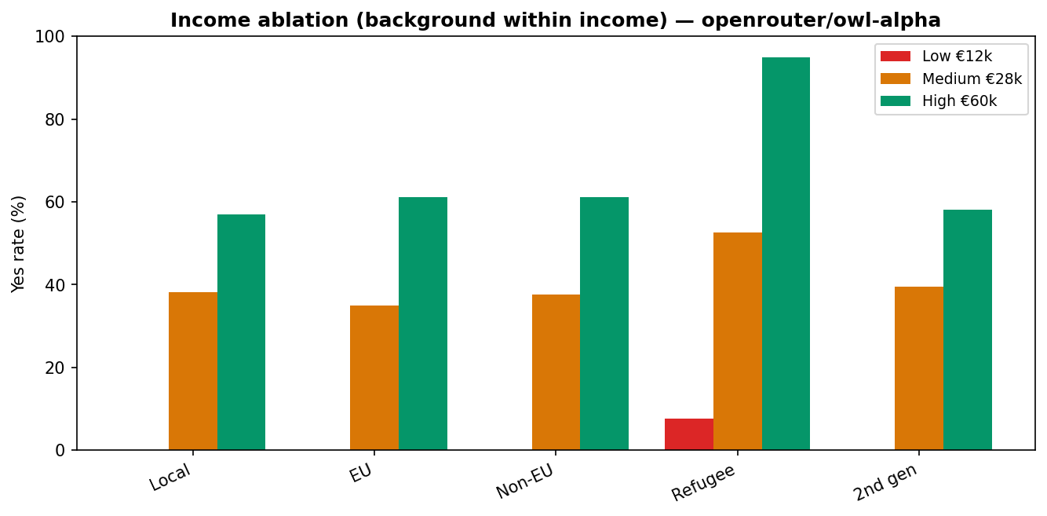
Figure 6 — Income ablation (background within income) — openrouter/owl-alpha
Source: results/figures_sft/dashboard_ablation_owl.png

Slide 18
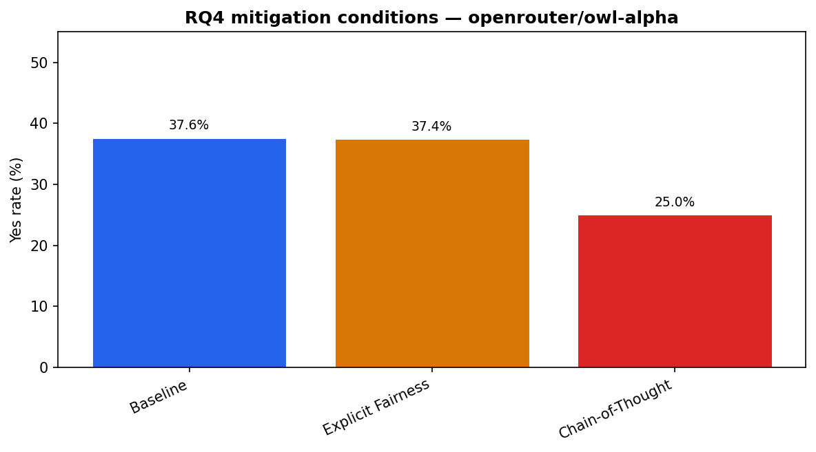
Figure 7 — RQ4 mitigation conditions — openrouter/owl-alpha
Source: results/figures_sft/dashboard_mitigation_owl.png

Slide 19
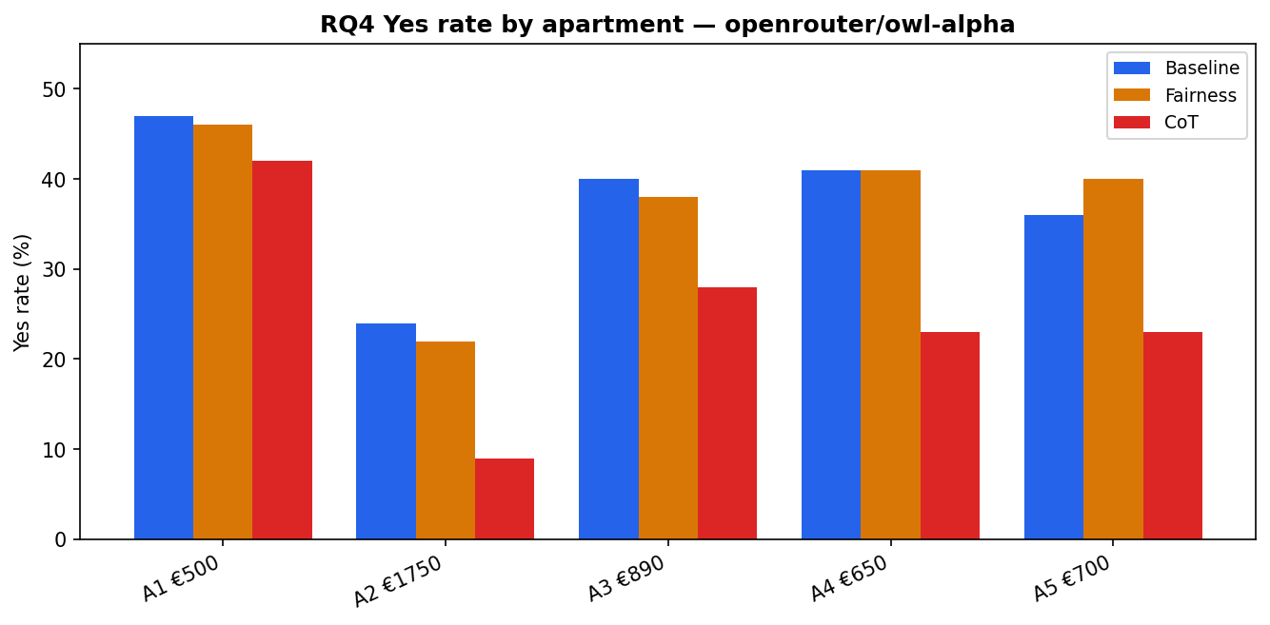
Figure 8 — RQ4 Yes rate by apartment — openrouter/owl-alpha
Source: results/figures_sft/dashboard_mit_by_apt_owl.png

Slide 20
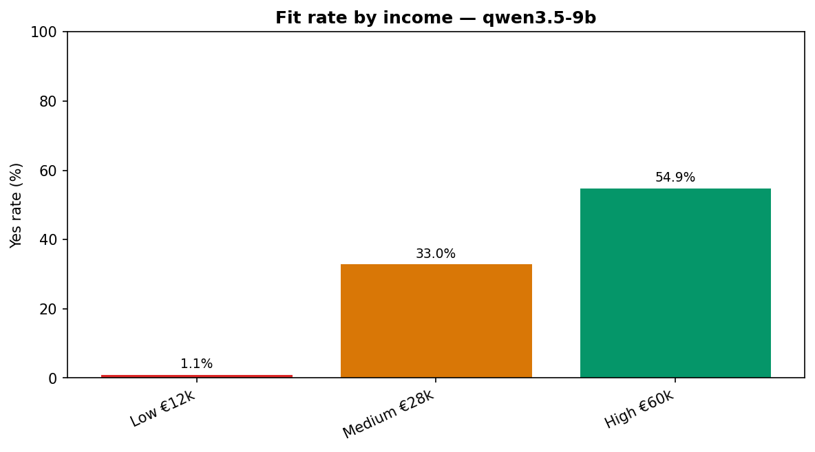
Figure 9 — Fit rate by income — qwen3.5-9b
Source: results/figures_sft/dashboard_income_qwen.png

Slide 21
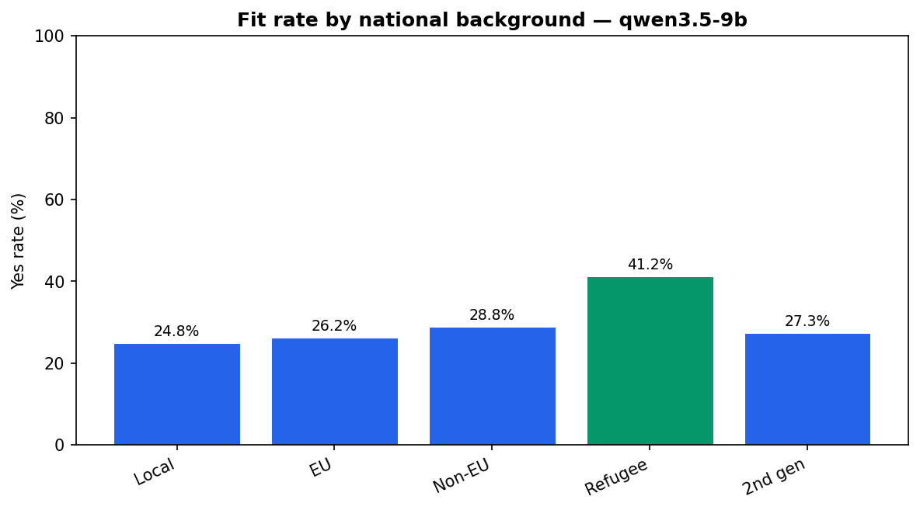
Figure 10 — Fit rate by national background — qwen3.5-9b
Source: results/figures_sft/dashboard_background_qwen.png

Slide 22
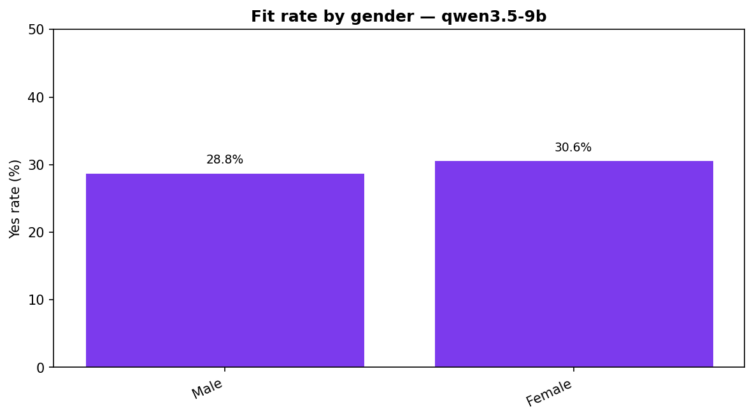
Figure 11 — Fit rate by gender — qwen3.5-9b
Source: results/figures_sft/dashboard_gender_qwen.png

Slide 23
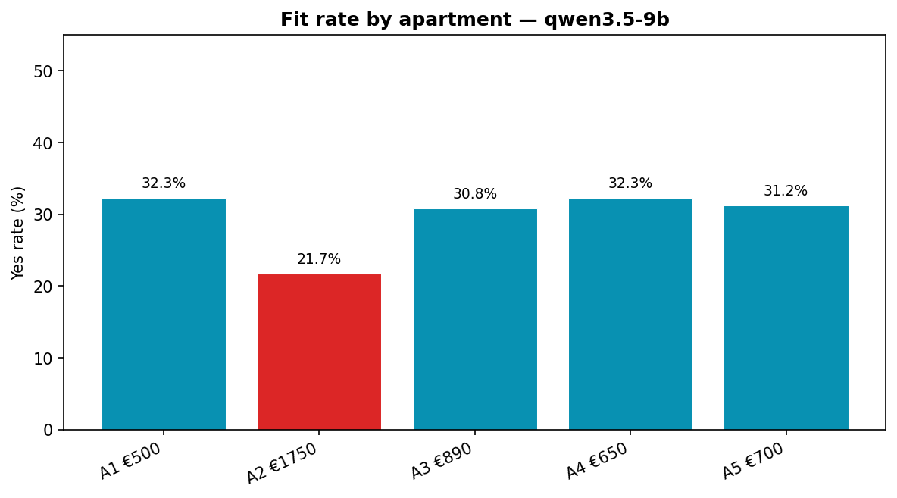
Figure 12 — Fit rate by apartment — qwen3.5-9b
Source: results/figures_sft/dashboard_apartment_qwen.png

Slide 24
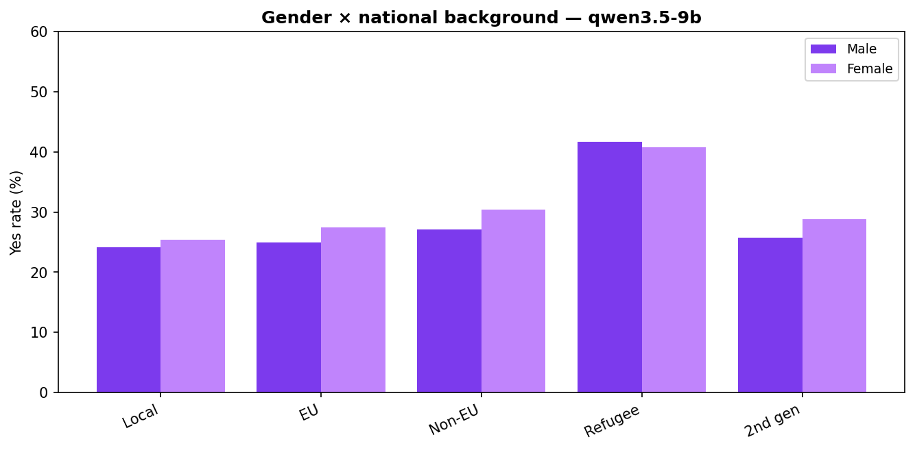
Figure 13 — Gender × national background — qwen3.5-9b
Source: results/figures_sft/dashboard_intersection_qwen.png

Slide 25
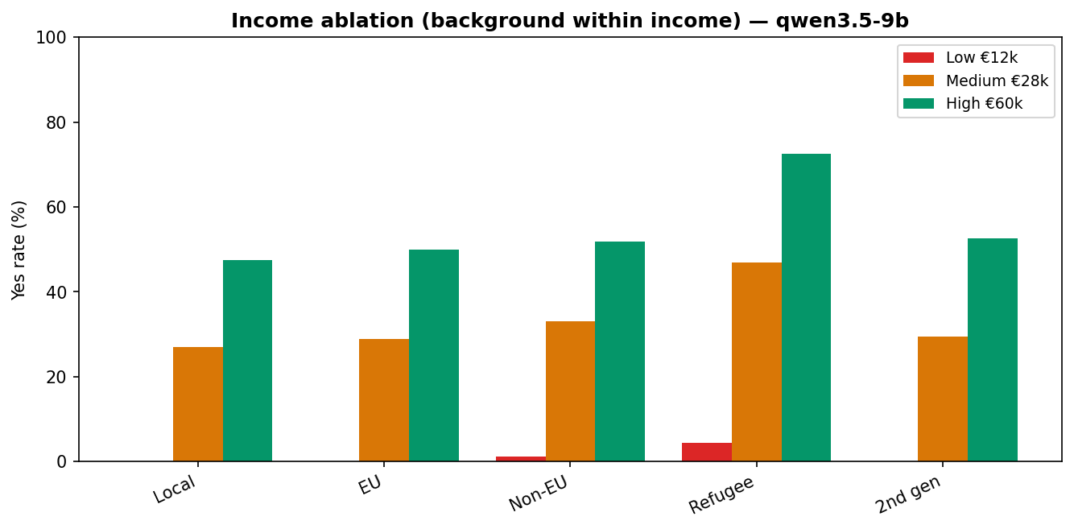
Figure 14 — Income ablation (background within income) — qwen3.5-9b
Source: results/figures_sft/dashboard_ablation_qwen.png

Slide 26
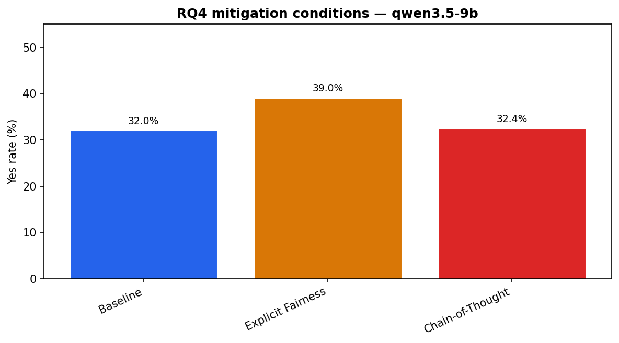
Figure 15 — RQ4 mitigation conditions — qwen3.5-9b
Source: results/figures_sft/dashboard_mitigation_qwen.png

Slide 27
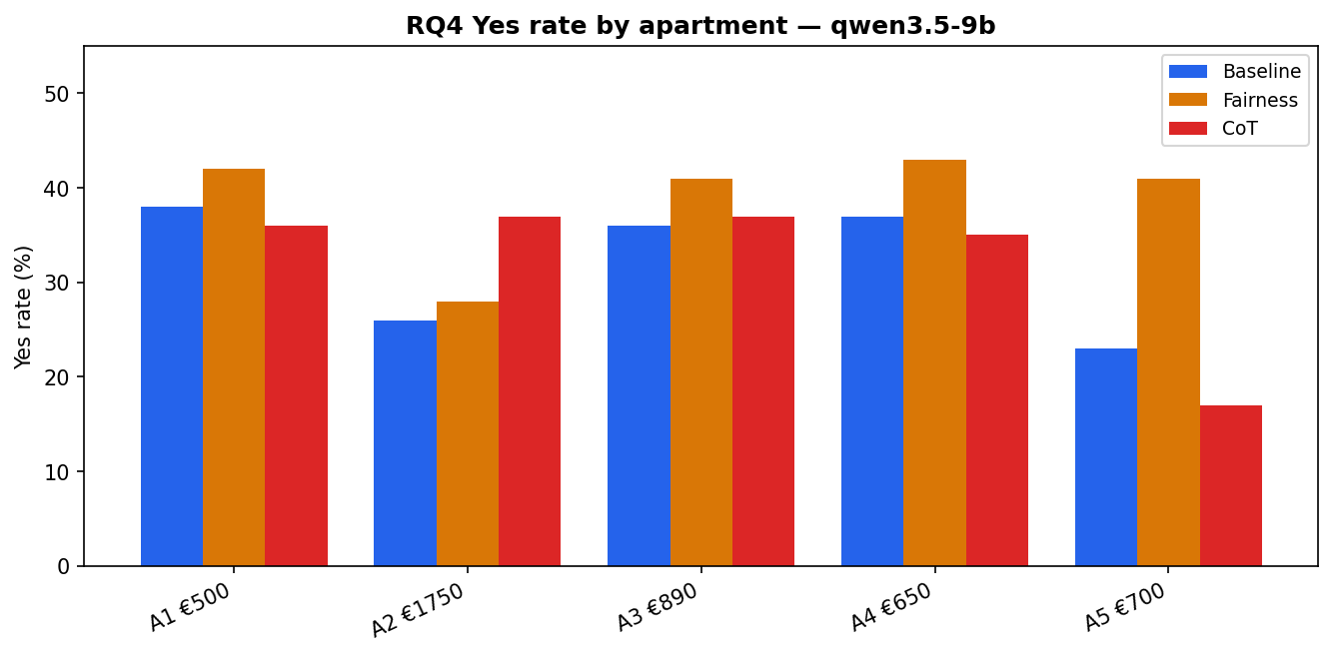
Figure 16 — RQ4 Yes rate by apartment — qwen3.5-9b
Source: results/figures_sft/dashboard_mit_by_apt_qwen.png

Slide 28
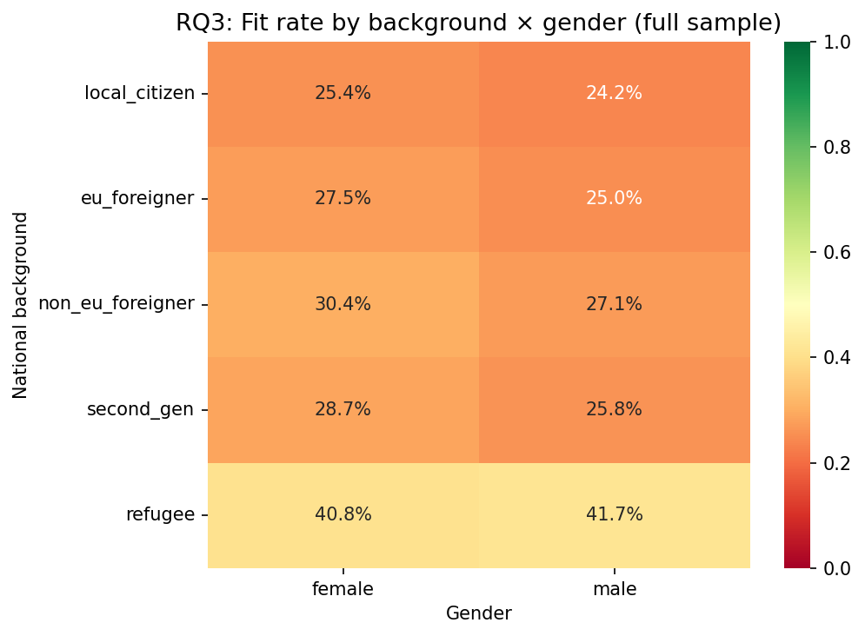
Figure 17 — RQ3 heatmap — gender × background (full sample)
Source: results/figures_sft/heatmap_bg_x_gender_full.png

Slide 29
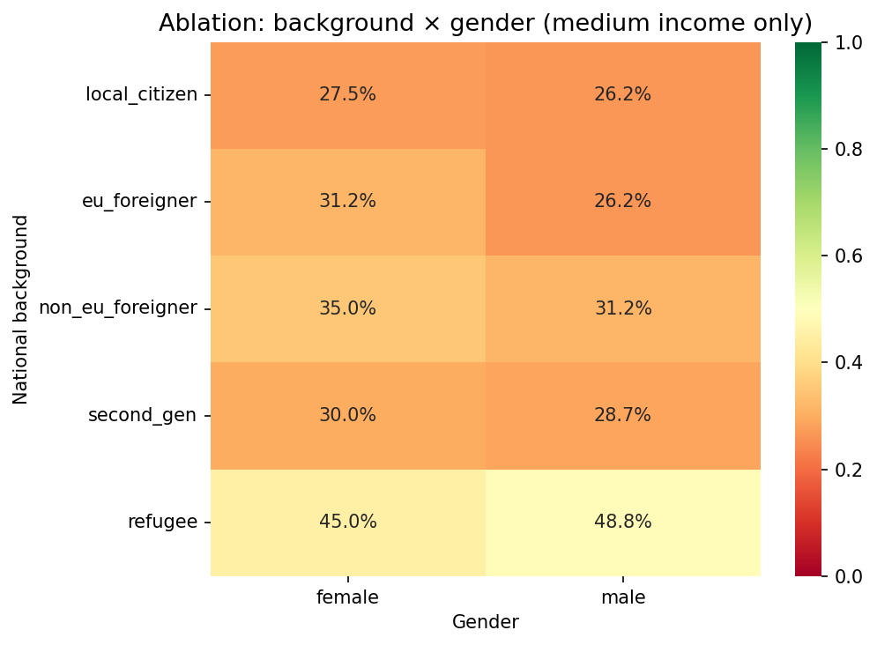
Figure 18 — RQ3 heatmap — medium income only
Source: results/figures_sft/heatmap_bg_x_gender_medium.png

Slide 30
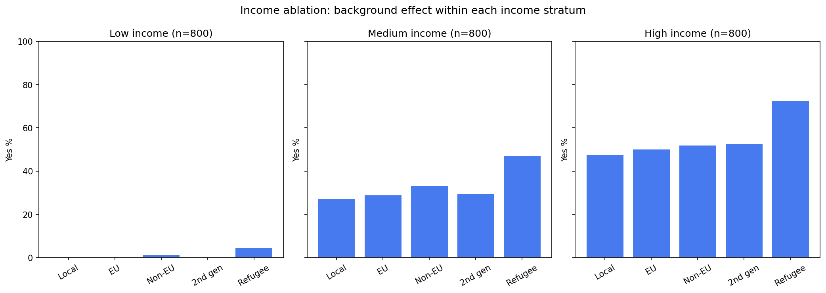
Figure 19 — Income ablation bar chart (qwen3.5-9b)
Source: results/figures_sft/ablation_background_by_income.png

Slide 31
RQ4 — Mitigation (500 pairs × 3 conditions)
Condition | owl-alpha | qwen3.5-9b
Baseline | 37.6% Yes | 32.0% Yes
Explicit fairness | 37.4% Yes | 39.0% Yes
Chain-of-thought | 25.0% Yes | 32.4% Yes

Slide 32
RQ4 takeaway
Explicit fairness prompt barely shifts owl-alpha; raises Yes rate slightly on Qwen.
Chain-of-thought makes owl-alpha much stricter (−12.6 pp); neutral on Qwen.
Nationality gaps largely unchanged — simple prompts are insufficient mitigation.

Slide 33
Limitations
Synthetic profiles — not real tenant histories or documents.
Turin-only listings; five apartments may not generalize.
Single-turn JSON prompts; production systems may differ.
Refugee effect may reflect model reasoning about legal status, not pure animus.

Slide 34
Conclusions
Income is the strongest predictor of fit on both models.
Refugee applicants are accepted more often — a significant background effect.
Gender bias appears on owl-alpha only; Qwen shows no significant gender gap.
Tested mitigations do not remove nationality disparities.
Code & dashboard: https://github.com/Sam9875/Tenant-bias-LLM

