Slide 1


Starting Out with Python
Sixth Edition
Chapter 1
Introduction to Computers and Programming
Copyright © 2023, 2021, 2018 Pearson Education, Inc. All Rights Reserved
Notes:
If this PowerPoint presentation contains mathematical equations, you may need to check that your computer has the following installed:
1) MathType Plugin
2) Math Player (free versions available)
3) NVDA Reader (free versions available)

Slide 2
Topics
1-1 Introduction
1-2 Hardware and Software
1-3 How Computers Store Data
1-4 How a Program Works
1-5 Using Python
Please pay attention to the numeric system for each section contained in a chapter, because we are going to use this number to identify the lectures and quizzes.
For example, “1-2-Lecture” means the video lecture for chapter 1 section 2 on subject of “Hardware and Software”, and “1-2-Quiz” refers to the quizzes designed for chapter 1 section 2 on subject “Hardware and Software”.

Slide 3
1-1 Introduction
Computers can be programmed
  Designed to do any job that a program tells them to
Program: set of instructions that a computer follows to perform a task
  Commonly referred to as Software
Programmer: person who can design, create, and test computer programs
  Also known as software developer

Slide 4
1-2 Hardware and Software
Hardware: The physical devices that make up a computer
  Computer is a system composed of several components that all work together
Typical major components:
  Central processing unit
  Main memory
  Secondary storage devices
  Input and output devices
tangible

Slide 5
The C P U
Central processing unit (C P U): the part of the computer that actually runs programs
  Most important component
  Without it, cannot run software
  Used to be a huge device
Microprocessors: C P U s located on small chips
execution

Slide 6
Main Memory
Bootstrap
Memory: RAM and ROM (Read-Only Memory)
Main memory: where computer stores a program while program is running, and data used by the program
Known as Random Access Memory or R A M
  C P U is able to quickly access data in R A M
  Volatile memory used for temporary storage while program is running
  Contents are erased when computer is off
Executable, binary, instructions
Otherwise, static in disk/SSD
Declared in the executable, including global data, instance data, or private data
CPU and Memory are physically located very close to each other, connected thru extremely fast data bus.

Slide 7
Secondary Storage Devices
Secondary storage: can hold data for long periods of time involatile, slower than accessing memory
  Programs normally stored here and loaded to main memory when running
Types of secondary memory
  Disk drive: magnetically encodes data onto a spinning circular disk
  Solid state drive: faster than disk drive, no moving parts, stores data in solid state memory
  Flash memory: portable, no physical disk
static
dynamic

Slide 8
Input Devices (I/O)
Input: data the computer collects from people and other devices
Input device: component that collects the data
  Examples: keyboard, mouse, touchscreen, scanner, camera
  Disk drives can be considered input devices because they feed programs into the main memory
Standard input
Loaded by “loader”, a component of OS

Slide 9
Output Devices (I/O)
Output: data produced by the computer for other people or devices
  Can be text, image, audio, or bit stream
Output device: formats and presents output
  Examples: video display, printer
  Disk drives and U S B drives can be considered output devices because data is sent to them to be saved
Disk drive is both input and output

Slide 10
Software (1 of 2)
Everything the computer does is controlled by software
  General categories:
    Application software
    System software
Application software: programs that make computer useful for everyday tasks
  Examples: word processing, email, games, and Web browsers
You initiate
Computer system initiates, to serve you

Slide 11
Software (2 of 2)
System software: programs that control and manage basic operations of a computer
  Operating system: controls operations of hardware components windows, Mac, Linux, Ubuntu, Android, iOS
  Utility Program: performs specific task to enhance computer operation or safeguard data virus scanning, file compressing
  Software development tools: used to create, modify, and test software programs assembler, compiler, interpreter

Slide 12
1-3 How Computers Store Data
All data in a computer is stored in sequences of 0s and 1s binary
Byte: just enough memory to store letter or small number 1 → “00000001”, A → “01000001”
  Divided into eight bits bit 7 → 0000 0001 ← bit 0
  Bit: electrical component that can hold positive or negative charge, like on/off switch
  The on/off pattern of bits in a byte represents data stored in the byte billions transistors in our computer system, such as in CPU, memory, disk drive, flip between on and off as reaction to the binary pattern.

Slide 13
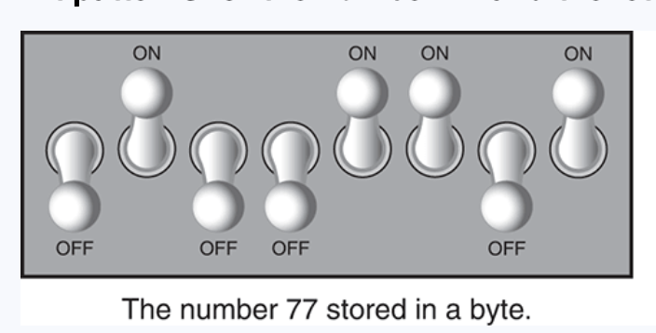
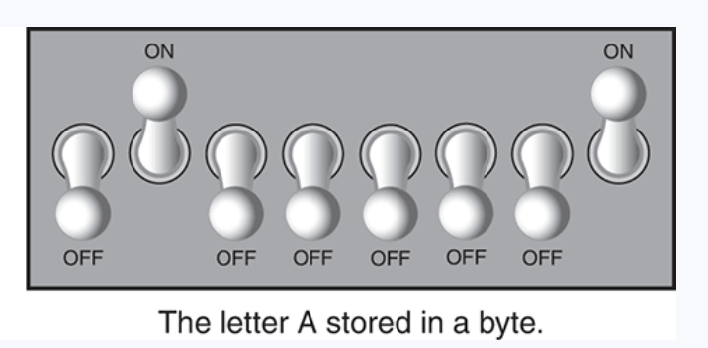
Bit Pattern: number and letter
0. 1. 0. 0. 1. 1. 0. 1
0. 1. 0. 0. 0. 0. 0. 1

Slide 14
Storing Numbers
Bit represents two values, 0 and 1
Computers use binary numbering system
the smallest unit of storage in computer system
  Position of digit j is assigned the value
  To determine value of binary number sum position values of the 1s
Byte size limits are 0 and 255
  0 = all bits off 0000 0000; 255 = all bits on 1111 1111
  To store larger number, use several bytes
The basic unit to size the storage: Byte
Other storage units commonly seen:
Word = 8 Bytes (64-bits system) 1KB = 1024 Bytes IMB = 1024K
1GB = 1025M 1TB = 1024GB 1EB = 1024TB 1ZB = 1024EB 1YB = 1024ZB
256 → 0000 0001 1111 1111
Notes:
EB = Exabyte
YB – Yottabytes

Slide 15
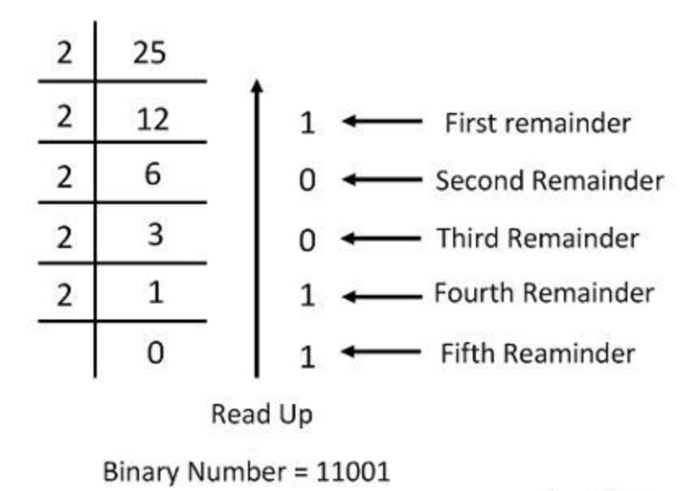
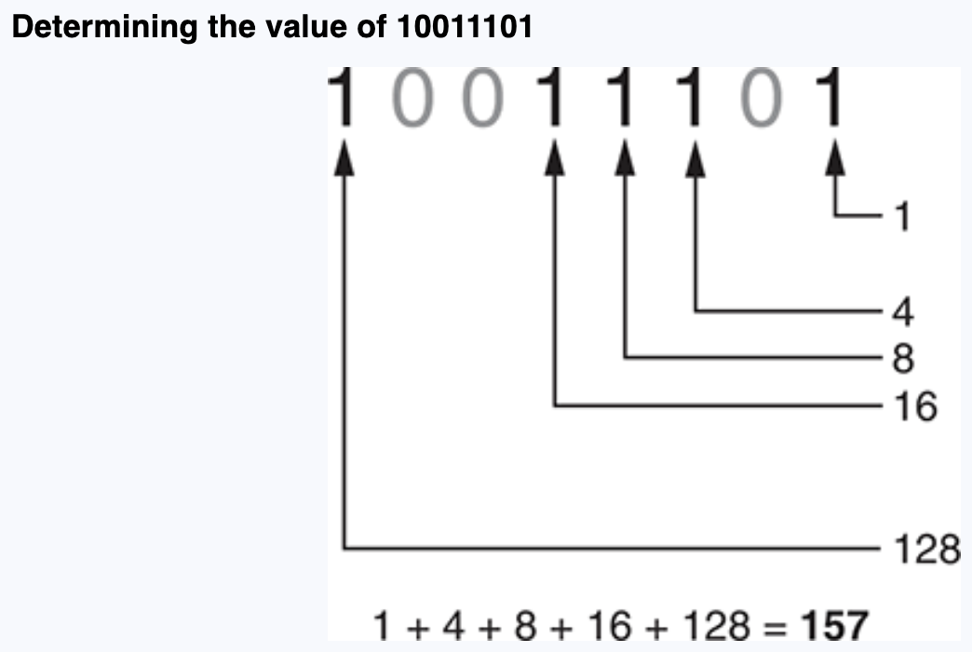
Conversion: Decimal ← → Binary
00011001

Slide 16
Storing Characters
Data stored in computer must be stored as binary number
Characters are represented by the numeric code, then further converted to binary form to be stored in memory.
  Most important coding scheme is ASCII
    ASCII is limited: defines codes for only 128 characters
  Unicode coding scheme becoming standard
    Compatible with ASCII
    Can represent characters for other languages
    UTF-8,UTF-16
Notes:
ASCII – American Standard Code for Information Interchange, firstly published in 1963， using 7 or 8 bits to represent major English characters
Unicode – published in 1991, modern and comprehensive encoding scheme represented for almost all world languages.
Unicode – theoretically support up to over 1 million code, although currently defined characters and symbols are 159,000+.
UTF-8: uses 1-4 bytes, used mainly in Web (HTML), Linux, JSON, Git
UTF-16: uses 2 or 4 bytes, mainly used to process Asian text like Chinese, Japanese,, or Korean.

Slide 17
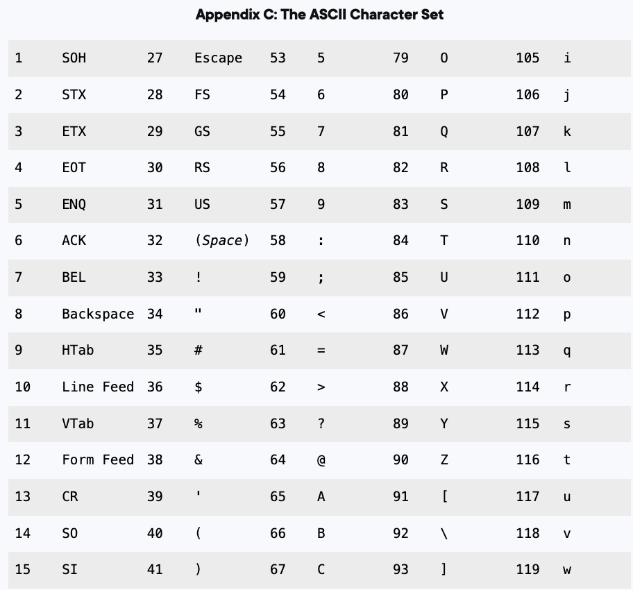
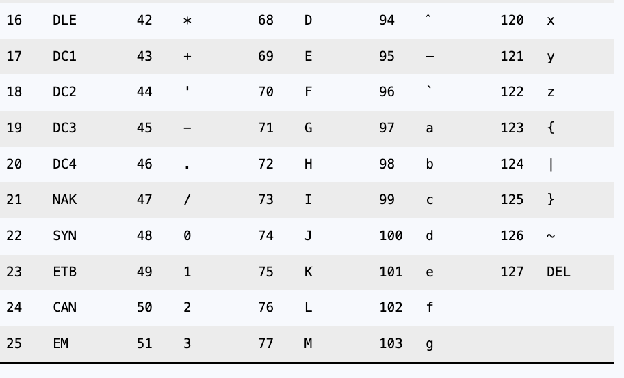
ASCII
I missed code “0” in the left screenshot. Code “0” is for “null”

Slide 18
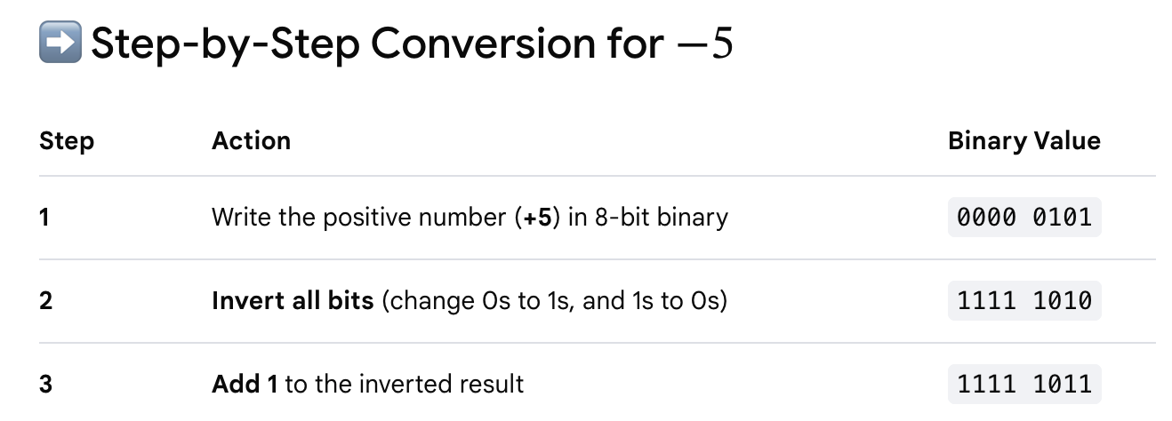

Advanced Number Storage
To store negative numbers and real numbers, computers use binary numbering and encoding schemes
  Negative numbers encoded using two’s complement
  Real numbers encoded using floating-point notation
Notes:
To represent a real number like 9.625 in computer systems, processors use the IEEE 754 floating-point standard. This system works like scientific notation but uses binary (base 2).
1 bit for sign (positive or negative)
8 bits represent the magnitude
13 bits represent the precision bits after the decimal point

Slide 19
Other Types of Data
Digital: describes any device that stores data as binary numbers
Digital images are composed of pixels
  To store images, each pixel is converted to a binary number representing the pixel’s color more pixels, better quality
Digital music is composed of sections called samples
  To store music, each sample is converted to a binary number. More samples in each second, better quality.
Notes:
44,100 samples in a sec of digital music.

Slide 20
1-4 How a Program Works (1 of 4)
C P U designed to perform simple operations on pieces of data
  Examples: reading data, adding, subtracting, multiplying, and dividing numbers
  Understands instructions written in machine language and included in its instruction set
    Each brand of C P U has its own instruction set (x86-64, ARM)
To carry out meaningful calculation, C P U must perform many operations
Think “instruction set” as the vocabulary of CPU, and machine language is the binary encoding of the instruction.
Notes:
The relationship between machine language and binary data:
When stored in the memory, the file is in the form of binary data.
When pulled into the CPU, the binary data are converted to machine instructions, also referred to as machine language.
Depending on the location, machine language refers to a different concept, although in both locations, it is tightly related to the binary data.
X86 for PC, ARM for mobile devices and modern laptops.

Slide 21
How a Program Works (2 of 4)
Program must be copied from secondary memory to R A M each time C P U executes it
C P U executes program in cycle:
  Fetch: read the next instruction from memory into C P U
  Decode: C P U decodes fetched instruction to determine which operation to perform
  Execute: perform the operation

Slide 22
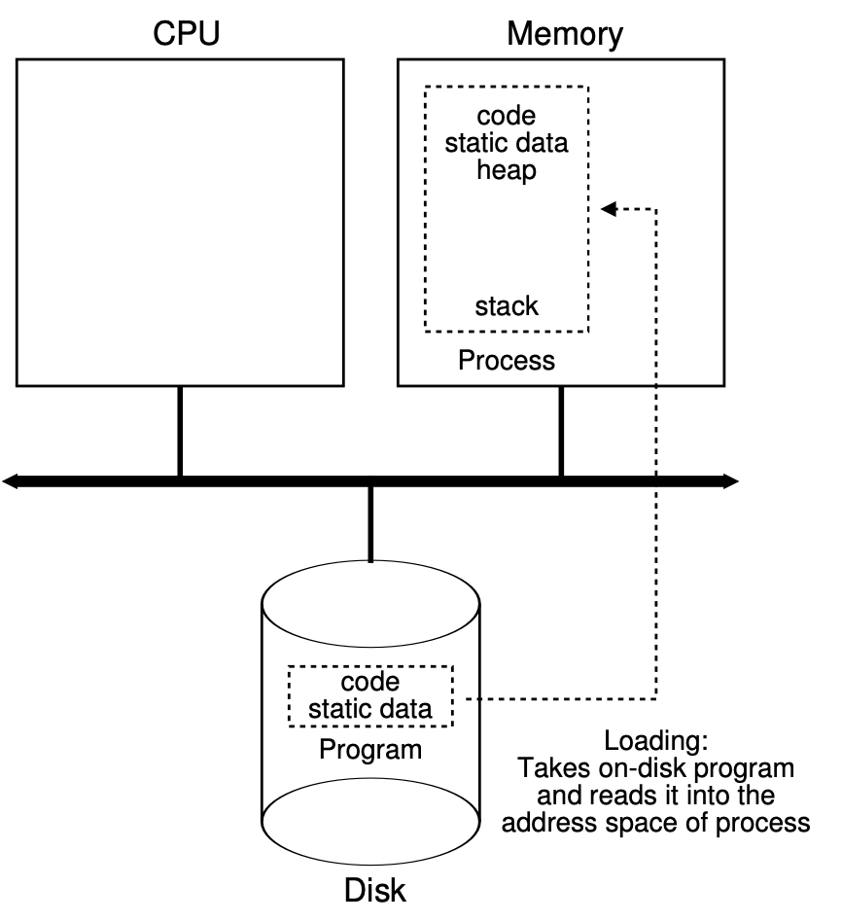
What happens when run a program? (3 of 4)
Executable:
Binary (machine
language

Slide 23
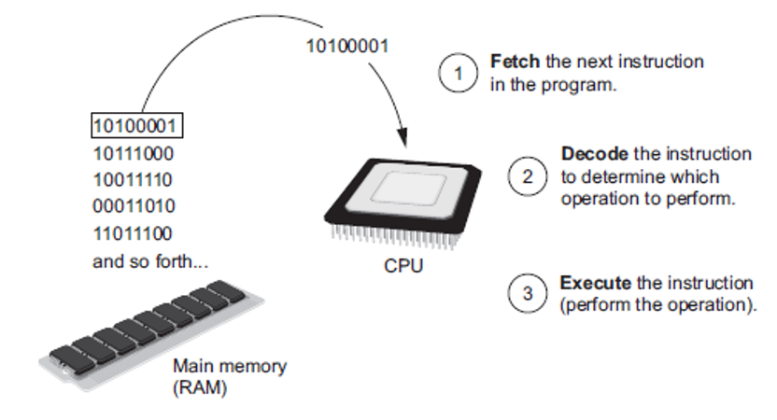
How a Program Works (4 of 4)
Figure 1-16 The fetch-decode-execute cycle
Notes:
The steps are as follows. The program in the form of machine language 1 0 1 0 0 0 0 1, 1 0 1 1 1 0 0 0, 1 0 0 1 1 1 1 0, 0 0 0 1 1 0 1 0, 1 1 0 1 1 1 0 0, and so forth, is fetched from the main memory R A M.
The binary number 1 0 1 0 0 0 0 1 is decoded from the main memory to determine which operation to perform.
The decoded program is sent to C P U to execute the instruction and perform the operation.

Slide 24
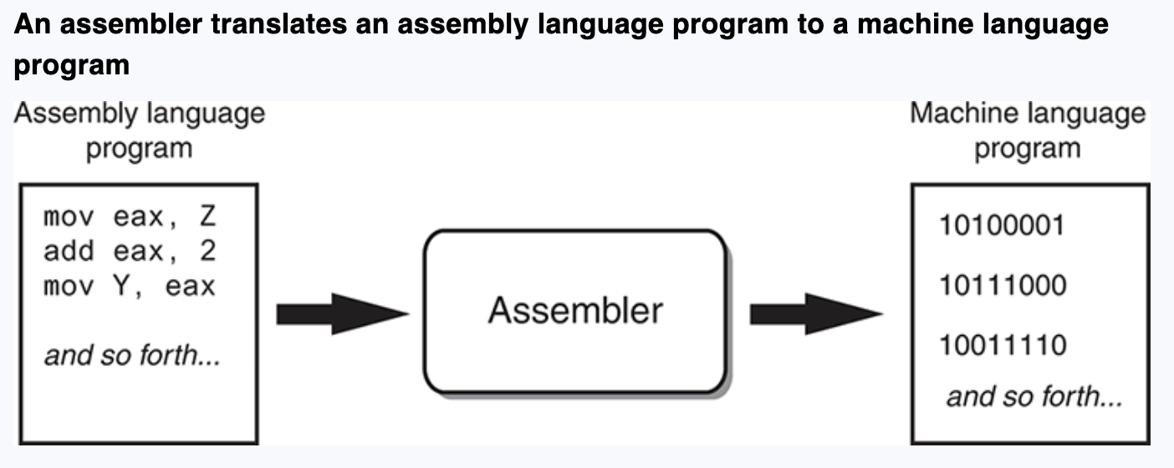
From Machine Language to Assembly Language
Impractical for people to write in machine language
Assembly language: uses short words (mnemonics) for instructions instead of binary numbers
  Easier for programmers to work with
Assembler: translates assembly language to machine language for execution by C P U
Notes:
Assembly language was invented in 1947.

Slide 25
High-Level Languages
Low-level language: close in nature to machine language
  Example: assembly language
High-Level language: allows simple creation of powerful and complex programs
  No need to know how C P U works or write large number of instructions
  More intuitive to understand
Python, java, C#, C++, C

Slide 26
Keywords, Operators, and Syntax: An Overview
Keywords: predefined words used to write program in high-level language
  Each keyword has specific meaning
Operators: perform operations on data
  Example: math operators to perform arithmetic
Syntax: set of rules to be followed when writing program indentation, colon, opening parenthesis and closing parenthesis, quote
Statement: individual instruction used in high-level language, consists of keywords, operator, punctuation, and other allowed programming elements. Assignment statement, calculation statement, condition check statement, repetition statement …
import,
if, elif, else
for, while, break
try/except/finally
+,-,*,/, //, %, +=

Slide 27
Compilers and Interpreters (1 of 4)
Programs written in high-level languages must be translated into machine language to be executed
Compiler: translates high-level language program into separate machine language program
Machine language program can be executed at any time
gcc – compile a C program: hello_world.c → hello_world.o
Javac – compile a Java program: HelloWorld.java → HelloWorld.class

Slide 28
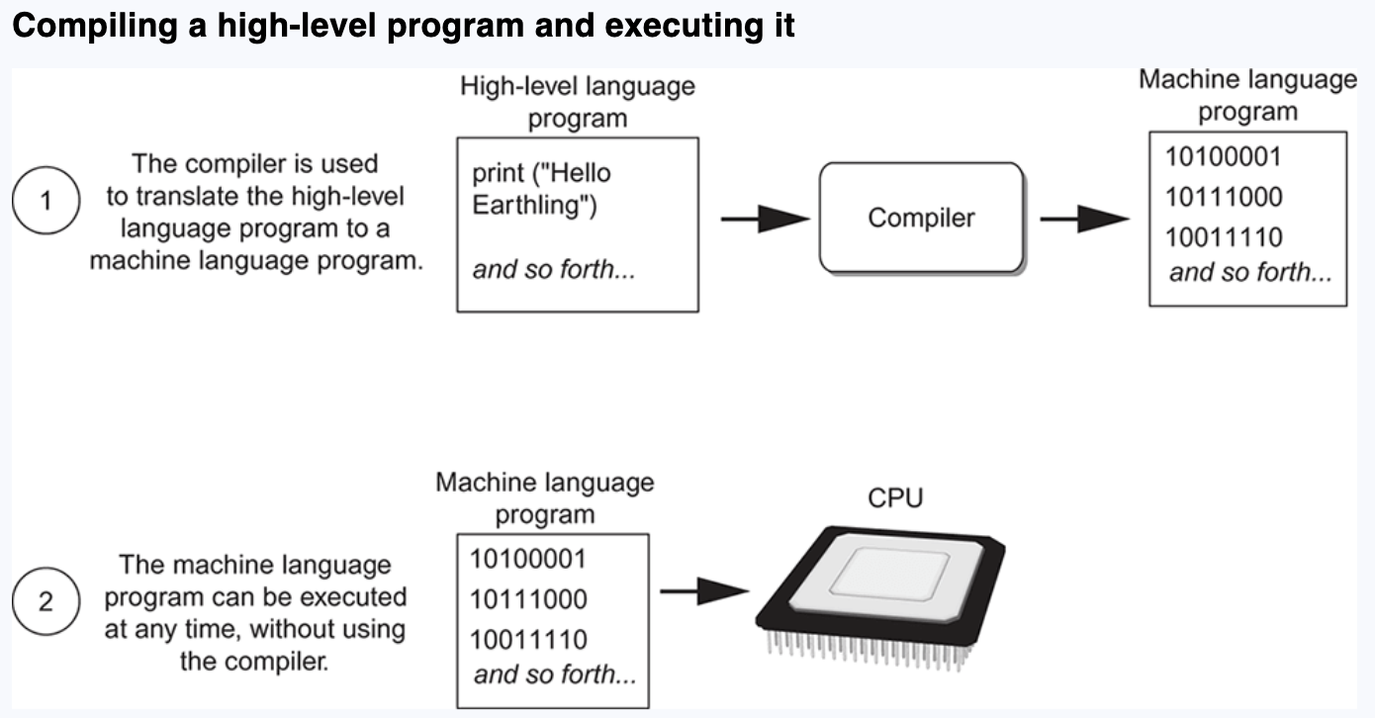
Compiler and Interpreter (2 of 4)
C source program → compiled to an executable file with gcc → machine language program

Slide 29
Compilers and Interpreters (3 of 4)
Interpreter: translates and executes instructions in high-level language program
  Used by Python language
  Interprets one instruction at a time
  No separate machine language program
Source code: statements written by programmer
  Syntax error: prevents code from being translated
Python and Java are often referred to “interpreted” language, they are similar but with difference:
Python source code → (compiled to binary code to a .pyc file placed in __pycache__) + executed by Python Virtual Machine
Java source code → compiled to binary code to a .class file by javac + executed by Java Virtual Machine with JIT optimization
Notes:
(Python’s compilation process is performed automatically and hidden)
The __pycache__ folder is a directory created automatically by Python to store compiled bytecode files (.pyc).
JIT turn the frequently used bytecode to native machine code for faster execution.

Slide 30
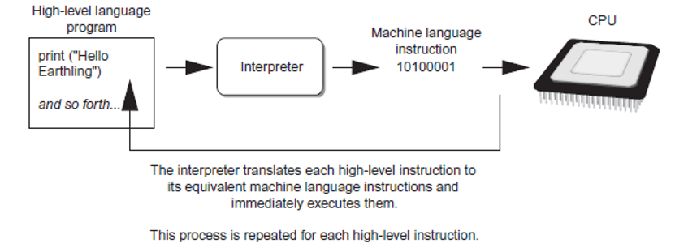
Compilers and Interpreters (4 of 4)
Compilation is performed automatically and hidden
Figure 1-19 Executing a high-level program with an interpreter
Notes:
.

Slide 31
1-5 Using Python
Python must be installed and configured prior to use
  One of the items installed is the Python interpreter
Python interpreter can be used in two modes:
  Interactive mode: enter statements on keyboard
  Script mode: save statements in Python script

Slide 32
Interactive Mode
When you start Python in interactive mode, you will see a prompt
>>>
  Indicates the interpreter is waiting for a Python statement to be typed
  Prompt reappears after previous statement is executed
  Error message displayed If you incorrectly type a statement
Good way to learn new parts of Python

Slide 33
Writing Python Programs and Running Them in Script Mode
Statements entered in interactive mode are not saved as a program
To create a program, use script mode
  Save a set of Python statements in a file
  The filename should have the .py extension
  To run the file, or script, type
  python filename (use python3 in MacOS)
  at the operating system command line

Slide 34
The I D L E Programming Environment
I D L E (Integrated Development Program): single program that provides tools to write, execute and test a program
  Automatically installed when Python language is installed
  Runs in interactive mode
  Has built-in text editor with features designed to help write Python programs

Slide 35
Summary
This chapter covered:
  Main hardware components of the computer
  Types of software
  How data is stored in a computer
  Basic C P U operations and machine language
  Fetch-decode-execute cycle
  Complex languages and their translation to machine code
  Installing Python and the Python interpreter modes

Slide 36
Copyright
This work is protected by United States copyright laws and is provided solely for the use of instructors in teaching their courses and assessing student learning. Dissemination or sale of any part of this work (including on the World Wide Web) will destroy the integrity of the work and is not permitted. The work and materials from it should never be made available to students except by instructors using the accompanying text in their classes. All recipients of this work are expected to abide by these restrictions and to honor the intended pedagogical purposes and the needs of other instructors who rely on these materials.

