Slide 1
LakeTemperature Testing Software
Slides by Aidan Bensch and Sam Allen

Slide 2
Background
We are testing a module of E3SM,¹ an environmental model. This module, LakeTemperature, is part of the greater ELM (E3SM Land Model) which was originally a fork of the CLM (Community Land Model).
We are able to test specifically this module using SPEL,² a software that adds a NetCDF³ interface for the constants, inputs, and outputs of a module of E3SM and compiles that specific part of the model. The executable produced by this is named elmtest.exe.
1. “Energy Exascale Earth System Model.” E3SM, U.S. Department of Energy: Office of Science, n.d., e3sm.org/.
2. Schwartz, Peter. “SPEL_OpenACC.” GitHub, 16 Oct. 2025, github.com/peterdschwartz/SPEL_OpenACC.git.
3. “NetCDF.” NSF UNIDATA, n.d., www.unidata.ucar.edu/software/netcdf.

Slide 3
Project Goals
Develop a software that can systematically change the constants used in the LakeTemperature model and allow us to visualize and observe patterns in how this affects its output.
Apply testing techniques to try and find values for constants that will cause physically impossible or otherwise erroneous outputs. Apply assertions pertaining to the values of constants, inputs, and outputs based around physical laws and other constraints provided by domain scientists.

Slide 4
Our Testing Solution
Automates the process of modifying constants in spel-constants0001.nc and the process of analyzing the resulting values in fut-outputs0001.nc
Both the process of choosing values for each constant and the process of analyzing the resulting outputs is extendable through sampling plugins and analysis plugins respectively.

Slide 5
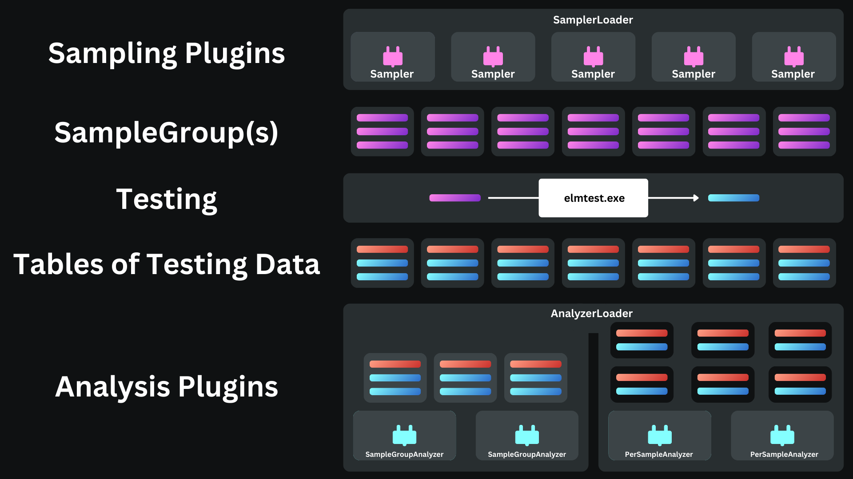



= Input Data
= Reference Data
= Output Data
Key

Slide 7
Constants, Inputs, and Outputs
The 28 constants control how the model behaves and manipulates data.
  We don’t yet support modification of the 3 array constants. Of the other 25 scalar constants we do experiment with, 8 have no observable effect on the output.
The 26 inputs provide starting data for the model.
The 9 outputs include data that the model has generated.
8 variables are both an input and an output in some instances.

Slide 8
Table of Constants, Inputs, and Outputs
Array Constants | crop
 | iscft
 | percrop
Scalar Constants (with observable effects) | betavis
 | cnfac
 | cpliq
 | denh2o
 | dtime_mod
 | grav
 | hfus
 | lake_no_ed
 | lakepuddling

Slide 9
Table of Constants, Inputs, and Outputs
Scalar Constants (with observable effects) | nlevgrnd
 | nlevlak
 | nlevsno
 | nlevsoi
 | thk_bedrock
 | tkwat
 | use_lch4
 | vkc
Scalar Constants (without observable effects) | cpice
 | denice
 | depthcrit
 | iulog

Slide 10
Table of Constants, Inputs, and Outputs
Scalar Constants (without observable effects) | mixfact
 | pudz
 | tkair
 | tkice
Inputs | betaprime_col
 | eflx_gnet
 | eflx_sh_grnd
 | eflx_sh_tot
 | eflx_snomelt
 | eflx_soil_grnd
 | errsoi
 | grnd_ch4_cond_col

Slide 11
Table of Constants, Inputs, and Outputs
Inputs | hc_soi
 | hc_soisno
 | imelt
 | lakeresist_col
 | lake_icefrac_col
 | lake_icethick_col
 | qflx_snofrz_lyr
 | qflx_snomelt
 | qflx_snow_melt
 | savedtke1_col
 | h2osno
 | snow_depth

Slide 12
Table of Constants, Inputs, and Outputs
Inputs | t_lake
 | t_soisno
Inputs & Outputs

Slide 13
Table of Constants, Inputs, and Outputs
Inputs & Outputs
Outputs | ch4_vars
 | col_ef
 | col_es
 | col_wf
 | col_ws
 | lakestate_vars
 | veg_ef

Slide 14
NetCDF
Network Common Data Form (NetCDF) is a format for self-describing datasets. Each file is composed of “dimensions” and “variables.” Variables are multi-dimensional arrays, with the meaning of each dimension described in the file.
netcdf x_times_y {
dimensions:
x = 5 ;
y = 5 ;
variables:
float x(x) ;
float y(y) ;
float z(x, y) ;
data:
x = -2, -1, 0, 1, 2 ;
y = -4, -2, 0, 2, 4 ;
z =
8, 4, -0, -4, -8,
4, 2, -0, -2, -4,
-0, -0, 0, 0, 0,
-4, -2, 0, 2, 4,
-8, -4, 0, 4, 8 ;
}

Slide 15
What is a Sample?
A sample is a set of values for the constants contained in spel-constants0001.nc.
  There are 28 constants in total. We don’t yet support modification of the 3 array constants. Of the 25 scalar constants we experiment with, 8 have no observable effect on the output.
elmtest.exe is run once for each sample.

Slide 16
What is a Sample? (Illustration)
Constants (formerly lakeparams.txt)
Example Sample (JSON used for illustration)
betavis
0.0
za_lake
0.6
n2min
7.4999999999999993E-005
tdmax
277.0
pudz
0.0
mixfact
10.0
depthcrit
25.0
{
"betavis": 0.0,
"za_lake": 0.6,
"n2min": 7.4999999999999993E-005,
"tdmax": 277.0,
"pudz": 0.0,
"mixfact": 10.0,
"depthcrit": 25.0
}

Slide 17
What Outputs are Received per Sample?
Analysis plugins will receive the outputs from the spel-outputs0001.nc file in the form of multidimensional numpy arrays, which range from one to three dimensions.
Outputs Received by Analysis Plugins (JSON for illustration)
{
"veg_ef%eflx_soil_grnd": [0.0, ...],
"veg_ef%eflx_gnet": [[0.0, ...], ...],
...
}

Slide 18
Sample Groups
Represents a grouping of samples, ordered—for the sake of simplicity, not necessity—to match indices with the list of model data
Analysis plugins can analyze the result of multiple consecutive runs of elmtest.exe in context this way.
Having multiple sample groups is useful because each one can cover a range of values for a specific combination of constants whose combined effect is being examined.

Slide 19
Sample Group Illustration
Sample Group Data (JSON for illustration)
Ordered Output Data (JSON for illustration)
[
{
"betavis": 0.0,
...
},
{
"betavis": 0.25,
...
},
{
"betavis": 0.5,
...
}
]
[
{
"lakestate_vars%betaprime_col": [0.0, ...],
...
},
{
"lakestate_vars%betaprime_col": [0.25, ...],
...
},
{
"lakestate_vars%betaprime_col": [0.5, ...],
...
}
]

Slide 20
Plugins
Our testing framework supports two types of plugins, sampling and analysis. Sampling plugins define values for constants, and analysis plugins view the outputs of the model.
  For example, if we have constants A and B, default input data, and a specific output variable O, one question we might have is which of the constants has a greater effect on the output variable O.
  We could answer this by defining a sampling plugin that would set the constants to be different values, such as A=5 and B=5 for one run, A=10 and B=5 for another run, and A=5 and B=10 for the third run.
  Then we would need an analysis plugin that focuses on the how the value of output O changes between runs to determine whether constant A or B affects it more.

Slide 21
Plugin UML Diagram

Slide 22
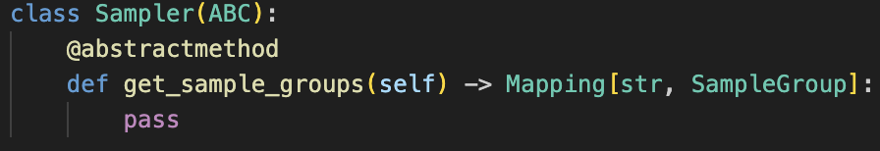
Sampling Plugin Interface
Sampling plugins define a subclass of Sampler, returning one or more SampleGroups, which are sequences of individual samples.

Slide 23
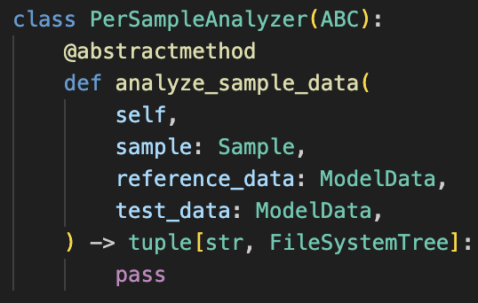
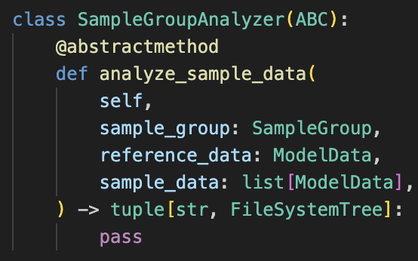
Analysis Plugin Interface
Analysis plugins can either be “per sample” or “sample group” analysis plugins.
“Per sample” plugins define a subclass of PerSampleAnalyzer, whose methods are called each time elmtest.exe is run, and which receives the outputs produced by that specific sample.
“Sample group” plugins define a subclass of SampleGroupAnalyzer, whose method is called after all samples in a group are run through elmtest.exe, and which receives all outputs from each.

Slide 24
Configuration

