Slide 1
Change Impact Analysis & Combinatorial Testing
Slides by Sam Allen

Slide 2
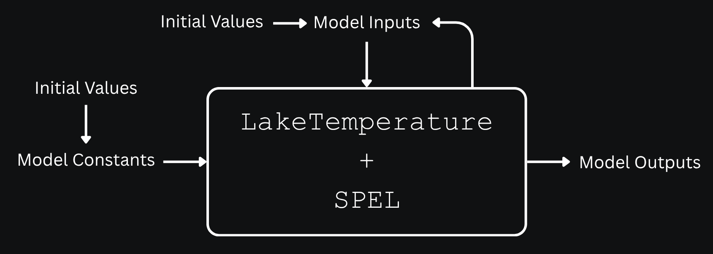
The Testing Boundary

Slide 3
Part 1: Prelude: Change Detection Analysis

Slide 4
Change Detection Analysis
Change detection analysis seeks to find how changes to individual model constants affect model outputs.
It does this by changing a single scalar model constant across its range of values while holding all other model constants at their default values.
Provides a simple form of qualitative analysis (one-constant-at-a-time) but misses interactions among model constants and their joint effect on output changes

Slide 5
Assumptions
Initial analysis is built on a few key assumptions.
First, not all the model constants have an effect on the model outputs.
Second, model constants do not influence what values other model constants could take.
Third, model constants’ effects on model outputs aren’t determined by preconditions being met.
These assumptions underlie the preliminary results from the change detection analysis plugin.

Slide 6
Usefulness (Despite the Limitations)
By discussing with the domain scientists and examining LakeTemperature source code, we found these assumptions do not always hold, meaning our initial results do not capture all of model outputs that the model constants affect.
However, this doesn’t discount the results of our change detection analysis.
It led to the discovery that certain model constants only affect model outputs under certain conditions.
The results are still valid and useful when the model constants are using the default values provided by the domain scientists.

Slide 7
Rationale
To determine which model constants affect which model outputs, 11 cases were created for every scalar model constant, where all model constants were held at their default values except the one which was being tested, which was linearly interpolated to get 11 values evenly spread across its valid range.
This assumed that model constants are independent of each other, and that no preconditions need to be met for a constant to have an effect on a model output.

Slide 8
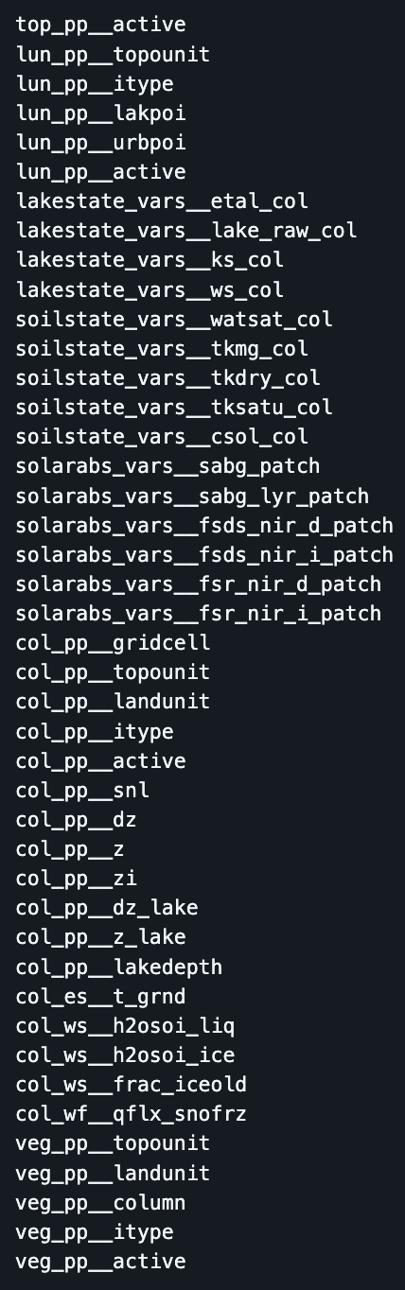
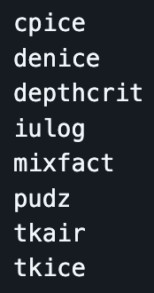
Preliminary Results
Scalar model constants that had no effect on any model output
Model outputs that didn’t change in response to any model constant
Scalar model constants (columns) and the model outputs (rows) they affect

Slide 9
Limitations and Next Steps
So far, the combinatorial test cases were only using the scalar model constants assumed to have an impact on model outputs. Next, they will include all scalar model constants.
The change detection analysis might be redone in the future by examining preconditions through LakeTemperature source code, however, further combinatorial testing and change impact analysis will not depend on these results, as all scalar model constants will be included.

Slide 10
Part 2: Change Impact Analysis

Slide 11
Change Impact Analysis
The goal is to visualize the impact of scalar model constants on model outputs.
Some challenges are:
Most of the 25 model constants we change affect multiple model outputs.
The 75 model outputs are multidimensional. The column dimension goes from 0 to 344.
Contrary to an initial assumption, some model constants only affect model outputs when certain preconditions are met.
We created a 3D graph using time as the x-axis, the one model constant we changed as the y-axis, and a single column of a single model output as the z-axis.

Slide 12
Graphing Process
Output data in the form of a NetCDF file was used.
From the output data we pulled the values for the model constant vkc, which represents the Von Kármán Constant.
Time was interpolated from 0 to 35.
From the output data we pulled the values for the model output lakestate_vars__savedtke1_col–the eddy conductivity at the top lake level saved for the next step–at the column numbered 336.
Using matplotlib, all three dimensions were graphed.

Slide 13
An Example Graph
This graph shows how the model constant vkc affects the model output lakestate_vars__savedtke1_col over a period of 35 time steps for the lake column numbered 336.

Slide 14
Part 3: Combinatorial Testing

Slide 15
Why Combinatorial Testing (CT)?
Ideally, LakeTemperature should be validated against all possible combinations of model constant values to ensure that no combination results in erroneous output.
Exhaustive testing is neither practical nor feasible due to the vast number of all possible combinations.
Combinatorial testing substantially reduces the number of required test cases while achieving near-exhaustive coverage.
Assuming most of the bugs are triggered by the interactions of model constants

Slide 16
Background of Combinatorial Testing
1. Automated Combinatorial Testing for Software (ACTS). NIST Computer Security Division. (2016, July 20). https://csrc.nist.rip/groups/SNS/acts/
2. User Guide for ACTS. NIST. (n.d.). https://csrc.nist.gov/csrc/media/Projects/automated-combinatorial-testing-for-software/documents/acts_user_guide_for_basic1.0_and_advanced3.3_versions_nov23.pdf
NIST research found most software bugs are caused by the interactions of only a small number of parameters¹.
By testing all combinations of a certain number of parameters, most software bugs can be found with much fewer test cases.
NIST’s ACTS tool can generate covering arrays from 1-way to 6-way or with mixed coverage².

Slide 17
Application of CT to LakeTemperature
The scalar model constants, which we can control when running LakeTemperature, are used as the parameters for the combinatorial test cases.
3 scalar model constants are Booleans, 7 are integers, and 15 are floats.
Booleans can be either 0 or 1.
For integers, we linearly interpolated over their ranges to get up to 11 values.
For floats, we linearly interpolated over their ranges to get exactly 11 values.
NetCDF Excerpts for Illustration
bool lakepuddling = 0, 1 ;
int nlevsno = 0, 1, 2, 3, 4, 5 ;
int depthcrit = 15, 17, 19, 21, 23, 25, 27, 29, 31, 33, 35 ;
float thk_bedrock = 2, 2.2, 2.4, 2.6, 2.8, 3, 3.2, 3.4, 3.6, 3.8, 4 ;

Slide 18
Test Oracle
Scientific software verification is challenging due to often lacking a test oracle.
We implemented checks that validate model outputs, supported by the fault finding analysis plugin.
Checks include ranges of outputs, signs, enumerated values, finiteness, relationships to other outputs, and certain physical laws and constraints.

Slide 19
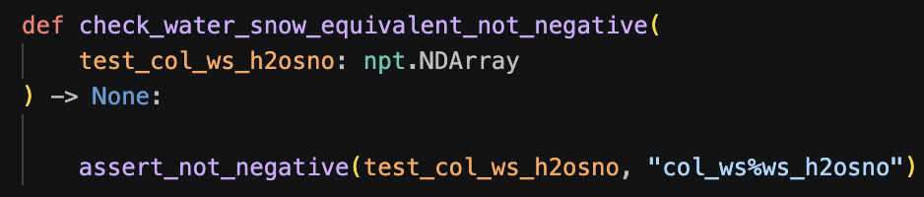
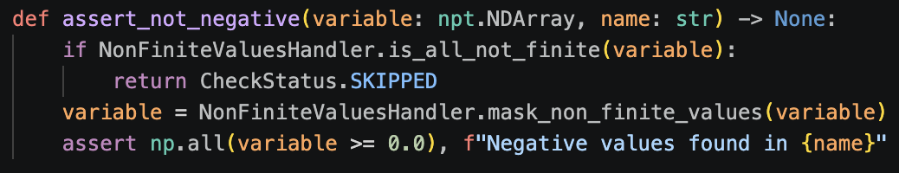
Sign Checks Overview
Check that a certain model output is not negative
11 out of 59 checks are of this type.
Example Check

Slide 20

All Sign Checks
$∀t∀c($ch4_vars%grnd_ch4_cond_col[t, c] ≥ 0)
ch4_conductance_check.check_methane_conductance_not_negative
Precondition: use_lch4 = 1
$∀t∀c($col_ws%h2osno[t, c] ≥ 0)
physical_bounds_check.check_water_snow_equivalent_not_negative
$∀t∀c($col_ws%snow_depth[t, c] ≥ 0)
physical_bounds_check.check_snow_depth_not_negative
$∀t∀j∀c($col_wf%qflx_snofrz_lyr[t, j, c] ≥ 0)
physical_bounds_check.check_snow_freeze_rate_not_negative
$∀t∀c($col_wf%qflx_snomelt[t, c] ≥ 0)
physical_bounds_check.check_snow_melt_flux_not_negative
CH4 Conductance Behavior Check
Physical Bounds Check
Physical Bounds Check
Physical Bounds Check
Physical Bounds Check

Slide 21

All Sign Checks (Continued)
$∀t∀c($col_wf%qflx_snow_melt[t, c] ≥ 0)
physical_bounds_check.check_net_snow_melt_not_negative
$∀t∀c($col_ef%eflx_snomelt[t, c] ≥ 0)
physical_bounds_check.check_snow_melt_heat_flux_not_negative
$∀t∀c($lakestate_vars%lakeresist_col[t, c] ≥ 0)
physical_bounds_check.check_lake_water_transport_resistance_not_negative
$∀t∀c($lakestate_vars%savedtke1_col[t, c] ≥0)
physical_bounds_check.check_saved_eddy_conductivity_not_negative
$∀t∀c($col_es%hc_soi[t, c] ≥ 0)
physical_bounds_check.check_soil_heat_content_not_negative
$∀t∀c($col_es%hc_soisno[t, c] ≥ 0)
physical_bounds_check.check_combined_heat_content_not_negative
All Physical Bounds Checks

Slide 22
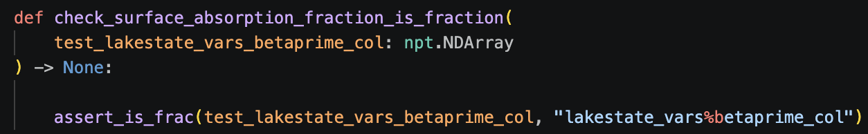
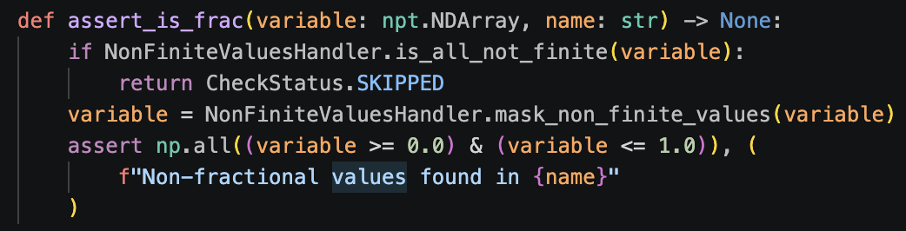
Range Checks Overview
Check that a certain model output is in [0, 1]
2 out of 59 checks are of this type.
Example Check

Slide 23

All Range Checks
All Physical Bounds Checks
$∀t∀j∀c($lakestate_vars%lake_icefrac_col[t, j, c] ∈ [0, 1])
physical_bounds_check.check_lake_layer_ice_fraction_is_fraction
$∀t∀c($lakestate_vars%betaprime_col[t, c] ∈ [0, 1])
physical_bounds_check.check_surface_absorption_fraction_is_fraction

Slide 24
Finiteness Checks Overview
Check that a certain model output is finite
22 out of 59 checks are of this type.
Example Check

Slide 25

All Finiteness Checks
All Finite Values Checks
$∀t∀j∀c($col_es%t_lake[t, j, c] != NaN $∩$ col_es%t_lake[t, j, c] != inf)
finite_values_check.check_lake_temperature_finite
$∀t∀j∀c(\text{col_es\%t_soisno}[t, j, c]\text{ != }\text{NaN} ∩\text{col_es\%t_soisno}[t, j, c]\text{ != inf)}$
finite_values_check.check_soil_snow_temperature_finite
$∀t∀p(\text{veg_ef\%eflx_gnet}$[t, p] != NaN $∩$ veg_ef%eflx_gnet[t, p] != inf)
finite_values_check.check_ground_net_heat_flux_finite
$∀t∀p(\text{veg_ef\%eflx_sh_grnd}$[t, p] != NaN $∩$ veg_ef%eflx_sh_grnd[t, p] != inf)
finite_values_check.check_ground_sensible_heat_flux_finite
$∀t∀p(\text{veg_ef\%eflx_sh_tot}$[t, p] != NaN $∩$ veg_ef%eflx_sh_tot[t, p] != inf)
finite_values_check.check_total_sensible_heat_flux_finite

Slide 26

All Finiteness Checks (Continued)
$∀t∀p(\text{veg_ef\%eflx_soil_grnd}$[t, p] != NaN $∩$ veg_ef%eflx_soil_grnd[t, p] != inf)
finite_values_check.check_ground_heat_flux_finite
$∀t∀c(\text{col_ef\%eflx_snomelt}$[t, c] != NaN $∩$ col_ef%eflx_snomelt[t, c] != inf)
finite_values_check.check_snow_melt_heat_flux_finite
$∀t∀j∀c(\text{col_wf\%qflx_snofrz_lyr}$[t, j, c] != NaN $∩$ col_wf%qflx_snofrz_lyr[t, j, c] != inf)
finite_values_check.check_snow_freeze_rate_finite
$∀t∀c(\text{col_wf\%qflx_snomelt}$[t, c] != NaN $∩$ col_wf%qflx_snomelt[t, c] != inf)
finite_values_check.check_snow_melt_water_flux_finite
$∀t∀c(\text{col_wf\%qflx_snow_melt}$[t, c] != NaN $∩$ col_wf%qflx_snow_melt[t, c] != inf
finite_values_check.check_new_snow_melt_rate_finite
$∀t∀c(\text{col_ws\%h2osno}$[t, c] != NaN $∩$ col_ws%h2osno[t, c] != inf)
finite_values_check.check_snow_water_equivalent_finite
All Finite Values Checks

Slide 27

All Finiteness Checks (Continued)
All Finite Values Checks
$∀t∀c(\text{col_ws\%snow_depth}$[t, c] != NaN $∩$ col_ws%snow_depth[t, c] != inf)
finite_values_check.check_snow_depth_finite
$∀t∀c(\text{lakestate_vars\%lakeresist_col}$[t, c] != NaN $∩$ lakestate_vars%lakeresist_col[t, c] != inf)
finite_values_check.check_lake_transport_resistance_finite
$∀t∀c(\text{lakestate_vars\%savedtke1_col}$[t, c] != NaN $∩$ lakestate_vars%savedtke1_col[t, c] != inf)
finite_values_check.check_saved_eddy_conductivity_finite
$∀t∀c(\text{lakestate_vars\%grnd_ch4_cond_col}$[t, c] != NaN $∩$ lakestate_vars%grnd_ch4_cond_col[t, c] != inf)
finite_values_check.check_ground_methane_conductance_finite
Precondition: use_lch4 = 1
$∀t∀c(\text{col_ef\%errsoi}$[t, c] != NaN $∩$ col_ef%errsoi[t, c] != inf)
finite_values_check.check_energy_conservation_residual_finite

Slide 28

All Finiteness Checks (Continued)
$∀t∀j∀c(\text{col_ef\%imelt}$[t, j, c] != NaN $∩$ col_ef%imelt[t, j, c] != inf)
finite_values_check.check_snow_layer_flag_finite
$∀t∀c(\text{col_es\%hc_soi}$[t, c] != NaN $∩$ col_es%hc_soi[t, c] != inf)
finite_values_check.check_soil_heat_content_finite
$∀t∀c(\text{col_es\%hc_soisno}$[t, c] != NaN $∩$ col_es%hc_soisno[t, c] != inf)
finite_values_check.check_combined_heat_content_finite
$∀t∀c(\text{lakestate_vars\%betaprime_col}$[t, c] != NaN $∩$ lakestate_vars%betaprime_col[t, c] != inf)
finite_values_check.check_surface_absorption_finite
$∀t∀j∀c(\text{lakestate_vars\%lake_icefrac_col}$[t, j, c] != NaN $∩$ lakestate_vars%lake_icefrac_col[t, j, c] != inf)
finite_values_check.check_ice_mass_fraction_finite
$∀t∀c(\text{lakestate_vars\%lake_icethick_col}$[t, c] != NaN $∩$ lakestate_vars%lake_icethick_col[t, c] != inf)
finite_values_check.check_ice_thickness_finite
All Finite Values Checks

Slide 29
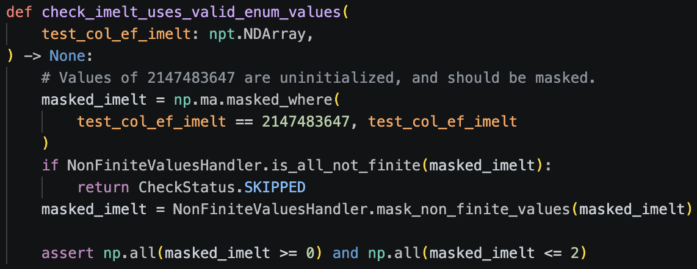
Enumerated Value Check Overview
Check that a certain model output consists of valid enumerated values
1 out of 59 checks are of this type.
Example Check

Slide 30

All Enumerated Value Checks
$∀t∀j∀c($col_ef%imelt[t, j, c] ∈ {0, 1, 2})
aggregation_and_consistency_check.check_imelt_uses_valid_enum_values
Aggregation and Consistency Check

Slide 31
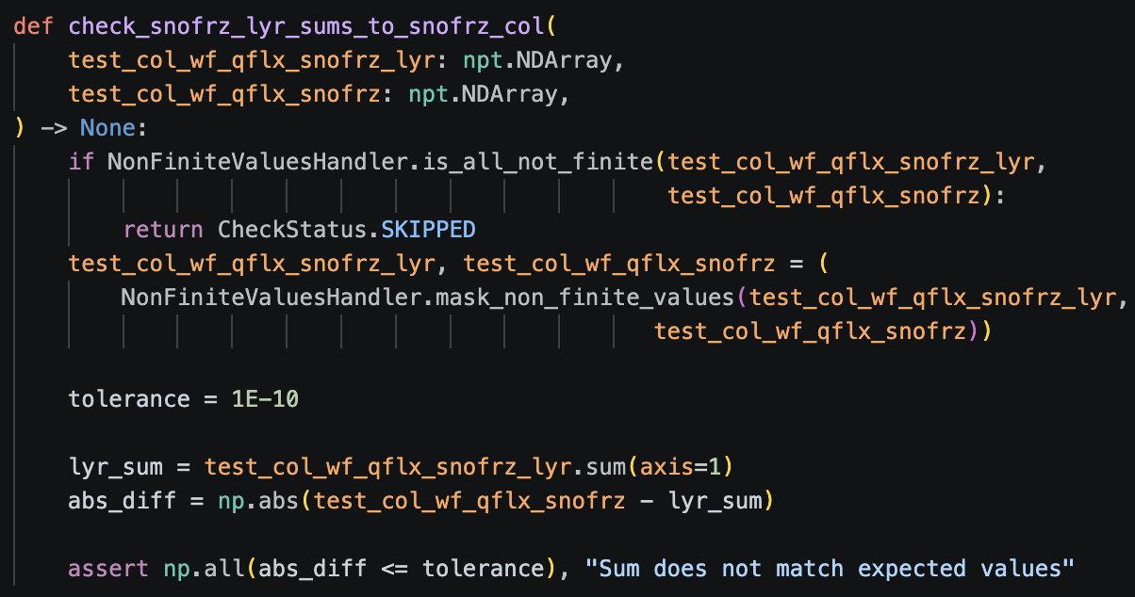
Relationship to Other Outputs Checks Overview
Check that a certain model output has a certain relationship to other model outputs
11 out of 59 checks are of this type.
Example Check

Slide 32

All Relationship to Other Outputs Checks
$∀t∀c((\sum_{j}{lakestate_vars\%lake_icefrac_col\left[t, j, c\right]×col_pp\%dz_lake[t, j, c]×denh2o÷denice)≈}$ $lakestate_vars\%lake_icethick_col$[t, c])
aggregation_and_consistency_check.check_icethick_col_is_sum
Tolerance: 1E-9
$∀t∀c({Δ(col_es\%hc_soisno[t, c])}/{Δt} ≈\int{(\sum_{p}{(veg_ef\%eflx_gnet[t, p]+veg_ef\%eflx_soil_grnd[t, p]+veg_ef\%eflx_sh_grnd[t, p]))}}dt$, where $veg_pp\%column[t,p]=c)$
key_physical_laws_check.check_heat_contents_close
Precondition: $∀t∀c(col_pp\%snl[t, c]=0∩col_ws\%h2osno[t,c]=0∩col_es\%t_lake[t, 0,c]>tfrz∩lakestate_vars\%lake_icefrac_col[t,0,c]=0)$
Tolerance: 1E-6
$∀t∀c(({Δ(\sum_{j}{col_ws\%h2osoi_ice[t, j, c] })}/{Δt})×hfus×{10}^{−6}≈{Δ(col_es\%hc_soisno\left[t,c\right])}/{Δt}$)
key_physical_laws_check.check_heat_diff_close
Precondition: $(∃t∃c(col_pp\%snl\left[t,c\right]<0∩col_ws\%h2osno[t,c]>0)∩∀t∀c(col_es\%t_lake[t,0,c]≤tfrz)∩∀t∀c(col_es\%t_soisno[t,0,c]<tfrz)$
Tolerance: 1E-6
Aggregation and Consistency Check
Energy Conversation Check
Snow Freezing Check

Slide 33

All Relationship to Other Outputs Checks (Continued)
$∀t∀c(\sum_{j}{col_wf\%qflx_snofrz_lyr[t,c]}≈col_wf\%qflx_snofrz\left[t,c\right]$)
aggregation_and_consistency_check.check_snofrz_lyr_sums_to_snofrz_col
Tolerance: 1E-10
$∀t∀c(col_ef\%eflx_snomelt[t,c]≈ col_wf\%qflx_snomelt[t,c]×hfus$)
key_physical_laws_check.check_energy_flux_consistent_with_latent_heat
Precondition: $∃t∃c(col_pp\%snl[t,c]=0∩col_ws\%h2osno[t,c]>0)∩∀t∀c(col_es\%t_lake[t, 0,c] >tfrz)$
Tolerance: 1E-6
$∀t∀c($col_es%hc_soisno[t, c] ≥ col_es%hc_soi[t, c])
physical_bounds_check.check_combined_heat_content_not_less_than_soil_heat_content
$∀t∀c(lakestate_vars\%lake_icefrac_col[t, 0,c]=0→(1/(lakestate_vars\%lakeresist_col[t,c]+lakestate_vars\%lake_raw_col[t,c]))≈ch4_vars\%grnd_ch4_cond_col[t,c]$)
key_physical_laws_check.check_methane_conductance_allowed_without_ice
Precondition: use_lch4 = 1
Tolerance: 1E-6
Aggregation and Consistency Check
Snow Melting Check
Physical Bounds Check
CH4 Conductance Behavior Check

Slide 34

All Relationship to Other Outputs Checks (Continued)
$∀t∀c((col_pp\%snl[t,c]=0∩col\%ws_h2osno[t,c]>0)∩(col_pp\%snl[t+dt,c]=0∩col\%ws_h2osno[t+dt,c]>0) →(Δ(col_ws\%snow_depth[t,c]×1000)/Δt)/dtime_mod≈col_wf\%qflx_snomelt[t+dt,c]$)
key_physical_laws_check.check_snow_depth_decreases_with_snow_melt_rate
Tolerance: 1E-3
Precondition: $∃t∃c(col_pp\%snl[t,c]=0∩col_ws\%h2osno[t,c]>0)∩∀t∀c(col_es\%t_lake[t, 0,c] >tfrz)$
$∀t∀c((col_pp\%snl[t,c]=0∩col\%ws_h2osno[t,c]>0)∩(col_pp\%snl[t+dt,c]=0∩col\%ws_h2osno[t+dt,c]>0) →(Δ(col_ws\%h2osno [t,c]×1000)/Δt)/dtime_mod≈col_wf\%qflx_snomelt[t+dt,c]$)
key_physical_laws_check.check_snow_water_equivalent_decreases_with_snow_melt_rate
Tolerance: 1E-3
Precondition: $∃t∃c(col_pp\%snl[t,c]=0∩col_ws\%h2osno[t,c]>0)∩∀t∀c(col_es\%t_lake[t, 0,c] >tfrz$
All Snow Melting Checks

Slide 35

All Relationship to Other Outputs Checks (Continued)
$∀t∀c(col_pp\%snl[t,c]=0→lakestate_vars\%betaprime_col[t,c]≈\sum_{p}{(solarabs_vars\%sabg_lyr_patch[t,0,p]÷solarabs_vars\%sabg_patch[t,p])}$) , where $veg_pp\%column[t,p]=c)$
key_physical_laws_check.check_betaprime_close_to_solar_rad_where_snow
Tolerance: 1E-6
$∀t∀c∀p(col_pp\%snl\left[t,c\right]=0→\sum_{p}{\left(\left({NIR}_{frac\left[t,p\right]}\right)+\left(1−{NIR}_{frac\left[t,p\right]}\right)×betavis\right)}≈lakestate_vars\%betaprime_col[t,c])$, where $NIR_frac[t,p]=((solarabs_vars\%fsds_nir_d_path[t,p]+solarabs_vars\%fsds_nir_i_patch[t,p])−\%(solarabs_vars\%fsr_nir_d_path[t,p]+solarabs_vars\%fsr_nir_i_patch[t,p]))/solarabs_vars\%sabg_patch[t,p]$ and $veg_pp\%column[t,p]=c)$
key_physical_laws_check.check_betaprime_close_to_solar_rad_where_no_snow
Tolerance: 1E-6
All Radiation Absorption Checks

Slide 36
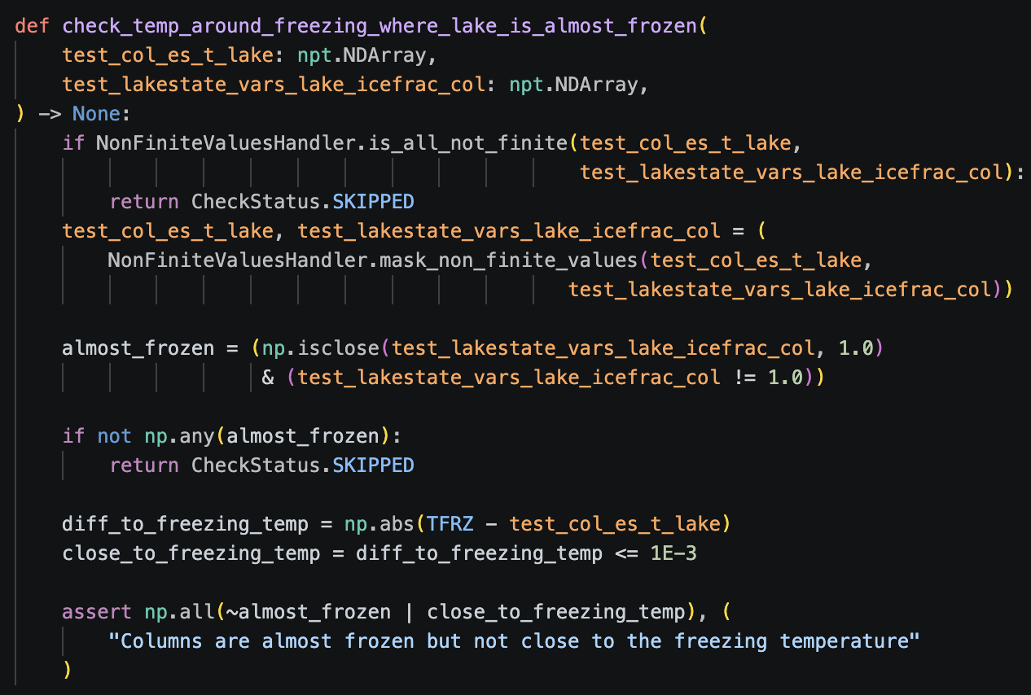
Physical Laws and Constraints Checks Overview
Check that a certain model output obeys physical laws and constraints
12 out of 59 checks are of this type.
Example Check

Slide 37

All Physical Laws and Constraints Checks
$∀t∀c(lakestate_vars\%lake_icefrac_col[t, 0, c]>0.1→ch4_vars\%grnd_ch4_cond_col[t,c]≈0$)
ch4_conductance_check.check_methane_conductance_frozen_lake
Tolerance: 1E-5
Precondition: use_lch4 = 1
$∀t∀c(col_ef\%errsoi[t,c]≈0$)
key_physical_laws_check.check_errsoi_threshold
Tolerance: 1E-6
Precondition: $∀t∀c(col_pp\%snl[t, c]=0∩col_ws\%h2osno[t,c]=0∩col_es\%t_lake[t, 0,c]>tfrz∩lakestate_vars\%lake_icefrac_col[t,0,c]=0)$
$∀t∀c(col_pp\%snl[t,c]<0∩col_ws\%h2osno[t,c]>0→$ col_wf%qflx_snofrz_lyr[t, 0, c] > 0)
key_physical_laws_check.check_surface_snow_freezing_where_snow_present
Precondition: $∃t∃c(col_pp\%snl[t,c]<0∩col_ws\%h2osno[t,c]>0)∩∀t∀c(col_es\%t_lake[t,0,c]≤tfrz∩col_es\%t_soisno[t,0,c]<tfrz)$
$∀t∀c(col_pp\%snl[t,c]<0∩col\%ws_h2osno[t,c]>0→$ col_ef%imelt[t, 0, c] = 2)
key_physical_laws_check.check_snow_labeled_freezing_where_snow_present
Precondition: $∃t∃c(col_pp\%snl[t,c]<0∩col_ws\%h2osno[t,c]>0)∩∀t∀c(col_es\%t_lake[t,0,c]≤tfrz∩col_es\%t_soisno[t,0,c]<tfrz)$
CH4 Conductance Behavior Check
Energy Conservation Check
Snow Freezing Check
Snow Freezing Check

Slide 38

All Physical Laws and Constraints Checks (Continued)
$∀t∀c(col_pp\%snl[t,c]<0∩col_ws\%h2osno[t,c]>0→$col_wf%qflx_snomelt[t,c] = 0)
key_physical_laws_check.check_snow_not_melting_where_snow_present
Precondition: $∃t∃c(col_pp\%snl[t,c]<0∩col_ws\%h2osno[t,c]>0)∩∀t∀c(col_es\%t_lake[t,0,c]≤tfrz∩col_es\%t_soisno[t,0,c]<tfrz)$
$∀t∀c({Δ(col_ws\%h2osno[t,c])}/{Δt}≥0$)
key_physical_laws_check.check_snow_water_not_decreasing
Precondition: $∃t∃c(col_pp\%snl[t,c]<0∩col_ws\%h2osno[t,c]>0)∩∀t∀c(col_es\%t_lake[t,0,c]≤tfrz∩col_es\%t_soisno[t,0,c]<tfrz)$
${∀t∀c(Δ(col_ws\%snow_depth[t, c])}/{Δt≥0}$)
key_physical_laws_check.check_snow_depth_not_decreasing
Precondition: $∃t∃c(col_pp\%snl[t,c]<0∩col_ws\%h2osno[t,c]>0)∩∀t∀c(col_es\%t_lake[t,0,c]≤tfrz∩col_es\%t_soisno[t,0,c]<tfrz)$
$∀t∀c(col_pp\%snl[t,0,c]=0∩col_ws\%h2osno[t,c]>0∩col_es\%t_lake[t,0,c]>tfrz →$ col_wf%qflx_snomelt[t, c] > 0)
key_physical_laws_check.check_snow_melting_where_snow_water_present
Precondition: $∃t∃c(col_pp\%snl[t,c]=0∩col_ws\%h2osno[t,c]>0)∩∀t∀c(col_es\%t_lake[t, 0,c] >tfrz)$
Snow Freezing Check
Snow Freezing Check
Snow Freezing Check
Snow Melting Check

Slide 39

All Physical Laws and Constraints Checks (Continued)
$∀t∀c(col_pp\%snl[t,c]=0∩col_ws\%h2osno[t,c]>0∩col_es\%t_lake[t,0,c]>tfrz →$col_wf%qflx_snow_melt[t, c] > 0)
key_physical_laws_check.check_snow_melted_where_snow_water_present
Precondition: $∃t∃c(col_pp\%snl[t,c]=0∩col_ws\%h2osno[t,c]>0)∩∀t∀c(col_es\%t_lake[t, 0,c] >tfrz)$
$¬∃t∃c$(ch4_vars%grnd_ch4_cond_col[t, c] > 0 $∩$ lakestate_vars%lake_icefrac_col[t, 0, c] > 0.1)
key_physical_laws_check.check_methane_conductance_gated_by_ice
Precondition: use_lch4 = 1
$∀t∀j∀c(lakestate_vars\%lake_icefrac_col[t,j,c]>0.999∩lakestate_vars\%lake_icefrac_col[t,j,c]≠1→col_es\%t_lake[t,j,c]−tfrz≈0$)
physics_check.check_temp_around_freezing_where_lake_is_almost_frozen
Tolerance: 1E-3
$∀t∀c(lakestate_vars\%savedtke1_col[t,c]>0→lakestate_vars\%lake_icefrac_col[t,0,c]≈0∩$ $col_pp\%snl[t,c]=0$)
physics_check.check_surface_unfrozen_when_tke_present
Tolerance: 1E-6
Snow Melting Check
CH4 Conductance Behavior Check
Physics Sanity Check
Physics Sanity Check

Slide 40
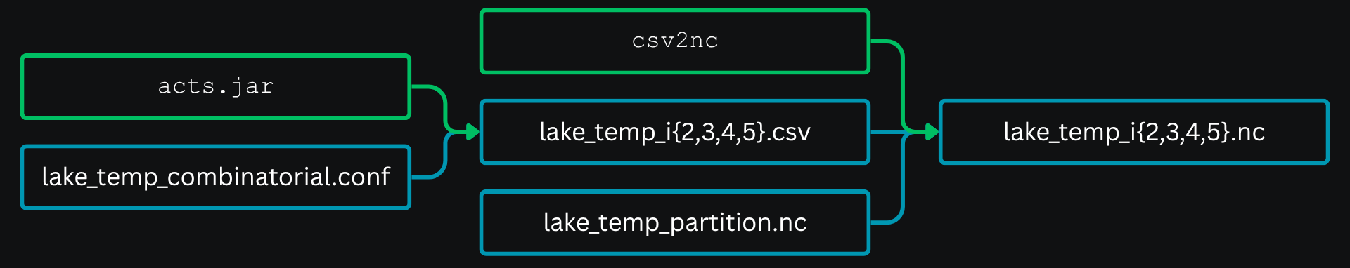
Workflow for Sample Generation
The configuration file provides the indices for the number of values each model constant can take.
ACTS uses these indices to generate covering arrays from 2-way to 5-way and outputs a CSV file for each.
The partition file provides the values that correspond to the indices in the csv files.
The Python script (csv2nc) uses the partition file’s values to create NetCDF files which are run on the model using the NetCDF cases sampling plugin.

Slide 41
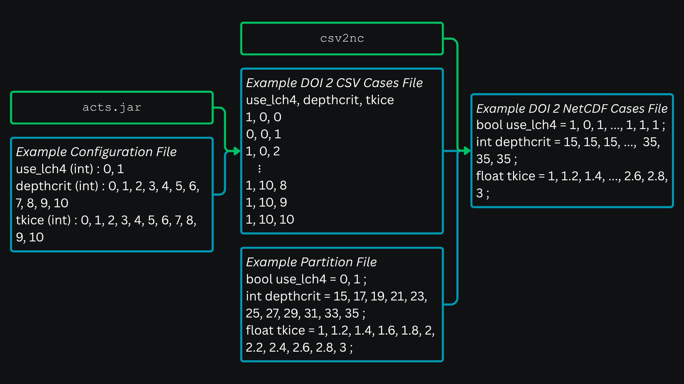

Slide 42
Test Suite Sizes and Timings for
Cases with All Scalar Model Constants
For ten samples, the mean time it takes to run elmtest (for 35 time steps) is 0.622 seconds, with a standard deviation of 0.030. This time is used to estimate how long testing each interaction level would take, assuming tests run sequentially.
*Large test cases haven’t been executed yet.
DOI | Case Count | Estimated Execution Time | Actual Execution Time
2 | 231 | 0 days, 00:02:24 | 0 days, 00:02:17
3 | 4,706 | 0 days, 00:48:47 | 0 days, 00:46:50
4 | 72,964 | 0 days, 12:36:24 | - days, --:--:--*
5 | 1,009,602 | 7 days, 06:26:12 | - days, --:--:--*

Slide 43
ACTS Case Generation Timings for
Cases with All Scalar Model Constants
DOI | Case Count | Time (seconds) Mean | Sample Standard Deviation
2 | 231 | 0.303 | 0.016
3 | 4,706 | 1.638 | 0.027
4 | 72,964 | 201.699 | 2.937
5 | 1,009,602 | 15421.421 | 171.548
This represents the amount of time it took to generate the csv test cases with all scalar model constants using ACTS.
The mean and standard deviation were calculated using 7 runs of ACTS for each DOI level.

Slide 44
csv2nc Script Timings for
Cases with All Scalar Model Constants
DOI | Case Count | Time (seconds) Mean | Sample Standard Deviation
2 | 231 | 0.671 | 0.030
3 | 4,706 | 6.187 | 0.102
4 | 72,964 | 88.892 | 0.382
5 | 1,009,602 | 1155.359 | 16.407
This represents the amount of time it took to convert the csv test cases with all scalar model constants to NetCDF using the csv2nc script.
The mean and standard deviation were calculated using 7 runs of csv2nc for each DOI level.

Slide 45
Test Suite Sizes and Timings for
Cases with Some Model Constants*
The estimated execution times for cases with some constants use the same mean elmtest time as the estimated execution times for cases with all scalar model constants.
*Combinatorial cases with some constants exclude the constants originally believed to have no effect on model outputs (following the change detection analysis) in addition to excluding the 3 non-scalar model constants.
**Large test cases haven’t been executed yet.
DOI | Case Count | Estimated Execution Time | Actual Execution Time
2 | 231 | 0 days, 00:02:24 | 0 days, 00:02:20
3 | 3,685 | 0 days, 00:38:12 | 0 days, 00:37:28
4 | 53,170 | 0 days, 09:11:12 | - days, --:--:--**
5 | 688,290 | 4 days, 22:55:16 | - days, --:--:--**

Slide 46
ACTS Case Generation Timings for
Cases with Some Model Constants
DOI | Case Count | Time (seconds) Mean | Sample Standard Deviation
2 | 231 | 0.213 | 0.006
3 | 3,685 | 0.632 | 0.024
4 | 53,170 | 12.641 | 0.197
5 | 688,290 | 1107.923 | 16.651
This represents the amount of time it took to generate the csv test cases with only some scalar model constants using ACTS.
The mean and standard deviation were calculated using 7 runs of ACTS for each DOI level.

Slide 47
csv2nc Script Timings for
Cases with Some Model Constants
DOI | Case Count | Time (seconds) Mean | Sample Standard Deviation
2 | 231 | 0.648 | 0.114
3 | 3,685 | 3.226 | 0.054
4 | 53,170 | 41.233 | 1.146
5 | 688,290 | 501.764 | 2.276
This represents the amount of time it took to convert the csv test cases with only some scalar model constants to NetCDF using the csv2nc script.
The mean and standard deviation were calculated using 7 runs of csv2nc for each DOI level.

Slide 48
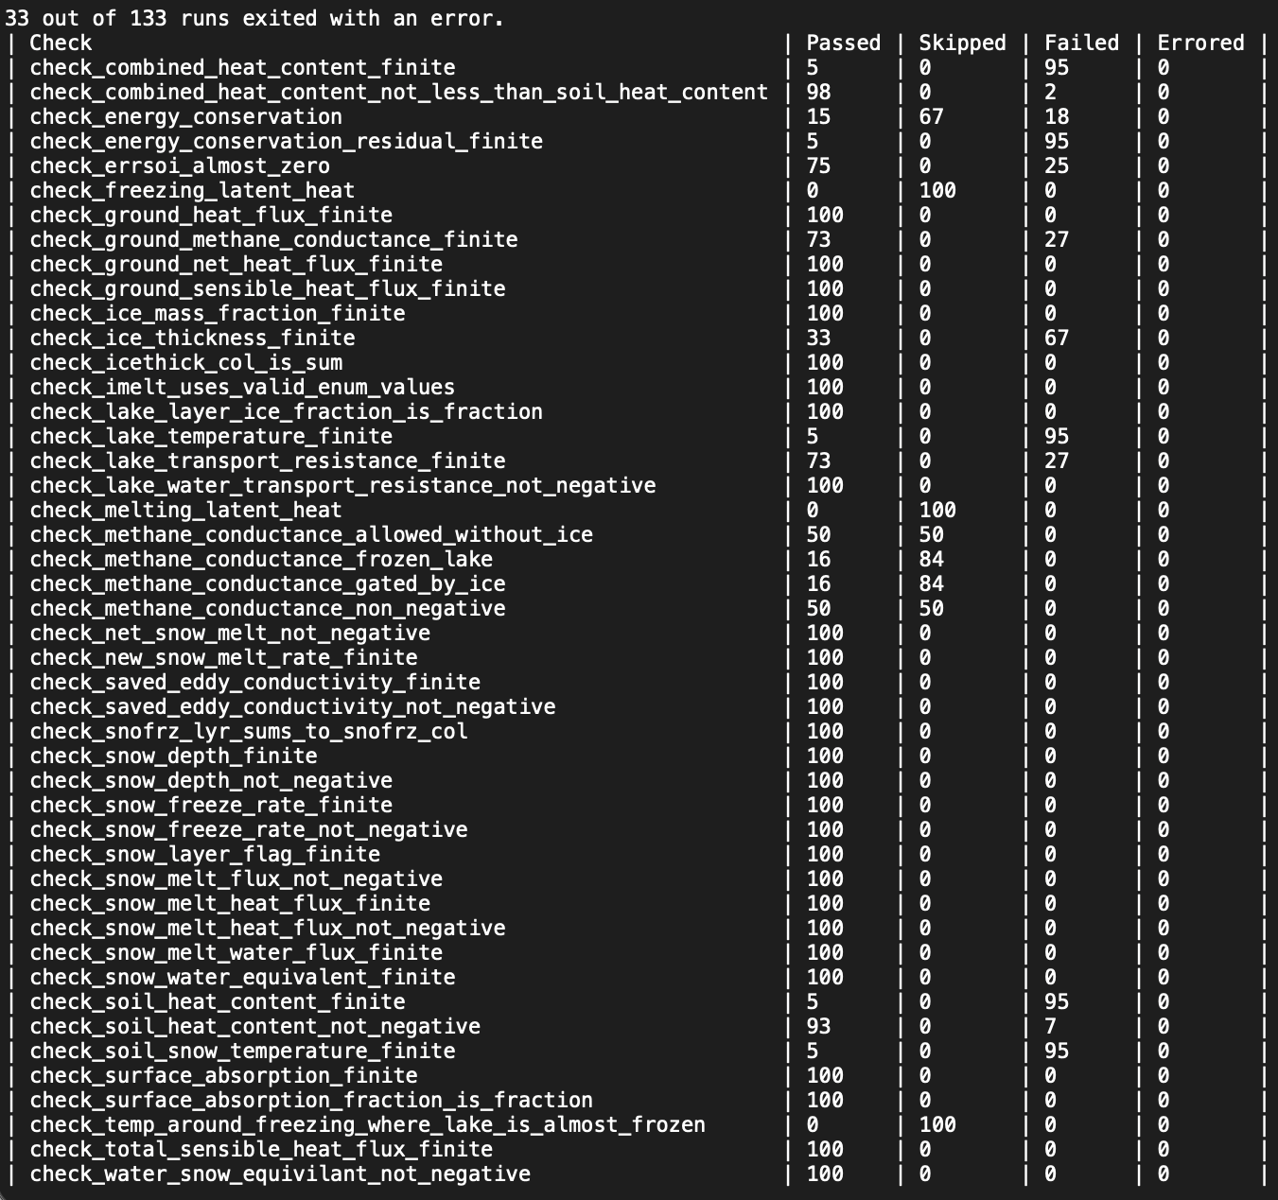
DOI 2 Results
Degree of Interaction (DOI) 2 results in 231 test cases when only changing the values of constants known to affect the outputs of LakeTemperature.
33 runs exited with an error because they used values outside of the valid ranges for some model constants.

Slide 49
DOI 2 Results Explanation
These checks were run using a 35 time step limit. Once we finalize our checks, we will run them using the 1000 time step limit. As LakeTemperature runs longer, we are more likely to expose issues with its design and/or implementation.
Some checks were skipped because they are only valid under certain preconditions. For example, check_methane_conductance_allowed_without_ice cannot run when use_lch4 == 0, when methane is turned off.
We cannot ensure some of the preconditions are met because they rely on the starting values of some model inputs, which we cannot control.
Every check makes an assertion about model output data. When that assertion fails, the check fails. This can point to a problem in the design of the check, SPEL, or LakeTemperature.
A check outputs an error when it is unable to run correctly, e.g., if there was a syntax mistake. Errors point to bugs in our code that will be fixed prior to final testing.

Slide 50
DOI 3, 4, 5 Results
When only changing the values of constants known to affect the outputs of LakeTemperature
DOI 3 results in 3,516 test cases.
DOI 4 results in 50,031 test cases.
DOI 5 results in 689,735 test cases.
We did not run these since running DOI 2 helped us find problems in our checks that we needed to fix before re-running the test cases and getting meaningful results.

Slide 51
Improvements to the Testing Framework
Our test cases originally had invalid values for constants that could only be used when certain preconditions were met, which caused crashes.
Some checks were implemented incorrectly, which were fixed.
For example, tests checking for things other than non-finite values had to ignore non-finite values, otherwise they would fail and output an inaccurate error message.

Slide 52
Findings from Preliminary Testing
SPEL might be initializing data with NaN values that LakeTemperature then never overwrites or LakeTemperature might be outputting data with NaN values. Currently …/231 combinatorial cases with all constants have at least one model output with NaN values and …/231 combinatorial cases with some constants have at least one model output with NaN values.
Largely, LakeTemperature output data appeared valid and within physical bounds. However, some cases resulted in physically impossible outputs, likely due to the interactions between model constants.

