Slide 1
West of Scotland Bus Accessibility Analysis
Sam Allwood

Slide 2
Bus Accessibility Metrics
Published by Transport Scotland in 2017 and 2019 by datazone
Derived from numbers of buses per hour serving the datazone, ajusted to emphasise peak periods
No update in 2021 due to COVID-19 pandemic and no updates currently foreseen
Plotting Change between 2017 and 2019, it is clear why they have stopped publishing the data!

Slide 3
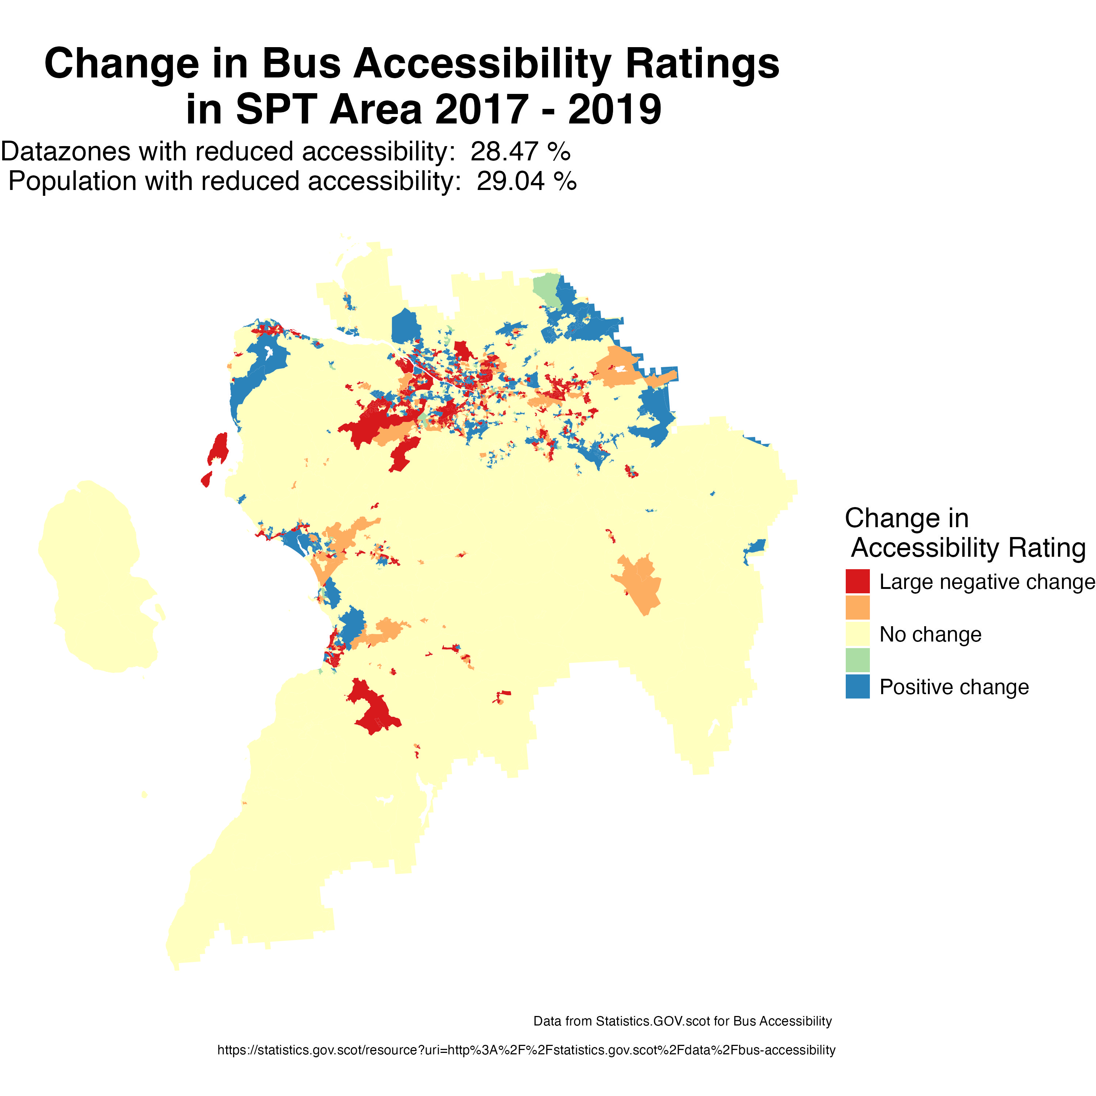
Strathclyde Partnership for Transport Area

Slide 4
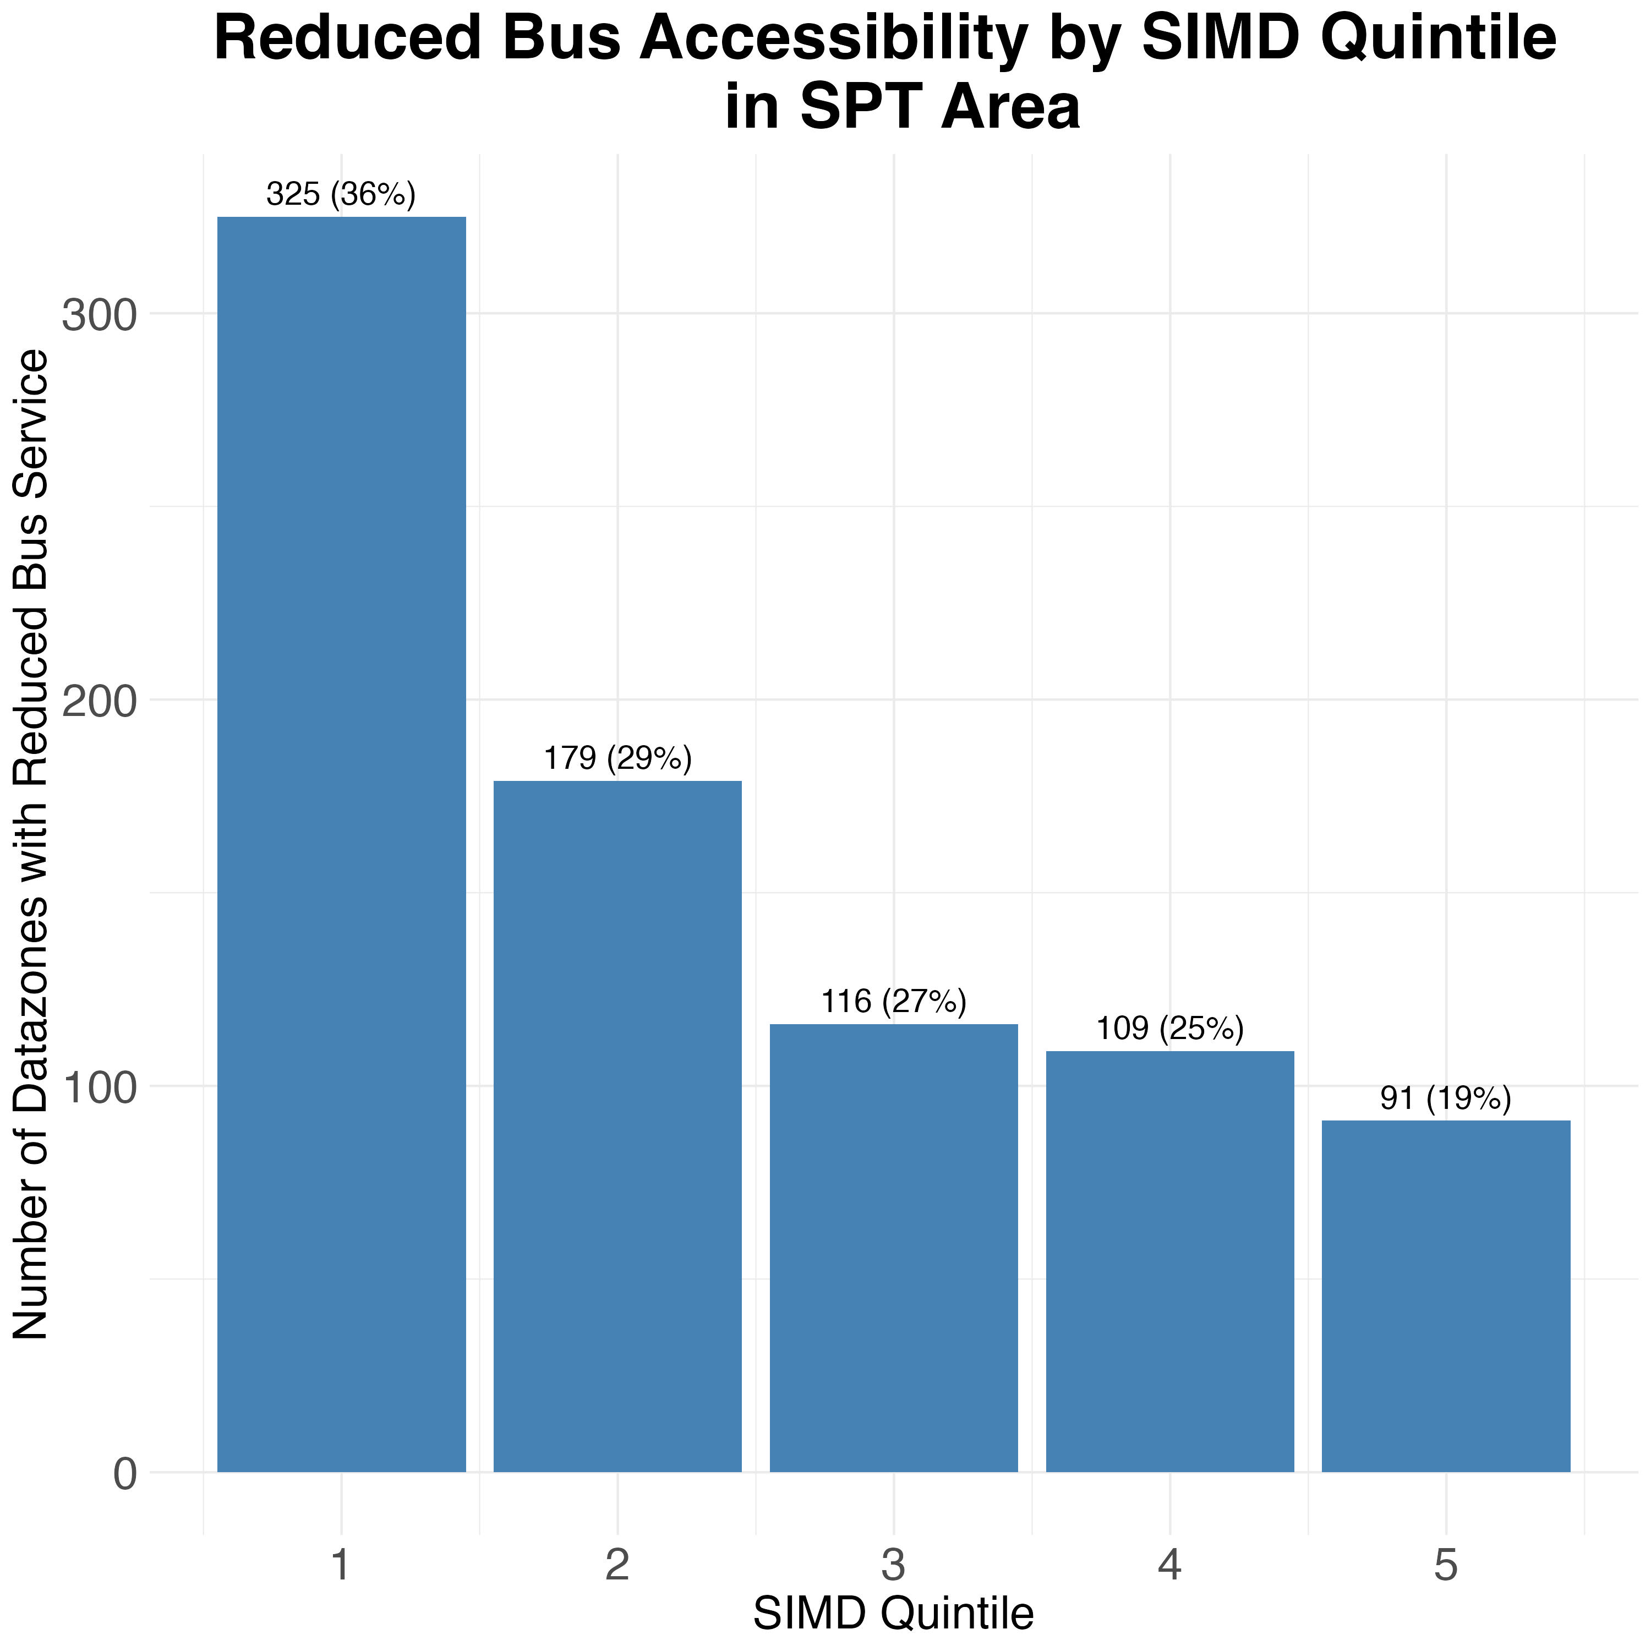

Slide 5
Not good news if you live in Glasgow!

Slide 6
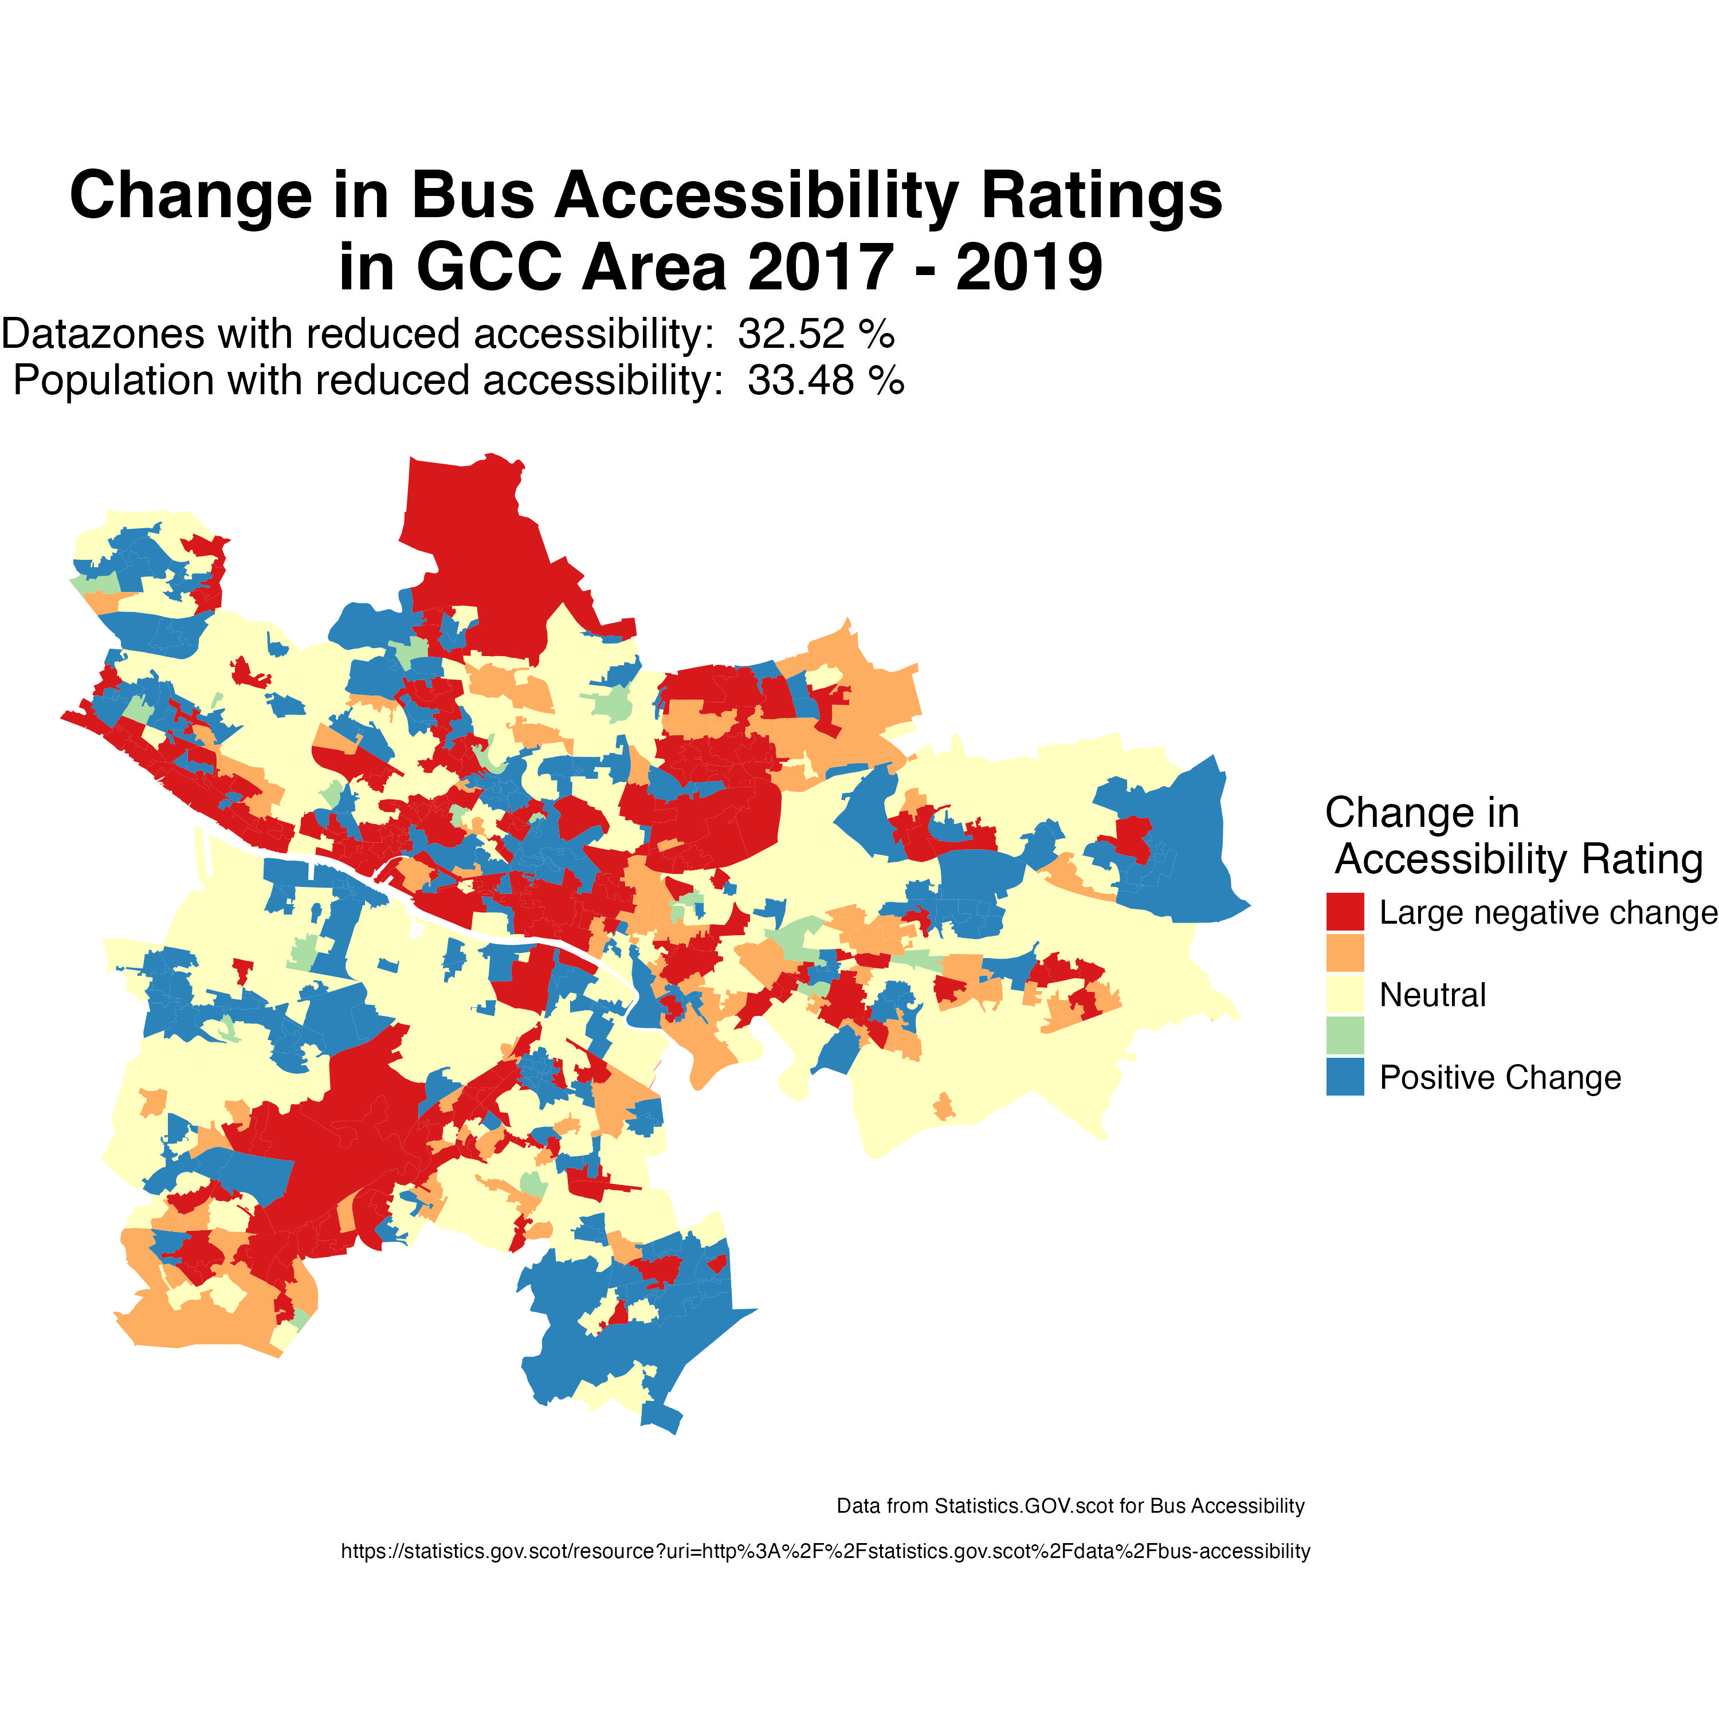
Glasgow City Council Area

Slide 7
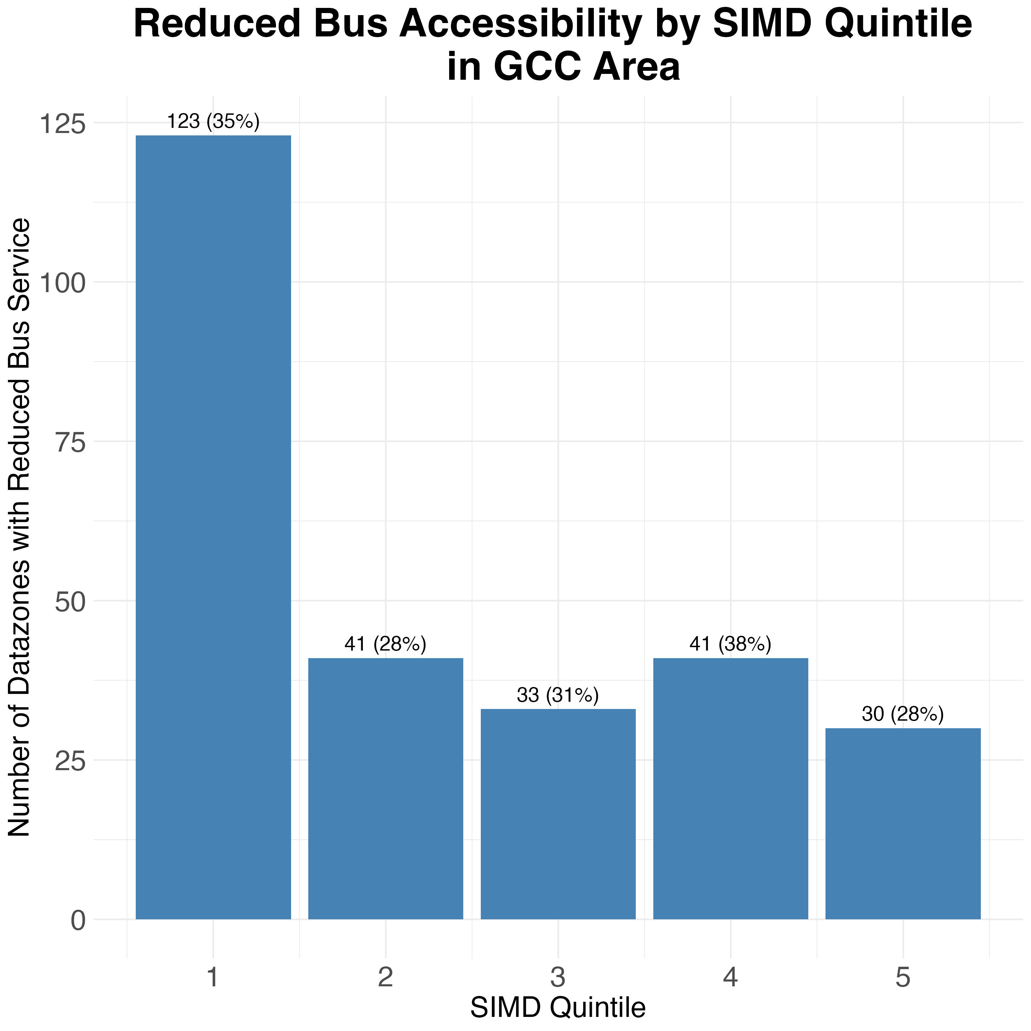

Slide 8
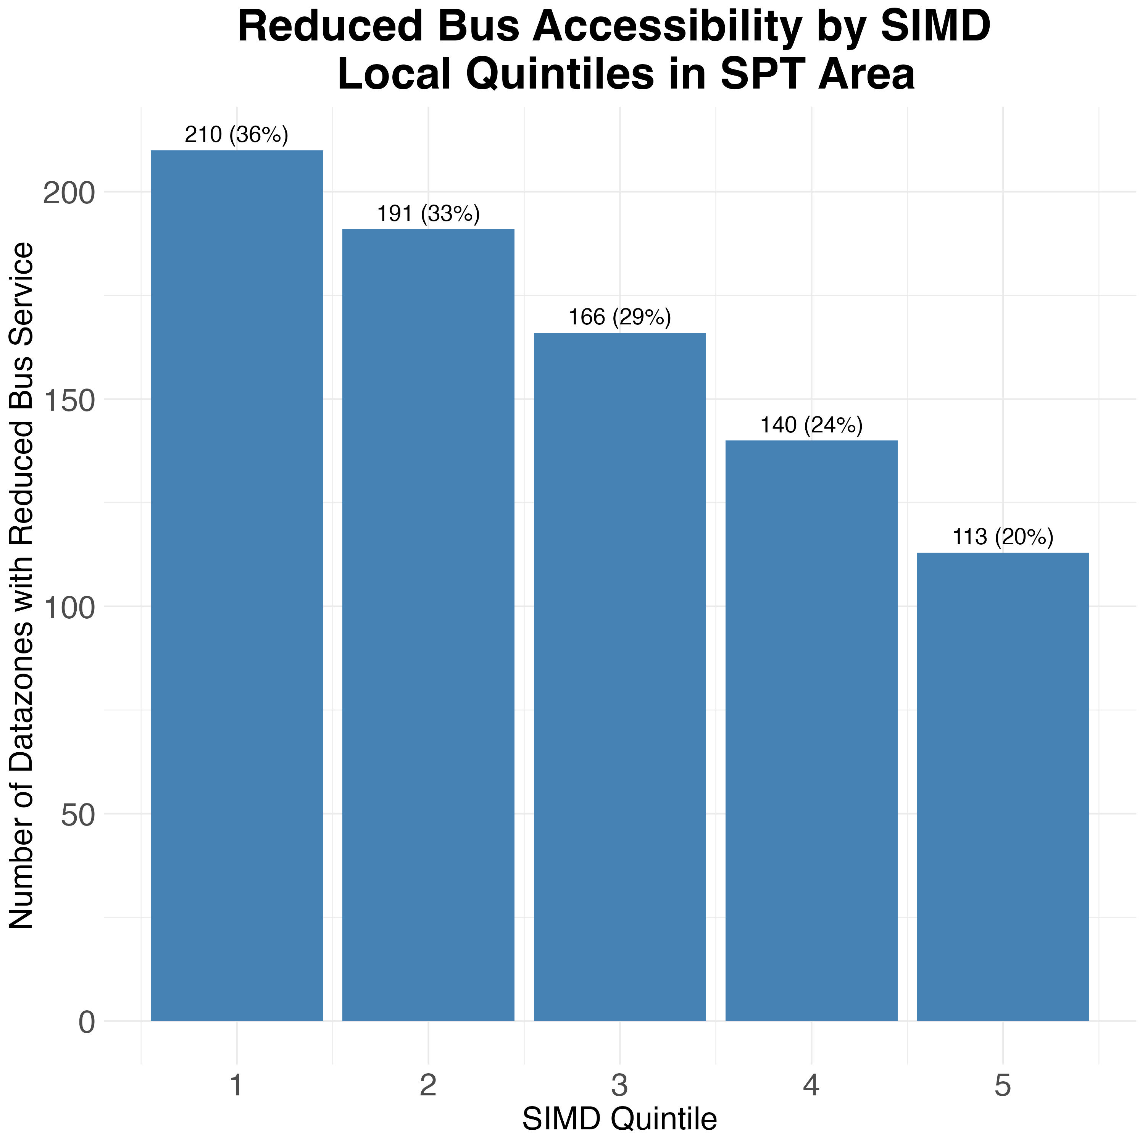
Even worse news in Glasgow if you’re in the more deprived areas!
But! The quintiles are measured across the whole of Scotland, so there are uneven numbers in West of Scotland (and likewise for Glasgow). The percentages show the proportion of the quintile datazones in the region. E.g. 35% of the 1st quintile of deprivation have had reduced bus services.
How can we present to demonstrate the inequality of bus accessibility reduction? Rather than just showing how much deprivation is concentrated in West of Scotland…
The SIMD includes a ranking of the Datazones across Scotland. We can use that to calculate quintiles of deprivation within each area.

Slide 9
