Slide 1



BUILDING A GAME AROUND AN EVOLUTIONARY ALGORITHM

Slide 2
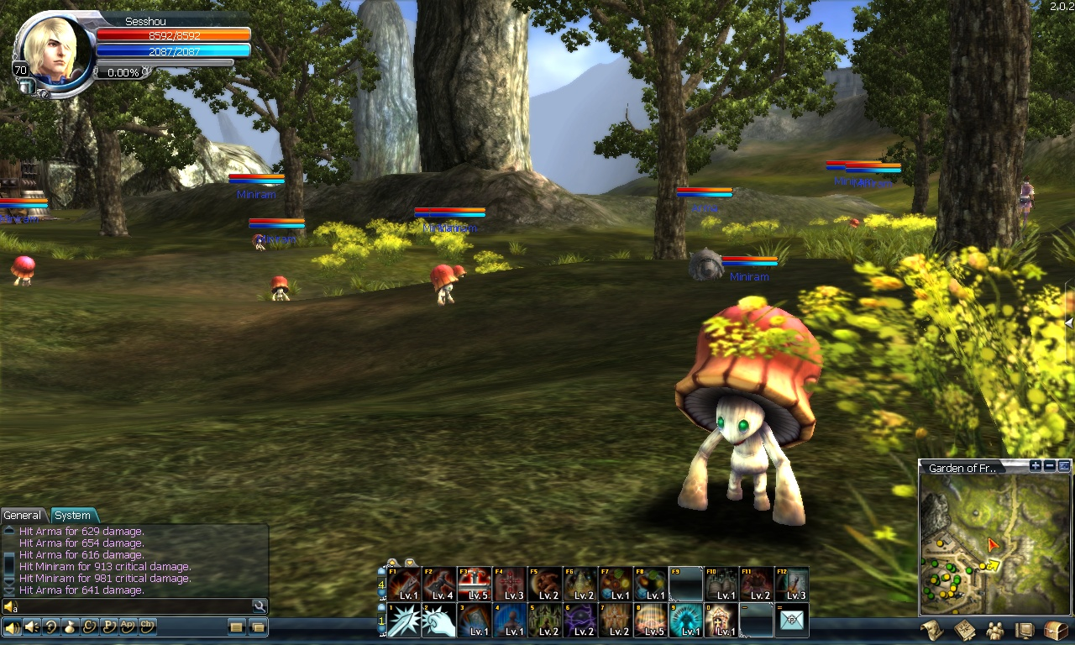
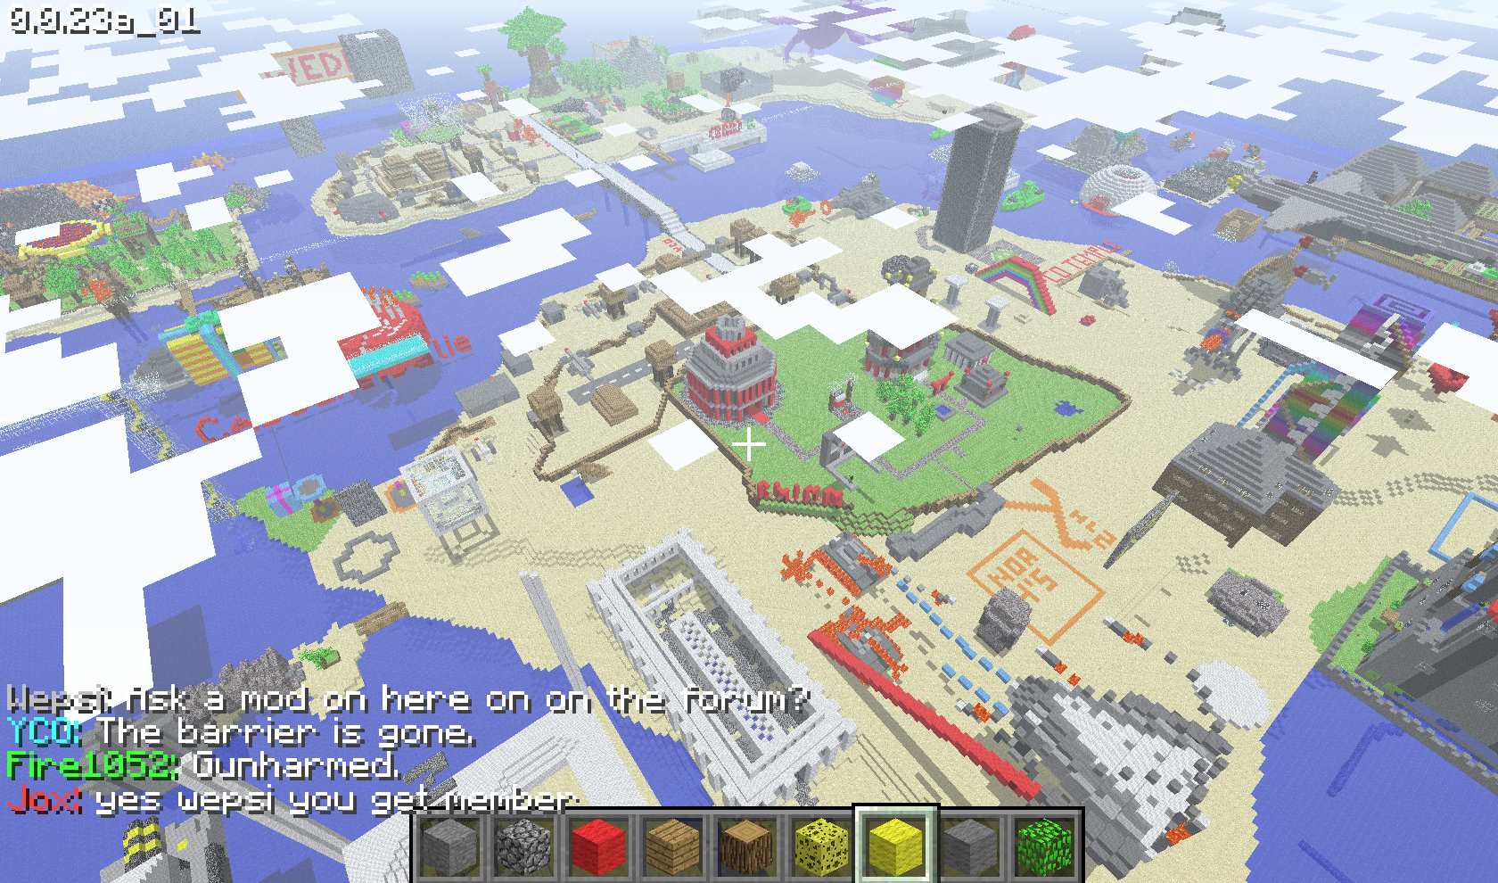
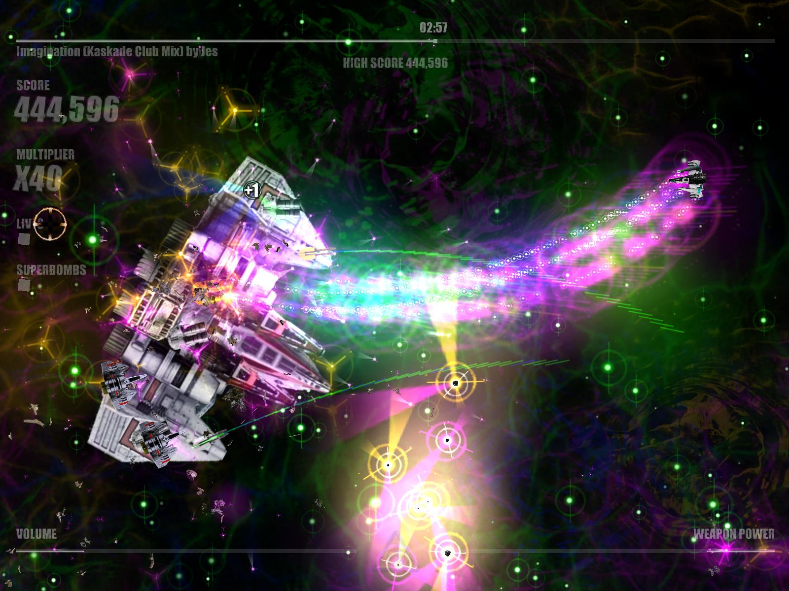
...The next step for gaming?

Slide 3
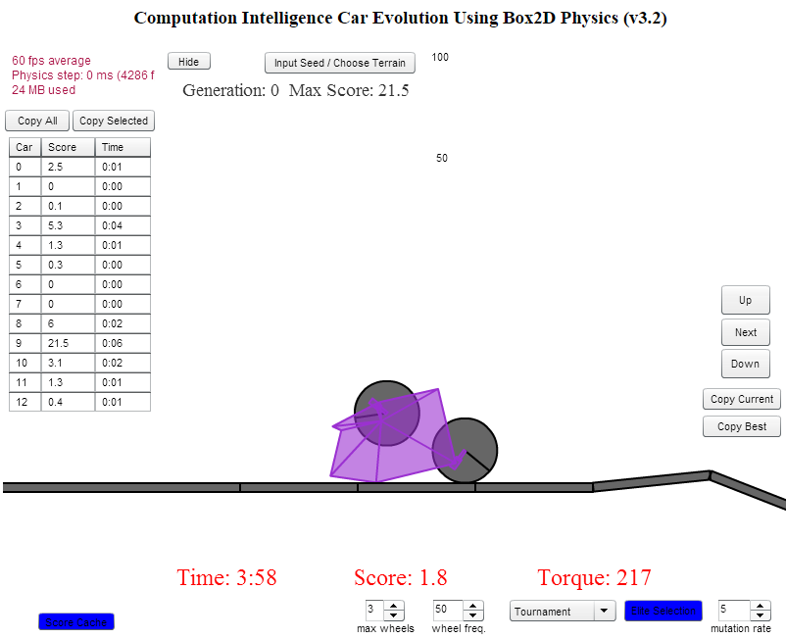
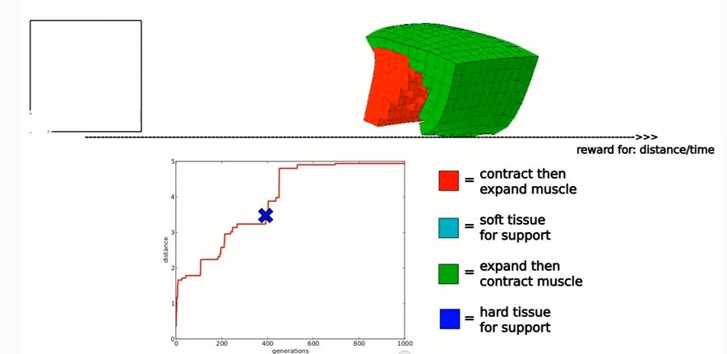
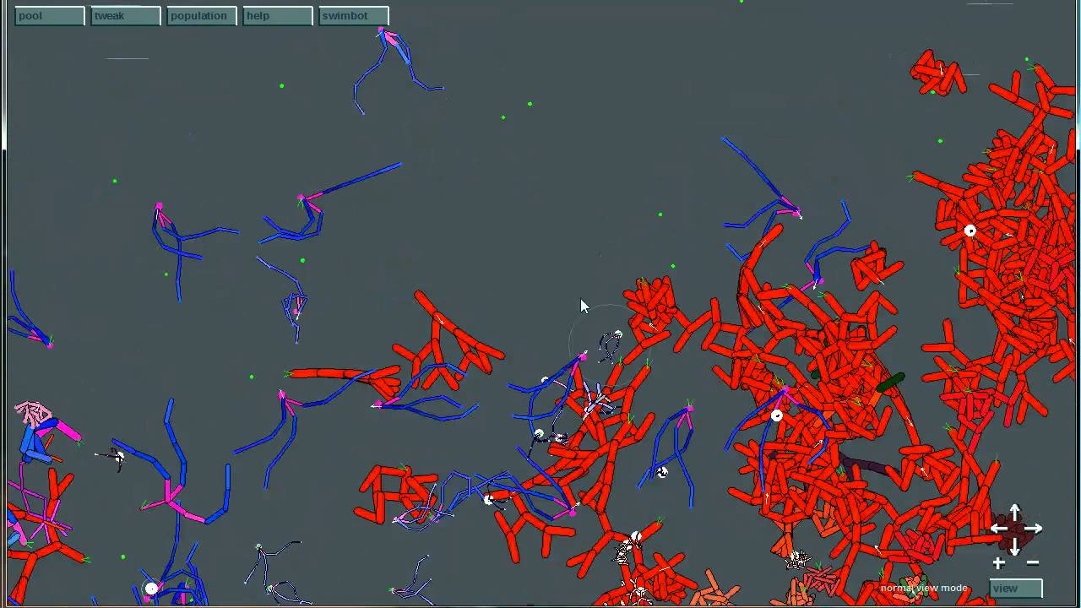
My inspiration...

Slide 4
Aim...
To explore the use of genetic algorithms as a means of improving gaming experience, with a view to develop a game to demonstrate this.

Slide 5
Objectives...
Use a set time to research the extent to which genetic algorithms are currently used in games.
Use a set time to explore ideas for other potential uses of genetic algorithms to improve gaming experience.
Design a game that uses an evolutionary algorithm.
Write an efficient code base for evolutionary computation within the game.
Implement the game and tune the evoltionary algorithm(s), exploring the effects of different configurations.

Slide 6
Research
Evolving competitive car controllers for racing games with neuroevolution
Luigi Cardamone†, Daniele Loiacono†, Pier Luca Lanzi†∗
“Learning a context aware weapon selection policy in unreal tournament III”
Luca Galli, Daniele Loiacono, and Pier Luca Lanzi
“Optimizing flocking strategies through genetic algorithms for the ghost team in pac-man”
F. Liberatore, A.M. Mora, P.A. Castillo, J.J. Merelo

Slide 7
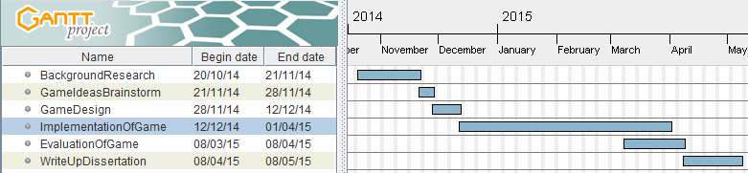
The Plan...

Slide 8
...Summary
Is evolution the next step for games?
Explore the use of genetic algorithms in games in general.
Bridge the gap between evolution enthusiasts and game developers.

