Slide 1





Image Editor 0.0.0.1

Slide 2
bla bla
Image
Metadata
Image Data Mode
Image Data Edit Mode
Image
Metadata
Hardware Data Mode
HW Data Edit Mode
Image
Metadata
Geographical Data Mode
Geo Data Edit Mode
Start
Image
Metadata
Actor Data Mode
Actor Data Edit Mode
Edit User Data
Login
Actor
Database
Image
Metadata
Main mode
Event Data Mode
Event Data Edit Mode
Event
Database
Image Edit mode
Grayscale
Gaussian
Exit
Discard changes
Save changes
RGB-enh.
:

Slide 3
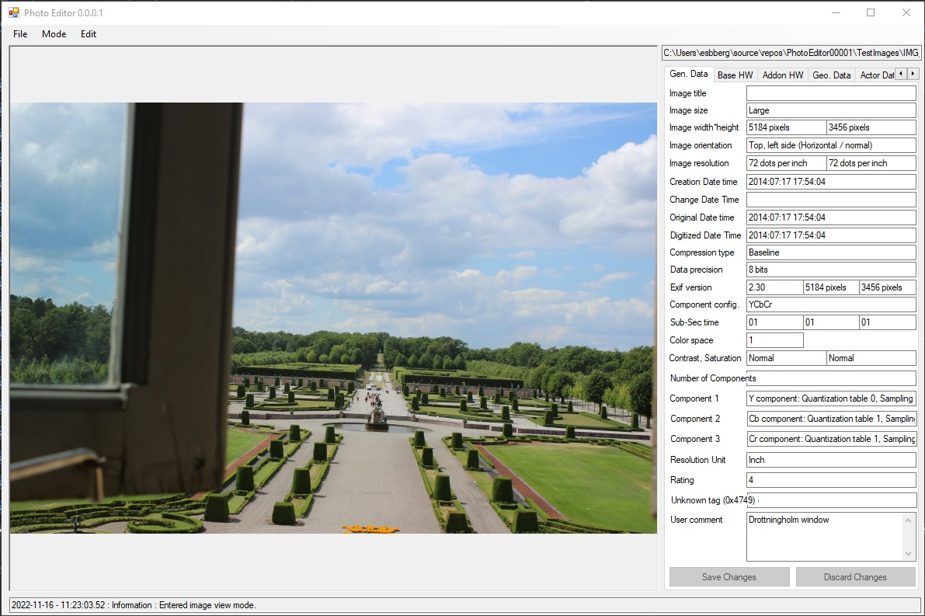
Image View – General Data Mode
ImageTitleTextBox
ImageSizeTextBox
ImageWidthTextBox
ImageHeightTextBox
ImageOrientationTextBox
ImageXResTextBox
ImageYResTextBox
ImageDateTimeTextBox
ChangeDateTimeTextBox
OriginalDateTimeTextBox
DigitizedDateTimeTextBox
CompTypeTextBox
DataPrecisionTextBox
ExifVersionTextBox
ExifImageWidthTextBox
ExifImageHeightTextBox
SubSecTimeTextBox
ComponentConfigTextBox
OrigSubSecTimeTextBox
DigSubSecTimeTextBox
ColorSpaceTextBox
SaturationTextBox
ContrastTextBox
Extra info.
UserCommentTextBox

Slide 4
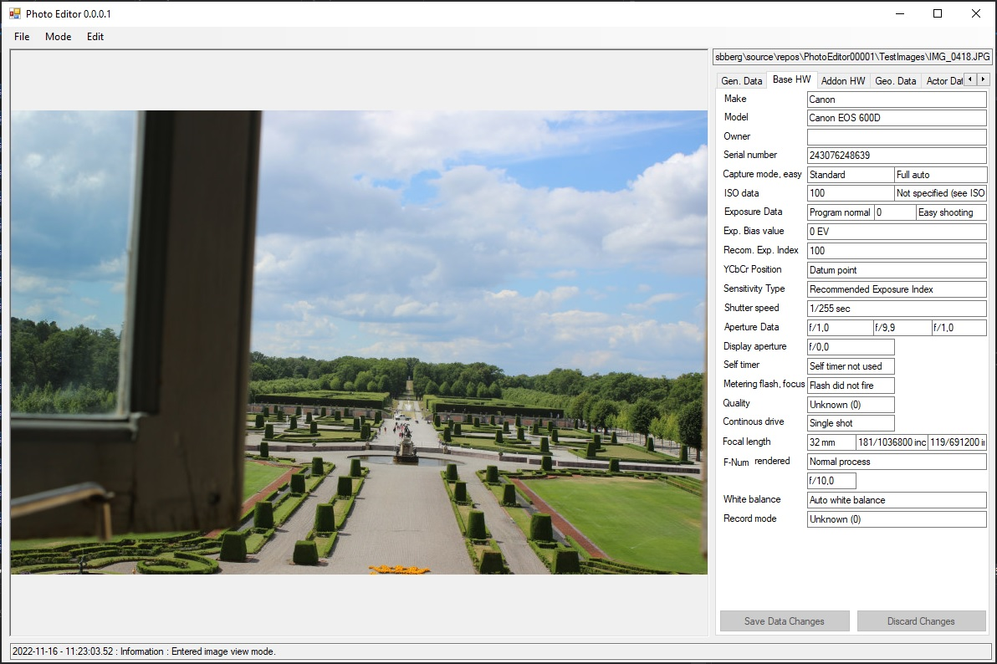
Image View – Basic Hardware Data Mode

Slide 5
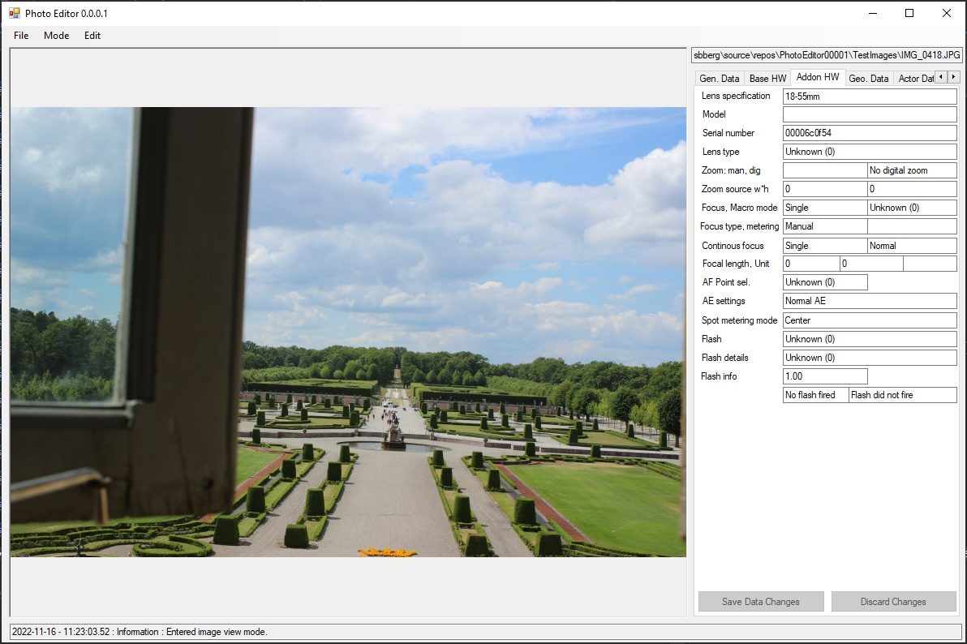
Image View – Add-on Hardware Data View

Slide 6
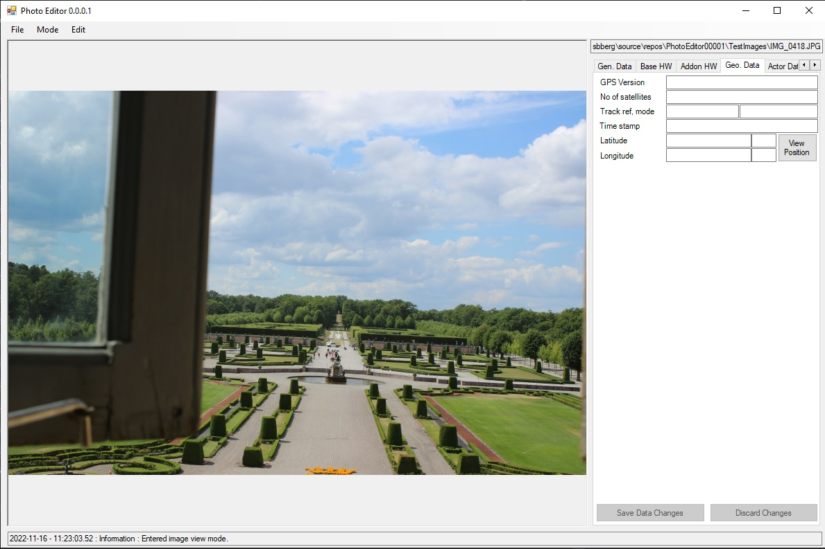
Image View – Geographical Data Mode

Slide 7
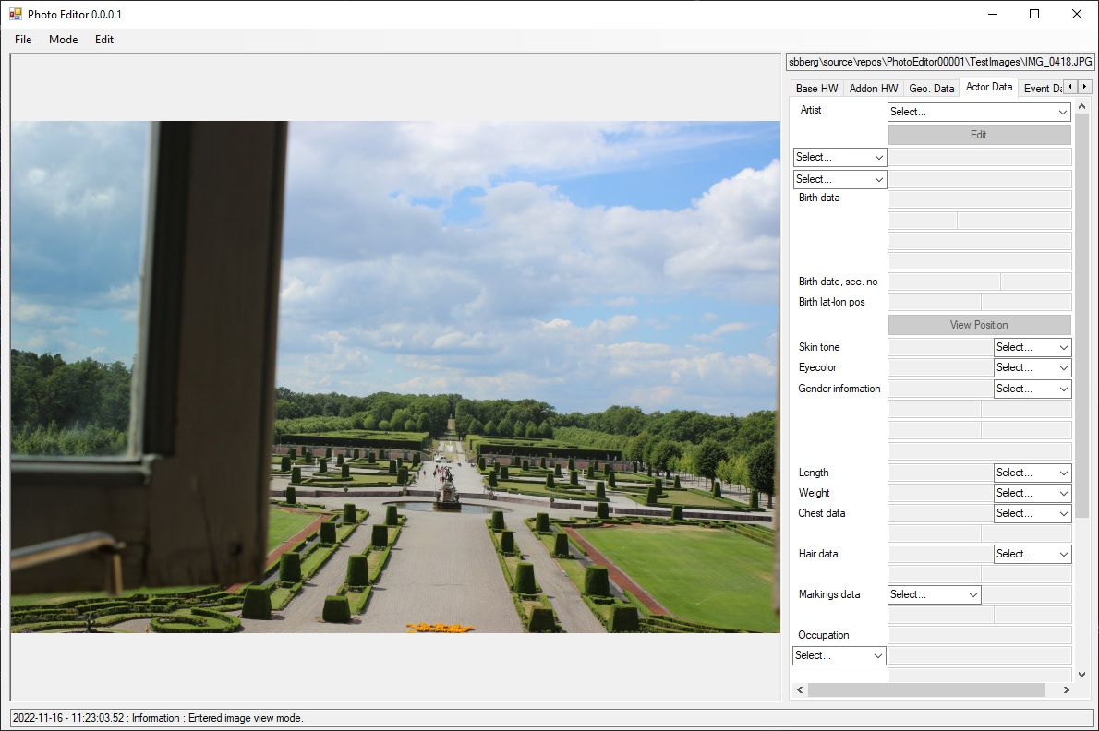
Image View – Actor Data Mode (1)

Slide 8
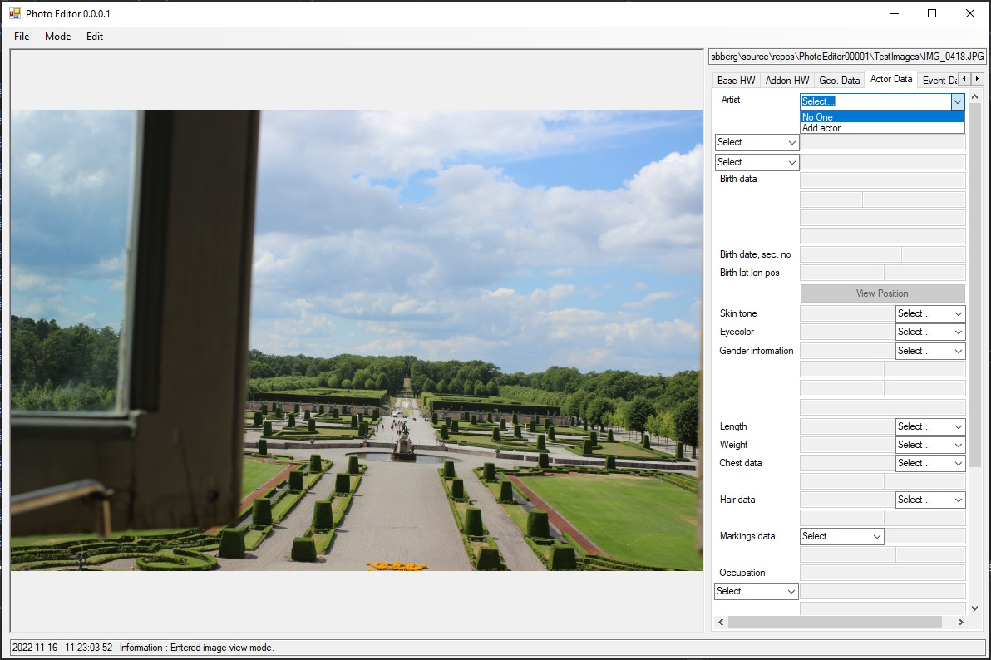
Image View – Actor Data Mode (2)

Slide 9

Image View – Actor Data Mode (3)

Slide 10

Image View – Event Data Mode (1)

Slide 11

Image View – Event Data Mode (2)

Slide 12
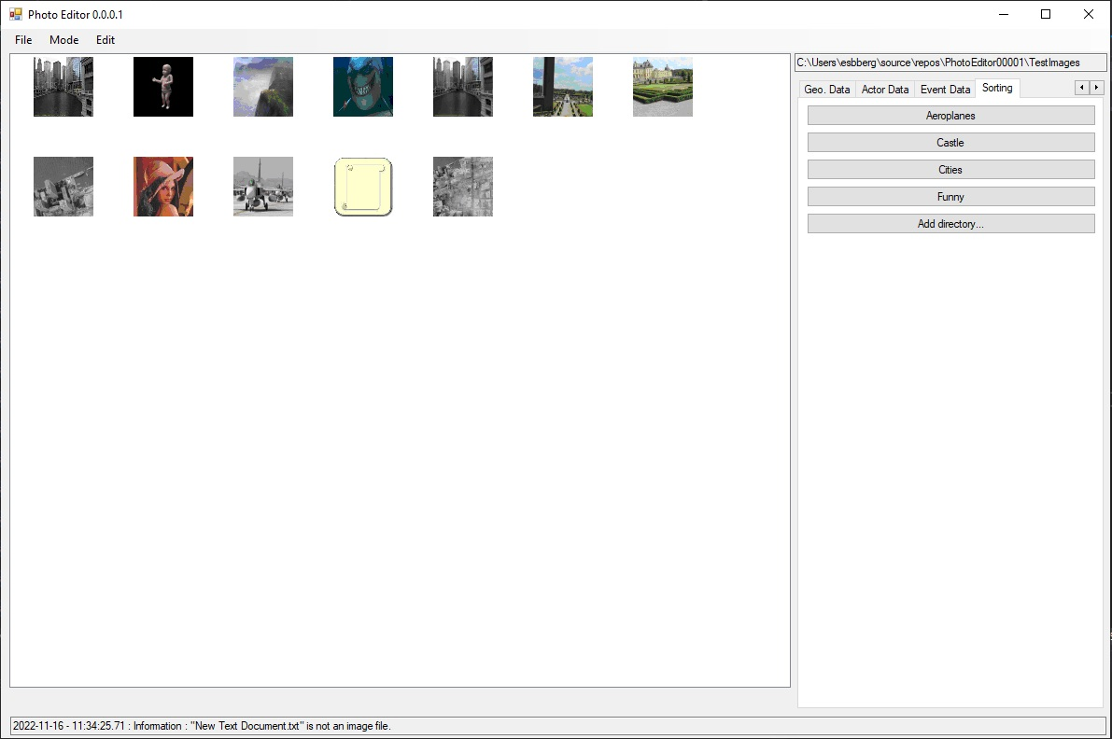
Sorting View

Slide 13
Notations to invoke
When saving a file with the same name we actually delete the file and save the loaded image with the same name.
When moving a file we actually save the file with the same name in the new directory and then delete the file at the original location.
Deletion of a file is handled by:
if(File.Exists(filepath))
{
try
{
File.Delete(filepath);
}
catch (Exception err)
{
// Do something
}
}

