Slide 1
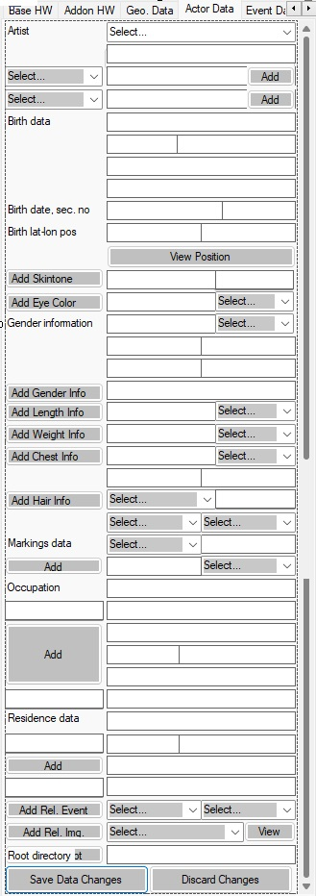
ActiveArtistComboBox
NameTypeComboBox
ArtistIdentityEnterTextBox
AddNewNameButton
ActorContactTypeComboBox
SelNameTypeTextBox
AddContactButton
BirthStreetAddrTextBox
SelContactTypeTextBox
BirthZipCodeTextBox
BirthAreaNameTextBox
BirthCitynameTextBox
BirthDateTextBox
BirthCountryTextBox
BirthLatitudeTextBox
SocSecNumberTextBox
BirthLongitudeTextBox
ViewGeoPosButton
AddSkinToneButton

