Slide 1

Image Editor 0.0.0.1
Photo Editor
1.0

Slide 2
bla bla
Image
Metadata
Image Data Mode
Image Data Edit Mode
Image
Metadata
Hardware Data Mode
HW Data Edit Mode
Start
Image
Metadata
Geographical Data Mode
Geo Data Edit Mode
User
Data
Actor
Database
Login
Image
Metadata
Actor Data Mode
Actor Data Edit Mode
Edit User Data
Image
Metadata
Event
Database
Main mode
Event Data Mode
Event Data Edit Mode
Image Edit mode
Grayscale
Discard changes
Save changes
Gaussian
RGB-enh.
:
Exit

Slide 3
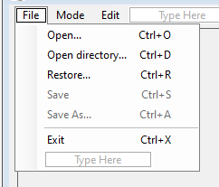
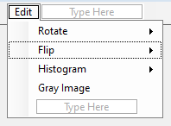
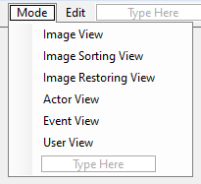

Slide 4
User Data

Slide 5
Image Metadata

Slide 6
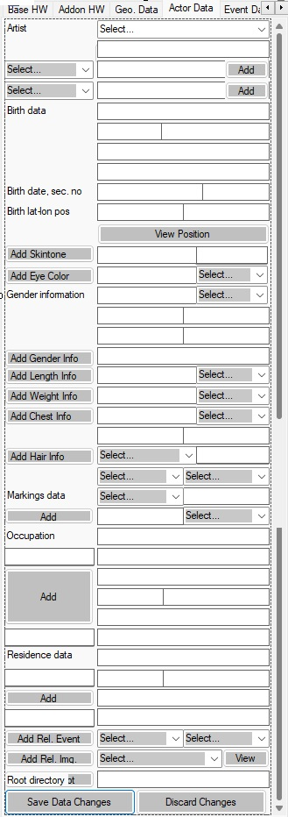
Actor Data
ArtistLabel
ActiveArtistComboBox
NameTypeComboBox
ArtistIdentityEnterTextBox
ActorContactTypeComboBox
AddNewNameButton
SelNameTypeTextBox
BirthDataLabel
AddContactButton
BirthZipCodeTextBox
SelContactTypeTextBox
BirthStreetAddrTextBox
BirthDateTextBox
BirthAreaNameTextBox
label1
BirthCitynameTextBox
label2
BirthCountryTextBox
BirthLatitudeTextBox
SocSecNumberTextBox
BirthLongitudeTextBox
AddSkinToneButton
SkinToneLabel
ViewGeoPosButton
SkinToneTagTextBox
SkinToneTagCmbBx
AddEyeColorButton
EyeColorLabel
SkinToneDateTxtBox
SkinToneDateTimePicker
EyeColorDateTxtBox
EyeColorValidDateComboBox
EyeColorDteTmePckr
GenderInfoLabel
SelEyeColorTextBox
eyeColorTagsCmbBx
GenderTypeTextBox
GenderInfoValidDateComboBox +
GdrLengthTextBox
GdrCircumfTextBox
GdrLookTypeTextBox +
GdrBehaveTypeTextBox +
AddGenderInfoButton
GdrPresentTextBox
AddLengthInfoButton
LengthLabel
LengthTextBox
AddWeighInfoButton
WeightLabel
LengthValidDateComboBox, LengthDateTimePicker
AddChestInfoButton
ChestLabel
WeightTextBox
WeightValidDateComboBox
ChestCircTextBox
ChestTypeTextBox
ChestValidDateComboBox
ChestDateTimePicker
AddHairInfoButton
HairDataLabel
ChestSizeTextBox
hairColorCmbBox
hairColorTextBox
hairLengthCmbBx
HairLengthTextBox
hairValidDateTxtBx
hairValidDateComboBox
hairDateTimePicker
hairTextureCmbBx
HairTextureTypeTextBox
MarkingPosTextBox
MarkingsLabel
MarkingTypeComboBox
MarkingTypeTextBox
MarkingsValidDateComboBox
MarkingDateTextBox
MarkingsDateTimePicker
AddMarkingDataButton
OccupTitleTextBox
Label4
MarkingMotifTextBox
occupationStartTextBox
occupationStartDateTimePicker
ActorOccupationCompanyTextBox
AddOccupationDataButton
ActorEmployAddressTextBox
occupationEndTextBox
occupationEndDateTimePicker
ActoryEmployZipCodeTextBox
ActorEmployAreanameTextBox
ActorEmployCitynameTextBox
residenceStartTxtBx
ResidStartDateComboBox
ResidStartDateTimePicker
ResidenceLabel
ActorEmployCCountryTextBox
ResidAddressTextBox
ResidAreanameTextBox
AddResidenceButton
ResidCitynameTextBox
ResidZipCodeTextBox
AttdEventsDateComboBox
attdEvtDateTxtBx
AttdEventsDateTimePicker
residenceEndTxtBx
ResidEndDateComboBox
ResidEndDateTimePicker
ResidCountryTextBox
addAttdEventBtn
AttEventLabel
AttEvtIDCmbBx
EventIdTextBox
ActorRelImageComboBox
btnDelRoot
updRootBtn
ViewSelActorRelImageButton
cmbBoxRootDir
rootDirTxtBx
SaveActorDataChangesButton
DiscardActorDataChangesButton

Slide 7
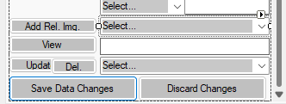
Actor Related Images
addRelActorImatesBtn
ActorRelImagesLabel
ActorRelImageComboBox
ViewSelActorRelImageButton
ActorRelImgContextTxtBx
updRootBtn
cmbBoxRootDir
rootDirTxtBx
btnDelRoot

Slide 8
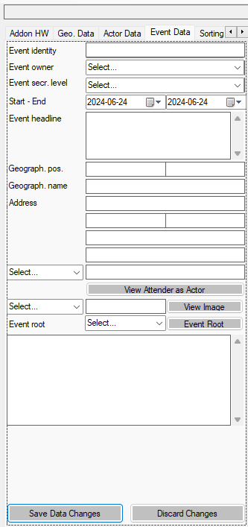
Event Data
pictureName
EventIdLabel
ActiveEventTextBox
ActiveEventComboBox
CopyrightLabel
EventSecrLevelLabel
EventStartEndLabel
CopyrightTextBox
CopyrightComboBox
EventStartTextBox
EventStartDateTimePicker
EventSecrecyLevelTextBox
EventSecrecyLevelComboBox
EventHeadlineLabel
EventGeoPosLabel
EventEndTextBox
EventEndDateTimePicker
EventLatitudeTextBox
GeoNameLabel
EventHeadlineTextBox
EventAddressLabel
EventLongitudeTextBox
EventZipCodeTextBox
EventGeographNameTextBox
EventStreetnameNumberTextBox
EventAttenderIDComboBox1
EventAreanameTextBox
EventImageLevelTextBox
EventCitynameTextBox
EventImageNameComboBox
EventCountrynameTextBox
EventAttenderNaneTextBox
EventRootLabel
ViewAttenderAsActorButton
EventRootTextBox
ViewSelEventImageButton
EventDescriptionTextBox
EventRootComboBox
EventRootButton
DiscardEventDataChangesButton
SaveEventDataChangesButton

Slide 9
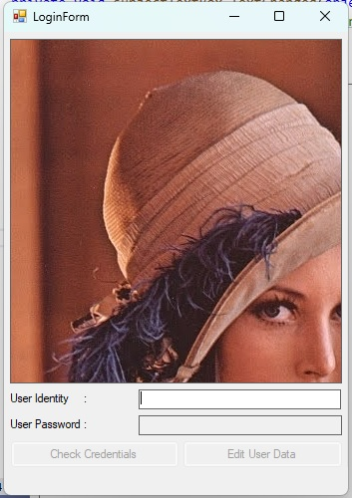
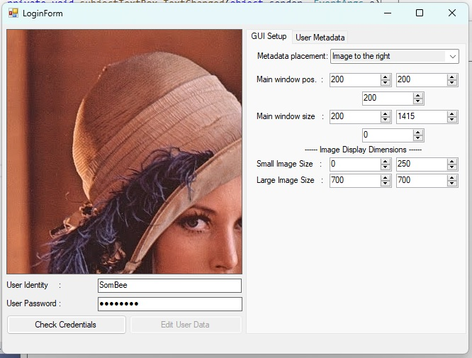
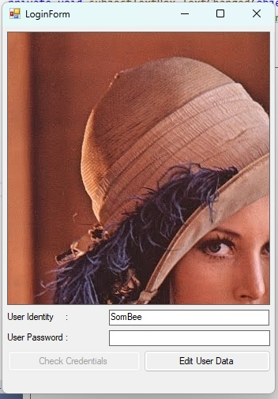

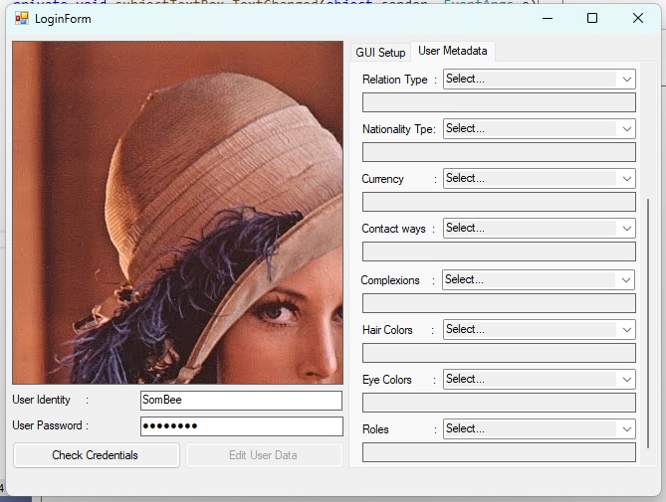
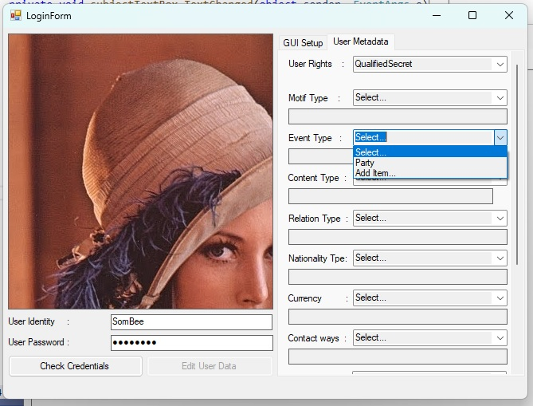
Log-In Handling
New user
Edit data
Edit User Data
Check Credentials
User Identity
start
Validate user
Check Credentials
User Identity
User Password
Check Credentials
Existing user
Edit data
Edit User Data
Entering data into the ”User Identity”-field shall make it possible to enter ”Edit data”-mode.
Entering an existing user identity requires a correct password to enter ”Edit data”-mode.
User Identity
User Password
Entering a new user identity shall create a new user with default, ”Undefined” parameters and the password set to ”password”.
Pressing the ”Check Credentials” button requires a correct password entry.
In the ”Edit data”-mode it shall be possible to edit:
Image placement, left or right.
Main window position
Main window size
Small image size (used in ”Sorting”- and ”Recovery”-mode.
Large image size (used in ”Sorting”- and ”Recovery”-mode.
Select user-rights level.
Add, edit and remove type definitions for motif, event, content, relation, nationality, currency, contact ways, complexions, hair color, eye color, and roles.
When having entered a correct password it shall be possible to change it.

Slide 10
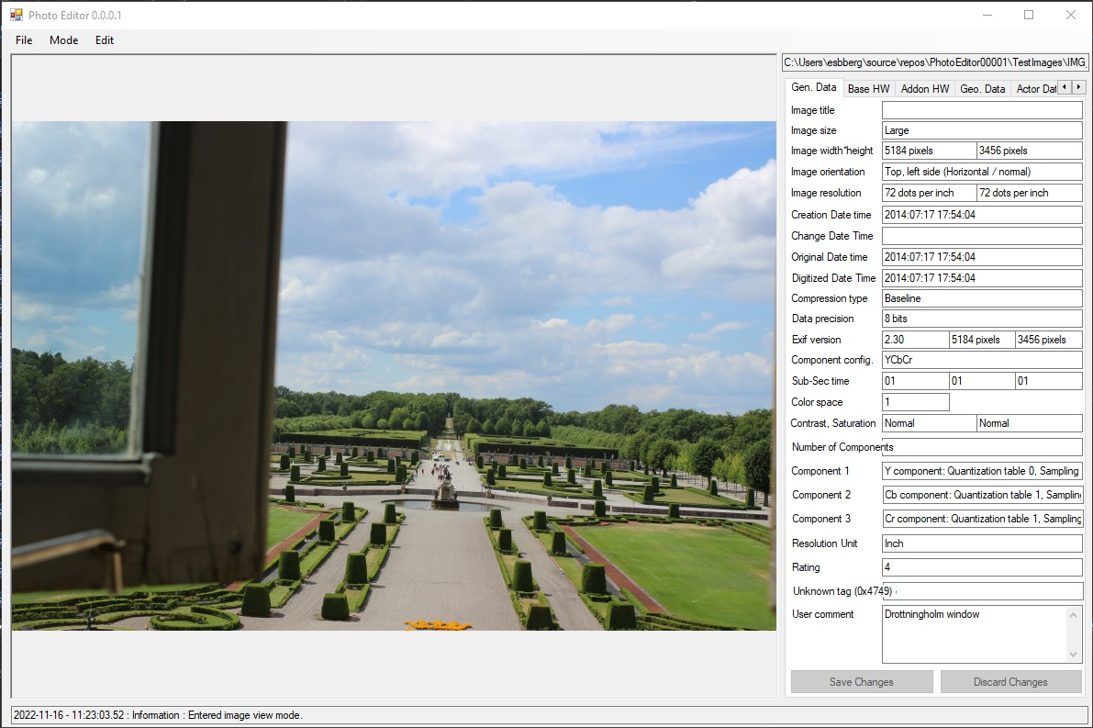
Image View – General Data Mode
ImageTitleTextBox
ImageSizeTextBox
ImageWidthTextBox
ImageHeightTextBox
ImageOrientationTextBox
ImageXResTextBox
ImageYResTextBox
ImageDateTimeTextBox
ChangeDateTimeTextBox
OriginalDateTimeTextBox
DigitizedDateTimeTextBox
CompTypeTextBox
DataPrecisionTextBox
ExifVersionTextBox
ExifImageWidthTextBox
ExifImageHeightTextBox
SubSecTimeTextBox
ComponentConfigTextBox
OrigSubSecTimeTextBox
DigSubSecTimeTextBox
ColorSpaceTextBox
SaturationTextBox
ContrastTextBox
Extra info.
UserCommentTextBox

Slide 11
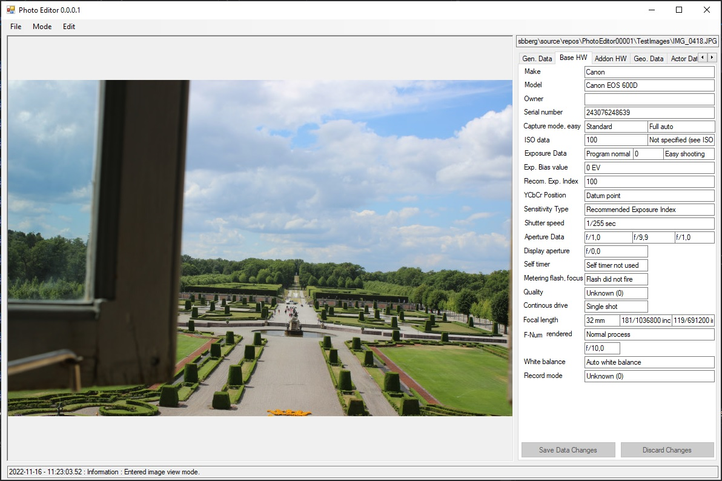
Image View – Basic Hardware Data Mode

Slide 12
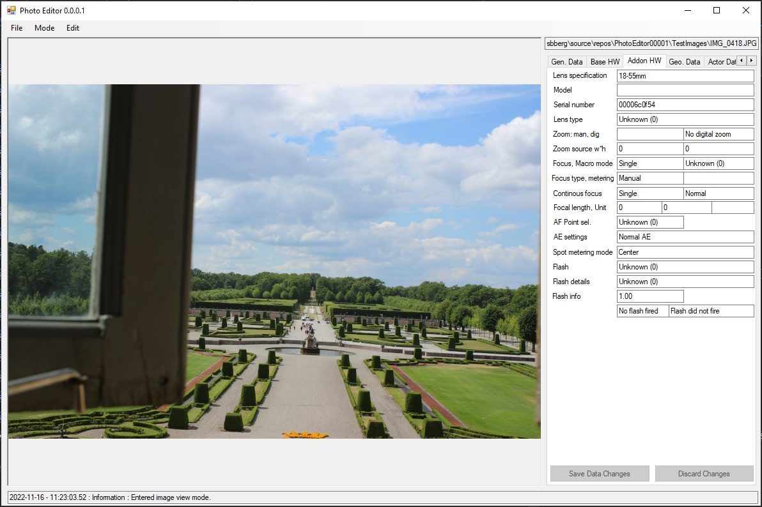
Image View – Add-on Hardware Data View

Slide 13
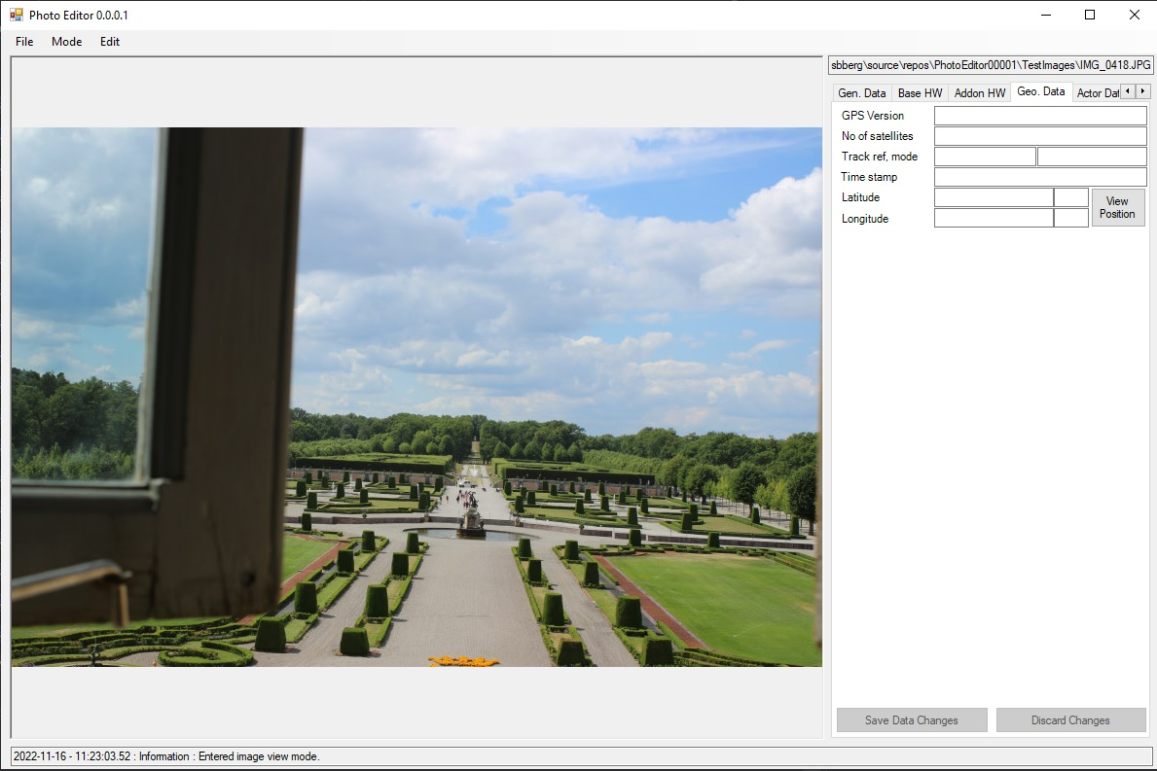
Image View – Geographical Data Mode

Slide 14
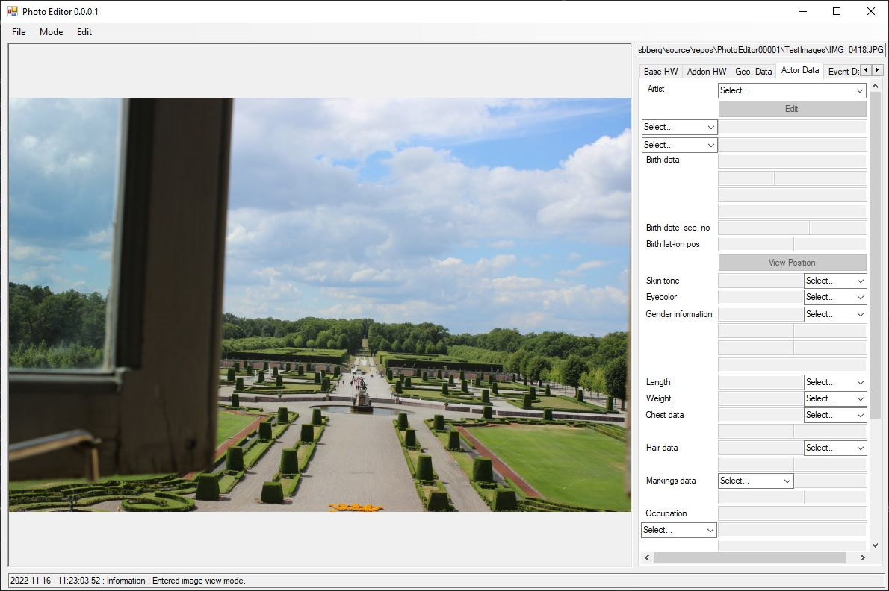
Image View – Actor Data Mode (1)
ActiveArtistsComboBox

Slide 15
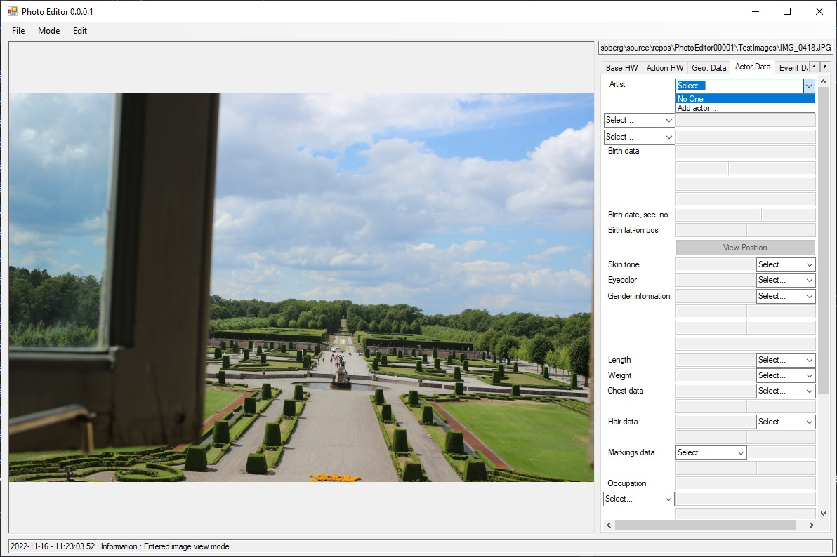
Image View – Actor Data Mode (2)

Slide 16

Image View – Actor Data Mode (3)

Slide 17

Image View – Event Data Mode (1)

Slide 18

Image View – Event Data Mode (2)

Slide 19
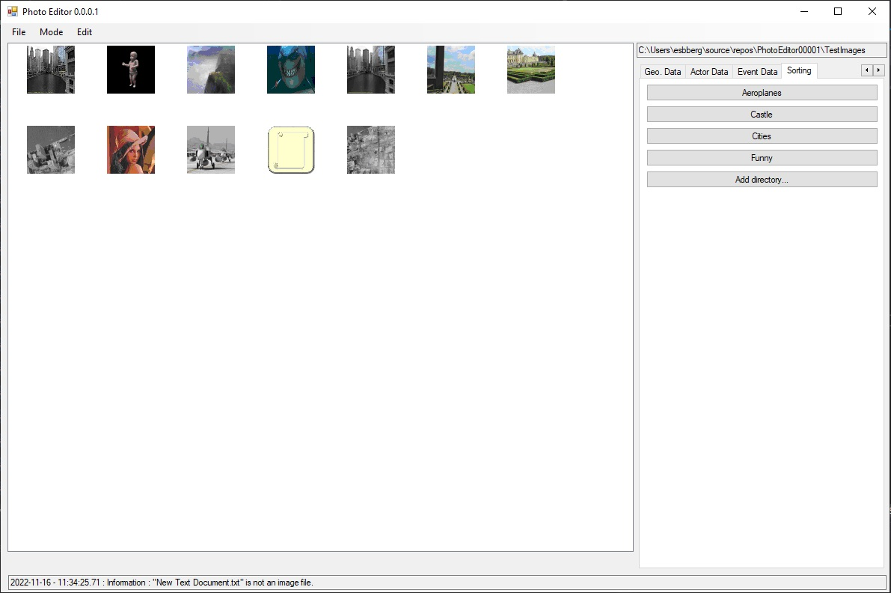
Sorting View

Slide 20
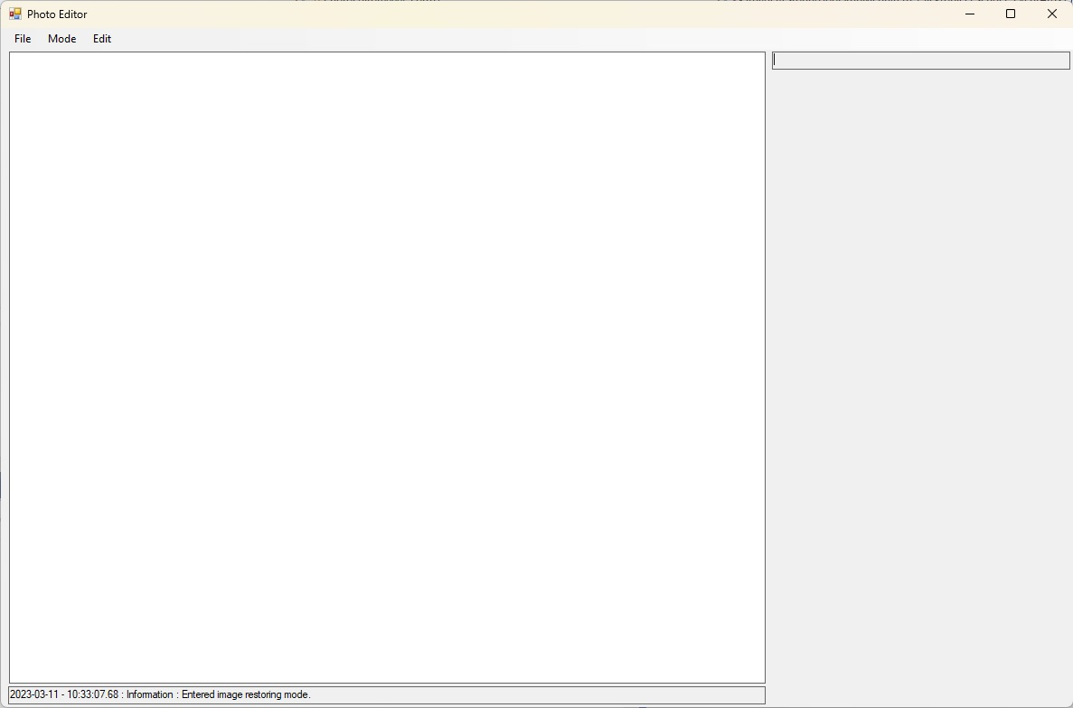
Restoring Mode

Slide 21
Notations to invoke
When saving a file with the same name we actually delete the file and save the loaded image with the same name.
When moving a file we actually save the file with the same name in the new directory and then delete the file at the original location.
Deletion of a file is handled by:
if(File.Exists(filepath))
{
try
{
File.Delete(filepath);
}
catch (Exception err)
{
// Do something
}
}

