Slide 1





Image Editor 0.0.0.1

Slide 2
bla bla
Image
Metadata
Image Data Mode
Image Data Edit Mode
Image
Metadata
Hardware Data Mode
HW Data Edit Mode
Start
Image
Metadata
Geographical Data Mode
Geo Data Edit Mode
Login
Image
Metadata
Actor
Database
Actor Data Mode
Actor Data Edit Mode
Edit User Data
Image
Metadata
Event
Database
Main mode
Event Data Mode
Event Data Edit Mode
Image Edit mode
Grayscale
Discard changes
Save changes
Gaussian
RGB-enh.
:
Exit

Slide 3
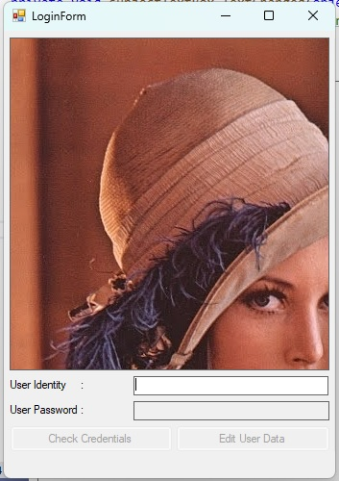
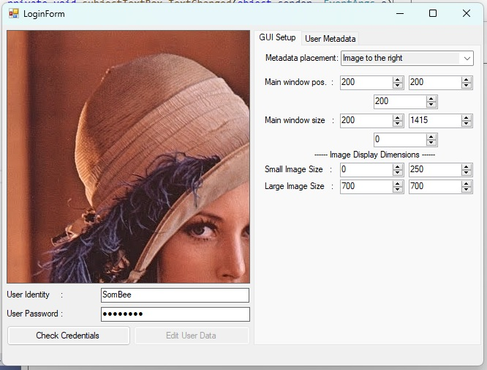
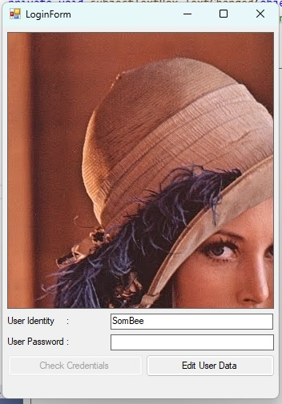

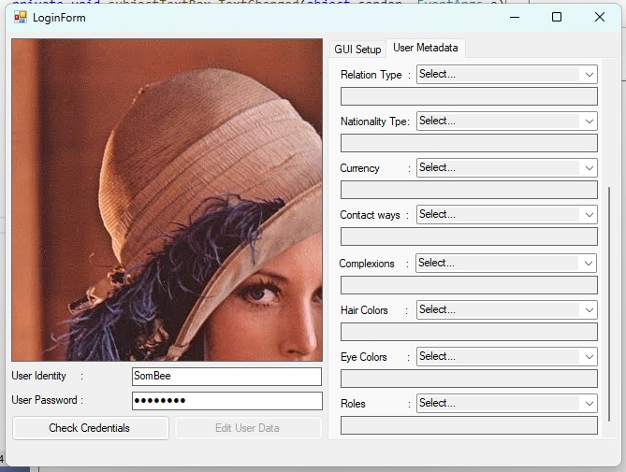
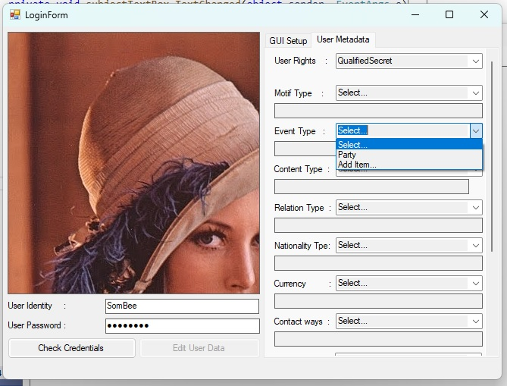
Log-In Handling
New user
Edit data
Edit User Data
Check Credentials
User Identity
start
Validate user
Check Credentials
User Identity
User Password
Check Credentials
Existing user
Edit data
Edit User Data
Entering data into the ”User Identity”-field shall make it possible to enter ”Edit data”-mode.
Entering an existing user identity requires a correct password to enter ”Edit data”-mode.
User Identity
User Password
Entering a new user identity shall create a new user with default, ”Undefined” parameters and the password set to ”password”.
Pressing the ”Check Credentials” button requires a correct password entry.
In the ”Edit data”-mode it shall be possible to edit:
Image placement, left or right.
Main window position
Main window size
Small image size (used in ”Sorting”- and ”Recovery”-mode.
Large image size (used in ”Sorting”- and ”Recovery”-mode.
Select user-rights level.
Add, edit and remove type definitions for motif, event, content, relation, nationality, currency, contact ways, complexions, hair color, eye color, and roles.
When having entered a correct password it shall be possible to change it.

Slide 4
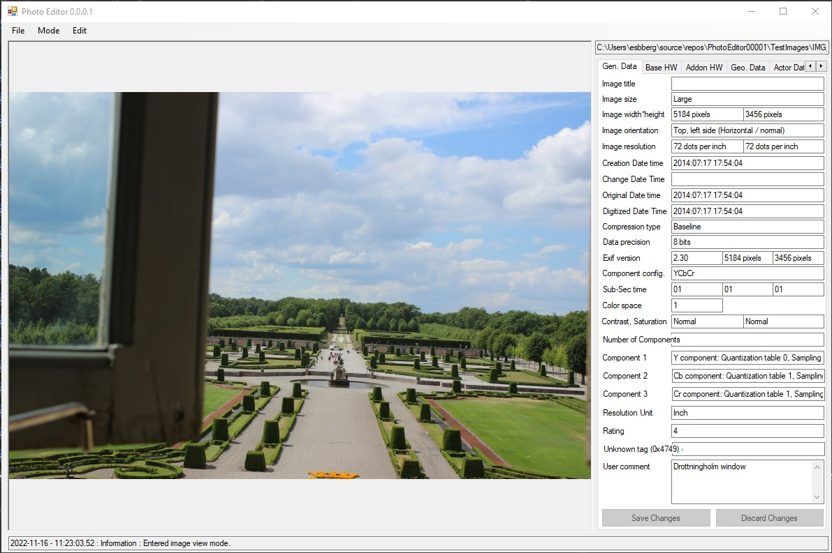
Image View – General Data Mode
ImageTitleTextBox
ImageSizeTextBox
ImageWidthTextBox
ImageHeightTextBox
ImageOrientationTextBox
ImageXResTextBox
ImageYResTextBox
ImageDateTimeTextBox
ChangeDateTimeTextBox
OriginalDateTimeTextBox
DigitizedDateTimeTextBox
CompTypeTextBox
DataPrecisionTextBox
ExifVersionTextBox
ExifImageWidthTextBox
ExifImageHeightTextBox
SubSecTimeTextBox
ComponentConfigTextBox
OrigSubSecTimeTextBox
DigSubSecTimeTextBox
ColorSpaceTextBox
SaturationTextBox
ContrastTextBox
Extra info.
UserCommentTextBox

Slide 5
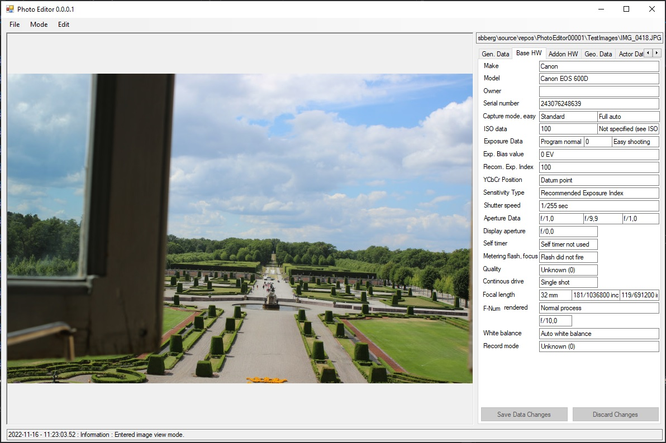
Image View – Basic Hardware Data Mode

Slide 6
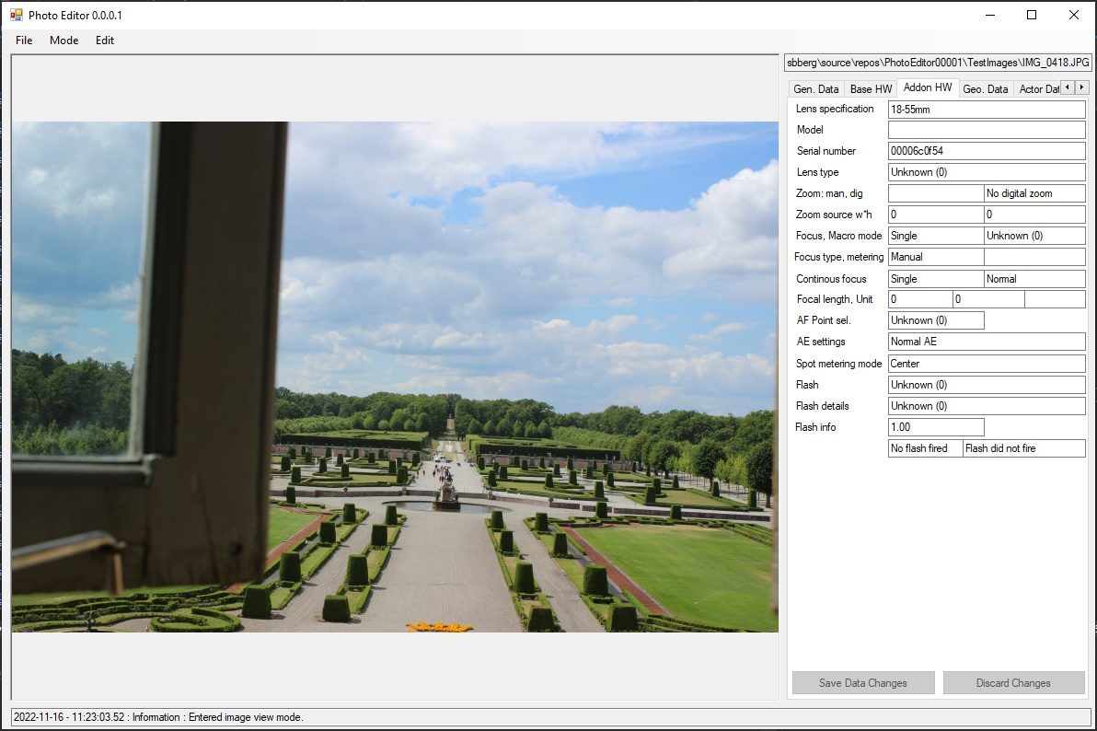
Image View – Add-on Hardware Data View

Slide 7
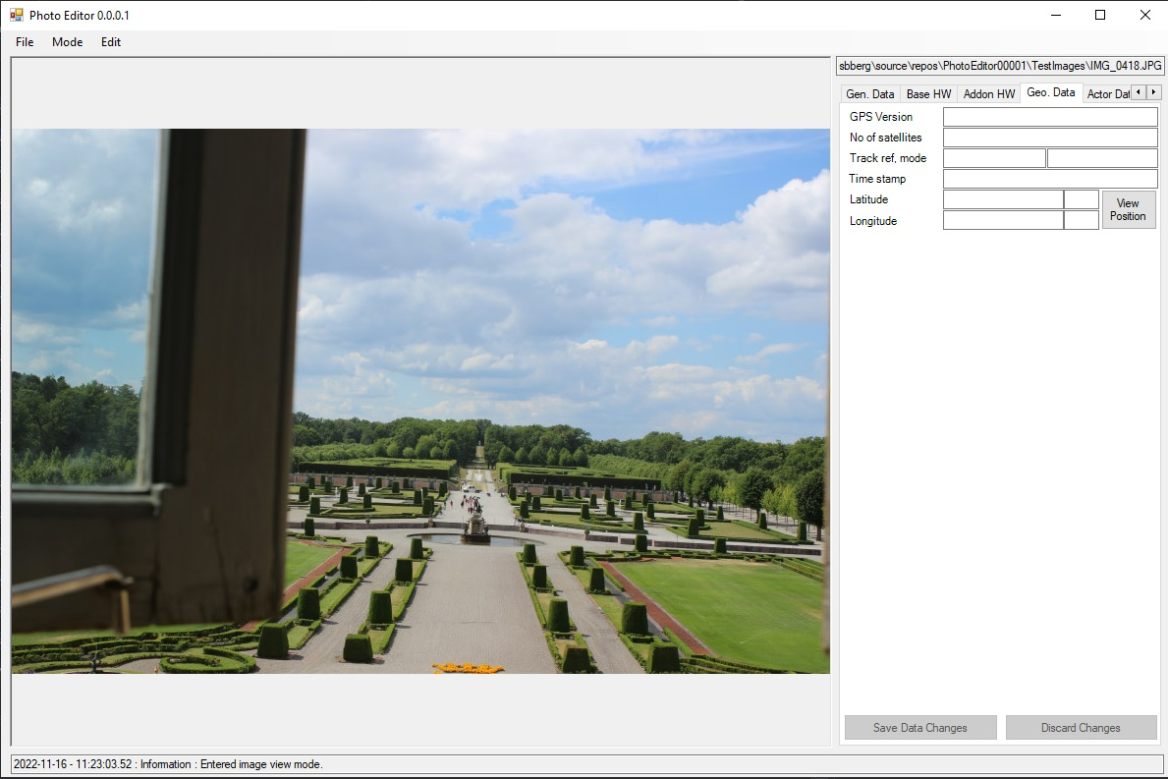
Image View – Geographical Data Mode

Slide 8
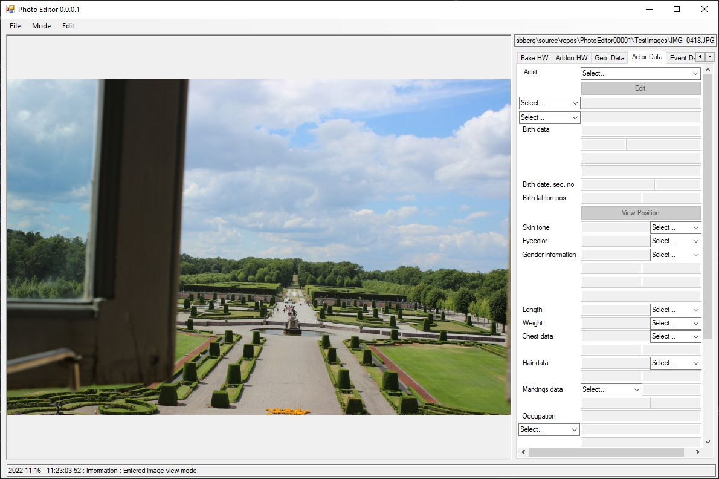
Image View – Actor Data Mode (1)
ActiveArtistsComboBox

Slide 9
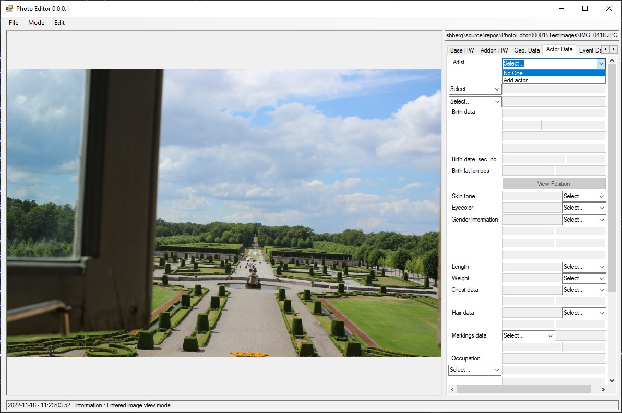
Image View – Actor Data Mode (2)

Slide 10

Image View – Actor Data Mode (3)

Slide 11

Image View – Event Data Mode (1)

Slide 12

Image View – Event Data Mode (2)

Slide 13
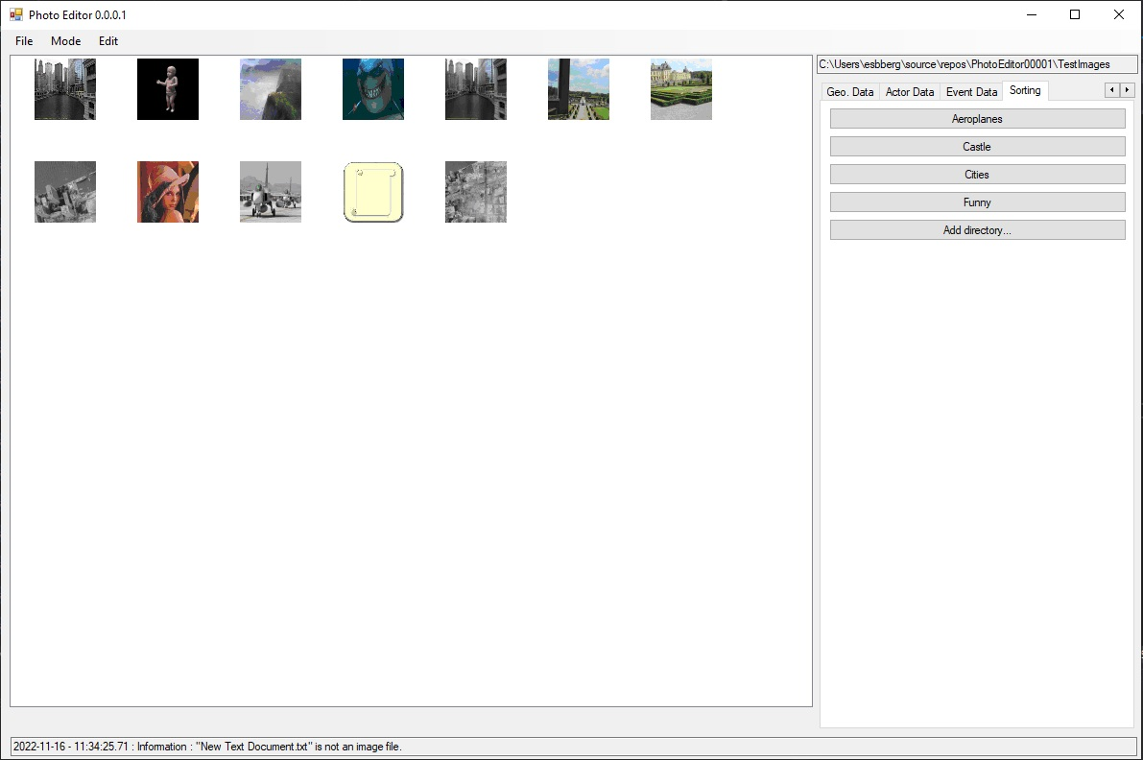
Sorting View

Slide 14
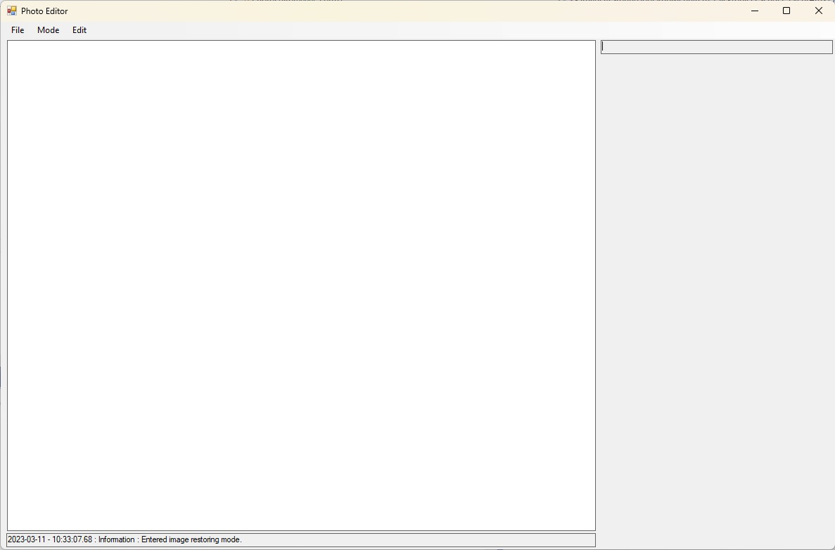
Restoring Mode

Slide 15
Notations to invoke
When saving a file with the same name we actually delete the file and save the loaded image with the same name.
When moving a file we actually save the file with the same name in the new directory and then delete the file at the original location.
Deletion of a file is handled by:
if(File.Exists(filepath))
{
try
{
File.Delete(filepath);
}
catch (Exception err)
{
// Do something
}
}

