Slide 1
The De-Identification of Protected Health Information
By: Hashim Khan, Samuel Brown

Slide 2


Introduction: Setting the Stage
In the 2000s, the abundance of raw medical data led to a boom in research.
Consequently, this led to pressures within the industry to make research data public.
In turn, Patient privacy would be compromised, as medical data often includes:
Biometric Identifiers
Medical Record Numbers
SSNs
Account Numbers
Healthcare/Insurance Plans
etc.

Slide 3

Introduction: The Problems
Researchers and the industry alike didn’t want to fully privatize the records.
So, our problems arise:
How do we protect patient privacy while making medical data public for researchers?
How do we stop someone from using a separate data set in combination with ours to specifically identify a patient?

Slide 4
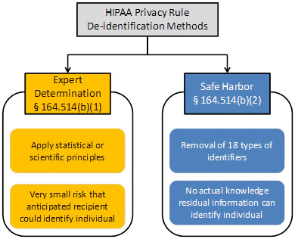
Introduction: The Given Solution
HIPAA came up with their Privacy Rules for medical records.
The HIPAA de-identification Standard:
Expert Determination
Minimize risk of dataset mapping.
Safe Harbor
Removing all personally identifiable information.

Slide 5

Objectives
The objectives for our project involve:
Explaining and implementing the HIPAA standardized de-identification techniques.
Suppression
Generalization
Randomization/Perturbation
K-Anonymity
Quantifying the effectiveness of the anonymization technique.
Comparing the usability of the dataset afterwards.
Evaluating which of the methods is best.

Slide 6
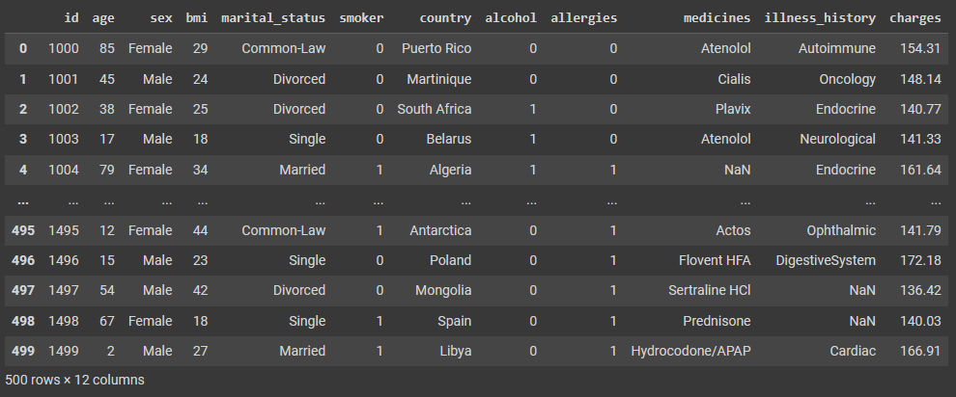
The Dataset
The paper used a fake data set that includes sensitive healthcare information. We found a data set from kaggle that has sensitive information for testing the four methods.

Slide 7
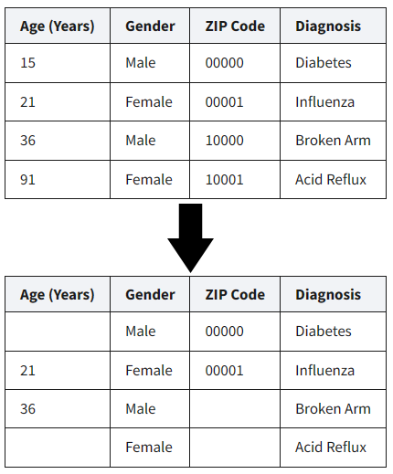
De-Identification Method #1: Suppressing Patient Values
Removal or elimination of features about the data prior to dissemination.
Suppression of an entire feature may be performed.
Individual records may also be entirely suppressed.

Slide 8
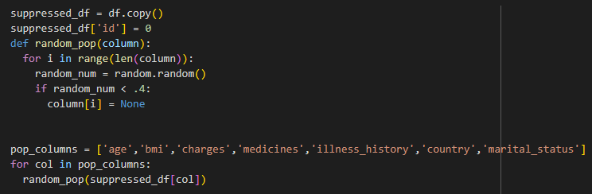
De-Identification Method #1: Code
This function random_pop is changing a value in the data set to ‘none’.
We set the probability to 40% chance that the value will be removed.

Slide 9
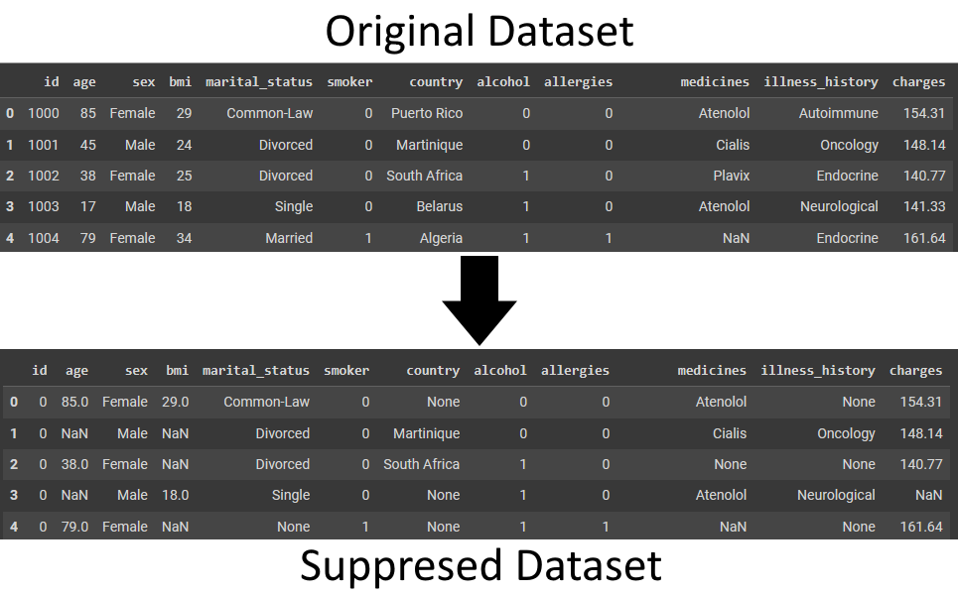
De-Identification Method #1: Results

Slide 10
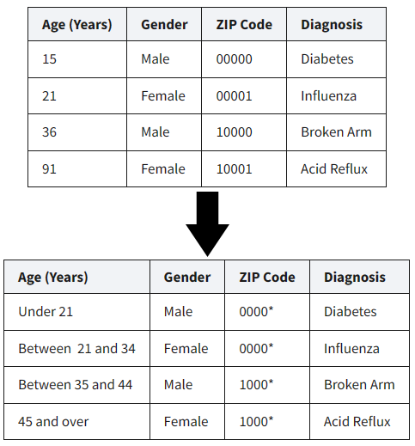
De-Identification Method #2: Generalize Patient Data
Transform data into more abstract representation.
The removal of exact numbers for ranges.
EX. five-digit zip to four-digit zip
EX. Age of patients generalized in five year groups

Slide 11
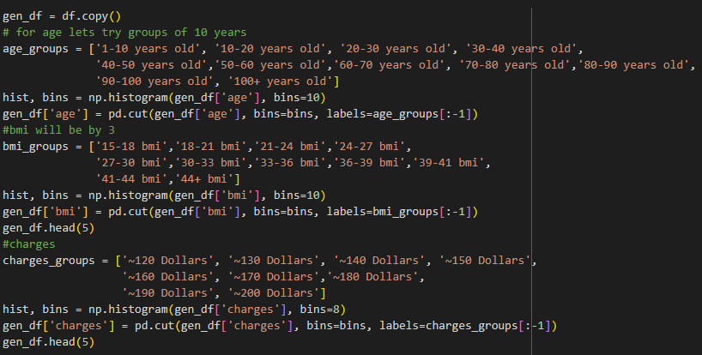
De-Identification Method #2: Code
This code creates groups for:
Age
BMI
Charges
The three numerical columns in the dataset.

Slide 12
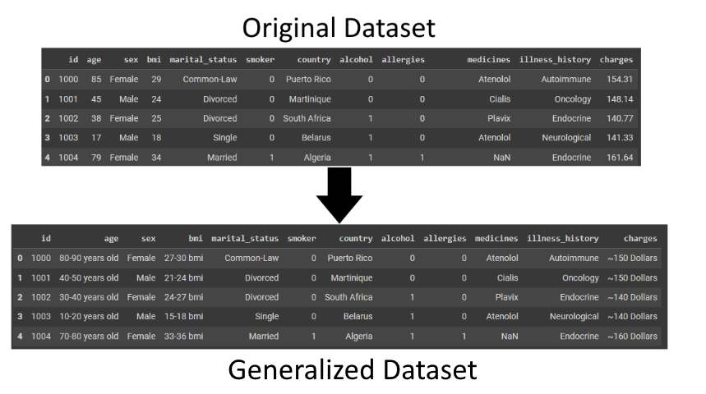
De-Identification Method #2: Results

Slide 13
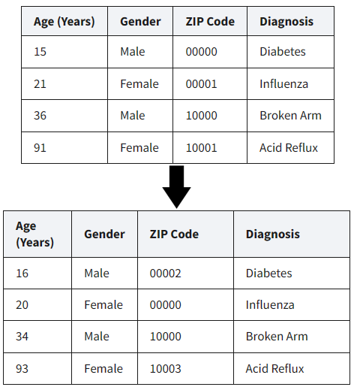
De-Identification Method #3: Randomized Patient Values
Randomize:
Specific values are replaced with equally specific, but different, values.
EX. Age reported as a random value within a 5-year window of actual age.

Slide 14
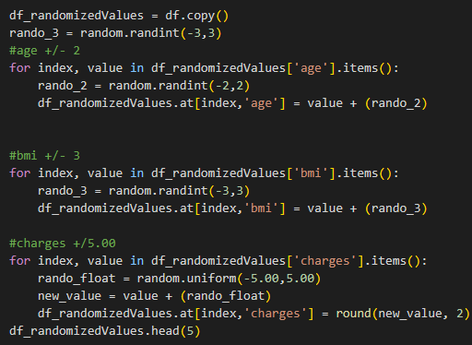
De-Identification Method #3: Code
We changed the values in:
Age
BMI
Charges
By adding or subtracting by an amount that won’t affect the mean of the data.

Slide 15
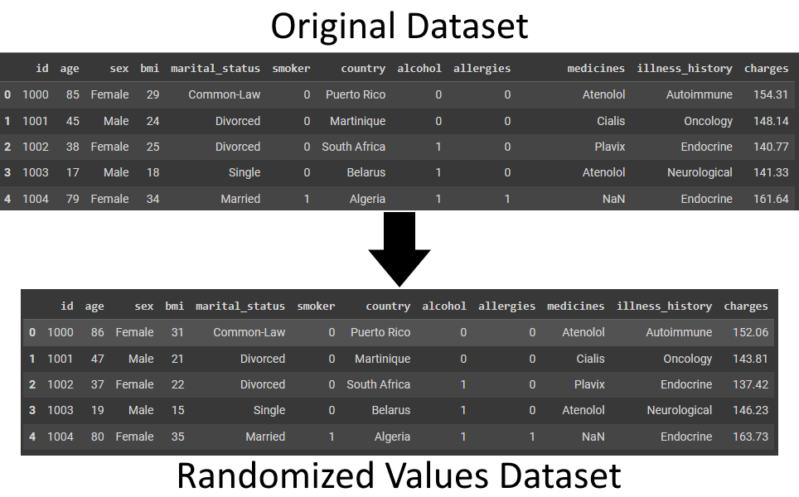
De-Identification Method #3: Results

Slide 16
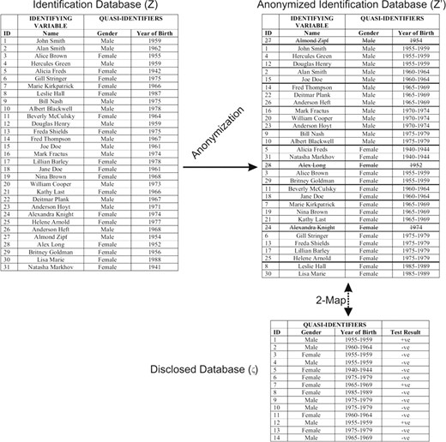
De-Identification Method #4: K-Anonymity Principle
K-Anonymity is the industry standard for de-identification.
We take a combination of the 3 prior methods and apply it to the data set to produce a ‘disclosed database.’
The database given to outsiders.

Slide 17
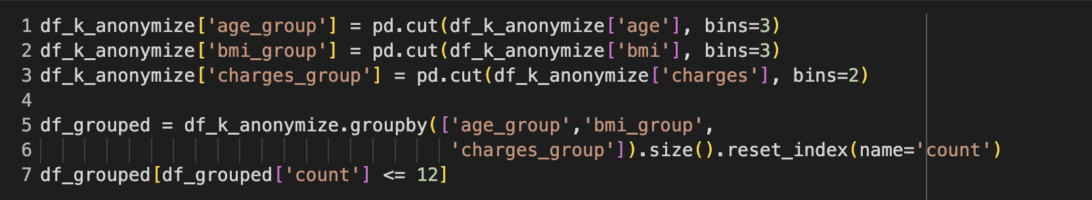
De-Identification Method #4: Code
We now need to create groups of values for age, bmi, and charges.
Make sure no group has “1” value.
To do this we had to play around with the bin sizes and found these values reached a k-anonymity of k=13.

Slide 18


De-Identification Method #4: Results
This output having no rows means that there are 0 groups that have only 1 value inside.
Whoever has the disclosed data won't be able to track which patient fits into a specific group.

Slide 19
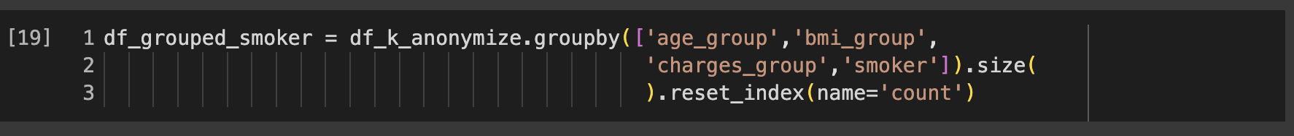
Disclosed Data Base Code
Now that we have all the data 13-anonymized let pretend that some company wanted to analyze how much smokers were spending on healthcare.
Lets create a disclosed data base for them.

Slide 20
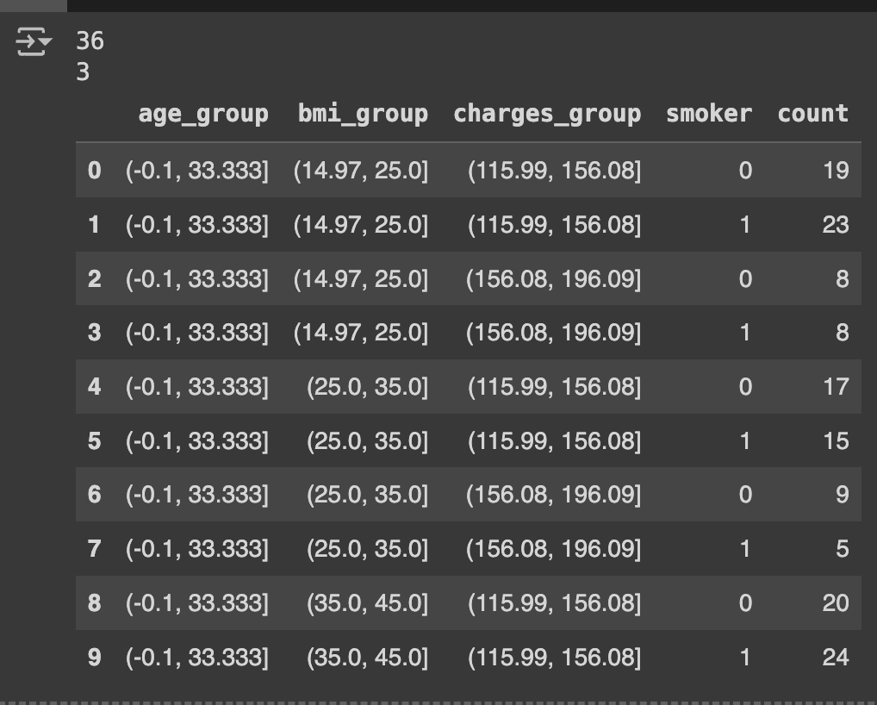
Disclosed Data Base
The original data set had 500 rows of patient values
This disclosed data set was grouped down to 36 rows with each row having a different group based on:
Age
BMI
Charges
The ‘count’ column shows how many patients fit into each group.
The fake company would be given this 36 row dataset.

Slide 21

Measuring Anonymity: K-Anonymity Eval.
To measure how identifiable a person is we will use principles from K-Anonymity.
We will be analyzing all the methods by seeing if there are any groups of values that have only 1 value in them
(meaning that that person is unique and identifiable).

Slide 22
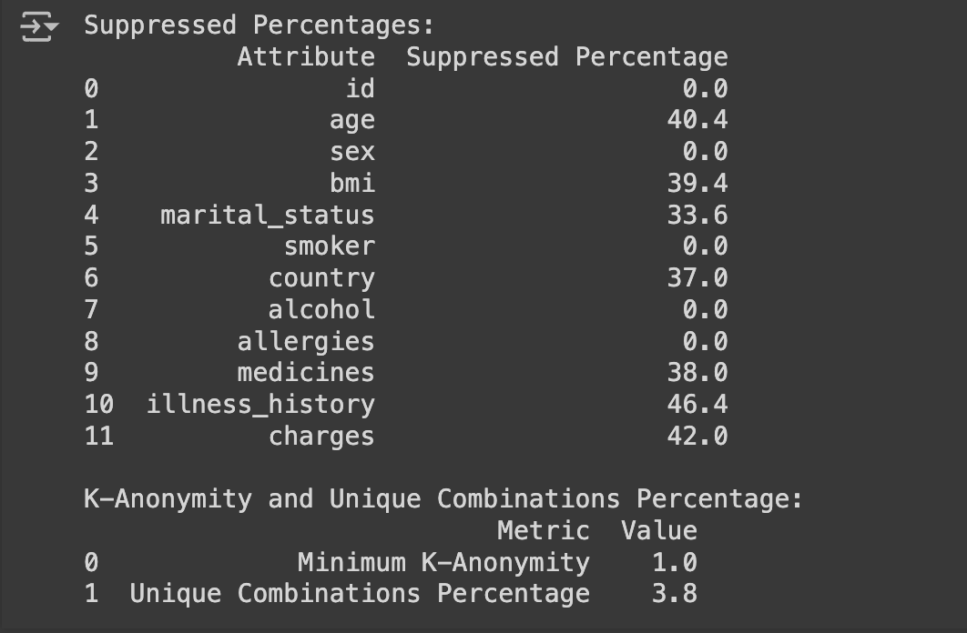
Analysis for Method #1 Suppressing Patient Values
The percentage column shows the percentage of data that is suppressed compared to total data
Min K-Anonymity level of one shows that there are still values in the data set that are completely unique, which is bad.
Limitations:
Raising the suppression better anonymizes the data but makes it worse for research.

Slide 23

Analysis for Method #2: Generalized Values
500 piece of data 384 of them can be grouped together with another piece of data into one of the generalizations we created.
Min K-Anonymity of 0 means that there are some combinations of groups that don't have any data points that can fit into it, which is effectively as bad as Method #1
Limitations:
Identifiable information that isn’t numerical can’t be effectively generalized.

Slide 24
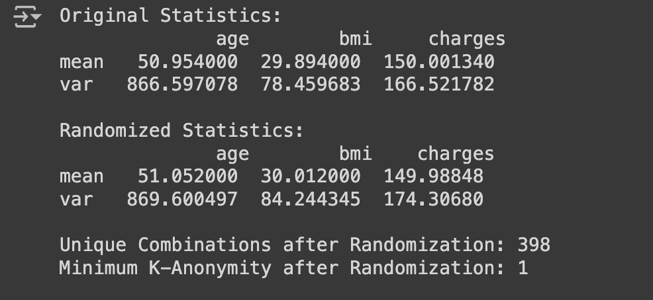
Analysis for Method #3: Randomized Patient Values
The mean for each column changed by less than 1:
Preserving the useability for research.
The variances have increased:
Harder to link the randomized data to original data but not enough to affect the usability of the data

Slide 25



Overall Findings/Result
Suppression:
Minimum K-Anonymity: 1 :(
Generalization
Minimum K-Anonymity: 0 :(
Randomization
Minimum K-Anonymity: 1 :(
Higher Variance with Same Mean: Indicates effective randomization where data points are more dispersed, enhancing privacy while preserving the central tendency.
K-Anonymization
General Minimum K-Anonymity: 13 :)
Smoker Minimum K-Anonymity: 3 :l

Slide 26
Summary/Conclusion
In this project we explored the different HIPAA de-identification methods for anonymizing patient medical data:
Suppression
Generalization
Randomization
K-Anonymization
The goal of this project was to showcase,explore, and compare these methods, as well as implement them to our own dataset.
Out of all the methods we tested, we found that K-Anonymization was the best method for de-identifying patient health data.

Slide 27
References
[1]O. for C. R. (OCR), “Methods for de-identification of phi,” HHS.gov, https://www.hhs.gov/hipaa/for-professionals/privacy/special-topics/de-identification/index.html#top (accessed May 15, 2024).
[2] Mirelly, “Health Data X Charges,” Kaggle, https://www.kaggle.com/datasets/m1relly/healthdataxcharges (accessed May 16, 2024).
[3] K. El Emam and F. K. Dankar, “Protecting privacy using K-anonymity,” Journal of the American Medical Informatics Association, vol. 15, no. 5, pp. 627–637, Sep. 2008. doi:10.1197/jamia.m2716

