Slide 1
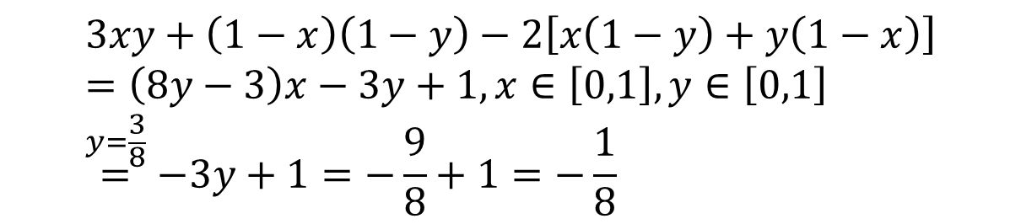
 | H | T
You | x | 1-x
Opponent | y | 1-y
HH | 3
TT | 1
HT, TH | 2
$$3xy+\left(1−x\right)\left(1−y\right)−2\left[x\left(1−y\right)+y\left(1−x\right)\right] \\ =\left(8y−3\right)x−3y+1,x∈\left[0,1\right],y∈\left[0,1\right] \\ \overset{y=\frac{3}{8}}{=}−3y+1=−\frac{9}{8}+1=−\frac{1}{8}$$

Slide 2
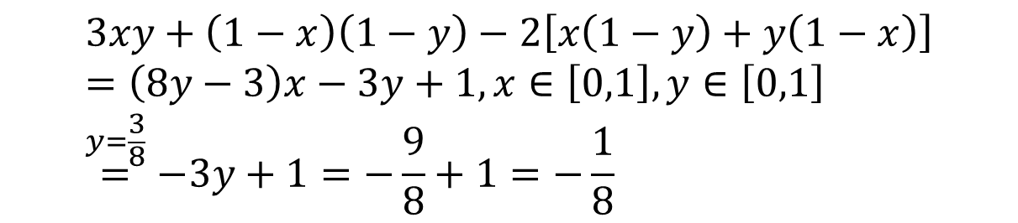
$$3xy+\left(1−x\right)\left(1−y\right)−2\left[x\left(1−y\right)+y\left(1−x\right)\right] \\ =\left(8y−3\right)x−3y+1,x∈\left[0,1\right],y∈\left[0,1\right] \\ \overset{y=\frac{3}{8}}{=}−3y+1=−\frac{9}{8}+1=−\frac{1}{8}$$
$$z=f\left(x,y\right)=\left(8y−3\right)x−3y+1,x∈\left[0,1\right],y∈\left[0,1\right]$$

Slide 3
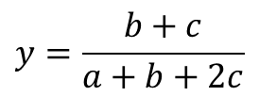


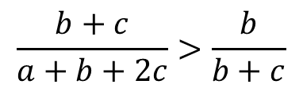
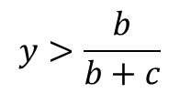

 | H | T
You | x | 1-x
Opponent | y | 1-y
$$x∈\left[0,1\right],y∈\left[0,1\right]$$
HH | 3 a>0
TT | 1 b>0
HT, TH | 2 c>0
$$3xy+1\left(1−x\right)\left(1−y\right)−2\left[x\left(1−y\right)+y\left(1−x\right)\right]$$
$$axy+b\left(1−x\right)\left(1−y\right)−c\left[x\left(1−y\right)+y\left(1−x\right)\right] \\ =\left[\left(a+b+2c\right)y−\left(b+c\right)\right]x+\left(−b−c\right)y+b$$
$$y=\frac{b+c}{a+b+2c}$$
$$y>\frac{b}{b+c}$$
$$\frac{b+c}{a+b+2c}>\frac{b}{b+c}$$
$$c^{2}>ab$$

Slide 4
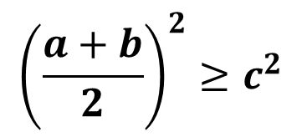
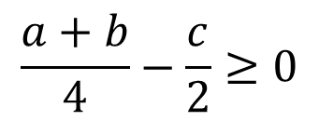
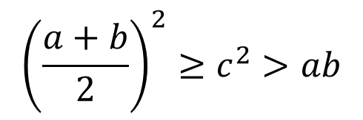

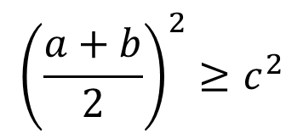


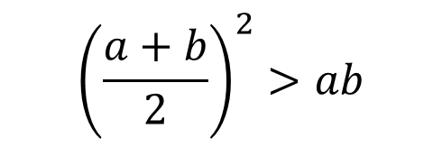
$$c^{2}>ab$$
$${\left(\frac{a+b}{2}\right)}^{2}≥c^{2}>ab$$
$$\frac{a+b}{4}−\frac{c}{2}≥0$$
$${\left(\frac{a+b}{2}\right)}^{2}≥c^{2}$$
$${\left(\frac{a+b}{2}\right)}^{2}>ab$$
$$a+b≥2c$$
$${\left(\frac{a+b}{2}\right)}^{2}≥c^{2}$$
$${\left(a−b\right)}^{2}>0$$

Slide 5
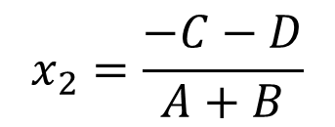

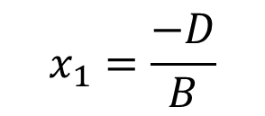


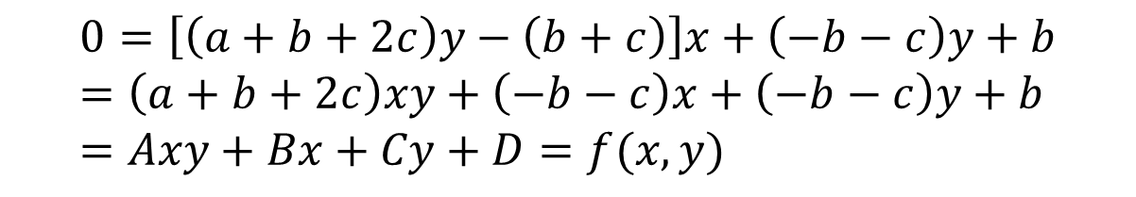

$$f\left(x,y\right)=\left[\left(a+b+2c\right)y−\left(b+c\right)\right]x+\left(−b−c\right)y+b$$
$$0=\left[\left(a+b+2c\right)y−\left(b+c\right)\right]x+\left(−b−c\right)y+b$$
$$0=\left[\left(a+b+2c\right)y−\left(b+c\right)\right]x+\left(−b−c\right)y+b \\ =\left(a+b+2c\right)xy+\left(−b−c\right)x+\left(−b−c\right)y+b \\ =Axy+Bx+Cy+D=f(x,y)$$
$$f\left(x,0\right)=0$$
$$y=\frac{−Bx−D}{Ax+C}$$
$$x_{1}=\frac{−D}{B}$$
$$A=a+b+2c, \\ B=−b−c, \\ C=−b−c, \\ D=b, \\ E=BC−AD$$
$$f\left(x,1\right)=0$$
$$x_{2}=\frac{−C−D}{A+B}$$

Slide 6
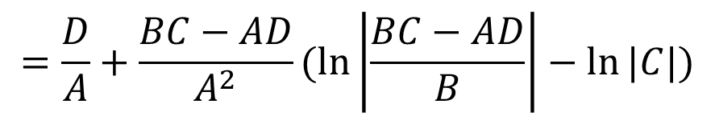
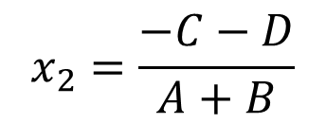
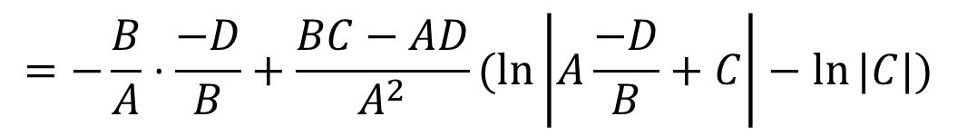
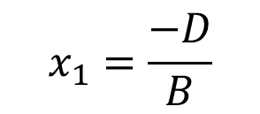
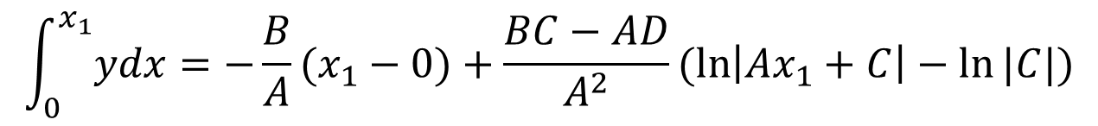
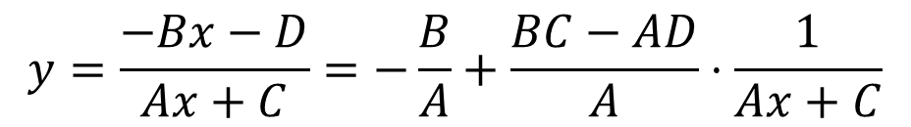
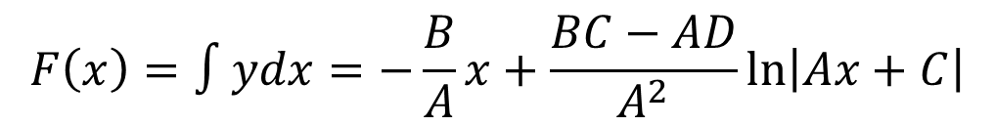
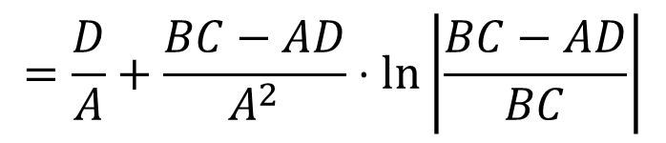
$$x_{1}=\frac{−D}{B}$$
$$x_{2}=\frac{−C−D}{A+B}$$
$$y=\frac{−Bx−D}{Ax+C}=−\frac{B}{A}+\frac{BC−AD}{A}⋅\frac{1}{Ax+C}$$
$$F\left(x\right)=∫ydx=−\frac{B}{A}x+\frac{BC−AD}{A^{2}}\ln\left|Ax+C\right|$$
$$\int_{0}^{x_{1}}{ydx}=−\frac{B}{A}(x_{1}−0)+\frac{BC−AD}{A^{2}}(\ln\left|Ax_{1}+C\right|−ln⁡|C|)$$
$$=−\frac{B}{A}⋅\frac{−D}{B}+\frac{BC−AD}{A^{2}}(\ln\left|A\frac{−D}{B}+C\right|−ln⁡|C|)$$
$$=\frac{D}{A}+\frac{BC−AD}{A^{2}}(\ln\left|\frac{BC−AD}{B}\right|−ln⁡|C|)$$
$$=\frac{D}{A}+\frac{BC−AD}{A^{2}}⋅\ln\left|\frac{BC−AD}{BC}\right|$$

Slide 7
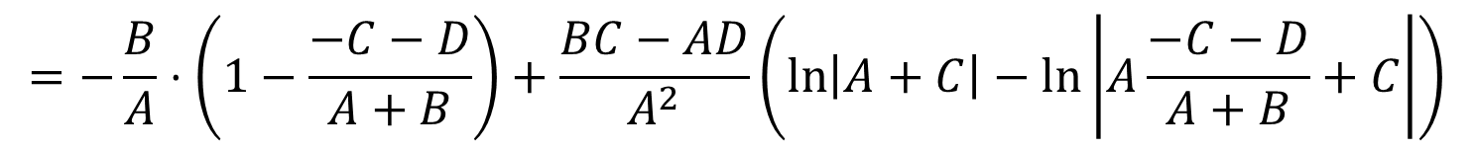
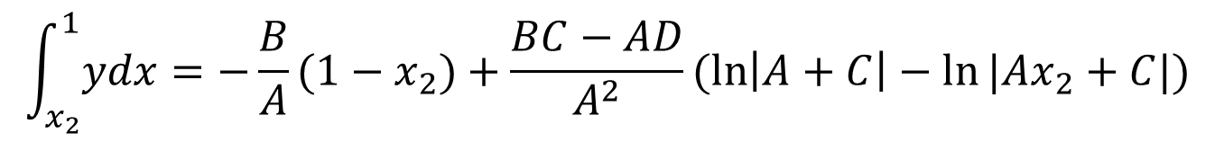
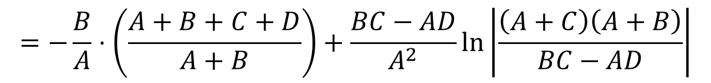
$$x_{1}=\frac{−D}{B}$$
$$x_{2}=\frac{−C−D}{A+B}$$
$$y=\frac{−Bx−D}{Ax+C}=−\frac{B}{A}+\frac{BC−AD}{A}⋅\frac{1}{Ax+C}$$
$$F\left(x\right)=∫ydx=−\frac{B}{A}x+\frac{BC−AD}{A^{2}}\ln\left|Ax+C\right|$$
$$\int_{x_{2}}^{1}{ydx}=−\frac{B}{A}(1−x_{2})+\frac{BC−AD}{A^{2}}(\ln\left|A+C\right|−ln⁡|Ax_{2}+C|)$$
$$=−\frac{B}{A}⋅\left(1−\frac{−C−D}{A+B}\right)+\frac{BC−AD}{A^{2}}\left(\ln\left|A+C\right|−\ln\left|A\frac{−C−D}{A+B}+C\right|\right)$$
$$=−\frac{B}{A}⋅\left(\frac{A+B+C+D}{A+B}\right)+\frac{BC−AD}{A^{2}}\left(\ln\left|A+C\right|−\ln\left|A\frac{−C−D}{A+B}+C\right|\right)$$
$$=−\frac{B}{A}⋅\left(\frac{A+B+C+D}{A+B}\right)+\frac{BC−AD}{A^{2}}\ln\left|\frac{\left(A+C\right)\left(A+B\right)}{BC−AD}\right|$$

Slide 8
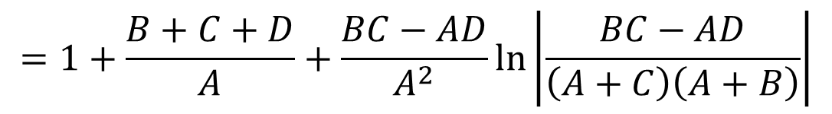
$$x_{1}=\frac{−D}{B}$$
$$x_{2}=\frac{−C−D}{A+B}$$
$$y=\frac{−Bx−D}{Ax+C}=−\frac{B}{A}+\frac{BC−AD}{A}⋅\frac{1}{Ax+C}$$
$$F\left(x\right)=∫ydx=−\frac{B}{A}x+\frac{BC−AD}{A^{2}}\ln\left|Ax+C\right|$$
$$1−x_{2}−\int_{x_{2}}^{1}{ydx}=1−\frac{−C−D}{A+B}−\left(−\frac{B}{A}⋅\left(\frac{A+B+C+D}{A+B}\right)+\frac{BC−AD}{A^{2}}\ln\left|\frac{\left(A+C\right)\left(A+B\right)}{BC−AD}\right|\right)$$
$$=\frac{A+B+C+D}{A+B}−\frac{B}{A}⋅\left(\frac{A+B+C+D}{A+B}\right)+\frac{BC−AD}{A^{2}}\ln\left|\frac{\left(A+C\right)\left(A+B\right)}{BC−AD}\right|$$
$$=\frac{A+B+C+D}{A+B}+\frac{B}{A}⋅\left(\frac{A+B+C+D}{A+B}\right)−\frac{BC−AD}{A^{2}}\ln\left|\frac{\left(A+C\right)\left(A+B\right)}{BC−AD}\right|$$
$$=1+\frac{B+C+D}{A}+\frac{BC−AD}{A^{2}}\ln\left|\frac{BC−AD}{\left(A+C\right)\left(A+B\right)}\right|$$

Slide 9
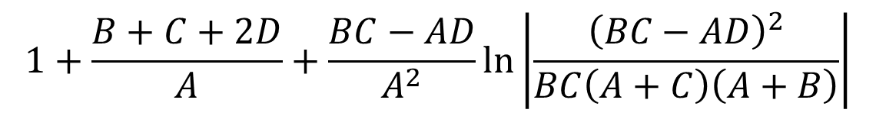
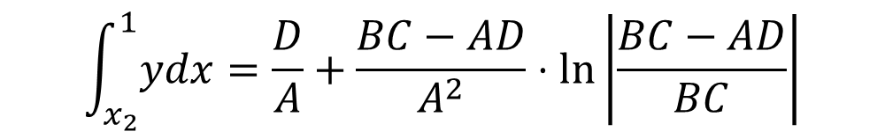
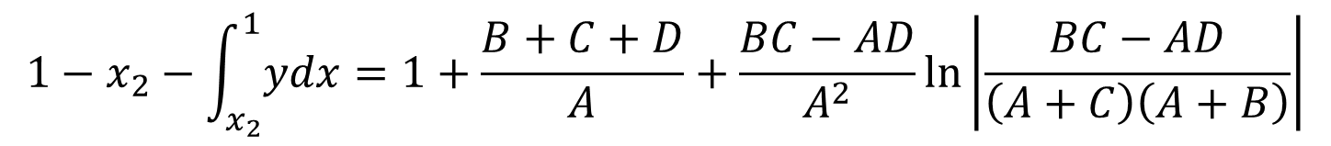
$$x_{1}=\frac{−D}{B}$$
$$x_{2}=\frac{−C−D}{A+B}$$
$$y=\frac{−Bx−D}{Ax+C}=−\frac{B}{A}+\frac{BC−AD}{A}⋅\frac{1}{Ax+C}$$
$$F\left(x\right)=∫ydx=−\frac{B}{A}x+\frac{BC−AD}{A^{2}}\ln\left|Ax+C\right|$$
$$\int_{x_{2}}^{1}{ydx}=\frac{D}{A}+\frac{BC−AD}{A^{2}}⋅\ln\left|\frac{BC−AD}{BC}\right|$$
$$1−x_{2}−\int_{x_{2}}^{1}{ydx}=1+\frac{B+C+D}{A}+\frac{BC−AD}{A^{2}}\ln\left|\frac{BC−AD}{\left(A+C\right)\left(A+B\right)}\right|$$
$$1+\frac{B+C+2D}{A}+\frac{BC−AD}{A^{2}}\ln\left|\frac{{\left(BC−AD\right)}^{2}}{BC\left(A+C\right)\left(A+B\right)}\right|$$

