Slide 1
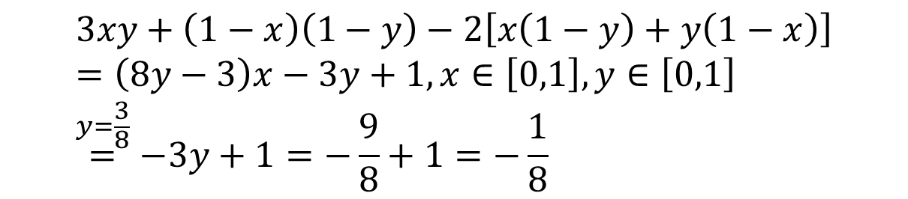
 | H | T
You | x | 1-x
Opponent | y | 1-y
HH | 3
TT | 1
HT, TH | 2
$$3xy+\left(1−x\right)\left(1−y\right)−2\left[x\left(1−y\right)+y\left(1−x\right)\right] \\ =\left(8y−3\right)x−3y+1,x∈\left[0,1\right],y∈\left[0,1\right] \\ \overset{y=\frac{3}{8}}{=}−3y+1=−\frac{9}{8}+1=−\frac{1}{8}$$

Slide 2
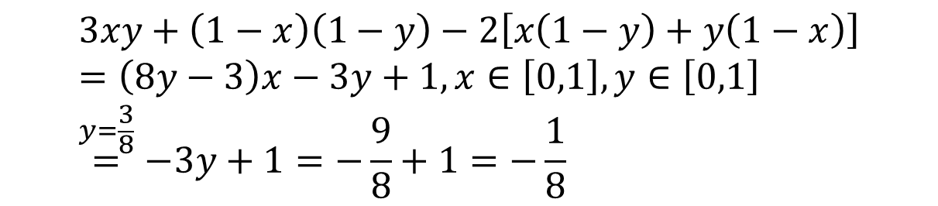
$$3xy+\left(1−x\right)\left(1−y\right)−2\left[x\left(1−y\right)+y\left(1−x\right)\right] \\ =\left(8y−3\right)x−3y+1,x∈\left[0,1\right],y∈\left[0,1\right] \\ \overset{y=\frac{3}{8}}{=}−3y+1=−\frac{9}{8}+1=−\frac{1}{8}$$
$$z=f\left(x,y\right)=\left(8y−3\right)x−3y+1,x∈\left[0,1\right],y∈\left[0,1\right]$$

Slide 3
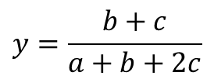


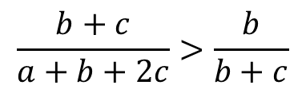
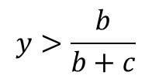

 | H | T
You | x | 1-x
Opponent | y | 1-y
$$x∈\left[0,1\right],y∈\left[0,1\right]$$
HH | 3 a>0
TT | 1 b>0
HT, TH | 2 c>0
$$3xy+1\left(1−x\right)\left(1−y\right)−2\left[x\left(1−y\right)+y\left(1−x\right)\right]$$
$$axy+b\left(1−x\right)\left(1−y\right)−c\left[x\left(1−y\right)+y\left(1−x\right)\right] \\ =\left[\left(a+b+2c\right)y−\left(b+c\right)\right]x+\left(−b−c\right)y+b$$
$$y=\frac{b+c}{a+b+2c}$$
$$y>\frac{b}{b+c}$$
$$\frac{b+c}{a+b+2c}>\frac{b}{b+c}$$
$$c^{2}>ab$$

Slide 4
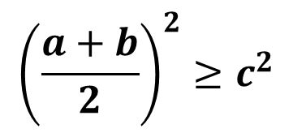
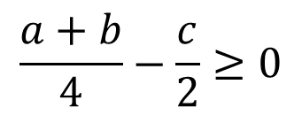
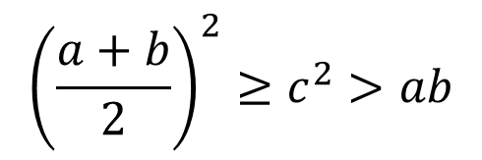

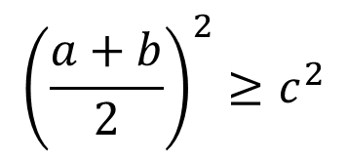


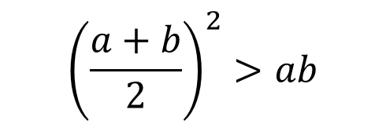
$$c^{2}>ab$$
$${\left(\frac{a+b}{2}\right)}^{2}≥c^{2}>ab$$
$$\frac{a+b}{4}−\frac{c}{2}≥0$$
$${\left(\frac{a+b}{2}\right)}^{2}≥c^{2}$$
$${\left(\frac{a+b}{2}\right)}^{2}>ab$$
$$a+b≥2c$$
$${\left(\frac{a+b}{2}\right)}^{2}≥c^{2}$$
$${\left(a−b\right)}^{2}>0$$

