Slide 1

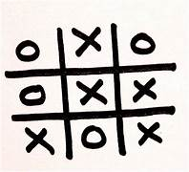
Tic-Tac-Toe
using Verilog
DIGI-WARE
GROUP PROJECT
Archit Kumar 220196
Souptik Majumder 221079
Shreyash Dwivedi 221035
Rohit Verma 220917
Sambuddha Chakrabarti 220947

Slide 2
INPUT CONTROLS
1.Reset :
Reset = 1: Reset the game when in the Game_Over state.
Reset = 0: The game begins.
2.Play:
Play = 1: When in the IDLE state, play = 1 is to switch the controller to the O_ PLAYER or X_PLAYER state and the player plays.
Play =0: Stay in the IDLE state.
3.Illegal_move :
Illegal_move = 0: When in any state, Illegal_move = 0 is to switch to current state .
Illegal_move = 1: Illegal moving from the player/ computer and switch to the IDLE state.
4.No_vacant_space
No_vacant_space = 0: still have space to play, continue the game.
No_vacant_space = 1: no more space to play, game over, and the board resets.
5.Result
Result = 0: Still waiting for the winner
Result = 1: There is a winner, finish the game, and the game resets.

Slide 3
IDLE State (00):
Initial state when the game starts.
Waits for the play signal to be asserted.
O_PLAYER State (01):
O player's turn.
Expects the oPlayerPos input for the move.
Checks for illegal moves, game-over conditions, or a valid move.
Transitions to X_PLAYER or GAME_OVER based on conditions.
X_PLAYER State (10):
X player's turn.
Expects the xPlayerPos input for the move.
Checks for illegal moves, game-over conditions, or a valid move.
Transitions to O_PLAYER or GAME_OVER based on conditions.
GAME_OVER State (11):
End state.
Display game results (winner, draw).
Resets back to IDLE State.

Slide 4
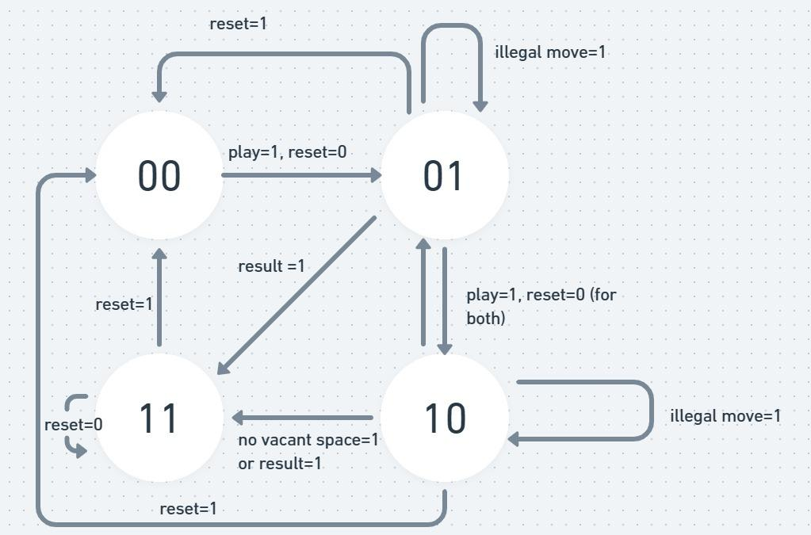
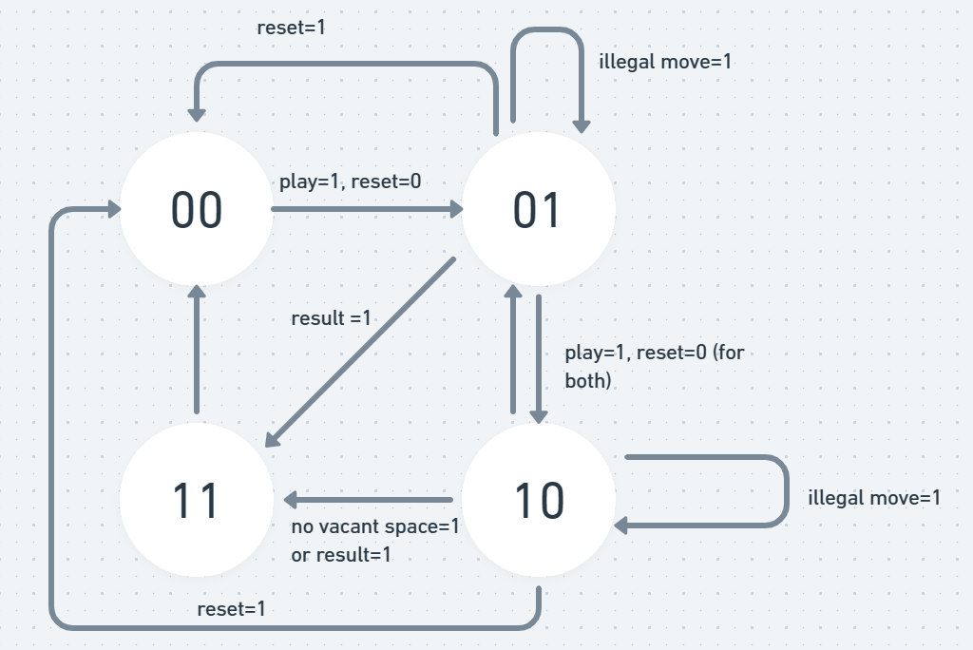
Defined States and
Transition Diagram
1. IDLE(00): when waiting for the player/ computer to play or when resetting the circuit, the FSM is at the IDLE state.
2. O_PLAYER(01): The O_player turns to play and “01” to be stored into the decoded position.
3. X_PLAYER(10):
The X_Player turns to play and “01” to be stored into the decoded position.
4. Game_over(11): The game is finished when there is a winner or no more space to play.

Slide 5
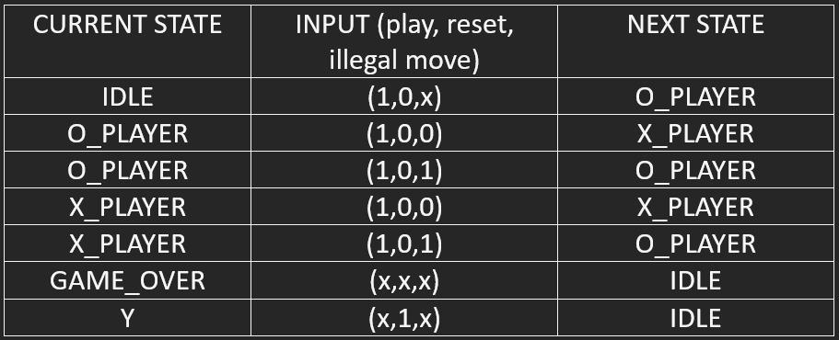
State transition
Table:

Slide 6
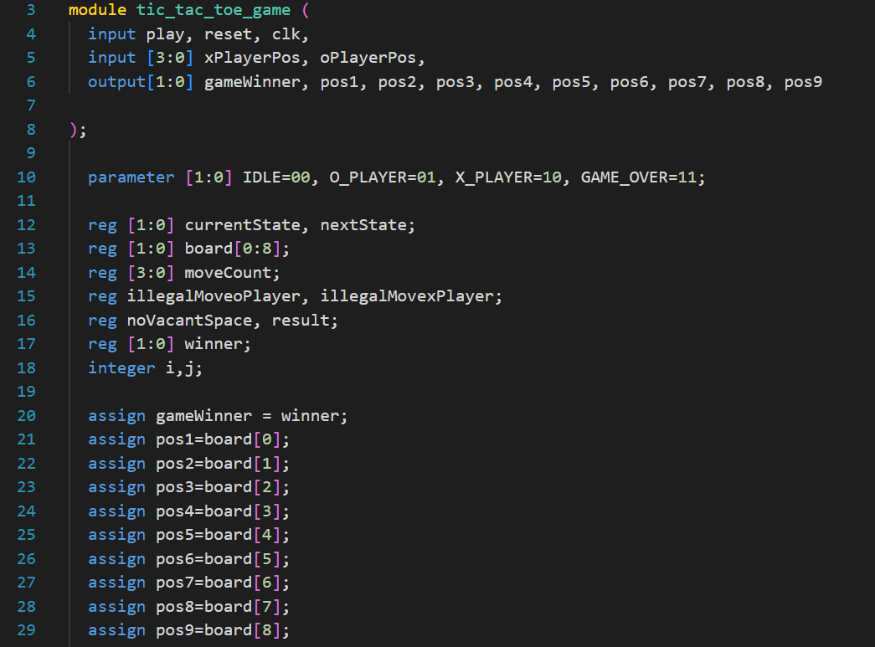
MODULE INPUTS,OUTPUTS AND PARAMETERS

Slide 7
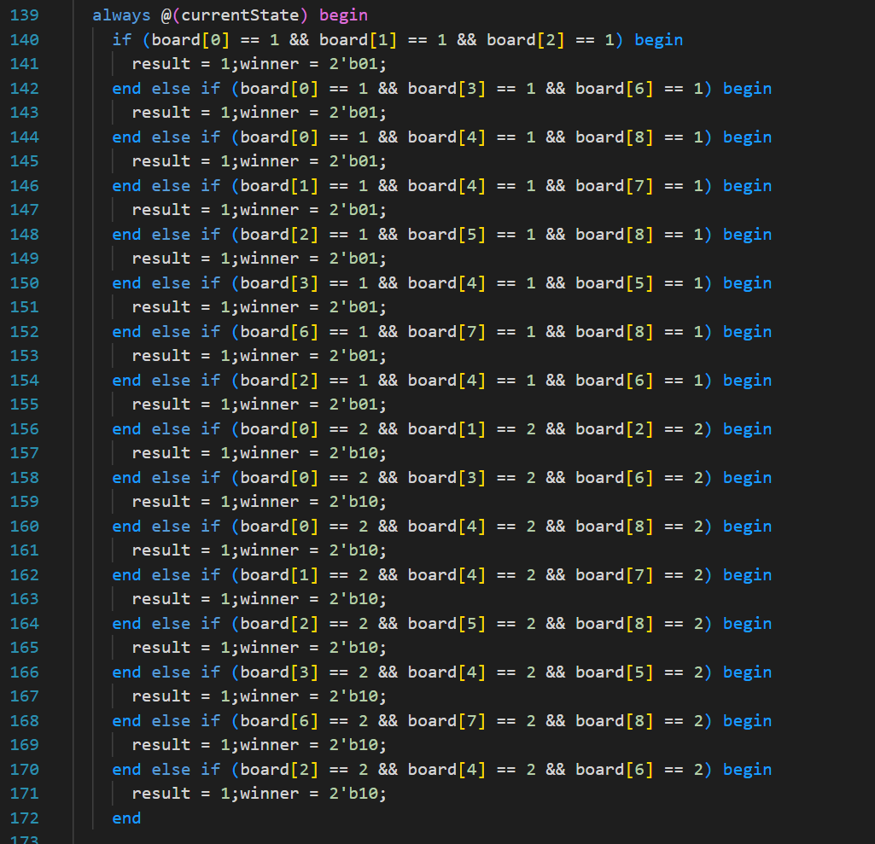
Game
winner
check
This block checks if the any of the row/column/diagonals is filled with 'O' (represented as 01 in the board array)or ‘X’ (represented as 10 in the board array). If true, it sets the result to 1 (indicating a win) and sets the winner to 01 (indicating the O player wins) or to 10(indicating the X player wins)

Slide 8
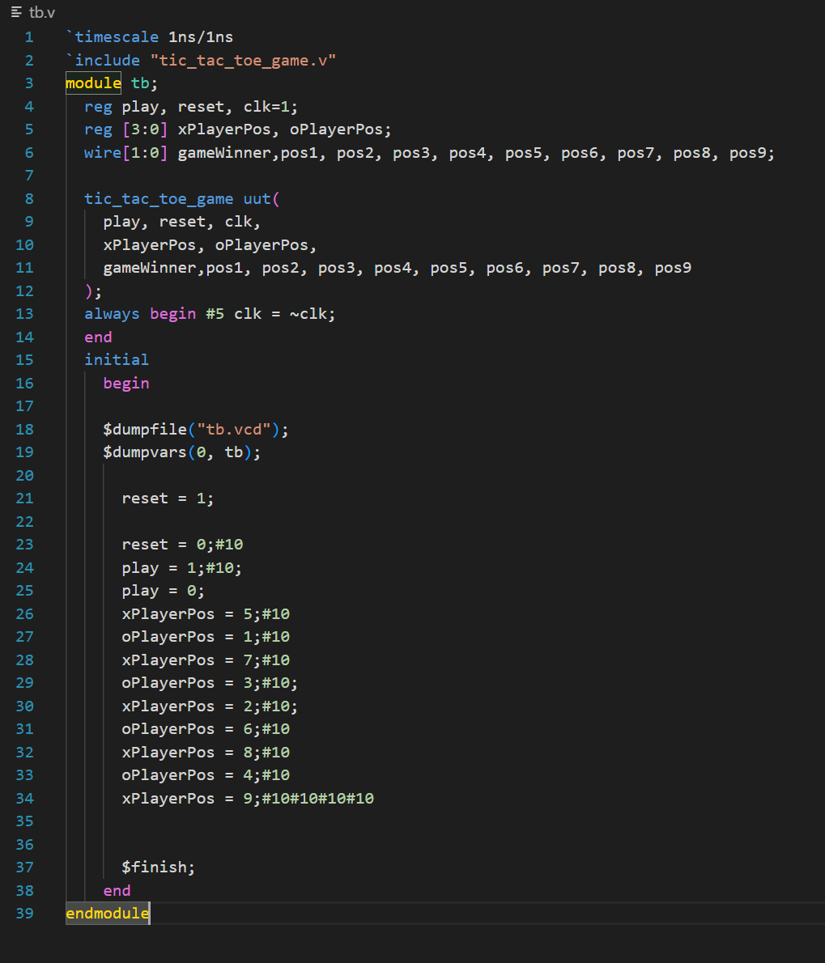
Test
Bench

Slide 9
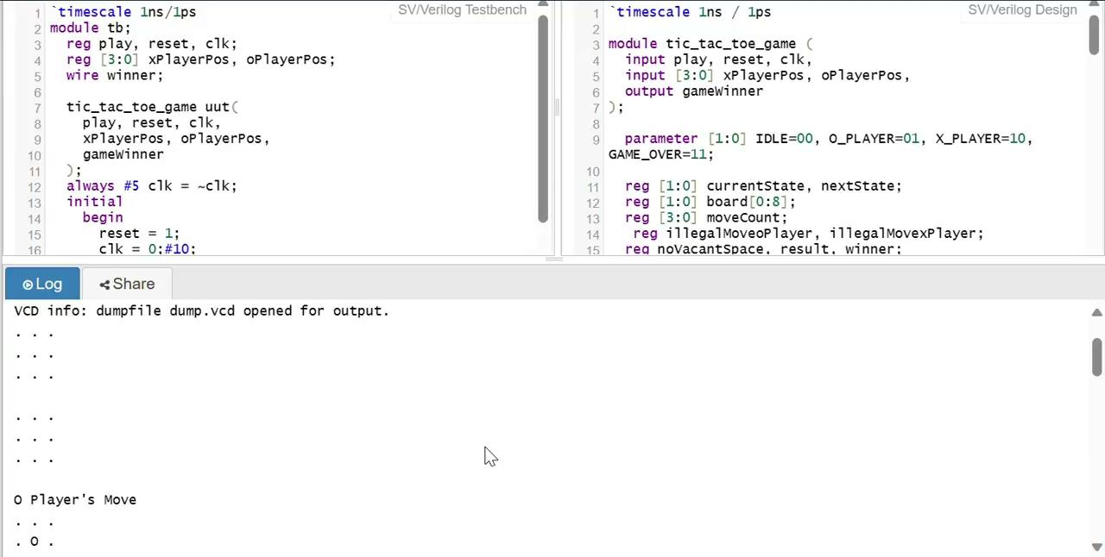
SIMULATION VIDEO

Slide 10
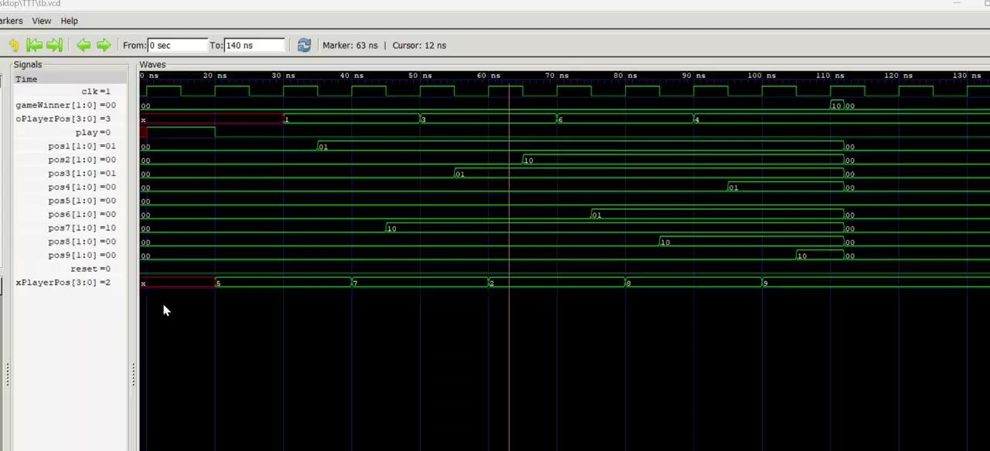
Wave Form simulation:

Slide 11
THANK
YOU

