Slide 1
Tongue and cheek
Sam Chami, Merci Magallanes, & John Scott
April 24, 2019

Slide 2
What is Tongue and Cheek?
2D side scroller game
Game built in Unity, graphics created in Autodesk Sketchbook and Adobe Photoshop
Character given simple tools to traverse through a map in a specific amount of time
Inspired by QWOP and Getting Over It

Slide 3
Why make Tongue and Cheek?
Fun:
something different from the usual programming; this time using C#!
Interdisciplinary: will be a challenge beyond only code
Computer Science
Graphic Design
Music
Scalable: lots of aspects can be expanded
Graphics/textures can always be improved
More levels and content can be added
New features could be added

Slide 4
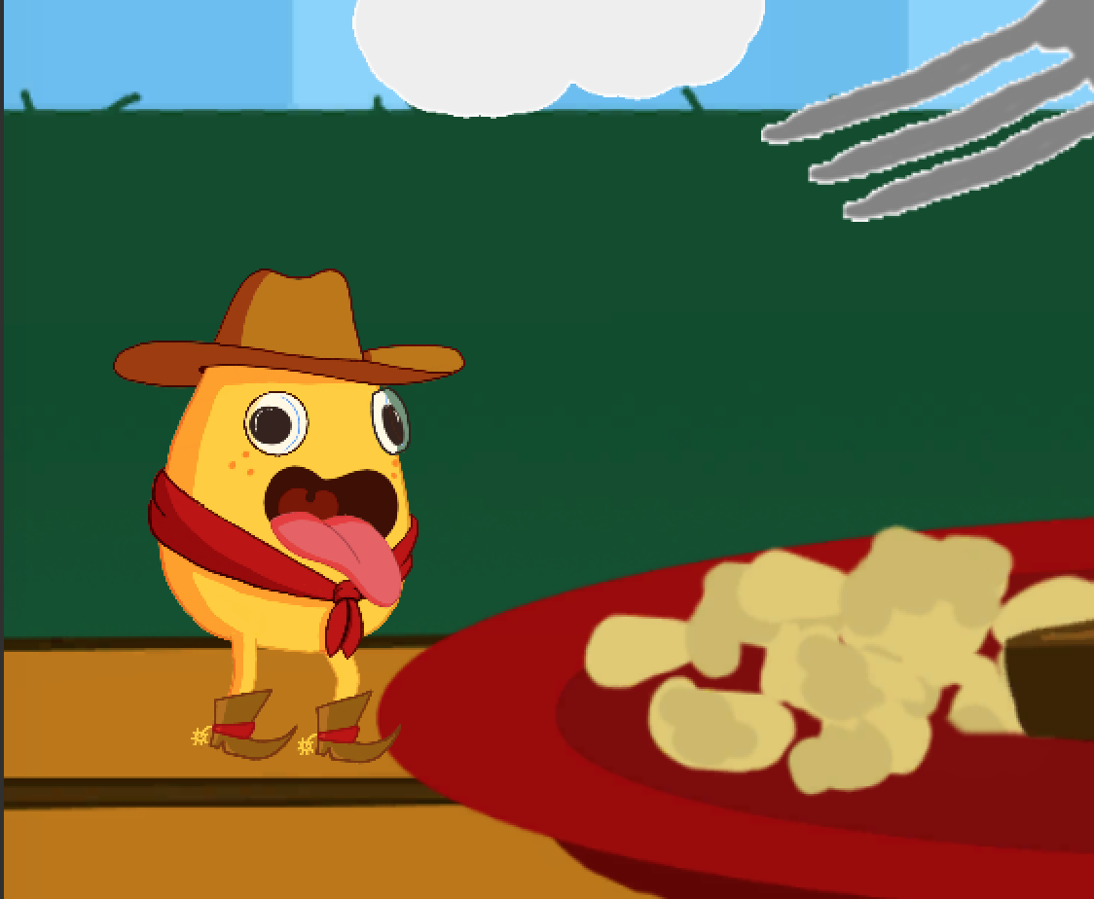
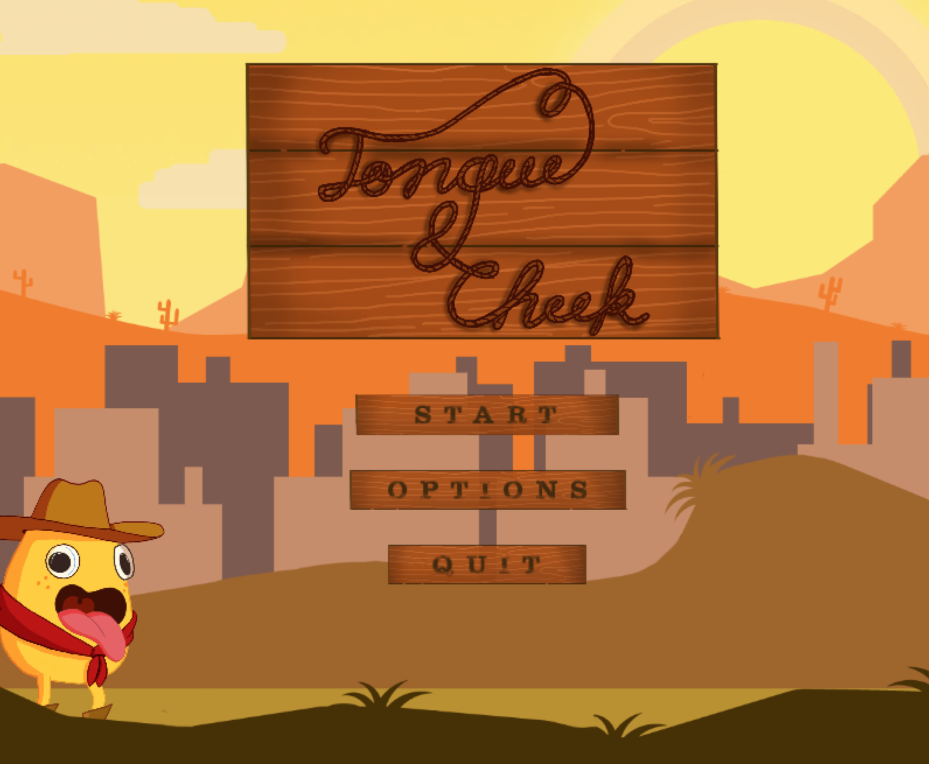
Screenshots
Main menu (right)
Level Zero (left)

Slide 5
Goals for Tongue and Cheek:
Challenge ourselves with interdisciplinary project
1
Develop working 2D platformer game in Unity
2
Learn a lot about game development
3
Have fun!
4

Slide 6
Challenges:
Proper collision physics of Cheek with objects
Importing and animating hand-drawn artwork
Getting components of Cheek to work synchronously
Rope/Grapple mechanics and animation of tongue
Scripting scrolling background for main menu

Slide 7

Tongue and Cheek demo

Slide 8
Status update/Future:
Add more levels
Music!
Microtransactions

Slide 9
Thanks! Questions?

